Slide 1
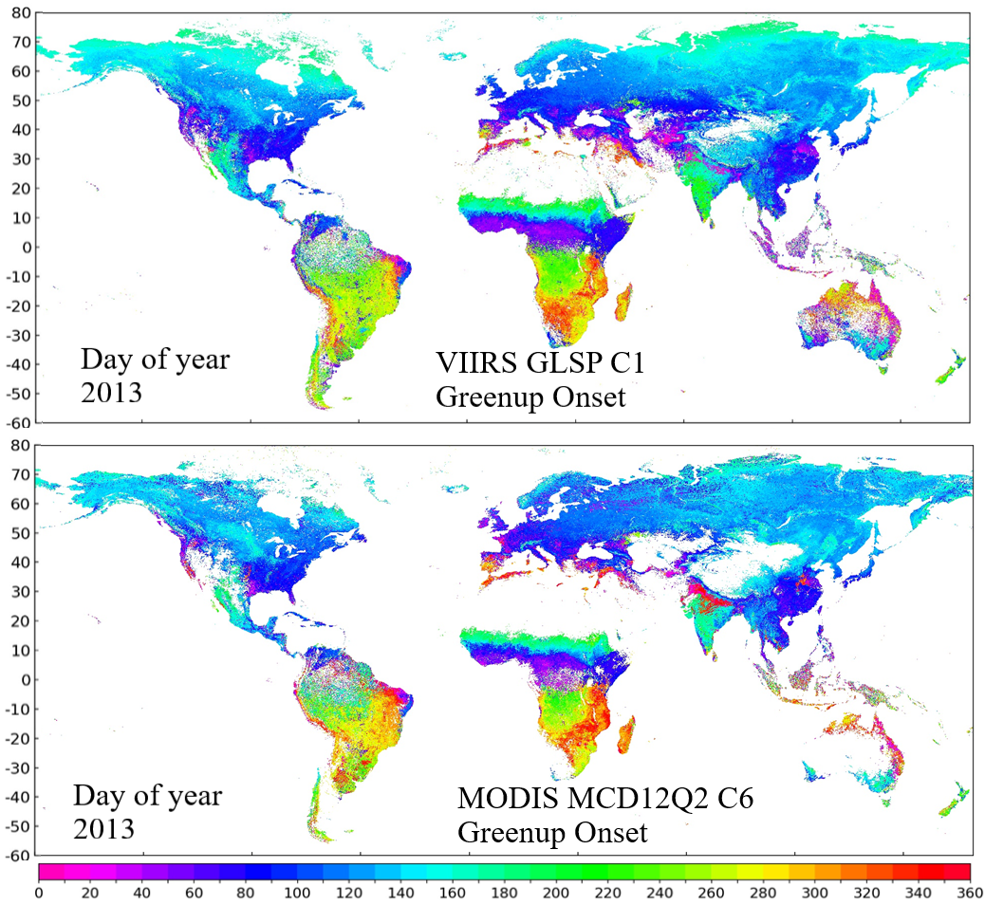
Status of VIIRS Global Land Surface Phenology (GLSP) Product
Xiaoyang Zhang, South Dakota State University, Brookings, SD
Status and Updates:
VIIRS GLSP C1 (VNP22Q2/C2) from 2013-2018 is available
VIIRS GLSP C1 was compared with MODIS land cover dynamics (MCD12Q2) C6.
VIIRS GLSP C2 algorithm has been improved:
Minimize impacts from the residual of cloud and snow cover and the surface moisture using the normalized difference water index (NDWI)
Fill gaps caused by persistent cloud cover in VIIRS time series using a shape model of climatology from MODIS NBAR from 2003-2019.
Evaluate VIIRS GLSP C2 using PhenoCam data
VIIRS GLSP C2 code has been tested and is expected to deliver in September
Highlights: VIIRS GLSP C2 algorithm greatly improves the GLSP detections in persistent cloud cover area
Technical Challenges:
VIIRS GLSP C2 algorithm could double the computing time relative to GLSP C1
VIIRS GLSP is produced using a different algorithm and data record format from MODIS Land Cover Dynamics C6. We expect to modify VIIRS GLSP C2 computer code for the generation of MODIS LSP product to improve the GLSP continuity
Recent Publications:
Liang, L., Henebry, G.M., Liu, L., Zhang, X., Li-Chi Hsu, L. 2020, Trends in land surface phenology across the conterminous United States (1982-2016) analyzed by NEON domains, Ecological Applications (submitted)
Liu, L., Zhang, X., 2020, Effects of temperature variability and extremes on spring phenology across the contiguous United States from 1982 to 2016, Scientific Reports (submitted revised version)
111Zhang, X., Wang, J., Henebry, G.M., Gao, F., 2020, Development and evaluation of a new algorithm for detecting 30 m land surface phenology from VIIRS and HLS time series, ISPRS Journal of Photogrammetry and Remote Sensing, 161, 37-51
Wang, J. and Zhang, X., 2020, Investigation of wildfire impacts on land surface phenology from MODIS time series in the western US forests, ISPRS Journal of Photogrammetry and Remote Sensing, 159, 281-295;
Zhang, X., Liu, L., Henebry, G., 2019, Impacts of land cover and land use change on long-term trend of land surface phenology: a case study in agricultural ecosystems, Environmental Research Letters, 14 044020
Yan, D., Zhang, X., Nagai, S., Yu, Y., Akitsu, T., Nasahara, K., Ide, R., Maeda, T., 2019, Evaluating land surface phenology from the Advanced Himawari Imager using observations from MODIS and the Phenological Eyes Network, International Journal of Applied Earth Observation and Geoinformation, 79: 71-83.

