Slide 1
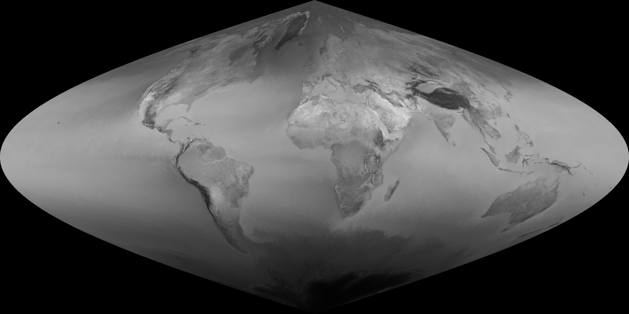
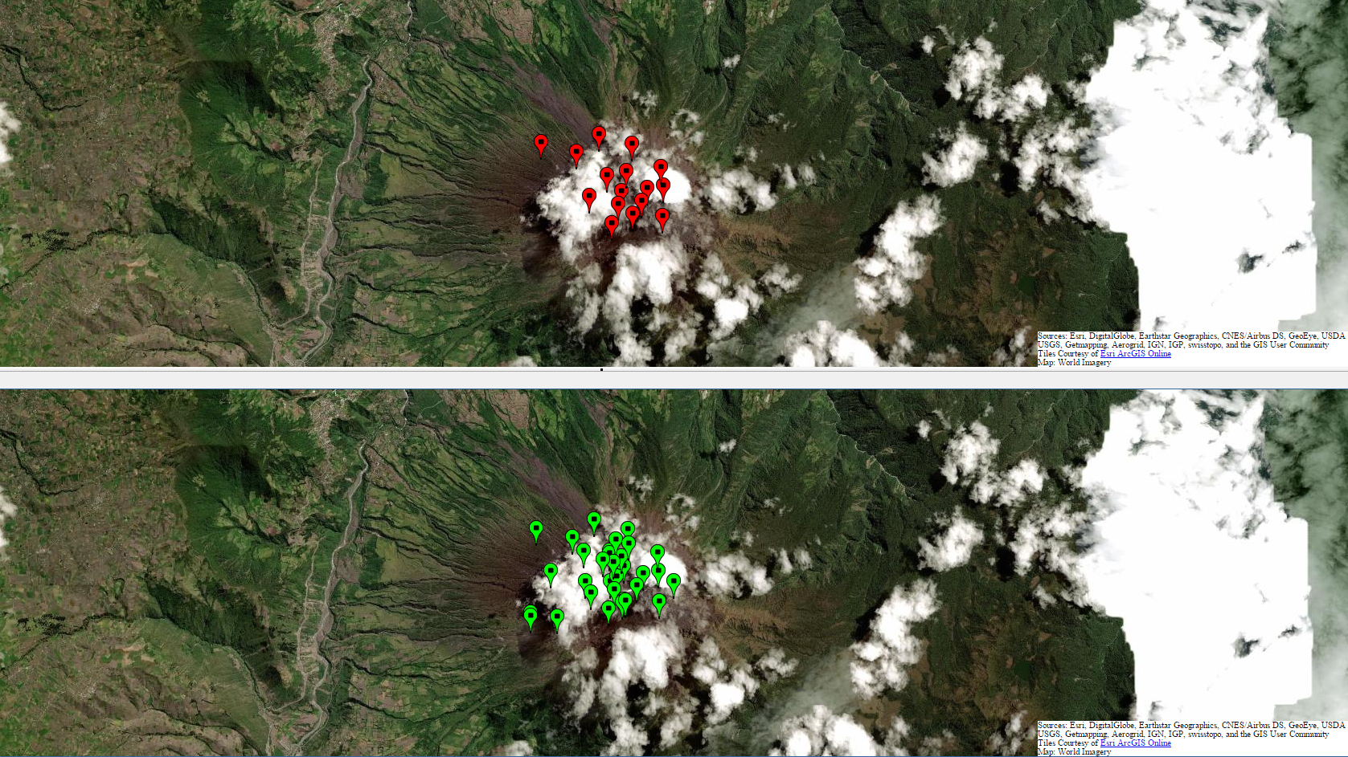
Multi-sensor analysis of global volcanic thermal unrest
PI: Robert Wright, Hawai'i Institute of Geophysics and Planetology, University of Hawai'i at Mānoa, Honolulu
1. Objective: Develop a computationally efficient method to detect and quantify excess volcanic heat fluxes at global scale using a multi-year time-series approach, which uses Terra/Aqua MODIS and VIIRS.
2. Method: Use 8 years of MODIS 1 km (021KM) data to define reference images quantifying the “normal” radiance emitted by each square km of Earth’s surface by day and night, during each calendar month (lower left). On a pixel-by-pixel basis compare the radiance measured for each pixel in each subsequently acquired image with its counterpart in the appropriate reference frame.
3. Status: Global reference images complete (lower left). Have tested performance on one year (2014) of Terra-MODIS nighttime data, at global scale. New approach (lower right) exhibits i) increased sensitivity, with ii) no increase in false positives, and iii) small increase in computational complexity, when compared to existing MODVOLC algorithm.
4. Next steps: Validate using MODIS daytime data for one calendar year. Then for VIIRS (one calendar year, night & day).
Robert Wright
Hawai'i Institute of Geophysics and Planetology, University of Hawai'i at Mānoa, Honolulu, U.S.A.
Tungurahua, Ecuador
MODVOLC
MODVOLC-2

