Slide 1
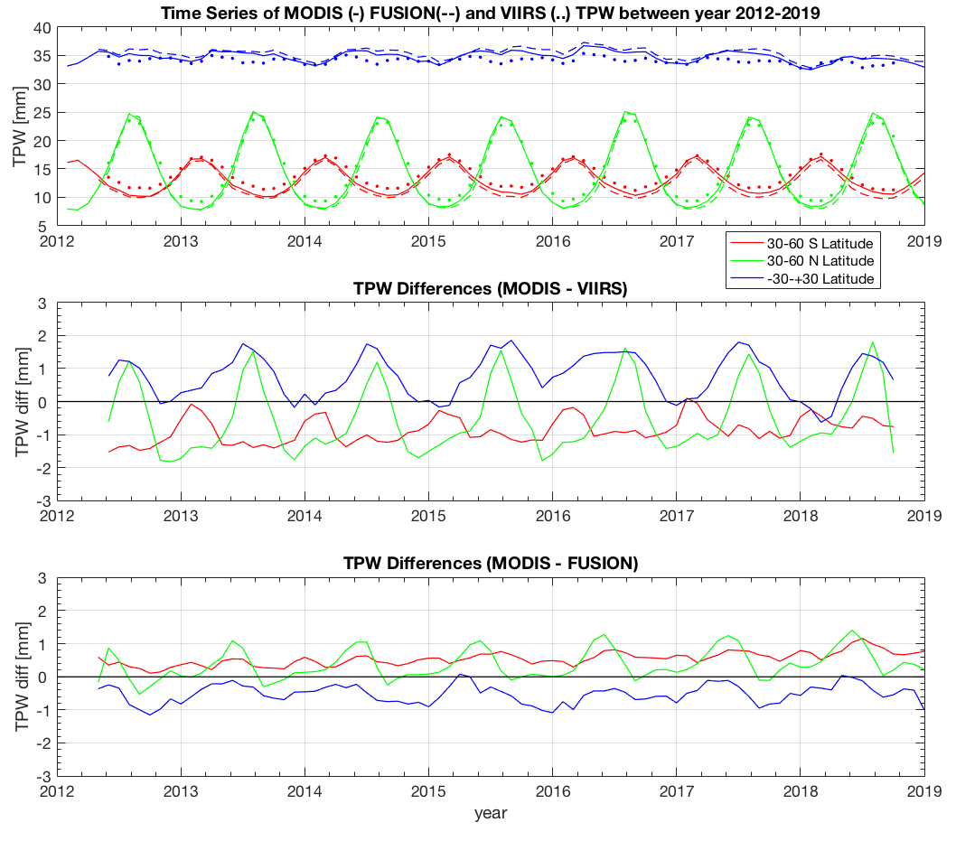
MOD07 Atmospheric Profile and VIIRS Moisture Retrieval
E. Éva Borbás, Paul Menzel, Steve Ackerman
Objective: To provide high spatial resolution total column water vapor (TPW) from MODIS and VIIRS infrared measurements. Profiles of temperature, water vapor, and ozone as well as stability indexes are also provided from MODIS. While MODIS has two water vapor channels within the 6.5 μm H2O absorption band and four channels within the 15 μm CO2 absorption band, VIIRS has no channels in either IR absorption band. The absence of any IR absorption channels on VIIRS degrades the capability for moisture column products. Our approach for mitigating this deficiency has been to supplement the VIIRS data with products based on the CrIS/ATMS sensors. In the future we plan to use the MODIS-like VIIRS fusion radiances.

Slide 2
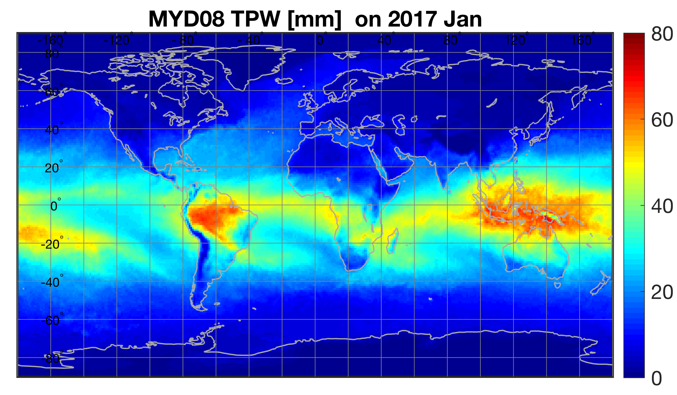
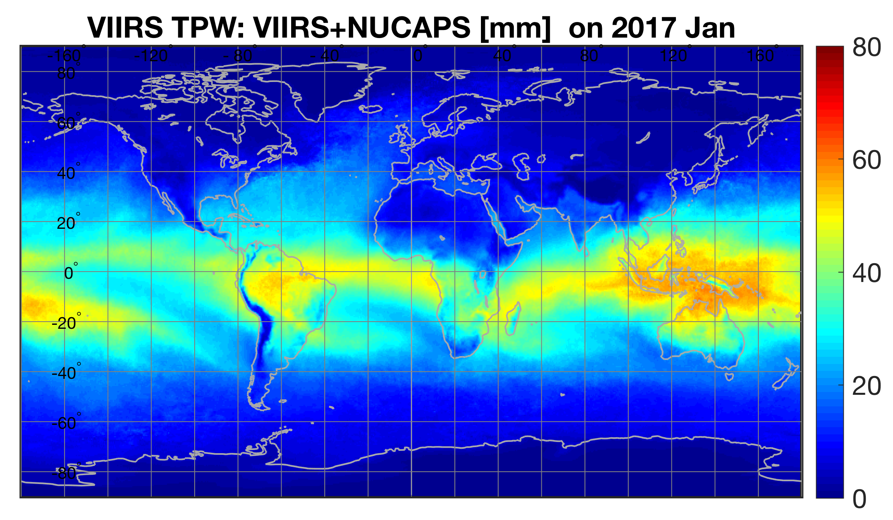
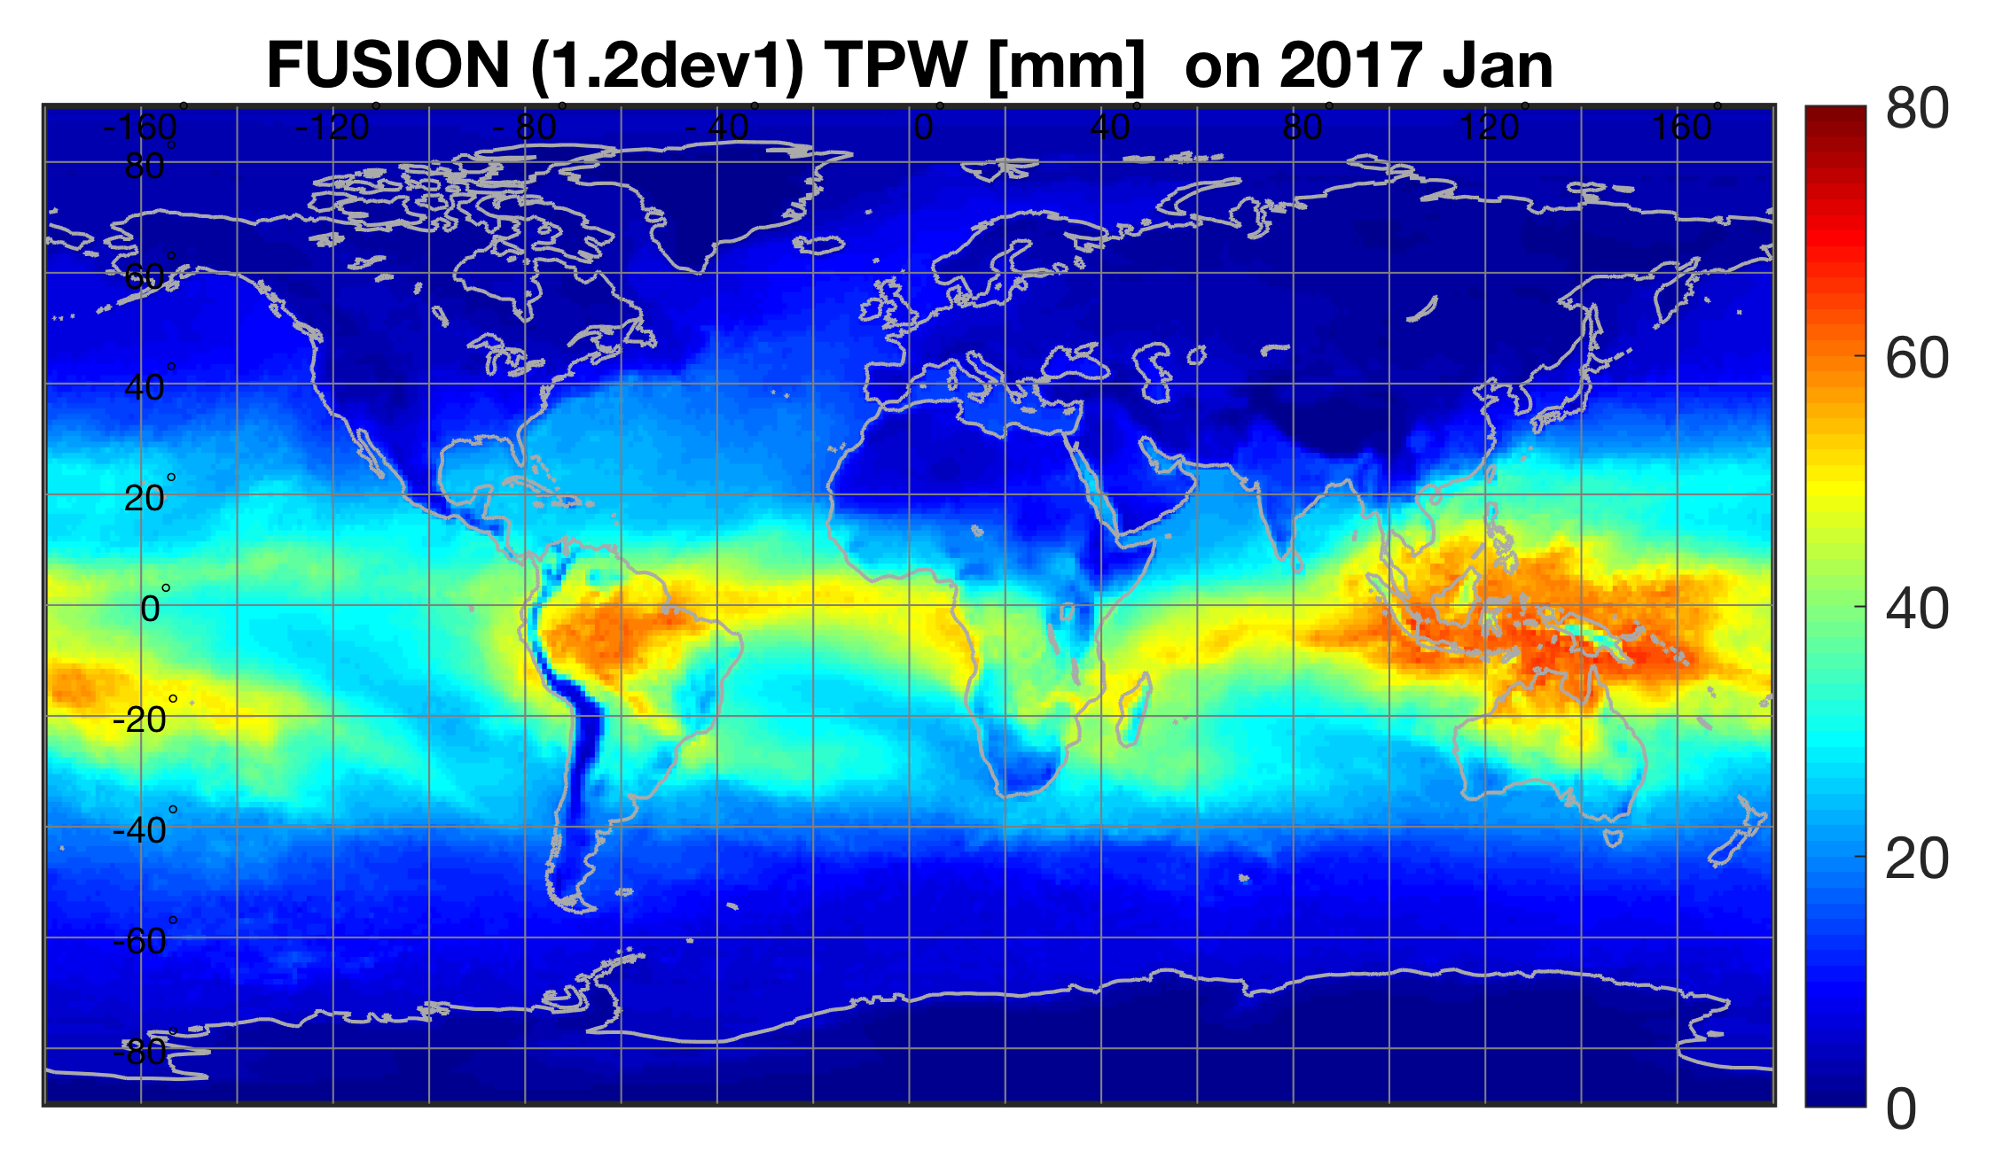
MOD07 Atmospheric Profile and VIIRS Moisture Retrieval
Status and Updates:
MOD07 preparation for Col7
S-NPP VIIRS_WATVP V001 is available up to Sept 2018
VIIRS_WATVP is not currently funded, so no more data was produced.
VIIRS_VATVP software has been updated (V002) by using fusion radiances; it has been integrated at A-SIPS.
The new fusion product is planned to be available for the entire record of both S-NPP and NOAA20.
Necessary Ancillary Products:
L1B radiances, Geolocation file, Cloud Mask, NWP analyses
Known Issues:
MOD07: inversion over ice causing instable retrievals in a small area at the Weddell Sea. This will be fixed in Col7.
VIIRS_WATVP: V001 product is available till Sept 2018, because the format of the input data has been changed and there is no funding/support for an update.
Recent Publications:
Borbas, E. E., E. Weisz, C. Moeller, W. P. Menzel, and B. A. Baum: Improvement in tropospheric moisture retrievals from VIIRS through the use of infrared absorption bands constructed from VIIRS and CrIS data fusion. Atmos. Meas. Tech., in review, 2020.

