Slide 1

Gigantic Dust Intrusion into the Caribbean Basin and Southern U.S. in June 2020: Satellite and Model Perspectives
Hongbin Yu, NASA Goddard Space Flight Center
Qian Tan, Lillian Zhou, Yaping Zhou, Huisheng Bian, Mian Chin, Dongchul Kim, Robert Levy, Yingxi Shi, Lorraine Remer, Qianqian Song, Zhibo Zhang, Yaswant Pradhan, Claire Ryder, Olga Mayol

Slide 2

A panorama of dual dust clouds snapped by EPIC/DSCOVR from 1 million miles above at 14:47:32 GMT on 6/23/2020
Sun glints
“gorilla” dust
“ordinary”dust
https://epic.gsfc.nasa.gov/

Slide 3
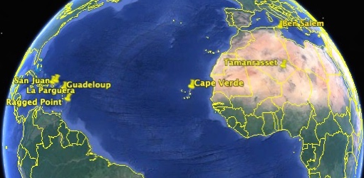
MODIS vs. AERONET
MODIS DT enhanced retrievals with new dust detection & spheroid model
by Yaping Zhou/Robert Levy
Terra & Aqua combined
Good agreement between MODIS & AERONET
Two dust plumes are featured:
Primary “Gorilla”: AOD ~ 3.5
Secondary “Ordinary”: AOD ~ 1.0

Slide 4
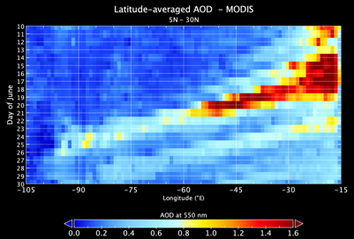
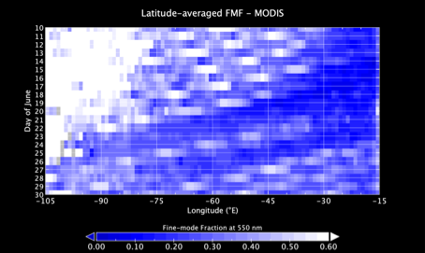
Progression of trans-Atlantic dust plumes
Time-Longitude Hovmöller Diagrams
AOD
FMF
Day of June
Day of June
Longitude
Longitude
Two dust plume tracks ~6 days apart are clearly seen in MODIS aerosol optical depth (left) and fine-mode fraction (right)

Slide 5
MODIS registered the event as historic over the last two decades
smoke

Slide 6
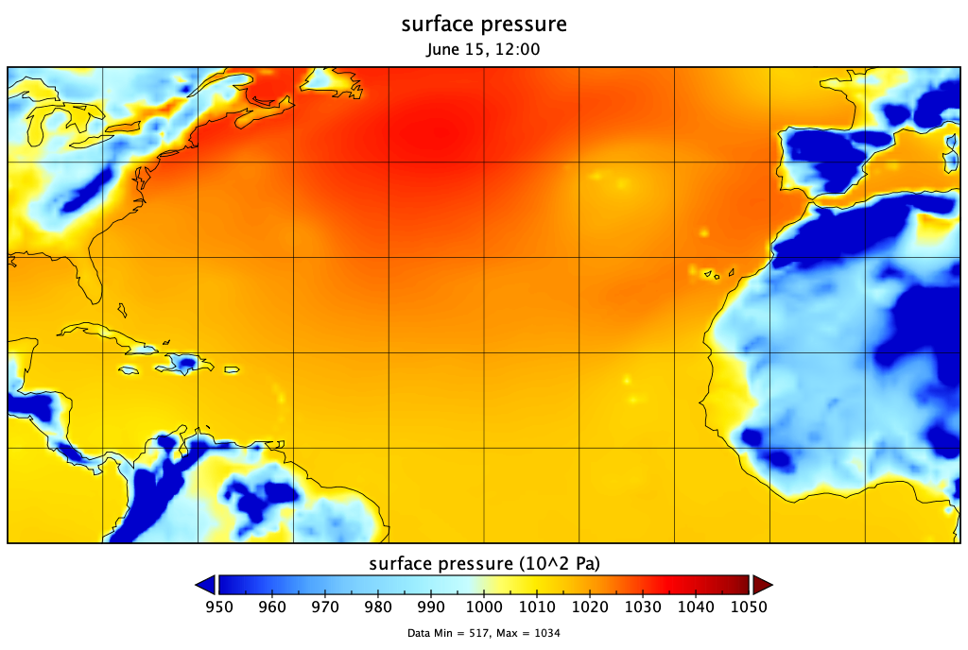
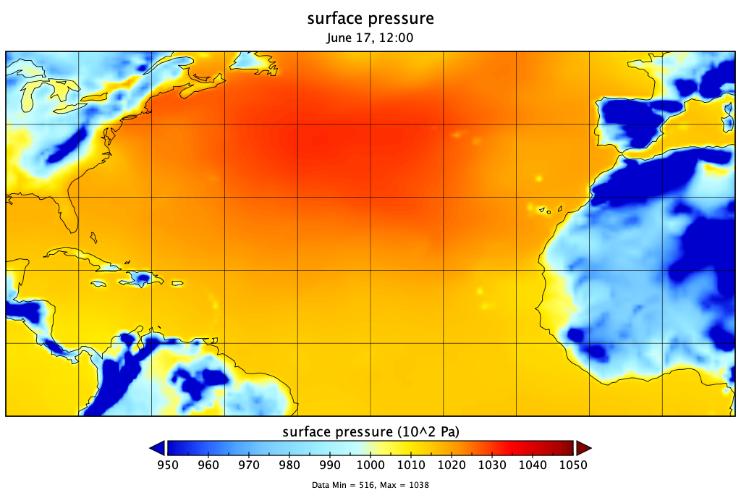
Emissions were large but not historic
The historic dust intrusion into the Caribbean Basin was a result of dust accumulation spanning over several days in the coastal region followed by the rapid transport in the trade winds.
The accumulation was controlled by the anomalous northern drifting of the Bermuda-Azores High.
MERRA-2 Surface Pressure
6/15
6/17
H
L
H
On June 14-16, the Bermuda-Azores High drifted northward and a Low system formed over Azores, leading to strong meridional winds and hence the dust accumulation in the coastal region.

Slide 7
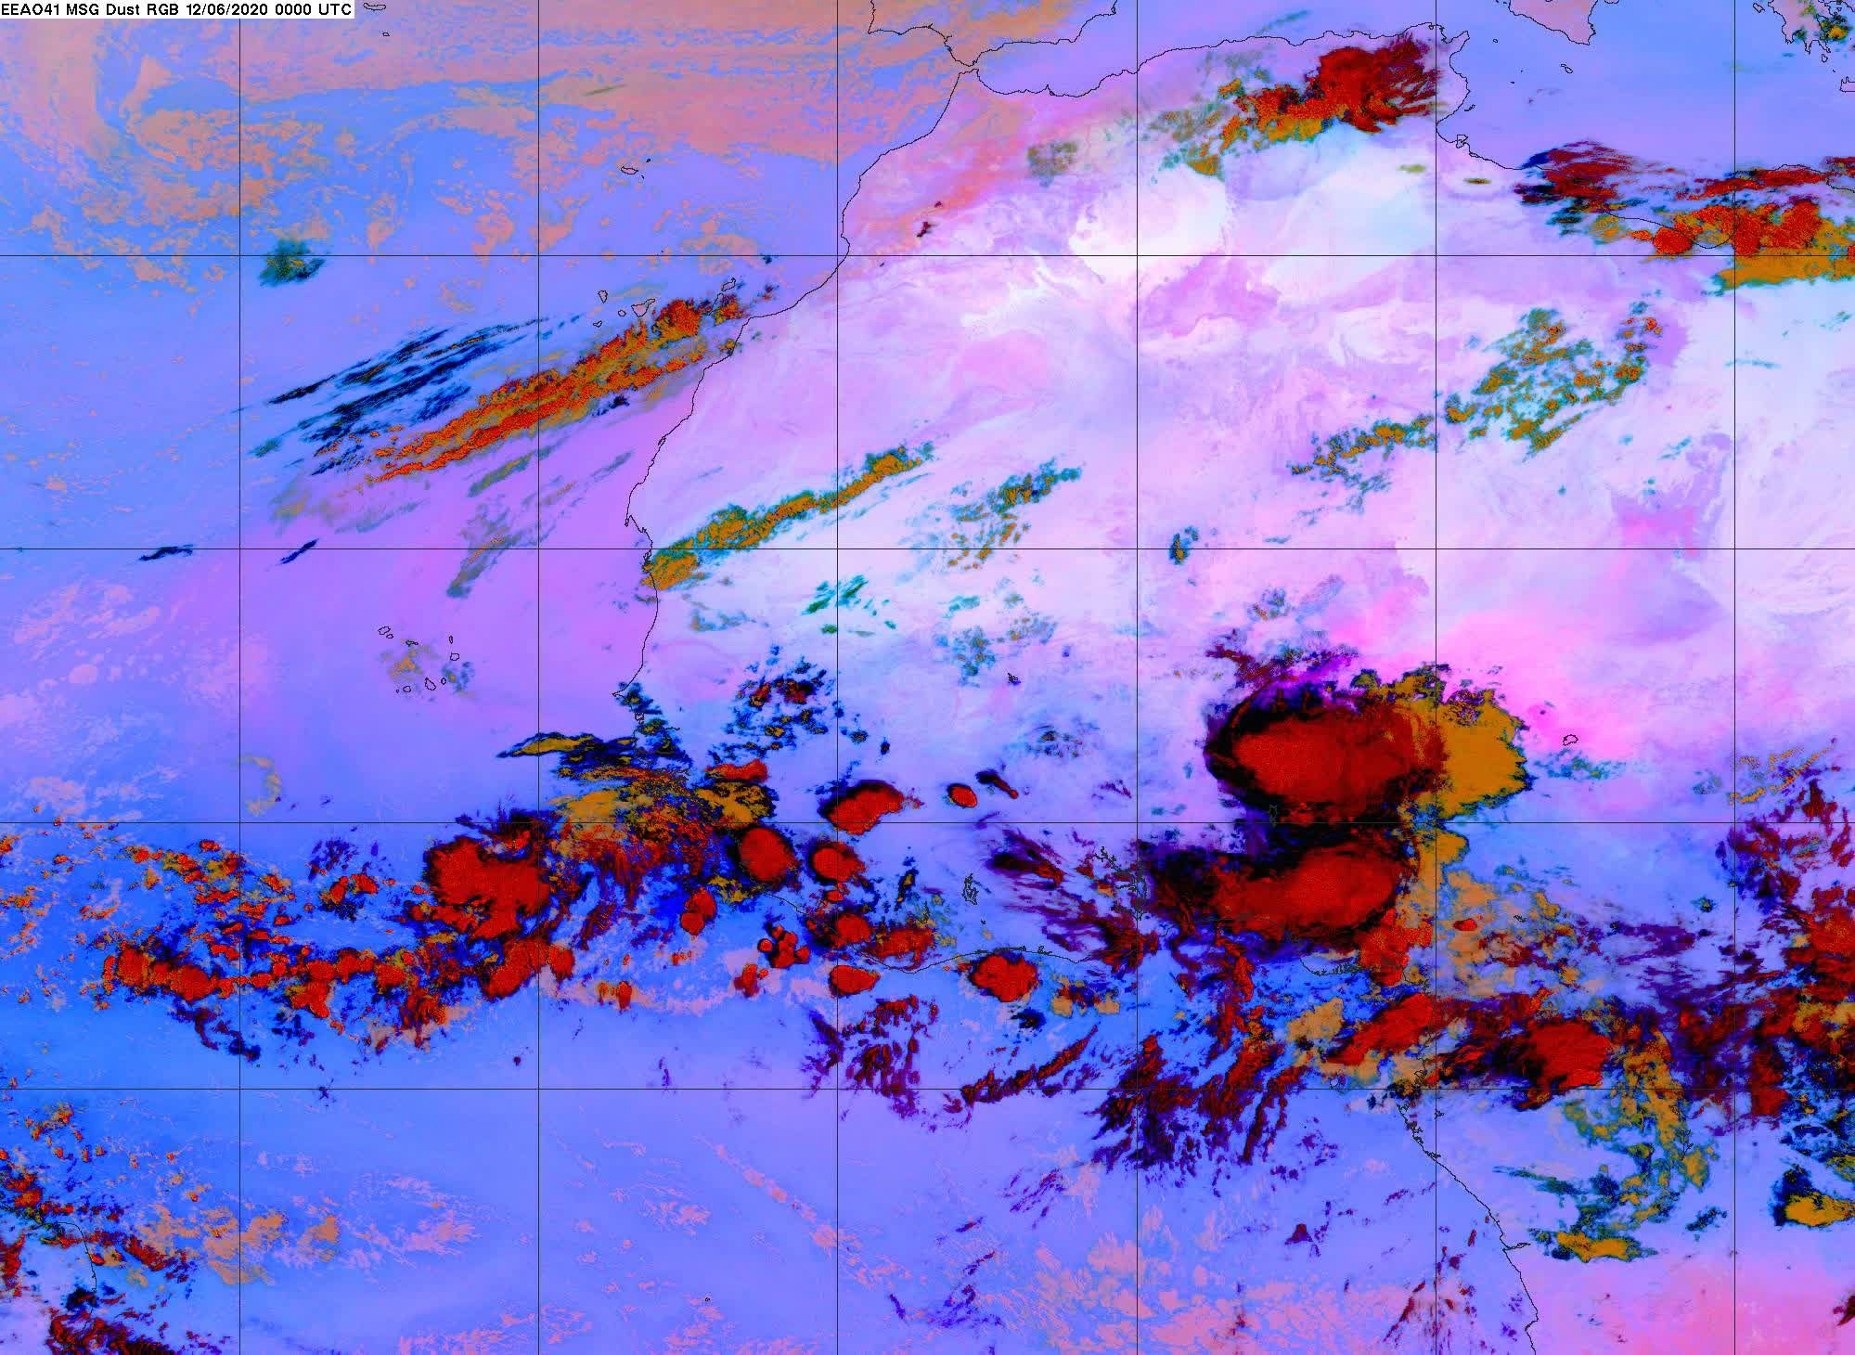
SEVIRI Dust RGB images every 15 min (June 12-15)
  Dark red: Deep clouds
  Orange: Middle clouds
  Dull pink: Low cloud
  Bright pink: DUST
Dust from large Haboobs and other sources in West Africa - Niger, Mali, Mauritania – was accumulated in the coastal area.
SEVIRI: Spinning Enhanced Visual and InfraRed Imager

Slide 8
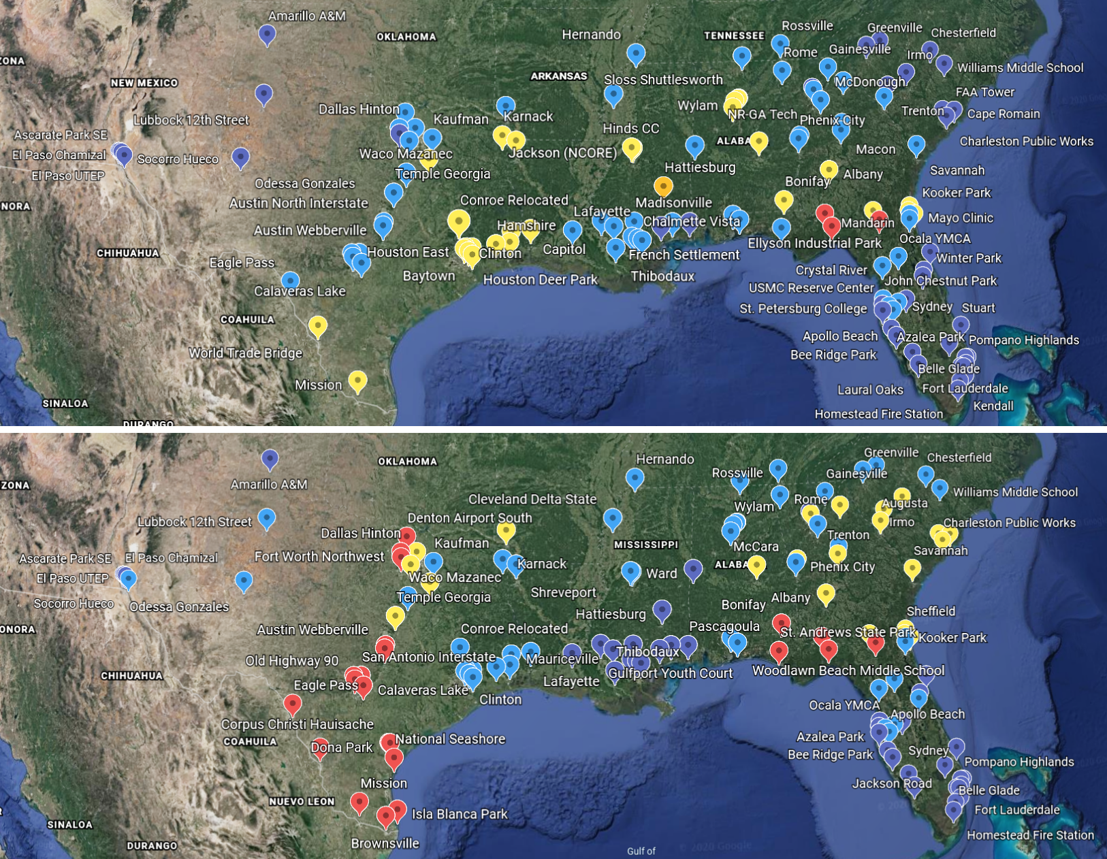
June 26
The dust intrusion degraded air quality in southern U.S. on 6/26-27.
# of sites in 9 southern U.S. states with daily PM_{2.5} exceeding the U.S. AQ standard of 35 µg/m³
6/26 - 31 out of 158 (20%)
6/27 - 62 out of 150 (41%)
June 27
> 50
35 ~ 50
15 ~ 35
< 15

Slide 9
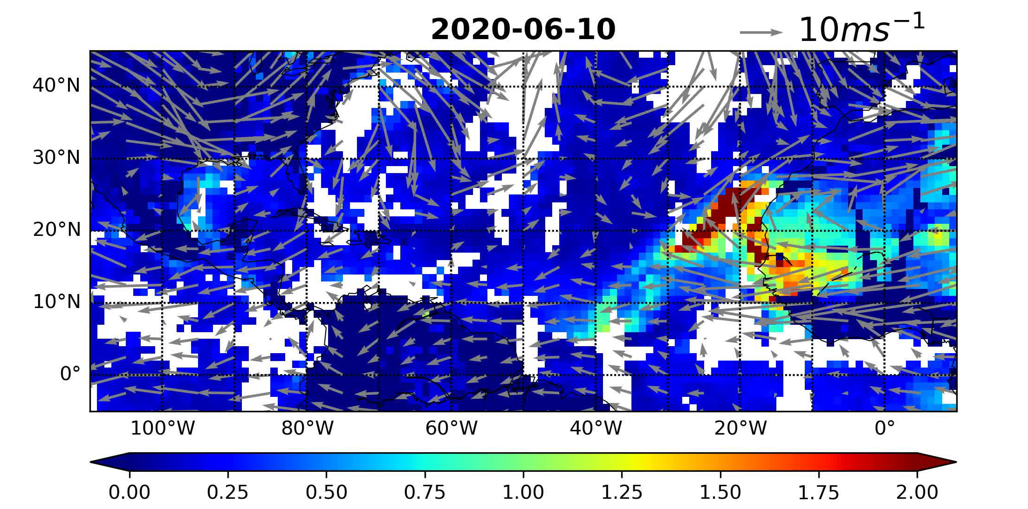
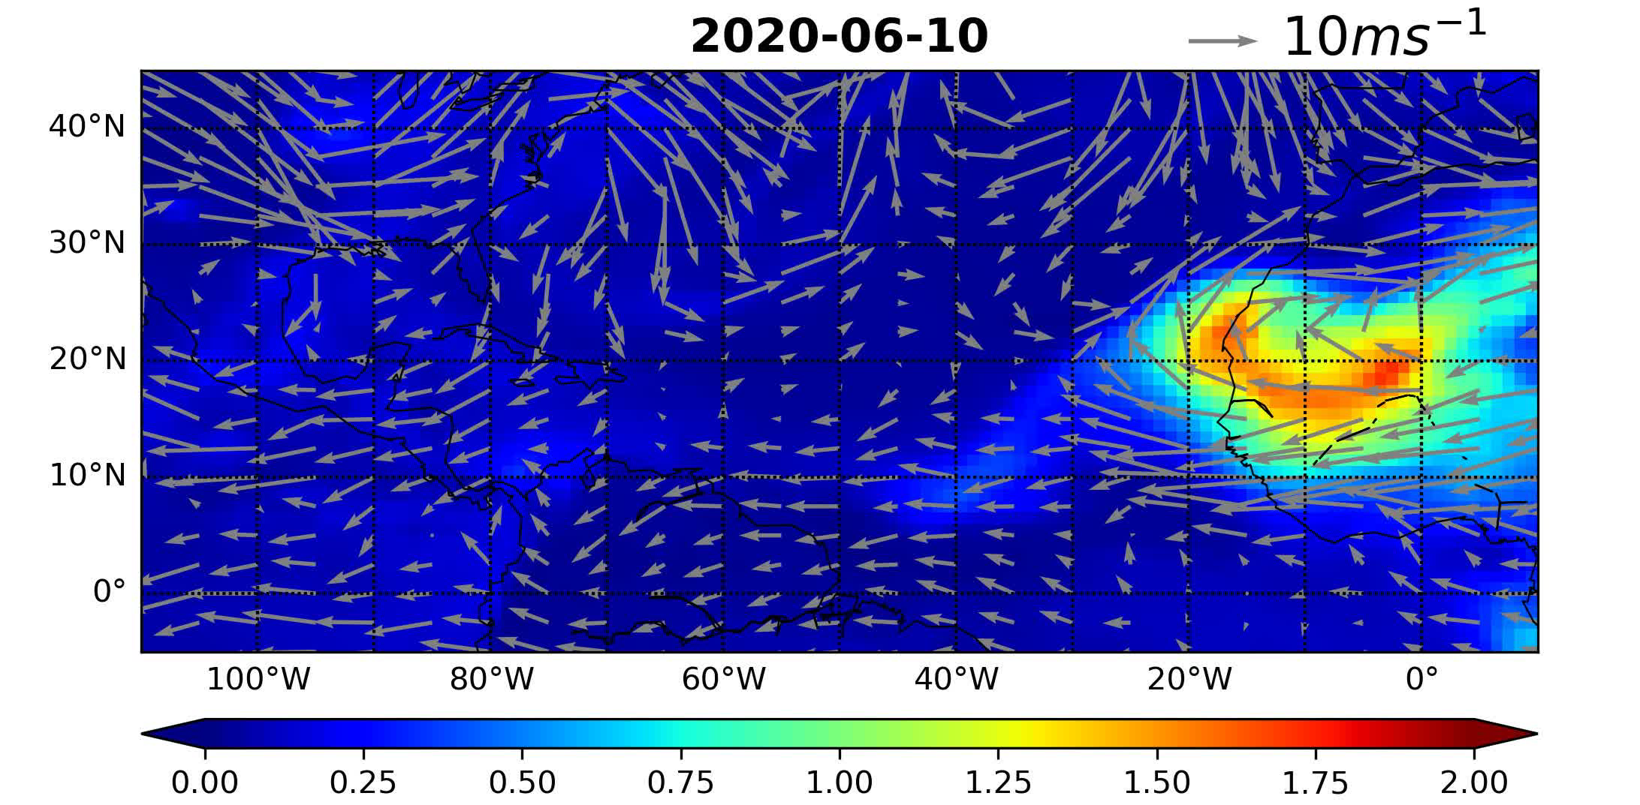
MODIS
Does GEOS model capture the journey of trans-Atlantic dust plumes observed by MODIS?
GEOS
consistent path
different magnitude

Slide 10
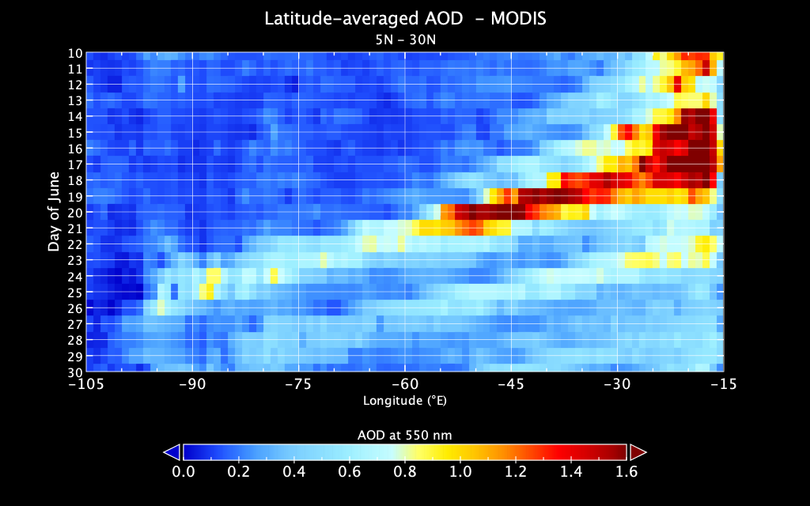
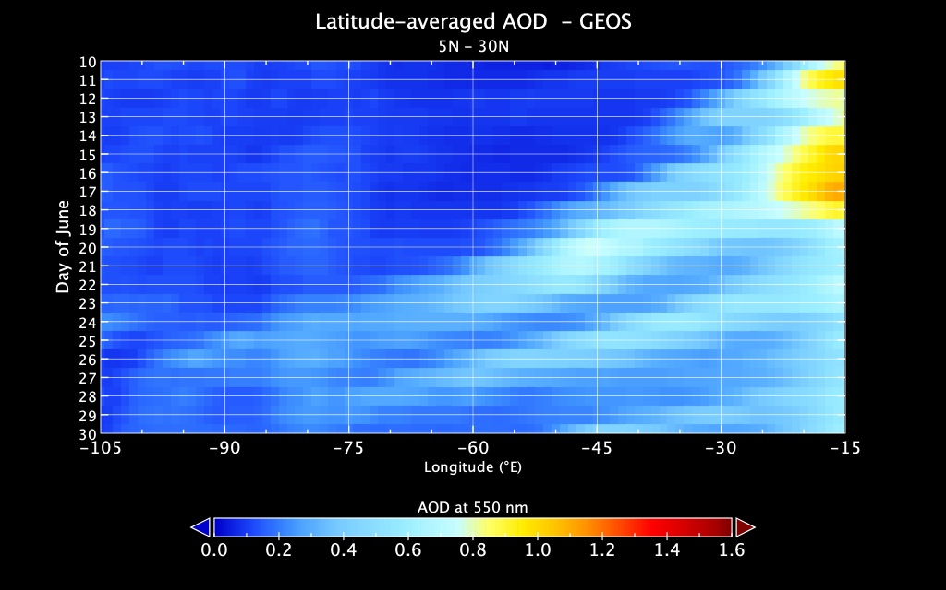
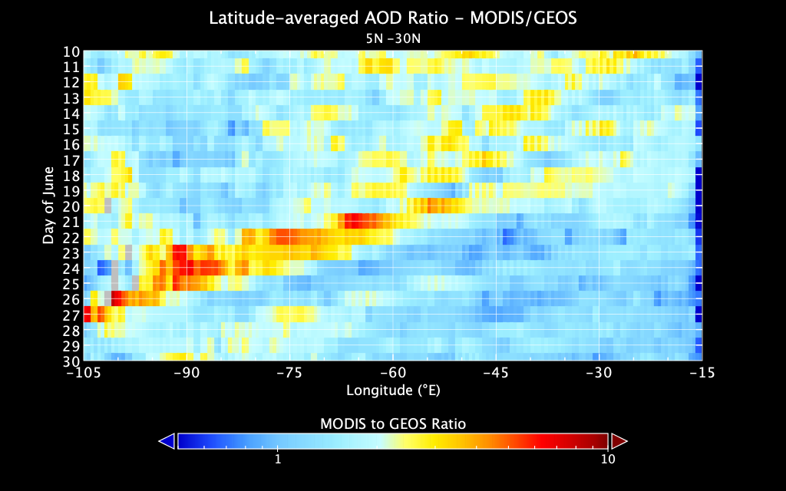
MODIS vs. GEOS
Longitude–Time Hovmöller Diagram
MODIS
GEOS
MODIS / GEOS
Day of June
Day of June
Day of June
Longitude
Longitude
Longitude
GEOS underestimated MODIS AOD by factors of 2-5 for the “gorilla” plume.
GEOS did better job for the “ordinary” plume (x2).

Slide 11
CALIOP
GEOS
6/25
6/23
6/21
6/18
6/15
CALIOP track
GEOS simulate dust plume is generally lower than CALIOP observations.
GEOS don’t reproduce fine structures of the plume.
GEOS substantially underestimates the aerosol extinction.

Slide 12
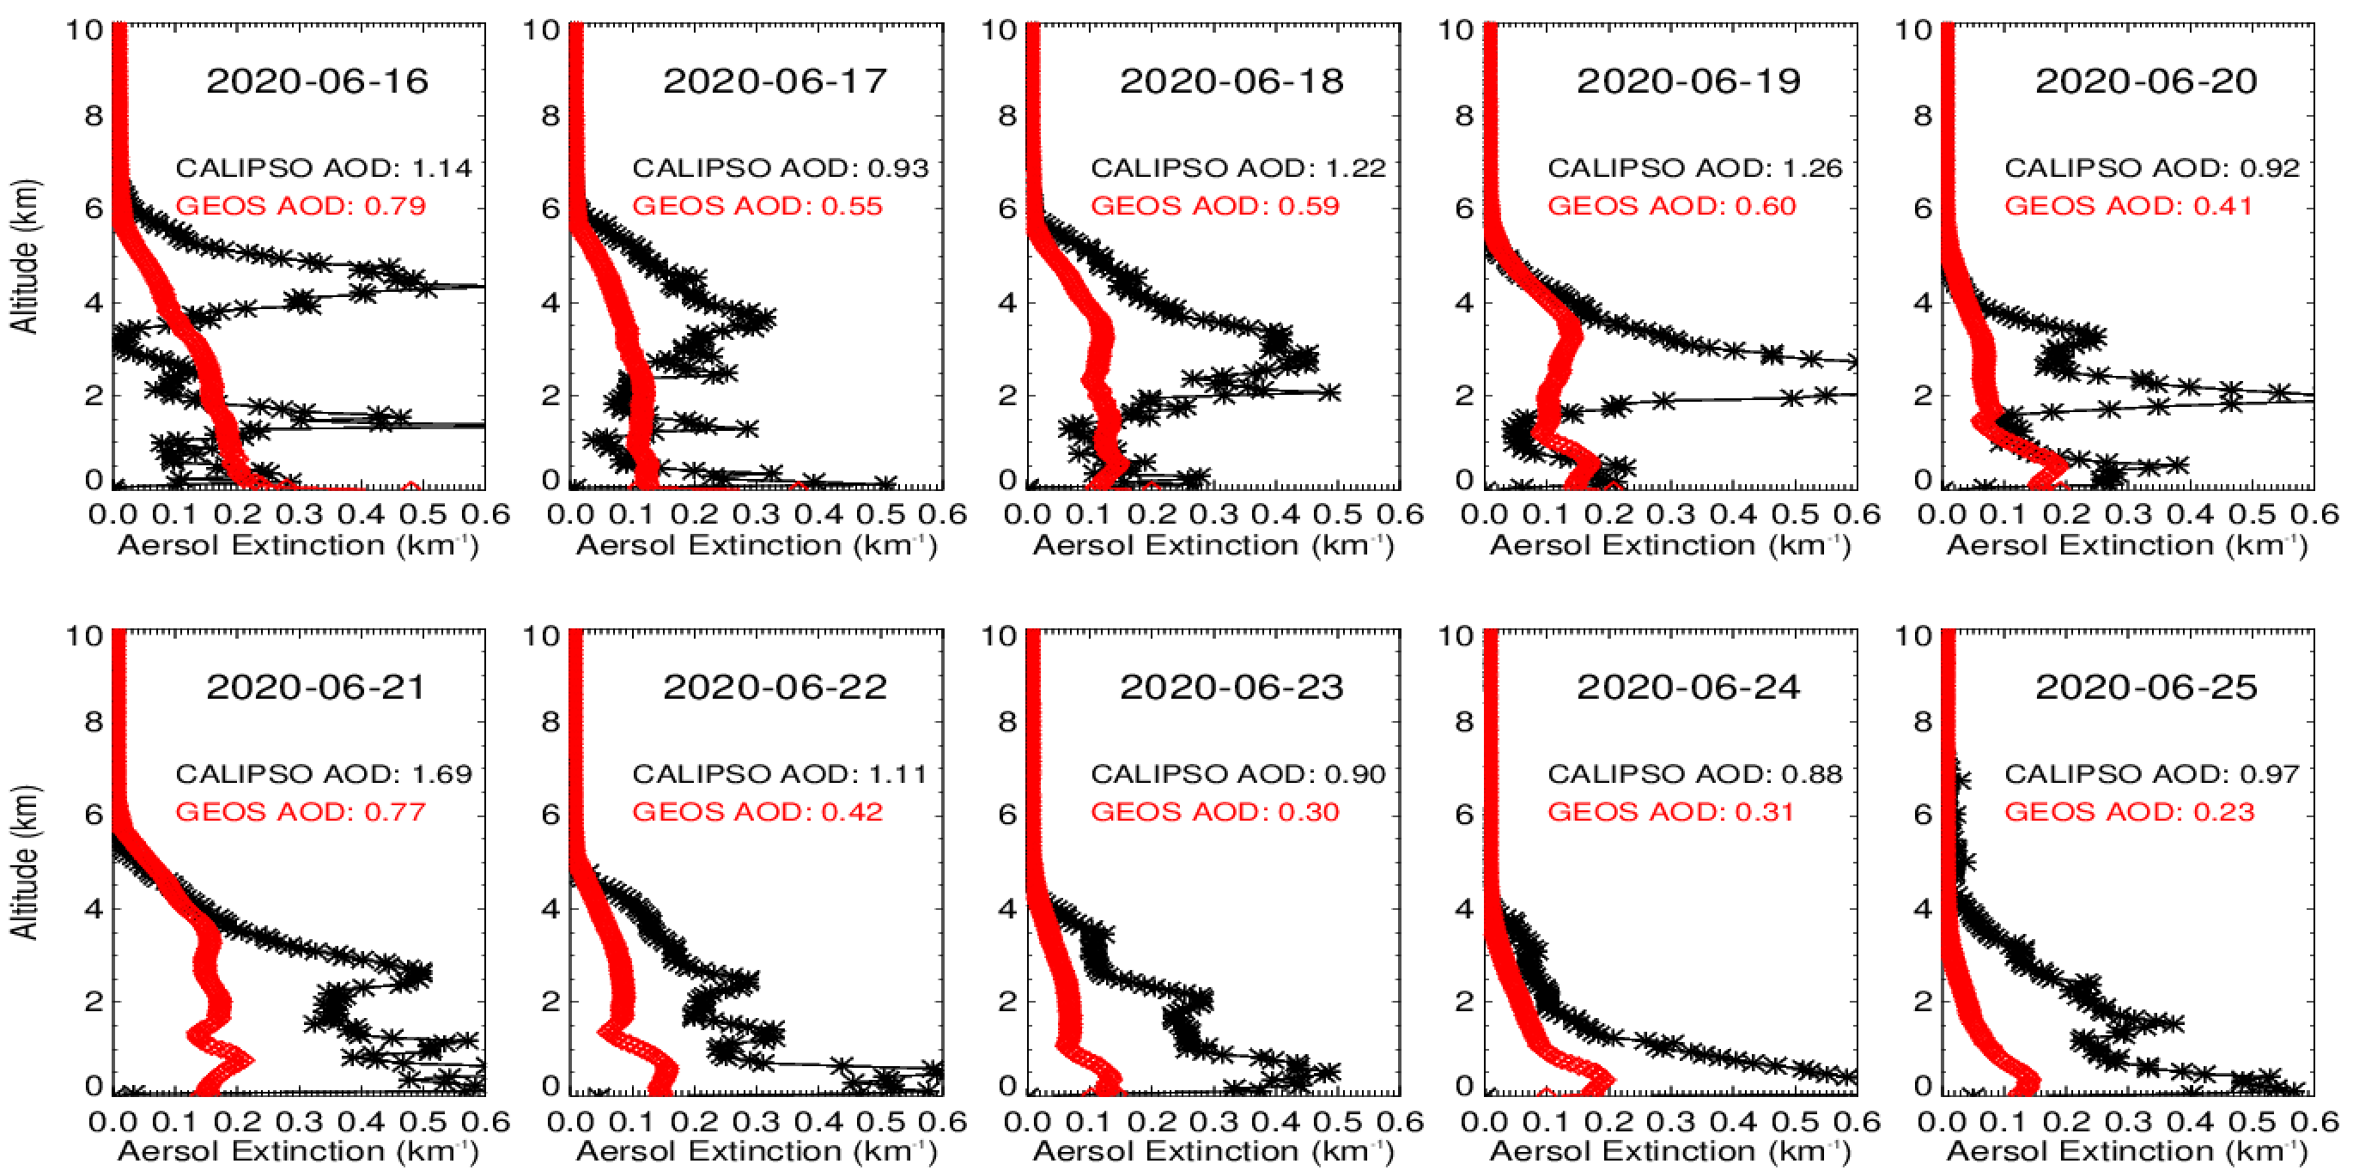
Average profiles
C
1
2
3
4
5
6
7
8
9
GEOS model outputs were sampled based on CALIOP observations of aerosol & clear-clean features (cloud & attenuated excluded)

Slide 13
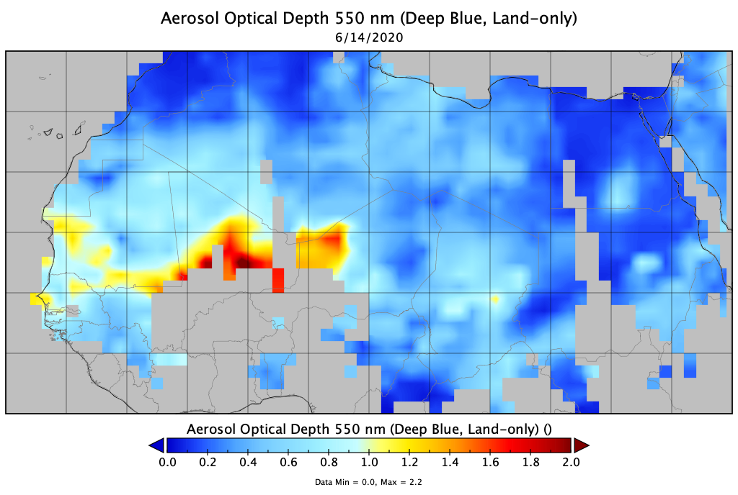
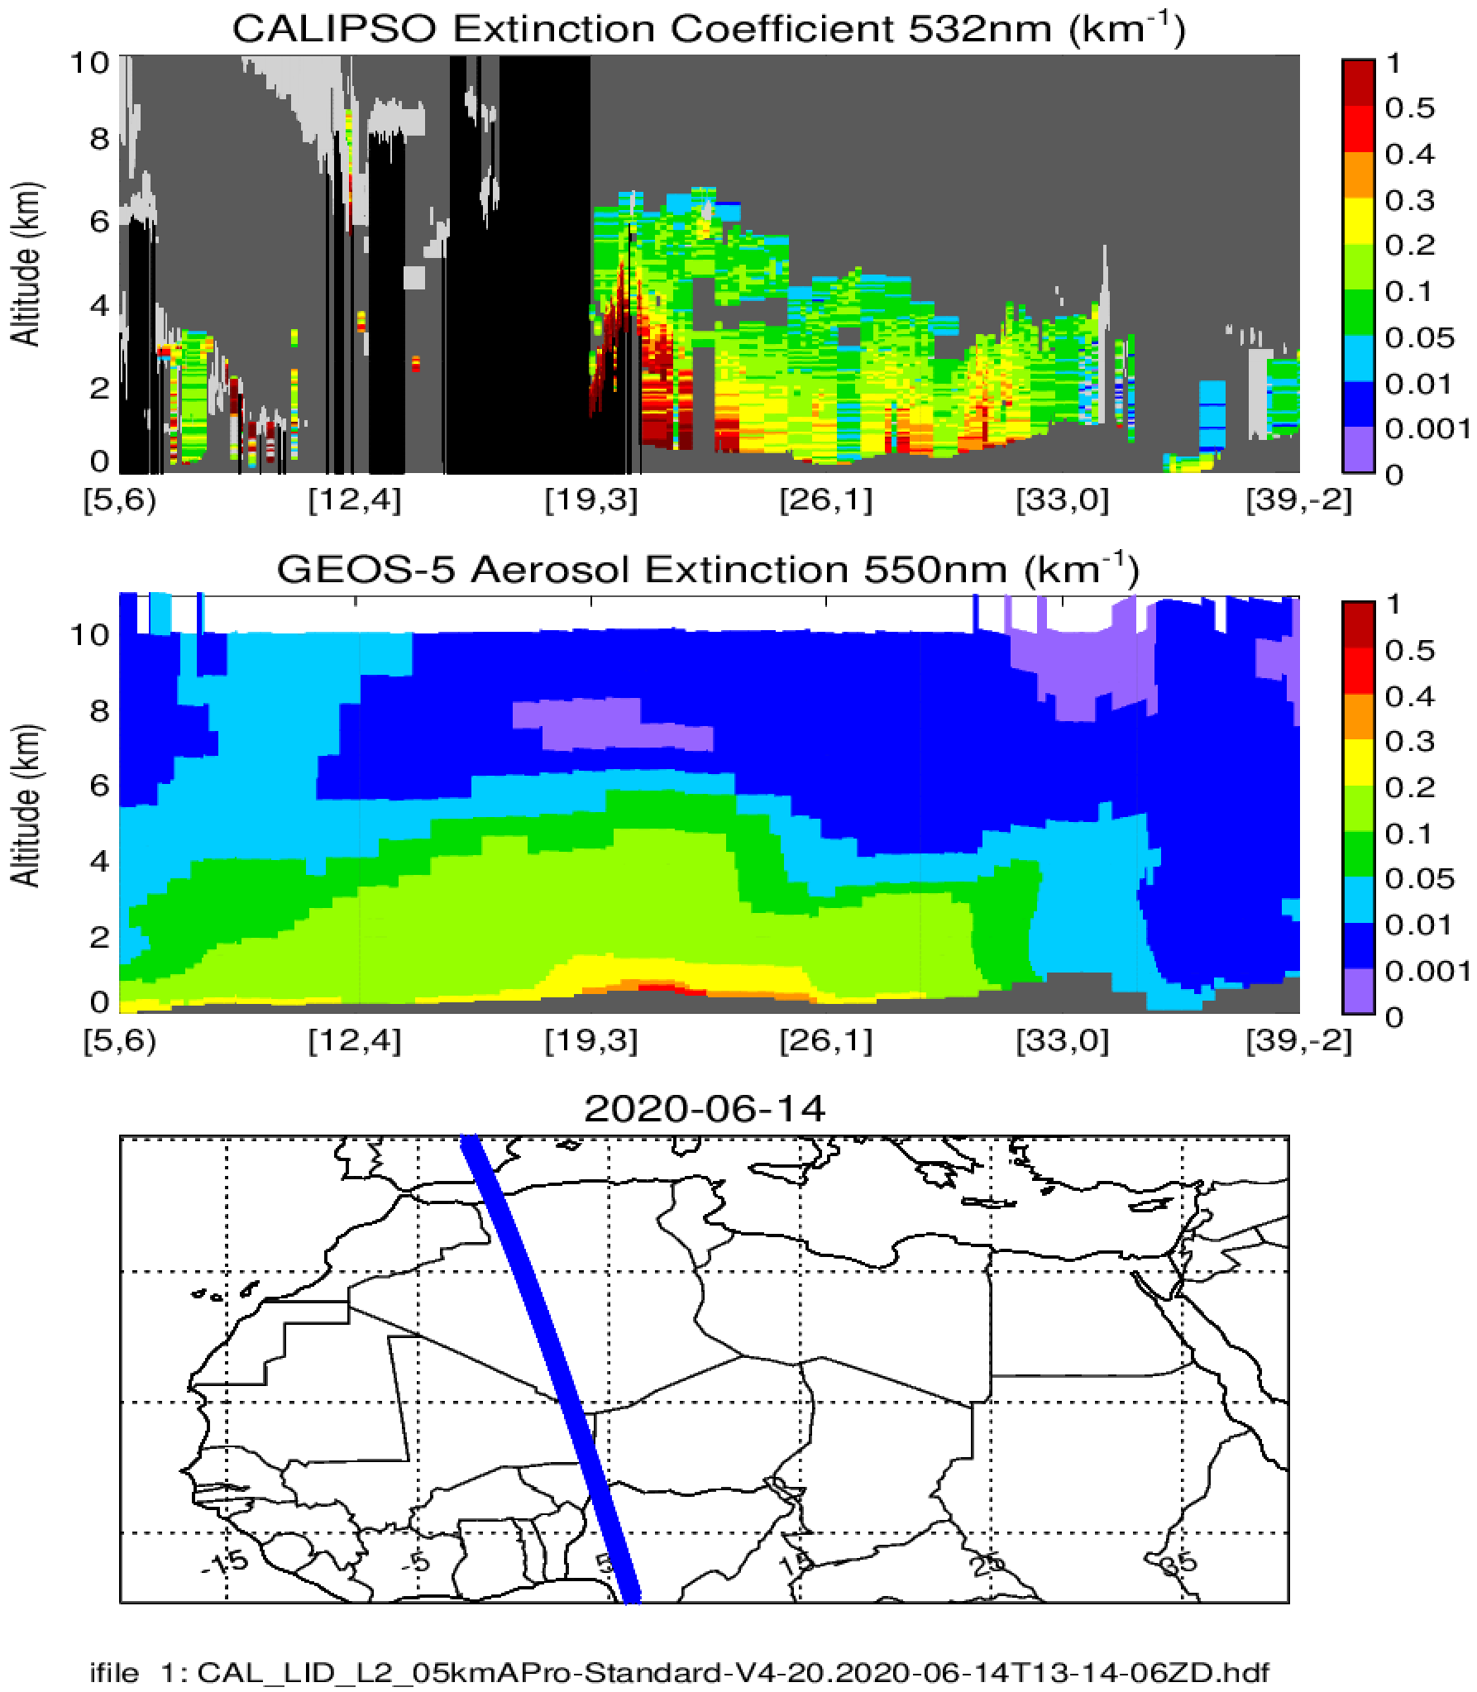
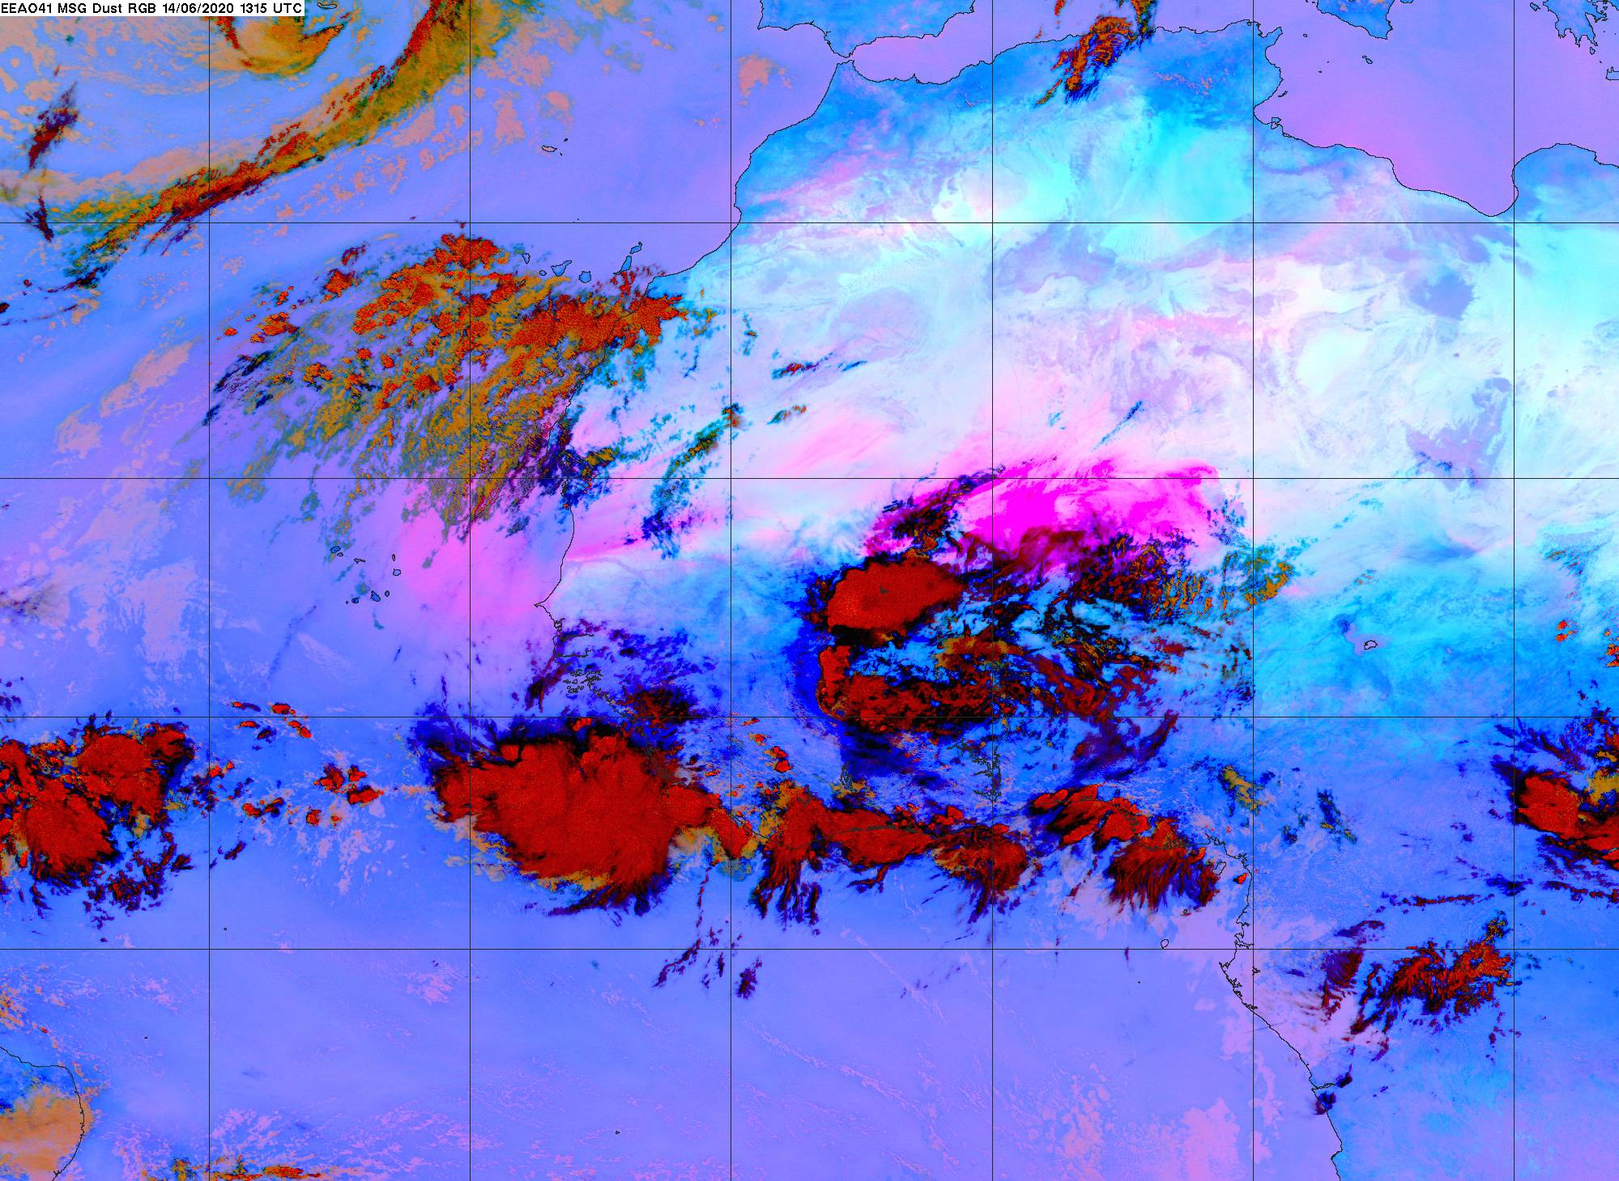
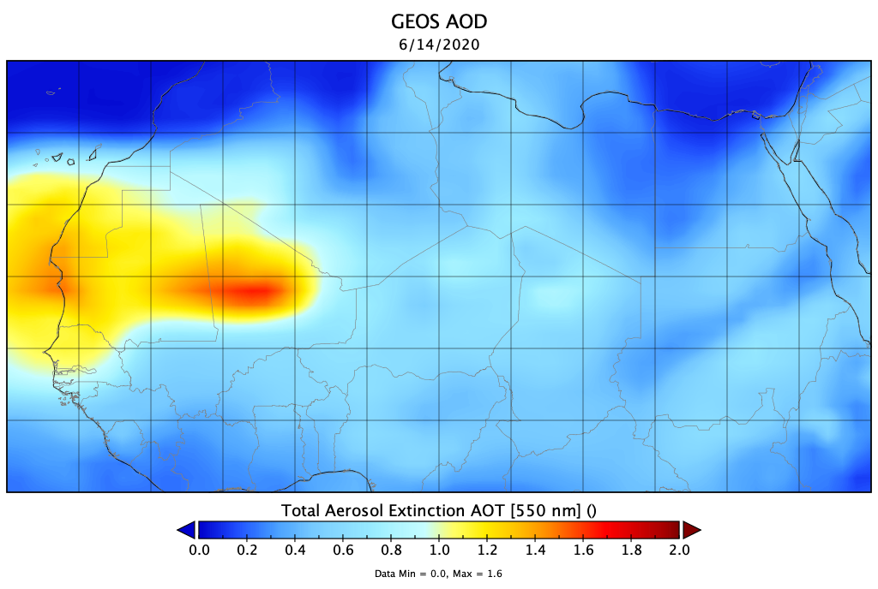
Saharan Deserts: Satellites vs. GEOS
MODIS AOD
2020-06-14
SEVIRI RGB
CALIOP Ext
GEOS AOD
GEOS Ext
GEOS underestimated AOD of Nigerian dust sources.
GEOS didn’t raise up adequate dust in haboob to high altitudes.

Slide 14
Take-home Messages
MODIS observations registered this event as historic over the past two decades.
Impacts on air quality were significant in the southern U.S.
The historic dust intrusion was a result of dust accumulation spanning over several days in eastern Atlantic Ocean followed by a rapid trade-wind transport; and this was controlled by the anomalous drifting of the Bermuda-Azores High.
GEOS captured dust plume track quite well.
However, the model underestimated dust sources in Niger, didn’t lift haboob dust high enough, and substantially underestimated magnitude of the dust intrusion.

