Slide 1
SNPP/NOAA20 VIIRS DNB Calibration and On-orbit Performance
VIIRS Characterization Support Team, NASA, GSFC
(Presented by Hongda Chen)
02/25/2021
1
Notes:
1
1

Slide 2
Outline
VIIRS DNB Calibration Algorithm
LGS F-factor, DN0 and Gain ratio.
Straylight estimation and special considerations.
On-orbit Trending Performance
SNPP: LGS F-factor, DN0 and Gain ratio (mode-1, 21)
NOAA20: LGS F-factor, DN0 and Gain ratio (mode-1, 21)
SNR meets system design specifications.
Straylight Correction Performance
SNPP: NH night images before/after correction.
NOAA20: NH night images before/after correction.
HAM-side Evaluation on straylight estimates.
Summary
2
Notes:
2

Slide 3
VIIRS DNB Calibration Algorithm Overview
LGS Gain Calculation
SD radiance:
SD-SUN angle, HAM relative response at SD AOI, transmittance of pinhole screen, SD degradation index, relative spectral response, solar spectral power distribution.
Calculate LGS gain coefficient (1/F-factor):
Dark Offset
Estimate dark trend using the minimum of SV/BB/SD data as sun declination angles in 40~140 degree.
Normalize dark trend at the pitch maneuver value (Mode, Det, HAM, Gain).
Cross-stage Gain Ratios and Coefficients
Compute daily average gain ratio: MGS/LGS, HGS/MGS
MGS gain = LGS gain * MGS/LGS
HGS gain = MGS gain * (HGA/MGS +HGB/MGS)/2
Algorithm Modification
Instead of all data, a linear fit of the most recent 1-year data is used for predication on N20 F-factor, DN0 and gain ratios.
3
Notes:
3

Slide 4
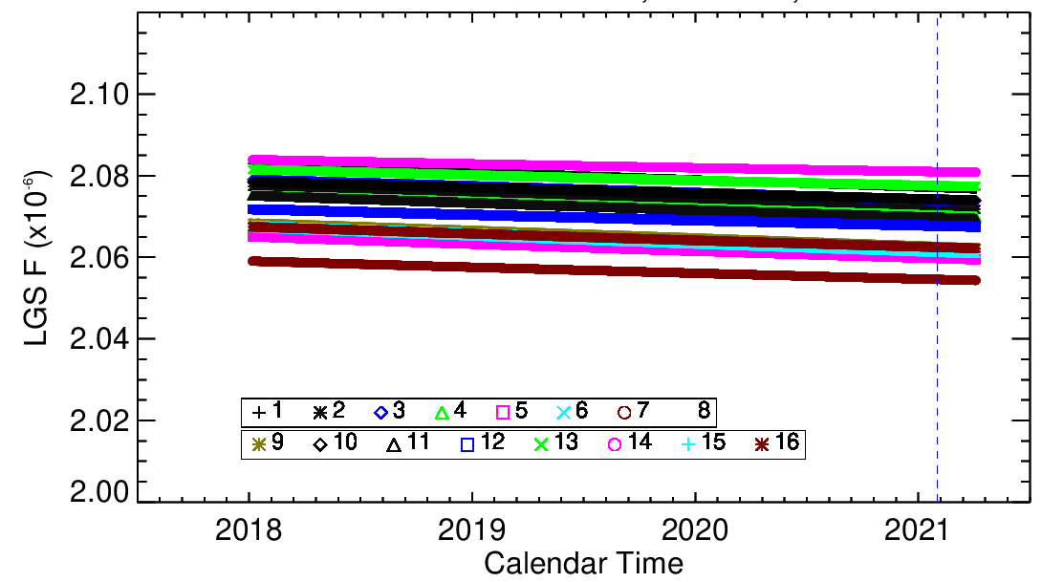
SNPP/N20 DNB LGS F-factor: Mode-1, HAM-1
SNPP/N20 LGS F-factor trends (Mode/Detector/HAM) are stable.
SNPP LGS F-factor shows a large degradation slope in the early mission.
N20 LGS F-factor is extremely stable.
Linear fit is used for predication in forward deliveries.
SNPP
N20
4
Notes:
4

Slide 5
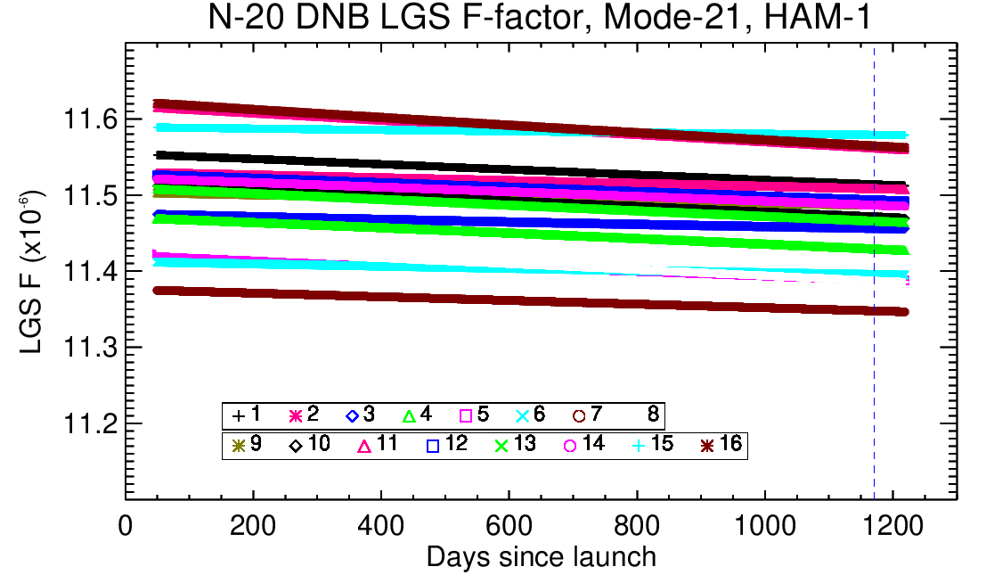
SNPP/N20 DNB LGS F-factor: Mode-21, HAM-1
SNPP/N20 LGS F-factor trends (Mode/Detector/HAM) are stable.
SNPP: Mode-1 to Mode-32.
N20: Mode-1 to Mode-21.
SNPP: Trends in Higher Modes show larger variations ( ~1.5 %).
N20: Some detectors are with a down trend-slope in Mode-21 (< 0.4%).
SNPP
N20
5
Notes:
5

Slide 6
SNPP Gain-Ratio: M/L and H/M (Mode-1,HAM1)
Gain ratio is calculated using OBC data excluding saturations.
MGS/LGS ratios are relatively stable.
HGS/MGS ratios show yearly oscillations ( ~ 2%).
There is no obvious group distribution for all 16 detectors.
M/L
H/M
6
Notes:
6

Slide 7
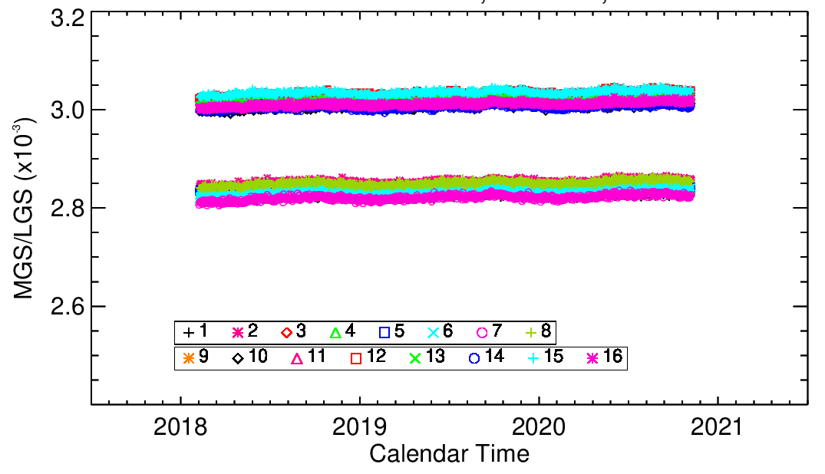
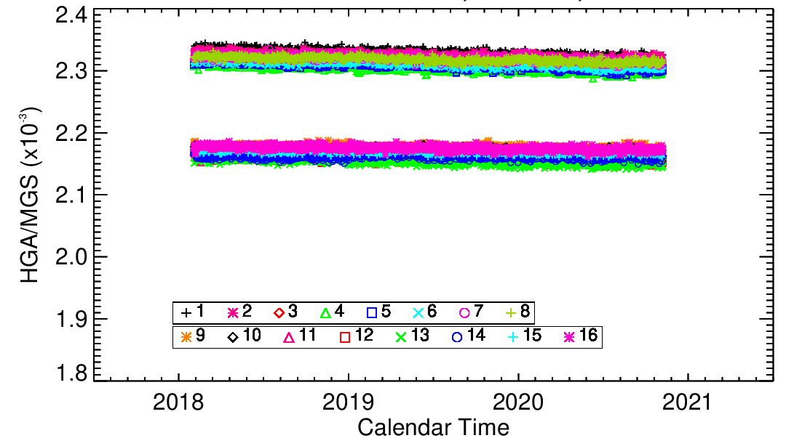
N20 DNB Gain Ratio: Mode-1, HAM-1
Gain ratio is calculated using OBC data excluding saturations.
Two families are observed in the ratios of MGS/LGS and HGS/MGS, mainly depending on detector locations.
Gain ratios of HGS-to-LGS are roughly in one family for all detectors
Trending is stable for all detectors.
7
Notes:
7

Slide 8
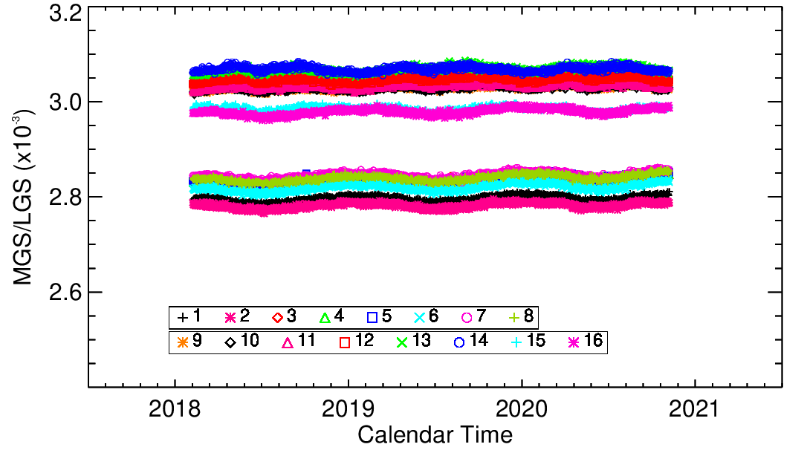
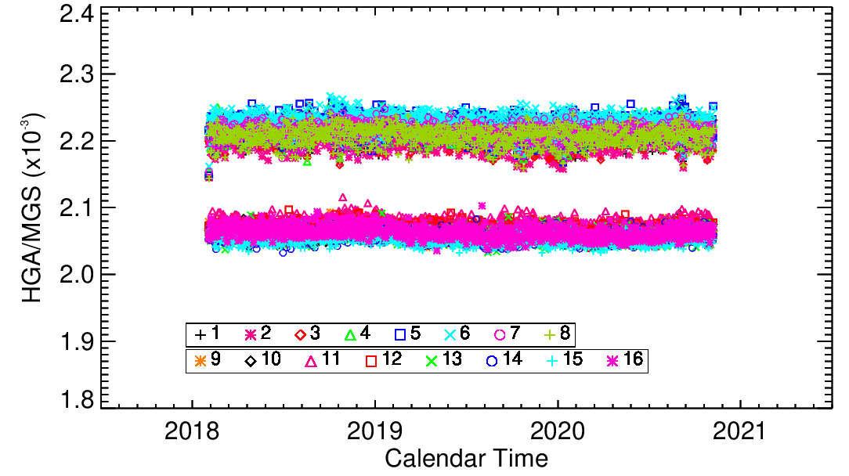
N20 Gain-Ratio: M/L and H/M (Mode-21,HAM1)
High mode-21 is shown.
Two families are observed in the ratios of MGS/LGS and HGS/MGS.
Trending in higher modes is with larger variations, comparing with mode-1.
8
Notes:
8

Slide 9
SNPP Dark Offset at Mode-1: HGS/MGS/LGS
Dark offsets are tracked using minimal values from OBC data, and then normalized to pitch maneuver values (February 20, 2012).
Dark offsets show gradually increased for HGS and MGS, however, changes in MGS are less than 1 digital count. Dark offsets in LGS are relatively small, and the changes are in 0.5 digital count.
There is a large drop at the time around 2700 in the case of HGS, where the flight software FSW_0x4018 is uploaded on January 8, 2020.
9
Notes:
9

Slide 10
N20 Dark Offset at Mode-1: HGS/MGS/LGS
Dark offsets are tracked using minimal values from OBC data, and then normalized to pitch maneuver values (January 31, 2018).
Dark offsets show gradually increased for HGS and MGS. Changes in MGS are less than 0.6 digital count. Dark offsets in LGS are stable with changes less than 0.2 digital count.
N20 dark offsets are more stable than SNPP.
10
Notes:
10

Slide 11
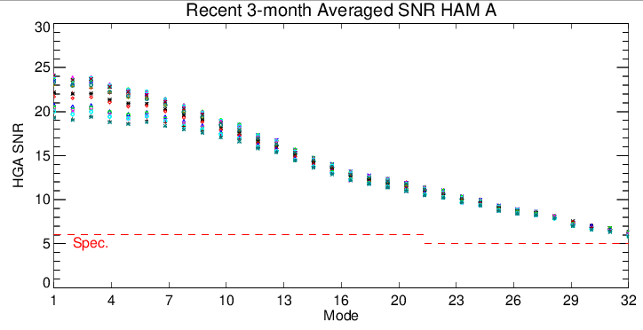
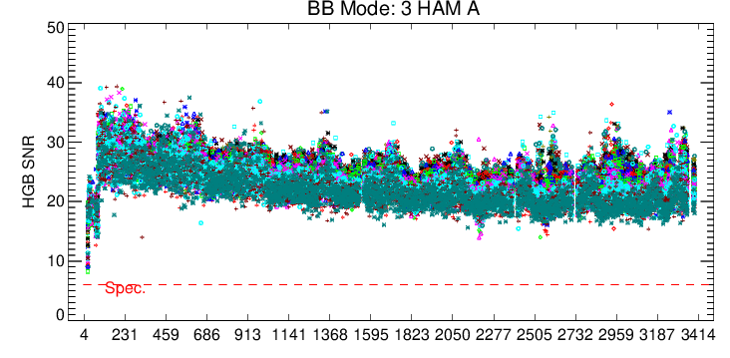
SNPP DNB HGS SNR Evaluation
Recent three-month averaged SNR (Nov-20/Dec-20/Jan-21) shows above system specifications for all Modes 1~32.
Higher modes show smaller SNR as expected.
Mode-3 BB SNR trends below. All other modes have a similar behavior.
11
Days since launch
Notes:
11

Slide 12
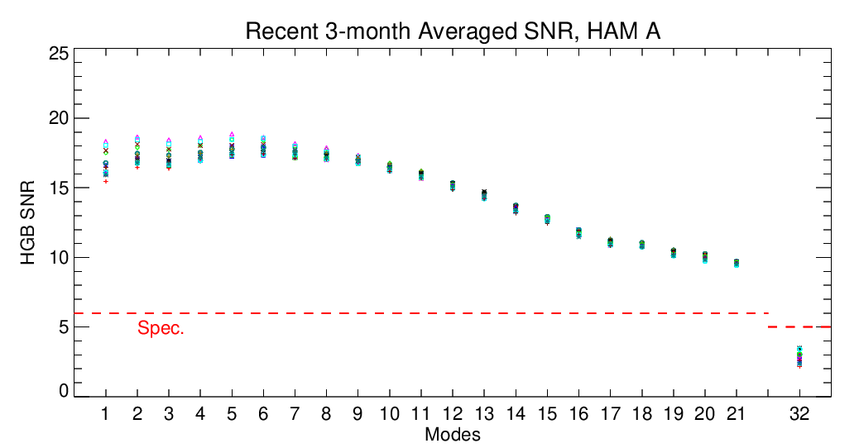
N20 DNB HGS SNR Evaluation
Recent three-month averaged SNR (Nov-20/Dec-20/Jan-21) shows above system specifications for operational Modes 1~21.
Mode-32 is below the specification, which was identified in pre-launch test.
In cases of modes less than 8, SNR is around 17dB. Higher modes (larger than Mode-8) show a decreased SNR trend as expected.
12
Notes:
12

Slide 13
SNPP/N20 DNB Stray Light Correction
Dark Signals
Use 15 orbits of EV data from terminator crossing during new moon.
Separate EV samples into 127 bins of 32 pixels each (4064=127x32).
Determine each bin radiance: mean of lower 20% pixels within bin.
Perform median of all 15 orbits as bin radiance.
Stray Light Estimation
Smooth data except regions with sharp changes.
In twilight regions (solar zenith angle < 105), stray light is assumed the same to the last known value.
127 bins are interpolated to 4064 in-scan pixels (LUT format).
N20: Special treatment to edge pixels of impacted images (3920~4064).
Stray Light Correction Strategy
Produce correction LUT per hemisphere, detector, HAM, sample and SZA.
Update correction LUT per month (every new moon)
Stray Light LUT Modification
Use same values on both HAM sides to decrease the LUT size.
13
Notes:
13

Slide 14
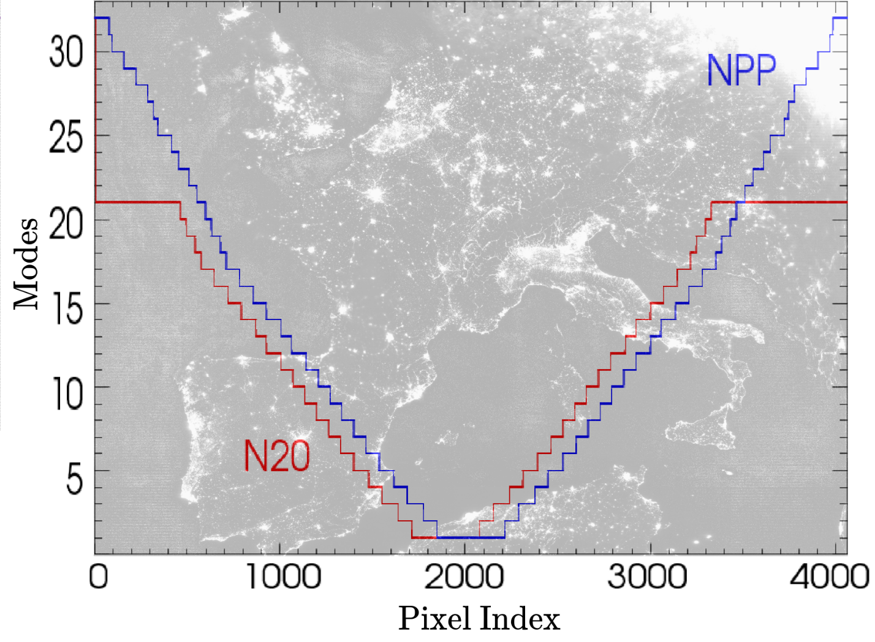
SNPP and N20 modes versus pixel
14
Notes:
14

Slide 15
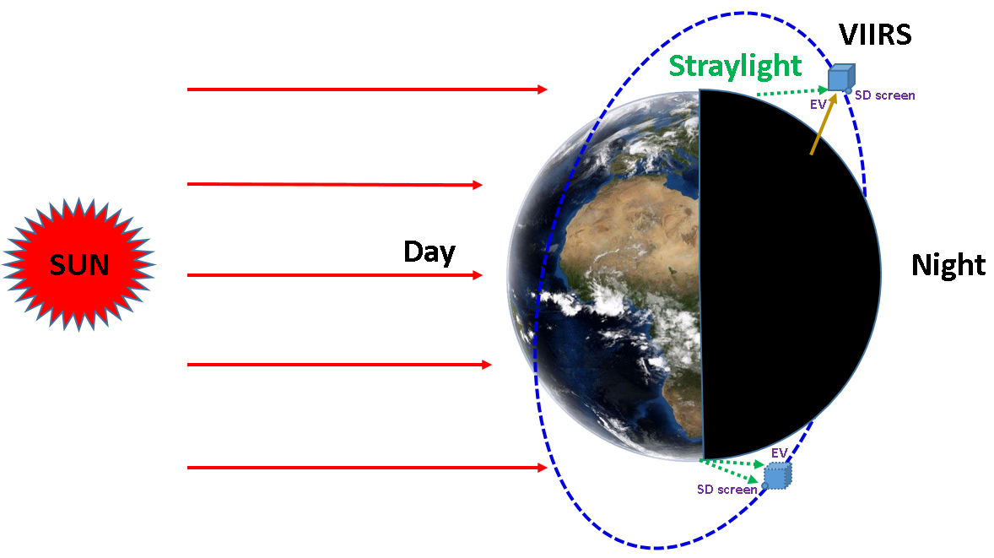
Straylight Estimate/correction Illustration
RAW
Straylight Estimate
Straylight Corrected
Solar zenith
Solar zenith
Solar zenith
Example shows bin-1 for new moon day-2021012, where all 16 detectors are plotted.
Straylight estimate is based on the raw radiance profile, which is detector/HAM dependent in general.
Straylight corrected is calculated by
Radiance = Raw – Est + airglow.
15
Notes:
15

Slide 16
N20 Edge Straylight Estimate/correction
RAW
Straylight Estimate
Straylight Corrected
N20 edge pixels have large straylight contamination (pixel index > 3920, mode-21).
Special treatment has been developed for N20 edge pixels in night images.
Straylight corrected is calculated by Radiance = Raw – Est + airglow.
16
Notes:
16

Slide 17
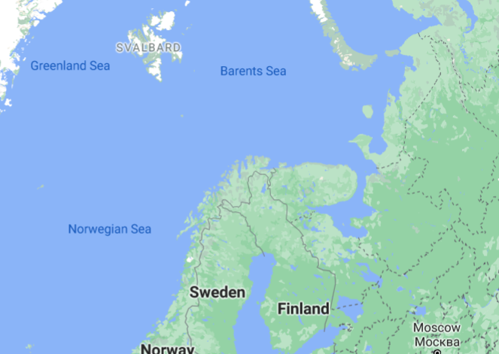
Example selected area for straylight evaluations

Slide 18
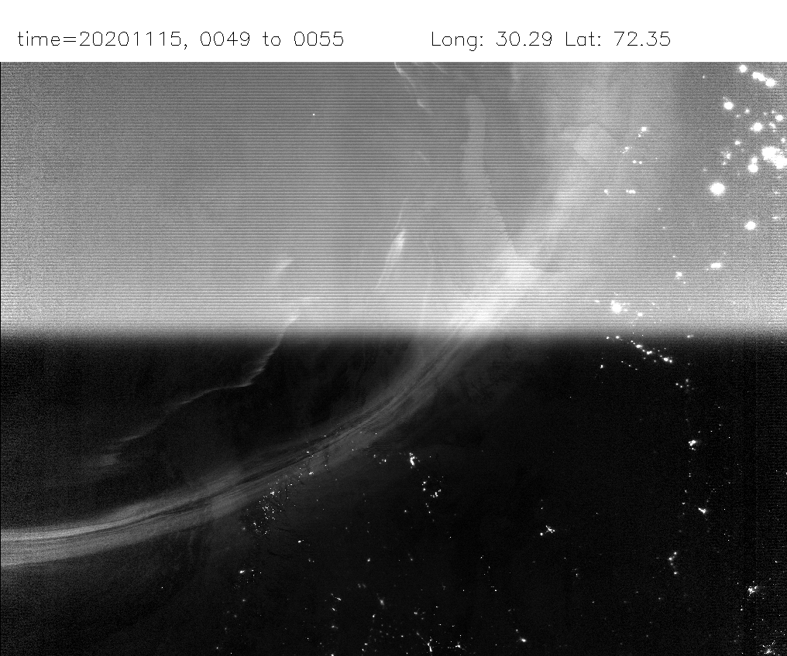
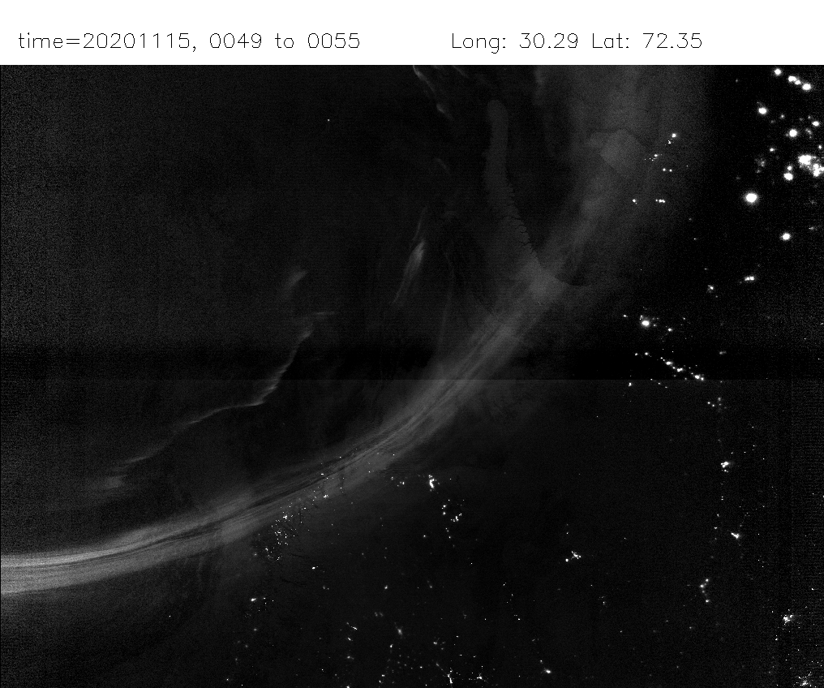
SNPP DNB Starlight Evaluation
Before correction
After correction
11/15/2020
Europe (lat 72.35, lon 30.29) Before/After correction
Example shows that straylight is effectively removed.
Some features may be removed as well. Further improvement is under research.

Slide 19
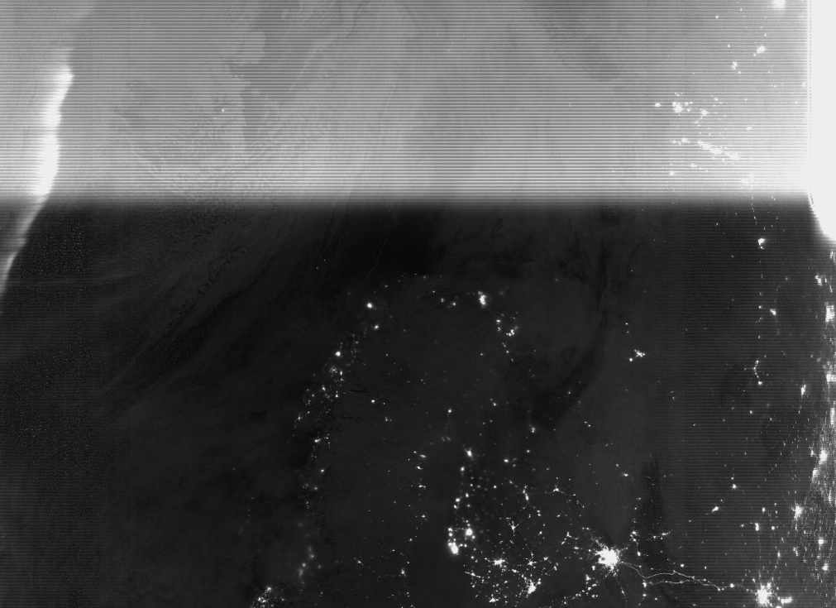
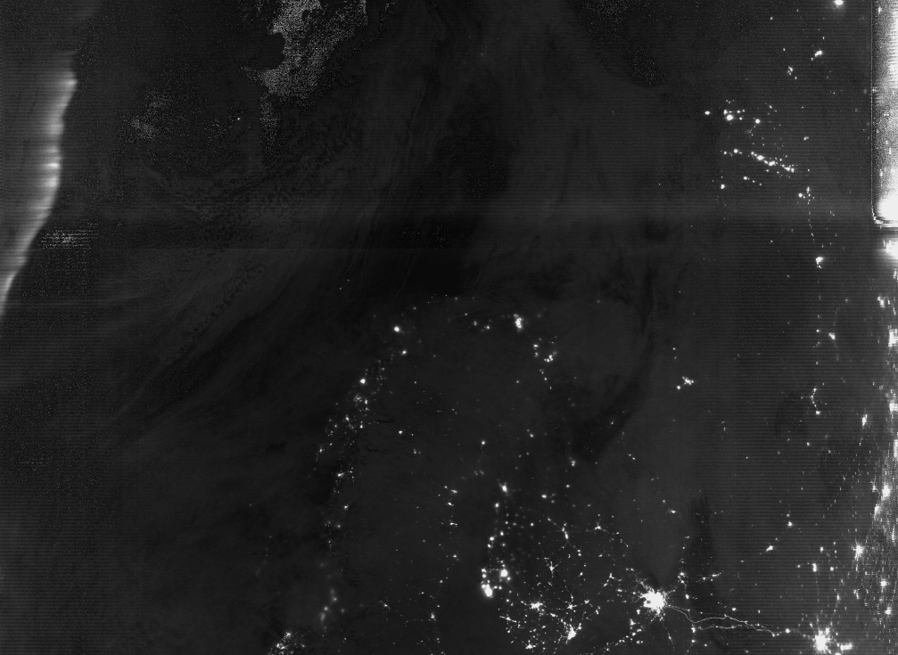
N20 DNB Straylight Evaluation
11/16/2020, UTC time 01:22
Europe (lat 72, lon 30)
N20 straylight is about 1/3~1/2 of SNPP at center pixels (Modes 1~10).
Example shows that straylight is effectively removed.
Edge pixels have much larger straylight. Future Improvement is under research.
Before correction
After correction

Slide 20
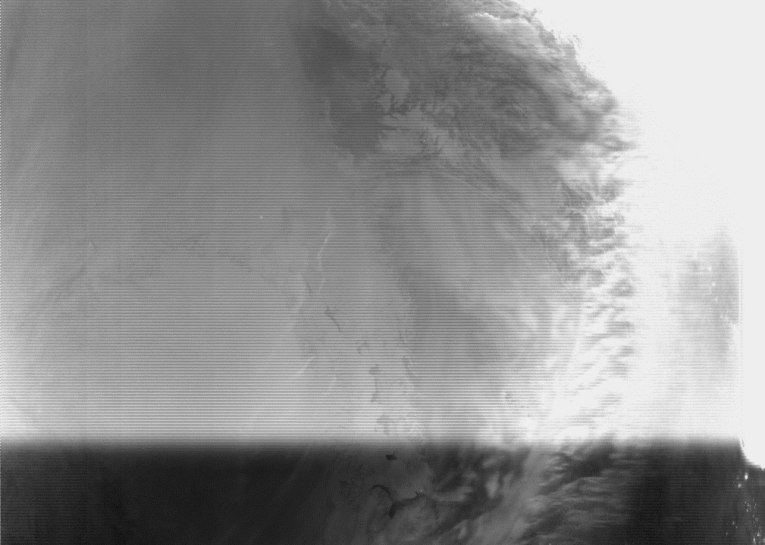
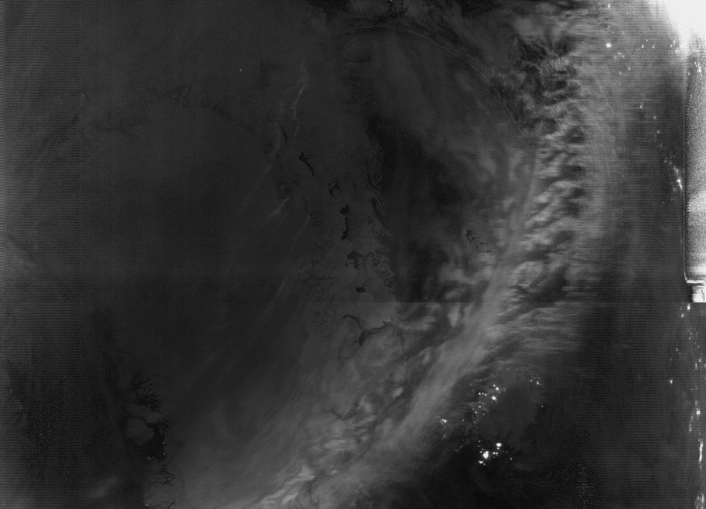
N20 DNB Straylight HAM-side Impact
Before correction
After correction (I)
Night image: 11/15/2020, UTC time 05:03
After correction (I): using the regular straylight LUT.
After correction (II): using the same HAM side values of LUT.
Both cases show similar image quality. The difference is ignorable.
After correction (II)

Slide 21
Summary
SNPP/N20 VIIRS DNB are in normal operations, and on-orbit calibration has been successfully performed.
On-orbit trending performance shows stable behavior in LGS, MGS, and HGS of SNPP/N20 VIIRS DNB. Comparison of F-factor, DN0 and gain-ratio demonstrates good agreements with IDPS results.
DNB straylight has been effectively corrected. The data size of LUT can be significantly decreased by using the same values on both HAM sides.
Future works
1) Straylight estimation and predication improvements.
2) Uncertainty analysis and index generations.
3) DNB on-orbit calibration improvements.
21
Notes:
21

