Slide 1
MODIS/VIIRS Cal/Val Using RadCaTS Jeffrey Czapla-Myers and Nikolaus Anderson Wyant College of Optical Sciences University of Arizona MODIS/VIIRS Calibration Workshop 25–26 Feb 2021

Slide 2
Topics
The Radiometric Calibration Test Site (RadCaTS)
Current status of RadCaTS
Radiometric calibration and surface reflectance validation results
Summary and future work

Slide 3
Radiometric Calibration Test Site (RadCaTS)
UArizona is using the Radiometric Calibration Test Site (RadCaTS) at Railroad Valley, NV, as the primary data collection site
RadCaTS has been in operation in its current form since 2012
Previous studies were used to determine amount and placement of GVRs for spatial sampling similar to traditional reflectance-based approach
Reflectance-based approach and RadCaTS are two independent methods
Reflectance-based:
Surface reflectance: ratio method of surface to reference panel
Automated solar radiometer used for atmospheric measurements
RadCaTS
Surface reflectance: absolutely-calibrated multispectral radiometers
AERONET Cimel solar/lunar photometer used for atmospheric measurements
MODTRAN used to determine atmospheric propagation in both cases

Slide 4
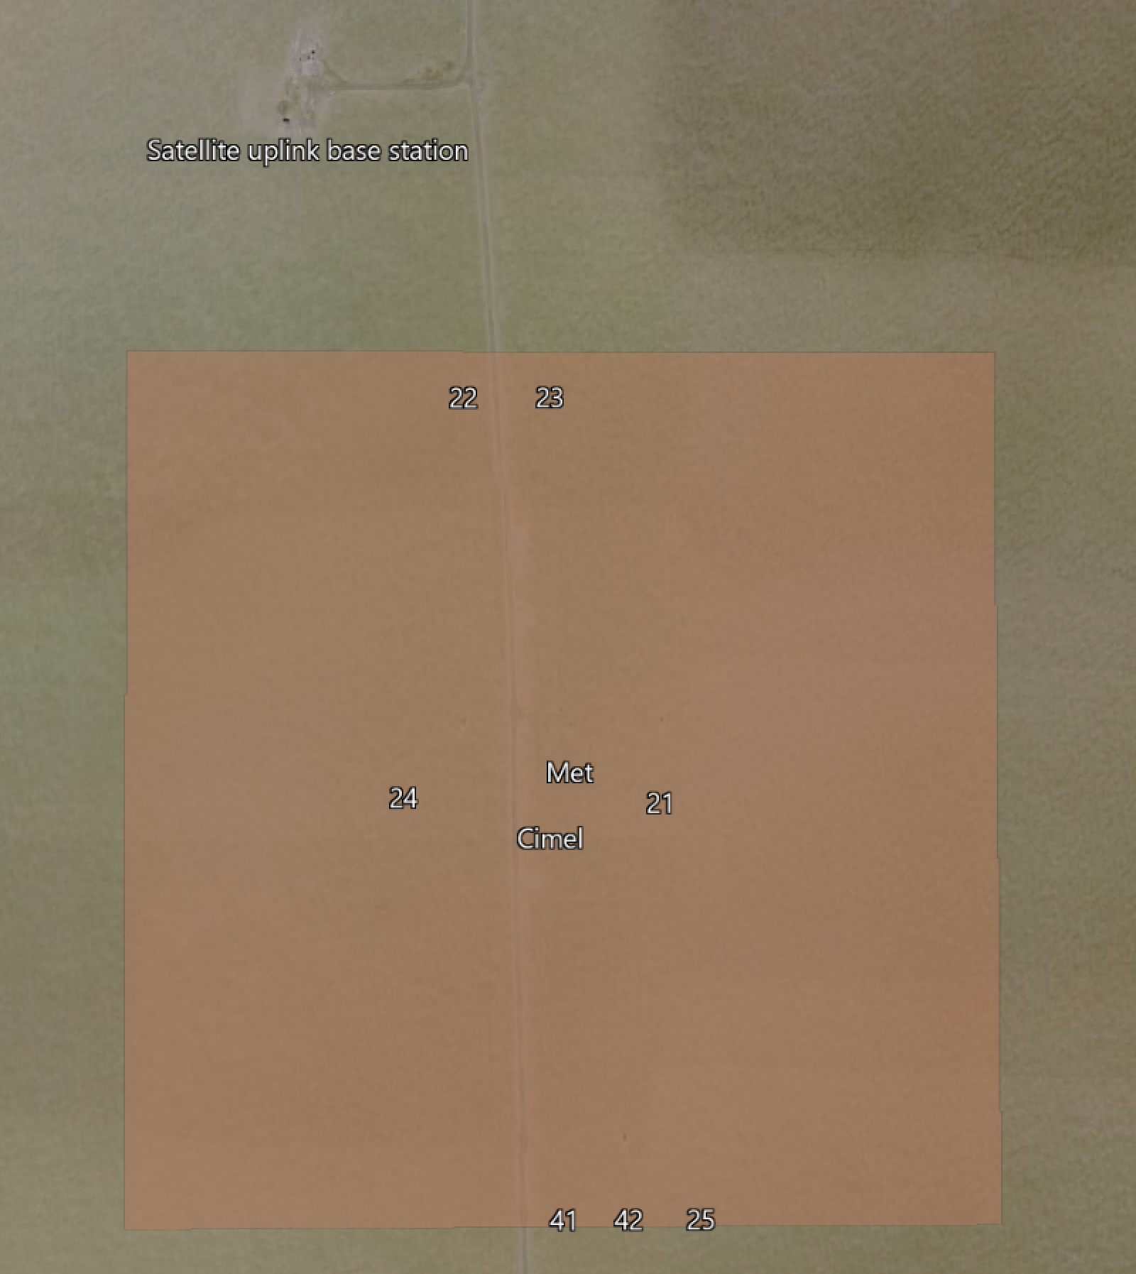
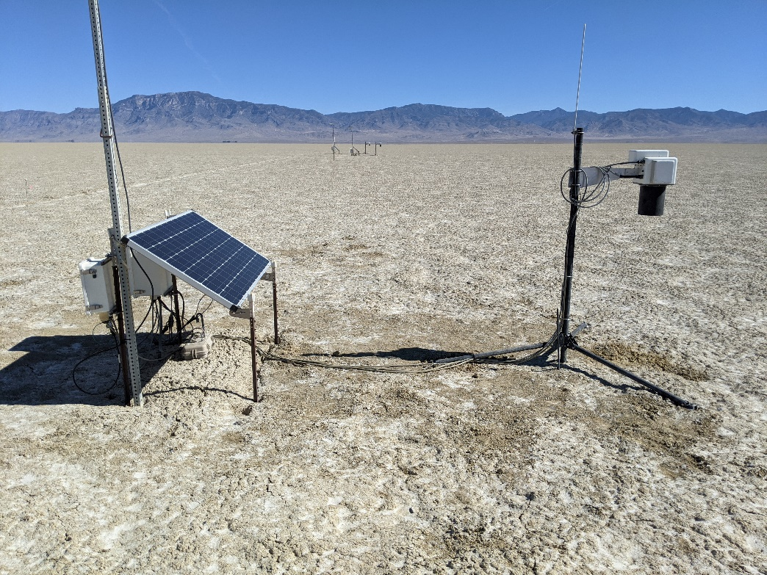
Equipment at RadCaTS
7 ground-viewing radiometers (GVRs)
All in nadir viewing configuration (as of 18 Oct 2020)
Monitoring ground under 41 and 42 to determine when to include in processing (recently moved from GOES-E and -W config)
One GVR (23) has 80 cm of linear motion
1 VNIR spectroradiometer (SpAM)
2 Cimel sun photometers (314 and 786)
Met station
Satellite uplink
Web camera
(back in Tucson for refurb)
(linear motion)

Slide 5
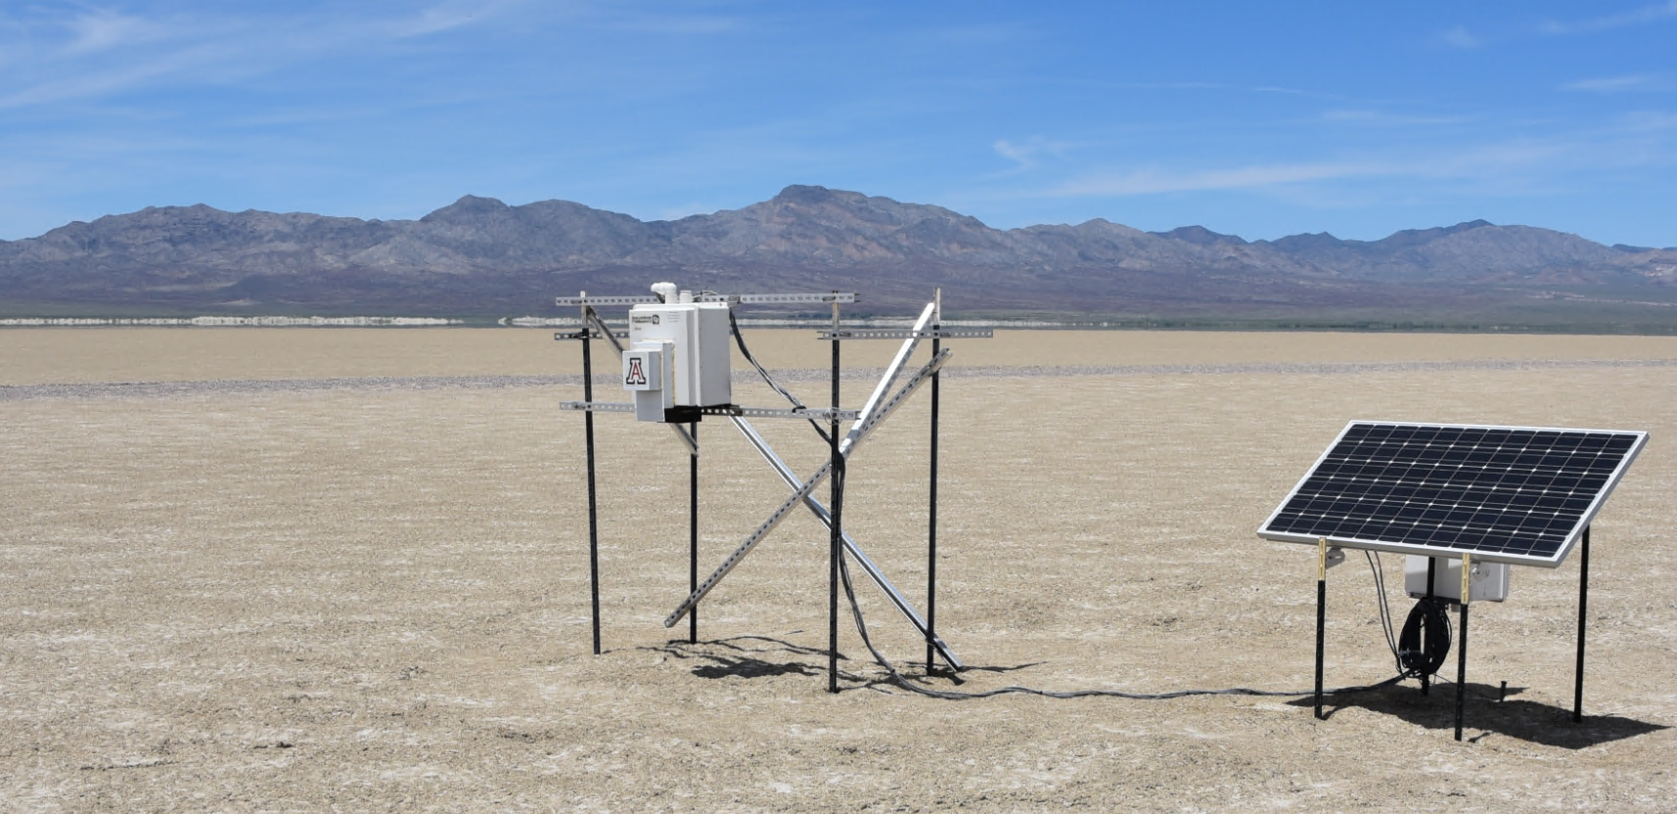
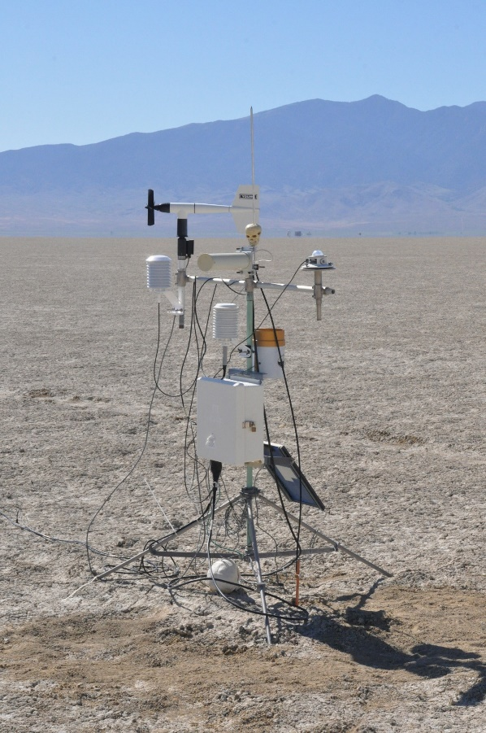
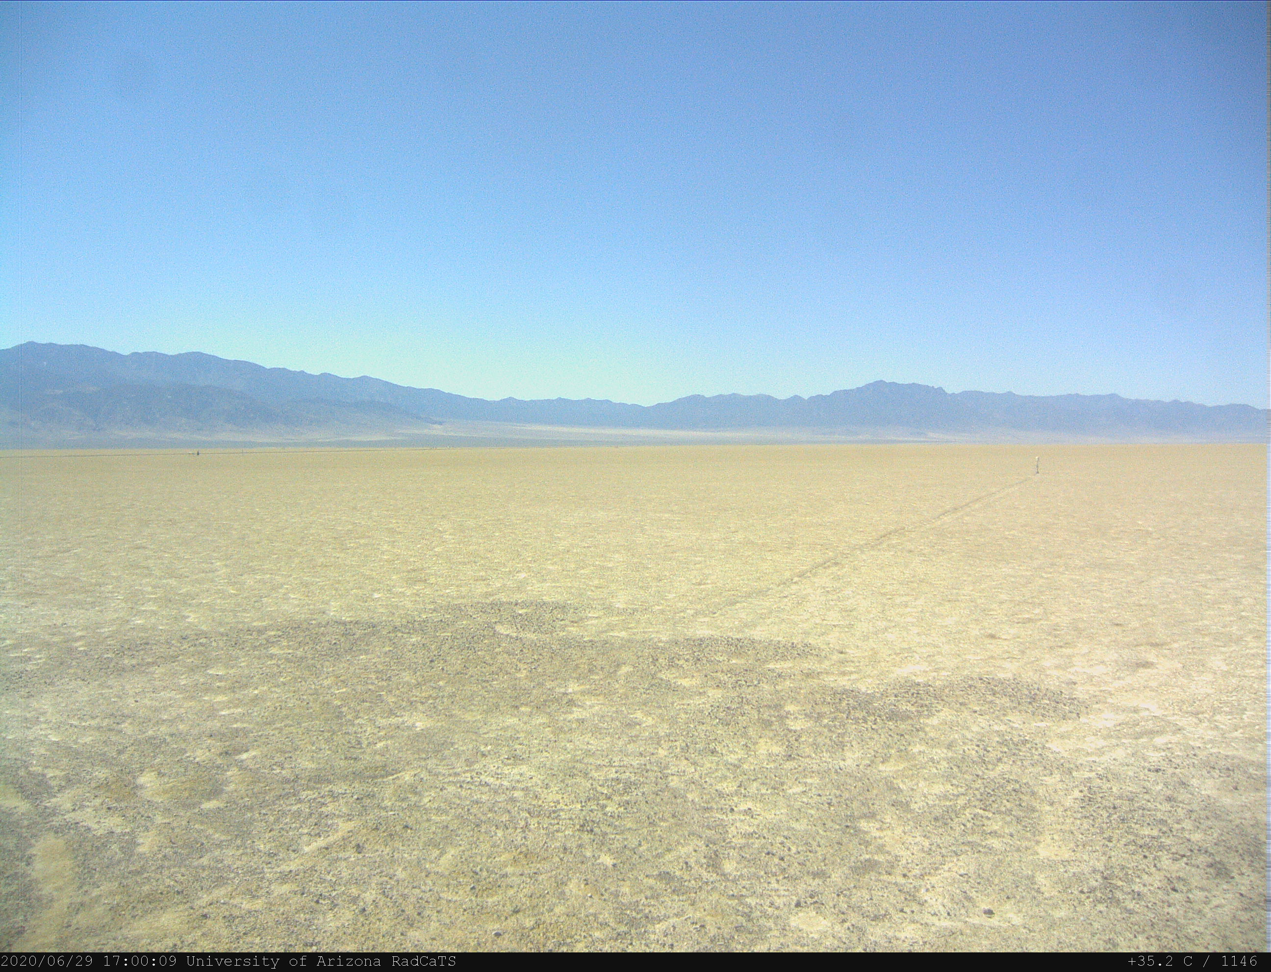
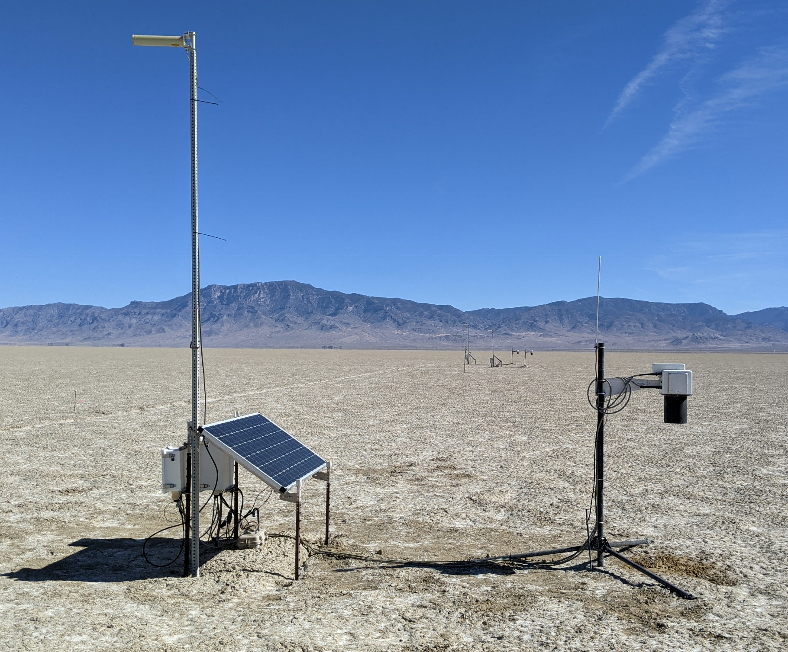
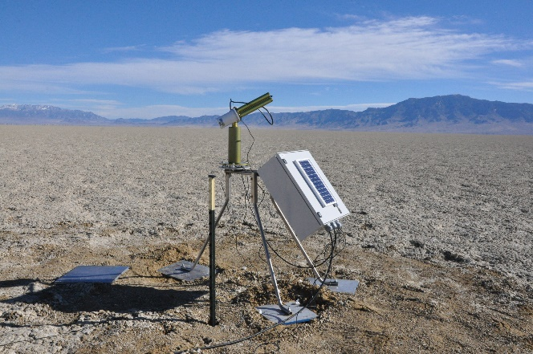
Equipment at RadCaTS
VNIR Spectrometer
Met station
Web cam
Satellite uplink station
Ground-viewing radiometers (GVRs)
Cimel CE318-T

Slide 6
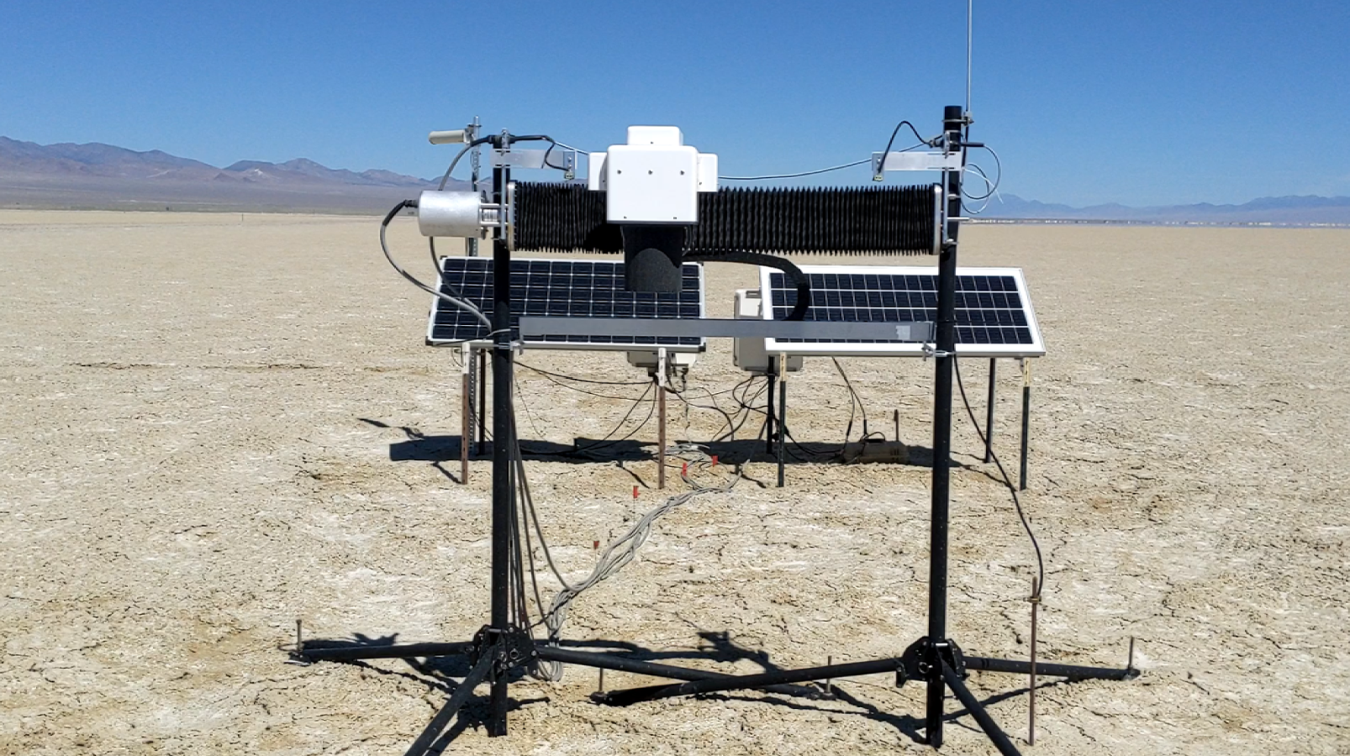
GVR 23: Linear Motion
Operating since Mar 2020
Same 10° field of view as current GVRs
Mounted at same height as current GVRs
Translation: ~80 cm at a rate of 0.5 cm s⁻¹
Data collected every 10 s (equivalent to 5 cm)
6.8 minutes for full lap
Operates from 16:00–23:00 UTC

Slide 7
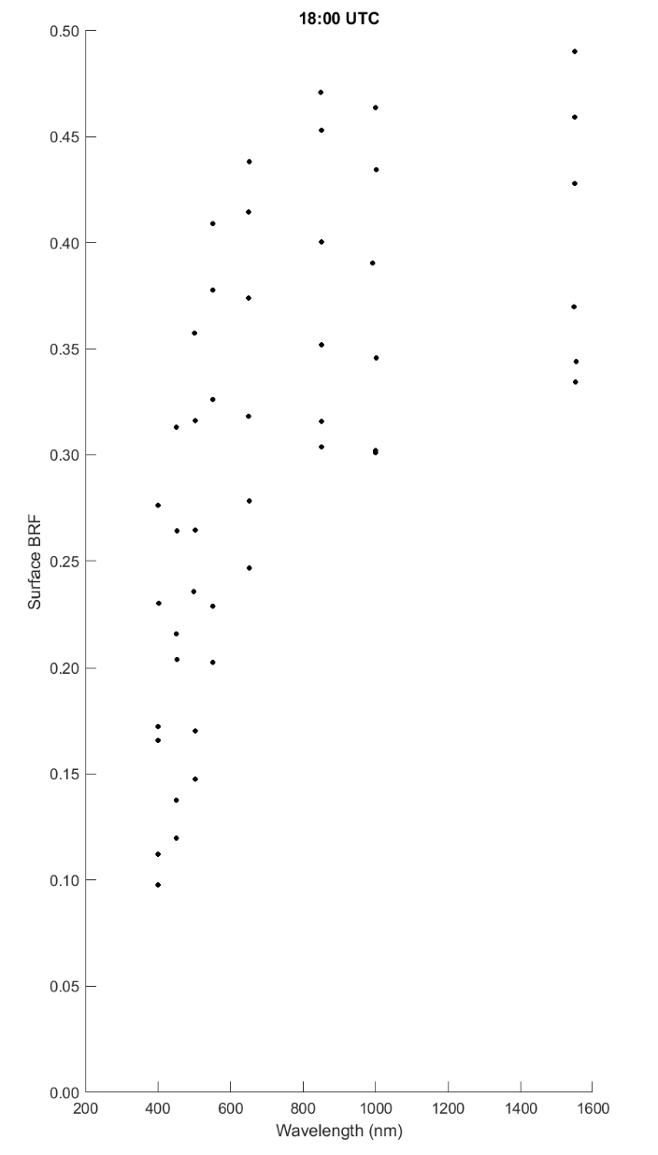
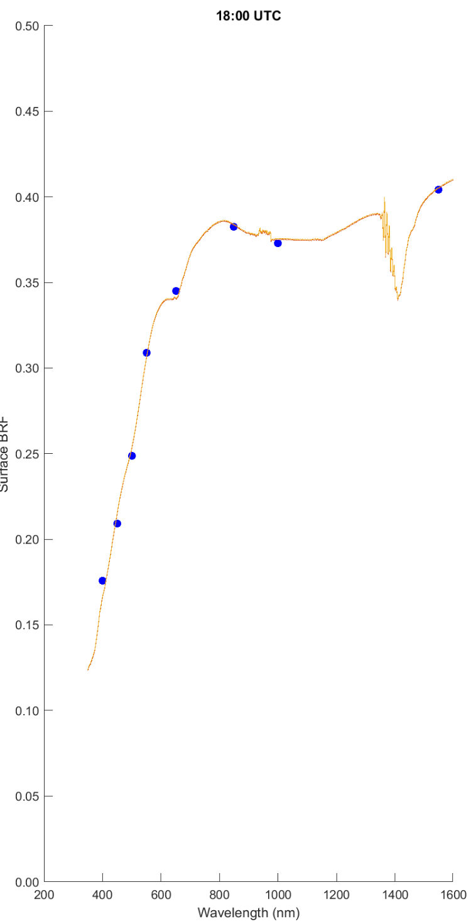
Surface Reflectance Determination at RadCaTS
For a given time of interest:
Determine surface reflectance in each of GVR’s 8 spectral bands
Determine the average for each of the 8 bands
Convert the multispectral results to hyperspectral by fitting to library of data collected from 2000–present using portable spectroradiometer (e.g. ASD)
GVR 41 and 42 are currently showing low BRF due to surface disturbance during installation. Will monitor and include them when surface dries.
Note: graphs are from 4 Nov 2020. Low sun angle. Two lowest BRFs in each band are due to ‘watered’ area under GVRs 41 and 42.
6 GVRs
GVRs 41 & 42

Slide 8
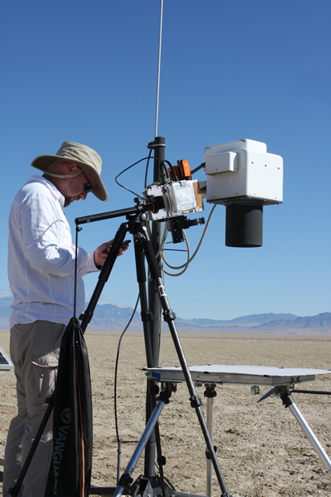
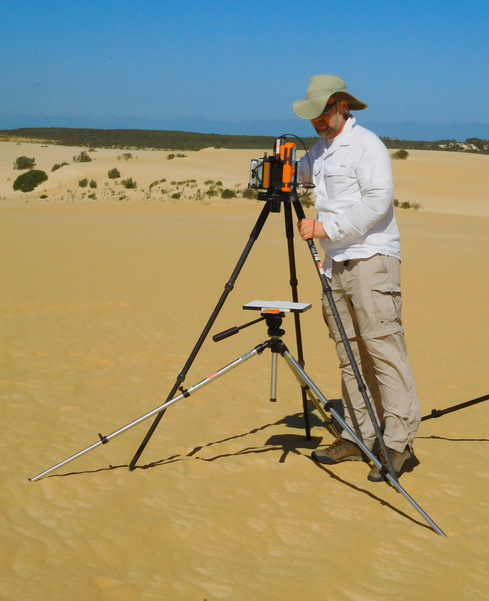
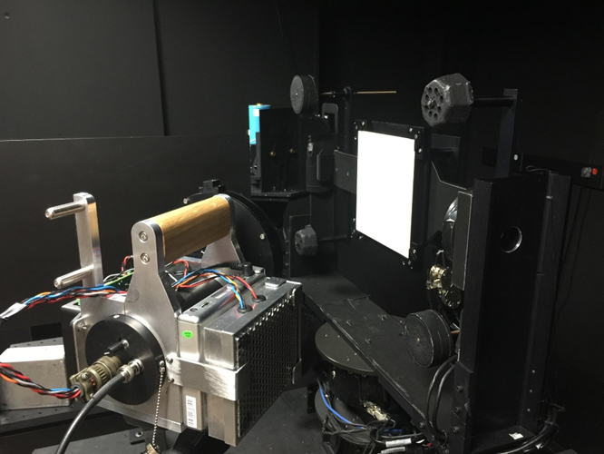
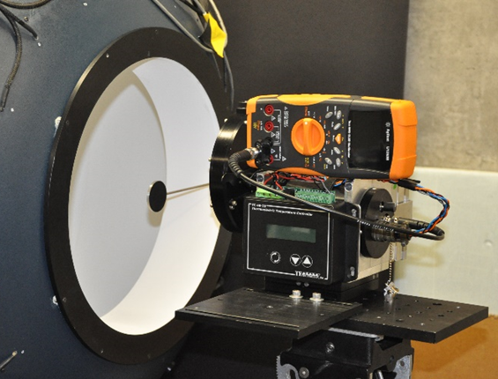
Support Instrumentation and Measurements
Field deployment at RadCaTS
Calibration Test Site SI-Traceable Transfer Radiometer (CaTSSITTR)
Same seven VNIR bands as RadCaTS ground-viewing radiometer
400, 450, 500, 550, 650, 850, 1000 nm
One-person operation, wireless data logging
Temperature-controlled focal plane (35 °C)
Travelling transfer radiometer for test site intercomparison and uncertainty analysis (e.g. RadCalNet)
Field deployment at Pinnacles, Australia
Field deployment
Radiometric calibration
Stray light test
8

Slide 9
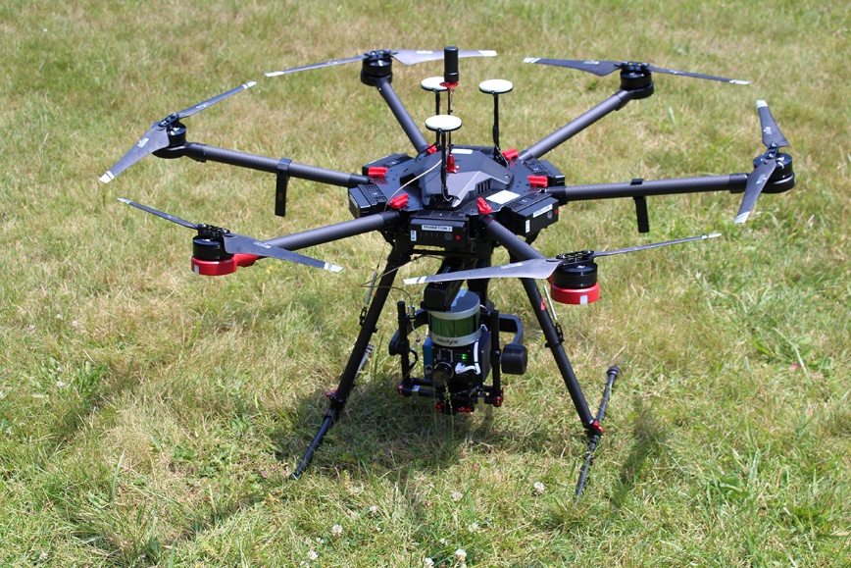
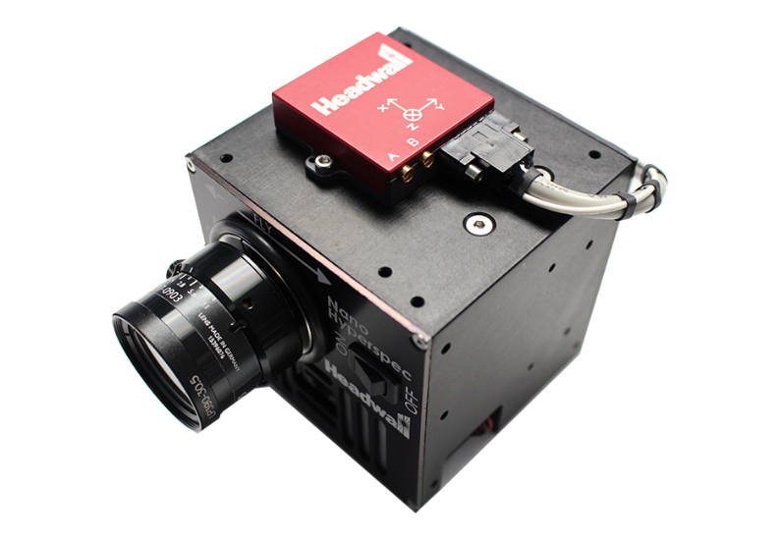
Support Instrumentation and Measurements
UAS
Laboratory calibration of Headwall hyperspectral instrument
Spectral
Radiometric
Temporal stability
Deployment at Railroad Valley and partner sites for BRDF and spatial uniformity analysis
RRV field measurements and comparison to previous PARABOLA-III and ULGS-II results
Spatial uniformity comparison with GVR linear motion system

Slide 10
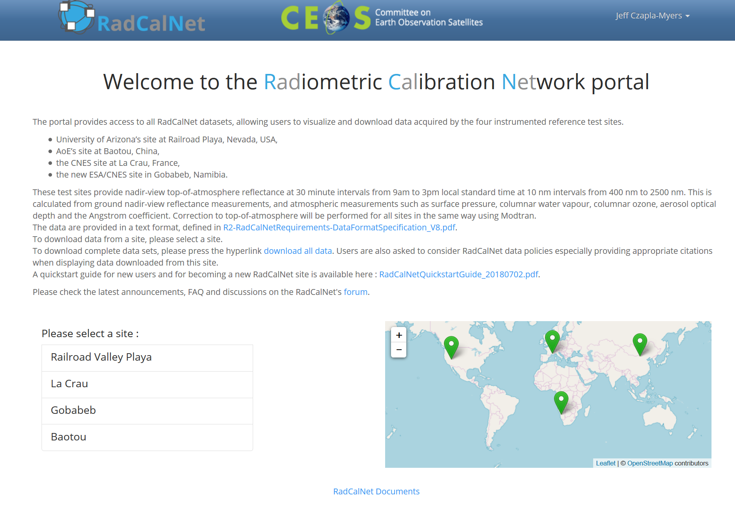
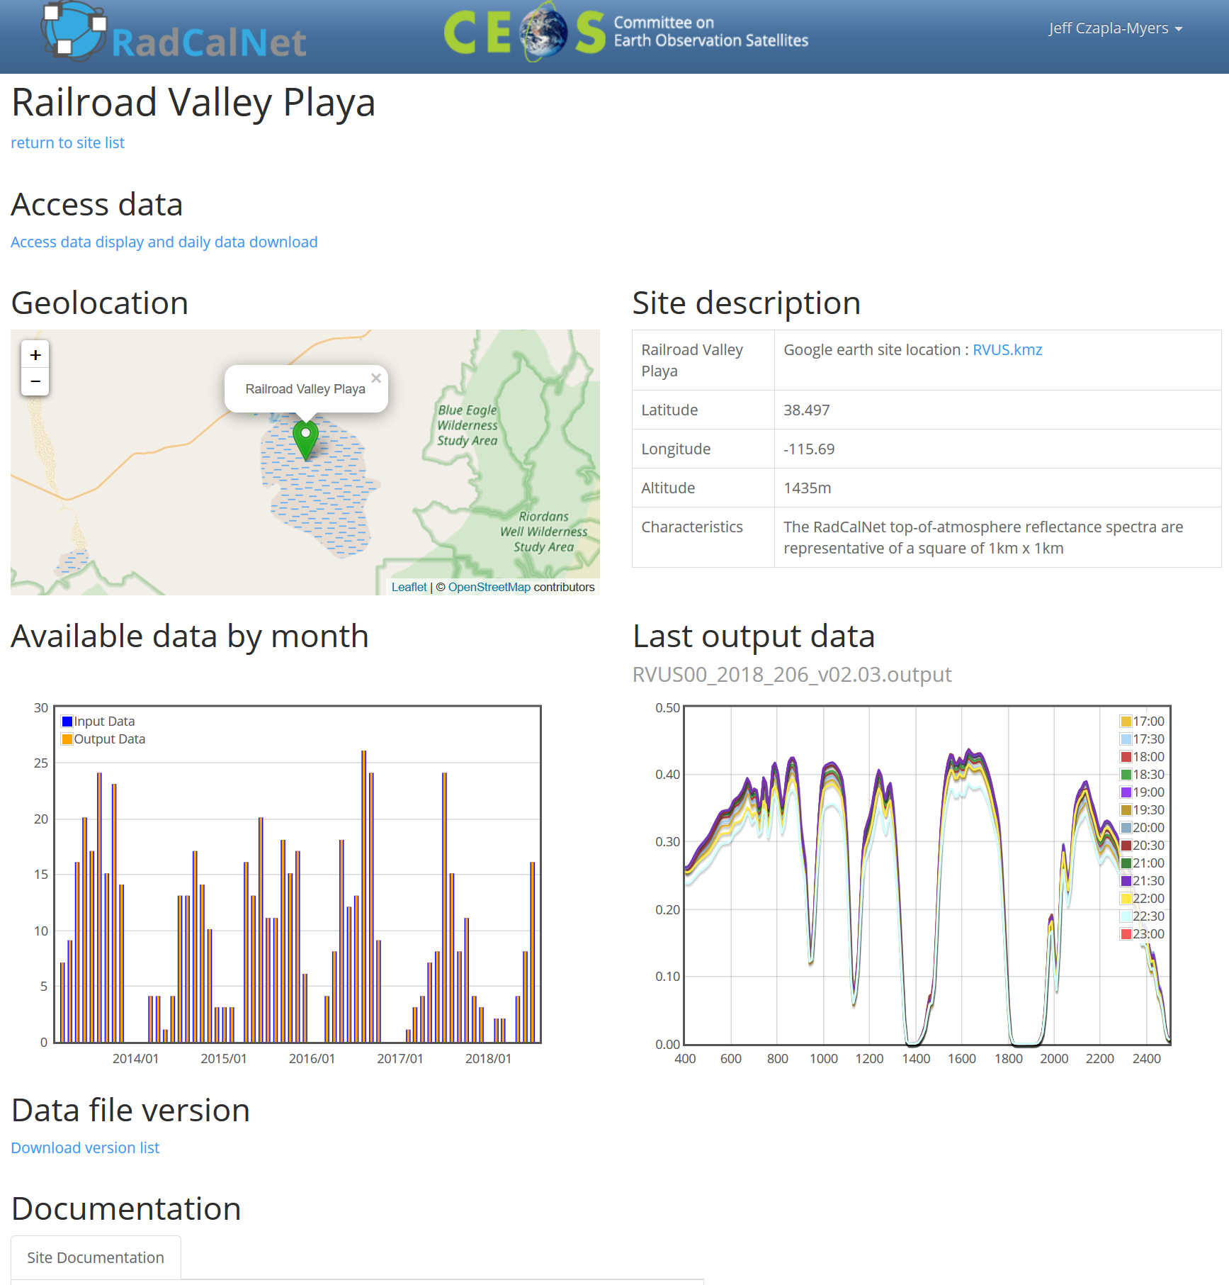
Radiometric Calibration Network (RadCalNet)
Online data portal went live in Jul 2018: www.radcalnet.org
TOA reflectance from 09:00–15:00 local standard time
400 nm to 2500 nm, Δλ = 10 nm
Surface reflectance and atmospheric data are also available
RadCalNet forum: forum.radcalnet.org (announcements, FAQs, documentation, etc.)

Slide 11
MODIS and VIIRS Imagery
Source:
LAADS DAAC
Radiometric Calibration
Terra & Aqua MODIS: Collection 6.1 (2013–2021)
SNPP VIIRS: Collection 1 (Archive 5110) (2013–2021)
NOAA-20 VIIRS: Collection 2 (Archive 5200) (2018–2021)
Surface Reflectance Validation
Terra & Aqua MODIS: Collection 6 (2013–2021)
SNPP VIIRS: Collection 1 (Archive 5000) (2013–2021)
NOAA-20 VIIRS: No imagery (still working on extracting from NOAA-CLASS imagery)

Slide 12
Sensor Viewing Conditions (as of 1 Jan 2021)
Sensor | Time (UTC) | View Zenith Angle | View Azimuth Angle (from ground)
TMODIS | 18:32 18:38 18:44 | 13.1° 1.5° 10.2° | 102.4° 103.1° 284.3°
AMODIS | 20:48 20:55 | 7.3° 4.5° | 75.9° 256.9°
SNPP VIIRS | 20:33 20:39 20:45 | 11.0° 0.6° 9.8° | 74.7° 75.1° 256.7°
NOAA-20 VIIRS | 20:33 20:39 20:46 | 10.9° 0.4° 9.9° | 74.7° 74.7° 256.7°

Slide 13
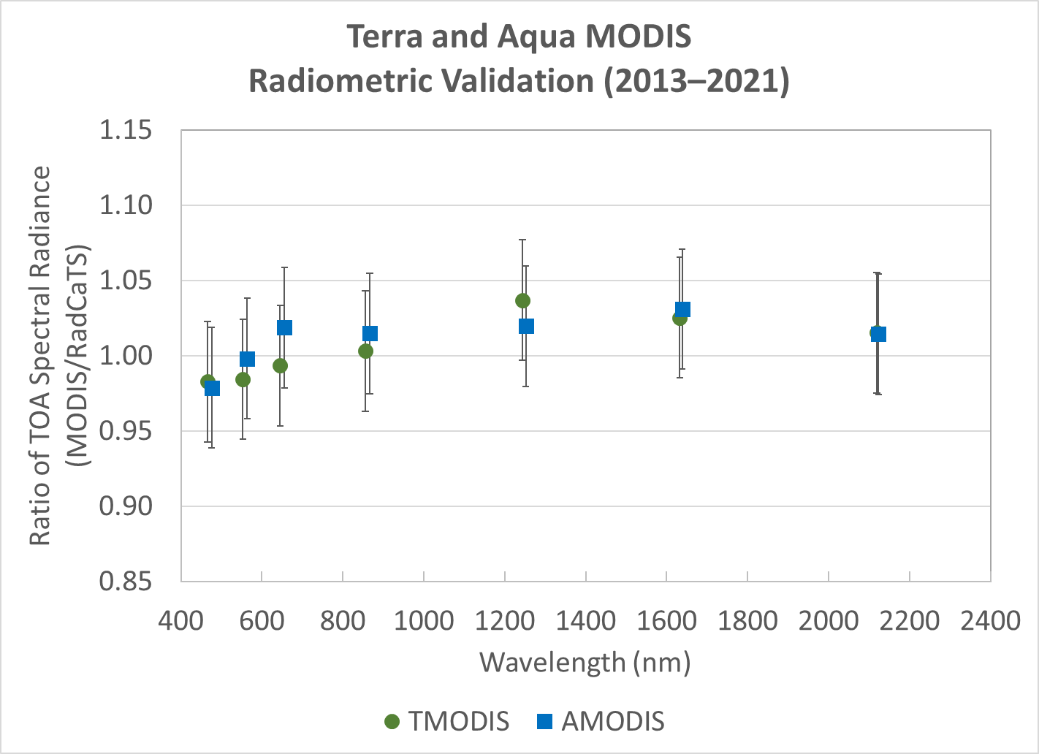
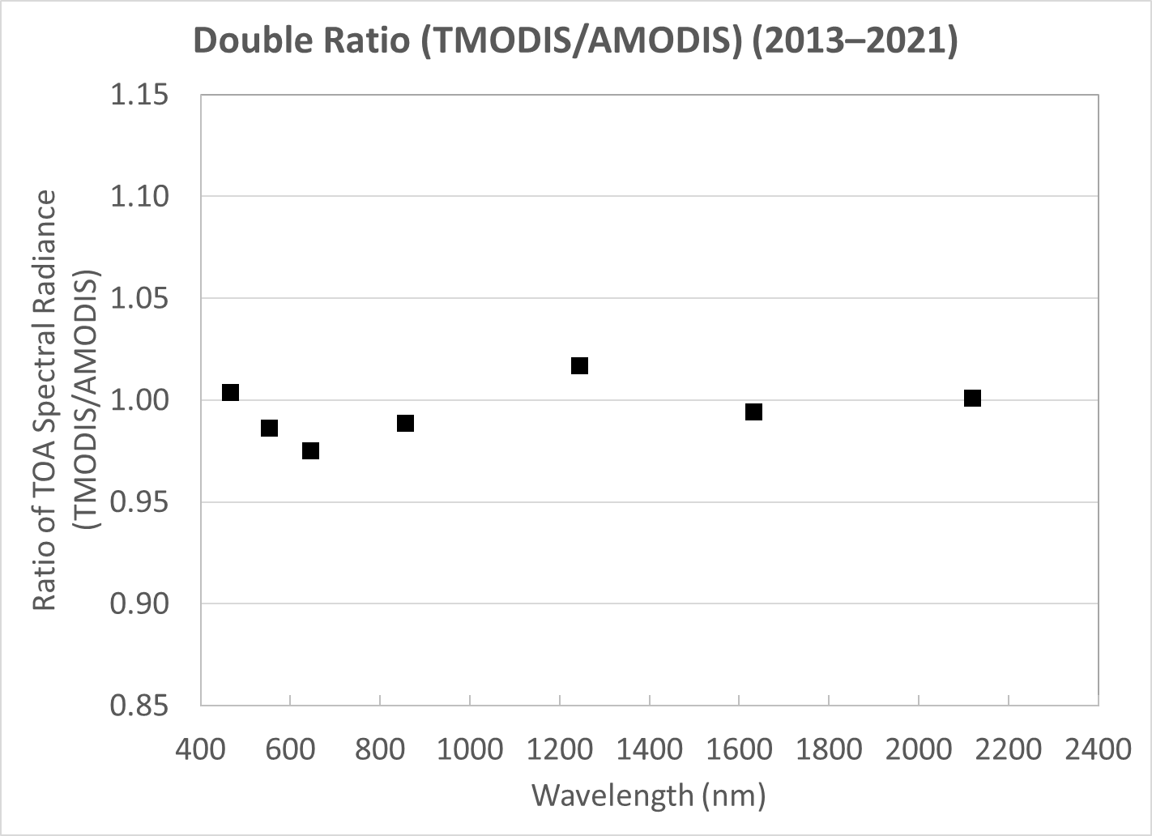
Current MODIS Radiometric Calibration Results
2013–2021
TMODIS: N=135, AMODIS: N=112 Double ratio to remove RadCaTS
MODIS Bands: 1–7
Double ratio: (TMODIS/RadCaTS)/(AMODIS/RadCaTS) = TMODIS/AMODIS

Slide 14
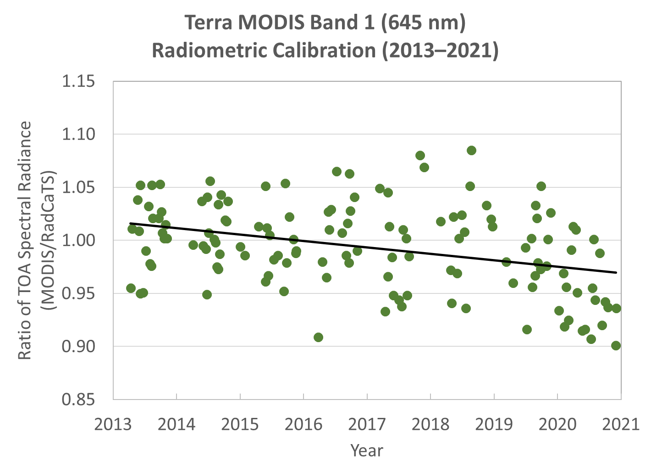
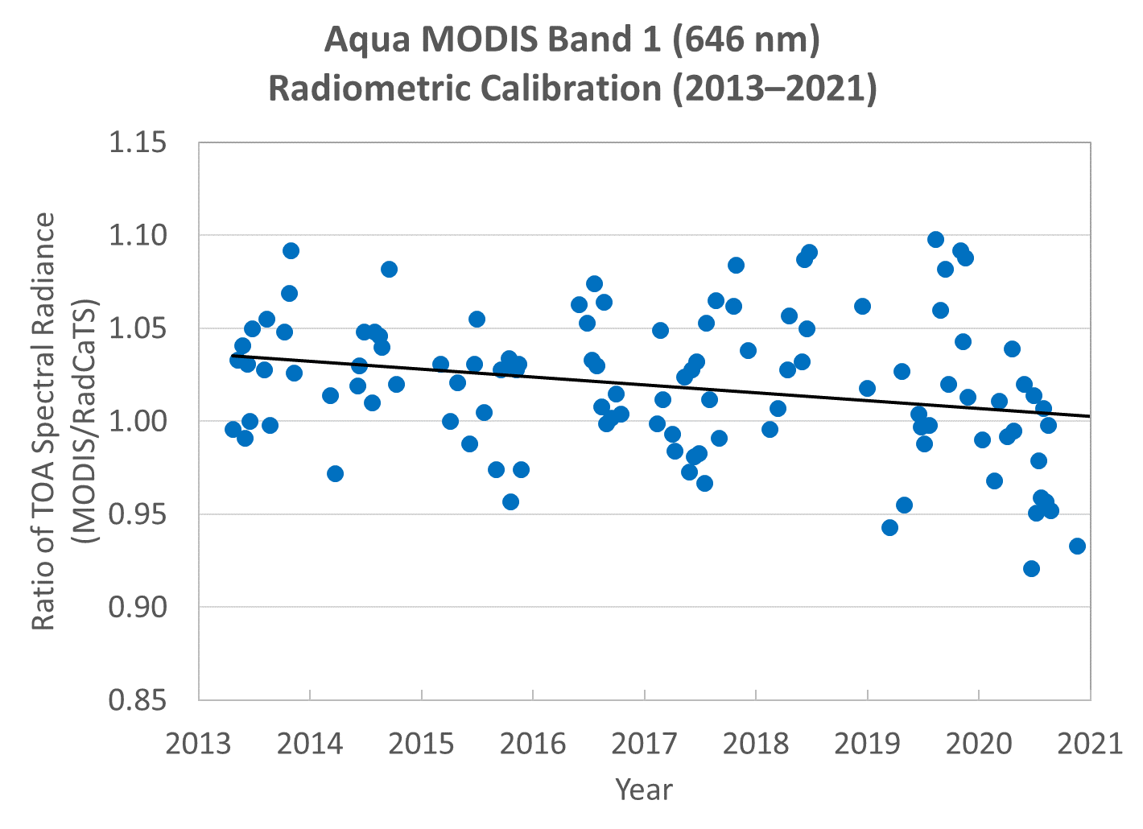
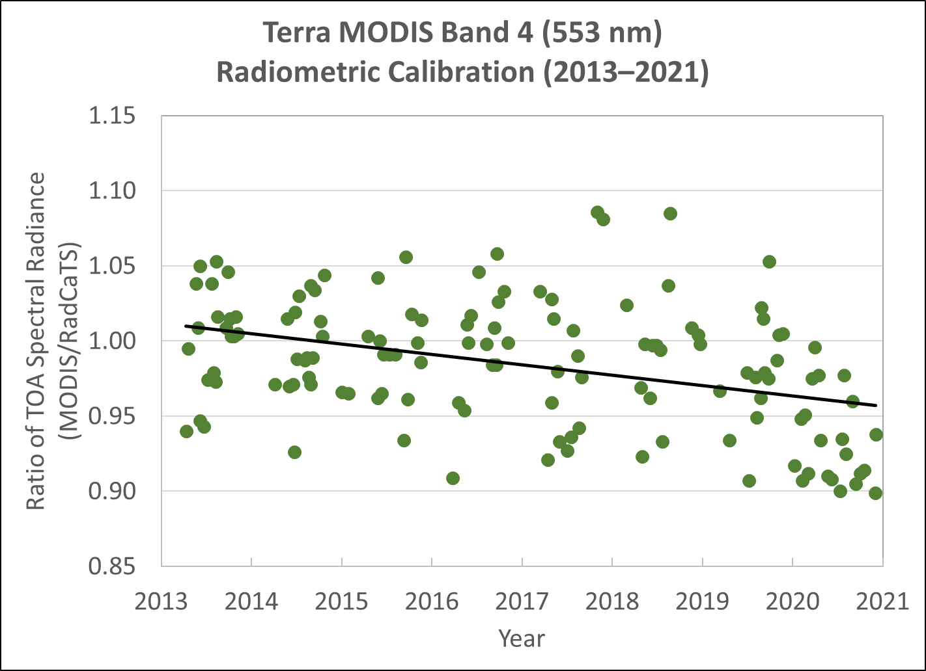
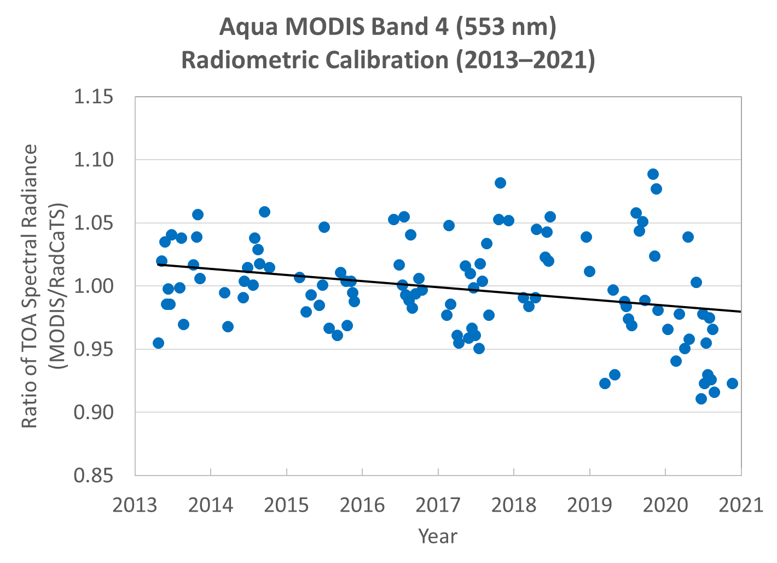
Temporal Radiometric Calibration Results
Terra MODIS Aqua MODIS
Band 1 (645 nm)
Band 4 (553 nm)

Slide 15
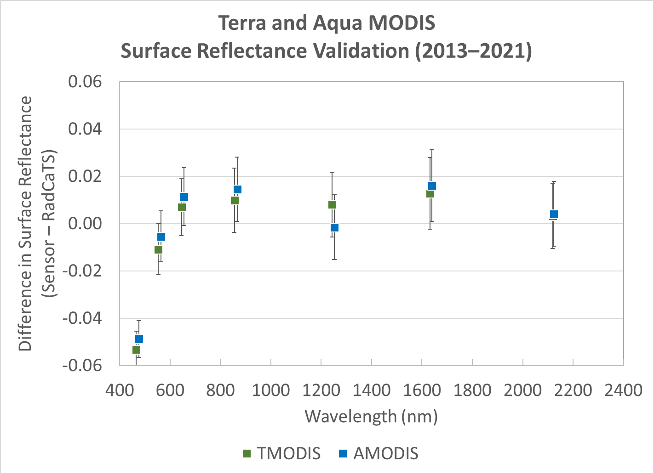
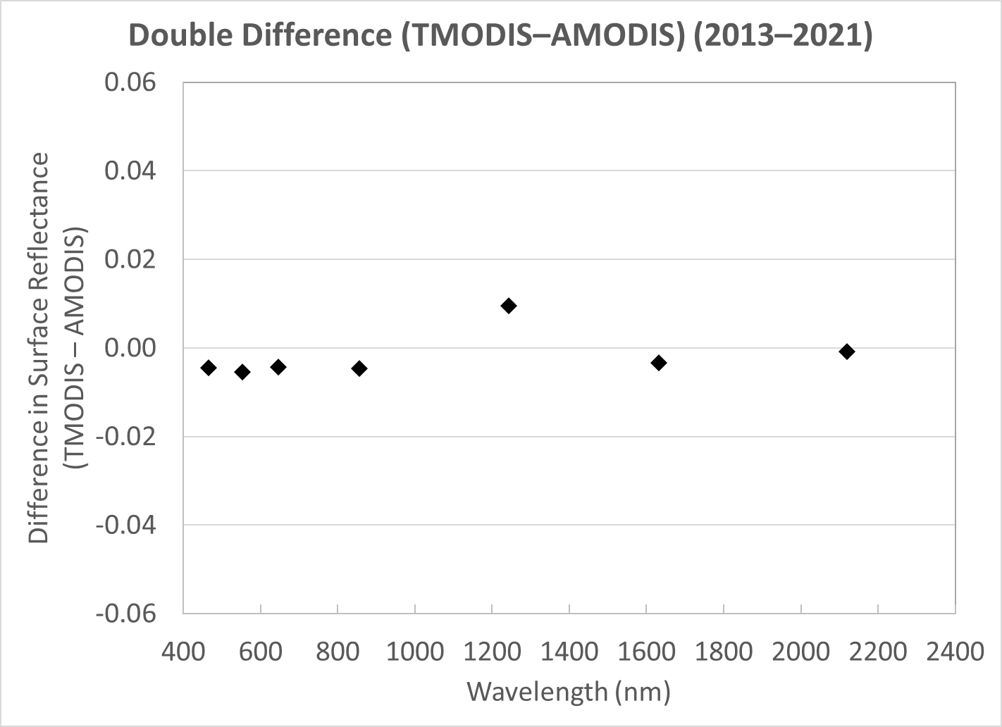
Current MODIS Surface Reflectance Validation Results
2013–2021
TMODIS: N=135, AMODIS: N=112 Double difference to remove RadCaTS
MODIS Bands 1–7
Double difference: (TMODIS–RadCaTS)–(AMODIS–RadCaTS) = TMODIS–AMODIS

Slide 16
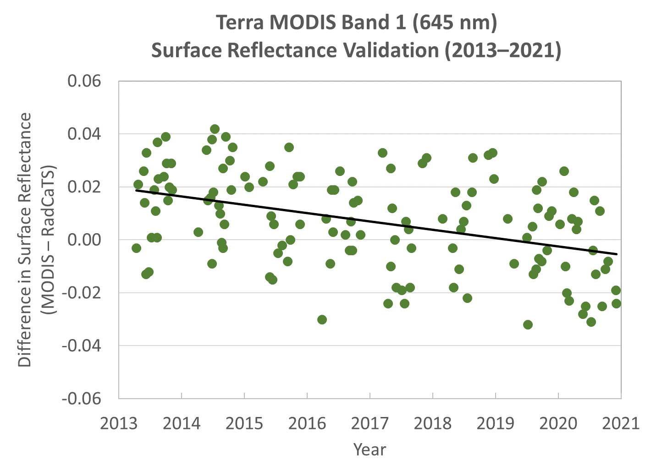
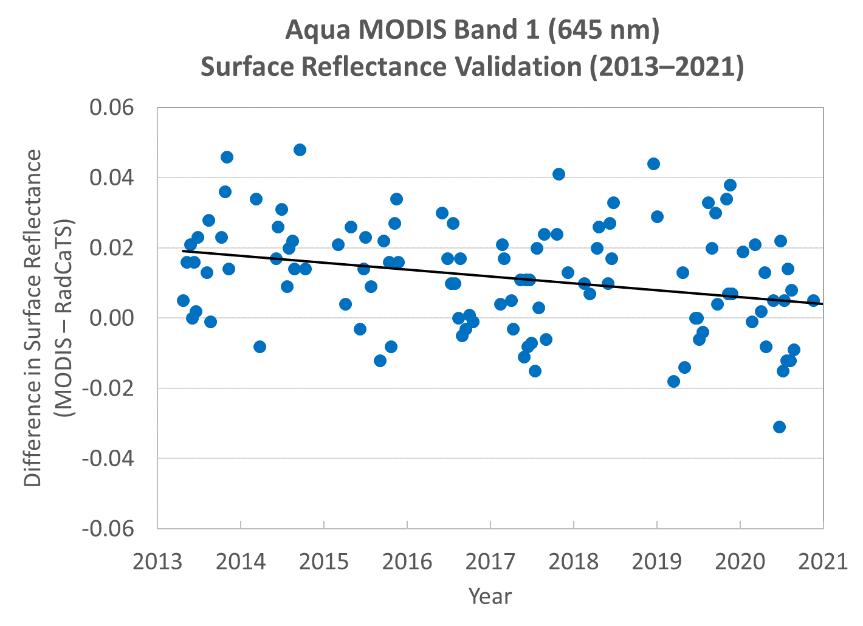
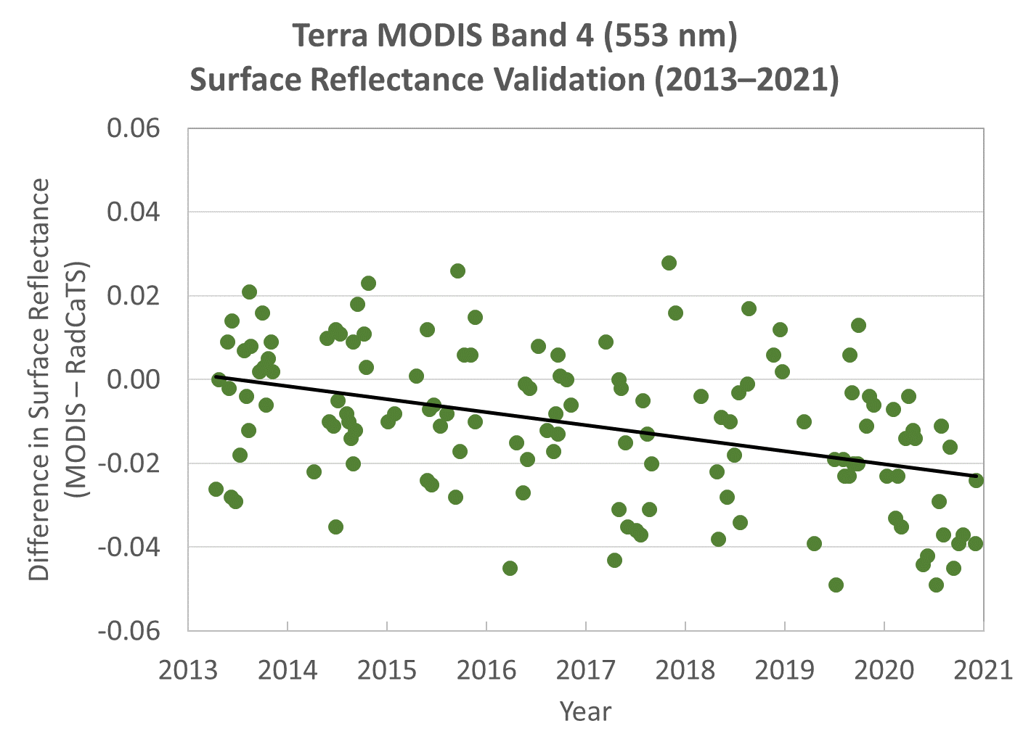
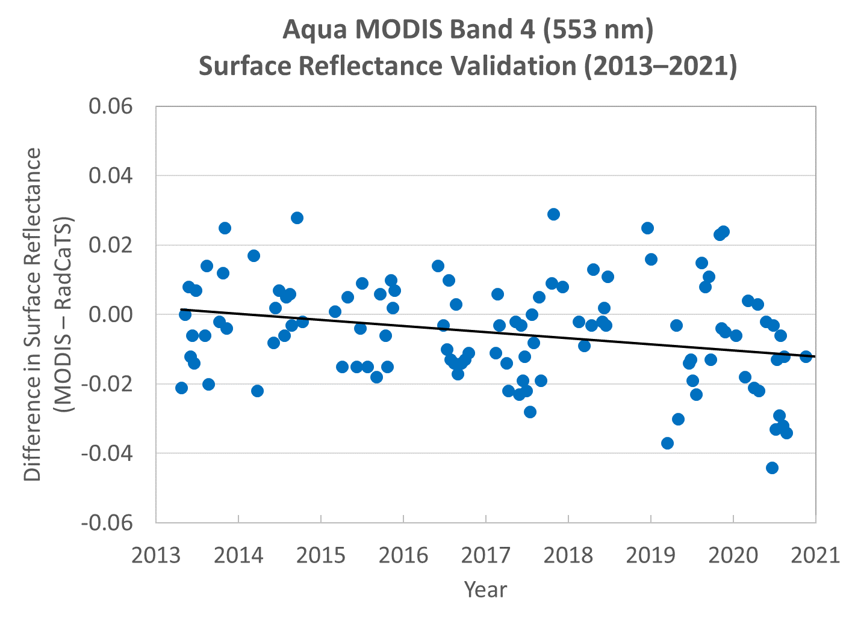
Temporal Surface Reflectance Validation Results
Terra MODIS Aqua MODIS
Band 1 (645 nm)
Band 4 (553 nm)

Slide 17
VIIRS Results

Slide 18
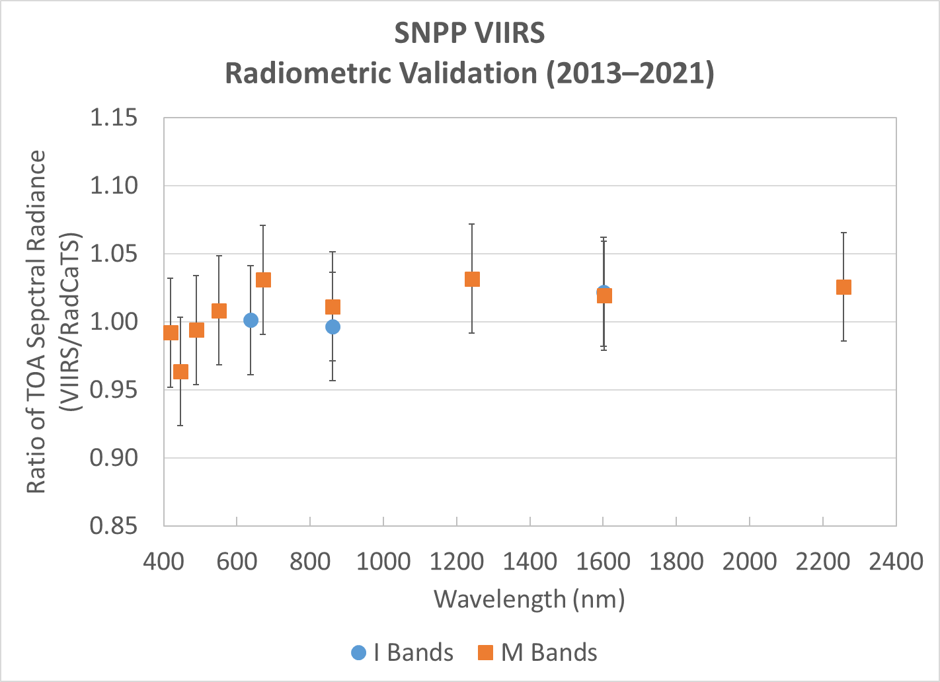
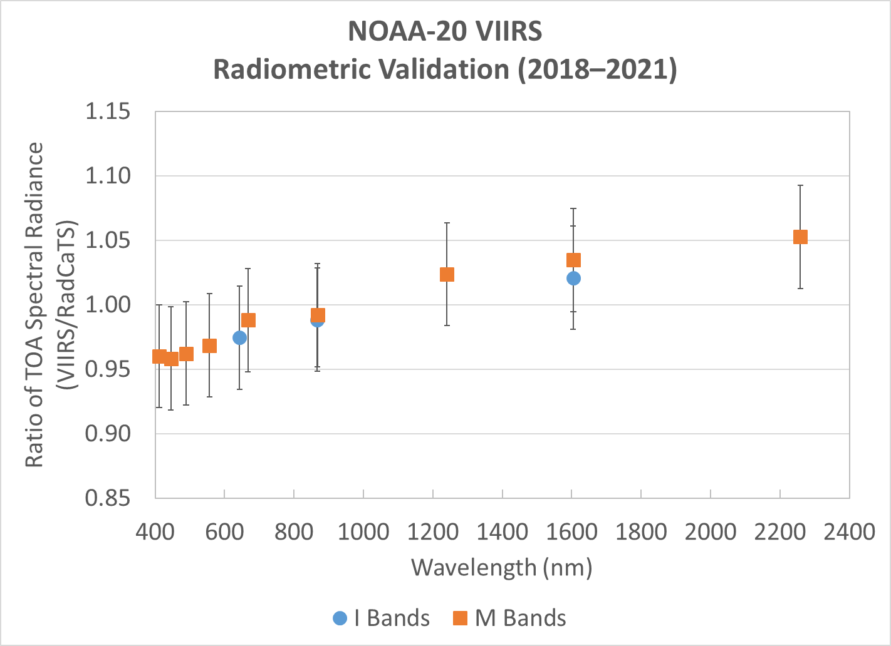
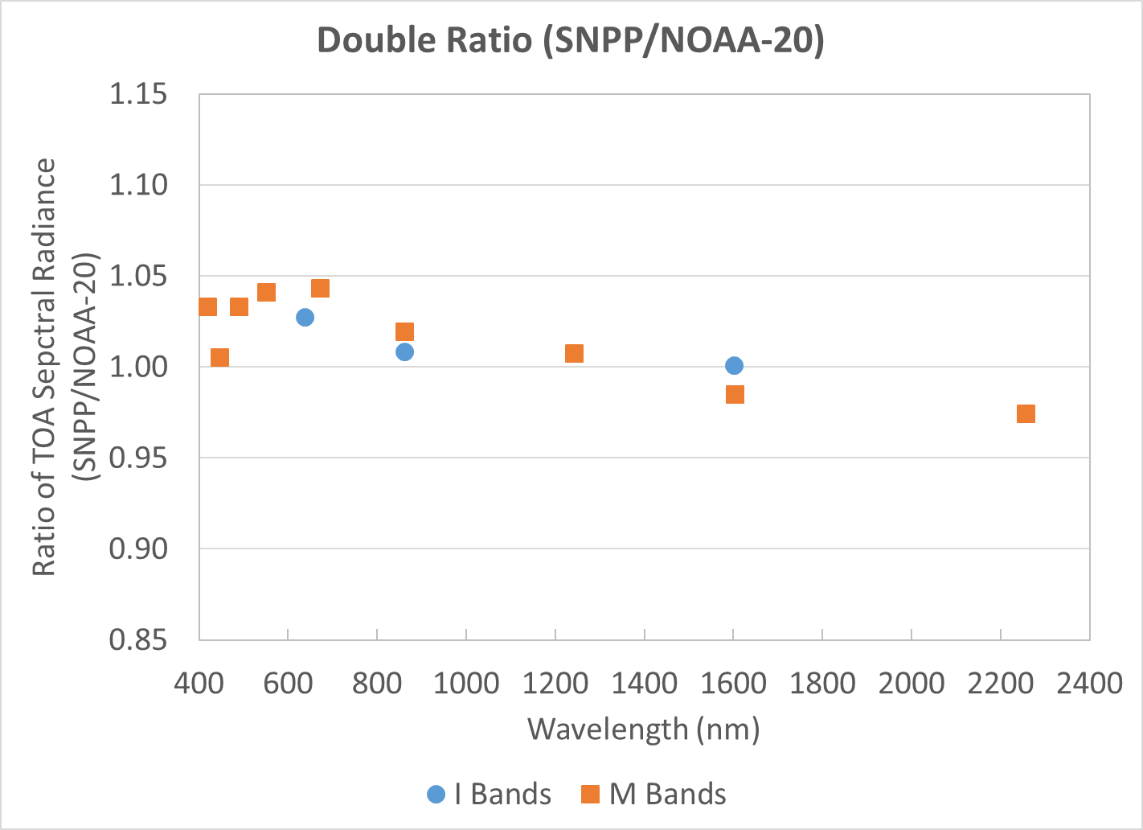
Current VIIRS Radiometric Calibration Results
2013–2021 (SNPP), 2018–2021 (NOAA-20)
SNPP: N=106 NOAA-20: N=64 Double ratio to remove RadCaTS
VIIRS bands: I1–I3, M1–M5, M7, M8, M10, M11
Double ratio: (SNPP/RadCaTS)/(N20/RadCaTS) = SNPP/N20

Slide 19
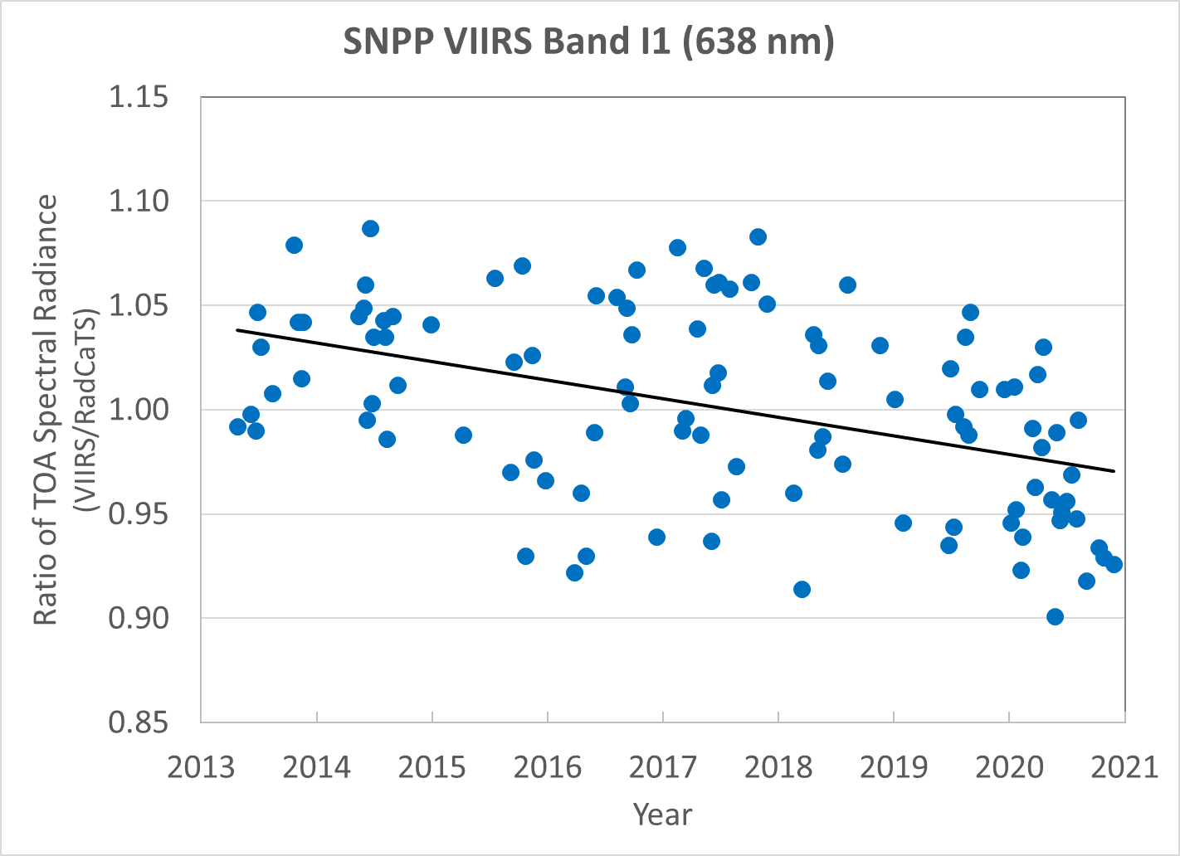
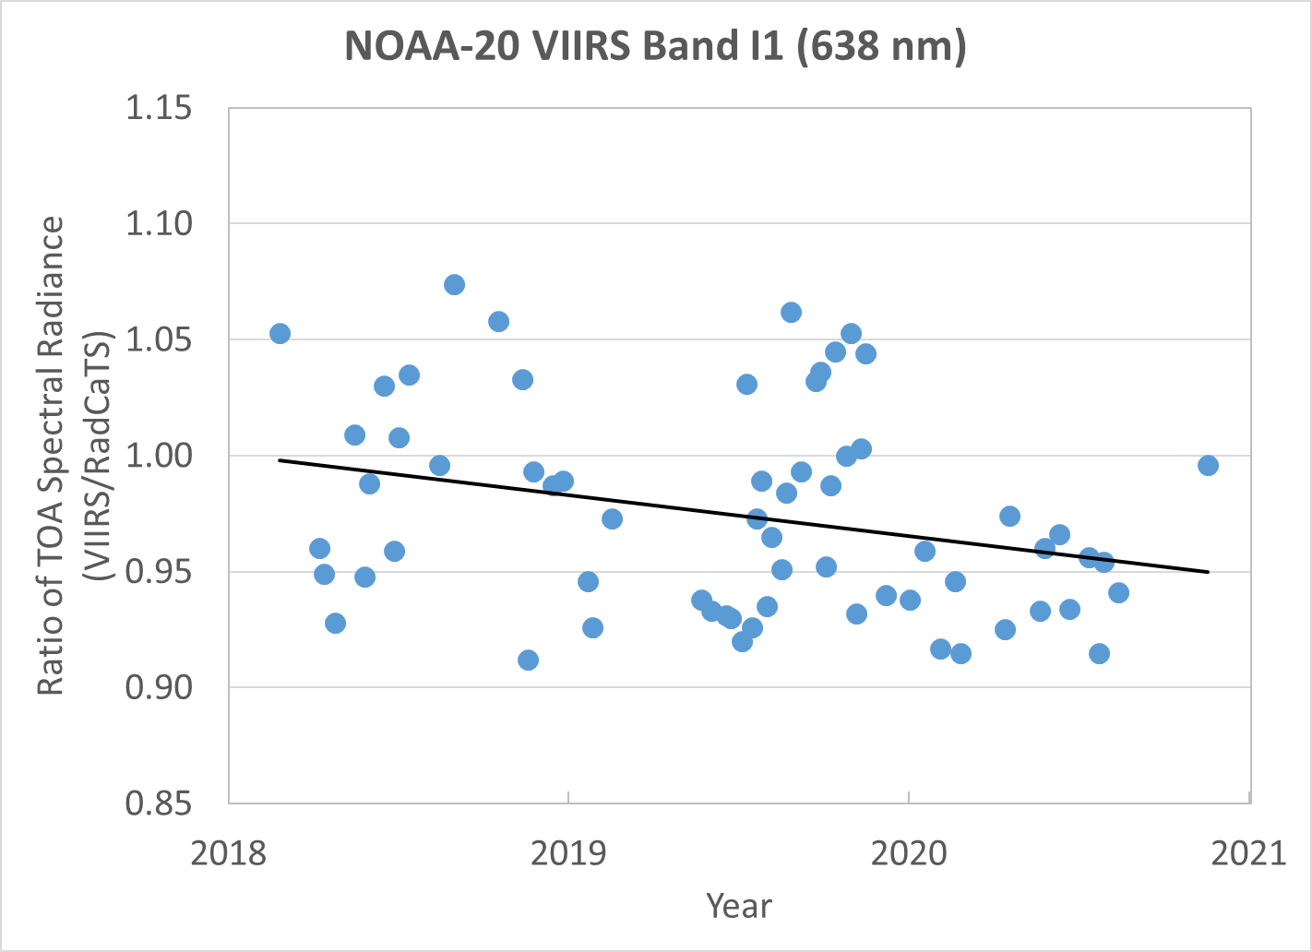
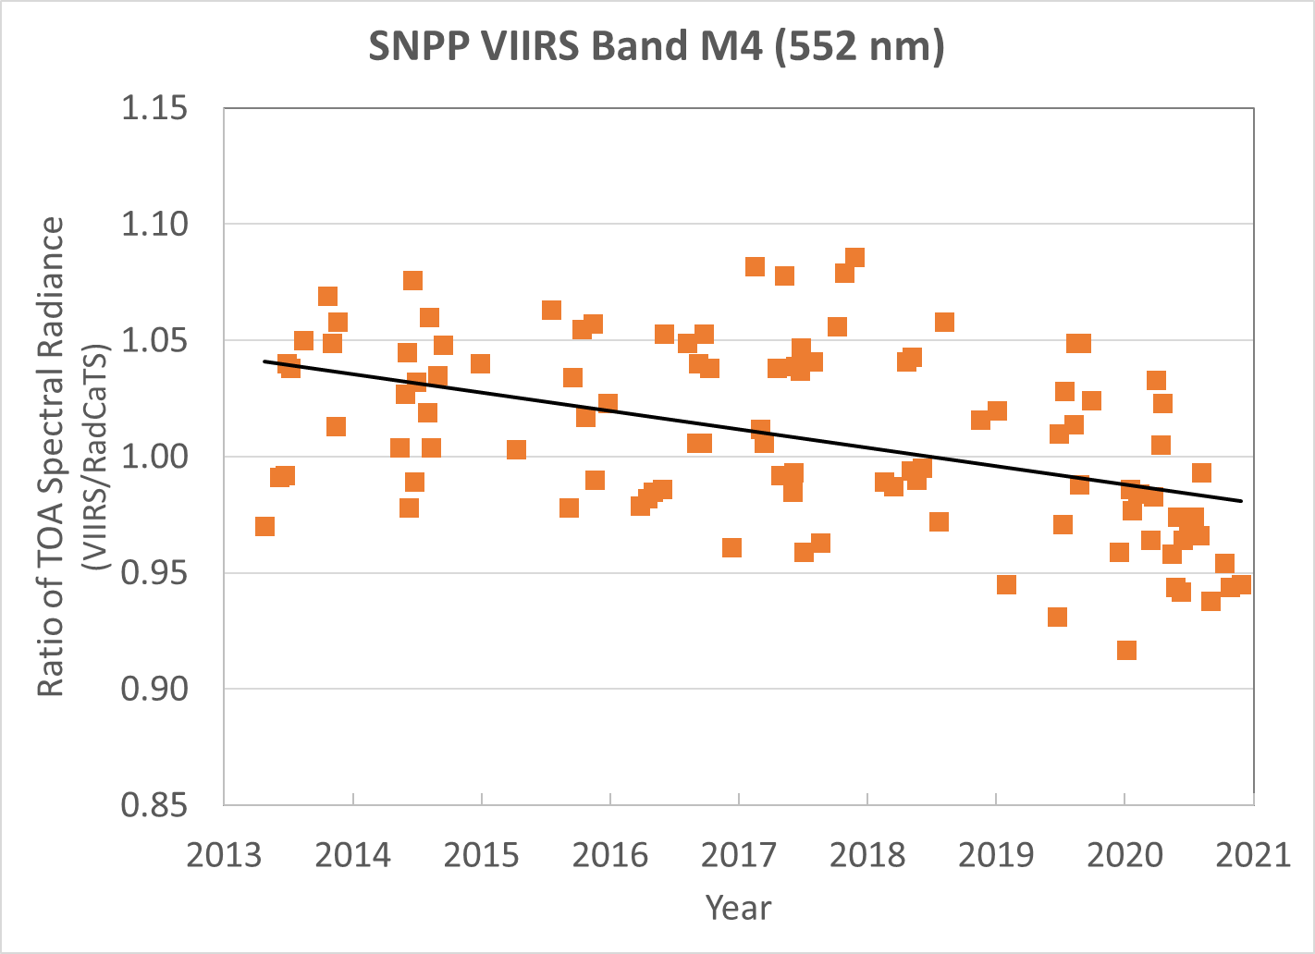
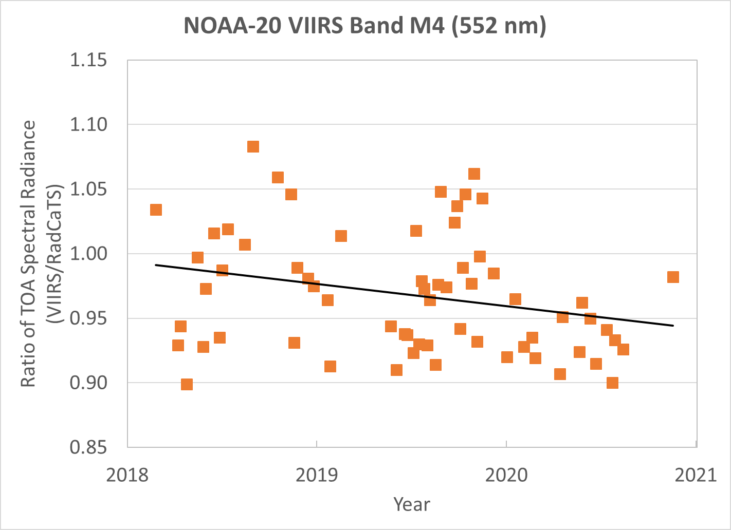
Temporal Radiometric Calibration Results
SNPP VIIRS NOAA-20 VIIRS
Band I1 (638 nm)
Band M4 (552 nm)

Slide 20
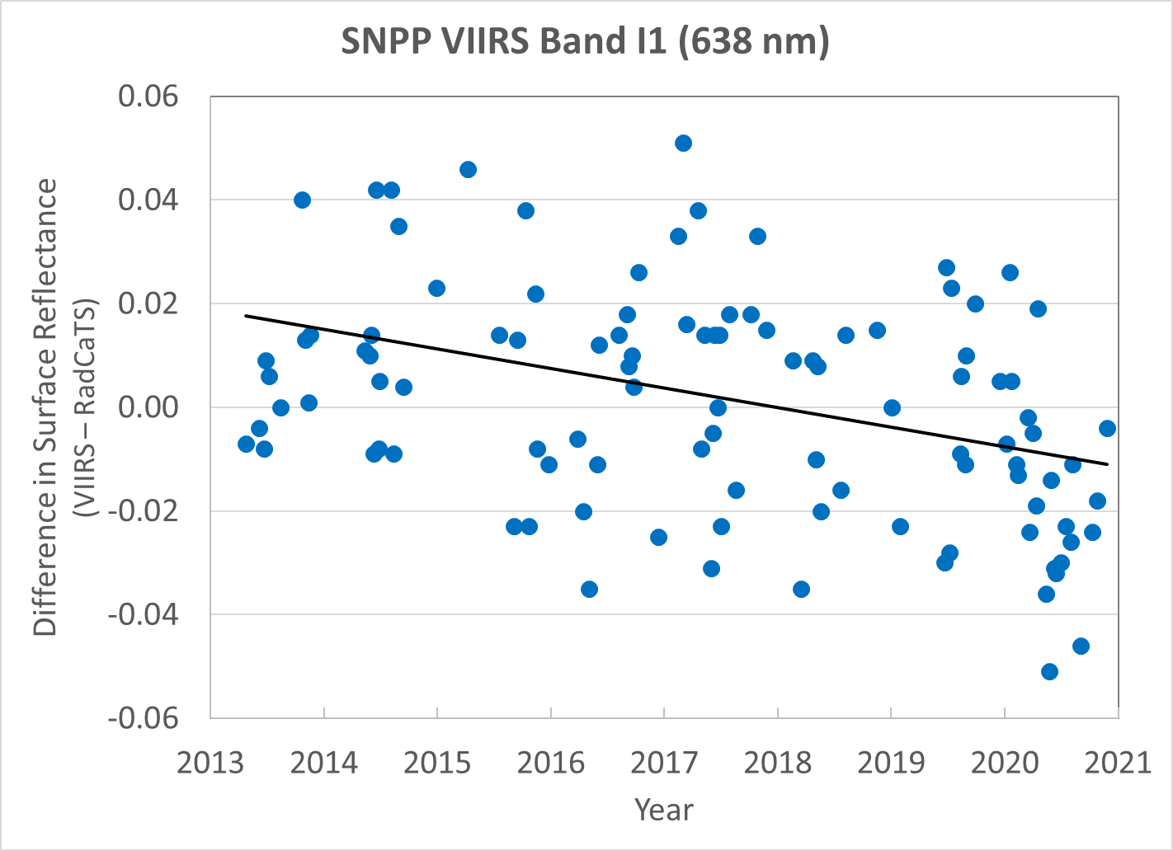
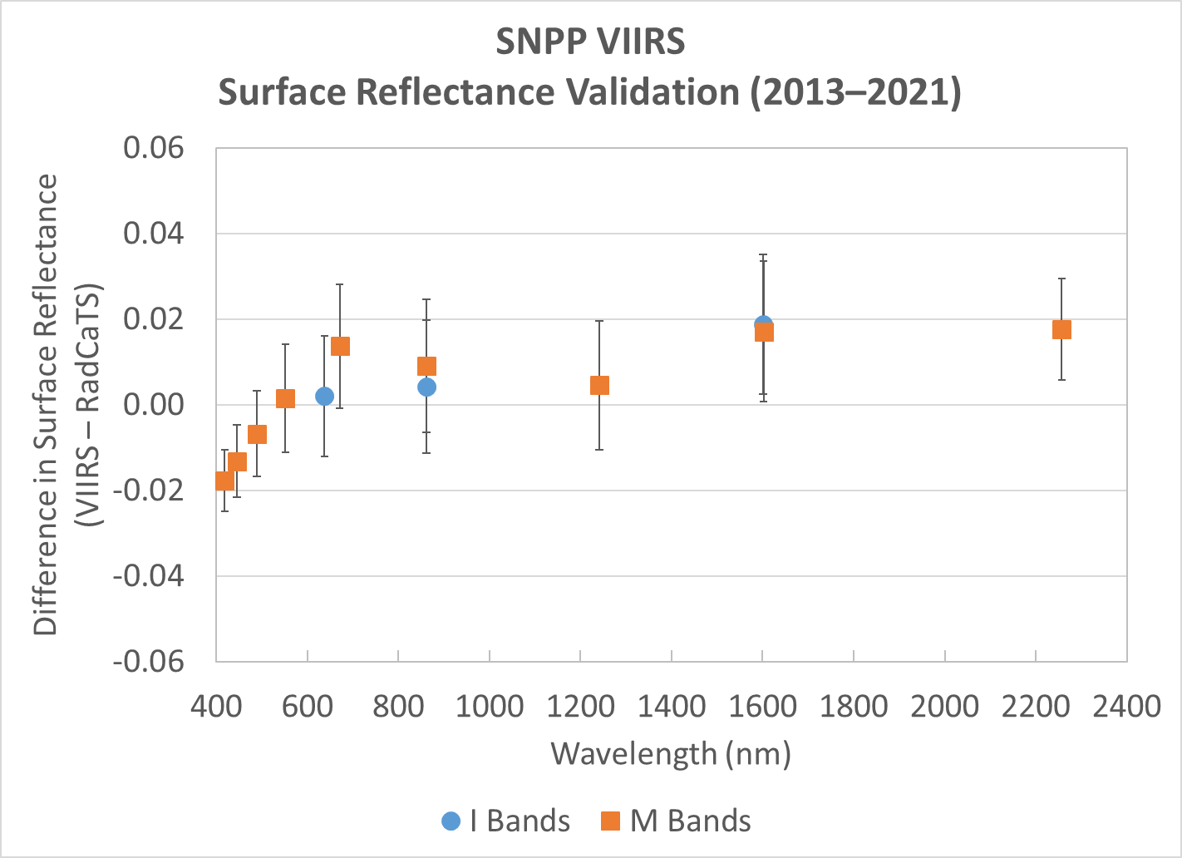
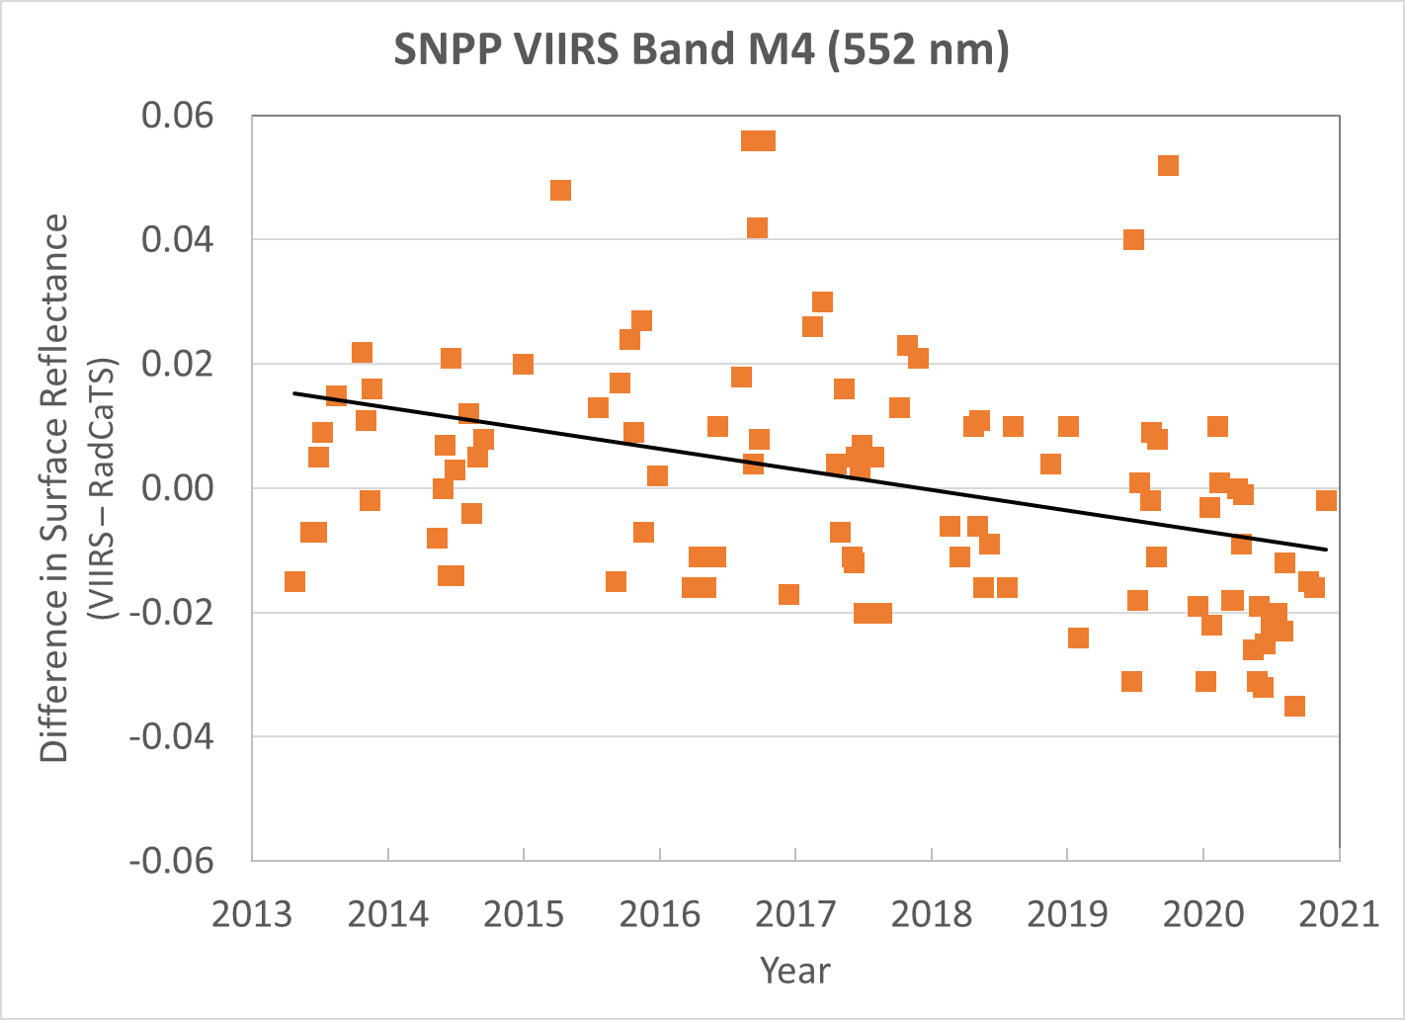
SNPP VIIRS Surface Reflectance Validation Results
2013–2021 Temporal Examples
N=106
Band I1 (638 nm)
Band M4 (552 nm)

Slide 21
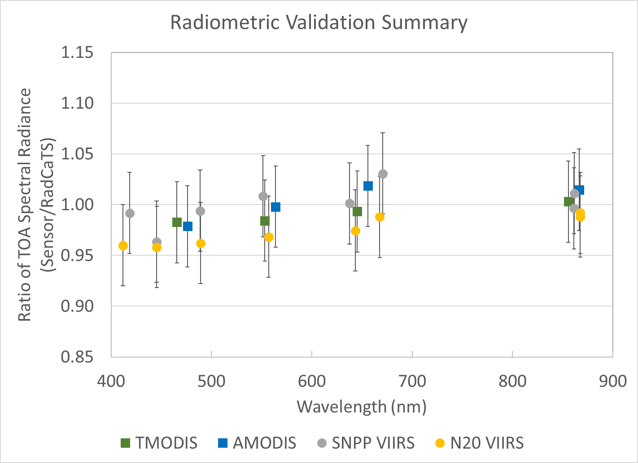
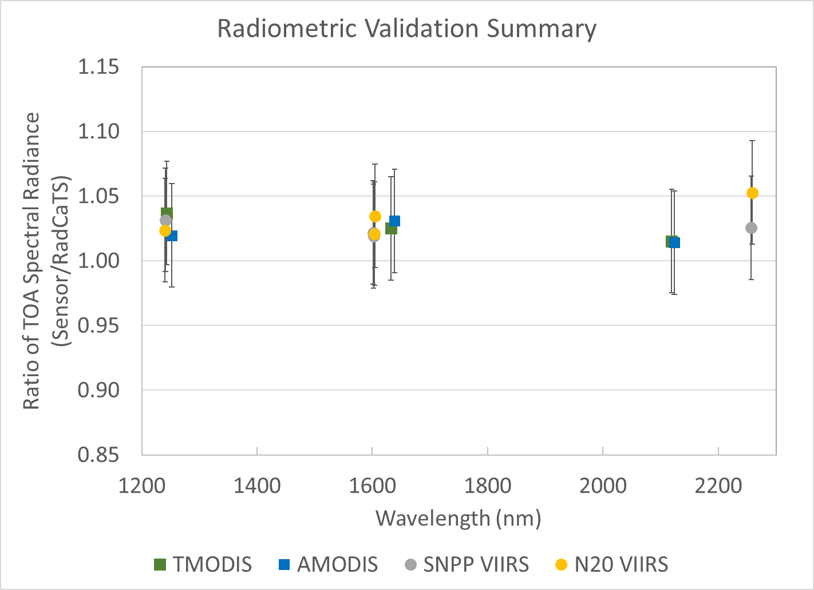
Recap
Summary of all radiometric calibration results
VNIR SWIR

Slide 22
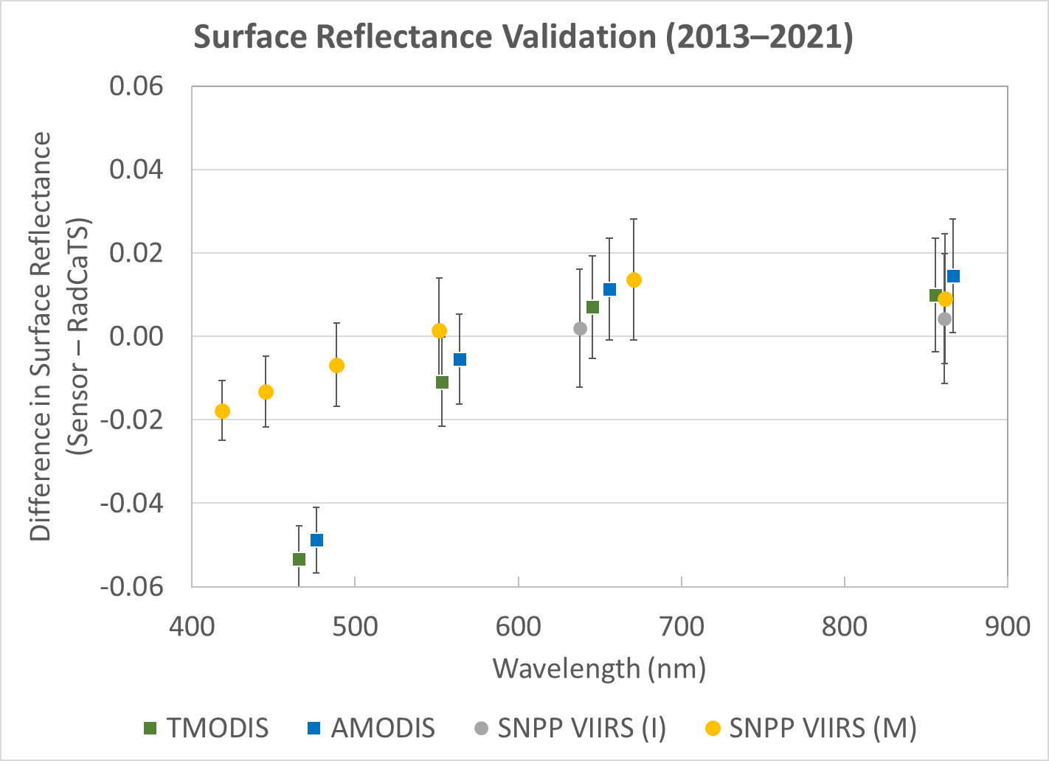
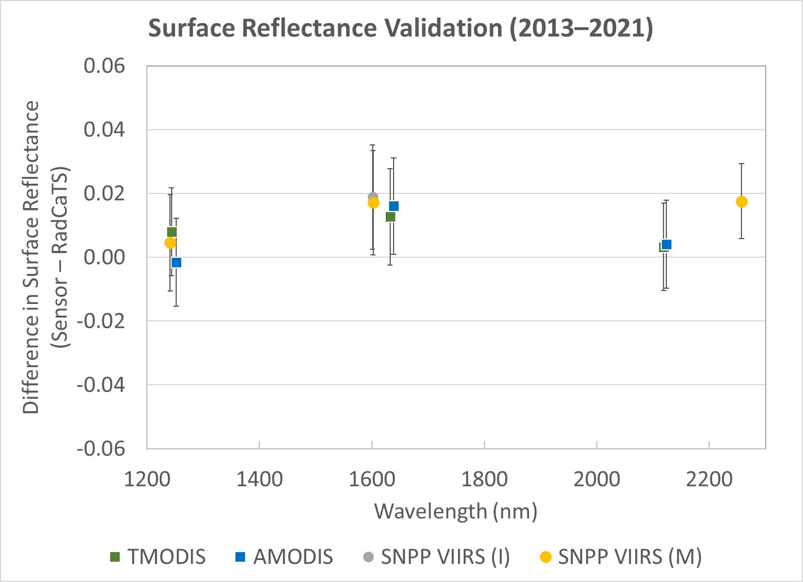
Recap
Summary of all surface reflectance validation results
VNIR SWIR

Slide 23
Conclusions and Future Work
Conclusions
Terra and Aqua MODIS radiometric calibration agrees with RadCaTS to within uncertainties
Terra and Aqua MODIS surface reflectance has bias with RadCaTS in blue band
SNPP and NOAA-20 VIIRS radiometric calibration also agrees with RadCaTS to within uncertainties, except for NOAA-20 Band M11 (2.3 µm)
Both pairs of sensors are in agreement to within RadCaTS uncertainty when using double ratio (or difference)
Upcoming work in 2021
Deployment of Headwall UAS for BRDF measurements at Railroad Valley
On-site calibration of GVRs using CaTSSITTR
Continued spatial analysis comparison with traditional reflectance-based approach and RadCaTS
Integrate on-site VNIR spectrometer data into RadCaTS processing
Note: these results will be presented at SPIE Optics and Photonics (Aug 2021)

