Slide 1
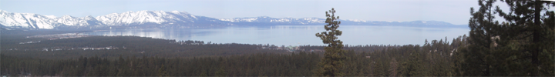
In-Flight Validation of Mid and Thermal Infrared Remotely Sensed Data from MODIS (Terra and Aqua) and VIIRS Using the Lake Tahoe and Salton Sea Automated Validation Sites
Simon J. Hook, Robert Radocinski, Kerry Cawse-Nicholson, Gerardo Rivera, William Johnson
Jet Propulsion Laboratory, California Institute of Technology, Pasadena, CA
© 2021 California Institute of Technology. Government sponsorship acknowledged.

Slide 2
Outline
Introduction
Location
Measurements and Calibration
Data Reduction Methodology
Results from various sensors
  TIR MODIS and a little VIIRS
  MIR MODIS
Summary and Conclusions

Slide 3
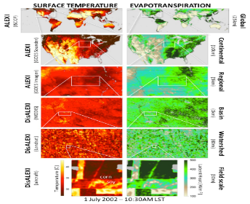
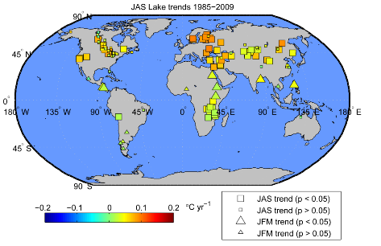
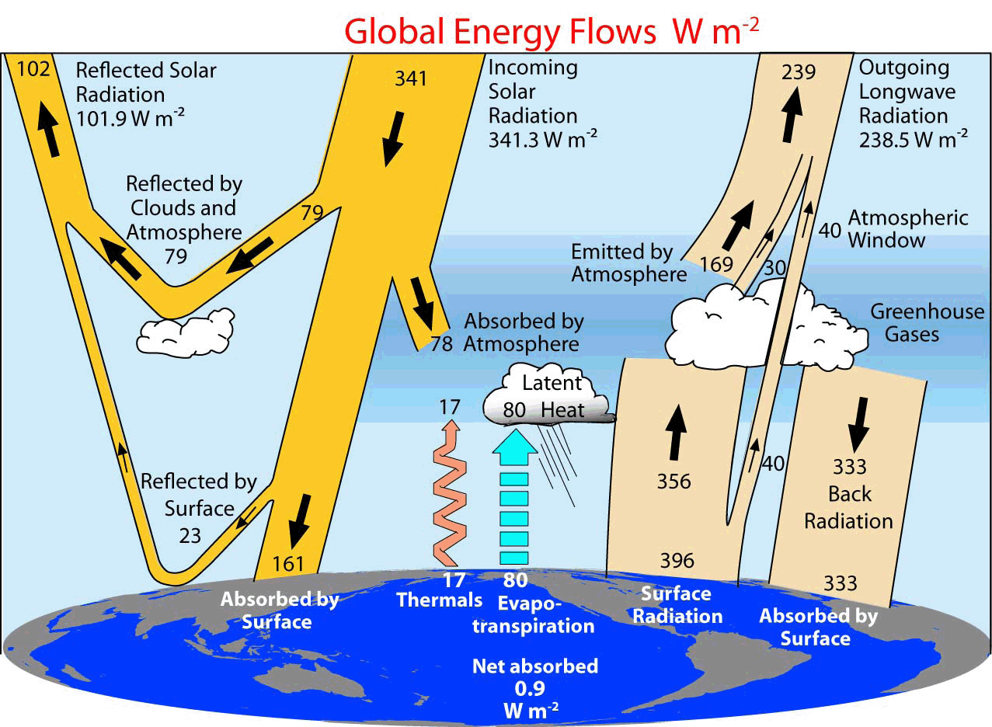
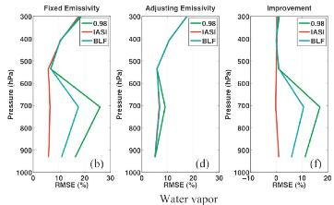
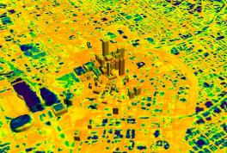
Earth Science Use of LST&E
Evapotranspiration (drought monitoring)
Understanding Climate Change
Surface Energy Balance
Urban Heat Island Studies
Atmospheric profile retrievals
Notes:
an error of 0.1 in the emissivity will result in climate models having errors of up to 7 Wm-2 in their upward longwave radiation estimates –a much larger term than the surface radiative forcing (~2-3 Wm-2) due to an increase in greenhouse gases (Zhou et al. 2003).

Slide 4
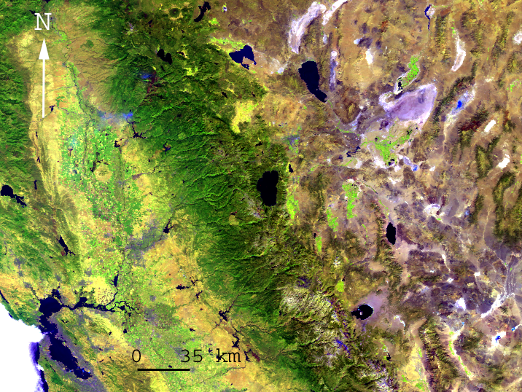
2000-09-20-D
Large 35 km x 16 km
High 2 km
Available year round (does not freeze in winter).
Homogenous compared with land.
Large annual temperature range 5-25 C.
Freshwater (kind to instruments!)
Good infrastructure and easy access.

Slide 5
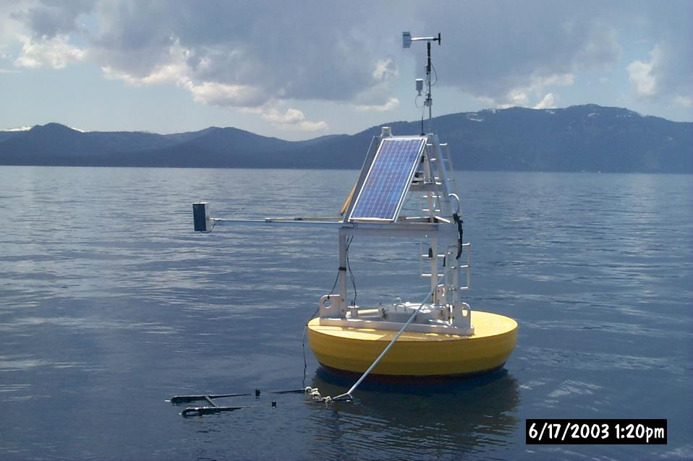
TB3 Installed 11-04-2002
Air temperature
& Rel. Humidity
Wind Speed
& Direction
Skin temperature
Logging
System
Batteries
Bulk Water
Temperature
3m

Slide 6
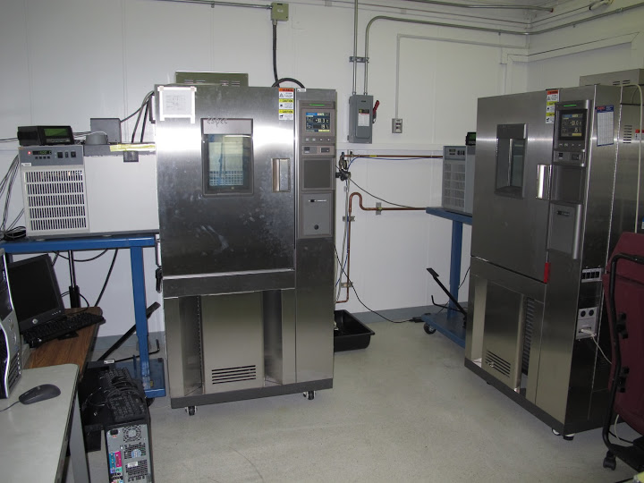
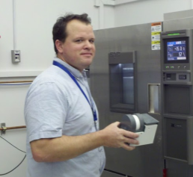
Custom-Built Radiometers Calibrated to NIST Traceable Blackbody

Slide 7
Now have large numbers of matchups – can restrict to optimum view angles

Slide 8
IR Window bands 31 and 32 align nicely with 1x1 line, but Band 29 does not.

Slide 9
Window bands 31 and 32 closely follow 1 to 1 line, but 29 is out of family

Slide 10
AOI relates to viewing geometry, more oblique views worse validation as expected

Slide 11
Analysis indicate get excellent results with in situ out to about 30 degrees but problem with calibration of b29

Slide 12
Excellent calibration until 2009. Since 2009 channel 29 calibration has degraded

Slide 13
Similar analysis to previous slides but notice how range of Aqua data has increased

Slide 15
No sign of problems in channel 29 on Aqua-MODIS, VIIRS performance similar to MODIS

Slide 17
Can also use buoy data to validate MIR channels but cannot use daytime values since affected by
reflected solar (as illustrated above). Since buoys operate 24x7 use just nighttime data (see next slide)

Slide 18
Nighttime only – no problems with reflected solar

Slide 19
When look at vicarious minus observed bias, Terra is warm.

Slide 20
No bias in MIR channels of Aqua

Slide 21
Summary and Conclusions
Established an automated site for validating thermal infrared data at Lake Tahoe CA/NV. Site has been operating since 1999.
Measurements made at the site include skin- bulk- air- temperature, wind speed, wind direction and net radiation at multiple locations every 2 minutes. Multiple locations (4 buoys) allow validation of several points within a scene.
Second site added at Salton Sea in 2008 to enable validation at high water temperatures (~35 C).
Validated data from multiple instruments including, AATSR, ASTER, ECOSTRESS, MODIS (Terra, Aqua), VIIRS, Landsat 5, 7, 8 and MTI.
Results so far indicate
  MODIS-Terra at-sensor radiance: TIR 29,31, 32, no bias, abs. acc. ± 0.25K
  MODIS-Aqua at-sensor radiance: TIR, 31, 32 no bias, abs. acc. ± 0.25K
  MODIS-Terra at-sensor radiance: TIR 29, small bias, abs. acc. ± 0.25K
  MODIS-Terra at-sensor radiance: MIR, bias 0.24 K
  MODIS-Aqua at-sensor radiance: MIR, bias 0.10 K

