Slide 1
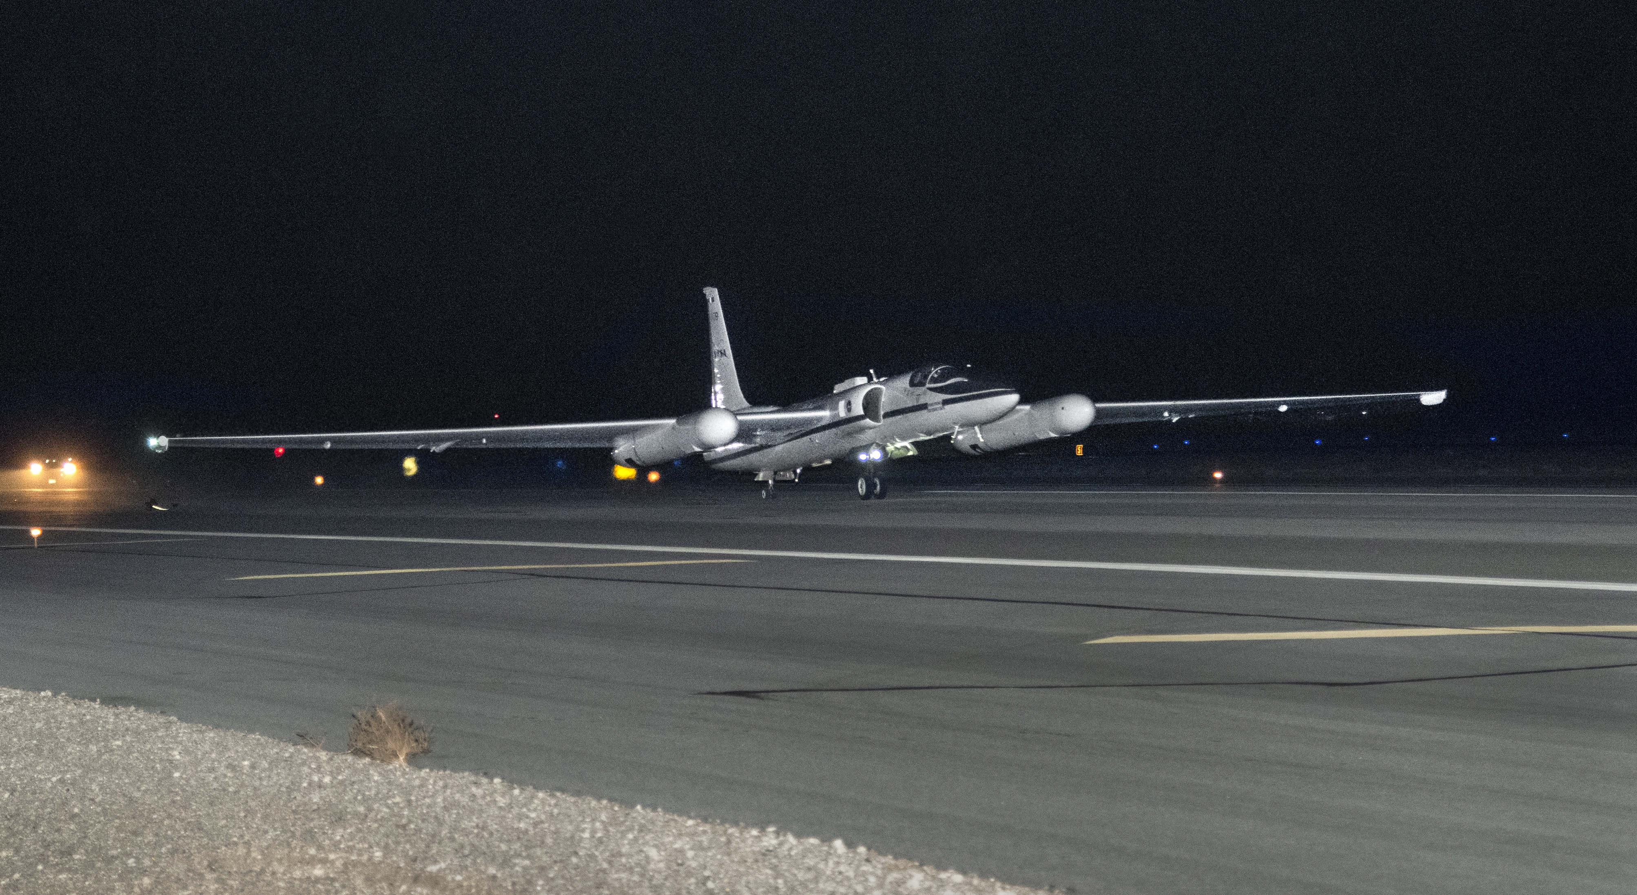
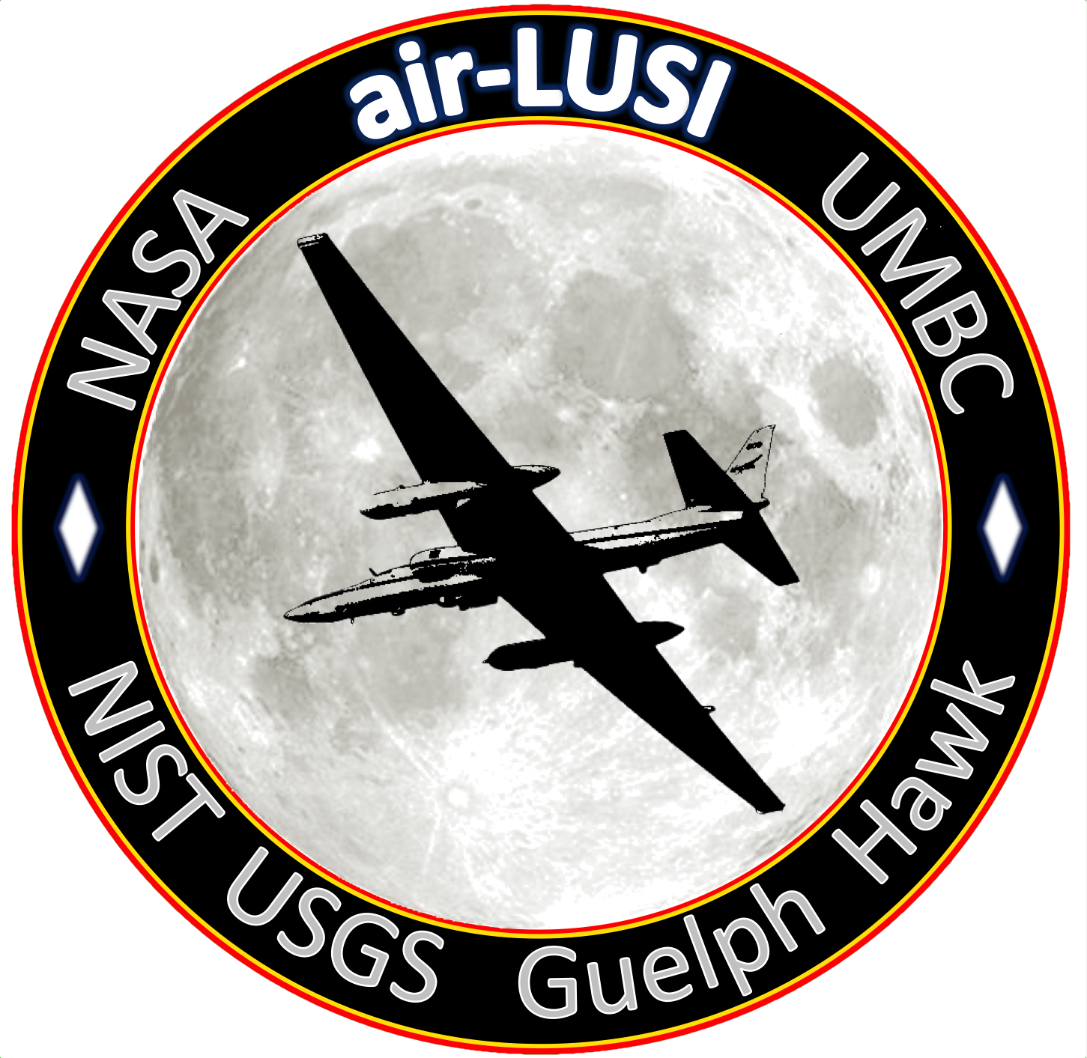
An Update on the
Airborne Lunar Spectral Irradiance
(Air-LUSI)
K. Turpie, UMBC / JCET
MODIS/VIIRS Calibration Workshop
26 February 2021

Slide 2
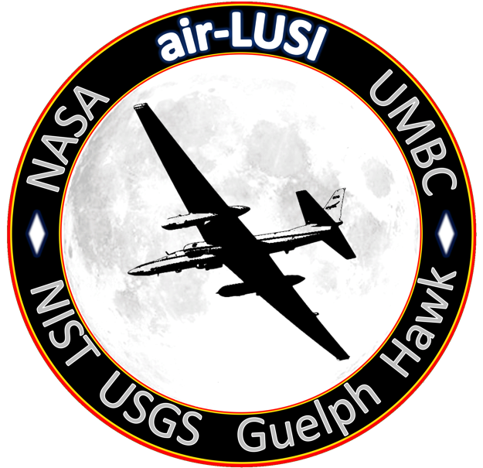
Air-LUSI
AITT Program Team
Kevin Turpie, PI (UMBC/GSFC 616.2)
Steve Brown, Co-I (NIST)
John Woodward, Co-I (NIST)
Andrew Gadsden, Co-I (U of Guelph)
Tom Stone, Co-I (USGS)
Andrew Newton (U of Guelph)
Steve Grantham (NIST)
Tom Larason (NIST)
Stephen Maxwell (NIST)
Joe Rice (NIST)

Slide 3
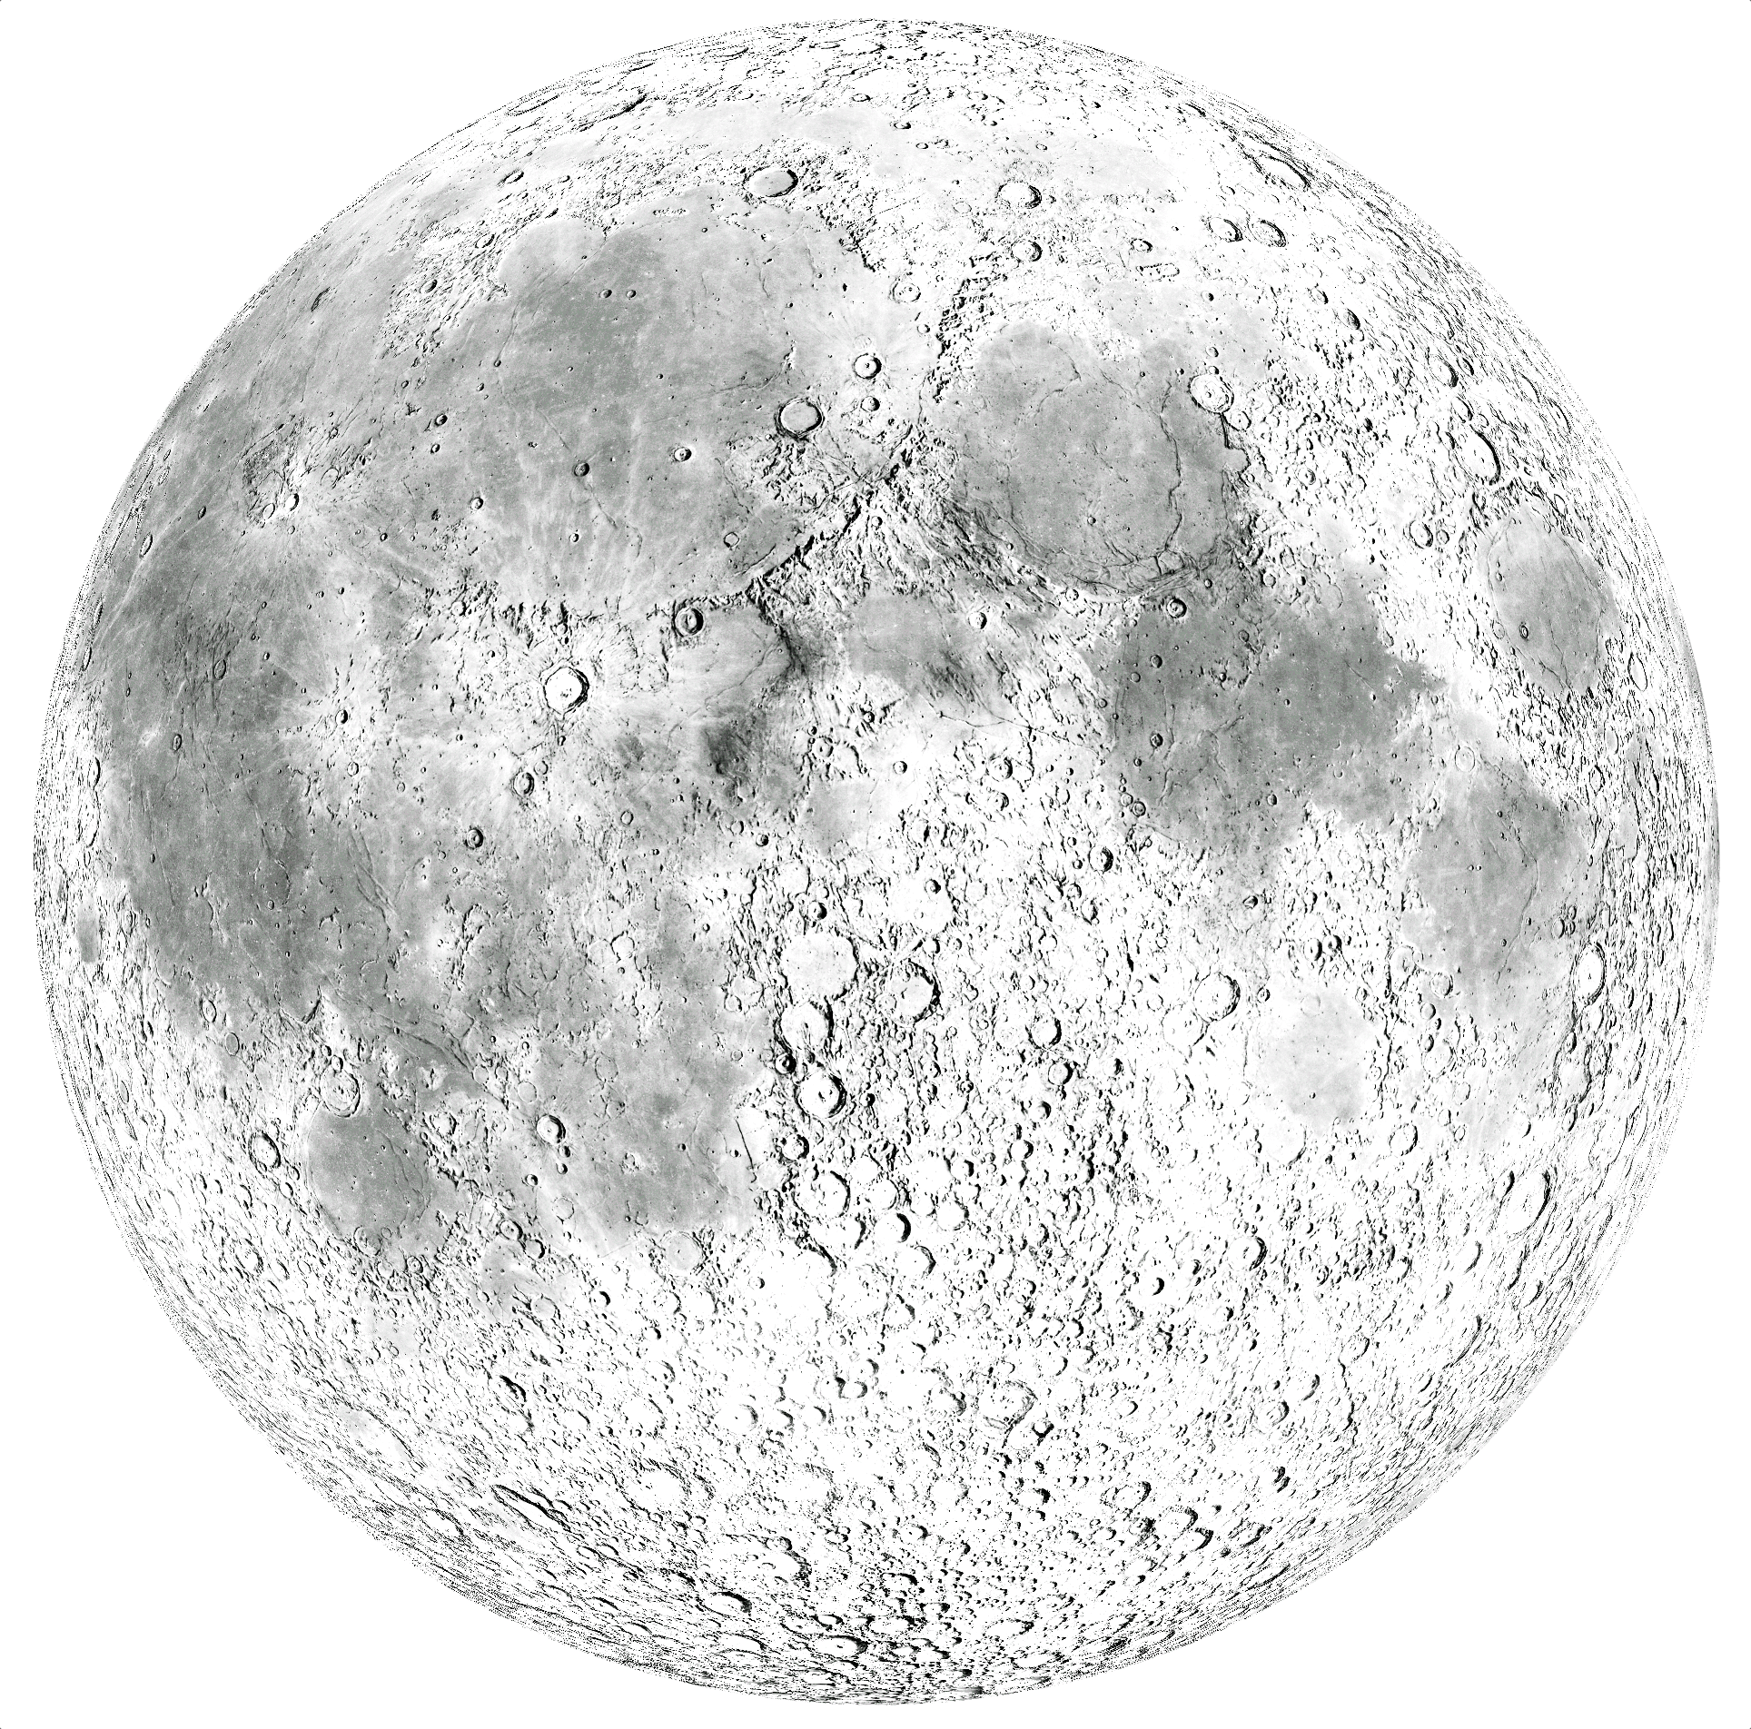
ADVANCEMENT OF ABSOLUTE LUNAR CALIBRATION
Lunar calibration potentially can provide cost-effective absolute calibration of reflected solar bands that is accurate and inter-consistent across multiple sensors.
Benefits
A permanent (and retrospective) common reference not affected by climate.
Inter-consistent Earth climate data records across series of missions and data gaps.
Intercalibration of sensors between international partners.
Enable future constellation architectures and very small or inexpensive platforms.
Enhanced calibration for aquatic remote sensing.
Cost: Low
Steps
Improve lunar calibration reference:
- Acquire high-accuracy, SI-traceable measurements of the Moon.
- Use new measurements to advance the lunar model.
Improve techniques for lunar measurements by satellite sensors.
3

Slide 4
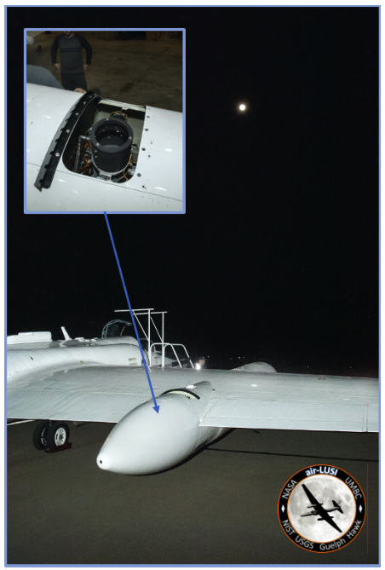
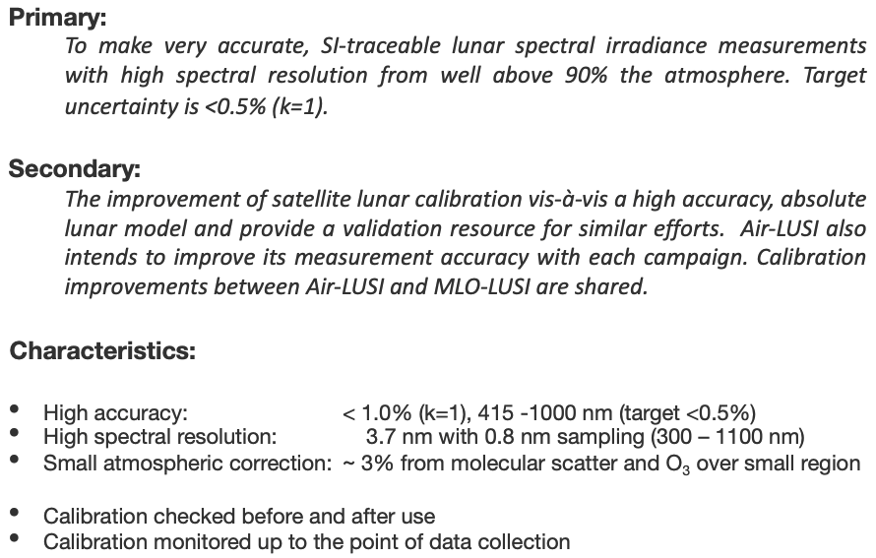
Objectives
Air-LUSI
4

Slide 5
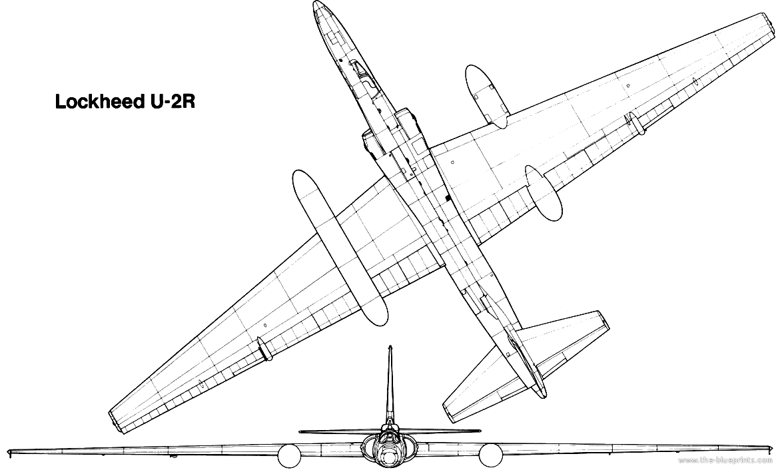
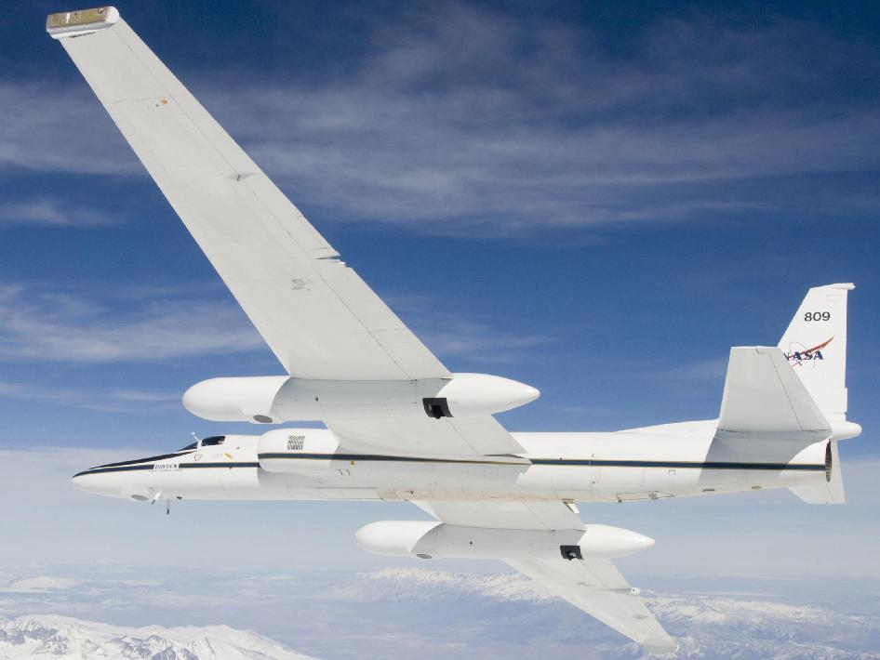
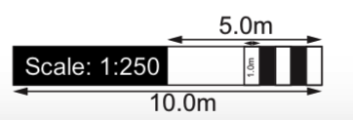
ER-2 Aircraft
Air-LUSI
Superpod
The telescope and robotic mount are in Superpod Aft-body.
The sensor enclosure and control computer are in Mid-body.
IRIS telescope views to port through Aft-body Zenith Viewport.
Fore-body
Aft-body
Mid-body
ABOVE
RIGHT
NASA ER-2
Altitude
69,000 ft
21 km
BELOW
RIGHT
Aft-body
Zenith
Viewport
5

Slide 6
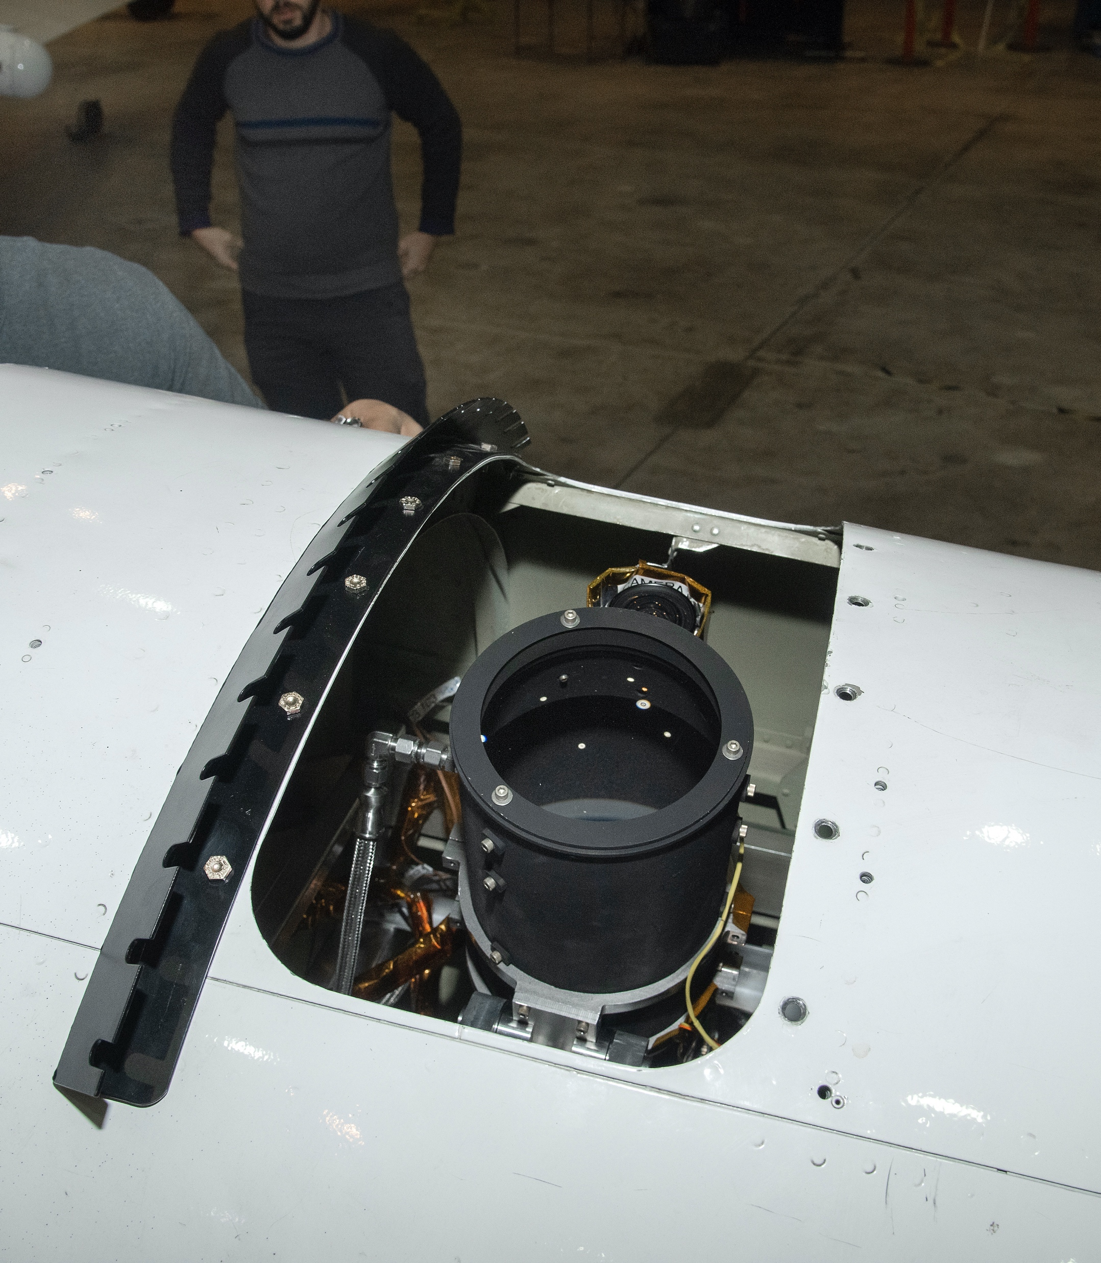
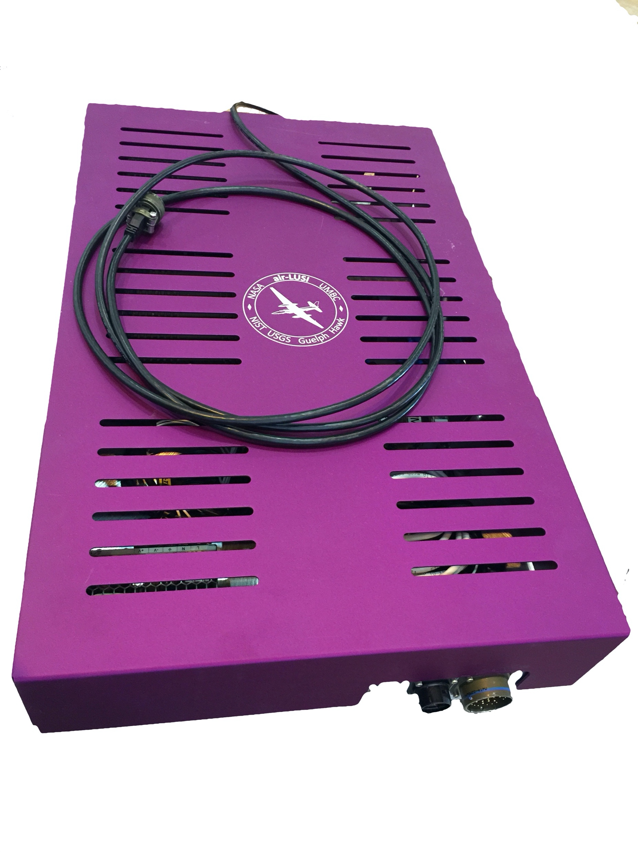
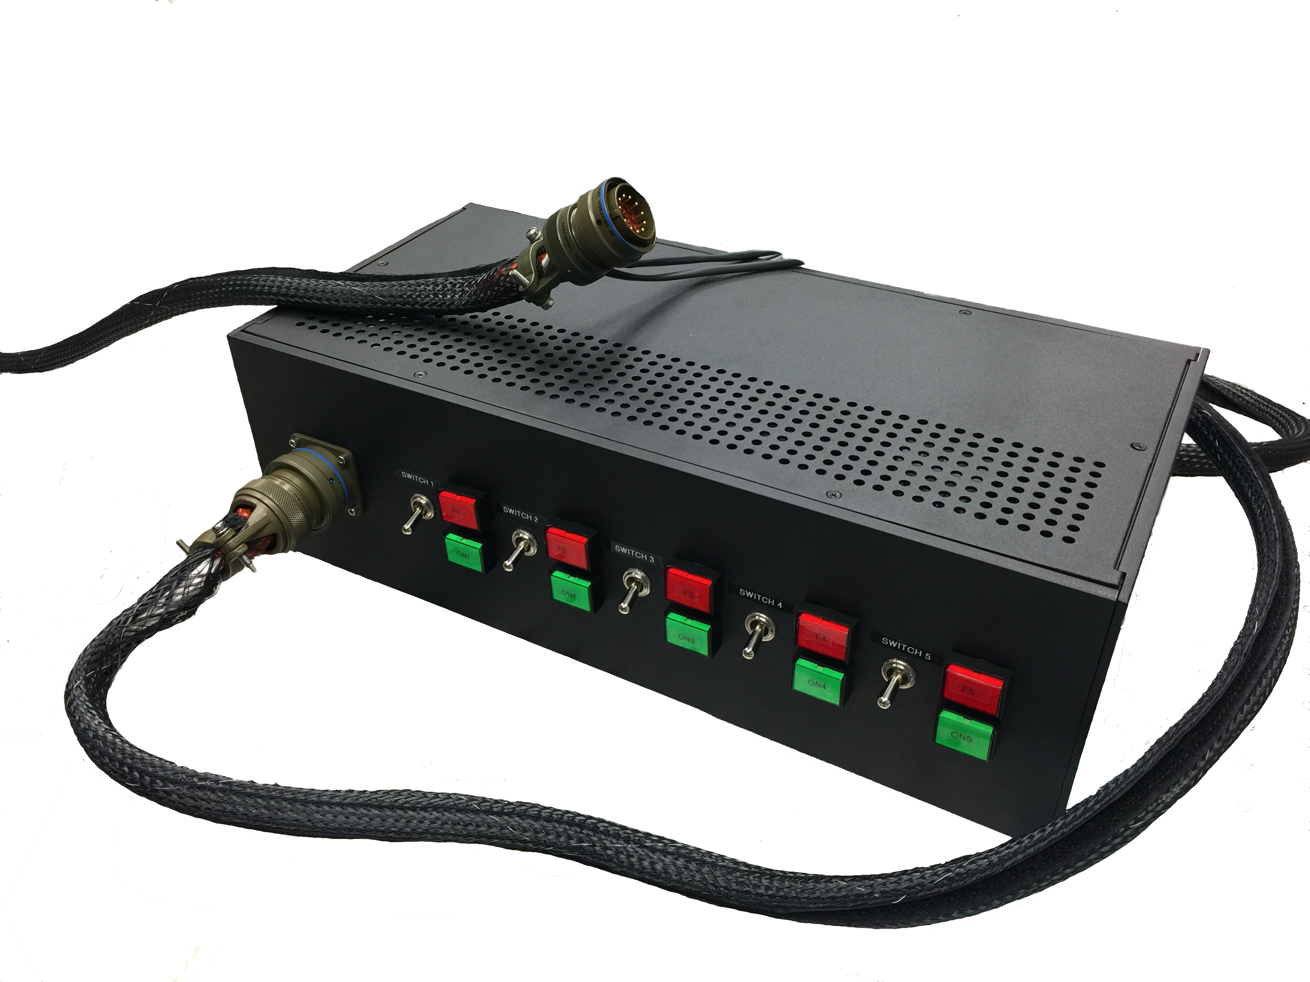
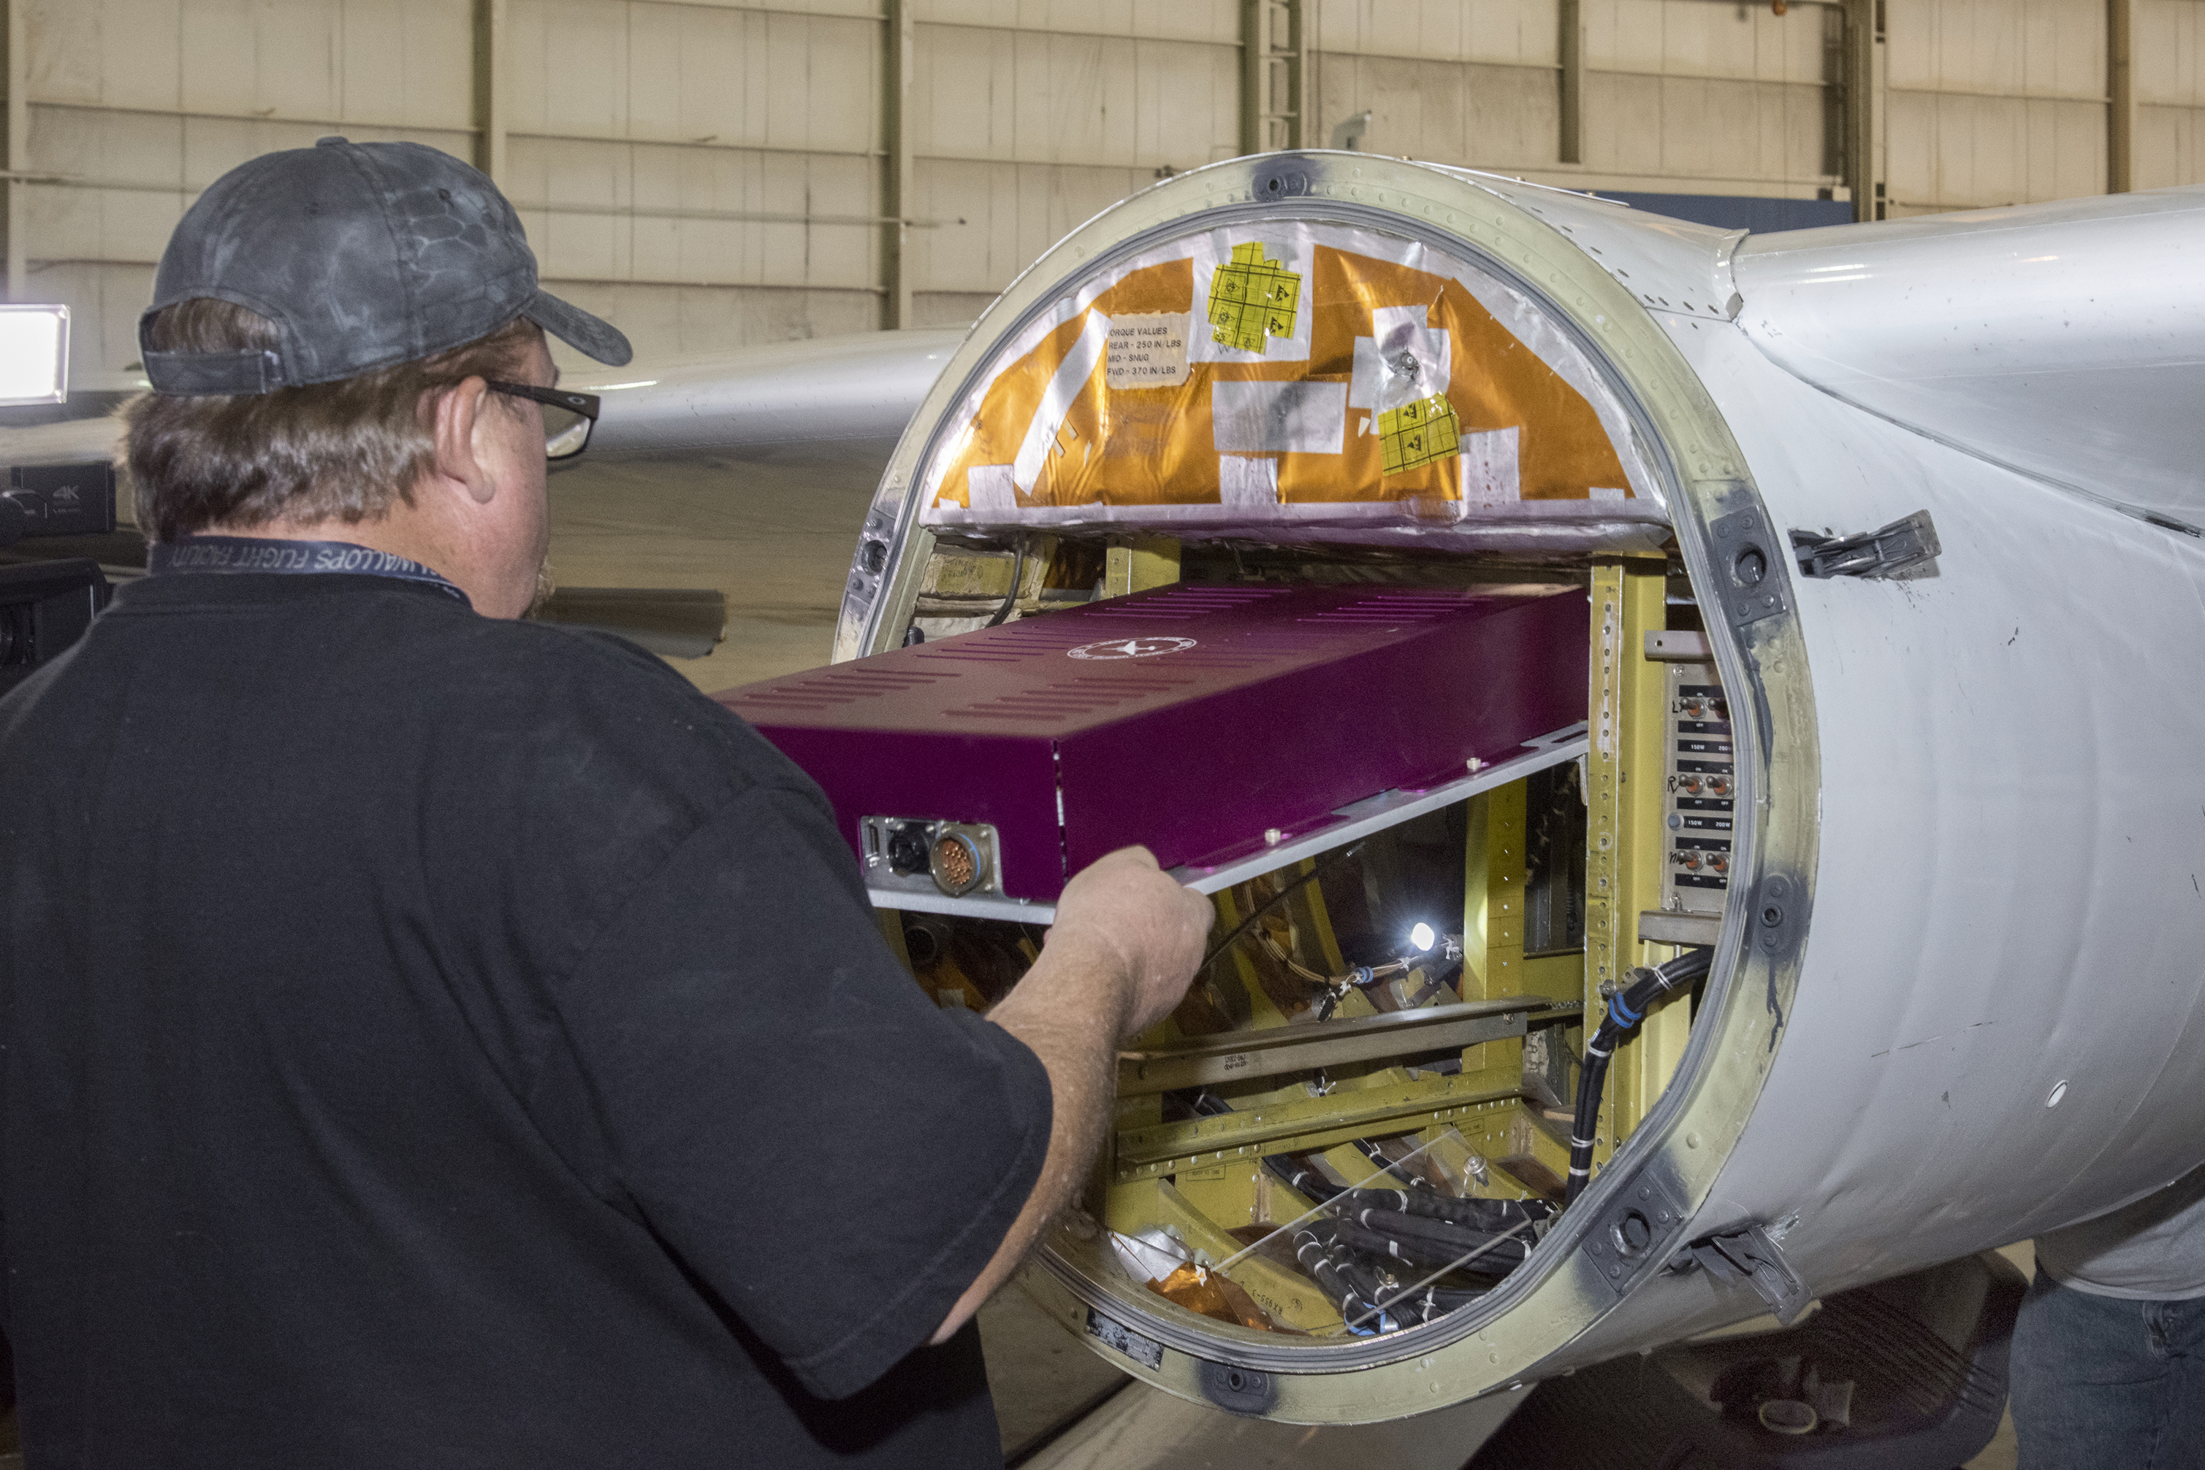
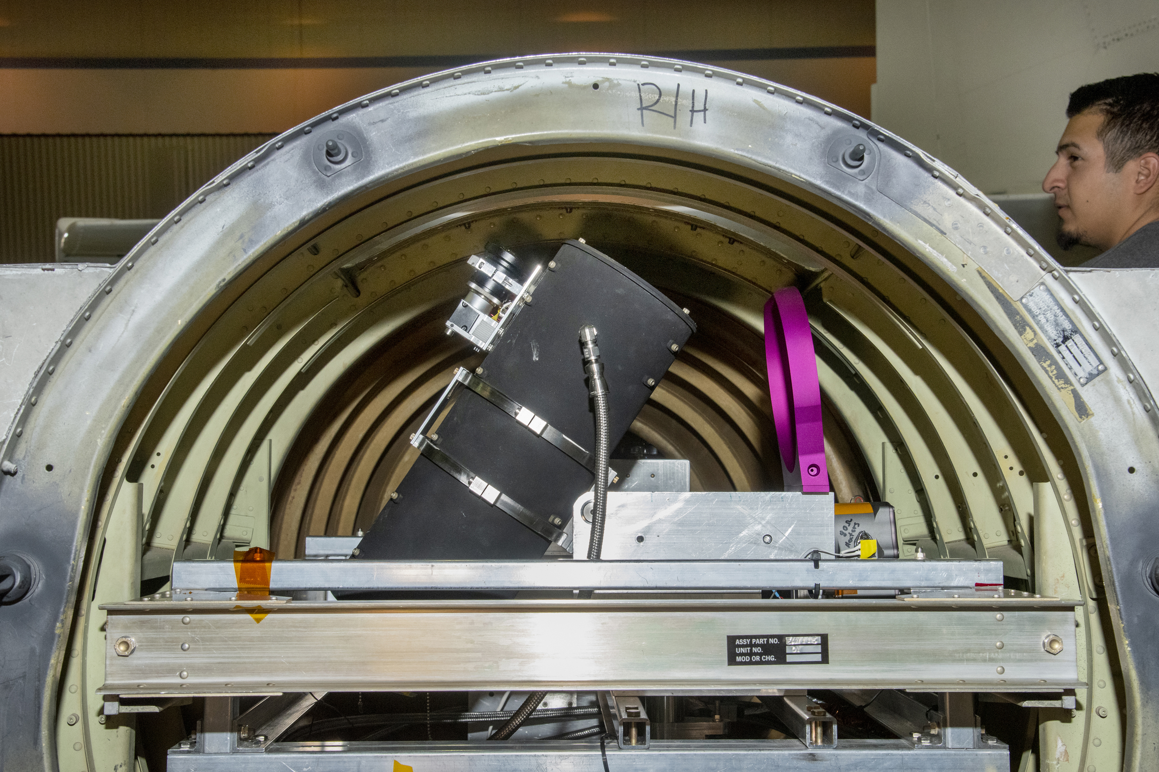
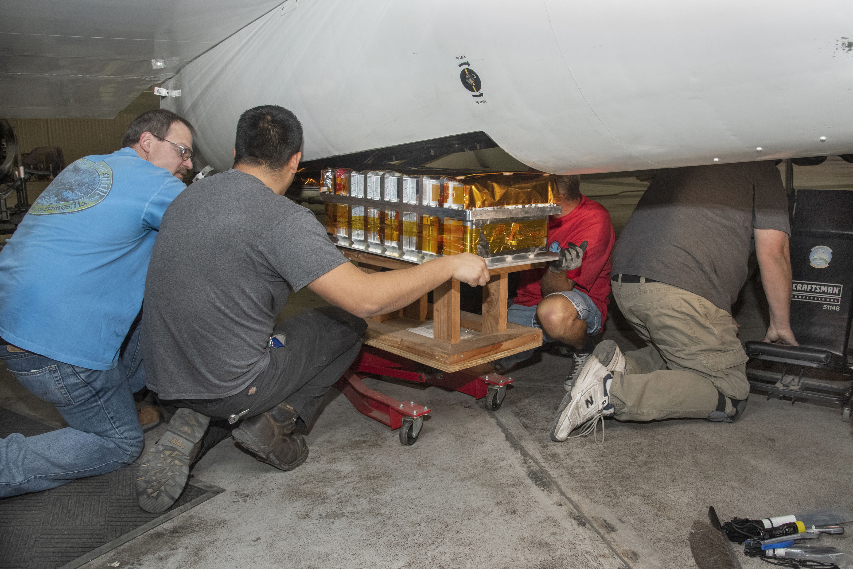
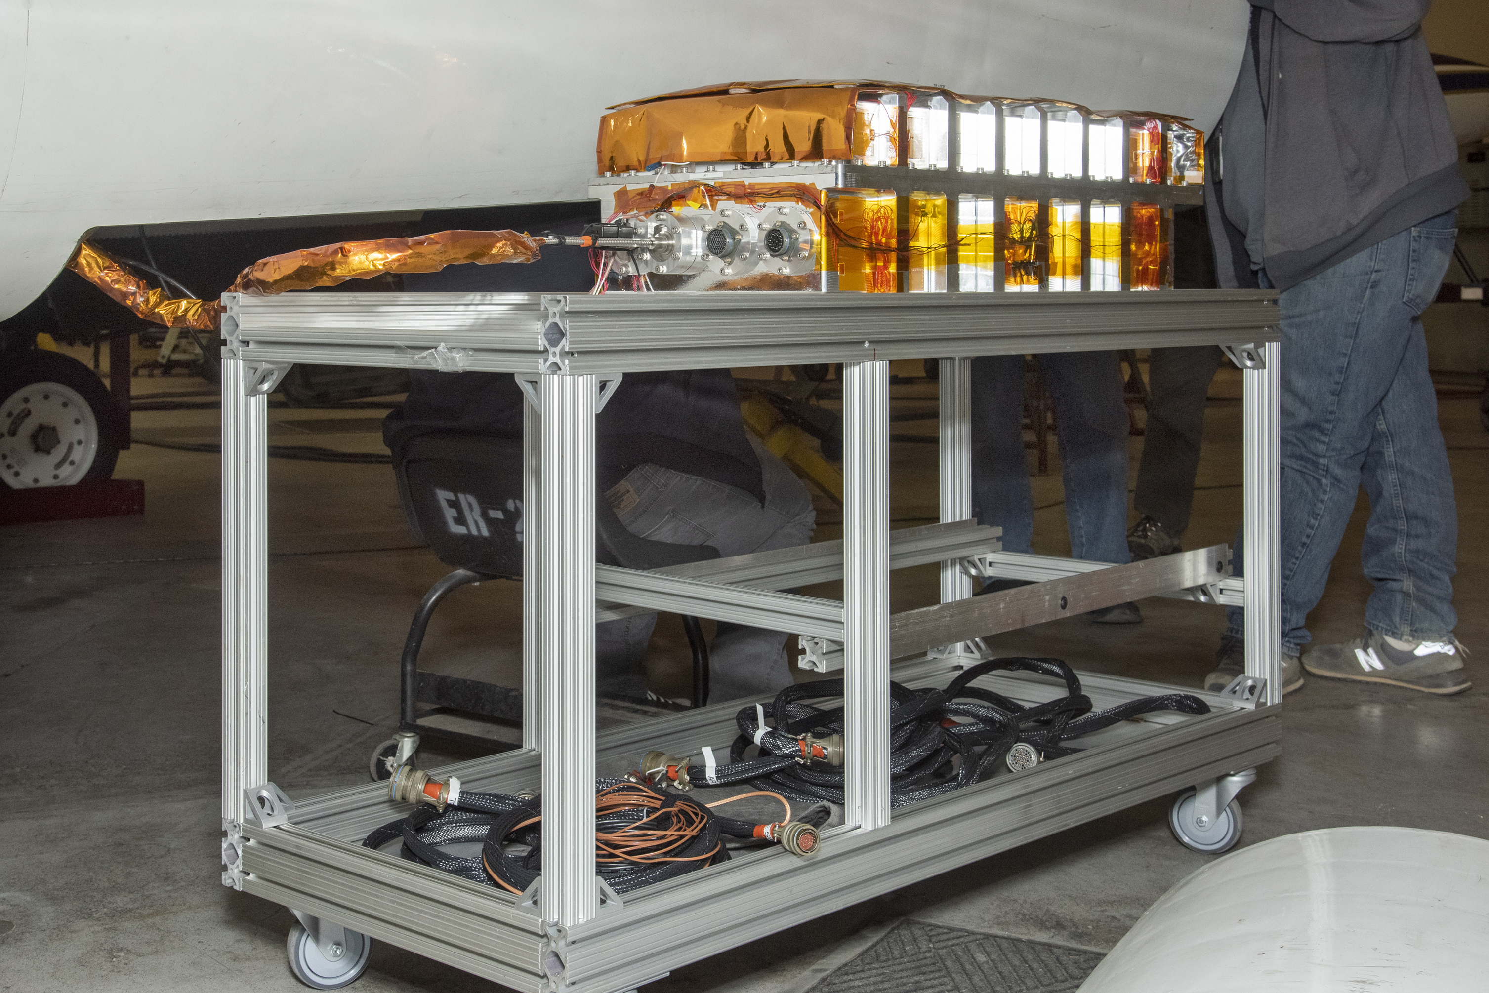
Instrument Subsystems
IRIS Telescope in view port
ARTEMIS – Autonomous, Robotic TElescope Mount Instrument Subsystem
Uses tracking camera on telescope and computer controlled PID loop.
Keeps telescope fixed on the Moon to within 0.1°.
ARTEMIS Control Assembly
IRIS Telescope
ARTEMIS
Tracking Camera
ARTEMIS Control Assembly
Installation
Pilot Switch Simulator
ARTEMIS Mount
IRIS – IRradiance Instrument Subsystem
A non-imaging telescope (integrating sphere at focal point).
Light fed via a fiber optic cable to a spectrograph.
On-board LED validation source.
Instrument enclosure keeps the spectrograph and validation source at surface-level P & T during flight.
IRIS Fiber Optics
Cable Harness
IRIS
Instrument Enclosure
IRIS Instrument Enclosure
Installation
6
Notes:
What is your critical path? A bulleted list of steps to our objective. Get h/w ready for engineering test for lunar obs late in May.

Slide 7
Robotic Telescope
Air-LUSI
Robotic Telescope system employs a tracking camera and image recognition software to keep the telescope boresight continuously aligned with the Moon in flight to within 0.1°.

Slide 8
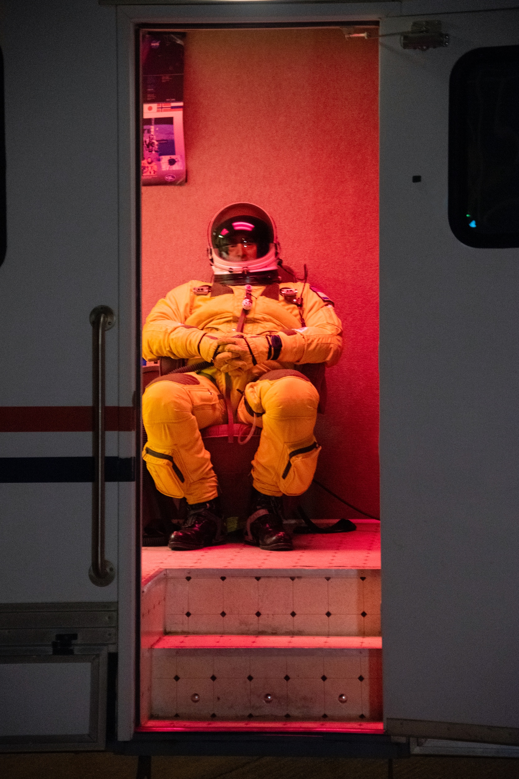
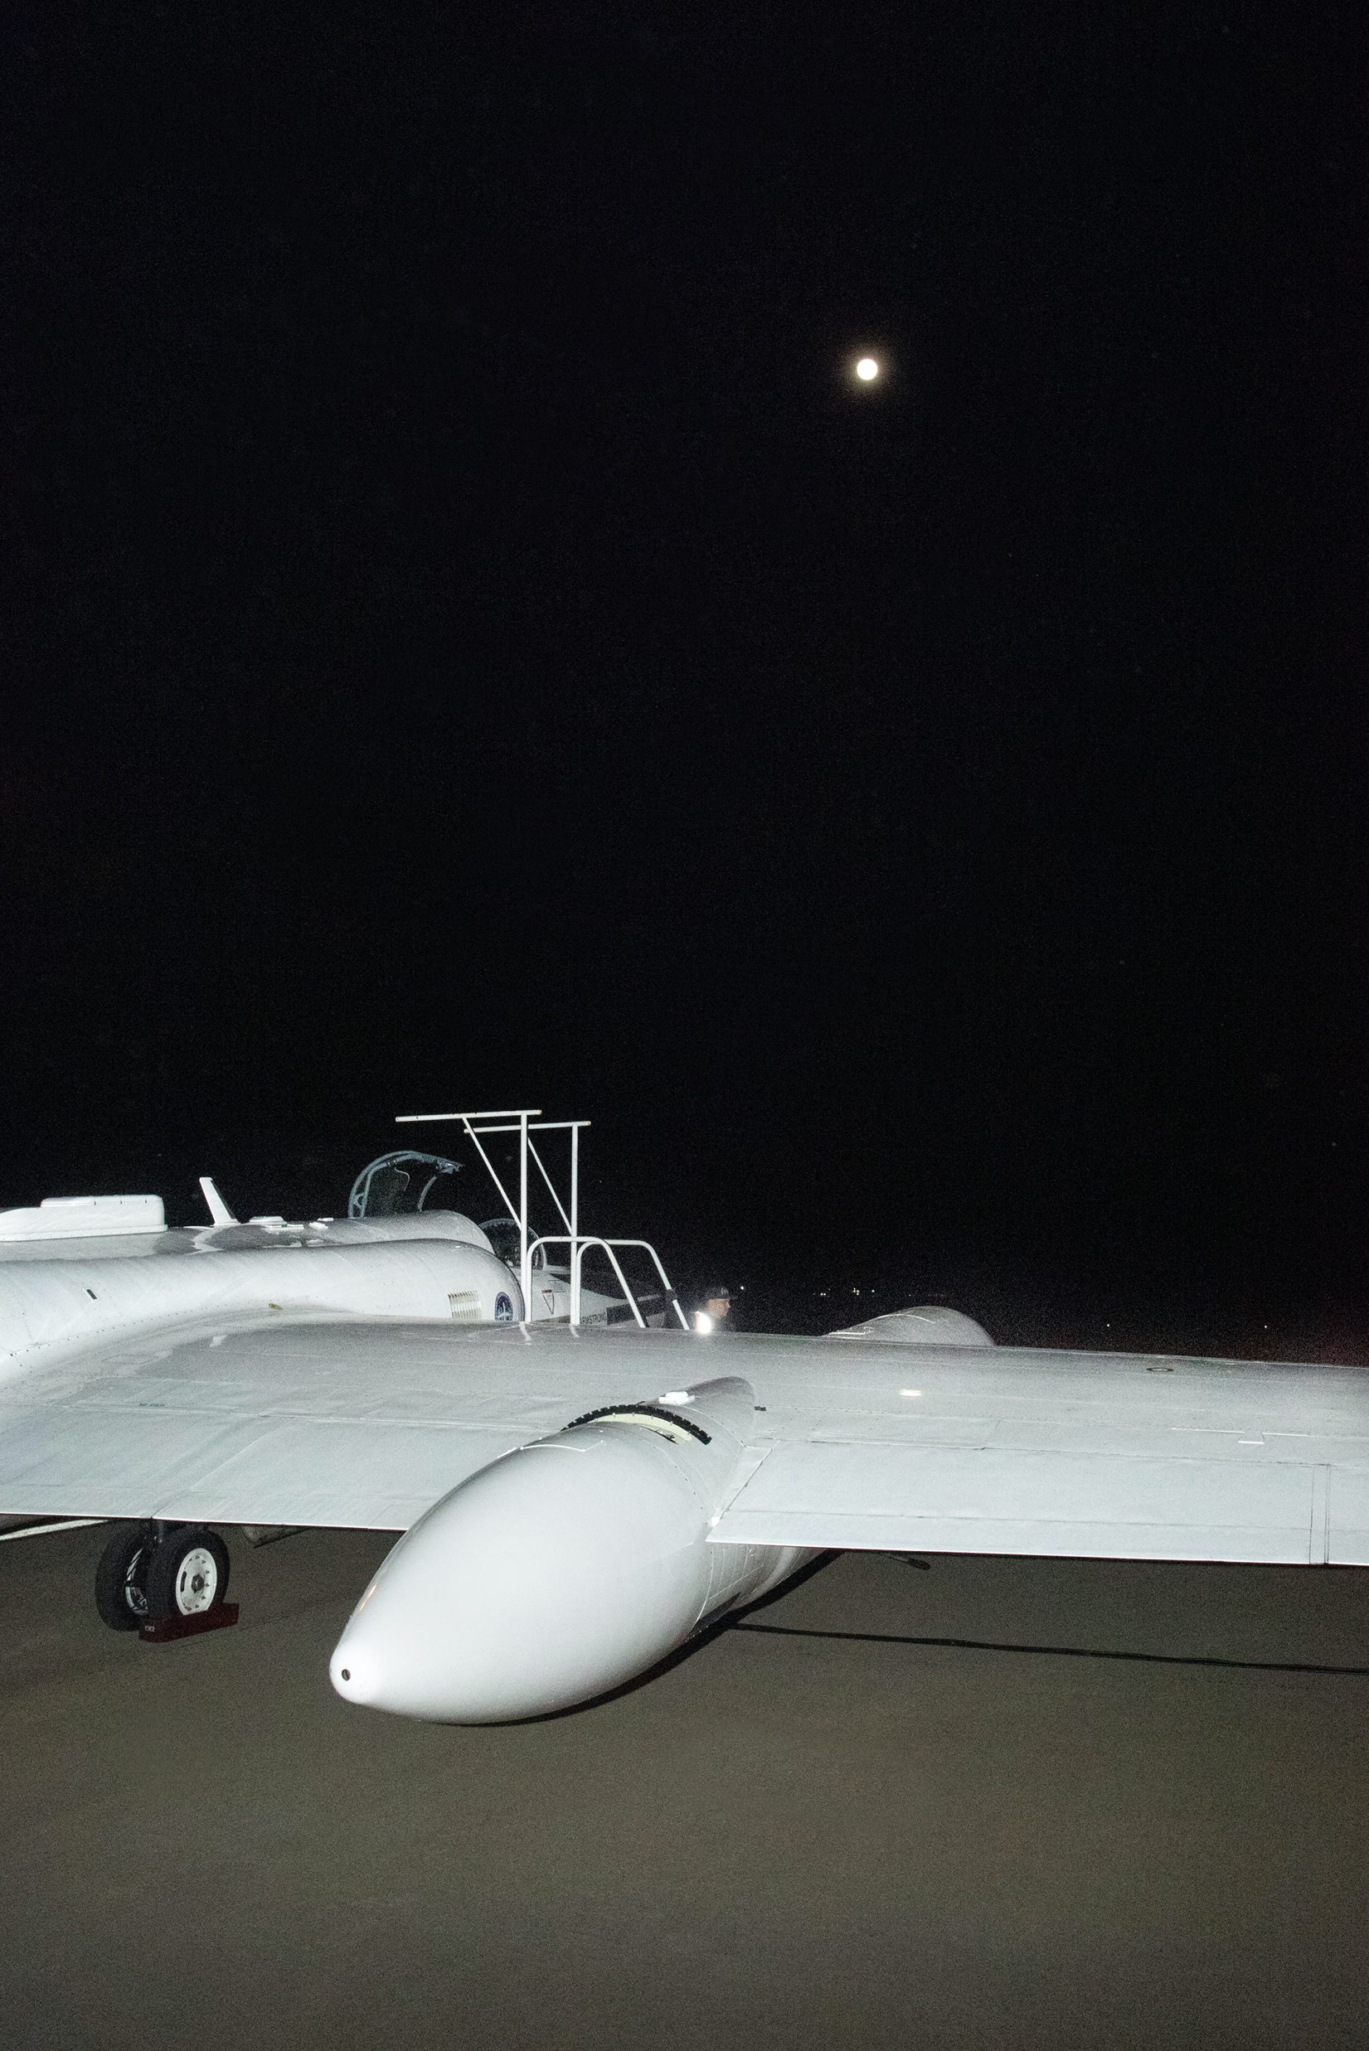
8

Slide 9
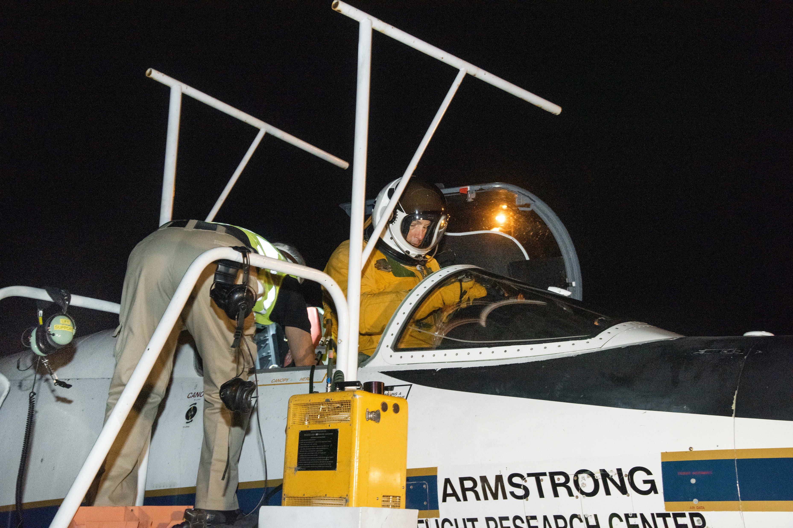
9

Slide 10
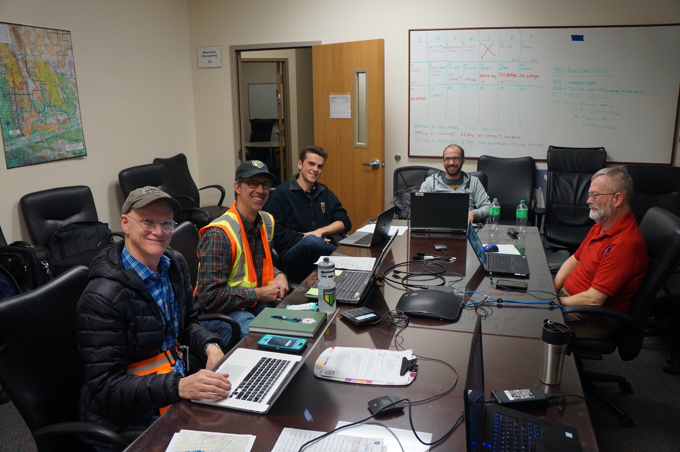
Mobile Pilot
Communication
Air-LUSI network
and telemetry
Robotics
Instrument
Function
Air-LUSI “Mission Control”
10

Slide 11
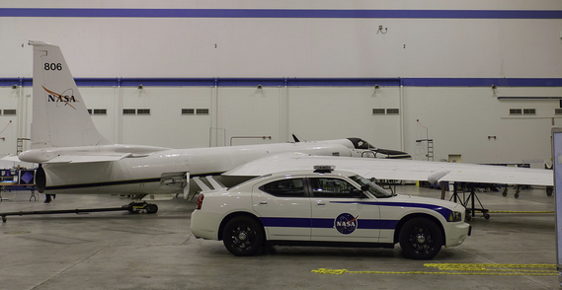
11
Notes:
This is the chase car. Yes, those are fins on the back. They're to let everyone know that this car can really fly down runaway. Having been in the vehicle, they seem superfluous.
The mobile pilot (another ER-2 pilot) follows with plane in the car as it taxis to the runway. Once there, he circles the plane before take off for a final check. Then, we chase the plane down the runway during takeoff. It's a short ride.

Slide 12
12
Notes:
The ER-2 can climb very rapidly. It reaches 40K ft in about 10 mins.
I text to the team back in the control room in the hangar, now about a 1 mile away, that the plane has left the ground. The response: We know.
The engine on the plane is very powerful, and very noisy. Ear protection is entirely necessary.
The duration of the flight is 2 hours. We wait either in the car or back in the hanger with the team, but return to the runaway just before landing.
Just as the plane reaches the start of the runway, the mobile pilot hits the gas, swerving in from the side and then pulls under the aircraft, which comes down in just front of us.

Slide 13
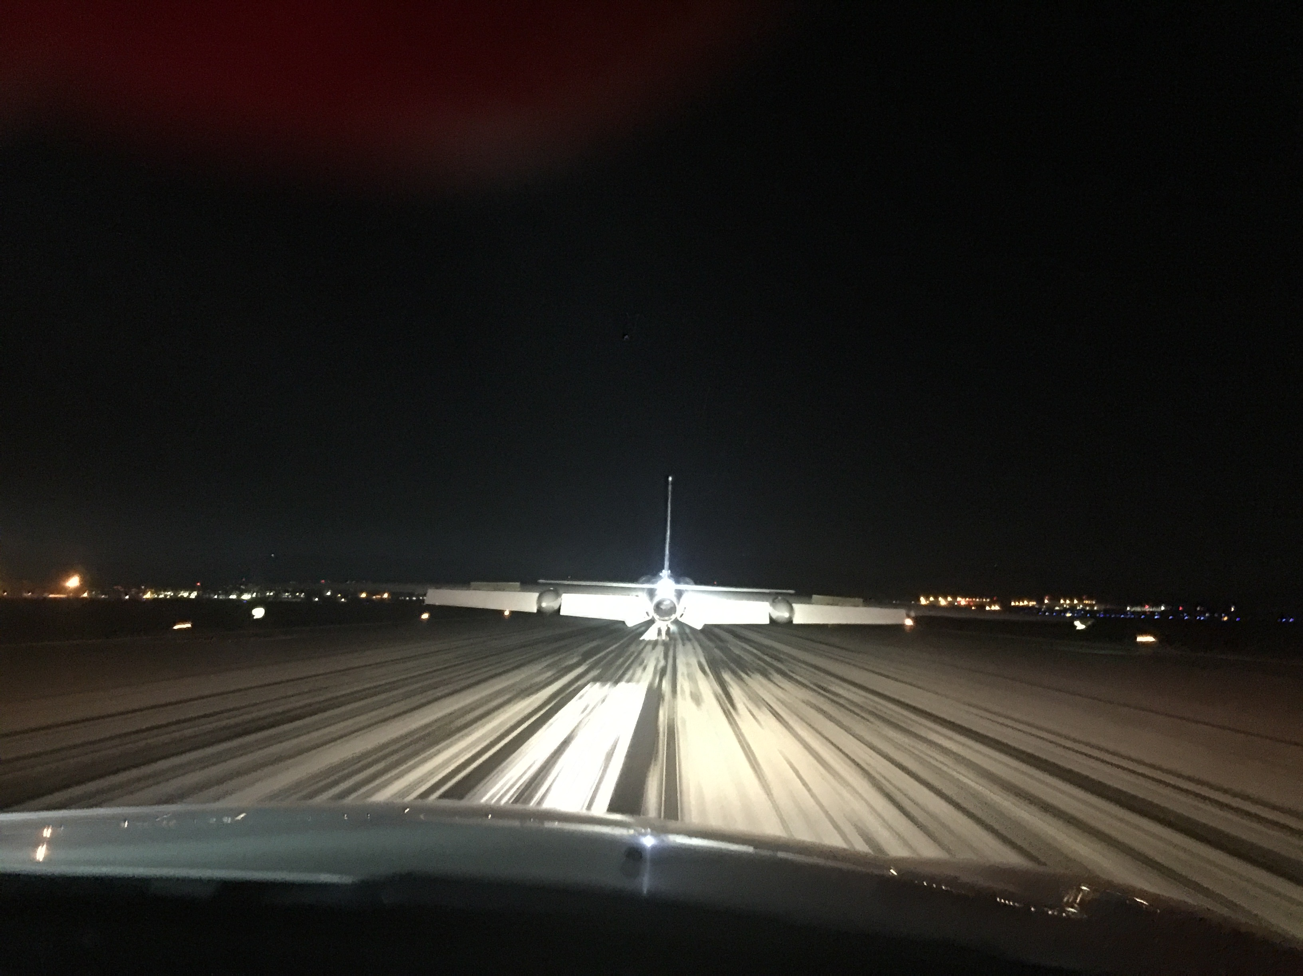
13
Notes:
The mobile pilot’s job is to provide guidance to the ER-2 pilot because the plane is an awkward craft to maneuver, especially with the limited visibility afforded by the spacesuit.
To keep up with the plane, the mobile pilot rapidly accelerates to triple digit speeds, one hand on the wheel, one hand on the radio talking to the pilot in the plane.
Did I mention that the driver is a jet pilot? Trust me. Afterwards, I didn't need coffee for the 3 AM post-flight pilot debrief.
But, independent of my adrenaline level, the entire team, was very excited to see the results.

Slide 14
Initial Results
Air-LUSI
14

Slide 15
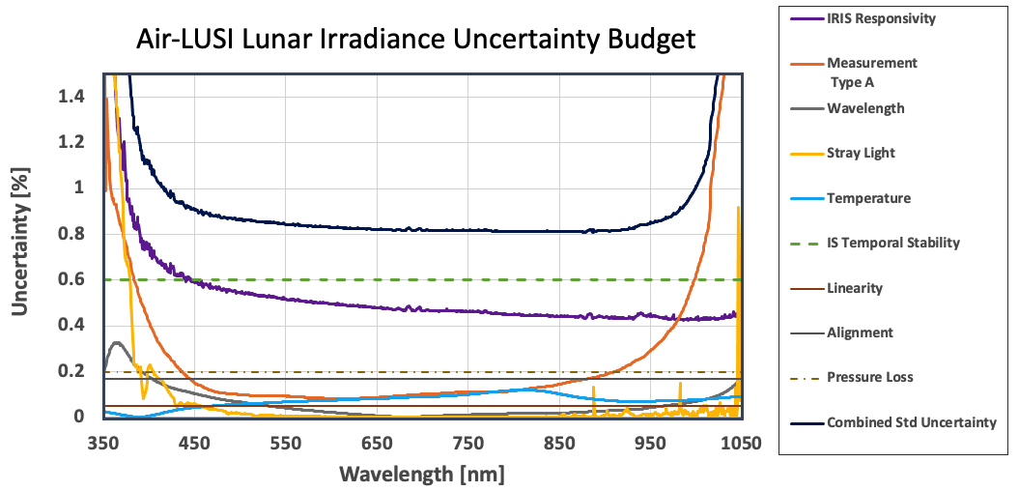
Initial Error Budget
Air-LUSI

Slide 16
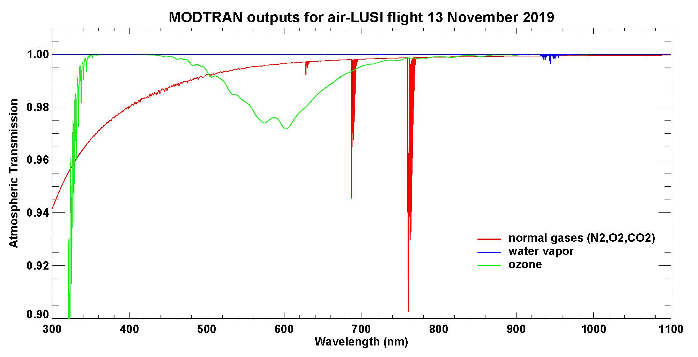
Initial Error Budget
Air-LUSI
MODTRAN atmospheric transmission for Air-LUSI flight 1
MODTRAN setup:
slant path to space from 21.215 km altitude, zenith angle = 22.047°
1976 US Standard Atmosphere, 380 ppmv CO₂
O2
16

Slide 17
Initial Error Budget
Air-LUSI
Error propagation for atmospheric correction:
The exo-atmospheric lunar spectral irradiance E_{LUSI} is computed by dividing the at-sensor lunar spectral irradiance by the transmission T_{s} as a function of λ. The relative uncertainty is RSS with the at-sensor uncertainty of the transmittance.
$$E_{LUSI}^{ }(\text{λ})=\frac{E_{IRIS}^{Moon}(\text{λ})}{T_{s}(\text{λ})}$$
$${\left(\frac{σ_{E_{LUSI}^{ }}}{E_{LUSI}^{ }}\right)}^{2}={\left(\frac{σ_{E_{IRIS}^{Moon}}}{E_{IRIS}^{Moon}}\right)}^{2}+{\left(\frac{σ_{T_{s}}}{T_{s}}\right)}^{2}$$
Assuming a conservative 10% error in the model, maxima are given at the following wavelengths, which has a nearly insignificant impact on the at-sensor uncertainty.
${\left(\frac{σ_{T_{s}}}{T_{S}}\right)}^{2}$≈ 0.20% @λ = 400 nm
${\left(\frac{σ_{T_{s}}}{T_{S}}\right)}^{2}$≈ 0.32% @λ = 620 nm
17

Slide 18
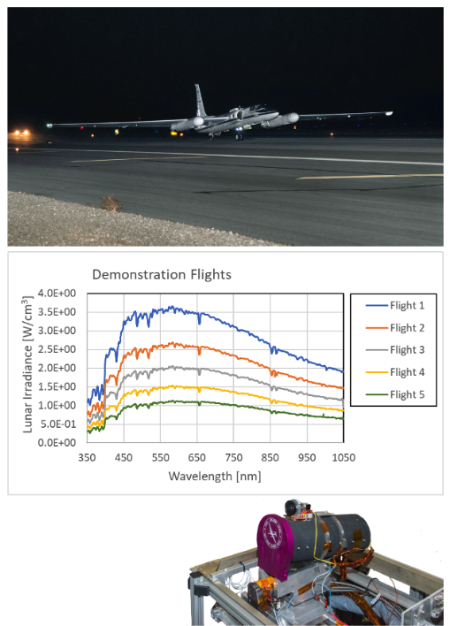
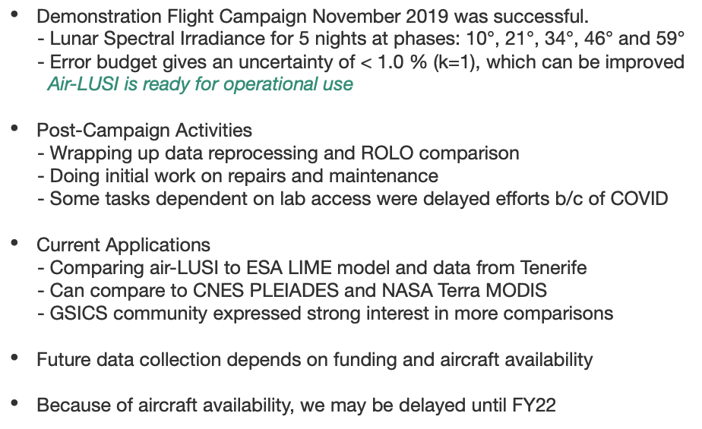
Results & Status
Air-LUSI
18

Slide 19
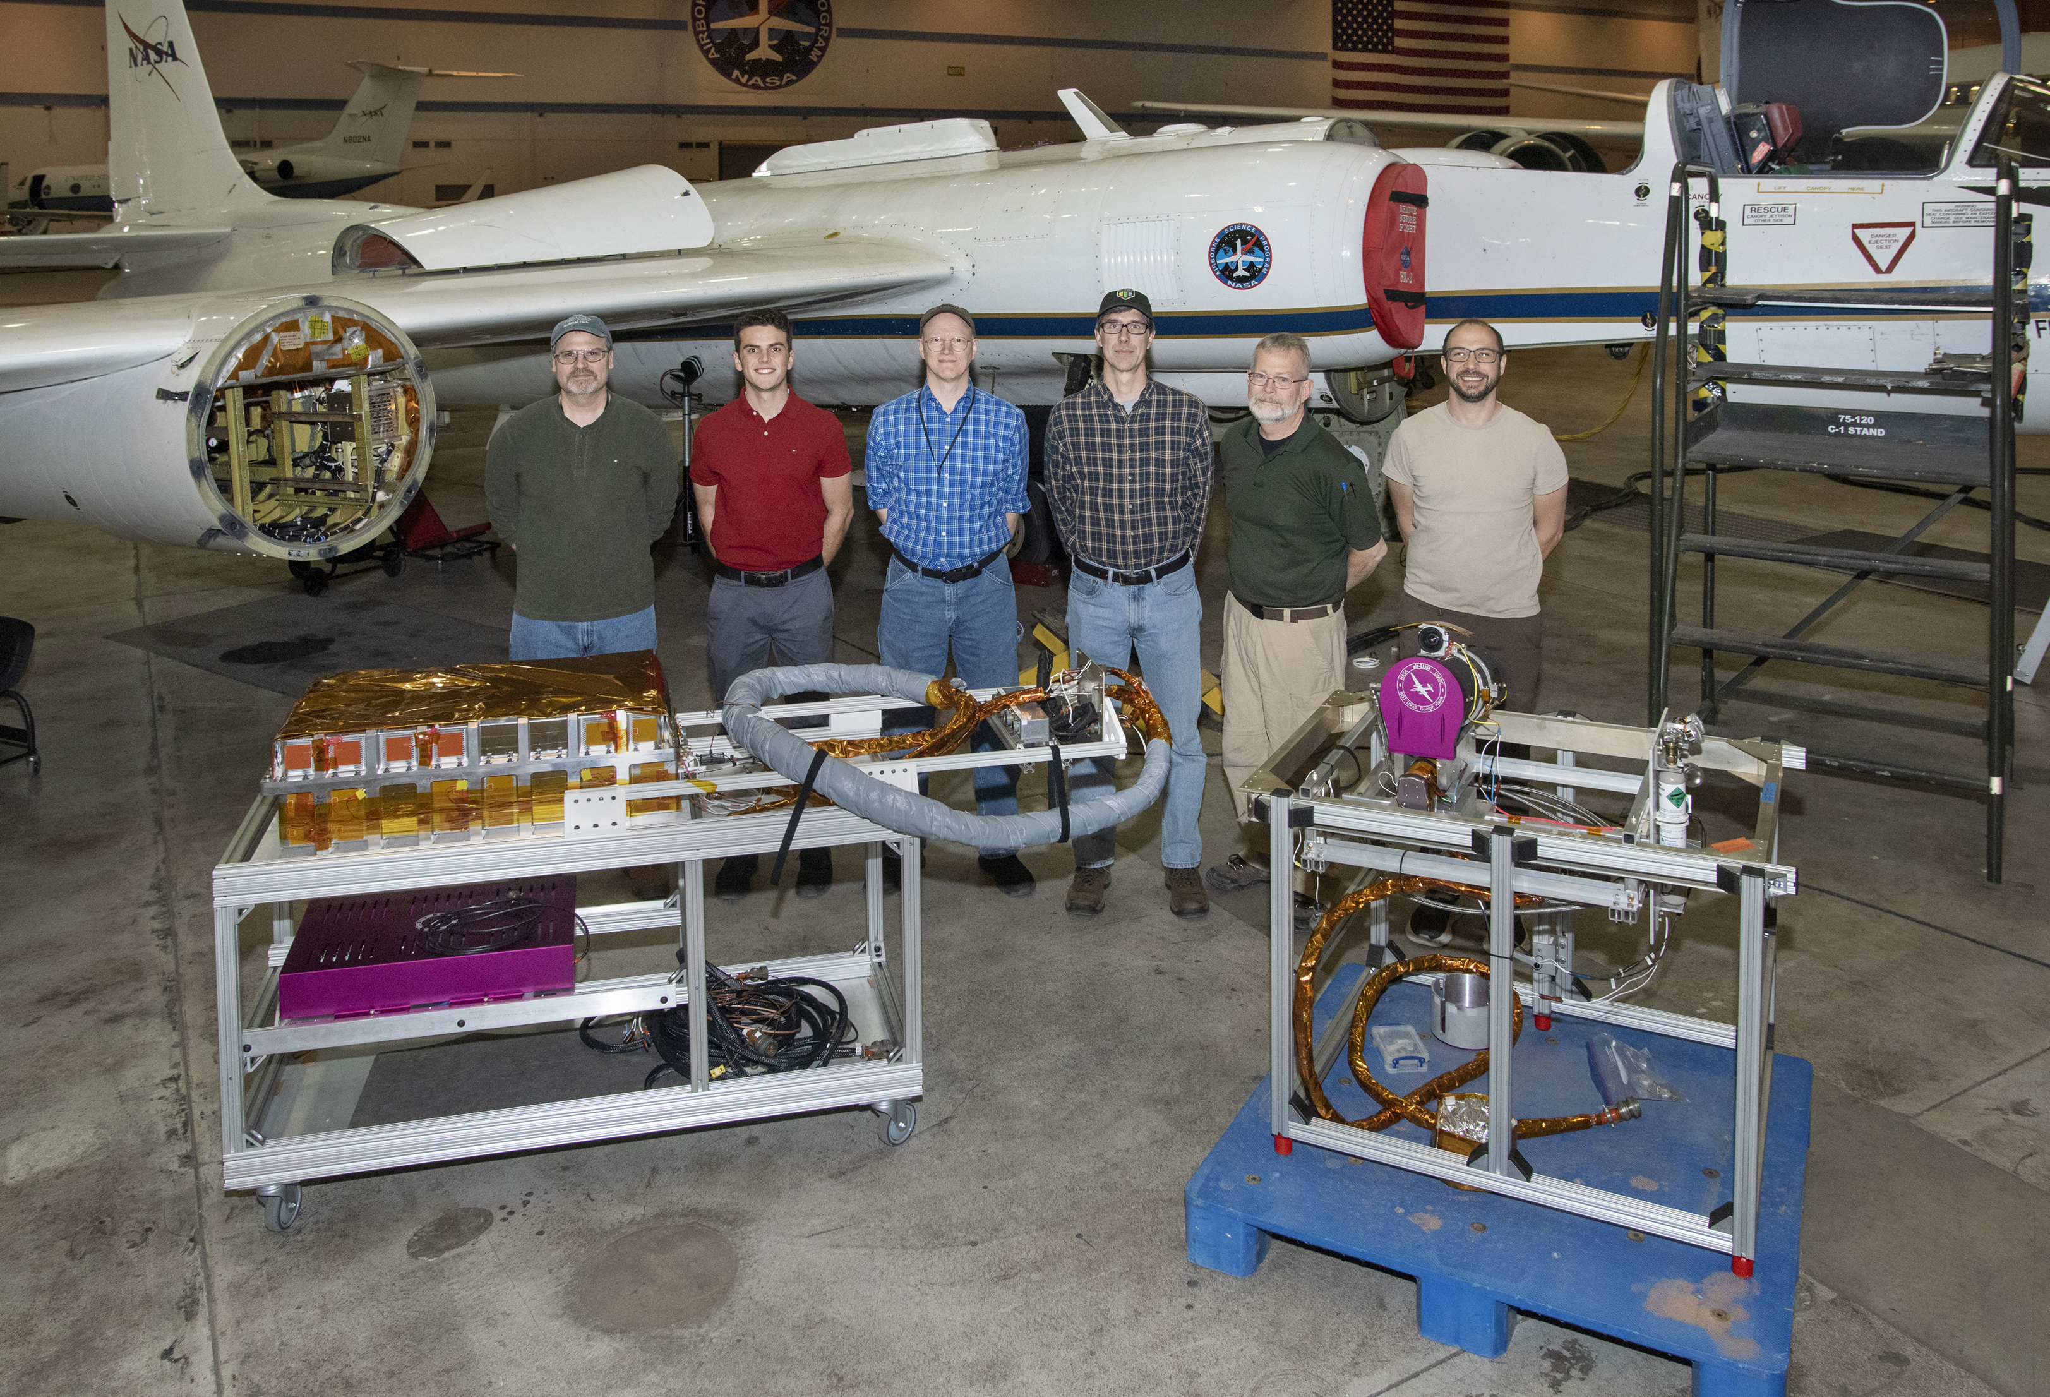
Thank You!
Air-LUSI
air-LUSI Team (Left to Right) – Steven Grantham, Andrew Newton, Kevin Turpie, John Woodward, Tom Larason, Stephen Maxwell (not shown: Steve Brown, Andrew Gadsden, Andrew Cataford, and Tom Stone)
19

