Slide 1


MODIS RSB Calibration and Performance
MODIS Characterization Support Team, NASA GSFC
(presented by Kevin Twedt)
MODIS/VIIRS Calibration Workshop (February 25, 2021)
Notes:
1

Slide 2
Outline
Review of MODIS RSB specs and on-orbit calibration
Update on SD degradation, RSB gain and SNR trends
Collection 7 algorithm improvements
  Presented at MSWG meeting on December 2, 2020
  Memos summarizing C7 changes are available at https://mcst.gsfc.nasa.gov/content/collection-7

Slide 3
RSB Design Specifications
Band | CW* | Ltyp⁺ | SNR | Primary Use
1 | 0.645 | 21.8 | 128 | Land/cloud/aerosol boundaries
2 | 0.858 | 24.7 | 201
3 | 0.469 | 35.3 | 243 | Land/cloud/aerosol properties
4 | 0.555 | 29.0 | 228
5 | 1.24 | 5.4 | 74
6 | 1.64 | 7.3 | 275
7 | 2.13 | 1.0 | 110
8 | 0.412 | 44.9 | 880 | Ocean color, phytoplankton & biogeochemistry
9 | 0.443 | 41.9 | 838
10 | 0.488 | 32.1 | 802
11 | 0.531 | 27.9 | 754
12 | 0.551 | 21.0 | 750
13 | 0.667 | 9.5 | 910
14 | 0.678 | 8.7 | 1087
15 | 0.748 | 10.2 | 586
16 | 0.869 | 6.2 | 516
17 | 0.905 | 10.0 | 167 | Atmospheric water vapor
18 | 0.936 | 3.6 | 57
19 | 0.940 | 15.0 | 250
26 | 1.37 | 6.0 | 150 | Cirrus cloud water vapor
*μm
⁺W/m²/sr/μm

Slide 4
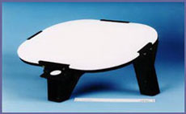
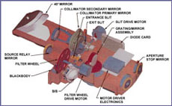
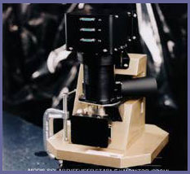
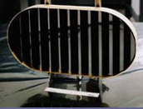
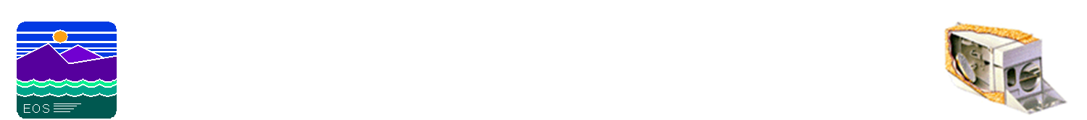
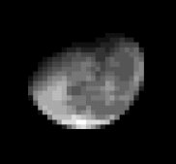
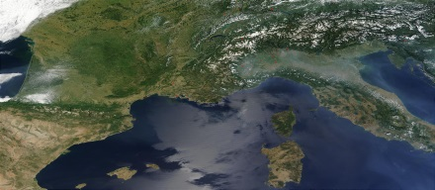
On-orbit Calibration Activities
SRCA:
Radiometric: monthly
Spatial: quarterly
Spectral: tri-annual
SD/SDSM:
Weekly to tri-weekly
Solar Diffuser
SRCA
SDSM
Blackbody
Scan Mirror
Space View
BB: quarterly
Spacecraft maneuvers:
Yaw (SD BRF, VF)
Roll (Moon)
Pitch (with Moon) for RSB RVS validation
Moon: monthly (nighttime orbits)
0-20° spacecraft roll maneuvers
55° phase angle
Notes:
Summary of the MODIS on-orbit calibration activities
MODIS scan-mirror is constantly rotating at 20.3 rpm to provide complete global coverage in less than 2 days
As the scan mirror rotates it is also able to sample the on-board calibrators
The primary calibrators for Reflective Solar Bands are the Solar diffuser and SD Stability Monitor
And space view port where the MODIS detectors can image the moon after a spacecraft roll maneuver

Slide 5
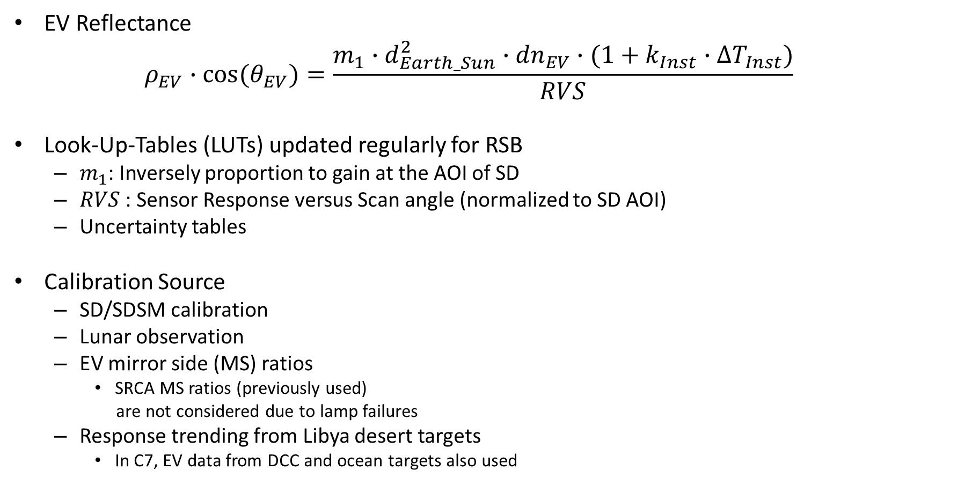
RSB Calibration
EV Reflectance
  $$ρ_{EV}∙\cos{{(θ}_{EV})}=\frac{m_{1}∙d_{Earth_Sun}^{2}∙{dn}_{EV}∙(1+k_{Inst}∙{∆T}_{Inst})}{RVS}$$
Look-Up-Tables (LUTs) updated regularly for RSB
  $m_{1}$: Inversely proportion to gain at the AOI of SD
  $RVS$: Sensor Response versus Scan angle (normalized to SD AOI)
  Uncertainty tables
Calibration Source
  SD/SDSM calibration
  Lunar observation
  EV mirror side (MS) ratios
    SRCA MS ratios (previously used)
    are not considered due to lamp failures
  Response trending from Libya desert targets
    In C7, EV data from DCC and ocean targets also used
SV Port 11.2
EV Start 10.5
BB 26.3
SRCA 38.2
Nadir 38
SD 50.25
EV Stop 65.5
Angle of Incidence (AOI)

Slide 6
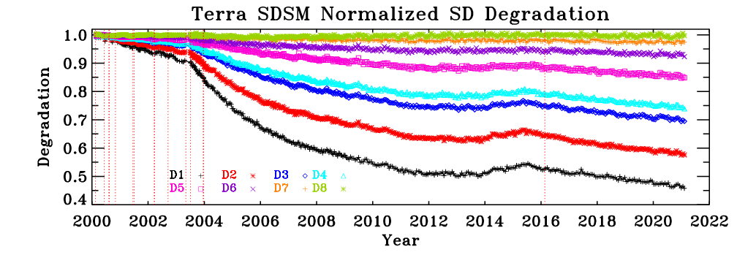
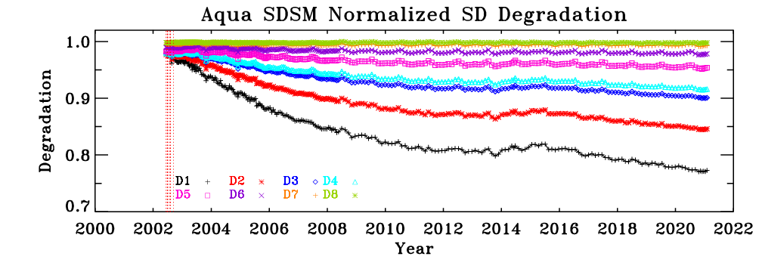
MODIS SD Degradation
Increased degradation after Terra SD door anomaly on July 2, 2003.
Larger SD degradation at shorter wavelengths for both instruments
A special “fix” mode operation was performed for Aqua MODIS SDSM in October 2020 to verify the results observed in previous years

Slide 7
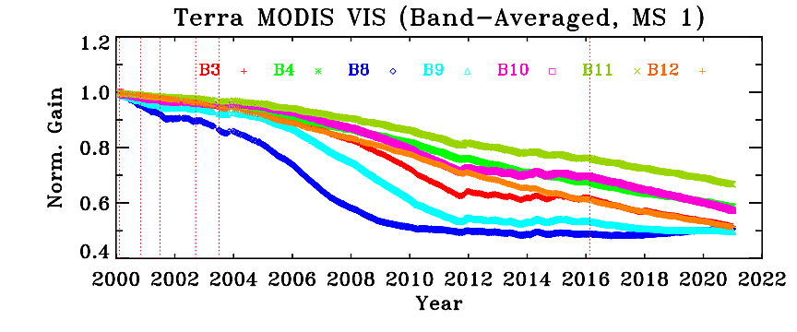
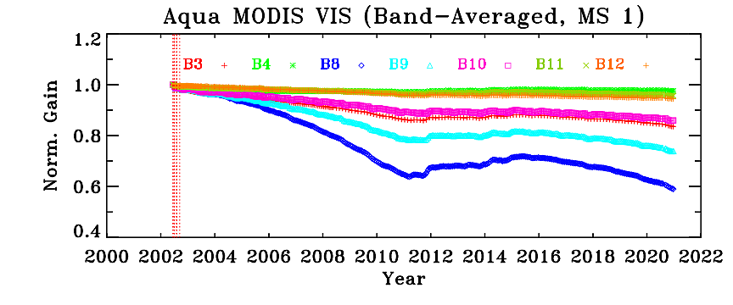
VIS Gain Trending from SD
Terra
Most change observed for short-wavelength bands
Band 8 (.412 µm) changes by over 50%
Terra VIS bands have a maximum mirror-side difference of about 11% at the SD AOI
Aqua
Most change observed for short-wavelength bands
Band 8 (.412 µm) maximum change is ~40%
Aqua VIS bands have a maximum mirror-side difference of about 3.5% at the SD AOI (Band 8)

Slide 8
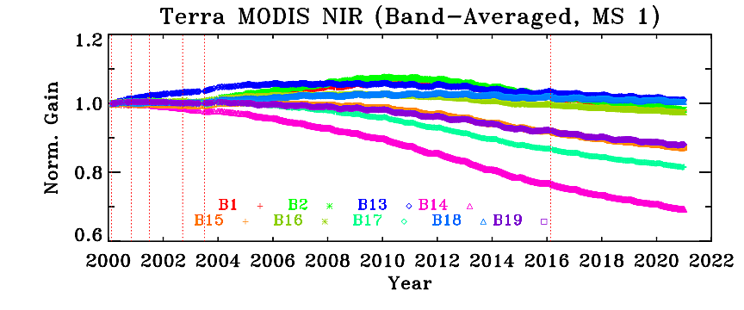
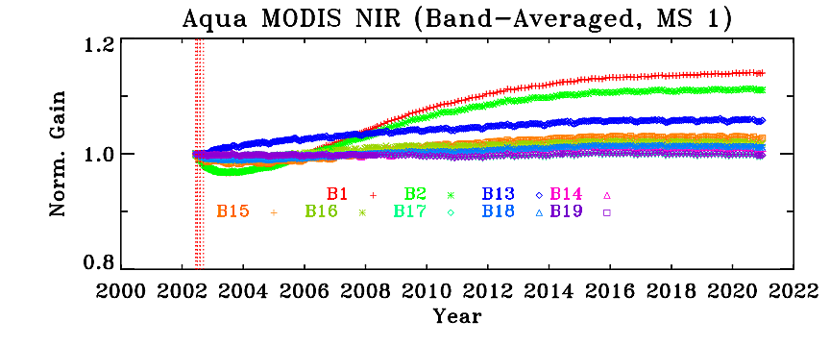
NIR Gain Trending from SD
Terra
Changes for most NIR bands are within 15%
Mirror-side differences are <1%
Aqua
Changes for most NIR bands are within 6%
Mirror-side differences are <1%

Slide 9
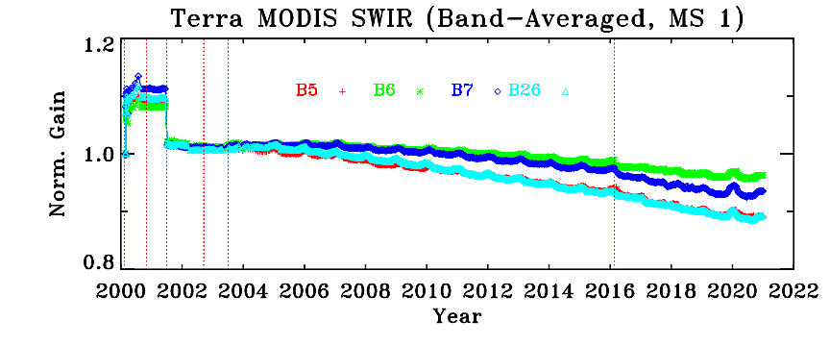
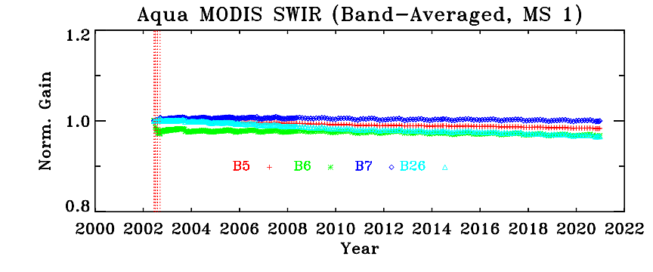
SWIR Gain Trending from SD
Terra
All SWIR bands change by < 12%
Mirror-side differences are <1%
* Noisy and inoperable detectors excluded
Aqua
All SWIR bands change by < 3%
Mirror-side differences are <1%
* Noisy and inoperable detectors excluded

Slide 10
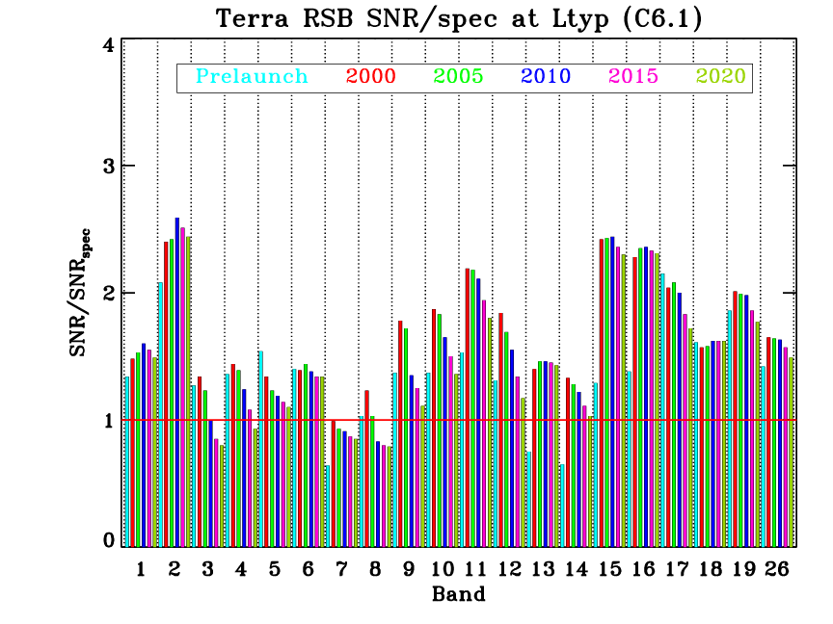
MODIS RSB SNR Bar-Charts
Most bands continue to meet the specification.
Decreased responsivity for some short wavelength RSB (Terra bands 8, 9, 3, 4)
Terra band 7 SNR known to be below specification since launch
Since 2019 science team meeting
No new inoperable detectors
Two new noisy detectors: band 5 detectors 3 and 5 flagged as noisy starting 2021/035

Slide 11
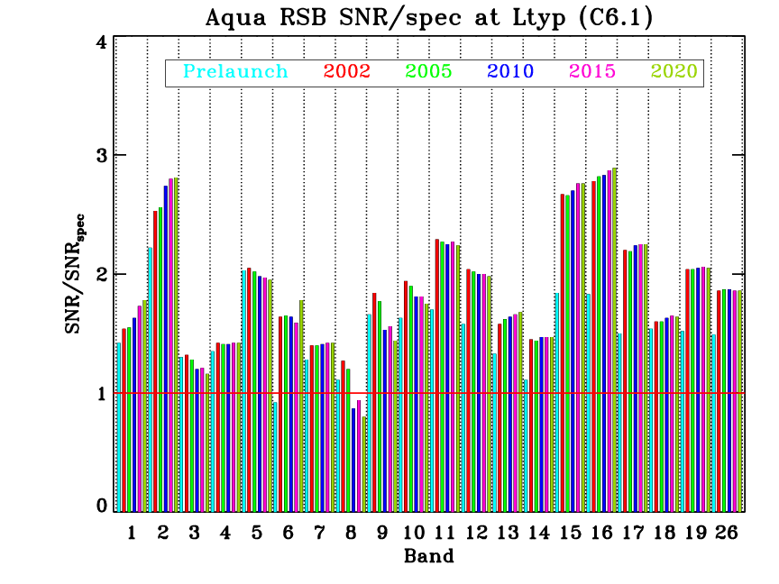
MODIS RSB SNR Bar-Charts
Most bands continue to meet the specification.
Decreased responsivity for some short wavelength RSB (Aqua band 8)
Known issues with the inoperable/noisy detectors in Aqua band 6.
Since 2019 science team meeting
No new inoperable or noisy detectors

Slide 12
C7 RSB Algorithm Improvements
Terra
Polarization correction applied to desert data prior to deriving RVS for Terra bands 3, 8, 9, and 10
Improvements to OOB/crosstalk correction algorithm for Terra SWIR bands applied for entire mission
  Implemented in forward Terra C6/C6.1 LUT starting June 2019.
SWIR bands 5 and 26 use time-dependent RVS based on DCC data
Use an inter-band approach that relies on relative trends of ocean data to derive RVS for Terra bands 11 and 12
Improvements to desert data fitting methods for RVS derivation
Extend detector-dependent RVS to Terra band 4
Aqua
Improved SD screen transmission function applied for ocean bands 8-16
Improvements to desert data fitting methods for RVS derivation

Slide 13
C7 RSB Algorithm Improvements
Bands where algorithm change applies; ordered by wavelength
Larger impact
Smaller impact
For all bands, all data inputs have been updated and the entire mission LUTs reprocessed with consistent algorithms to provide more accurate and stable LUTs.

Slide 14
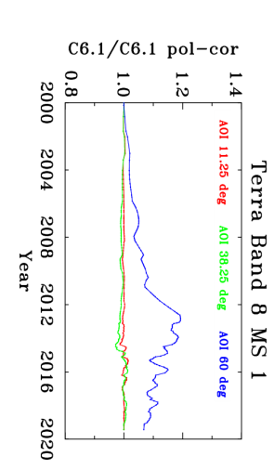
Terra Polarization correction
The polarization sensitivity of scan mirror has impacted performance of Terra MODIS short-wavelength RSB
C6/C6.1 L1B does not include any correction for polarization effects
Current mitigation strategy for L2 products
NASA OBPG has derived polarization correction coefficients from a cross-cal with SeaWIFS/Aqua MODIS over ocean targets
For land products, use the OBPG polarization coefficients to generate a L1B_PC product followed by de-trending to correct gain based on desert site trends
Collection 7
MCST will apply polarization correction prior to derivation of gain from desert sites for Terra bands 8, 9, 3, and 10.
Significant improvement in accuracy of L1B product and forward-predicted gain.
Will significantly reduce the magnitude of downstream gain (M₁₁) and de-trending corrections.
These changes will improve the instrument gain calibration only; there will still be scene-dependent impacts from polarization in the L1B product.
A. Angal et al., IEEE Trans. Geosci. Remote Sensing 58(8), 5428–5439 (2020)

Slide 15
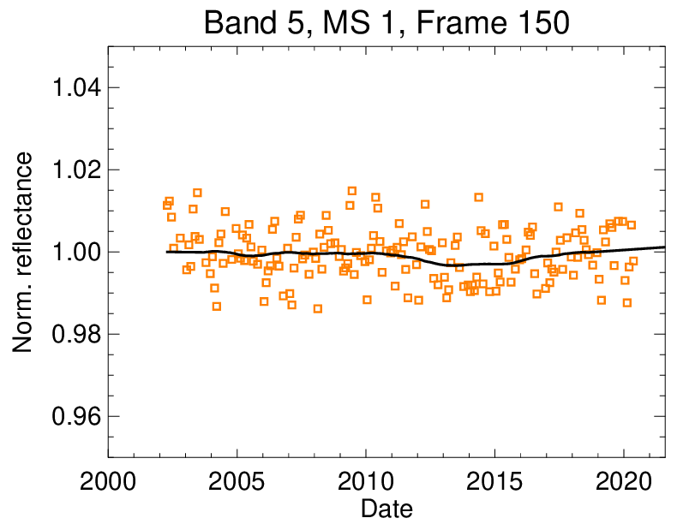
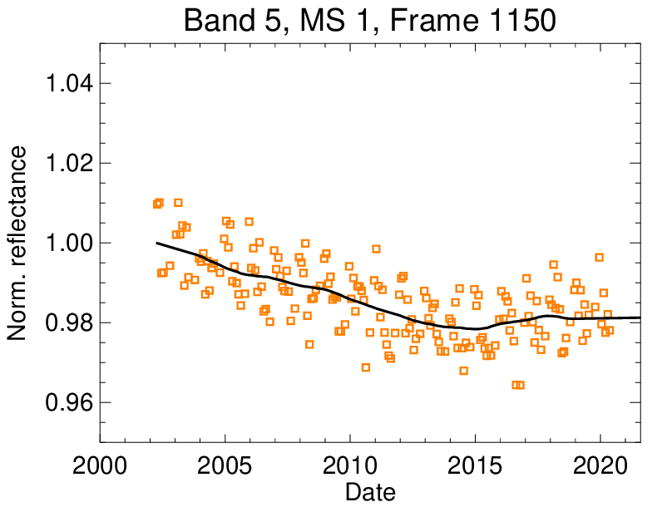
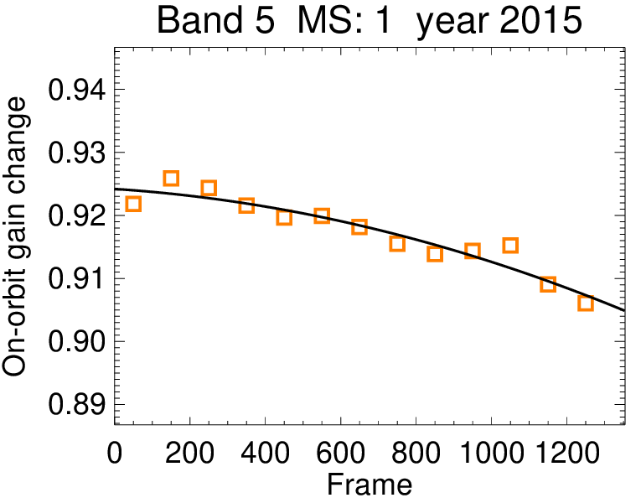
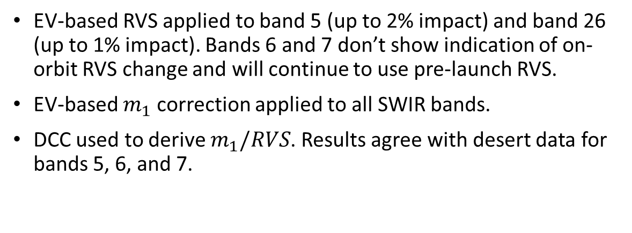
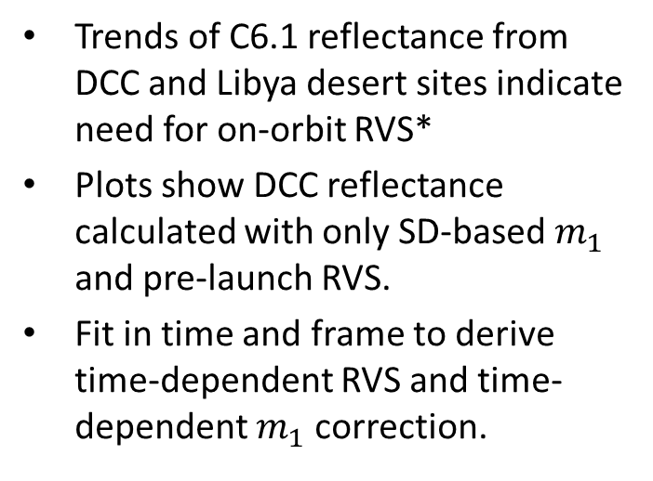
Terra SWIR RVS
Trends of C6.1 reflectance from DCC and Libya desert sites indicate need for on-orbit RVS*
Plots show DCC reflectance calculated with only SD-based $m_{1}$ and pre-launch RVS.
Fit in time and frame to derive time-dependent RVS and time-dependent $m_{1}$ correction.
EV-based RVS applied to band 5 (up to 2% impact) and band 26 (up to 1% impact). Bands 6 and 7 don’t show indication of on-orbit RVS change and will continue to use pre-launch RVS.
EV-based $m_{1}$ correction applied to all SWIR bands.
DCC used to derive $m_{1}/RVS$. Results agree with desert data for bands 5, 6, and 7.
*R. Bhatt et al., IEEE TGRS 58(4), 2276–2289 (2020)

Slide 16
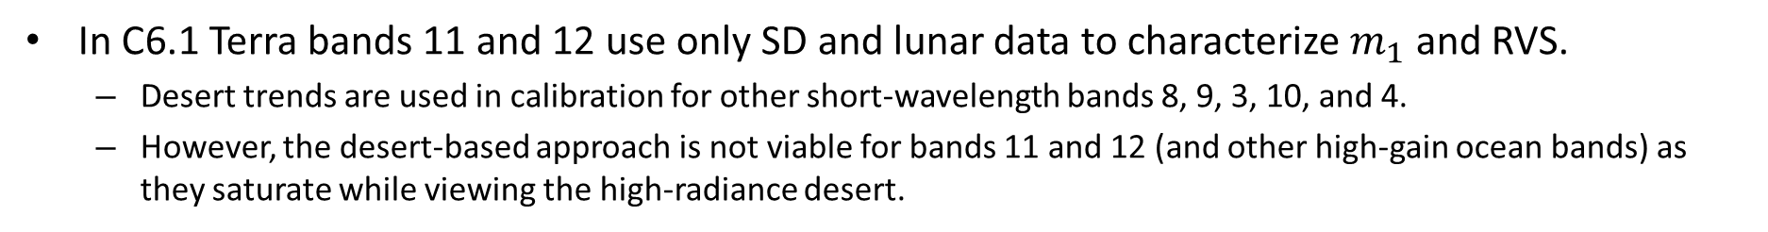
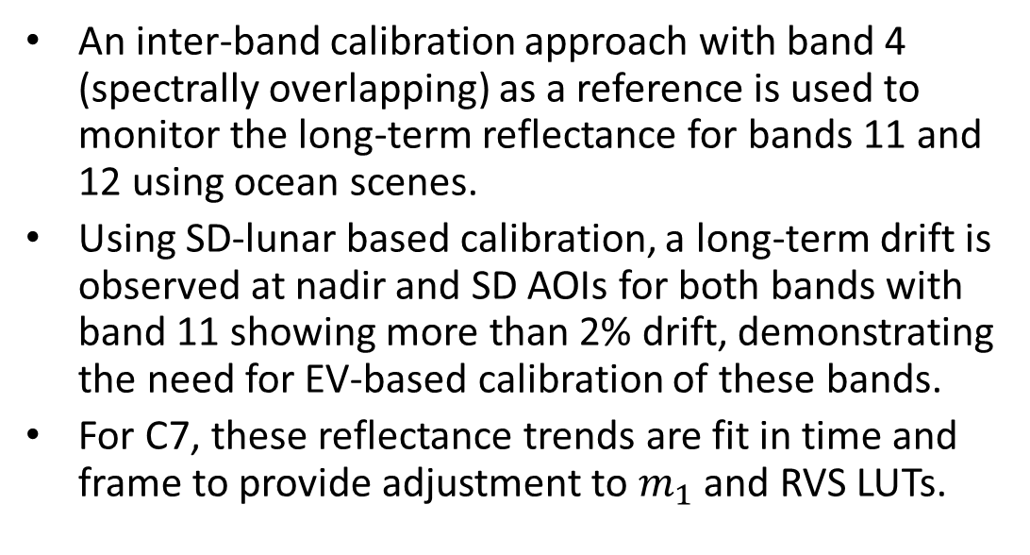
Ocean interband calibration for Terra B11,B12
In C6.1 Terra bands 11 and 12 use only SD and lunar data to characterize $m_{1}$ and RVS.
  Desert trends are used in calibration for other short-wavelength bands 8, 9, 3, 10, and 4.
  However, the desert-based approach is not viable for bands 11 and 12 (and other high-gain ocean bands) as they saturate while viewing the high-radiance desert.
An inter-band calibration approach with band 4 (spectrally overlapping) as a reference is used to monitor the long-term reflectance for bands 11 and 12 using ocean scenes.
Using SD-lunar based calibration, a long-term drift is observed at nadir and SD AOIs for both bands with band 11 showing more than 2% drift, demonstrating the need for EV-based calibration of these bands.
For C7, these reflectance trends are fit in time and frame to provide adjustment to $m_{1}$ and RVS LUTs.
Band 11
X. Geng, A. Angal, Y. Li, K. Twedt, X. Xiong, Proc. SPIE 11151, 1115124 (2019)

Slide 17
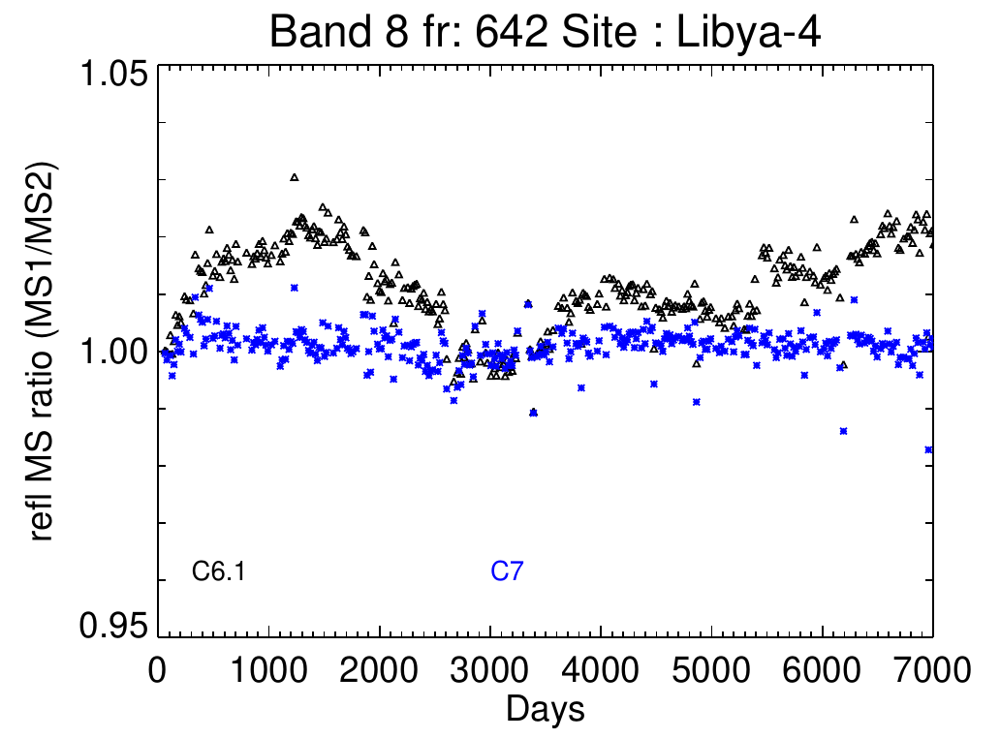
RVS fitting enhancements
A few changes/enhancements made to processing and fitting of data from desert observations for RVS derivation (Terra B1-4, 8-10, Aqua B1-4, 8-9)
  Use all available view angles from Libya 1, Libya 2, Libya 4 sites (C6/C6.1 used only a select subset of view angles)
  Fit over AOI first, then over time
  Sliding window averaging (2-year window) to fit reflectance trends in time
Motivation for making these changes?
  Fix some minor known problems with fitting of data in C6.1
  Planning for future de-orbiting period
Impact of making these fitting changes?
  No major change (most <1%) to mission-long band-average trends
  Improvement in the reflectance mirror-side ratio for some bands, e.g. Terra band 8
  C6.1: MS ratio errors in L1B corrected in downstream products using OBPG polarization correction
  C7: Stable MS ratio in L1B

Slide 18
RSB Summary
SD/SDSM and lunar observations are used to track RSB on-orbit gain change
  Additional information from EV response from desert sites are used for select RSB (Terra 1-4, 8-10 and Aqua 1-4, 8-9)
RSB performance is stable. No notable changes in instrument behavior since the last science team meeting (2019).
  Shorter wavelength VIS Bands show larger degradation (strong wavelength, mirror-side, and scan-angle dependence). Gain change over 50% seen in Terra Band 8 (.412 µm) at the AOI of SD (50.25°)
  NIR bands gain change mostly within 15%
  SWIR bands gain change within 10%
Collection 7
  Mission LUTs to be delivered in March 2021 and updated going forward
  Several algorithm improvements included for RSB, mostly impacting Terra MODIS VIS and SWIR bands.
Future Work
  Investigations into different calibration strategies to best maintain calibration quality into de-orbiting phase of Terra and Aqua missions

Slide 19
BACKUP
Page 19

Slide 20
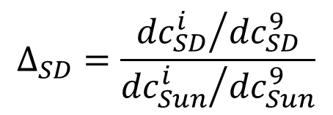
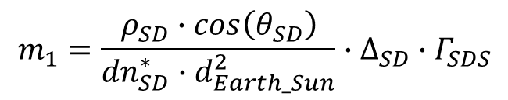
RSB SD Calibration
Sun
1.44 % screen
Optional 7.8 % screen (SD)
Terra: SD screen in permanent down position since July 2, 2003
SDSM
SD degradation
$$Δ_{SD}=\frac{{{dc}_{SD}^{i}}/{{dc}_{SD}^{9}}}{{{dc}_{Sun}^{i}}/{{dc}_{Sun}^{9}}}$$
Scan mirror
$$m_{1}=\frac{ρ_{SD}∙\cos\left(θ_{SD}\right)}{{dn}_{SD}^{∗}∙d_{Earth_Sun}^{2}}∙∆_{SD}∙Γ_{SDS}$$
SD
$ρ_{SD}∙\cos\left(θ_{SD}\right)=BRF, {dn}_{SD}^{∗}$ = Signal from SD (temperature and background corrected), $∆_{SD}=SD degradation, Γ_{SDS}=screen attenuation$

Slide 21
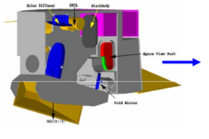
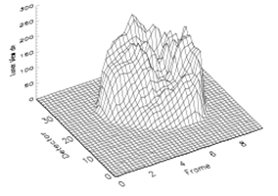
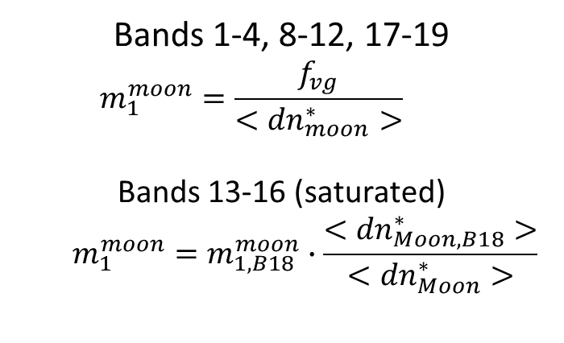
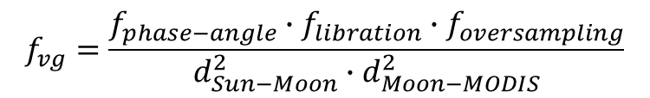
RSB Lunar Calibration
MODIS
Lunar calibration coefficients
Moon
Bands 1-4, 8-12, 17-19
  $$m_{1}^{moon}=\frac{f_{vg}}{<{dn}_{moon}^{∗}>}$$
Bands 13-16 (saturated)
  $$m_{1}^{moon}=m_{1,B18}^{moon}∙\frac{<{dn}_{Moon, B18}^{∗}>}{<{dn}_{Moon}^{∗}>}$$
MODIS Response
View geometry correction
$$f_{vg}=\frac{f_{phase−angle}∙f_{libration}∙f_{oversampling}}{d_{Sun−Moon}^{2}∙d_{Moon−MODIS}^{2}}$$
Near-monthly calibration
Phase angles between 55°- 56°
Oversampling effect also needs to be corrected if multiple scans are used

Slide 22
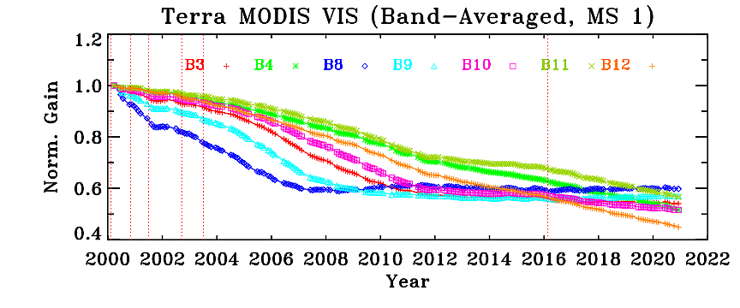
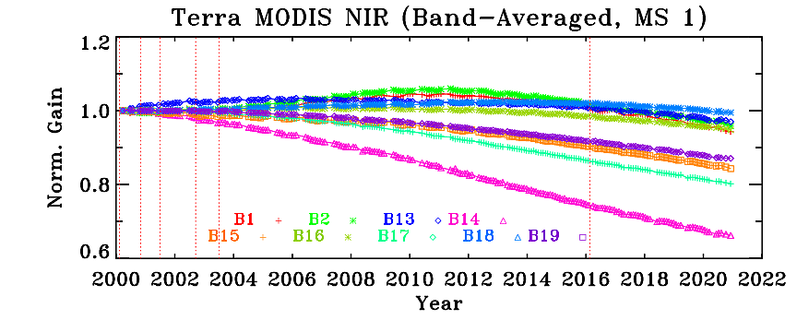
Terra MODIS
Gain Trending from SD and Lunar
SD
SD
Lunar
Lunar
SD & Lunar measurements used to derive the on‐orbit RVS change
SD AOI = 50.25° Lunar (SV Port) AOI = 11.2°

Slide 23
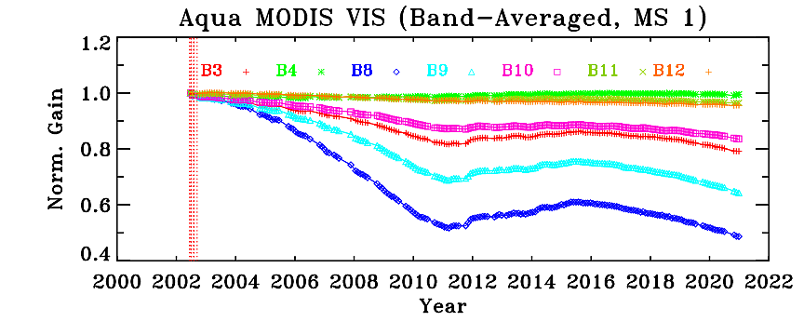
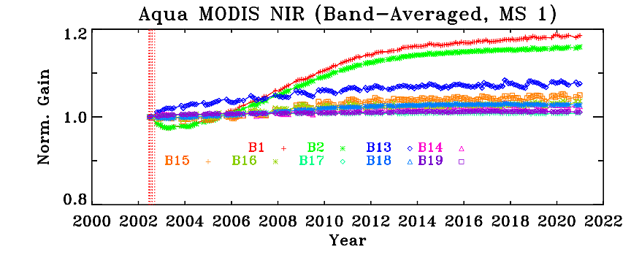
Aqua MODIS
Gain Trending from SD and Lunar
SD
SD
Lunar
Lunar
SD & Lunar measurements used to derive the on‐orbit RVS change
SD AOI = 50.25° Lunar (SV Port) AOI = 11.2°

Slide 24
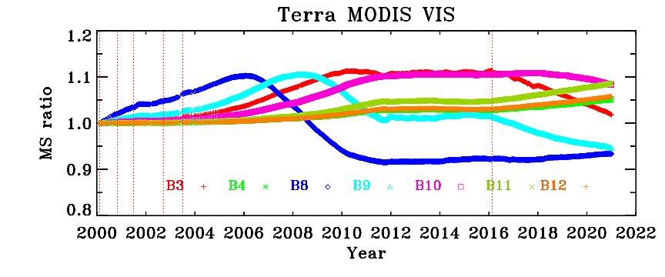
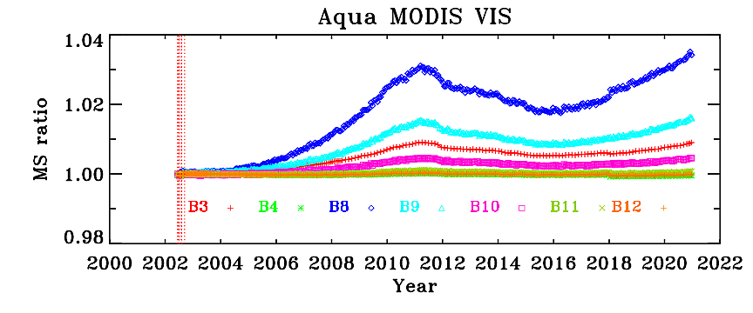
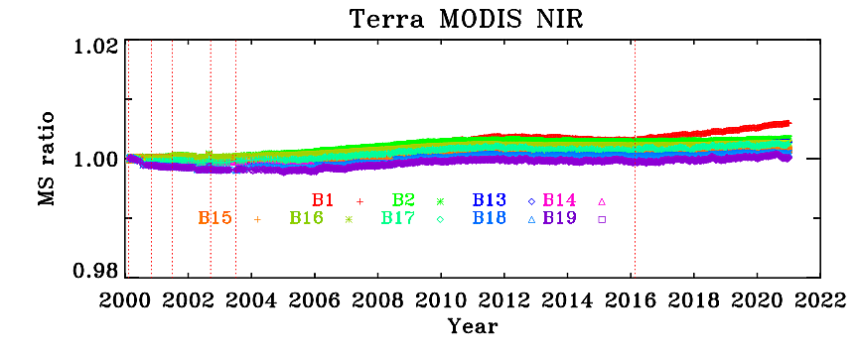
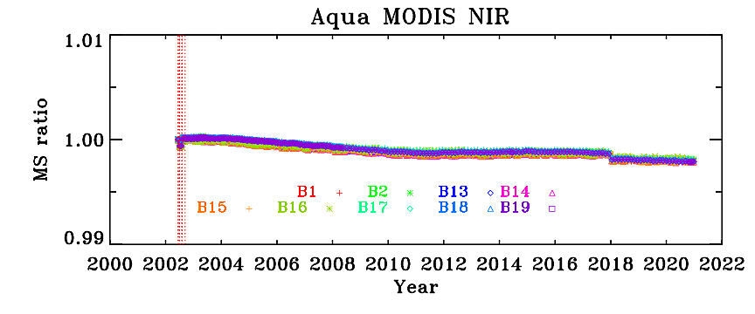
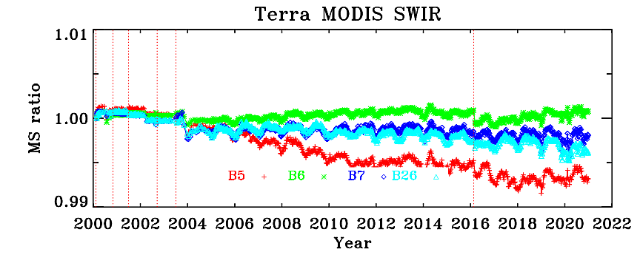
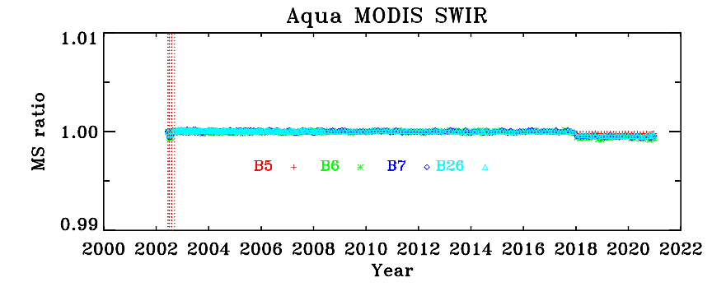
Gain Mirror Side Ratio Trends from SD

Slide 25
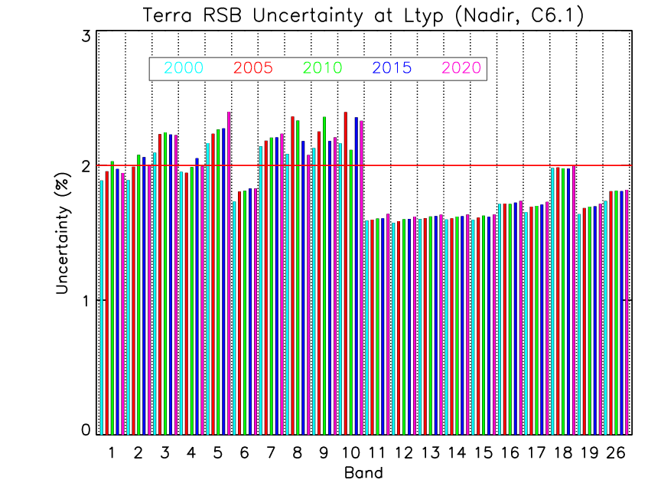
MODIS RSB Uncertainty Trends
Most bands continue to meet the specification.
Additional uncertainty associated with the bands that employ EV-based RVS characterization approach (Terra bands 1-4, 8-10)
On-orbit changes in the polarization sensitivity is also a contributing factor.

Slide 26
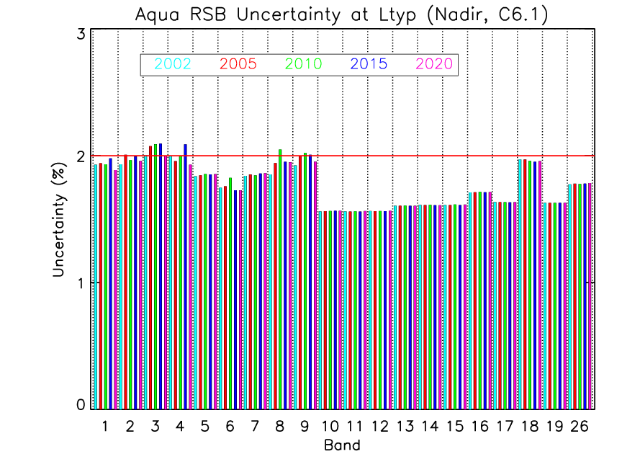
MODIS RSB Uncertainty Trends
Most bands continue to meet the specification.
Additional uncertainty associated with the bands that employ EV-based RVS characterization approach (Aqua bands 1-4, 8,9)

Slide 27
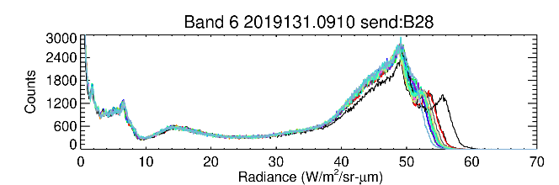
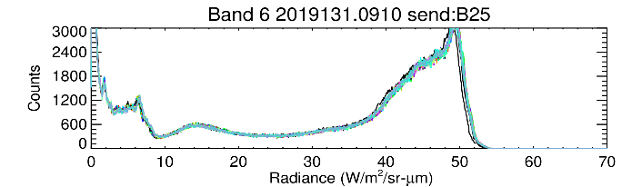
Terra SWIR crosstalk sending band switch
Collection 6.1
SWIR bands (5-7 and 26) have electronic crosstalk and out-of-band (OOB) optical leak problems, known since before launch.
In previous Collections through C6.1, band 28 was used as the sending band for crosstalk correction. Due to continued performance degradation of band 28 (PV LWIR crosstalk), a switch was made to use band 25 as sending band in forward production starting June 2019.
Collection 7
Band 25 will be used as sending band over entire mission.
More stable gain and reflectance trending, especially in later years of mission
Significantly reduced detector striping
Significantly reduced subframe striping
X. Xiong, A. Angal, Y. Li, and K. Twedt, J. Appl. Remote Sens. 14(4), 047503 (2020)

