Slide 1
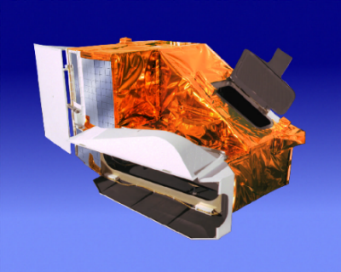
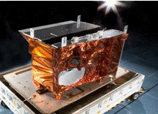
MODIS and VIIRS Calibration Workshop
February 25-26, 2021
MODIS
VIIRS

Slide 2
MODIS and VIIRS Science Team Meeting – Plenary Session (Nov. 19, 2020)
  https://modis.gsfc.nasa.gov/sci_team/meetings/202011/
  Terra and Aqua MODIS and VIIRS Instrument Status
Both Terra and Aqua MODIS C7 L1B/LUTs - Ready for Delivery (next month)
JPSS-3 VIIRS Completed TVAC Testing! (Feb 15, 2021)
Happy 100K Orbit Anniversary Aqua! (Feb 20, 2021)

Slide 5
Acknowledgements
Contributions:
MODIS and VIIRS Characterization Support Team (MCST and VCST)
MODIS and VIIRS Science Teams
Support:
Terra, Aqua, S-NPP, JPSS Project, and Mission/Flight Operation Team (MOT/FOT)
Instrument Vendor (Raytheon) and NASA On-site Support Team
NOAA JPSS Program and VIIRS SDR Team

