Slide 1
MODIS / VIIRS Land Workshop
April 2022
Chris Torbert
LP DAAC Manager
ctorbert@usgs.gov
Tom Maiersperger
LP DAAC Project Scientist
tmaiersperger@usgs.gov
U.S. Department of the Interior
U.S. Geological Survey

Slide 2
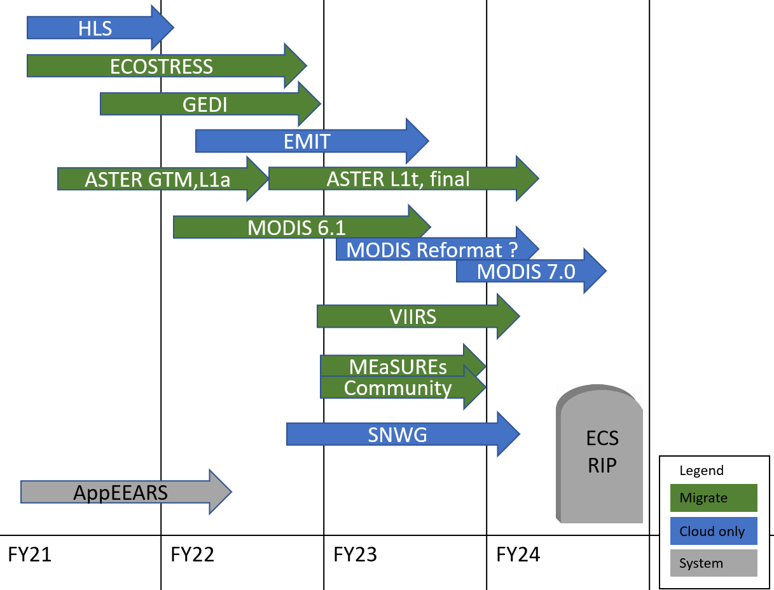
LP DAAC Migration Timeline
LP DAAC intends to migrate 100% of all dataset holding to EDC, except for obsolete versions intended for removal from the archive.
LP DAAC will operate ECS in parallel with EDC until migration is complete.
Migration from ECS will be complete no later than March 2024.

Slide 3
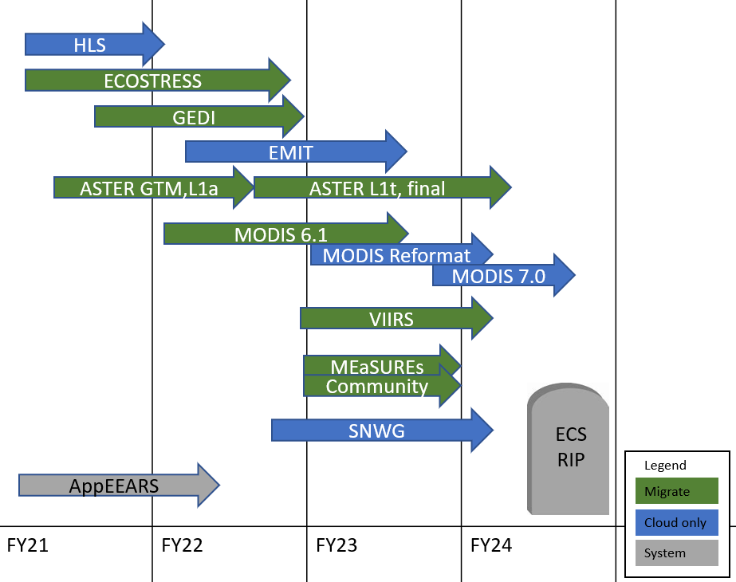
LP DAAC Migration Timeline
ASTER GDEM is in Cumulus and available via EarthData Search.
HLS 2.0 has been ingested to Cumulus directly from the data provider.
ECOSTRESS migration is under development. Level 0 is complete. The bulk of the data will migrate with the release of version 2 in 2022.
GEDI migration began development in July 2021. The ingest interface will be from EROS.
EMIT will be cloud native with the ingest directly from the SIPS in ~2022.
ASTER depends on an on-prem product generation system and will migrate later with the ingest interface from EROS.
MODIS 6.1 migration has started and will be reformatted later. MODIS version 7 will go directly to cloud storages.
All future missions will be migrated directly to cumulus.

Slide 4
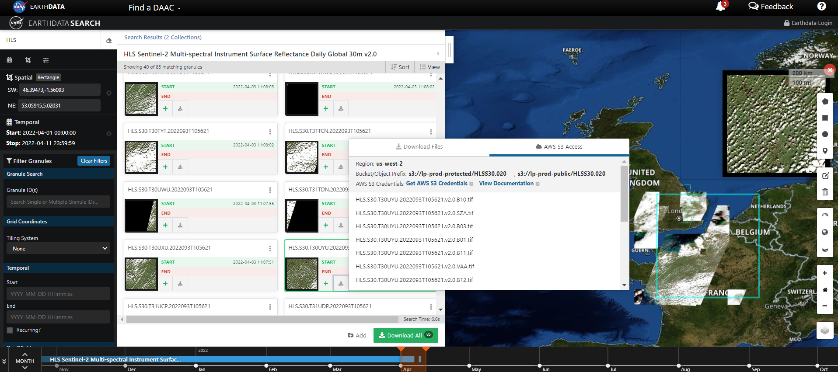
EarthData Search and S3

Slide 5
The Details
Migration Complete:
MOD11A1
MYD11A1
MOD13Q1
MOD15A2H
Migration Started:
MOD09GA
MYD09GA
MCD43A4
Next up:
MOD11A2
MYD11A2
MCD19A2
MOD14
MCD15A2H
MYD14
MCD43A3
MYD13Q1
MOD13A3
MYD13A3
MYD09GQ
Later this year:
MCD15A3H
MOD09A1
MOD09GQ
MOD16A2
MYD09A1
MOD09Q1
MYD09Q1
MOD11_L2
MYD11_L2

Slide 6
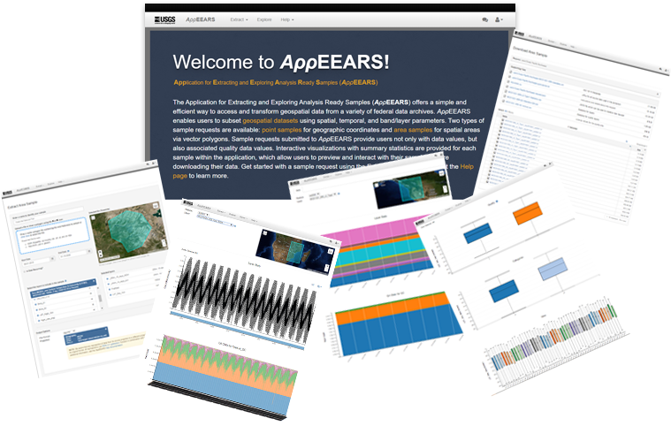
AppEEARS release 3.0
The Application for Extracting and Exploring Analysis Ready Samples (AppEEARS) v3.0 was released March 23, 2022 to the NASA EarthData Cloud by the LP DAAC.
The move to EDC is significant in that, It provides easier integration with data hosted in Cumulus.
In the previous year AppEEARS has had 69,941 unique users visit, who generated over 160,000 request
In a typical month AppEEARS will access ~500tb of data, provide visualization and analysis to the user. The size of the outputs is less than 5% of the original source, resulting in lower egress.
AppEEARS:
https://appeears.earthdatacloud.nasa.gov
AppEEARS is a tool for quickly extracting time series data, and quality information, for point and area locations. A selection of data from the LP DAAC, as well as other federal archives, are available.

Slide 7
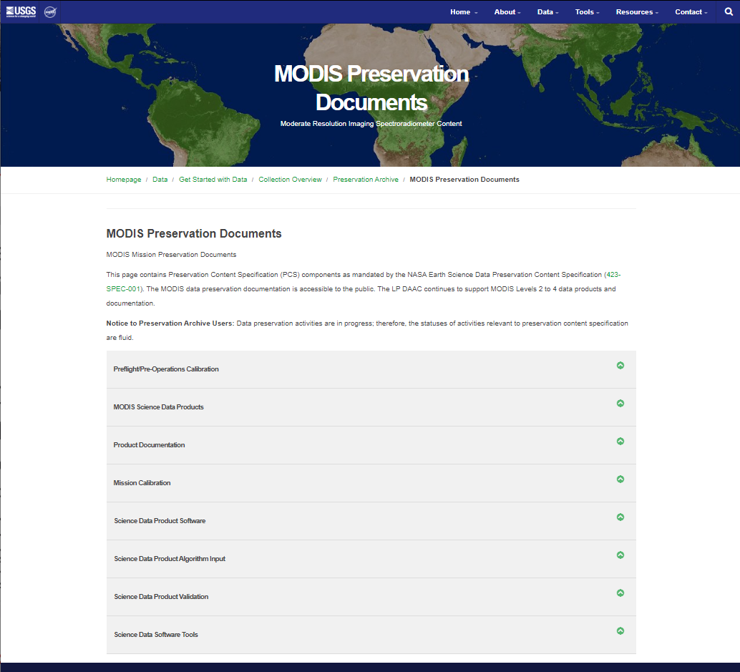
MODIS Preservation The purpose of this activity is to identify and collect all the content items that need to be preserved to ensure their availability to support future investigations in long-term scientific research. Follows: NASA Earth Science Data Preservation Content Specification 423-SPEC-001, Revision B, January 26, 2019

