Slide 1
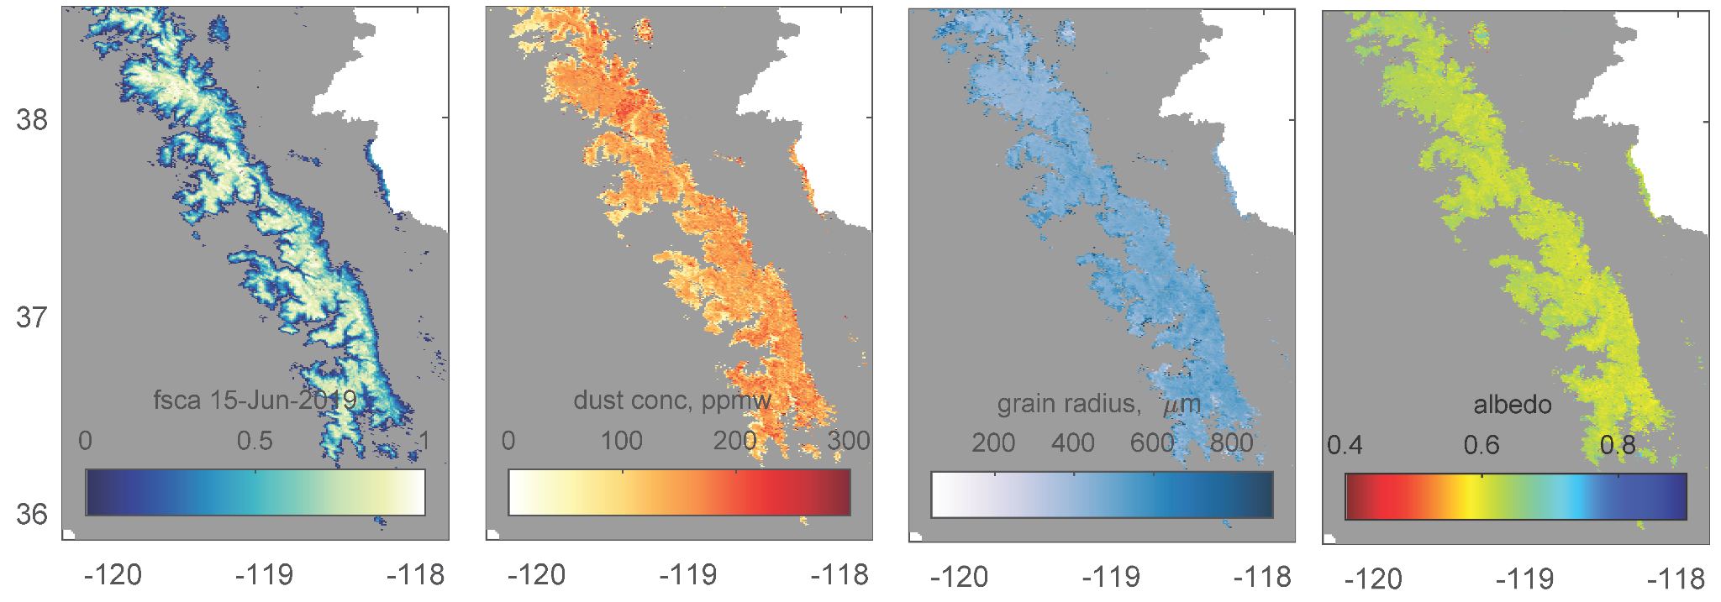
Snow Cover and Snow albedo In Near-real-time from SPIRES for MODIS and VIIRS
SPIReS a daily, gap filled, subpixel measurement of snow properties for multi or hyperspectral sensors.
Snow Covered Area
Physical properties of the snowpack
Contaminant Concentration
Snow grain size
Snow albedo
QA layers include error estimate
Planned tiles this project
Snow
cover
Dust
conc.
Albedo
Grain
radius

Slide 2
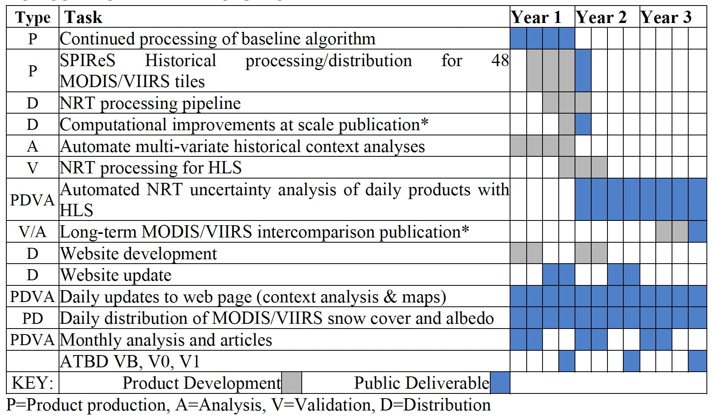
Snow Cover and Snow albedo In Near-real-time from SPIRES for MODIS and VIIRS
Product Status
Funding not yet received (at NSSC)
– planning has started
Western US and Indus available at: https://snow.ucsb.edu/index.php/remotely-sensed-products/
The project will implement SPIRES in near-real-time targeting sub-daily latency for the 48 tiles
The project centralize production, archiving, and distribution at the National Snow and Ice Data Center along with other snow datasets
Proposed Milestones
Technical
Challenges
In more northern latitudes solar zeniths are larger and extensive testing has not yet been done
Research computing Summit cluster is taking > 24 hours to run jobs
E. H. Bair, T. Stillinger and J. Dozier, "Snow Property Inversion From Remote Sensing (SPIReS): A Generalized Multispectral Unmixing Approach With Examples From MODIS and Landsat 8 OLI," in IEEE Transactions on Geoscience and Remote Sensing, vol. 59, no. 9, pp. 7270-7284, Sept. 2021, doi: 10.1109/TGRS.2020.3040328.

