Slide 1
New Land Data Products and LANCE Near Real-Time (NRT)
Chair: Miguel Román
PIs: Jun Wang (UIowa), Glynn Hulley (JPL), Volker Radeloff (UWisc), Karl Rittger (CU-Boulder), Robert Wright (UHawai), Fritz Policelli (GSFC), Monica Martinez Wilhelmus (UC-Riverside), and Michael Durand (OSU),
.

Slide 2
New Land Data Products and LANCE Near Real-Time (NRT)
A new satellite data product for studying fire combustion efficiency, fire emission speciation, and fire weather at night and beyond - Jun Wang (UIowa)
VNP21IMG Land Surface Temperature 375-m NRT product - Glynn Hulley (JPL)
The Dynamic Habitat Indices - Volker Radeloff (UWisc)
Snow Cover and Snow albedo In Near-real-time from SPIRES for MODIS and VIIRS Karl Rittger (CU-Boulder)
A New Near-Real-Time Volcanic Eruption Monitoring Algorithm for Suomi NPP and JPSS VIIRS, Providing Continuity with the MODIS/EOS Era MODVOLC System - Robert Wright (UHawai)
Daily Global Flood Maps and Potential Flood Alert based on Machine Learning and Computer Vision -Fritz Policelli (GSFC)
TBD, Monica Martinez Wilhelmus (UC-Riverside)
CoReSSD: A Cold Regions Snowpack and Snowfall Dataset constrained by Earth Observations for Continental Scale Snow Hydrology Science Michael Durand (OSU)

Slide 3
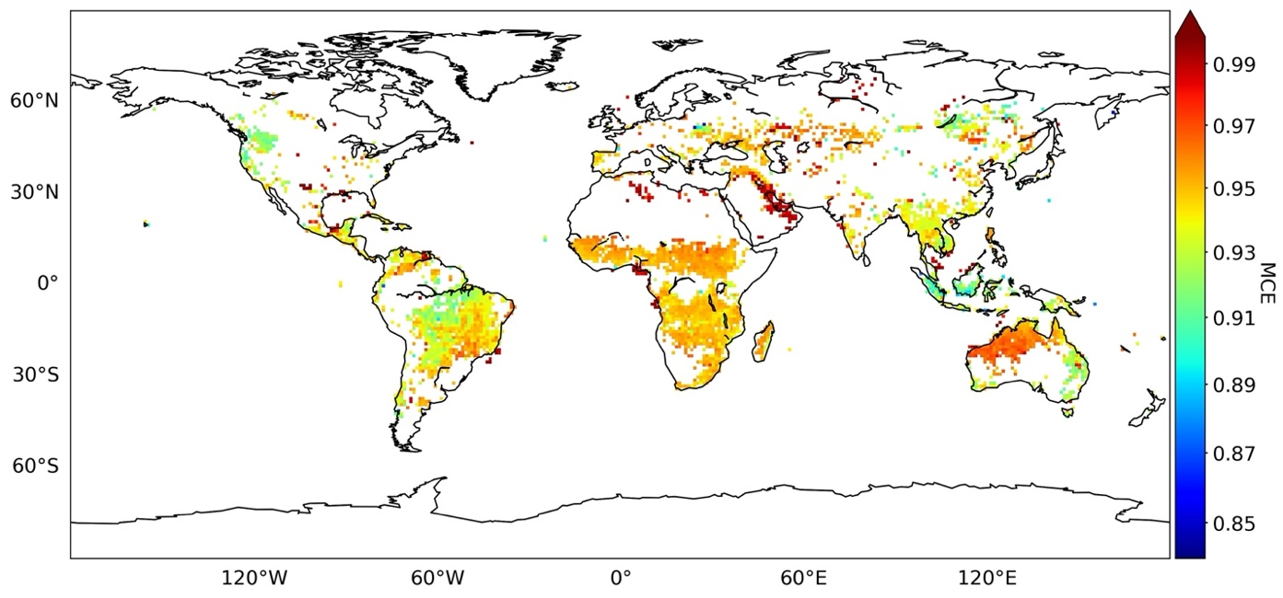
A new satellite data product for studying fire combustion efficiency, fire emission speciation, and fire weather at night and beyond
Jun Wang (PI), Meng Zhou, Lorena Castro Garcia (U. Iowa); Co-Is: Lu Hu, Bob Yokelson (U. Montana); Tara Yacovitch, Scott Herndon (Aerodyne Inc.); D. Peterson (NRL). Collaborator: Zhuosen Wang (UMCP).
Combustion Efficiency
Fire Modified Combustion Efficiency (MCE) from SNPP VIIRS.
FRP
CO₂ vs.
total carbon
FIre Light Detection Algorithm (FILDA)
MCE = CO₂/(CO+CO₂)
2015 mean
Wang et al., Remote Sensing of Environment, 237, 111466, 2020.
flaming
smoldering

Slide 4
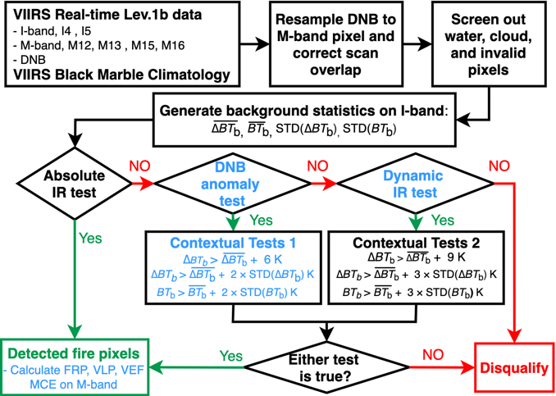
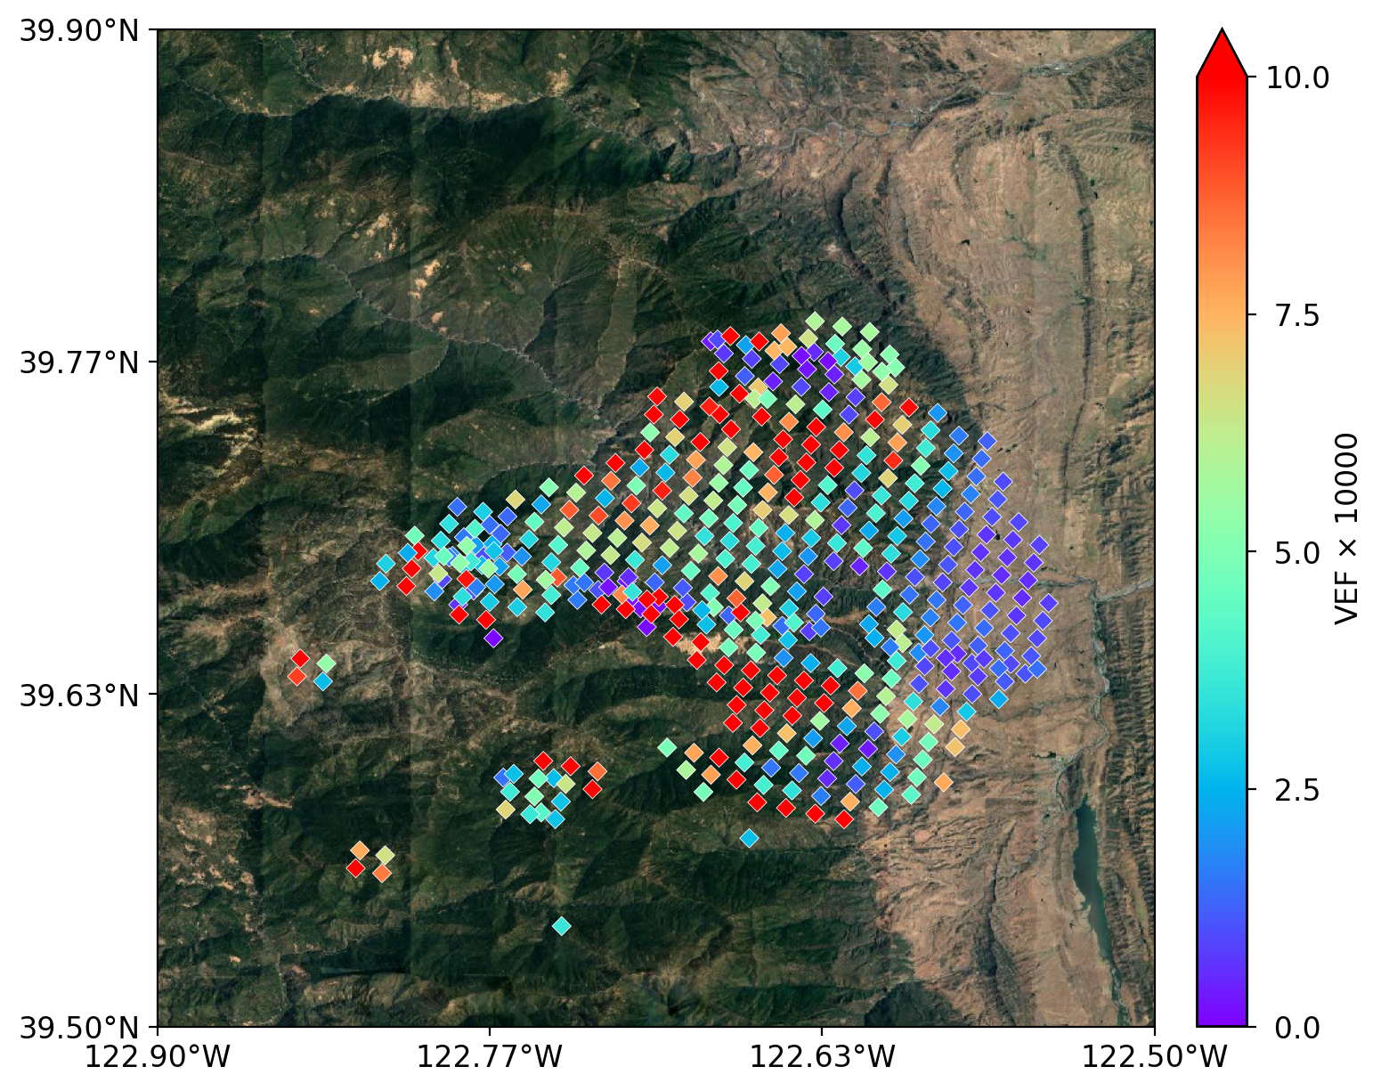
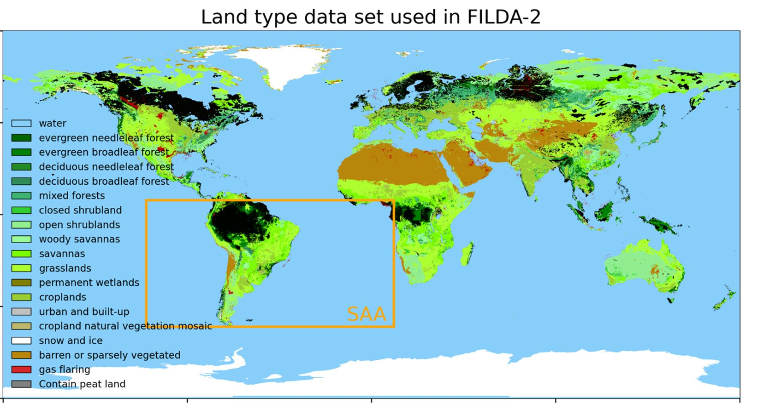
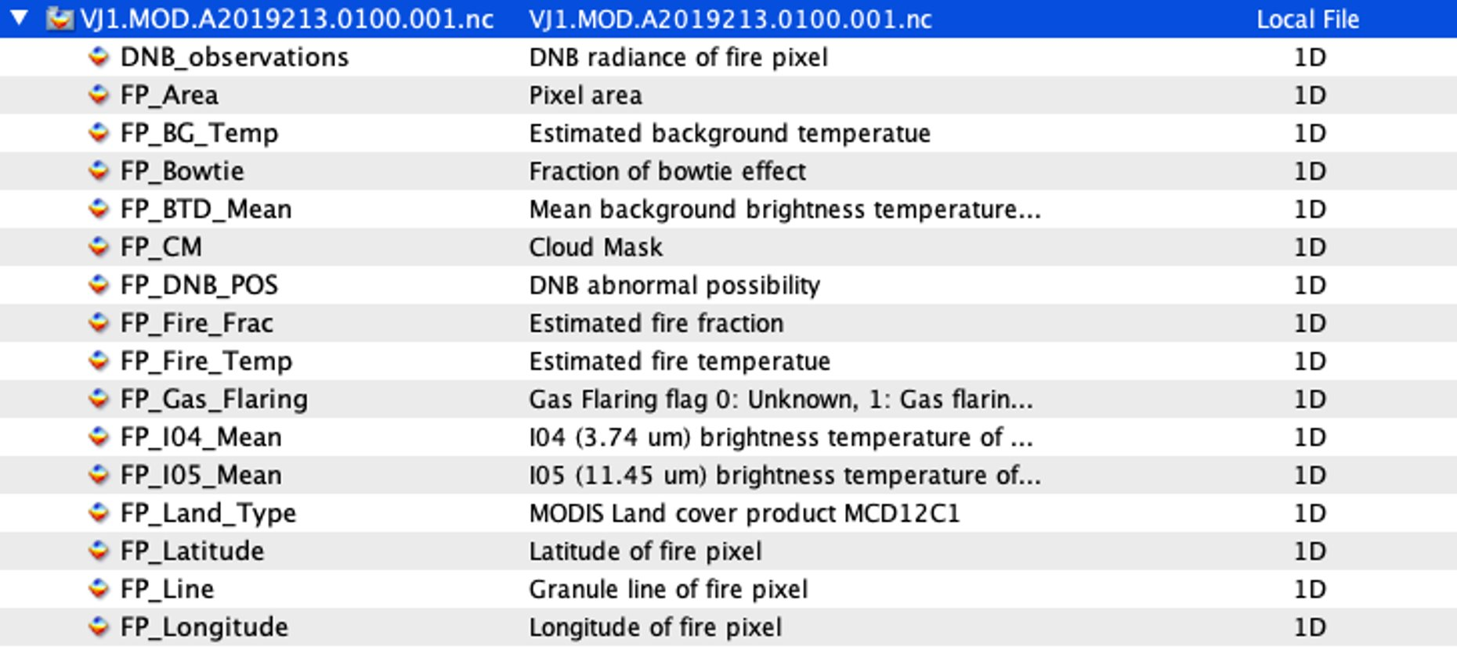
Status Summary
Progress…
Challenge & Next Step
ATBD and flow chart are nearly ready
Tested everything in house for 2019
Worked with a few users already to finalize the data content
Add IGGBP type, gas flares & peat burning as attributes
Output such variables that might be useful for users as FRP, Visible Light Power (VLP), VEF (Visible Energy Fraction) etc.
Bowtie effect in homogenization of I, M, and DNB bands
Assessment using ASTER, existing fire detection products, and field data (2nd year)
File name convention
Fire pixel classification
waste incineration
fracking
oil fracking facility
Assessment & validation
Adapt to NOAA-20
Applications…
Fire lines
Fire weather
NetCDF

Slide 5
VNP21IMG Land Surface Temperature 375-m NRT product
Product Overview:
Produce a 375m VIIRS LST product using the VIIRS I5 thermal infrared band
Product latency: Near Real Time (3 hrs)
LST sharpening to 100m or less (field-scale) using VSWIR imagery
High demand for NRT irrigation and management decision making (e.g. Irriwatch, openET, USDA)
Product Status:
VIIRS IMG test data acquired from 2018-2021 (VNP02IMG, VNP03IMG, CLD_MSK)
Research code (python) and operational code (C++) undergoing evaluation and validation at JPL
Inter-comparison project with coincident ECOSTRESS LST data (2018-2019)
First draft user guide and ATBD in progress
Product Challenges:
Developing a reliable cloud mask at 375m native resolution (ECOSTRESS approach)
Acquiring the necessary 100m VSWIR data for LST sharpening to 100m (HLS?, New data fusion approaches at JPL (Landsat-Sentinel-VIIRS)?
3 hr latency and NRT processing at LANCE

Slide 6
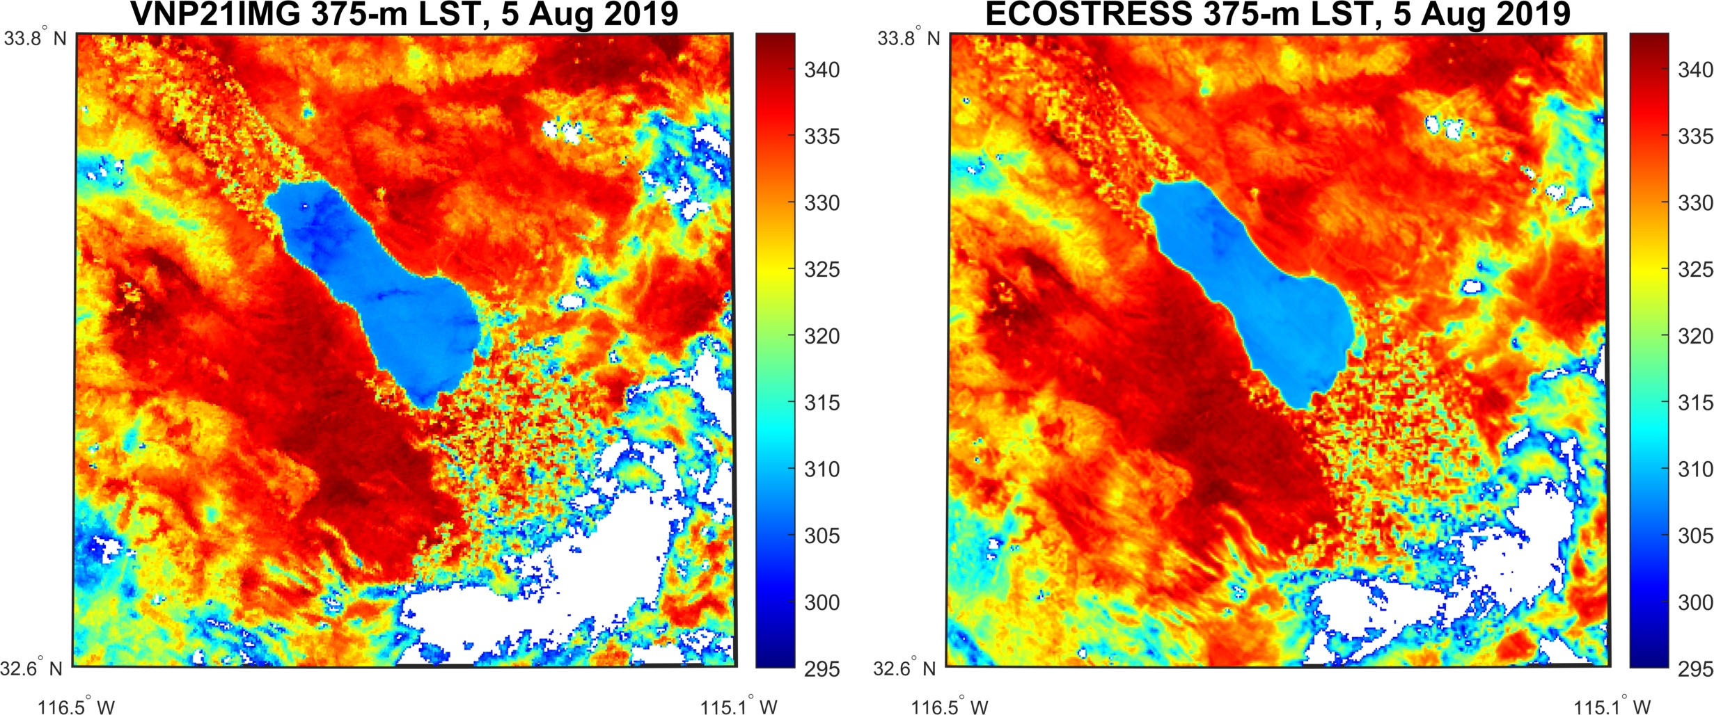
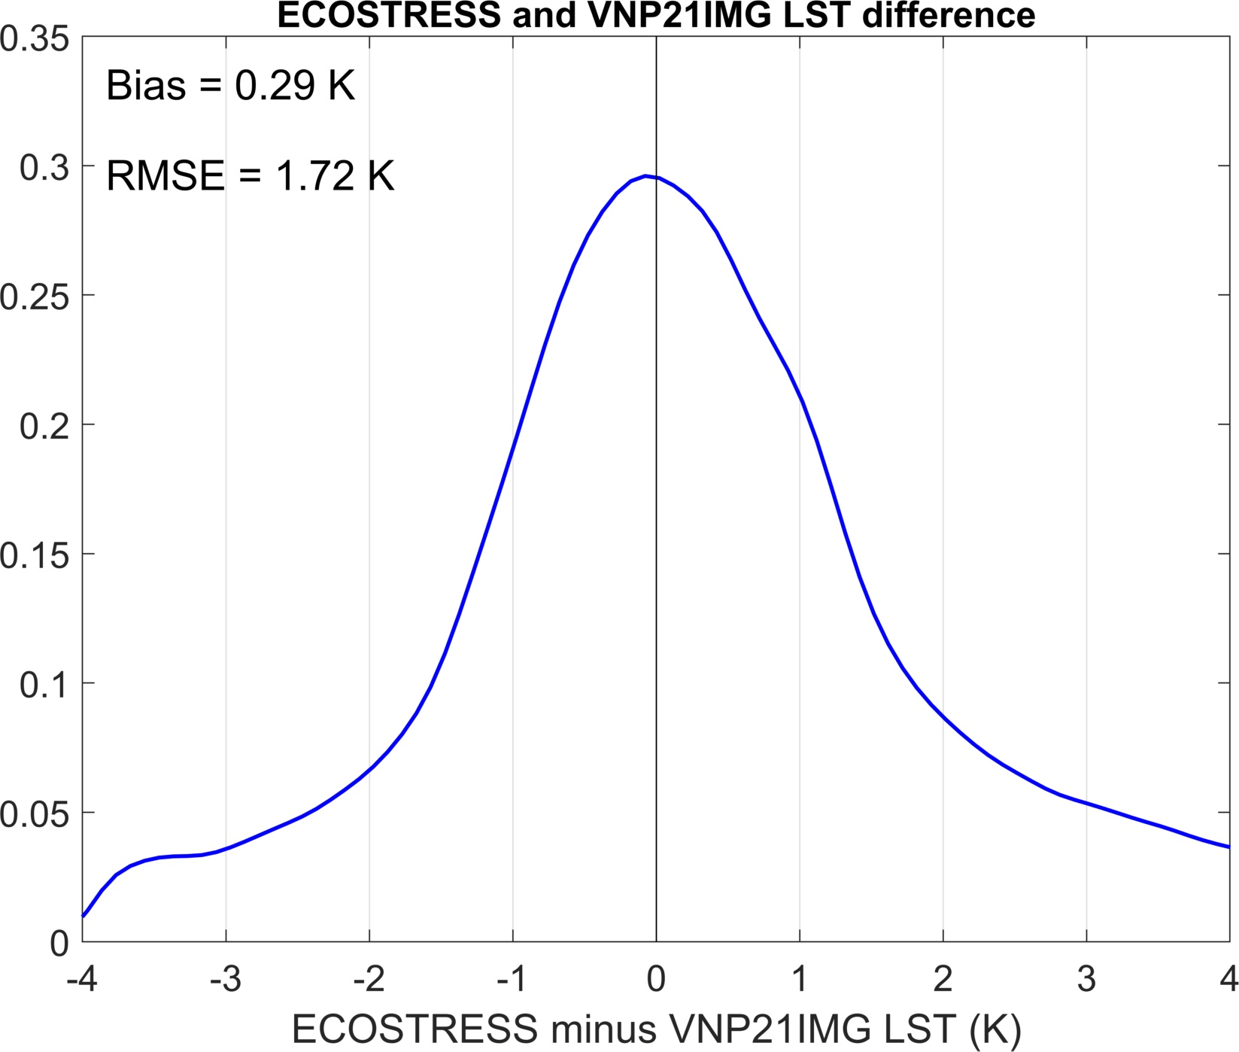
VNP21IMG Land Surface Temperature 375-m NRT product
 | Deliverables and Milestones
2022 | Development and testing of VNP21IMG LST algorithm v1 Two years of validation with ECOSTRESS and ground sites (Tahoe/Salton Sea) Deliver PGE v1 to LSIPS for integration and testing
2023 | Uncertainty quantification for error estimates and QC Finalize ATBD and User guide, deliver to LSIPS and LPDAAC Testing and evaluation of product at LSIPS and LANCE Generation of browse and gridded products (daily and 8-day sinusoidal)
2024 | Stage-1 validation over selected global sites for at least 3 years of data Refinement of LST sharpening algorithm (375m -> 100m) Reprocessing and delivery to LPDAAC (collection 3?)
✓

Slide 7
Radeloff et al, UW-Madison, The Dynamic Habitat Indices
Product Overview:
The Dynamic Habitat Indices (DHIs) capture three aspects of annual productivity: cumulative (green, minimum (blue), and variation (red)
Globally, the DHIs explain the majority of species richness in amphibians, mammals, and birds
Our goal is to create a continuous time-series of the DHIs from Terra, Aqua, Suomi NPP and JPSS data
Objectives:
Update DHIs from MODIS C5 to C6/7, and add Suomi NPP/JPSS VIIRS
Develop QA flags
Write an ATBD
Model biodiversity, adding reptiles
Analyze trends in the DHIs
MODIS C5 LAI DHIs

Slide 8
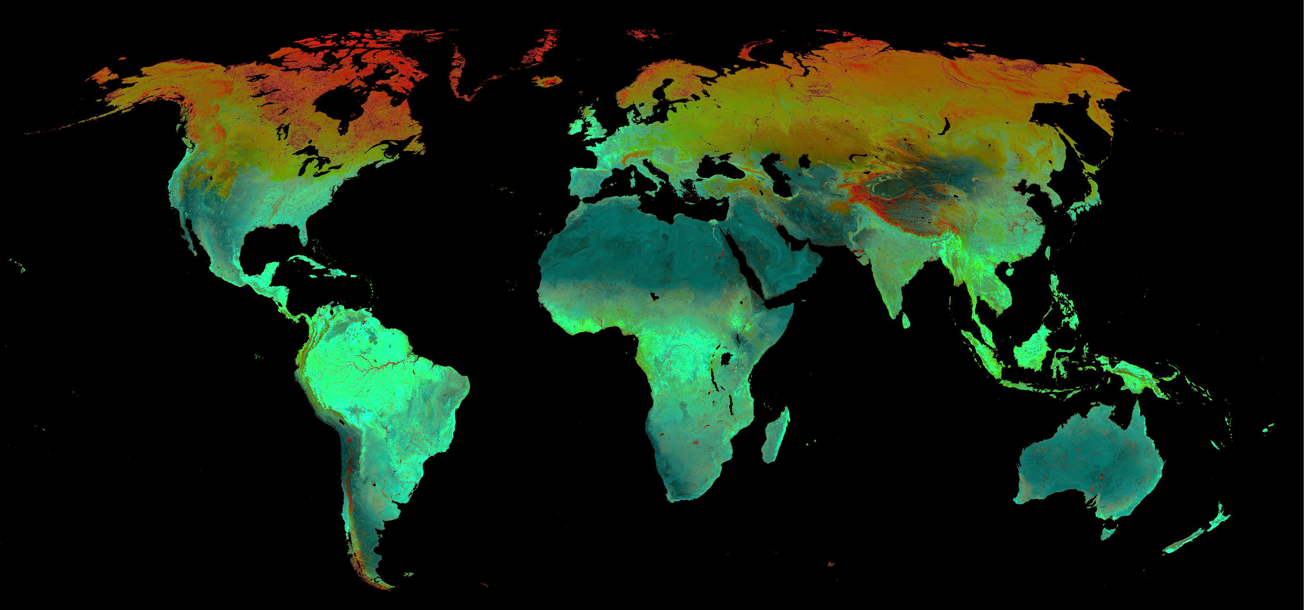
Radeloff et al, UW-Madison, The Dynamic Habitat Indices
Product Status:
Production of the DHIs going very well
Composite DHIs for:
- MODIS 250, 500, 1000-m NDVI and EVI
- MODIS 500-m LAI, FPAR, and GPP
- VIIRS 500-m NDVI, EVI, and EVI2
Comparisons C5/C6 & MODIS/VIIRS encouraging
CumDHI 1-km NDVI MODIS C5
CumDHI 500-m NDVI MODIS
CumDHI 1-km NDVI MODIS C6
CumDHI 500-m NDVI VIIRS
Product Milestones:
VIIRS 500-m NDVI DHIs

Slide 9
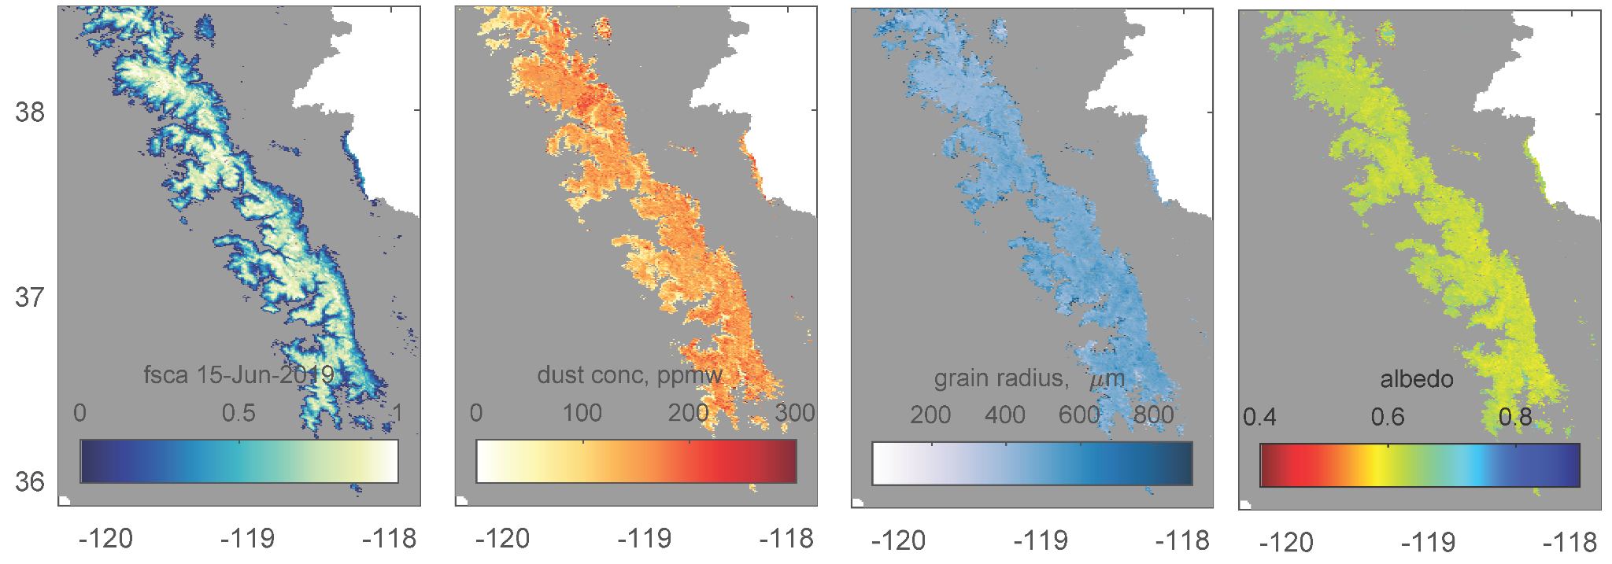
Snow Cover and Snow albedo In Near-real-time from SPIRES for MODIS and VIIRS
SPIReS a daily, gap filled, subpixel measurement of snow properties for multi or hyperspectral sensors.
Snow Covered Area
Physical properties of the snowpack
Contaminant Concentration
Snow grain size
Snow albedo
QA layers include error estimate
Planned tiles this project
Snow
cover
Dust
conc.
Albedo
Grain
radius

Slide 10
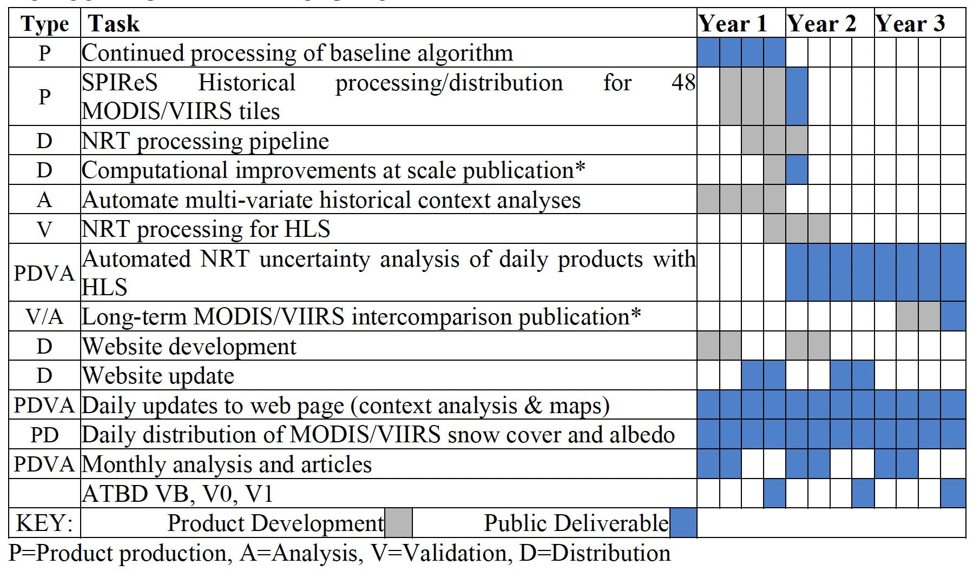
Snow Cover and Snow albedo In Near-real-time from SPIRES for MODIS and VIIRS
Product Status
Funding not yet received (at NSSC)
– planning has started
Western US and Indus available at: https://snow.ucsb.edu/index.php/remotely-sensed-products/
The project will implement SPIRES in near-real-time targeting sub-daily latency for the 48 tiles
The project centralize production, archiving, and distribution at the National Snow and Ice Data Center along with other snow datasets
Proposed Milestones
Technical
Challenges
In more northern latitudes solar zeniths are larger and extensive testing has not yet been done
Research computing Summit cluster is taking > 24 hours to run jobs
E. H. Bair, T. Stillinger and J. Dozier, "Snow Property Inversion From Remote Sensing (SPIReS): A Generalized Multispectral Unmixing Approach With Examples From MODIS and Landsat 8 OLI," in IEEE Transactions on Geoscience and Remote Sensing, vol. 59, no. 9, pp. 7270-7284, Sept. 2021, doi: 10.1109/TGRS.2020.3040328.

Slide 11
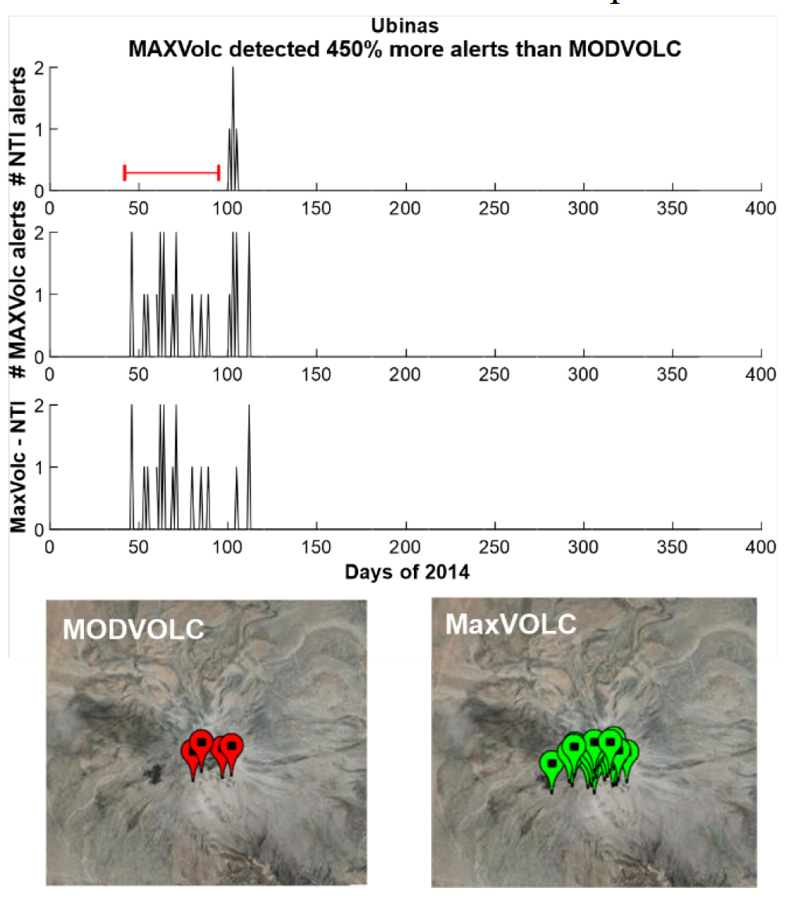
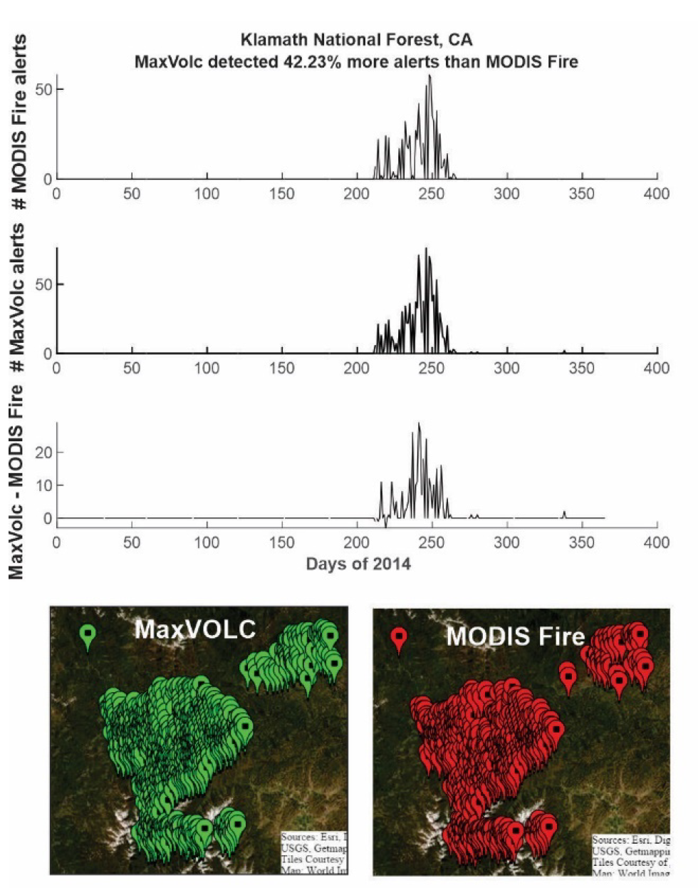
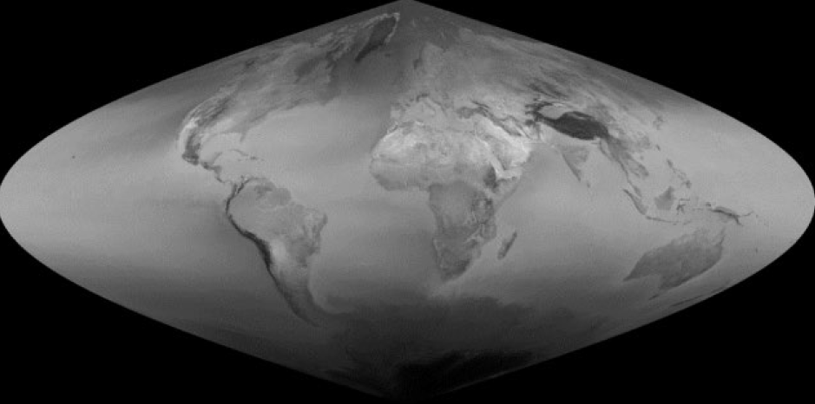
A NEW NEAR-REAL-TIME VOLCANIC ERUPTION MONITORING ALGORITHM FOR SUOMI NPP AND JPSS VIIRS, PROVIDING CONTINUITY WITH THE MODIS/EOS ERA MODVOLC SYSTEM
Robert Wright, Hawaiʻi Institute of Geophysics and Planetology, University of Hawaiʻi at Mānoa
Project description
New algorithm for detecting volcanic eruptions and quantifying volcanic thermal emissions. Implement algorithm to produce a seamless MODIS-VIIRS era record of global volcanic unrest:
Re-reduce MODIS archive
Process future MODIS acquisitions
Process archival and future VIIRS acquisitions
Algorithm relies on geocoded LUTs that describe baseline thermal properties of Earthʻs land surface, produced a priori (top left)
Each pixel individual in each MODIS L1B granule (and VIIRS equivalent) compared to its geographic counterpart in the appropriate LUT to determine if it is anomalously radiant. Land areas only.
Algorithm is a point operation
Outperforms both existing MODVOLC algorithm and Fire Product, with very low false positive rate (above)

Slide 12
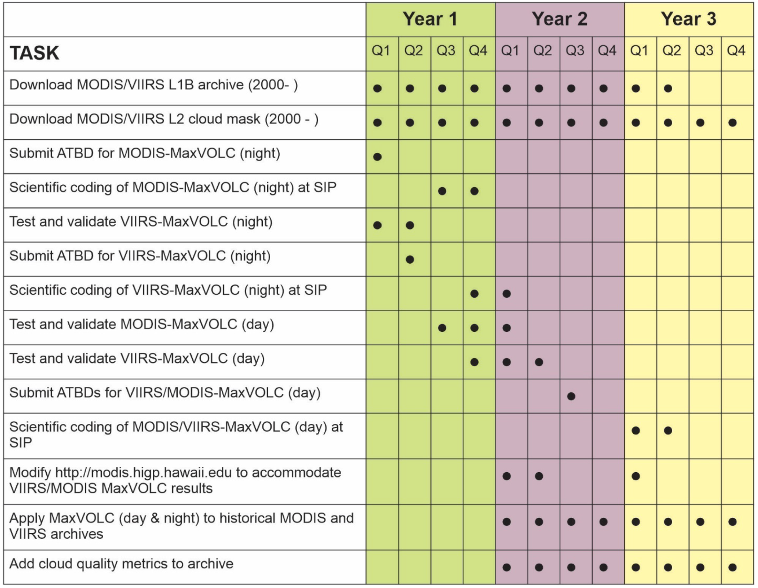
A NEW NEAR-REAL-TIME VOLCANIC ERUPTION MONITORING ALGORITHM FOR SUOMI NPP AND JPSS VIIRS, PROVIDING CONTINUITY WITH THE MODIS/EOS ERA MODVOLC SYSTEM
Robert Wright, Hawaiʻi Institute of Geophysics and Planetology, University of Hawaiʻi at Mānoa
Technical challenges
LUTs are large and numerous and will need to be tiled to allow comparison with ʻincomingʻ MODIS/VIIRS image granules
Adding an appropriate cloud contamination metric is important for facilitating ʻmachine learningʻ analysis - MODIS cloud mask works poorly over bare rock surface
Proposed Milestones and Deliverables

Slide 13
Daily Global Flood Maps and Potential Flood Alerts
Based on Machine Learning and Computer Vision
Partnership with LANCE
Fritz Policelli – NASA GSFC, PI
Chandana Gangodagamage – U. MD/GSFC, Co-I
Albert Kettner – Dartmouth Flood Observatory, Co-I
Bob Brakenridge – Darmouth Floood Observatory, Co-I
Sanmei Li – George Mason U., Collaborator
Sadashiva Devadiga – NASA GSFC, Collaborator
Andrea Amparore – UN Food and Agriculture Organization, Collaborator
Dan Slayback – SSAI/GSFC, Collaborator

Slide 14
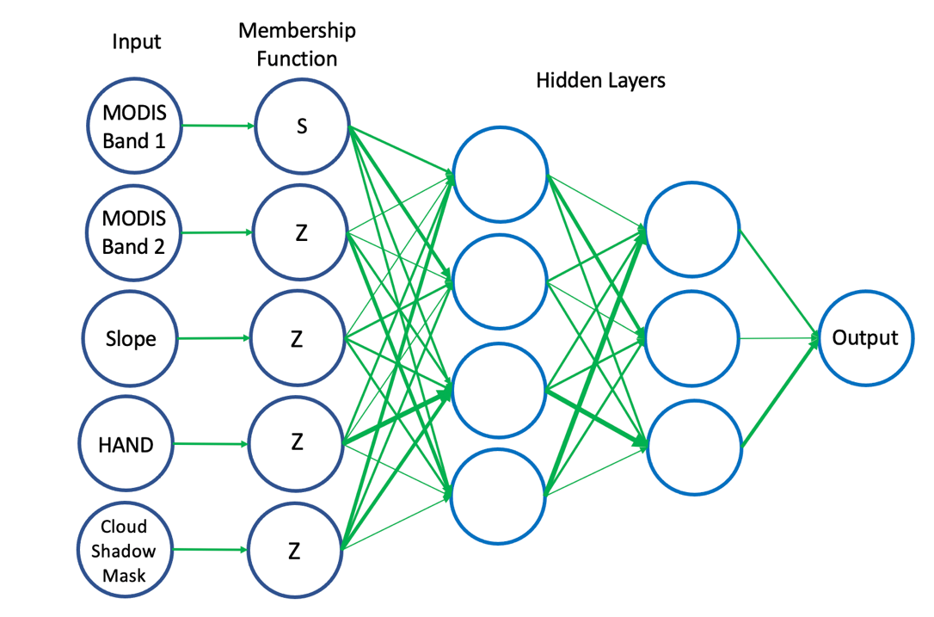
MODIS Flood Mapping
MODIS water maps for training
Output of Membership
Function is a fuzzy value
between 0 and 1
Adaptive Network Fuzzy Inference System (ANFIS; Jang, 1993)

Slide 15
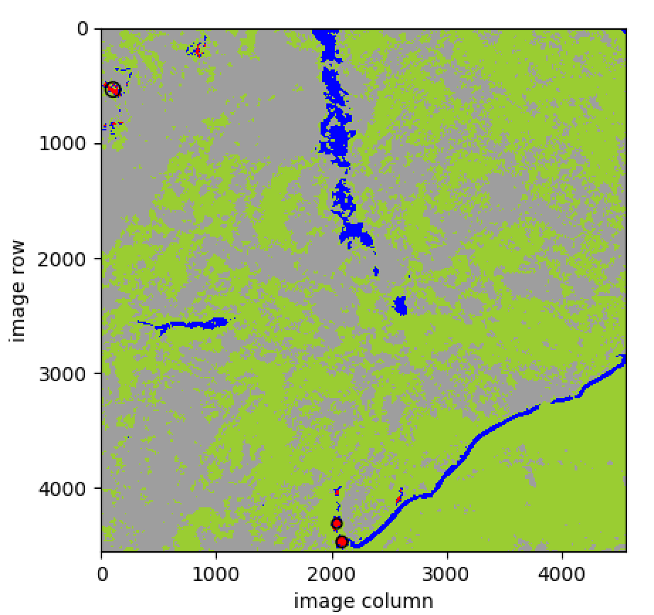
Experimental Potential Flood Location System
“Blob” Detection
Precise flood location information

Slide 16
Back up

Slide 17
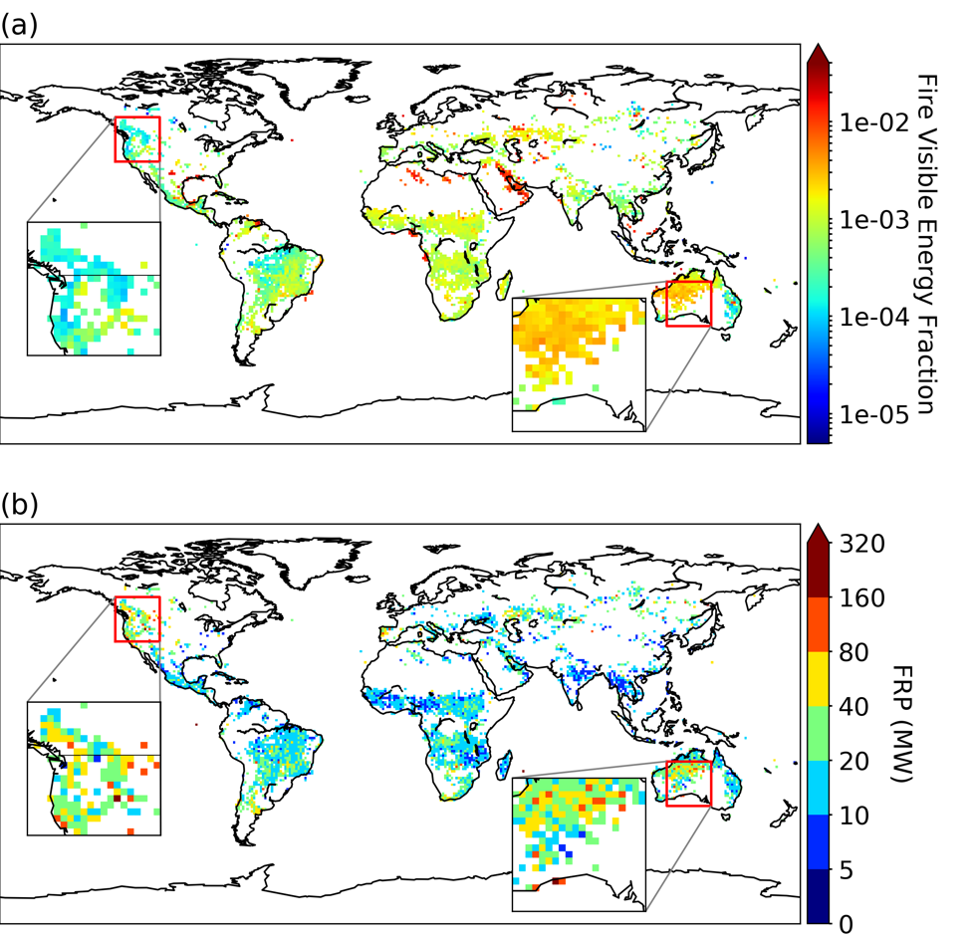
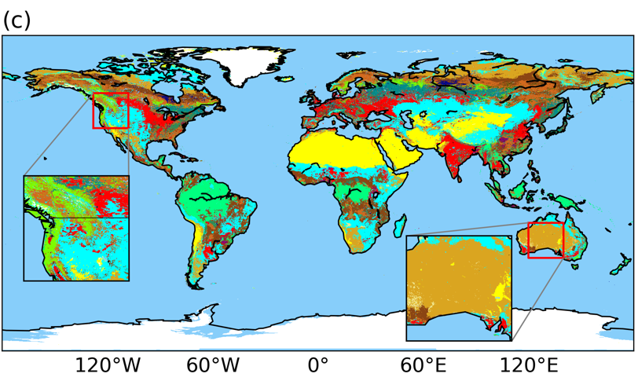
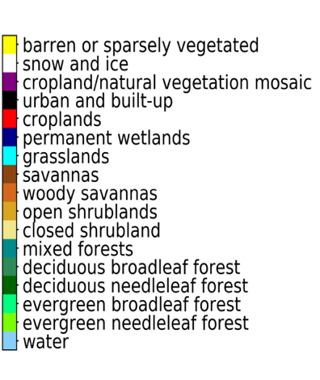
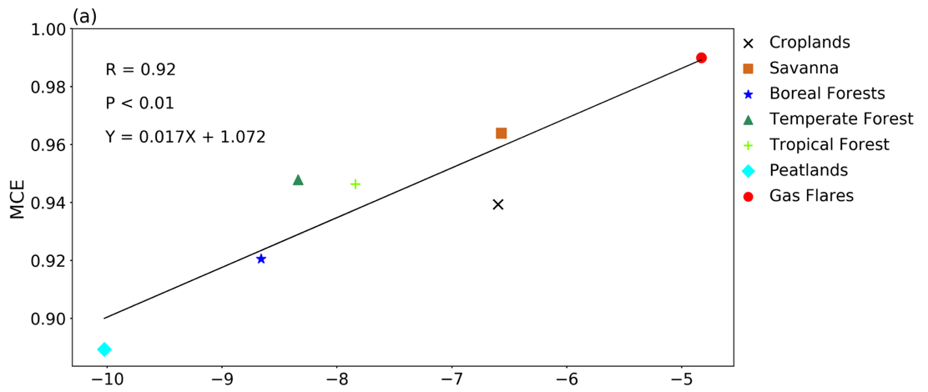
VEF is indicative of MCE
VEF spatial distribution clearly shows the impact of biome types on fire MCE
FRP has difficulty to describe MCE variation, such as shrubland vs. evergreen forests
VEF
MCE vs. VEF for different surface types
FRP
y = 0.017x + 1.072
Wang et al., 2020, RSE.
ln(VEF)
Notes:
To further illustrate this, we zoom in two areas.. VEFs in Shrubland in Australia is much higher than the VEF values of evergreen forests in North America, which is consistent with the literature. But, when we look at FRP distribution in these two areas, we can not see this distinction. Therefore, VEF clearly shows the influence of biome types on MCE, and indeed, the the liner correlation coefficient between ln(VEF) and MCE is as high as 0.92.

Slide 18
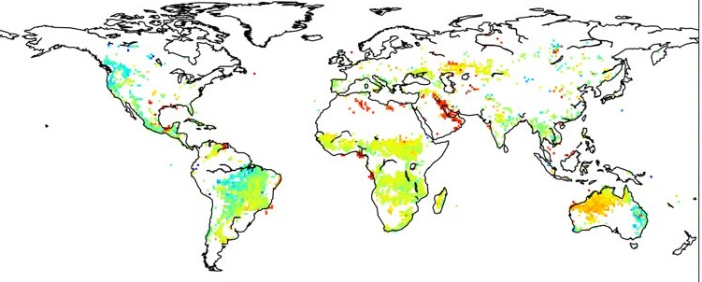
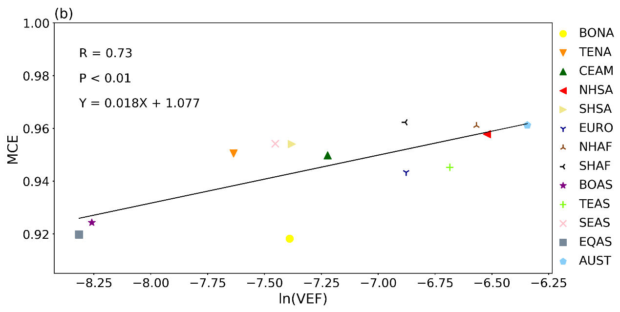
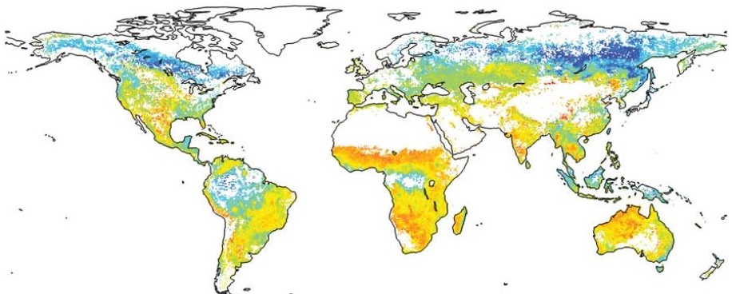
More Validation
VIIRS VEF
Comparison by region
GFED climatology of MCE
This study
y = 0.018x + 1.077
(van Leeuwen and van der Werf 2011)

Slide 19
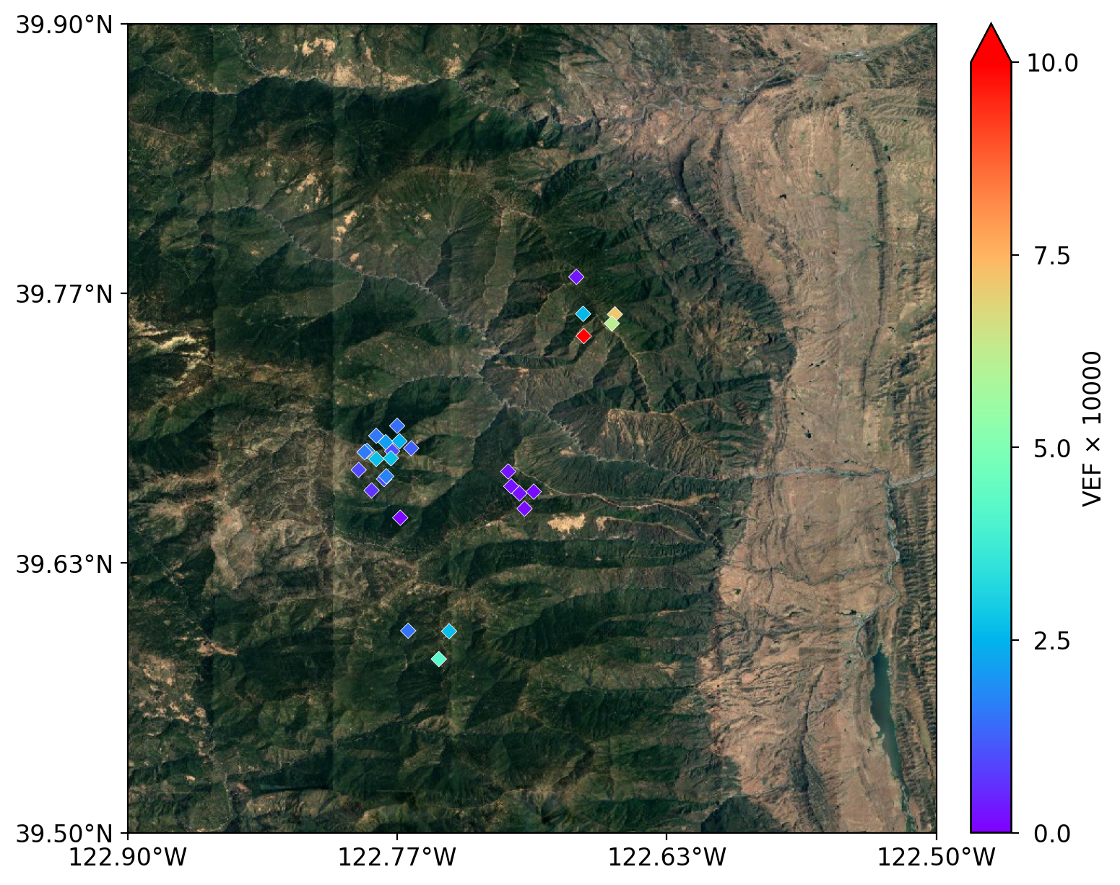
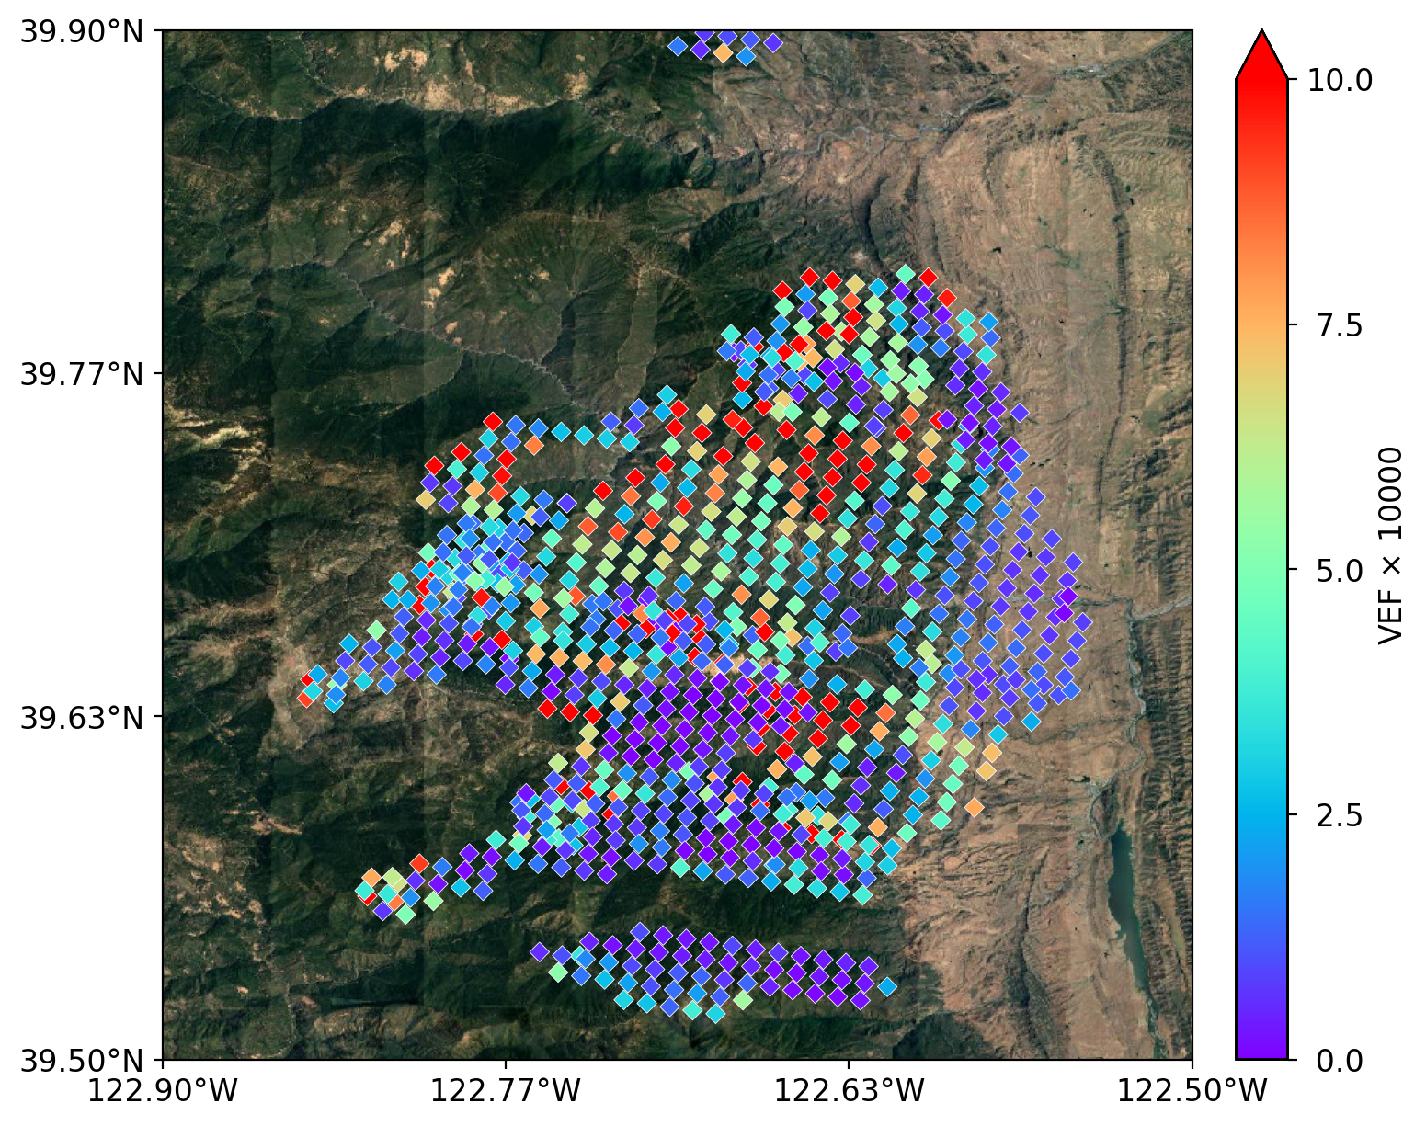
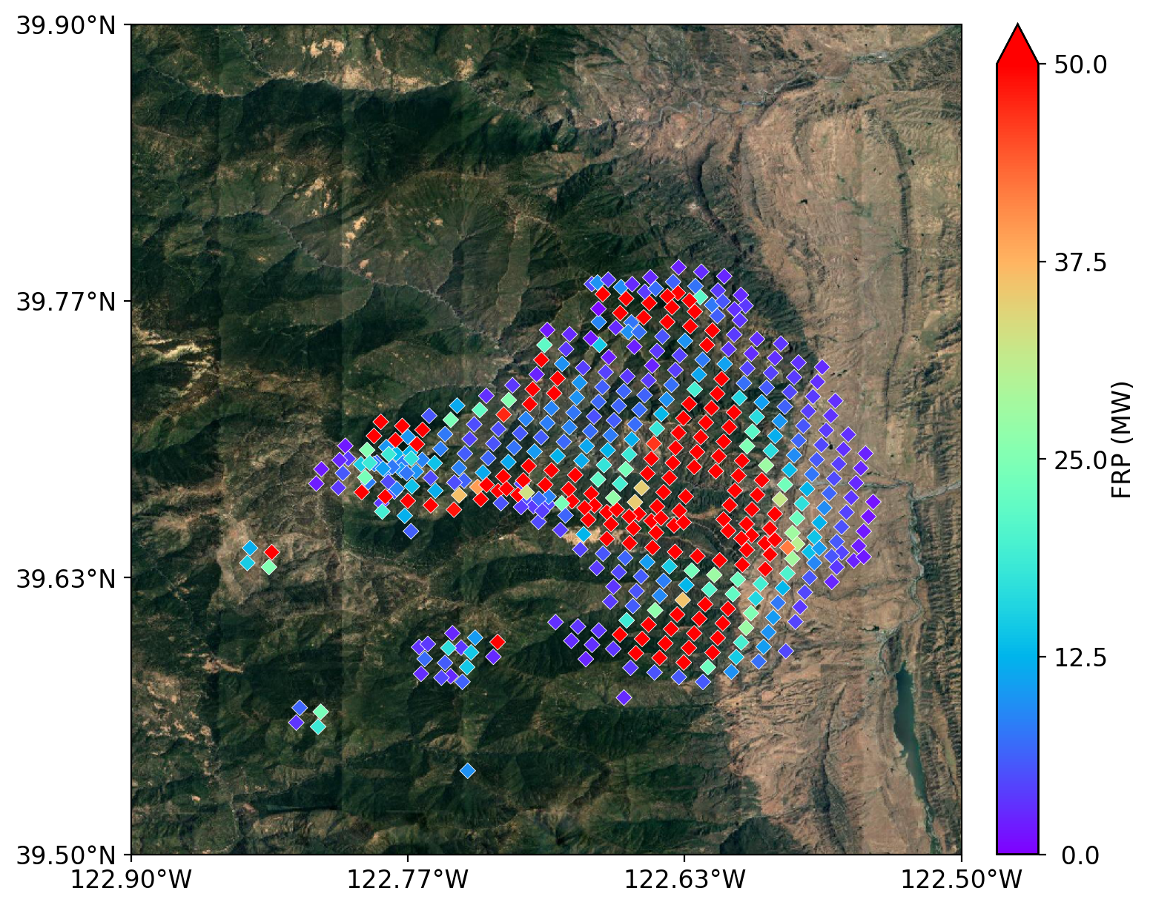
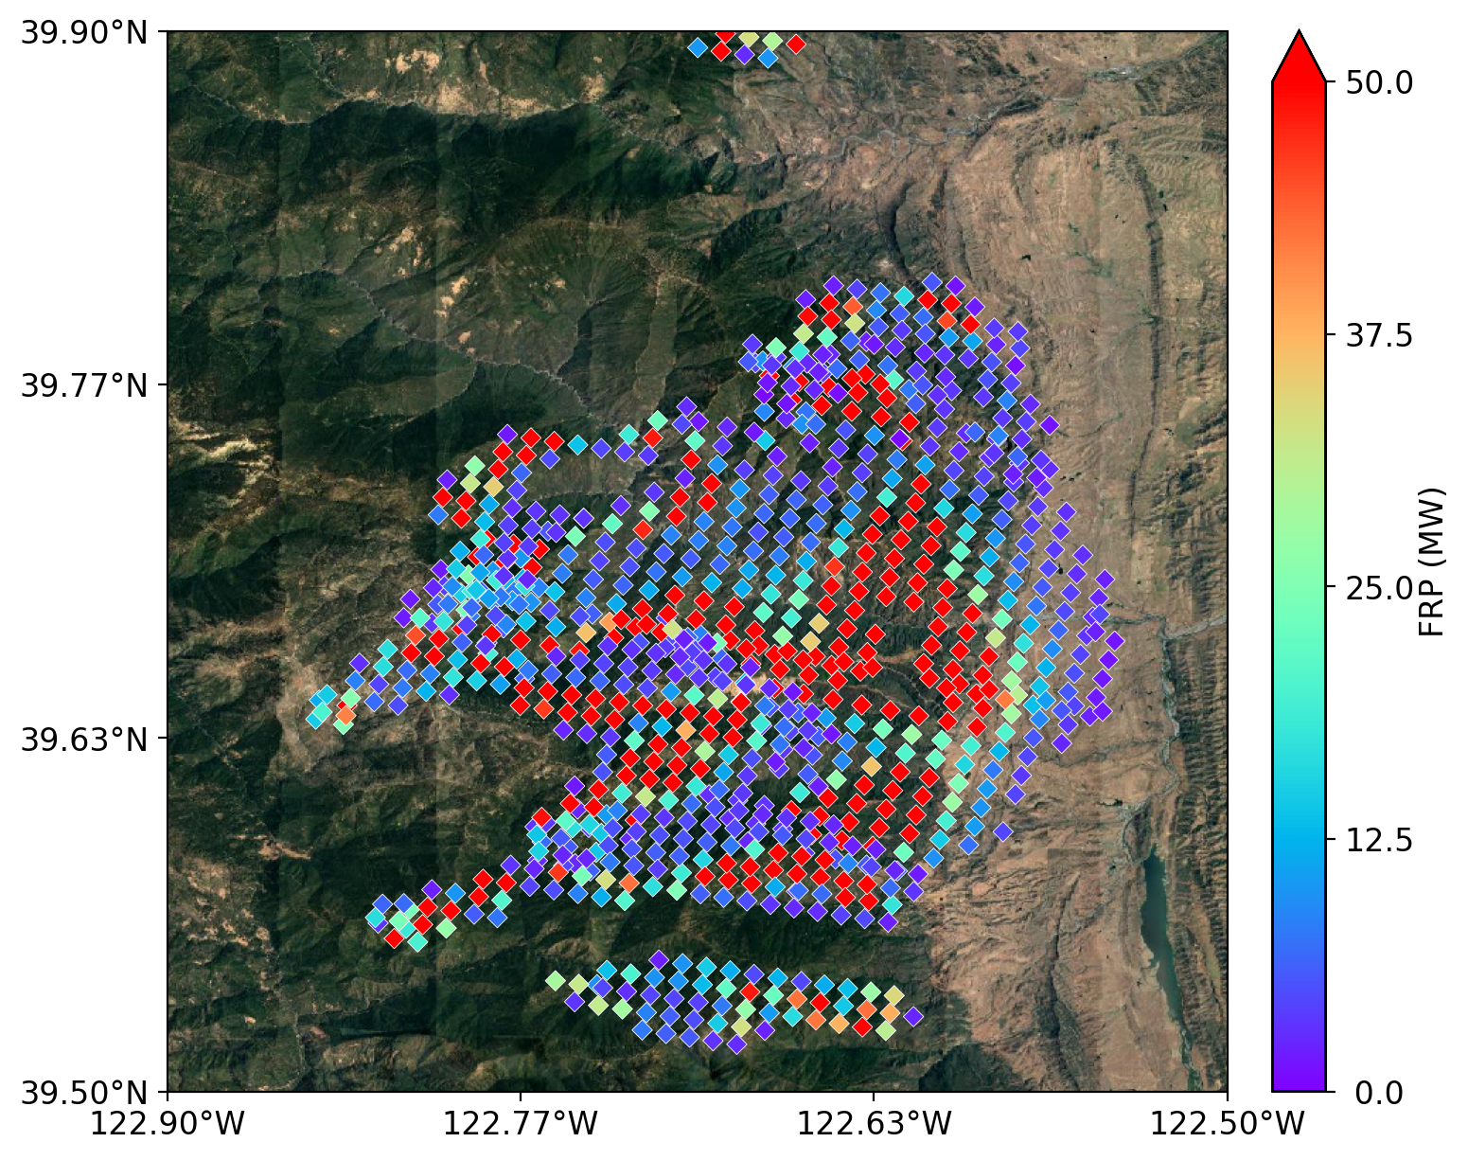
VEF has a potential to better predict fire growth
High VEF -> flaming → predicting movement of fire lines
VEF
2020-08-19
2020-08-20
2020-08-21
Highest
VEF
FRP
2020-08-19
2020-08-20
2020-08-21
Notes:
Finally, we also like to illustrate that VEF has the potential to predict the place of fire growth. As illustrate for this fire event in California this year, the event first started on August 19, and the starting location has the highest VEF. The next day, fire has grown a lot. But, if you look the FRP, you will find that at these edges, VEF is high, but FRP is low. So, where fire will grow? Of course, fire growth is driven by flambing and should be close to high VEF pixels. Surely, this is what happened indeeded. The next day, fire does growth along the edege where VEF is largest.

