Slide 1
Algorithm Delivery and Integration
Carol C Davidson
MODIS/VIIRS Software Testing and Integration Team Lead
Science Systems and Application Inc.

Slide 2
Overview
GitLab
Software Delivery Process
Software Integration
VIIRS Collections C2 vs C1
MODIS Collections C61 vs C7
Migration of MODIS C61 PGEs to C7

Slide 3
GitLab
Changing from subversion to GitLab for housing source code repository
  MODIS C6.1 and VIIRS C2: Transition to Gitlab in progress ( ~80% completed)
  Future MODIS C7 and VIIRS C2/C3: Science teams to deliver through Gitlab
  In house Libraries, science codes, and third-party libraries
  CentOS7 and Ubuntu supported currently, but will become all Ubuntu
Science Team on-boarding for future deliveries (MODIS C61/C7 and VIIRS C2/C3) through GitLab
  STIG will hold on-boarding sessions for science teams
  GitLab access via EarthData Login (EDL) and NASA Launchpad (more details available in backup slides)
  Interface for STMs to use for making code deliveries.
  Learning Resources
    Account access/setup go to: Accounts · Wiki · infrastructure / Help · GitLab (nasa.gov).
    Basics on working with PGE source codes within GitLab MODAPS / Documentation · GitLab (nasa.gov)
    More detailed User’s Guide pdf available as well.

Slide 4
Gitlab Organization
Code packages are organized into projects within GitLab and projects are organized into groups.
Top level group is named “MODAPS”
  Contains projects for third-party libraries, codes shared between MODIS and VIIRS, and documentation.
  Contains “MODIS” and “VIIRS” sub-groups
“MODIS” group contains sub-groups “ATMOS”, “Library”, “shared_src”, “LAND”, and “INHOUSE, each of which hold the projects for PGEs and/or shared codes.
“VIIRS” group contains projects for all PGEs, shared codes, and VIIRS specific libraries, like IDPS and OPS.

Slide 5
Software Delivery
Overview of the basic steps for updating/delivering a PGE. (actual sequence of steps for an example of PGE11 provided in Back up slides)
  Determine Project name and branch (i.e, PGE and collection) you want to update. For example, MODIS PGE11 for C6.1.
  Clone the project to the command line
  Switch to the C61 branch.
  Create a new branch for your updates; the new branch will be based on the C61 branch you are sitting on.
  Switch to the new branch you created and integrate your changes. Build and test the updates and when satisfied, send them back to the repository.
  Verify code pushed back built successfully within GitLab and resolve issues if it did not.
  Submit update for merging/integration by SSTG by creating a Merge Request

Slide 6
Software Integration and Unit Test
SSTG steps with STM delivery:
  Create a forked copy of the project to work in.
  Pull the STM delivery branch to forked copy/check that branch out.
  Review the STM delivery. Implement updates needed in PGE perl scripts for inputs, outputs, runtime parameter settings or production rules.
  Document changes in PGE HISTORY file.
  Commit and push any changes made to working copy in GitLab and verify successful build/deploy.
  Create a tag of the new version and use to execute command line and MODAPS tests with.
  If all tests complete successfully and no concerns, update original merge request with test information and approve merge request as the “reviewer”
  CM completes merge and tagging of PGE

Slide 7
VIIRS C1 vs C2
C1 PGEs currently in subversion, (planned for migration to GitLab at a later time ?)
C2 PGEs ported to Gitlab
  85% of existing land PGEs migrated to GitLab and successfully build to execute on Ubuntu system.
  Ubuntu version of SNPP C2 and JPSS1 C2.1 Geolocation deployed from Gitlab in operational processing
  All C1 land PGES updated to use NASA Geolocation and L1B data, both NetCDF4.2 format, as input.
  Standard products generated in netcdf4/HDF5/HDFEOS5 format
  Includes improvements to Land SIPS CloudMask, changes to metadata to be consistent with MODIS products.

Slide 8
MODIS C61 VS C7
Output file format: NetCDF (HDF-EOS5) vs HDF4 (HDF-EOS2)
  C61 : HDF4 format, support HDF-EOS Swath and Grid
  C7 : HDF5 format, CF-1.6 compliant, support HDF-EOS Swath and Grid
Metadata:
  C61: nested within ‘CoreMetadata.x’ attribute; generated using SDP Toolkit and MCF
  C7: global attributes for each metadata, Doesn’t use SDP Toolkit.
CF-compliant
  C7 output files will be CF compliant and can be georeferenced by NetCDF data viewers or tools
  L2 Swath data: latitude and longitude are resampled and added for different sizes of data in the file by the C7 libraries.
  L3 Grid data: projection parameter attributes will be added by the C7 libraries.
PCF file
  C7: ”key = value” format
  C7: LUN number -> LUN string. E.g. 600000 -> MxD03
MCF file
  C7: “name|mandatory|type|num_val|value” format
Toolkit
  C61: Uses SDP Toolkit
  C7: New API-trans and SDP-utils libraries developed by LDOPE/SSTG.

Slide 9
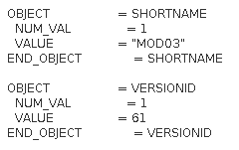
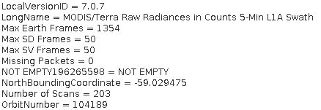
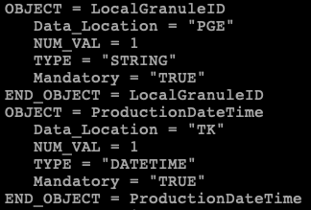
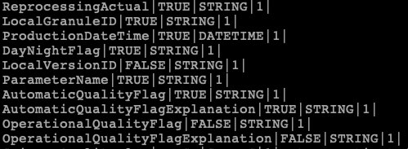
MODIS C7 VS C61
C61 metadata
C7 metadata
C61 MCF File
C7 MCF File

Slide 10
Migration of MODIS C61 to C7
How C7 libraries work
The New API-trans and SDP-util libraries developed by LDOPE/SSTG provides HDF4 to HDF5 API implementation for every HDF4 call in the current operational MODIS PGEs.
PGE code
apiTrans.h
#include <stdio.h>
#Include “hdf.h”
#Include “mfhdf.h”
#include “apiTrans.h”
int main(int argc, char *argv)
{
….
int32 id = SDstart(fname, DFACC_RDWR);
…
}
#define SDstart(fname, mode) h4to5_SDstart(fname, mode)
apiTrans.c
int32 h4to5_SDstart(char *filename, int32 access_mode)
{
if(isHdf4(filename)){
return SDstart(filename, access_mode);
}
else{
/* implement by HDF5 API*/
}
}

Slide 11
Migration of MODIS C61 to C7
How to convert C61 PGE to C7
Add ”apiTrans.h” to C files which include HDF4 or HDF-EOS2 calls;
Add compile and link flags to makefile for C7 Libraries (API-Trans and SDP-Utils);
Modify the Perl script to use new Perl libraries for C7 PCF format;
Use provided tool to convert MCF files to C7 format;
Note: C61 metadata are nested in a “CoreMetadata” while C7 are saved as global attributes for each of them. If PGE code uses SDP-Toolkit API to read/write metadata then nothing needs to be done; If PGE code parses the “CoreMetadata” string by itself then it will not work in C7.

Slide 12
Migration of MODIS C61 to C7
How to update C7 PGE code by science team
The PGE code is basically the same as C61 – still using HDF4/HDF-EOS2 function calls. Continue using HDF4/HDF-EOS2/SDP-Toolkit APIs if new attributes or SDS are added.
LDOPE and SSTG will create baseline C7 PGEs by taking operational C7 PGEs and integrating API related changes. STMs focus on scientific changes.
Note: C7 PGEs will be managed by Gitlab. Here is a Wiki how to update a PGE in Gitlab and run tests: https://gitlab.modaps.eosdis.nasa.gov/modaps/documentation/-/wikis/home

Slide 13
Backup Slides

Slide 14
GitLab Access
URL for MODAPS GitLab repository is Projects · Dashboard · GitLab (nasa.gov)
Preferred access method is NASA LaunchPad.
LaunchPad account holder should request access to the GitLab area via NAMS at https://idmax.nasa.gov/nams/asset/254154/670356850
STMs without LaunchPad accounts may connect using EarthData login.
For LaunchPad or EarthData, users must be added to appropriate user groups in order to access content.
SSTG can contact appropriate admin for gaining access needed.

Slide 15
Software Delivery (1 of 4)
Actual steps for update and delivery using mix of command line and web interface.
  Clone the MODIS PGE11 project to the command line:
  git clone https://GitLab.modaps.eosdis.nasa.gov/modaps/modis/land/pge11.git
  Switch to the pge11 directory created, go to the C61 branch so you start with the C61 code stored there:
    git checkout C61
  Create a new branch identical to the C61 branch for your updates using:
    git checkout –b pge11update0422
  Integrate your changes and then send them back to the repository using:
    git add . (to add any new files to the repository)
    git commit –am “<note about files modified/added/deleted>”
    git push origin pge11update0422
    Continued on next slide

Slide 16
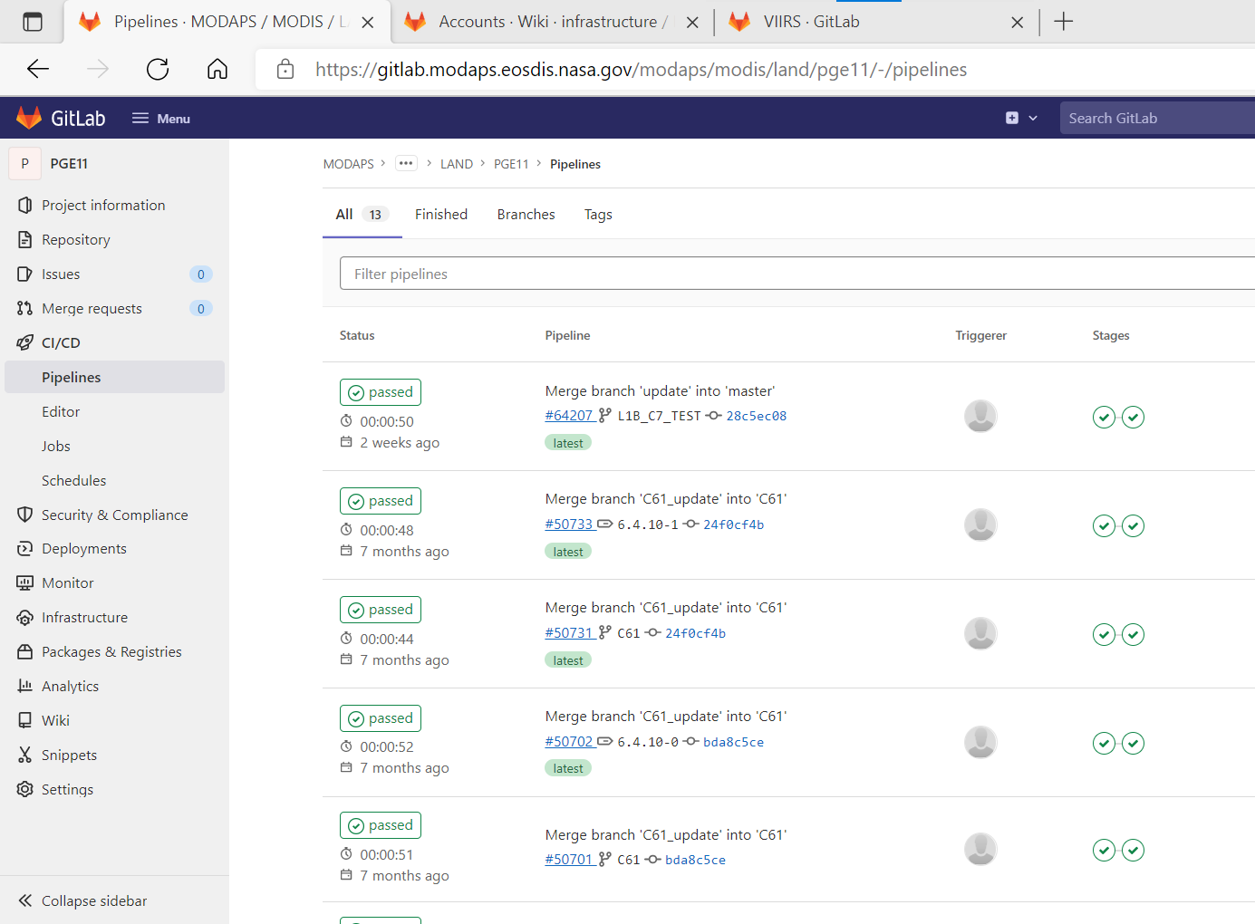
Software Delivery ( 2 of 4)
  Via GitLab web interface, go to project https://GitLab.modaps.eosdis.nasa.gov/modaps/modis/land/pge11.git
  From left hand menu click on “CI/CD” to view pipelines – this is where you verify the code you pushed built successfully.
    Continued on next slide

Slide 17
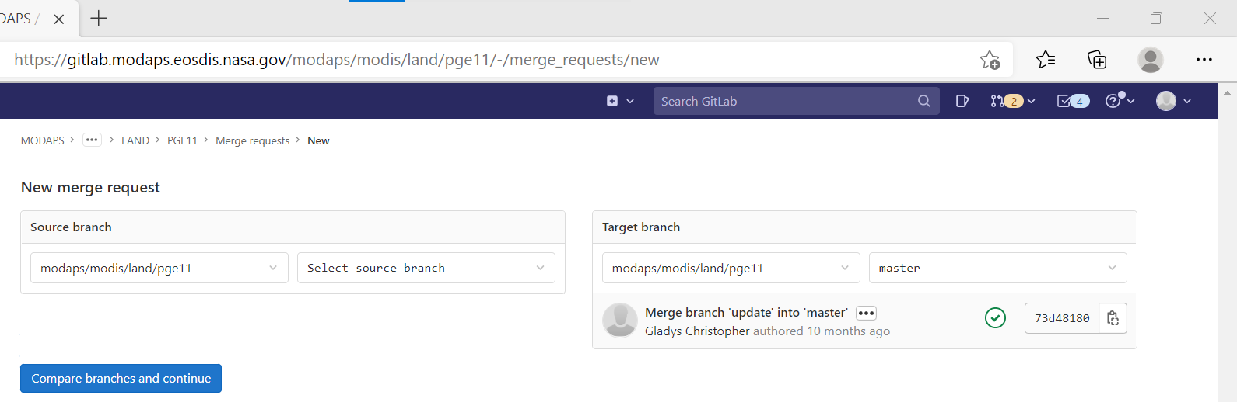
Software Delivery (3 of 4)
  Once pipeline is successful, submit your changes via a Merge Request
  From left hand menu click on “Merge Requests”
  On next page select “New merge request” button.
  On “New merge request” page, select the “source” and “target” branches. For our example, “source” is “pge11update0422”, and “target” is “C61”.
  Click on “Compare branches and continue”
    Continued on next slide

Slide 18
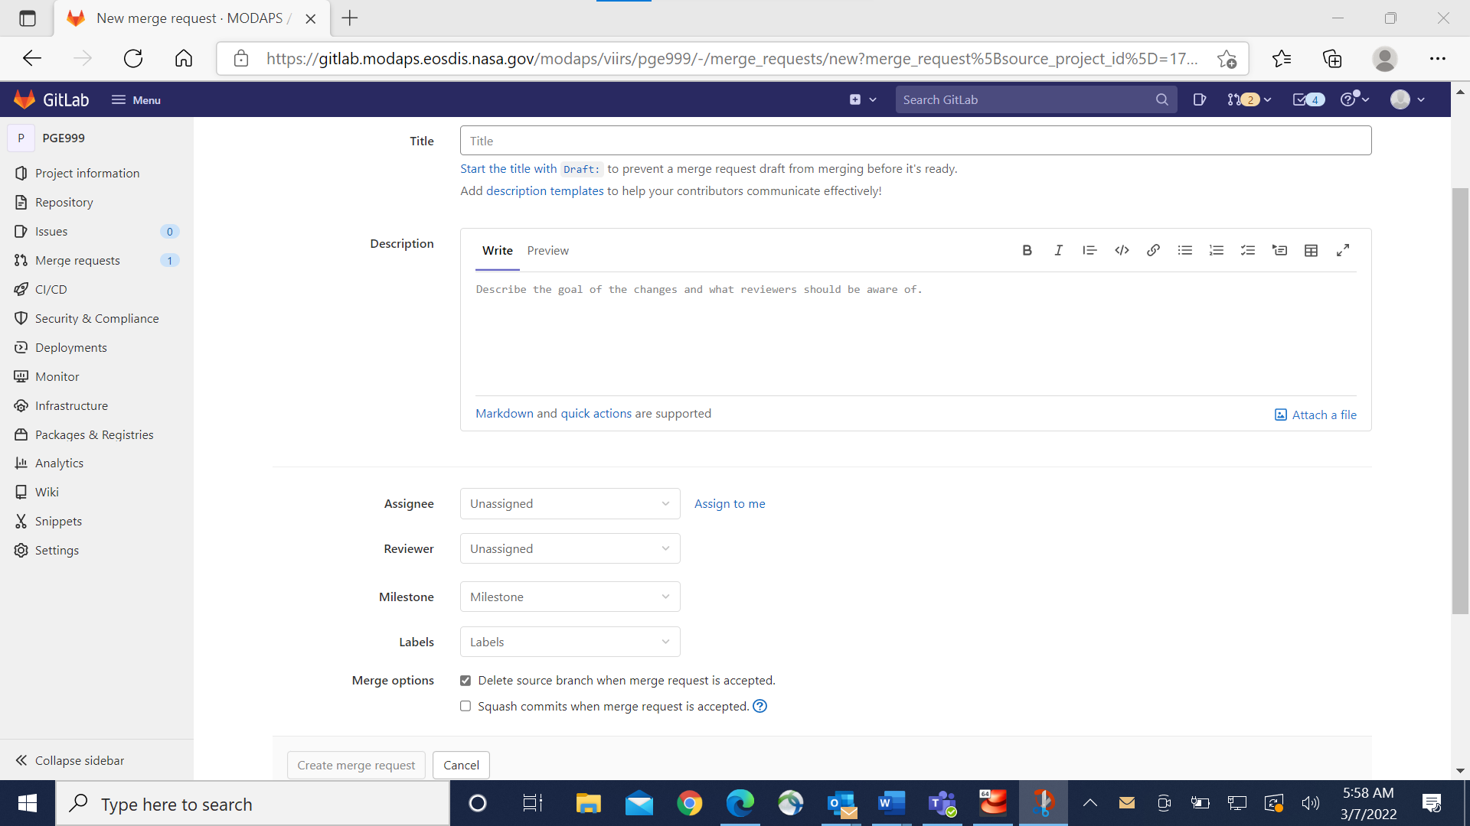
Software Delivery (4 of 4)
  On next “New merge request” page, fill out information as requested.
    Title: this should indicate PGE and/or process name and version, for example PGE11 v6.1.20 update
    Description: summary of changes made and what testing was done.
    Assignee: select “modiscm”
    Reviewer: Can be left blank or set to STIG member you communicated with regarding change.
    Merge options: the “Delete source branch when merge request accepted” is selected by default. Deselect this option if you wish to retain the branch.
    Click on “Create merge request”

Slide 19
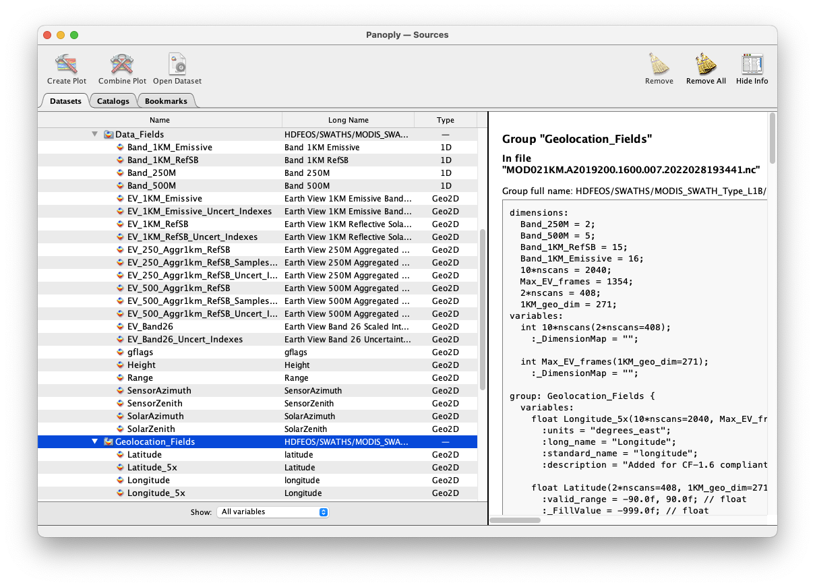
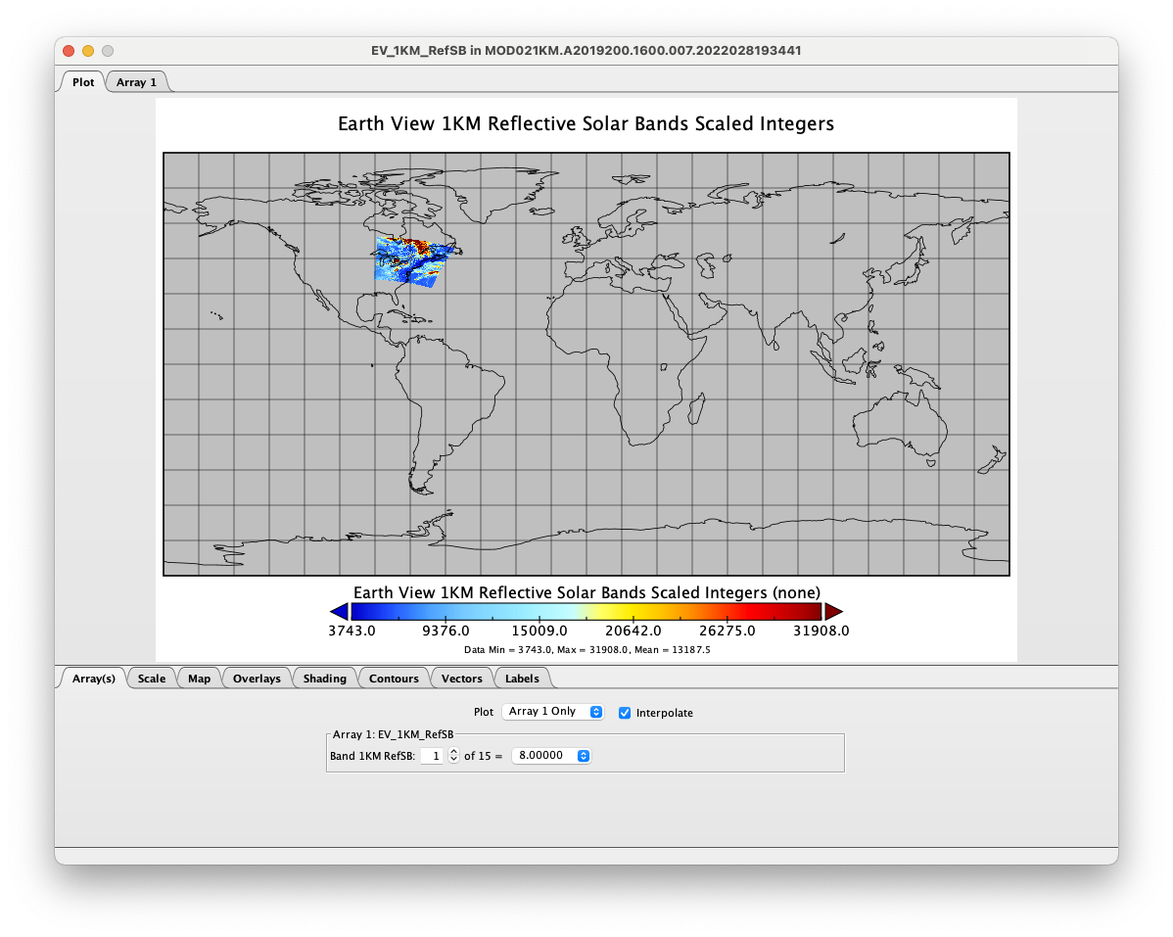
Display C7 L2 data in Panoply
Data with different resolution are all georeferenced

Slide 20
How C7 libraries work
C61 PGE code
HDF4 API
HDF-EOS2 API
SDP-TOOLKIT API
C7 Libraries
API-trans
SDP-Utils
C7 outputs
C7 Libraries will ”translate” HDF4 / HDF-EOS2 API function calls to HDF5 / HDF-EOS5;
C7 Libraries will handle the new format of PCF and MCF;
C61 PGE code need no change – except to include a “apiTrans.h” header in some C files.

