Slide 1
Science Testing and Product Quality Control
Sudipta Sarkar
LDOPE & MODAPS Lead
Science Systems and Applications Inc

Slide 2
LDOPE
Land Data Operational Product Evaluation (LDOPE) is a centralized facility that provide supports to the Land Science Team in quality assessment of the Land data products.
Undertake scientific and generic routine QA of operational products
Long Term Quality Monitoring
Algorithm Change Recommendation, Test and Verification
Collection Reprocessing
Product Maintenance (product that has no science team, intermediate products)
Develop, maintain and distribute QA tools
Disseminate QA results (product quality and known issues) to science team and data users

Slide 3
MODIS and VIIRS Land SIPS: Operational Interface
EDOS
L0 Processing
L1A and Geolocation Team
MODIS and VIIRS Calibration Support Teams
L1 and Geo Code and LUT
Test Requests
L1B Calibration code and LUT
L0 Data
Test Requests
MODAPS/ VIIRS Land SIPS
NASA MODIS VIIRS Land Science Team
Science Code Delivery
Science Data
Science Test Requests
Responses
Recomm-
endations
Science Data L0 – L3/l4
LP-DAAC
NSIDC
LAADS
LDOPE
Science Data

Slide 4
MODIS/VIIRS Land Product Software Life Cycle
Science team code development
and SCF testing
Integrate the code into MODAPS production environment
Code unit test
Update file specification and production rules
Integration
Run code in MODAPS
globally
multiple days
downstream and chain test
Science team and QA group evaluate
extent of the algorithm change
impact on downstream products
clear boxes: Science Team activities
colored boxes = STIG and LDOPE activities
Science Test
Production Test
Product Change Approval
Test in the MODAPS production environment, check
code performance
test product file size and metadata validity
Check test product can be exported to DAAC
MODAPS
Production

Slide 5
Specific QA Support Tasks
Perform routine QA and monitoring of all land data products from MODIS/VIIRS/AVHRR across multiple collections.
Work with science teams to address quality issues in the products.
Plan science tests, review test results, verify algorithm changes and product performance and communicate test results to science teams.
Provide QA and troubleshooting support for collection mission-wide reprocessing.

Slide 6
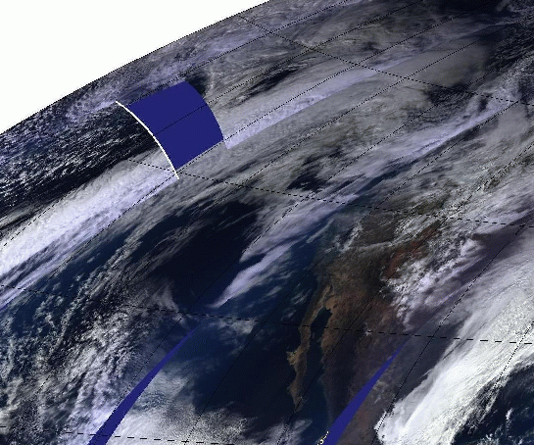
Sources of Product Errors
LDOPE performs QA of all products in the chain of production to trace the primary source of error causing quality issues in a product:
instrument errors
incomplete transmission of instrument and ephemeris data from the satellite to ground stations
incomplete instrument characterization and calibration knowledge
geolocation uncertainties
use of inaccurate or different ancillary data sets
software coding errors
algorithm sensitivity to surface, atmospheric and remote sensing variations
errors introduced by the production, archival and distribution processes

Slide 8
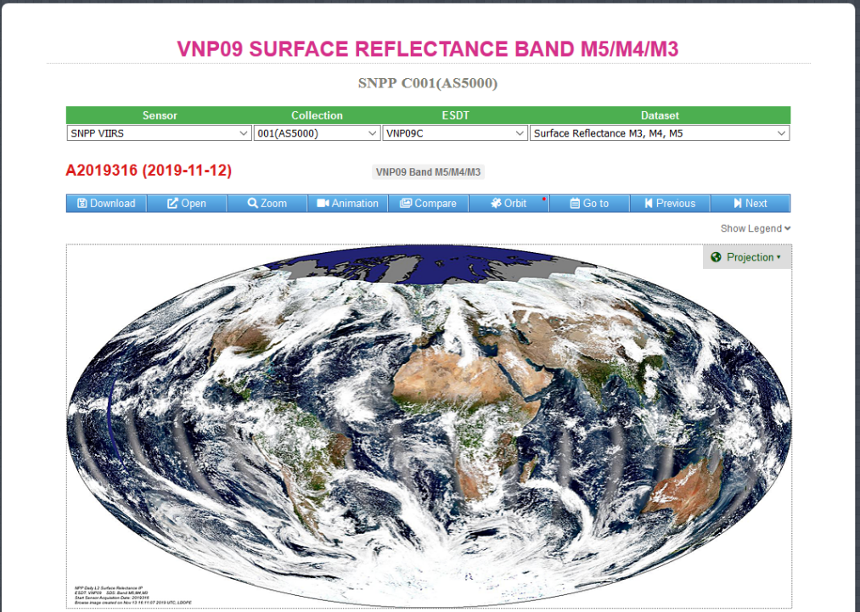
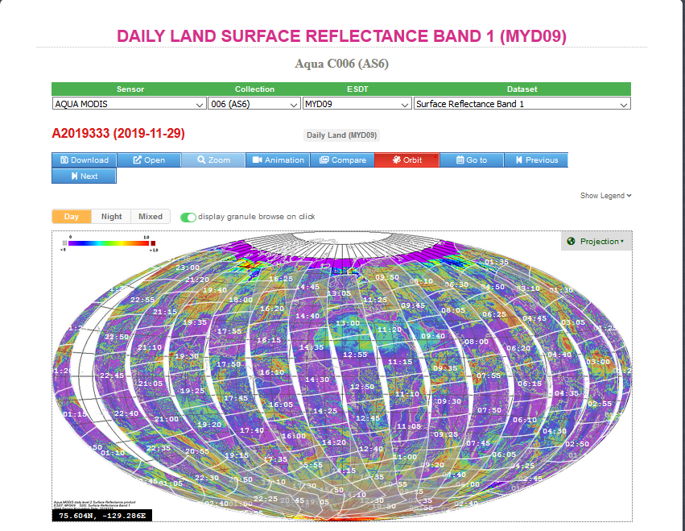
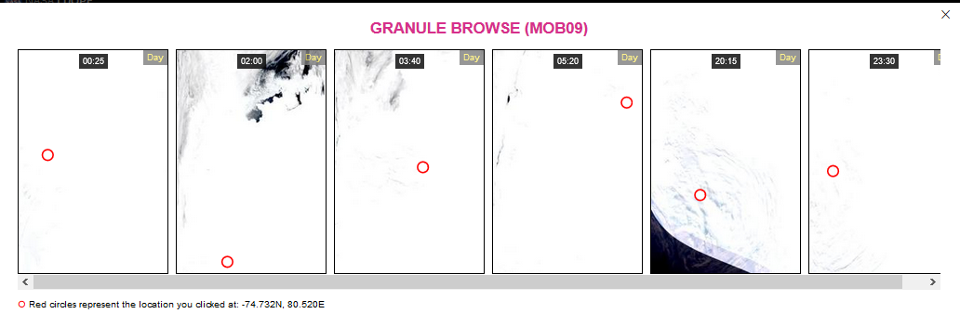
Global Browse and Granule Browse Images

Slide 9
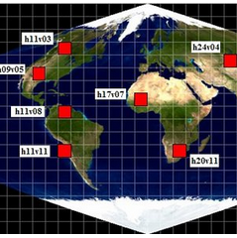
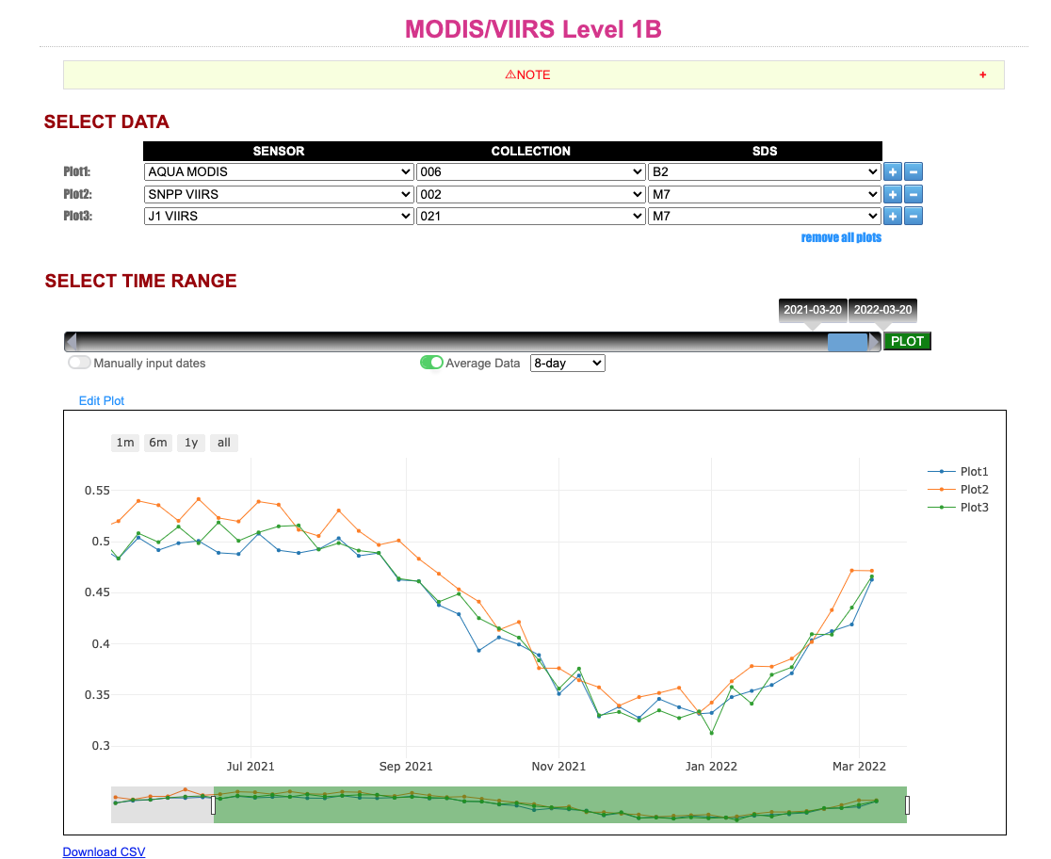
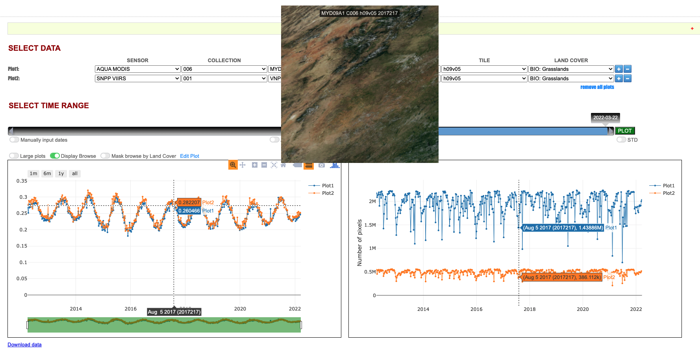
Long Term Monitoring: Golden Tile Time Series
Time series summary statistics are derived from L1B and a lot of the gridded Land products, over selected areas that are expected to be representative of the variability of most MODIS/VIIRS Land products.
These are maintained and monitored in order to enable synoptic quality assessment.
Notes:
Mention about coupling between global browses and time series – Display browse option in the GT TS plots

Slide 10
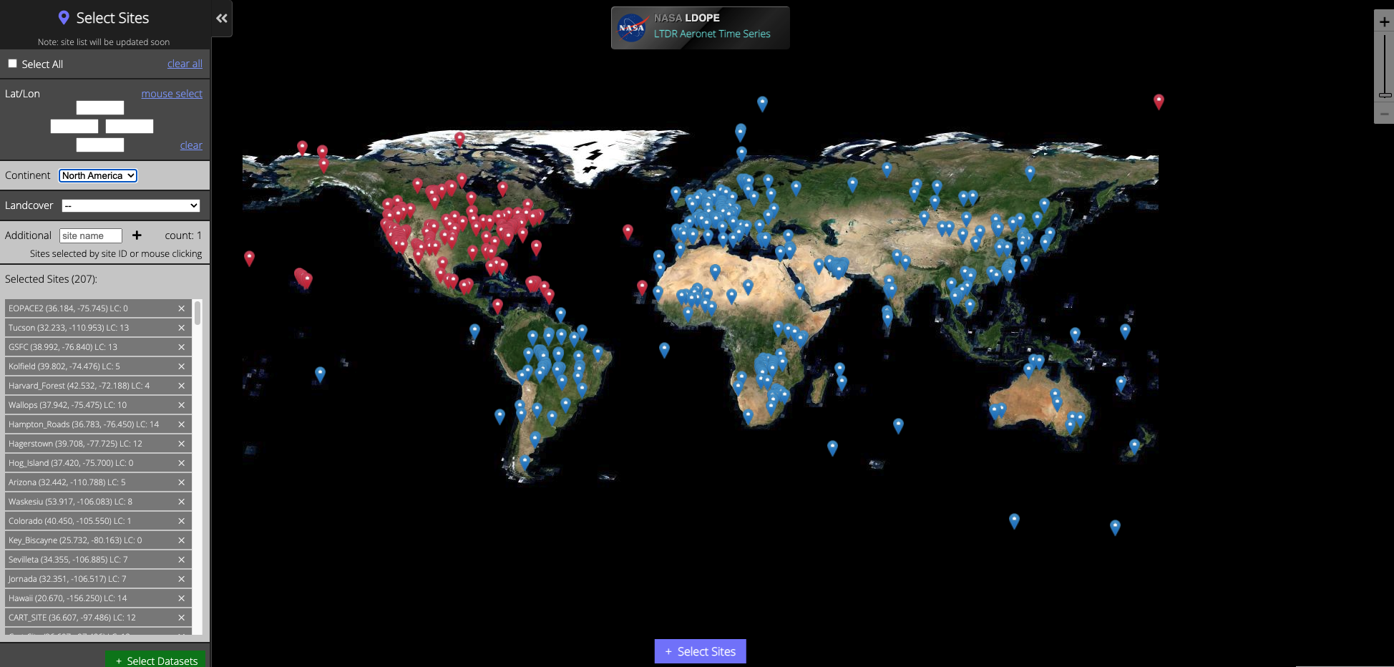
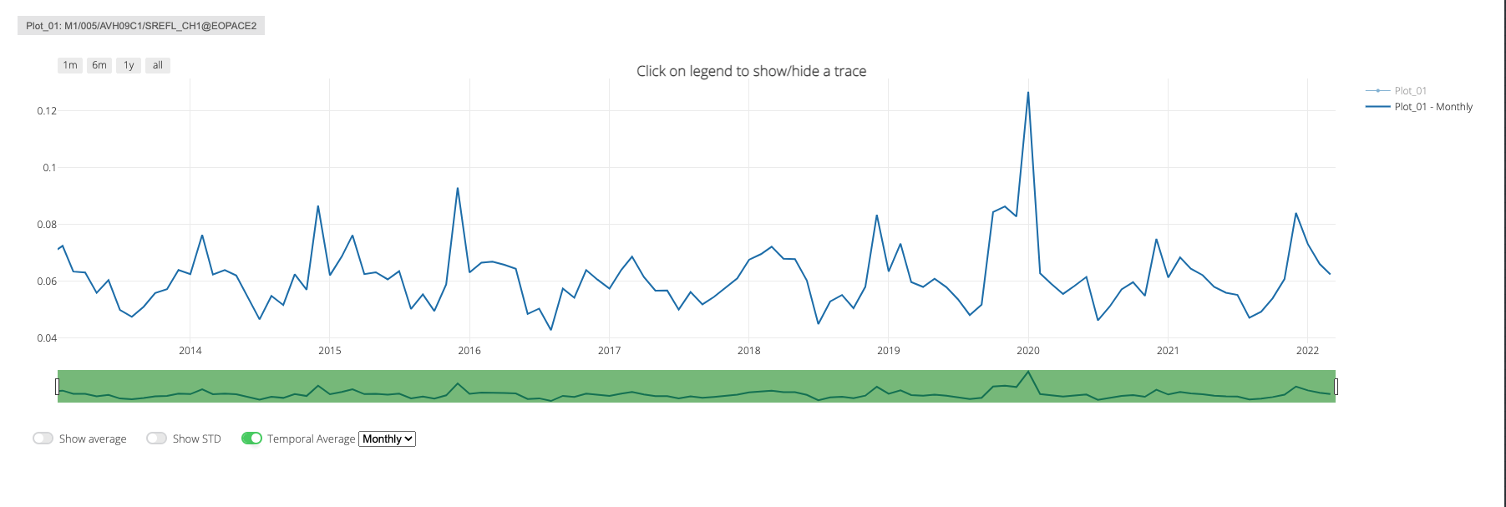
Station Based Time Series

Slide 11
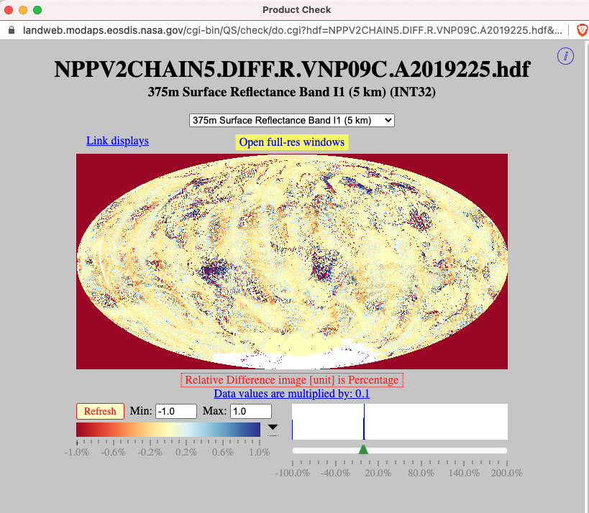
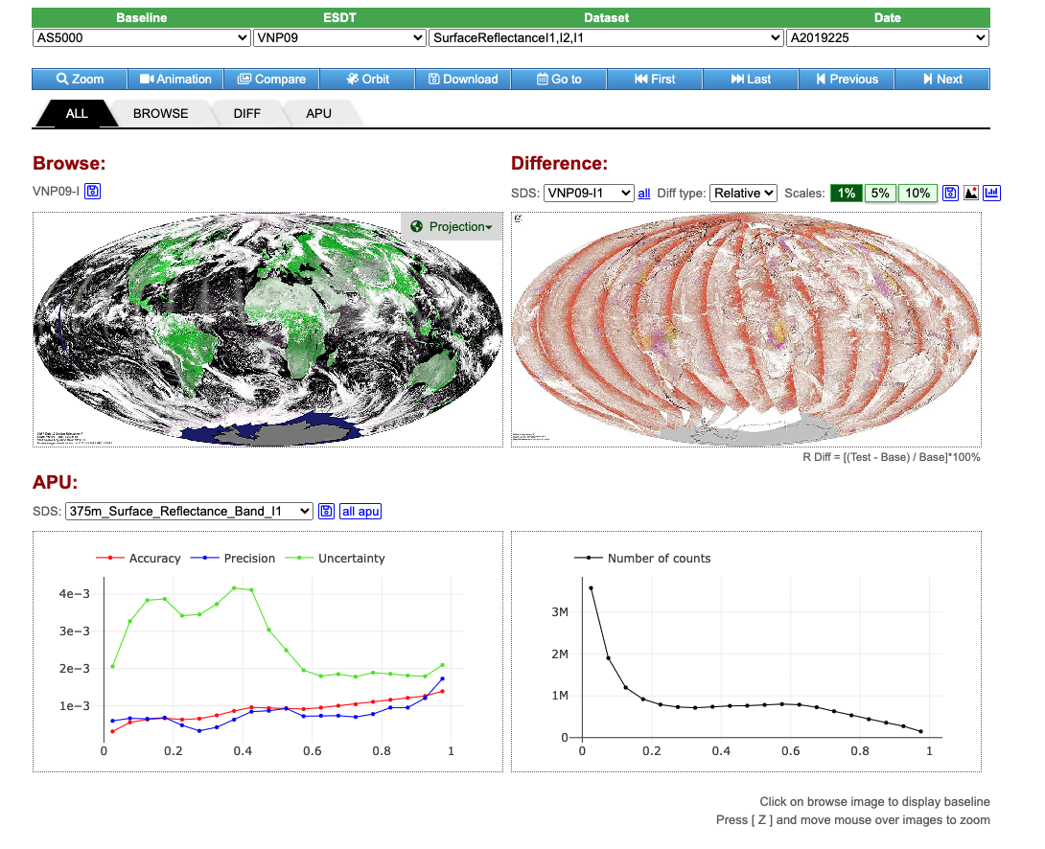
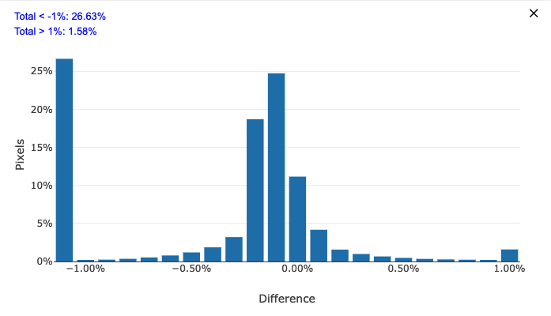
Science Test Review

Slide 12
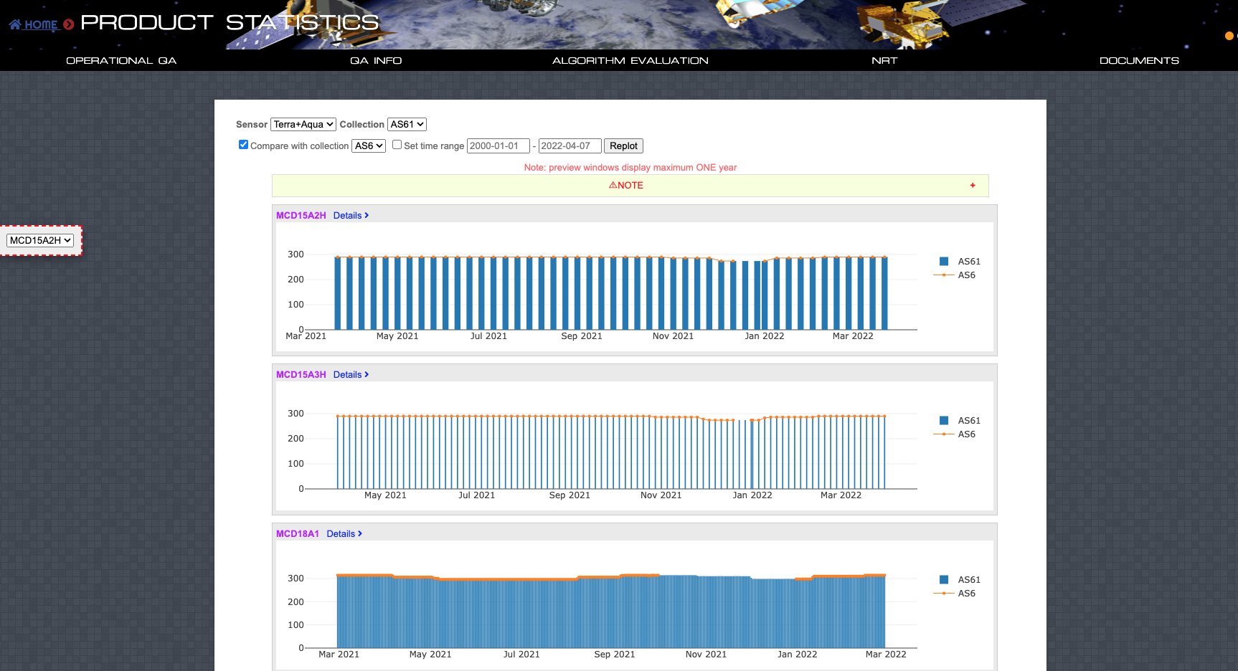
Production Monitoring

Slide 13
For more details on LDOPE please visit our website at: https://landweb.modaps.eosdis.nasa.gov/cgi-bin/QS/new/index.cgi or contact Sudipta.Sarkar@nasa.gov

