Slide 1
Product Maintenance and Long-term Continuity
Chair: Miguel Román
PIs: Eric Vermote (GSFC), Glynn Hulley (JPL), George Riggs (SSAI), Louis Giglio (UMCP),Alexei Lyapustin (GSFC), Ranga Myneni (BU), Crystal Schaaf (UMB) Zhuosen Wang (UMD-ESSIC), Xiaoyang Zhang (SDSU), Maosheng Zhao (SSAI

Slide 2
Product Maintenance and Long-term Continuity
MODIS/VIIRS Surface Reflectance Maintenance and Long Term Continuity – Eric Vermote (GSFC)
S-NPP VIIRS Land Surface Temperature (VNP21) - Glynn Hulley (JPL)
MODIS and VIIRS Snow Cover Continuity – George Riggs (SSAI).
S-NPP VIIRS Burned Area (VNP64A1) and Active Fire (VNP14/VNP14IMG) – Louis Giglio (UMD)
MAIAC Update and Continuity (VNP19A1/A2/A3) – Alexei Lyapustin (GSFC)
Status of MODIS & VIIRS LAI/FPAR Products – Ranga Myneni (BU)
Maintenance and Continuity of MODIS, SNPP, and JPSS BRDF, NBAR Albedo products – Crystal Schaaf (UMB)
Maintenance and Continuation of NASA's Black Marble Nighttime Lights Product Suite from Suomi-NPP and NOAA-20 VIIRS – Zhousen Wang (UMD-ESSIC)
Maintenance, Evolution, and Validation of the Global Land Surface Phenology Product from Suomi NPP and JPSS VIIRS Observations – Xiaoyang Zhang (SDSU)
Terrestrial Evapotranspiration (ET/LE, MxD16, VNP16) and Gross and Net Primary Production(GPP/NPP, MxD17, VNP17) – Maosheng Zhao (SSAI)

Slide 3
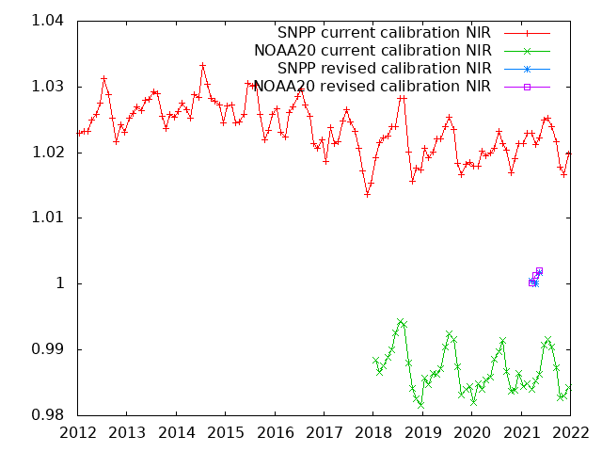
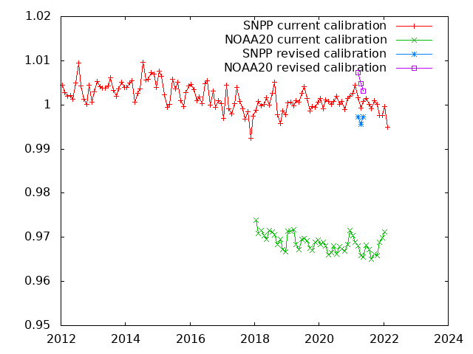
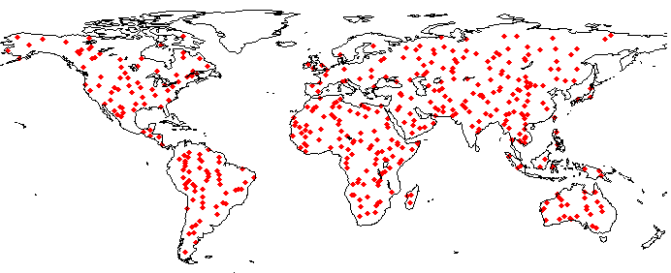
MODIS/VIIRS Surface Reflectance Maintenance and Long Term Continuity
MODIS SR Product suite (Aqua/Terra)
Collection 6.1
Bands 1 through 7 (0.47mic-2.13mic)
Level2, 2G,3 250m, 500m, 0.05 deg.
Daily, 8 days
Status and Updates:
MODIS SR collection 6 ( LaSRC: Land Surface Reflectance Code) is the basis for a variety of SR product (VIIRS, AVHRR, Landsat, Sentinel 2) assuring consistency and traceability in the SR products from multiple satellites/instruments.
Validation stage IV (AERONET) and BELMANIP ananlysis is on-going. ACIX-I-II (Landsat 8/ S2) is completed, ACIX-III,CMIX-II starting in June 2022
VIIRS is cross-calibrated with MODIS to ensure optimal consistency using Aqua (NIR), Deep Convective Clouds (VIS) and Sunglint (SWIR)
NIR, analysis over BELMANIP (ref Aqua)
Band | NOAA20 | SNPP
M1 | 1.0213+0.001292x(Year-2018) | 0.9652-0.000235x(Year-2012)
M2 | 1.0276+0.001683x(Year-2018) | 0.9799+0.000179x(Year-2012)
M3 | 1.0260+0.001680x(Year-2018) | 0.9850-0.000579x(Year-2012)
M4 | 1.0264+0.001605x(Year-2018) | 0.9827-0.000125x(Year-2012)
M5 | 1.0201+0.000917x(Year-2018) | 0.9806+0.000243x(Year-2012)
M7(I2)* | 1.0068+0.000814x(Year-2018) | 0.9724+0.000862x(Year-2012)
M7(M5) | 1.0080+0.000834x(Year-2018) | 0.9723+0.000821x(Year-2012)
I1 | 1.0333+0.001299x(Year-2018) | 0.9948+0.000433x(Year-2012)
I2 | 1.0121+0.000514x(Year-2018) | 0.9731+0.000760x(Year-2012)
Results of SIPS
(3 months test)
Red, analysis over BELMANIP (ref Aqua)
VIIRS SR Product suite (SNPP/NOAA20)
Collection 1
Bands M1-M11, I1-I3 (0.42mic-2.25mic)
375m, 500m,750m,1km, 0.05 deg.
Daily, 8 days
Status and Updates:
Adapted from MODIS LaSRC (Land Surface Reflectance Code)
Validation stage IV (AERONET) and cross-comparison with MODIS is on-going (BELMANIP).
Consistency with NOAA products is being work in collaboration with NOAA/STAR team.
M5,I1 were combined to spectrally match Aqua band 1
BELMANIP SITES
Eric Vermote NASA/GSFC

Slide 4
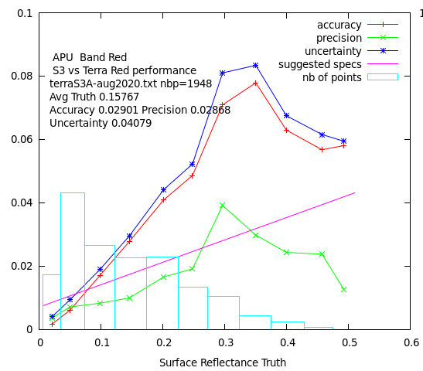
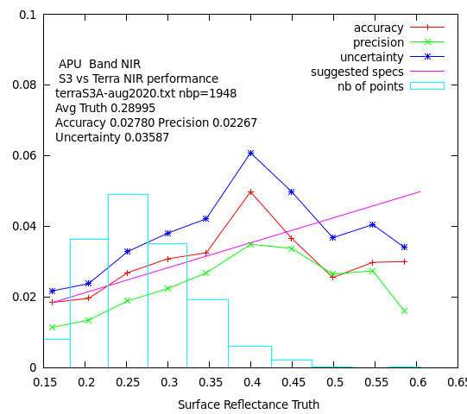
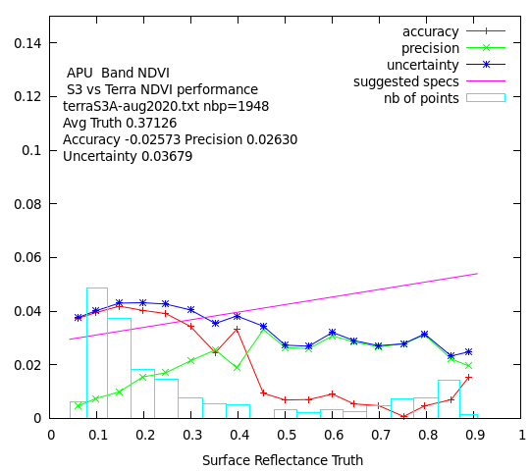
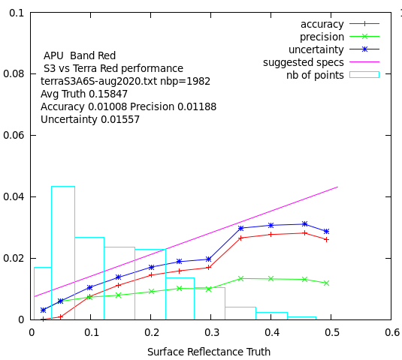
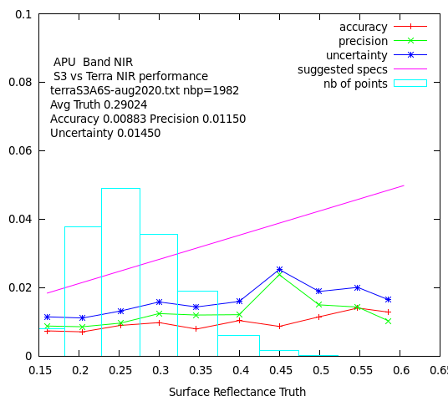
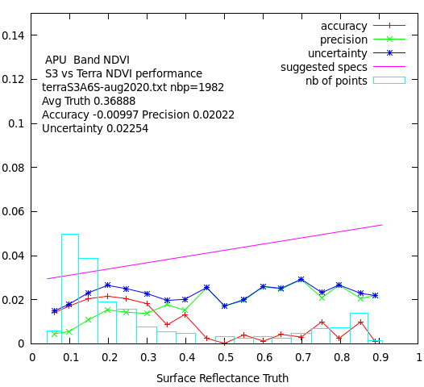
Beyond Terra MODIS…
Sentinel 3 official ESA SR versus Terra (APU) Aug 2020
Sentinel 3 Synergy (OLCI/SLSTR) 10:00am orbit
Covers MODIS spectral range including thermal (cloud screening)
Spatial resolution from 300m to 1km
S3A (2016), S3B(2018), S3C,D (TBL), S3-NG (planned)
Level 1,2 archive in MODAPS
Status and Updates:
Evaluation of L2 (surface reflectance) official ESA product shows room for improvement.
Development of a simple LaSRC prototype on the Level1 data shows promising results.
We are part of the ESA Expert working group on S3-NG
Sentinel 3 prototype LaSRC style SR versus Terra (APU) Aug 2020
Eric Vermote NASA/GSFC

Slide 5
S-NPP VIIRS Land Surface Temperature (VNP21)
Product Overview:
VNP21 L2 swath and gridded LST 750-m products using consistent MODIS LST algorithm (TES)
Collection 1 released to public on July 9, 2019, awaiting Collection 2 …
Completed 3 years of Stage-2 validation using a global set of sites (~1 K RMSE)
For 2018-2021, NASA MODIS and VIIRS LST&E recorded most downloaded files at LPDAAC (~26 million)
Product Strengths/Limitations:
Using consistent TES algorithm as MODIS results in long-term LST product continuity
Low impact on algorithm performance due to anticipated Aqua MLT sensor drift
TIR measurements are dependent on surface emission and are unaffected by changes in solar irradiance and sun view angle that may arise due to MLT drift.
Delay in C2 processing is limiting the use of VNP21 Climate Modeling Grid (CMG) data (daily, 8-day, monthly 0.05 degree global grids) for climate studies and modeling
Delaying production of MEaSUREs LST products at JPL for continuity with MODIS Aqua
Future code refinement involve inclusion of midwave infrared emissivity bands for MODIS/VIIRS

Slide 6
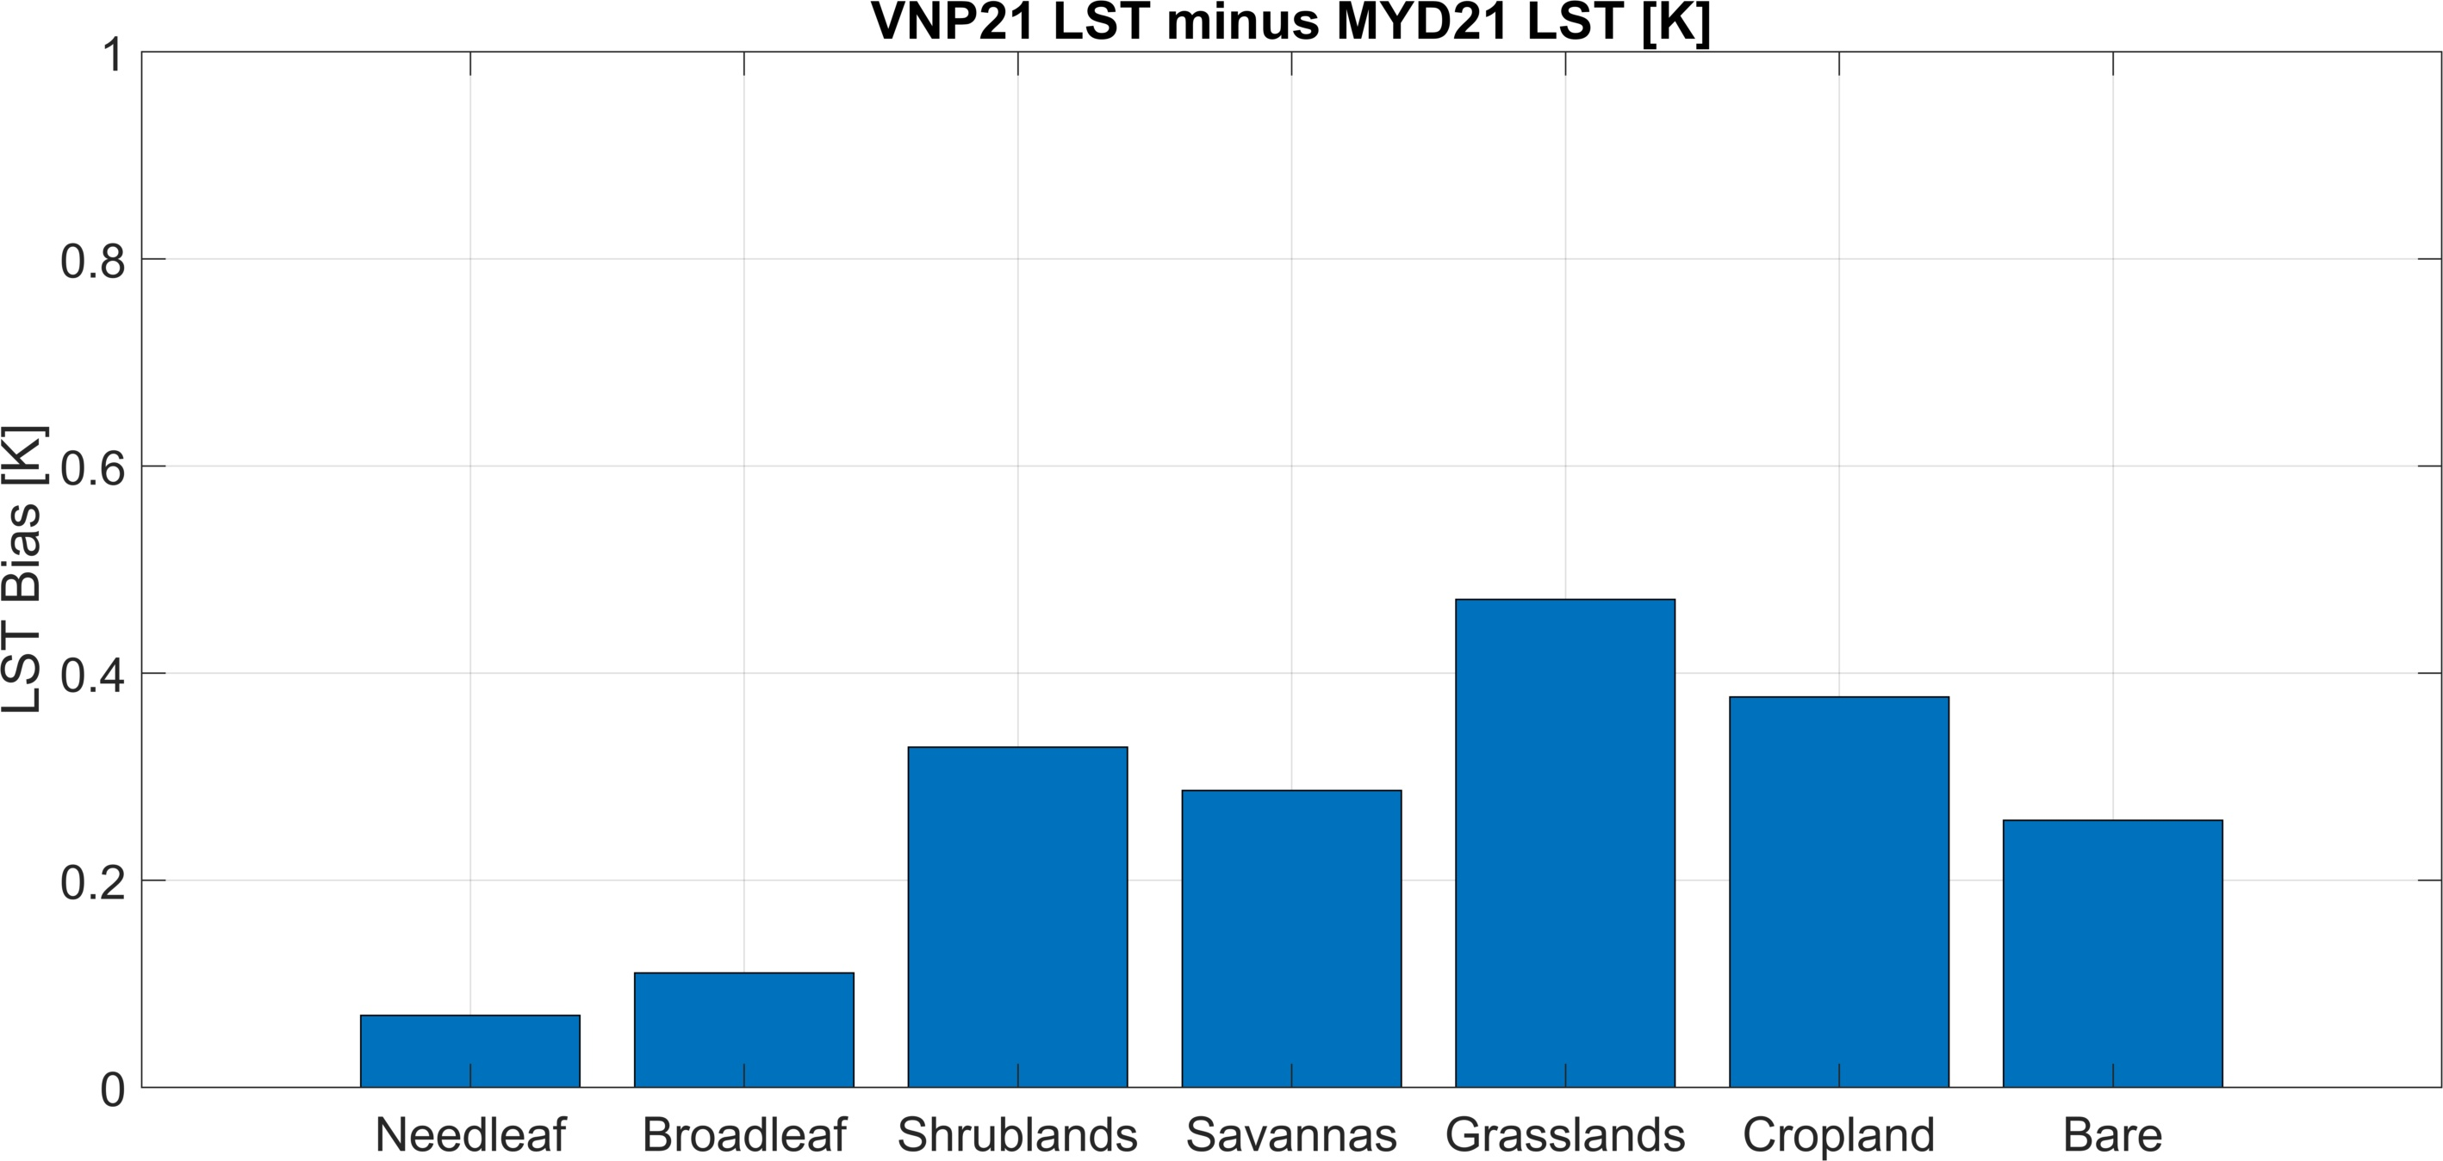
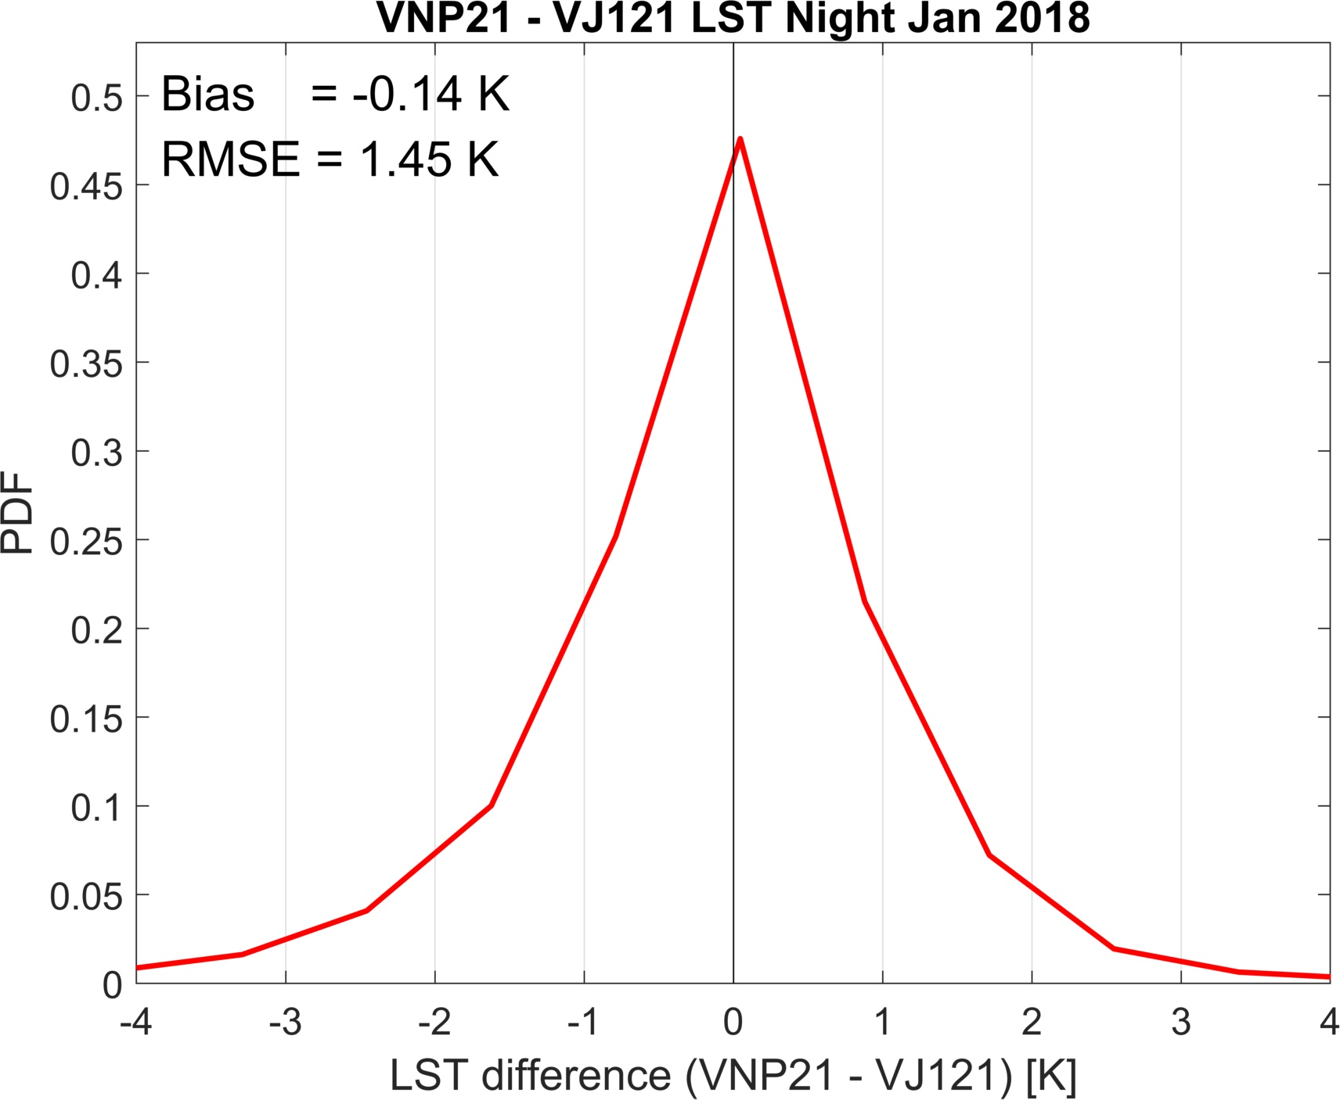
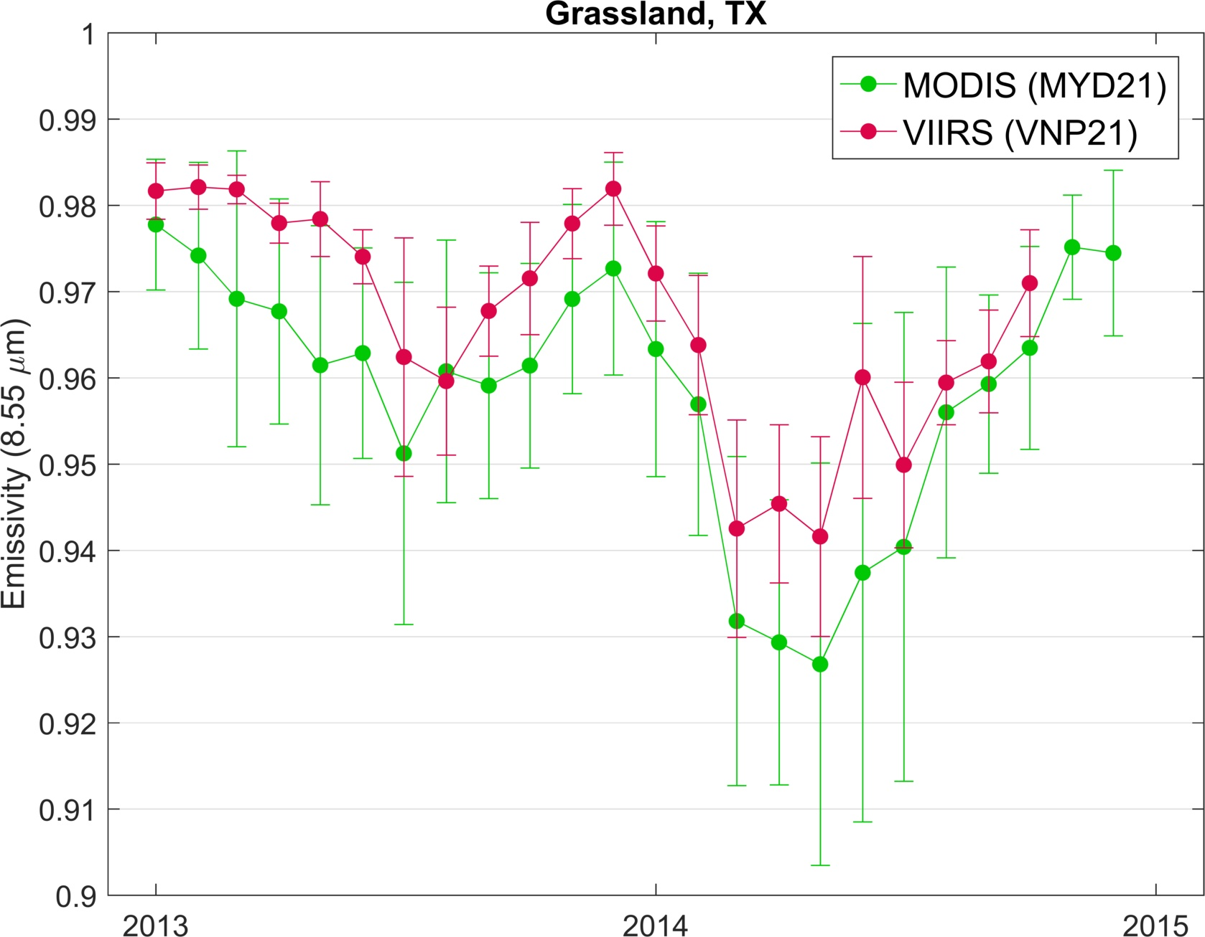
S-NPP VIIRS Land Surface Temperature (VNP21)
Aqua MODIS and S-NPP VIIRS Continuity
S-NPP VIIRS and JPSS-1 VIIRS Continuity
LST differences <0.5 K and independent of cover type
LST percent differences are generally <1%, with some localized differences of up to 3% due to differences in observation time and/or cloud masking.
Negligible Bias
Consistent emissivity temporal variability

Slide 7
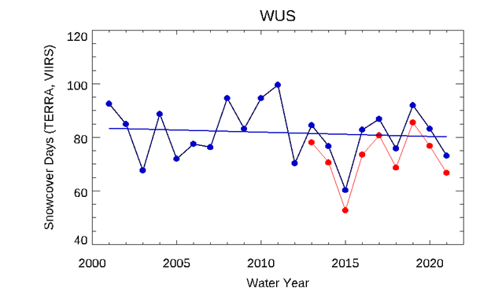
MODIS and VIIRS Snow Cover Continuity
Long-term Continuity: Strategy is to use the same or very similar snow cover algorithms for MODIS and VIIRS, and series of products.
Continuity of Terra and Aqua MODIS and SNPP VIIRS snow cover products is described in Riggs, G. and Hall, D., 2020, Continuity of MODIS and VIIRS Snow Cover Extent Data Products for Development of an Earth Science Data Record, Remote Sens. 2020, 12, 3781; doi:10.3390/rs12223781
Snow cover extent spatial and temporal consistency is observed.
Confounding factors affecting continuity:
Terra descending orbit, AM overpass / Aqua and SNPP ascending orbit, PM overpass
MODIS 500m resolution, VIIRS 375m resolution
MODIS and VIIRS band differences
Cloud cover, occurrence of clouds and extent can differ between morning and afternoon
Cloud mask algorithm differences
Snow cover extent can change between morning and afternoon in some situations
Sensor calibration
Snow Cover January 3, 2018
MOD10A1
MYD10A1
VNP10A1
Daily
100
SNOW COVER
TERRA MODIS
A comparison of Terra MODIS and SNPP VIIRS number of days of snow cover over the western US (WUS) over 8 years found consistency between products albeit there is a nearly consistent difference in number of days of snow mapped between Terra and SNPP.
Cloud-Gap-Filled (CGF)
10
SNPP VIIRS
MOD10A1F
MYD10A1F
VNP10A1F

Slide 8
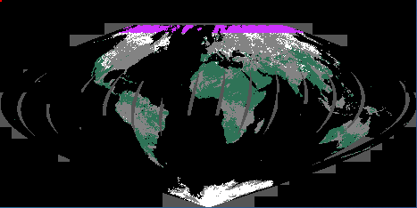
MODIS and VIIRS Snow Cover Maintenance & Improvement
Near-term milestone: Replace current MOD10C1 daily global 5 km product with a new daily global 500 m product. A special daily global 500 m product was produced for the SnowPEX project by SIPS.
Include a new data filter in L2 snow cover algorithm that decreases occurrence of false snow detections along edges of water bodies and periphery of clouds. Strength--it decreases false snow detections. Weakness—it can limit snow detection in some snow-covered forest situations. Technical challenge—revise the PGE codes for MODIS C7 and for VIIRS C2.
Investigate possible ways to further decrease cloud/snow confusion to improve detection of snow cover.
Update the MODIS and VIIRS products User’s Guides.
Possibly use the Algorithm Publication Tool (APT) to create revised ATBDs of existing products.
Investigate effects of Terra end of mission actions on products.
The cloud-gap-filled (CGF) products should supersede the 8-day products.
MOD10C1 CMG 5 km snow cover product 3 January 2015
Special SnowPEX global 500 m snow cover product 3 January 2015
New daily sea ice products at native sensor resolution should be produced.

Slide 9
S-NPP VIIRS Burned Area (VNP64A1)
Product Overview
Monthly global burned area with date of burn mapped to nearest day
Adapted MODIS MCD64A1 production code to use VIIRS data
Retained 500-m MODIS grid for compatibility
Limited C1 release due to artifacts in C1 cloud mask (fixed for C2)
Limitations and Strengths
No morning VIIRS overpass
750-m (vs. 500-m) imagery – I-bands not designed for BA mapping
Nevertheless, highly consistent with MODIS MCD64A1 product
C6 MODIS
C1 VIIRS
Global BA
(Mha/month)

Slide 10
S-NPP VIIRS Burned Area (VNP64A1)
Distribution Plan
October 2019: Released sample of C1 VNP64A1
Spring 2022 (?): C2 reprocessing
Re-tune VNP64A1
Summer 2022 (originally Spring 2020): Release full suite of C2 VNP64A1 products
HDF, GeoTIFF, Shapefiles, CMG
C3 Maintenance/Refinement
Update with “cross-tile” Collection 7 MODIS algorithm
Capture smaller burns
Modest improvement in cropland burn mapping
Improve product fidelity by combining S-NPP and NOAA-20 VIIRS observations
Greatest concern remains the protracted delay in commencing the C2 reprocessing.

Slide 11
VIIRS Active Fire (VNP14/VNP14IMG)
Product Overview
Level 2 swath + Level 3 gridded
375-m product is a significant improvement over MODIS and is used widely
750-m produce retained for continuity (more like MODIS)
Limitations and Strengths
SDR-induced bad scans in C1 product – fixed for C2 but reprocessing still pending
No morning VIIRS overpass
Sub-optimal M13 location (tweaked for later VIIRS)
Responsivity across swath is much more uniform
Unprecedented sensitivity to small fires

Slide 12
MAIAC Update
Status
MAIAC MODIS C6.1 re-processing to start shortly;
MAIAC VIIRS C2 is in integration and testing;
We cross-calibrated SNPP and N20 VIIRS to MODIS Aqua to ensure continuity of CDRs – used in MAIAC;
MAIAC VIIRS features Rotated Sin Projection.
Algorithm Updates vs MAIAC C6
Developed new regional aerosol models based on AERONET climatology → improves AOD and AC under smoke and dust conditions;
Relaxed cloud adjacency analysis: as a result, if MAIAC C6 showed 5-25% more high-quality data than MOD09 annually (Lyapustin et al., FRSen, 2021), this difference will further increase in MAIAC MODIS C6.1 and VIIRS C2;
Improved snow detection; aerosol retrievals and AC over high sediment waters etc;
Added CMG and gap-filled daily NDVI and snow fraction/grain size @1km/0.75km.
Alaska:
Illustration of Projection Change
Standard MODIS Projection
(global Sin)
MAIAC C2 VIIRS Projection
(rotated Sin)
MAIAC MODIS – VIIRS Re-projection tools for users coming soon

Slide 13
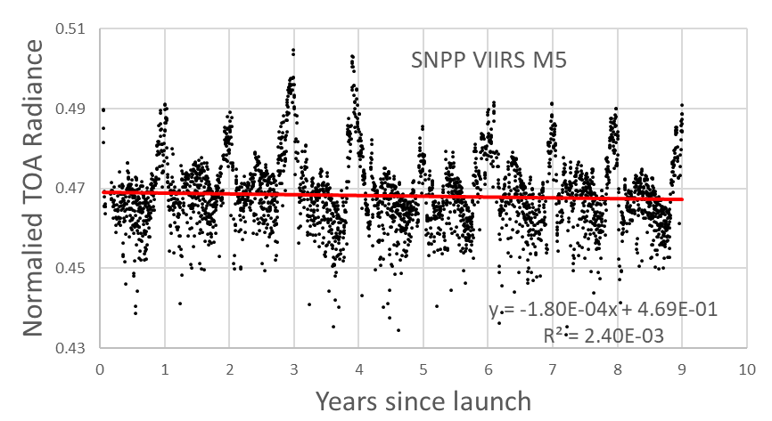
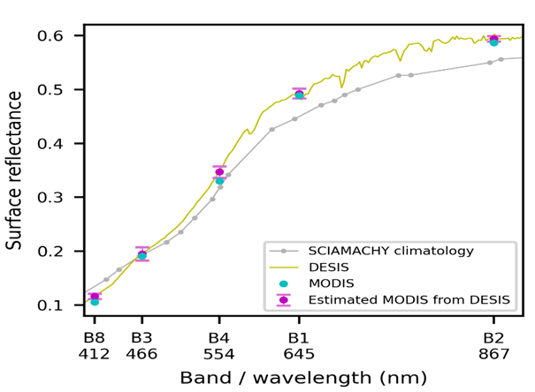
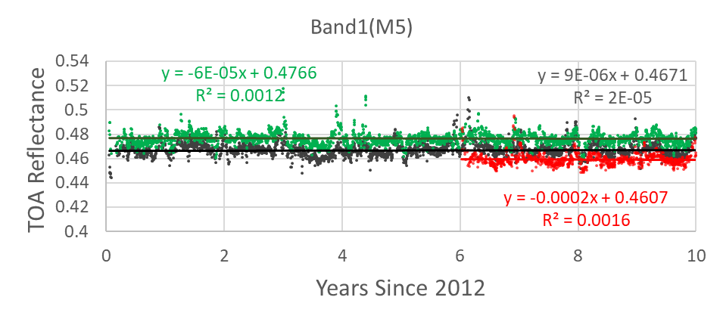
MAIAC Continuity
(Steps 1-2)
MAIAC VIIRS Calibration (Libya 4)
( based on Lyapustin et al., AMT, 2014)
1. Perform MAIAC retrievals (CM, AOD, WV, BRDF etc.);
2. Compute TOA reflectance (R_{n}) for a fixed view geometry (VZA=0°, SZA=30°) and evaluate trends in both MODIS Aqua and VIIRS SNPP and N20;
3. Applied spectral conversion factor based on DESIS to account for RSR difference;
4. Apply de-trending and compute VIIRS-MODIS Aqua X-calibration factors
5. Good overall agreement with MCST/VCST and NASA LaRC but more reliable in VIIRS X-calibration to MODIS Aqua (Lyapustin et al. (in preparation) )
6. Continuity of MAIAC MODIS and VIIRS Aerosol, surface reflectance (BRF), BRDF, NDVI records.
(Step 3) - Novel
(Step 4)

Slide 14
Status of MODIS & VIIRS LAI/FPAR Products
(2022 NASA Land Discipline Team Virtual Workshop, Apr 11-12)
Product Suite
MODIS LAI/FPAR Product suite
Terra (MOD), Aqua (MYD), and Terra and Aqua (MCD)
8 days for MOD/MYD, 4 days for MCD
500m
LAI (FPAR) Validation at stage 2 (1)
VIIRS LAI/FPAR Product suite
VNP15A2H
8 days
500m
LAI & FPAR Validation at stage 1
Publications
Algorithm & Product Evaluation
Yan et al., 2021. Performance stability of the MODIS and VIIRS LAI algorithms inferred from analysis of long time series of products. Remote Sensing of Environment, doi: 10.1016/j.rse.2021.112438
Yan et al., 2021. A Bibliometric Visualization Review of the MODIS LAI/FPAR Products from 1995 to 2020. Journal of Remote Sensing, doi: 10.1109/TGRS.2021.3064018
Pu et al., 2020. Evaluation of the MODIS LAI/FPAR Algorithm Based on 3D-RTM Simulations: A Case Study of Grassland. Remote Sens., doi:10.3390/rs12203391
Xu et al., 2020. Improving leaf area index retrieval over heterogeneous surface mixed with water. Remote Sens. Environ., doi:10.1016/j.rse.2020.111700
Science
Cortes et al., 2021. Where are Global Vegetation Greening and Browning Trends Significant? Geophys. Res. Lett., doi: 10.1029/2020GL091496
Zhu et al., 2021. Comment on “Recent global decline of CO2 fertilization effects on vegetation photosynthesis”. Science, doi: 10.1126/science.abg5673
Yan et al., 2021. Modeling the radiation regime of a discontinuous canopy based on the stochastic radiative transport theory: Modification, evaluation and validation. Remote Sens. Environ., doi: 10.1016/j.rse.2021.112728

Slide 15
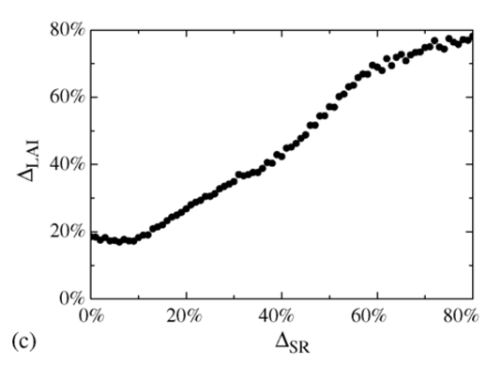
Status of MODIS & VIIRS LAI/FPAR Products
(2022 NASA Land Discipline Team Virtual Workshop, Apr 11-12)
Current & Planned Activities
Impact of Sensor Drift:
Product discontinuity will become severe when SZA is greater than 60º. This could be around when Aqua crossing times are past 4 PM.
The LAI product is less impacted because the geometry is an input and accounted for.
The FPAR product has a natural daytime variation and methods to suppress this are being studied and built into the algorithm either via minor code changes and/or changes to LUTs.
Uncertainties in upstream SR products (and to a lesser extent the Biome map) impact retrieval quality of LAI and FPAR. This is being studied. We use “LAI precision vs SR precision” curve to quantify the propagation (Fig. below; Tan et al., Agric. For. Meteorol.,135: 124-134 2006).
VIIRS Research:
Our VIIRS activities are geared towards operational generation of C2 LAI/FPAR products from SNPP (2012-2024) and JPSS1 (2018-2024) data that are consistent with the MODIS products. Specific proposed tasks are: (a) algorithm maintenance and SIPS implementation, (b) C2 product error and uncertainty analyses, (c) project activities and (d) scientific research with C2 products.
Multi-Decadal Time Series Products:
Developing a single time series of LAI & FPAR products by pooling best quality retrievals from MODIS (Terra & Aqua) and VIIRS and applying simple techniques to remove outliers and gap-fill. This time series will be extended to JPSS products and will be useful for monitoring global vegetation.

Slide 16
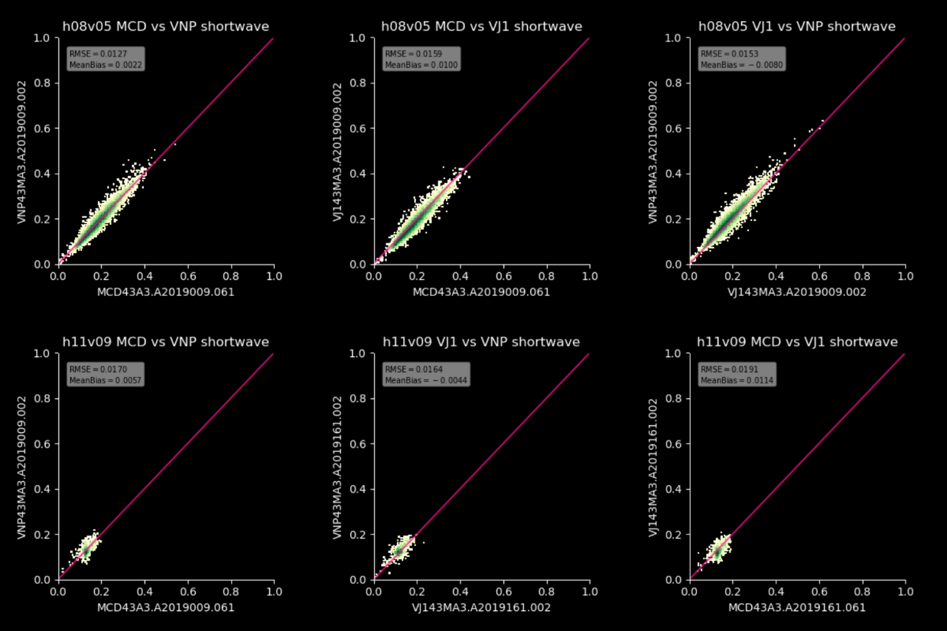
Maintenance and Continuity of MODIS, SNPP, and JPSS BRDF, NBAR Albedo products PI: C. Schaaf, CoIs: Z. Wang, I. Paynter, Collaborators: D. Hall, G. Riggs, X. Zhang
The global daily MODIS MCD43 BRDF (Bidirectonal Reflectance Distribution Function (BRDF) parameters , Nadir BRDF-Adjusted Reflectances (NBAR) and White Sky (diffuse) and Black Sky (direct) Albedos are available under reprocessing C6.1 from 2000 to present.
Seven spectral land bands and three shortwave broadbands at a gridded 500m spatial resolution in sinusoidal tiles, at 30arc second spatial resolution on a lat/lon projection (MCD43D*), and at a 0.05degree resolution (MCD43C*) – all with extensive QA.
Comparisons of MCD. SNP, VJI Shortwave Albedos Values
Daily snow-free gap-filled product (MCD43GF*) at a gridded 30arc second on a lat/lon projection.
VIIRS global daily VNP43 BRDF, NBAR, and Albedo product under C1 reprocessing are also available (awaiting calibration enhancements for C2 reprocessing).
Three Imagery spectral bands (VNP43I*) at a gridded 500m spatial resolution.
Nine Moderate Spectral Bands, the DayNight Band (VNP43M* and VNP43DNB*), and 3 shortwave broadbands) at a gridded 1km spatial resolution.
VIIRS VJ143 BRDF, NBAR, and Albedo products are also under development to provide continuity well into a third decade and beyond.

Slide 17
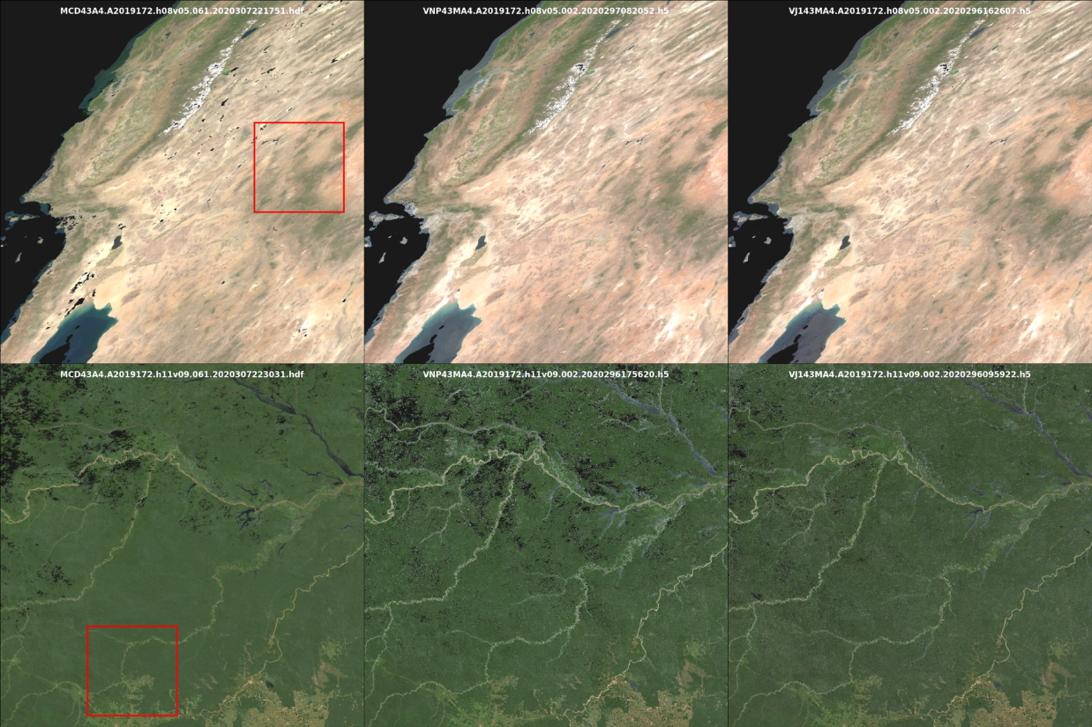
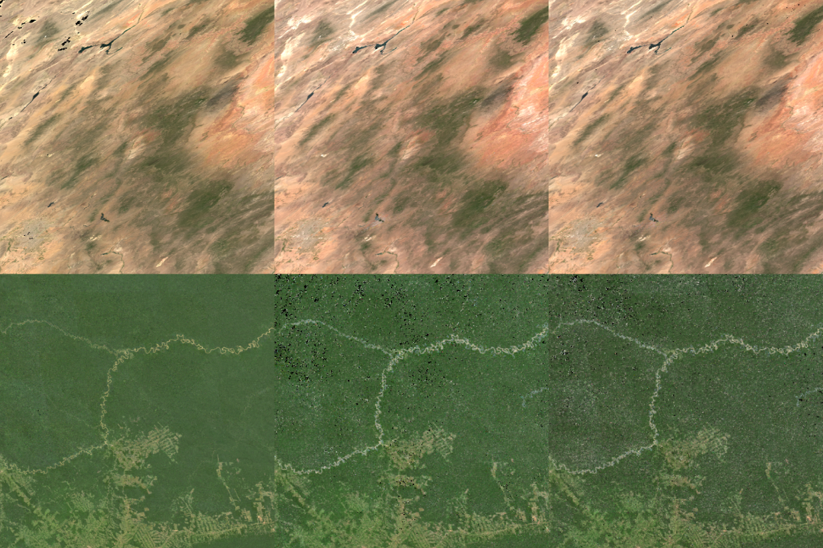
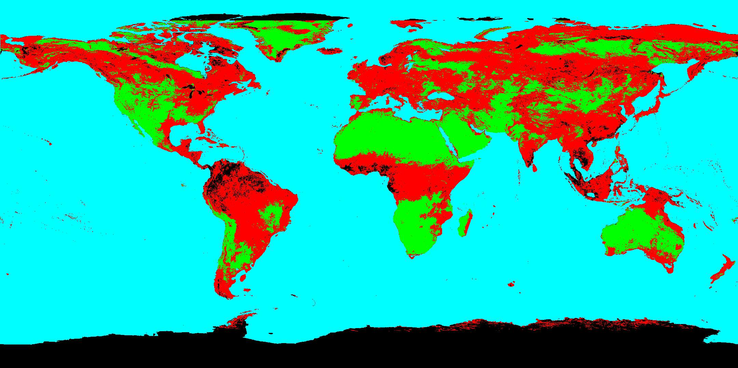
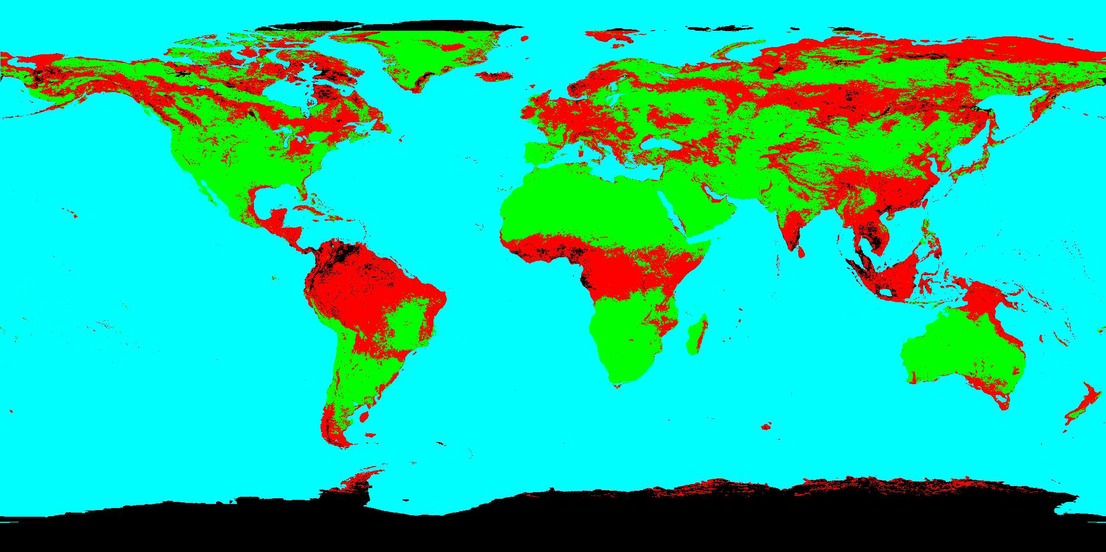
Maintenance and Continuity of MODIS, SNPP, and JPSS BRDF, NBAR Albedo products PI: C. Schaaf, CoIs: Z. Wang, I. Paynter, Collaborators: D. Hall, G. Riggs, X. Zhang
MODIS, SNPP, JPSS-1 NBAR
Comparisons
MCD43A42019172h08v05
MCD43
VNP43
VJ143
MCD43A42019172h11v09
MCD43 currently relies on both Aqua and Terra observations. Loss of one satellite does not affect the absolute values of the retrievals flagged as high quality, but it does reduce the number of high quality observations possible. Combined use of SNPP and VJ1 mitigates this impact.
Terra alone
Terra+Aqua
MCD43A4A2019172h11v09
Difference in MCD43 quality globally where green is high quality, red is poorer quality

Slide 18
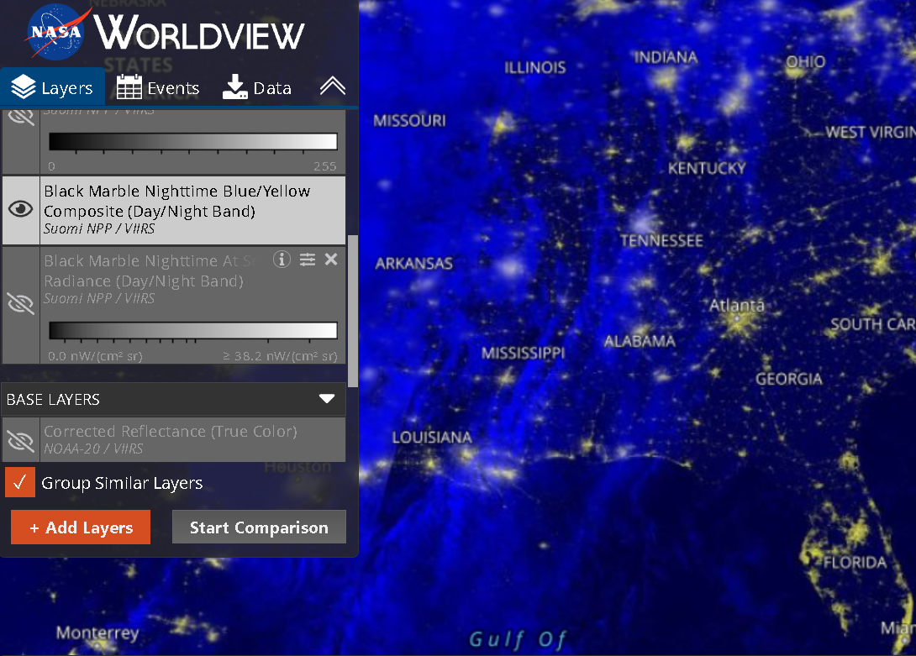
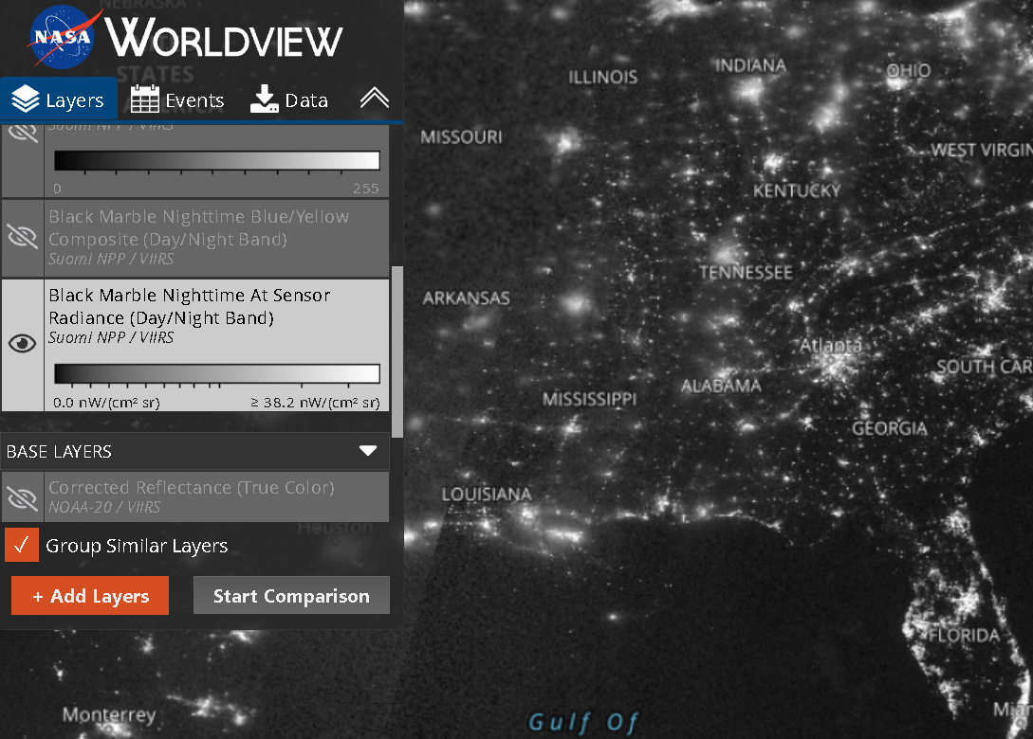
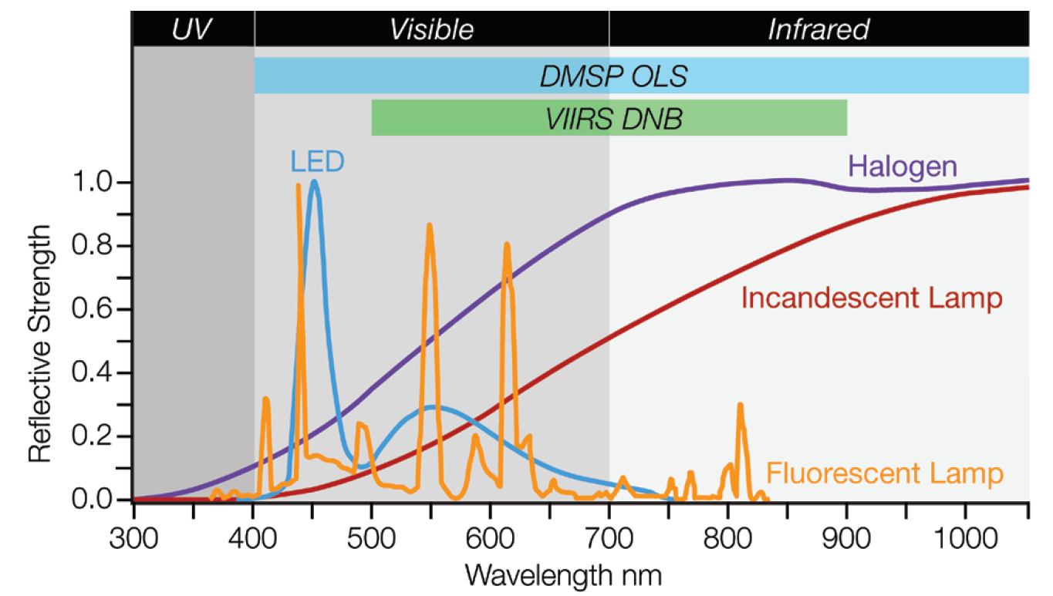
Maintenance and Continuation of NASA's Black Marble Nighttime Lights Product Suite from Suomi-NPP and NOAA-20 VIIRS
PI: Zhuosen Wang; Co-Is: Virginia Kalb, Ranjay Shrestha, Zhe Zhu, Srija Chakraborty, Eleanor Stokes, Miguel Román
Products Status
In operation 2012-present:
Daily - VNP46A1/VNP46A2
Monthly - VNP46A3
Annual - VNP46A4
LANCE and Blue-Yellow NTL -VNP46A1
To be implemented:
VNP46A5 (change metrics)
LANCE - VNP46A2
VCD46 (SNPP + NOAA-20 combined)
SNPP and NOAA-20 DNB cross-calibration
DESIS was applied for RSR adjustment at Libya
SNPP and NOAA-20 DNB match well after de-trending and RSR adjustment
Vegetation is impacted the most by SNPP and NOAA-20 DNB RSR difference

Slide 19
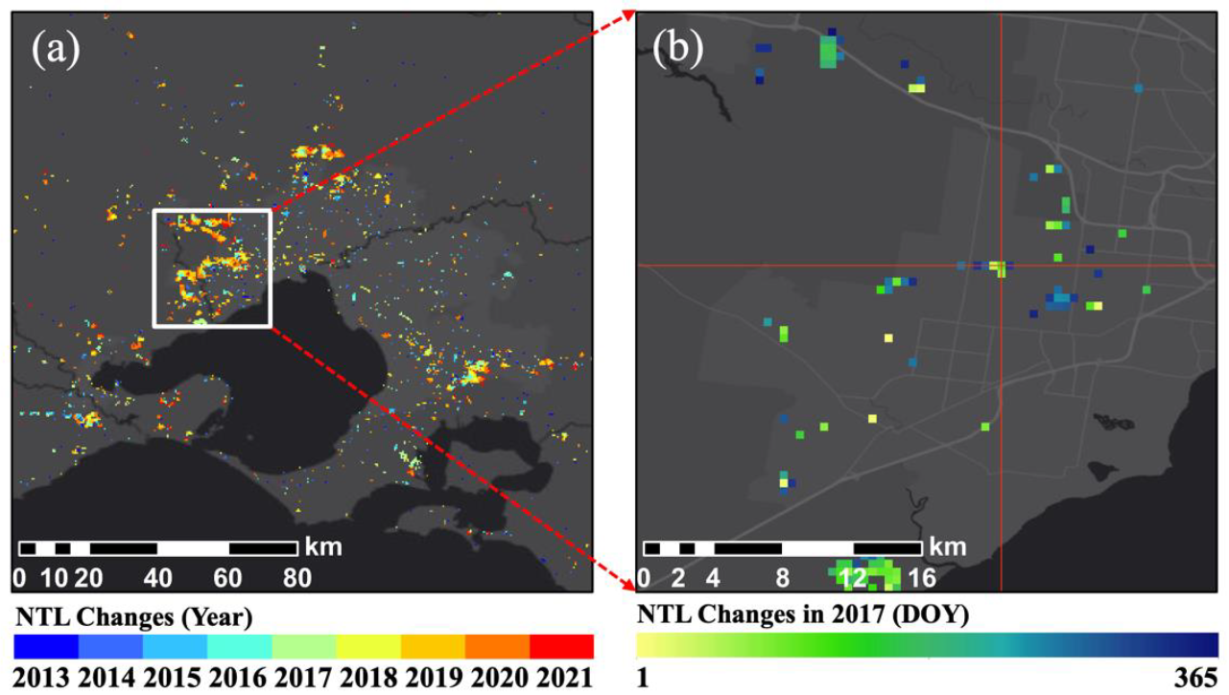
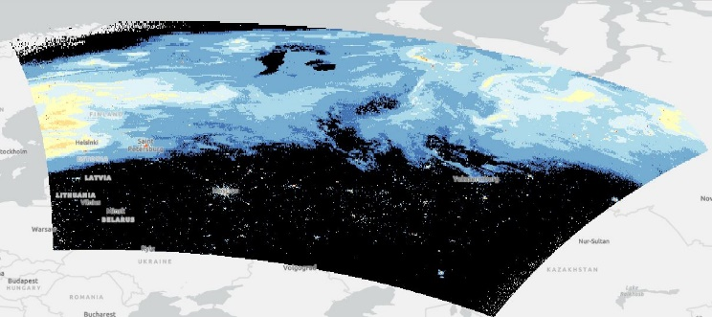
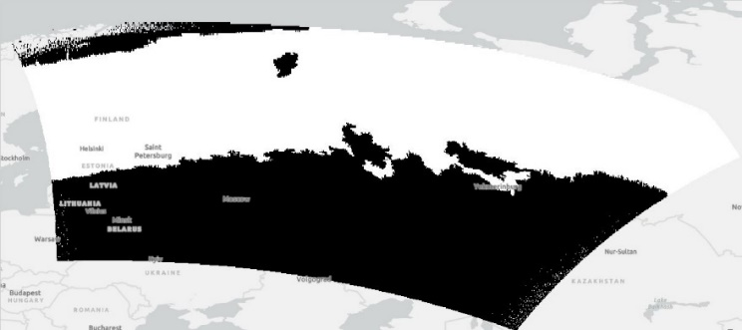
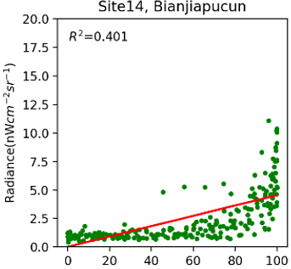
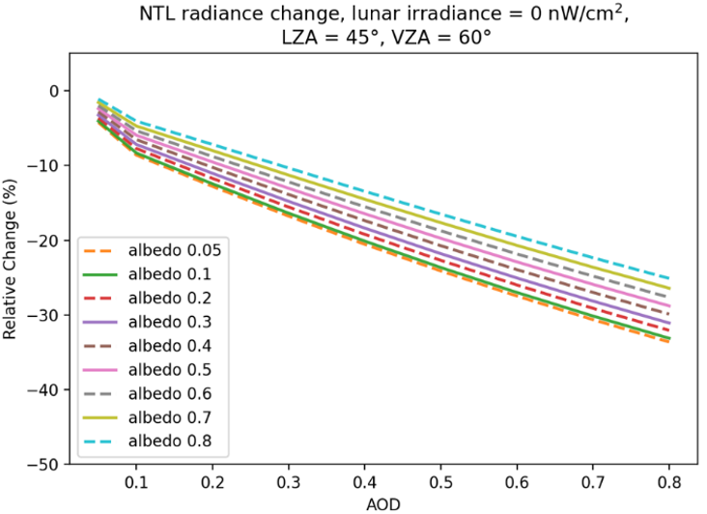
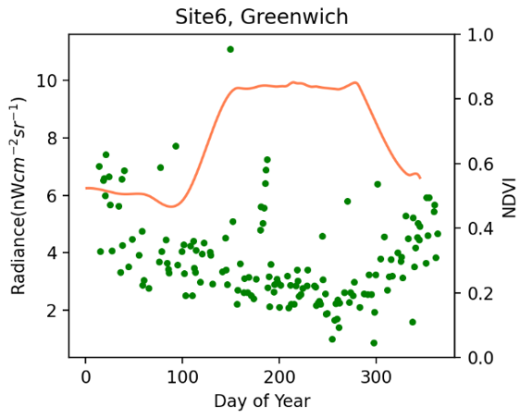
Maintenance and Continuation of NASA's Black Marble Nighttime Lights Product Suite from Suomi-NPP and NOAA-20 VIIRS
Change metrics (VNP46A5)
Lunar-BRDF-corrected nighttime radiance over ocean
Aurora mask
DNB radiance
Aurora mask
VNP46A1
VNP46A2
Uncertainty
Angular effect
Vegetation effect
Lunar effect
Atmospheric effect

Slide 20
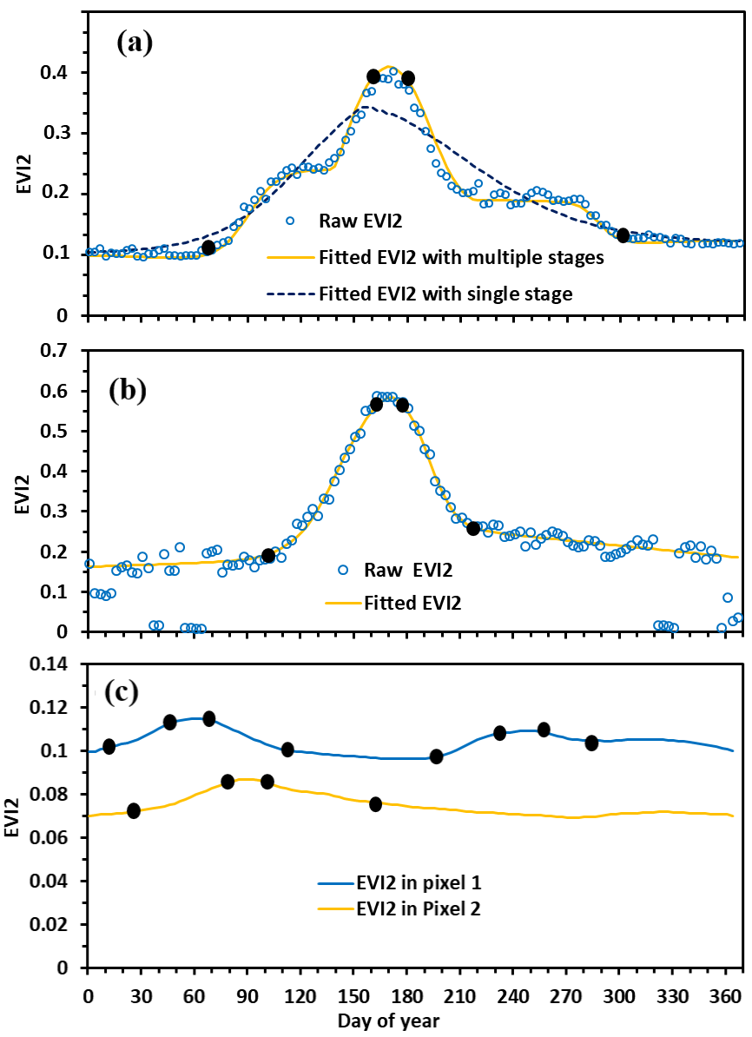
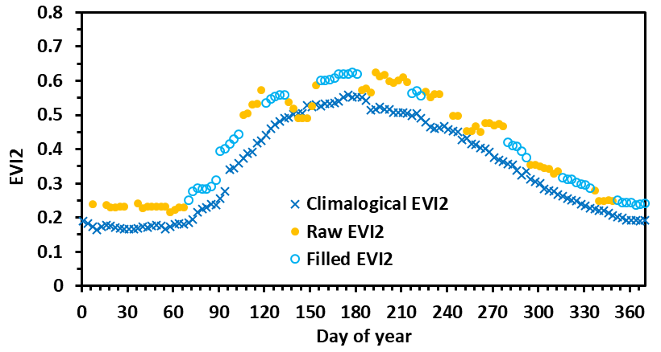
Maintenance, Evolution, and Validation of the Global Land Surface Phenology Product from Suomi NPP and JPSS VIIRS Observations
Principal Investigator: Xiaoyang Zhang; Co-Investigator: Geoffrey M. Henebry; Collaborators: Mark A. Friedl, Crystal Schaaf
Summary
1. Maintain and refine the algorithm for implementing the VIIRS Global Land Surface Phenology (GLSP) product generation
Evaluate VIIRS C2 GLSP products. Once the GLSP products (at both 500-m pixels and 0.05-degree grids) available from 2013-2022, we will compare the GLSP with observations from national phenology networks, PhenoCam networks, and finer resolution satellite observations.
Update algorithm for the generation of VIIRS C3 GLSP products.
Enhance the algorithm of phenology detections in arid and semiarid ecosystems.
Update climatology of EVI2 time series by blending VIIRS EVI2 climatology and geostationary satellite observations (particularly in tropical rainforests and monsoon regions) in order to fill the gaps with persistent cloud cover in VIIRS time series
Temporal EVI2 trajectories in arid and semiarid ecosystems. The solid dots are the key phenological transition dates.
2. Generate temporal continuity of C3 GLSP products from SNPP and JPSS-1 VIIRS observations at both 500-m pixels and 0.05-degree Climate Modeling Grid (CMG)
Investigate the temporal EVI2 trajectories observed from SNPP and JPSS-1 VIIRS data.
Investigate and calibrate the phenological difference or uncertainty between SNPP and JPSS-1 data at the scales of pixels and ecoregions.
Filling consecutive gaps in an EVI2 time series using climatology EVI2 and SSMM approach

Slide 21
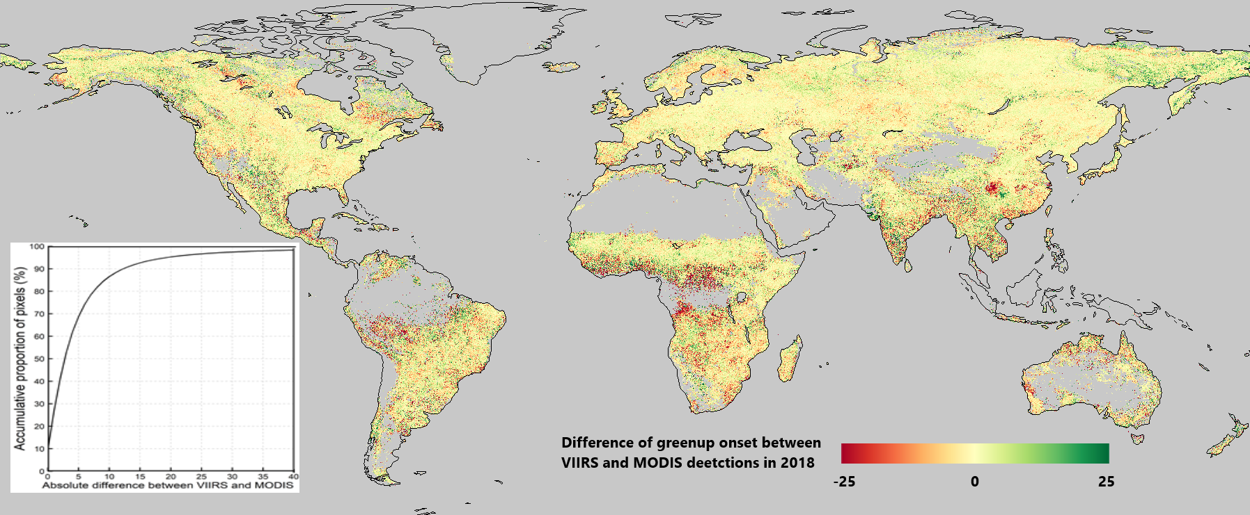
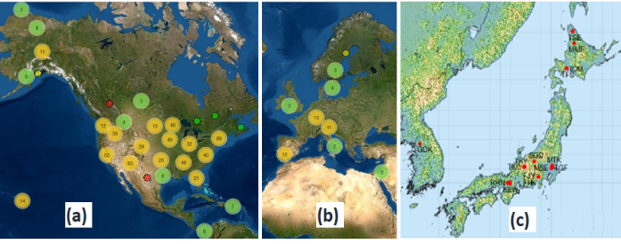
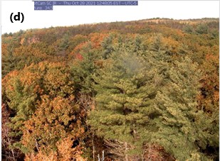
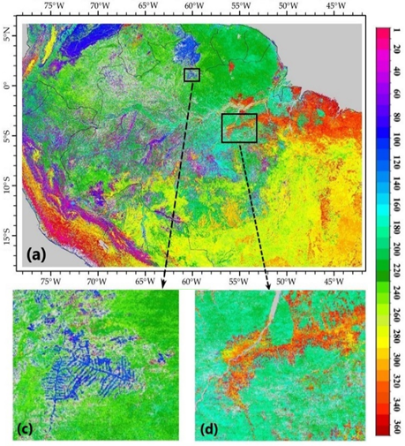
Maintenance, Evolution, and Validation of the Global Land Surface Phenology Product from Suomi NPP and JPSS VIIRS Observations
Investigate the continuity between VIIRS and MODIS GLSP detections.
Phenocam network in (a) North America, (b) Europe, and (c) Japan. (d) Phenocam imagery
(3) Validate and evaluate the stability, precision, uncertainty, accuracy, and spatial and temporal continuity of the SNPP and JPSS-1 GLSP products using multiple reference data sources
Develop standard phenological reference by fusing gap-free (poor geolocation accuracy) Phenocam time series with frequently cloud-contaminated (high geolocation accuracy) Landsat-Sententile-2 time series across the phenocam sites.
Calculate phenometrics from VENµS times series and PlanetScope time series, separately, with a spatial resolution of 3-5 m.
Generate phenological references from geostationary satellite observations in cloud-persistent regions (such as Amazon region and Southeast Asia).

Slide 22
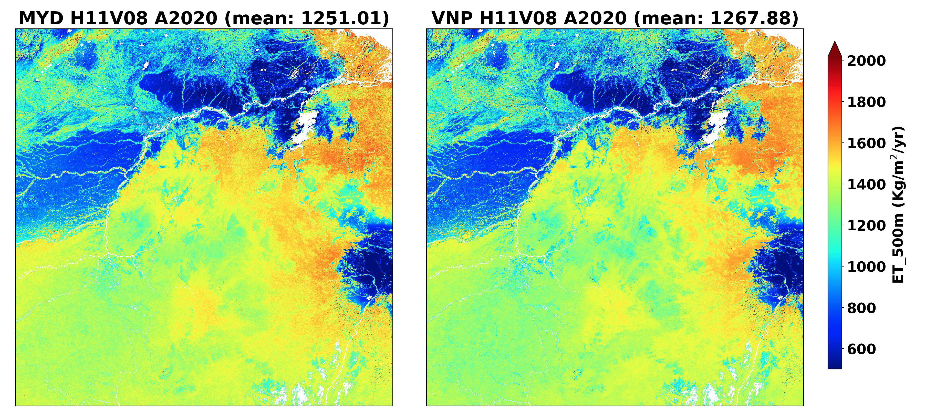
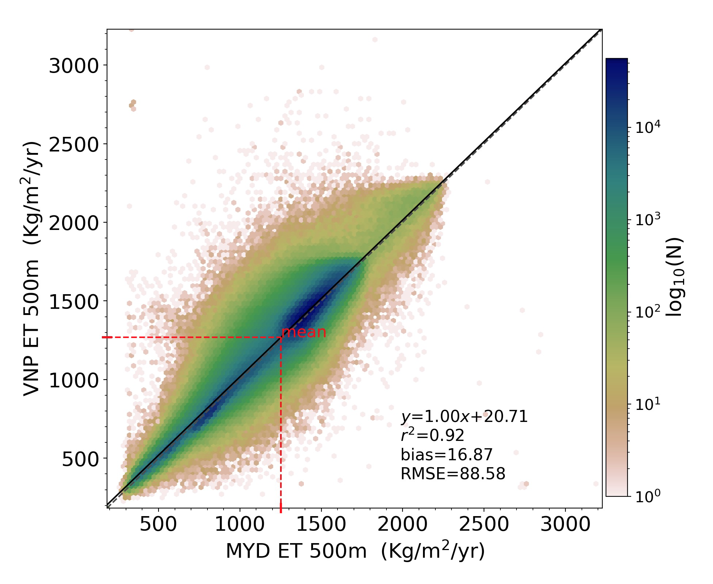
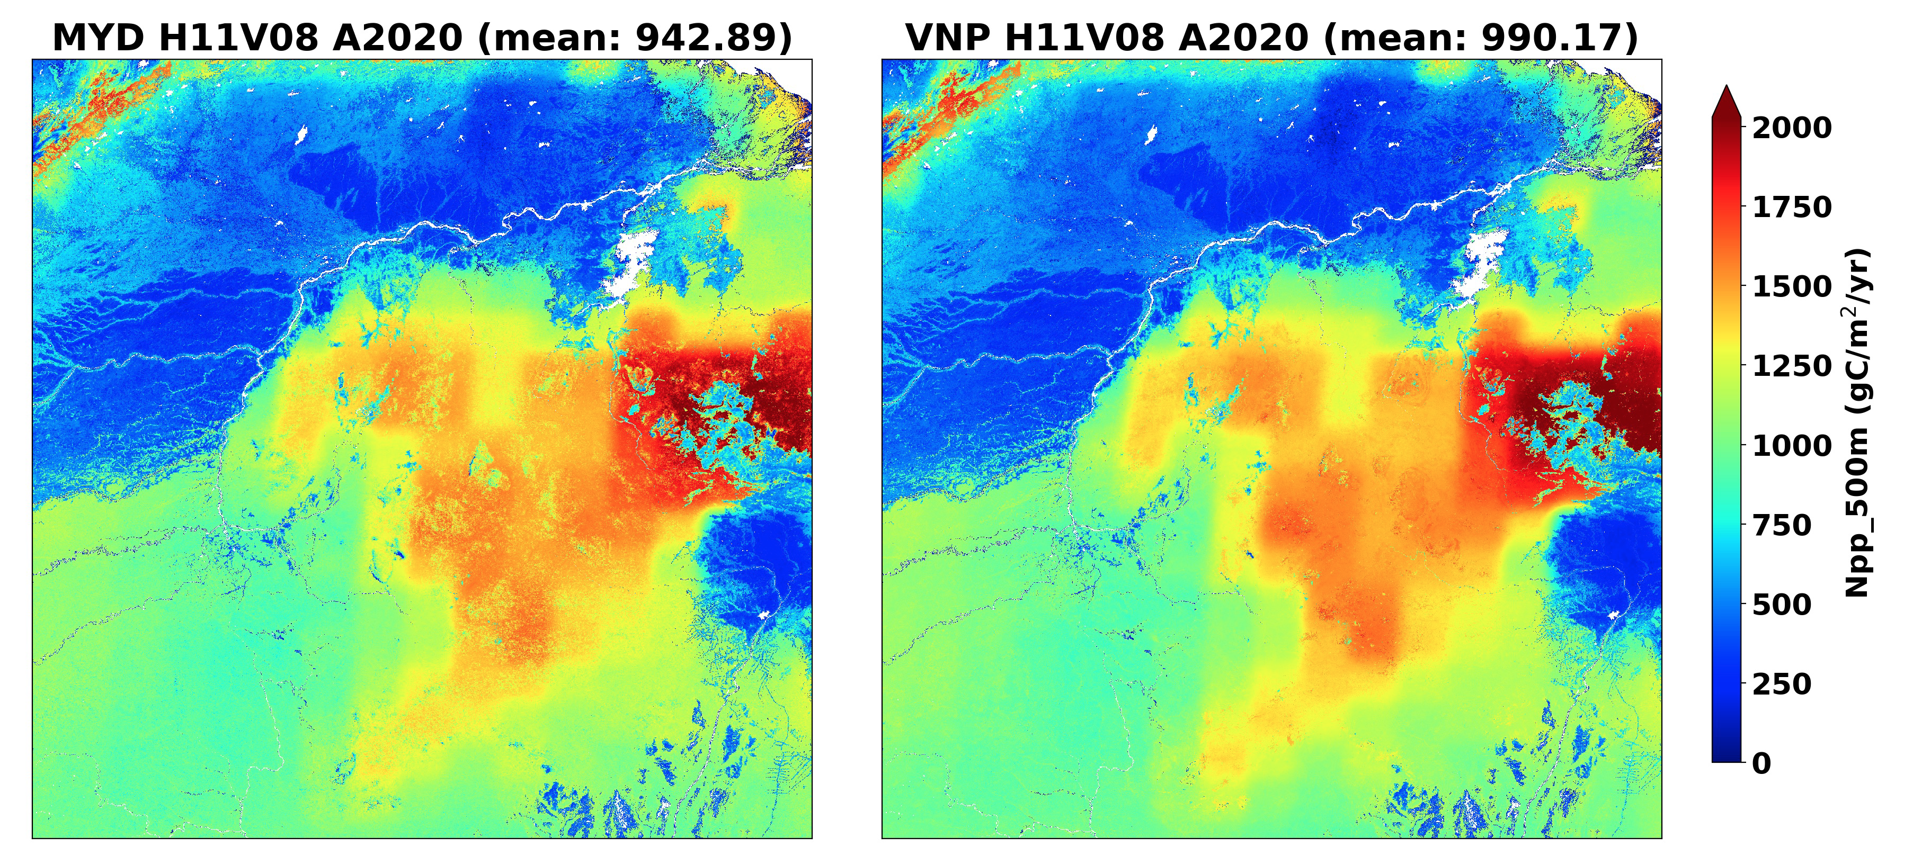
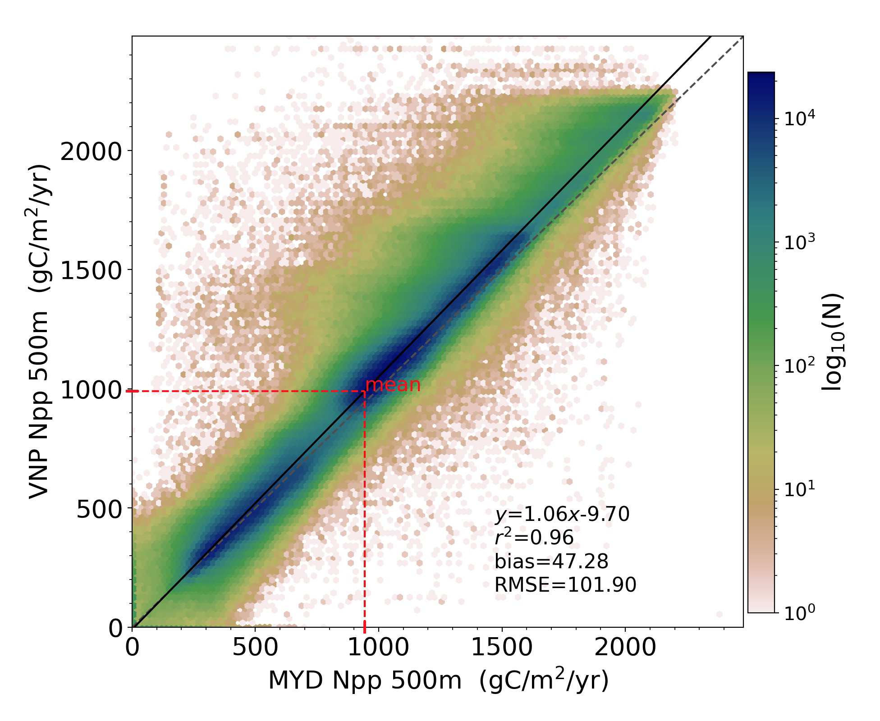
Terrestrial Evapotranspiration (ET/LE, MxD16, VNP16) and Gross and Net Primary Production(GPP/NPP, MxD17, VNP17)
Maosheng Zhao (SSAI), Arthur Endsley, John Kimball (UMT), Sadashiva Devadiga (NASA)
Proposed work will extend the two MODIS data records (MxD16/MxD17) into the VIIRS era by generating the VIIRS products (VNP16/VNP17).
Will use the proven MODIS heritage algorithms with VIIRS specific changes.
Perform calibration and validation, algorithm changes to provide continuity from MODIS -> SNPP -> JPSS.
General consistency has been found between C61 MODIS/Aqua ET/NPP and tested VIIRS ones using VIIRS FPAR/LAI as input.
Comparisons between annual ET and NPP for 2020 for h11v08 (Amazon tile) show general consistency between C61 Aqua MYD16A3/MYD17A3H and tested C1 VIIRS VNP16A3/VNP17A3H.
Zhao, M., S. Devadiga, J. Kimball, A. Endsley, S. Running, 2021 AGU Fall Meeting Poster
Notes:
First to brief talk about the importance of ET/GPP/NPP such as water cycle, surface energy balance, drought detection, carbon cycle, ecological conditions, environment change etc. It is critical to have consistent long-term ET/GPP/NPP data products…

Slide 23
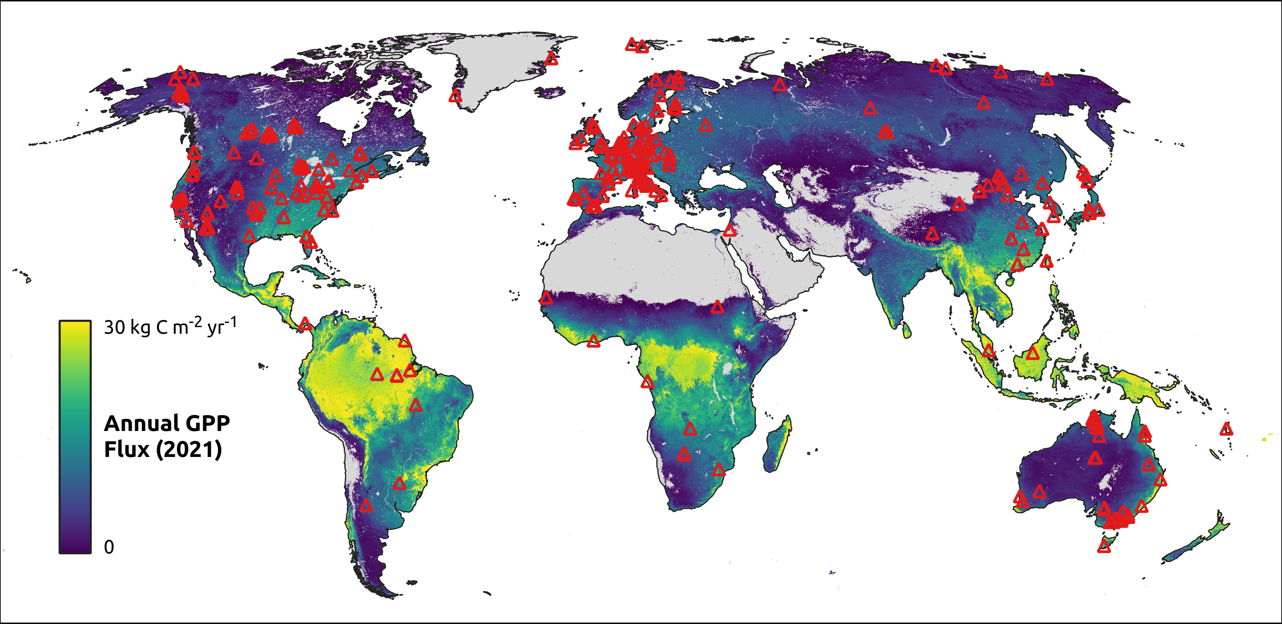
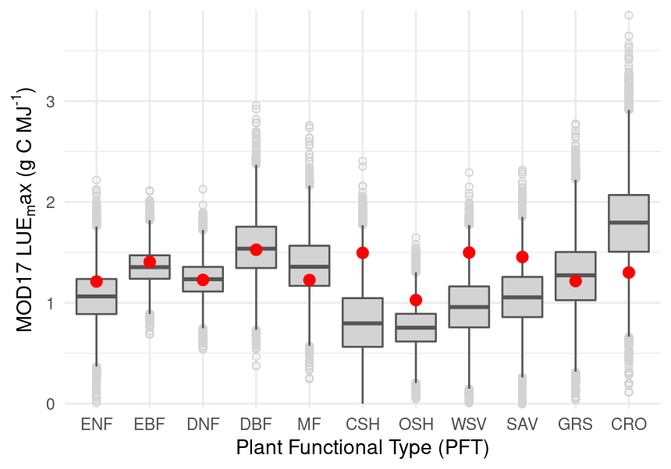
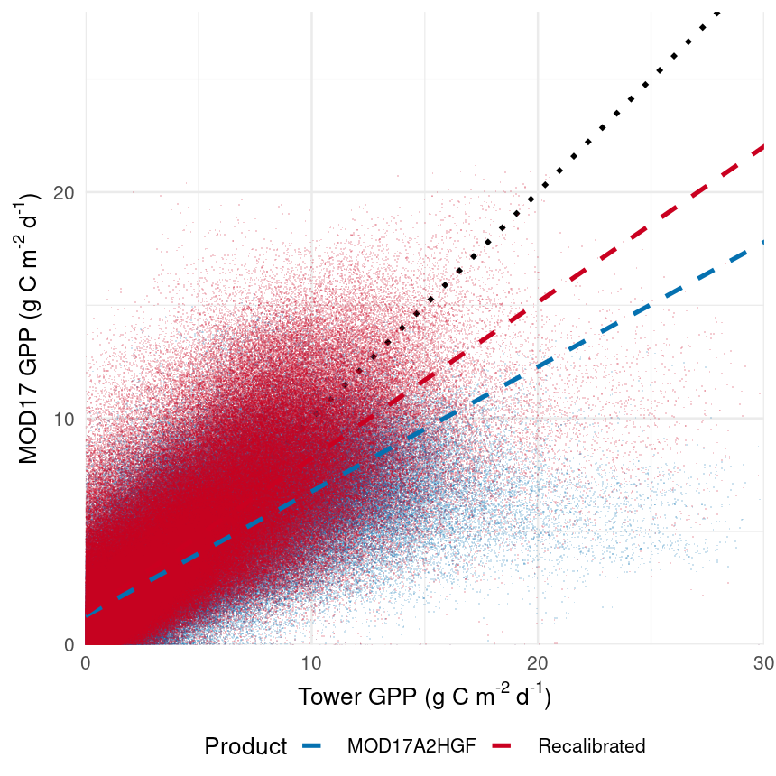
Terrestrial Evapotranspiration (ET/LE, MxD16, VNP16) and Gross and Net Primary Production(GPP/NPP, MxD17, VNP17)
Calibration and Validation are key to the quality of the data products!
Use global eddy covariance (EC) flux towers data (approx. 1,500 site-years of data) and in-situ NPP data for calibration and validation. Differential Evolution MCMC allows for quantification of parameter uncertainty. Here we show that calibrated LUEmax can improve 8-day GPP estimates. Continuing calibration of other parameters will further enhance data quality. C7 MxD16/MxD17 and C2 VNP16/VNP17 will use the recalibrated BPLUTs.
Perform product sensitivity and trend analysis from using different global meteorological reanalyses (GMAO, NCEP-II, ERA-ECMWF) (For long-term data products, quality generally has three aspects: magnitude, interannual variability, and trend. All these three aspects are sensitive to the different global meteorological reanalyses).
Up: Distribution of global EC flux tower sites (red triangles); Bottom Left: Distribution of posterior best-fit LUEmax parameters (boxes) shown with C61 values (red dots); Bottom Right: Improved 8-day Gpp using recalibrated LUEmax.
Notes:
We will recalibrate biophysical parameters in the BPLUTs and the recalibrated BPLUTs will be used for the C7 MxD16/MxD17 and C2 VNP16/VNP17 (Arthur may provide some details on the statistic method for calibrating BPLUT for MODIS and VIIRS ET and GPP/NPP).

