Slide 1
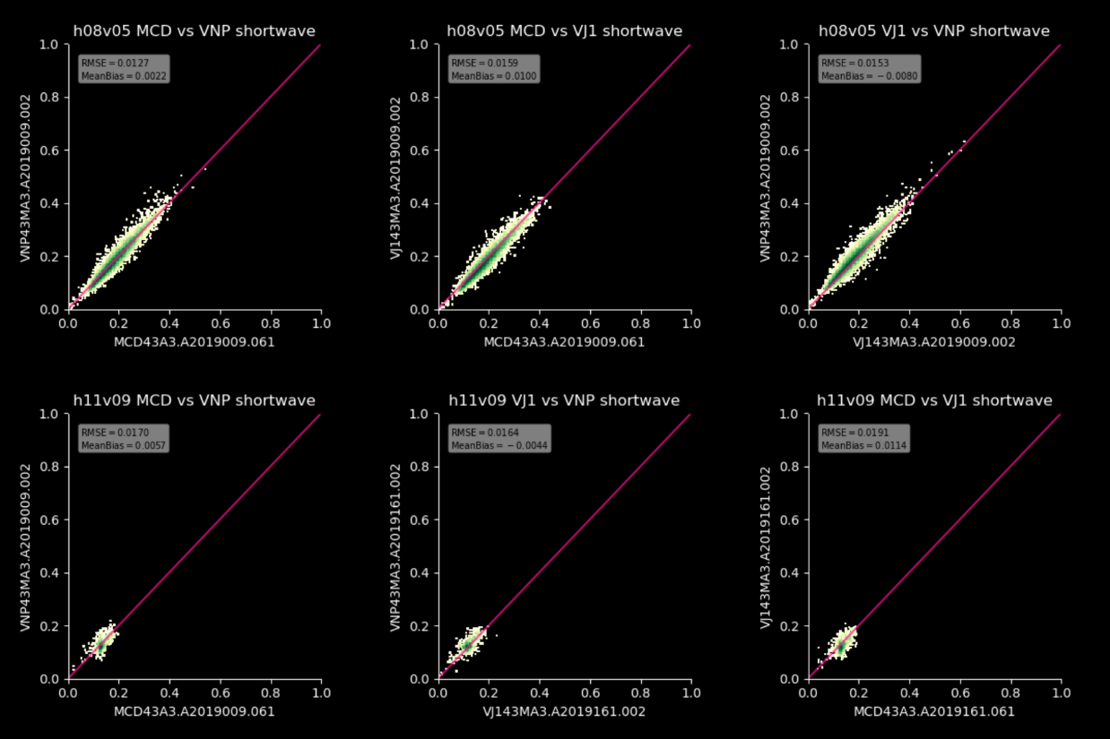
Maintenance and Continuity of MODIS, SNPP, and JPSS BRDF, NBAR Albedo products PI: C. Schaaf, CoIs: Z. Wang, I. Paynter, Collaborators: D. Hall, G. Riggs, X. Zhang
The global daily MODIS MCD43 BRDF (Bidirectonal Reflectance Distribution Function (BRDF) parameters , Nadir BRDF-Adjusted Reflectances (NBAR) and White Sky (diffuse) and Black Sky (direct) Albedos are available under reprocessing C6.1 from 2000 to present.
Seven spectral land bands and three shortwave broadbands at a gridded 500m spatial resolution in sinusoidal tiles, at 30arc second spatial resolution on a lat/lon projection (MCD43D*), and at a 0.05degree resolution (MCD43C*) – all with extensive QA.
Comparisons of MCD. SNP, VJI Shortwave Albedos Values
Daily snow-free gap-filled product (MCD43GF*) at a gridded 30arc second on a lat/lon projection.
VIIRS global daily VNP43 BRDF, NBAR, and Albedo product under C1 reprocessing are also available (awaiting calibration enhancements for C2 reprocessing).
Three Imagery spectral bands (VNP43I*) at a gridded 500m spatial resolution.
Nine Moderate Spectral Bands, the DayNight Band (VNP43M* and VNP43DNB*), and 3 shortwave broadbands) at a gridded 1km spatial resolution.
VIIRS VJ143 BRDF, NBAR, and Albedo products are also under development to provide continuity well into a third decade and beyond.

Slide 2
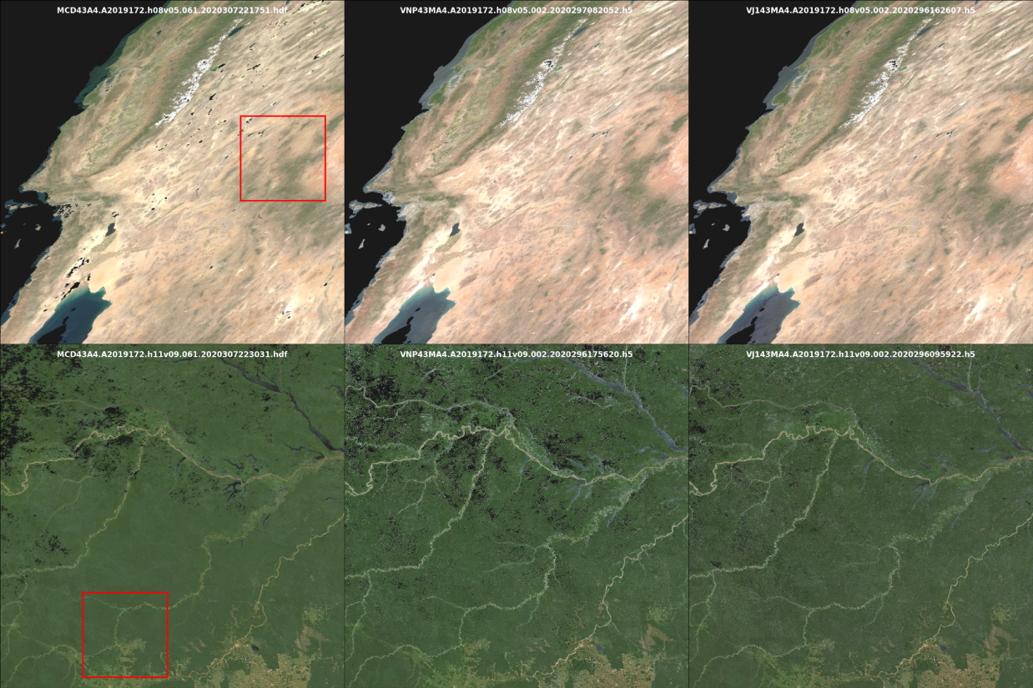
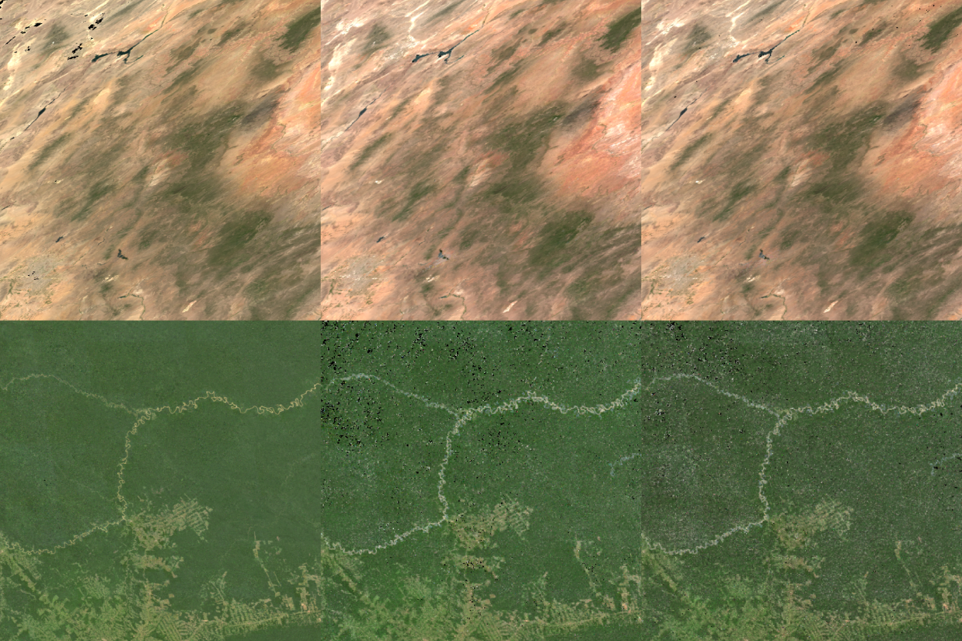
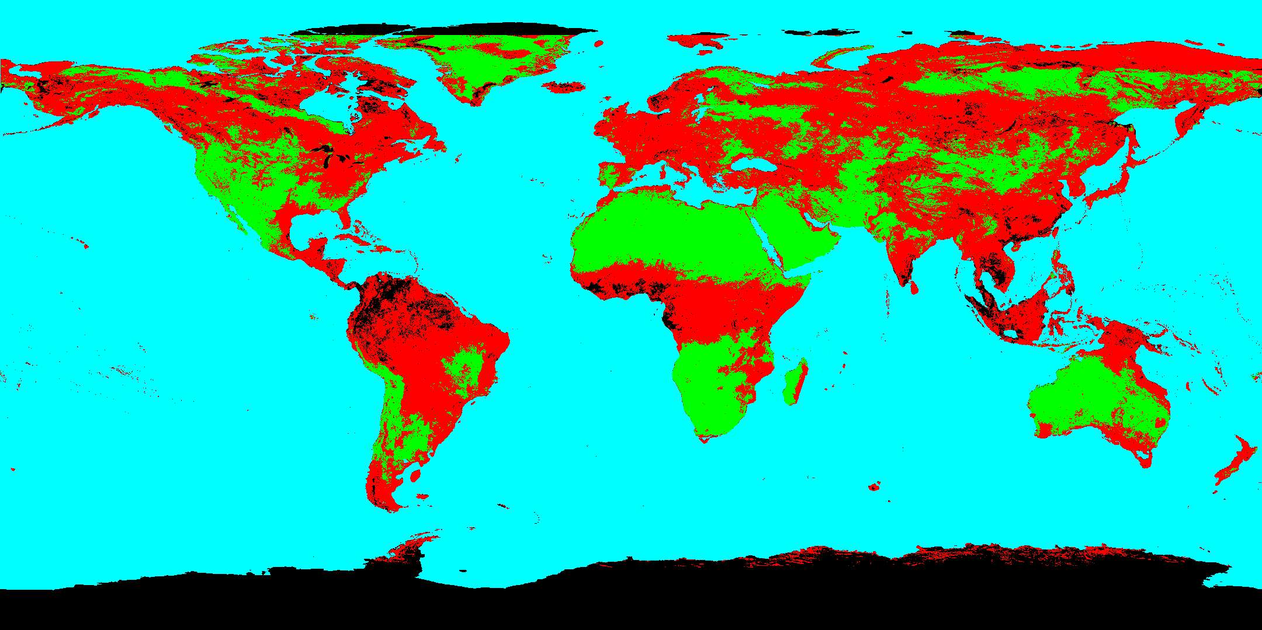
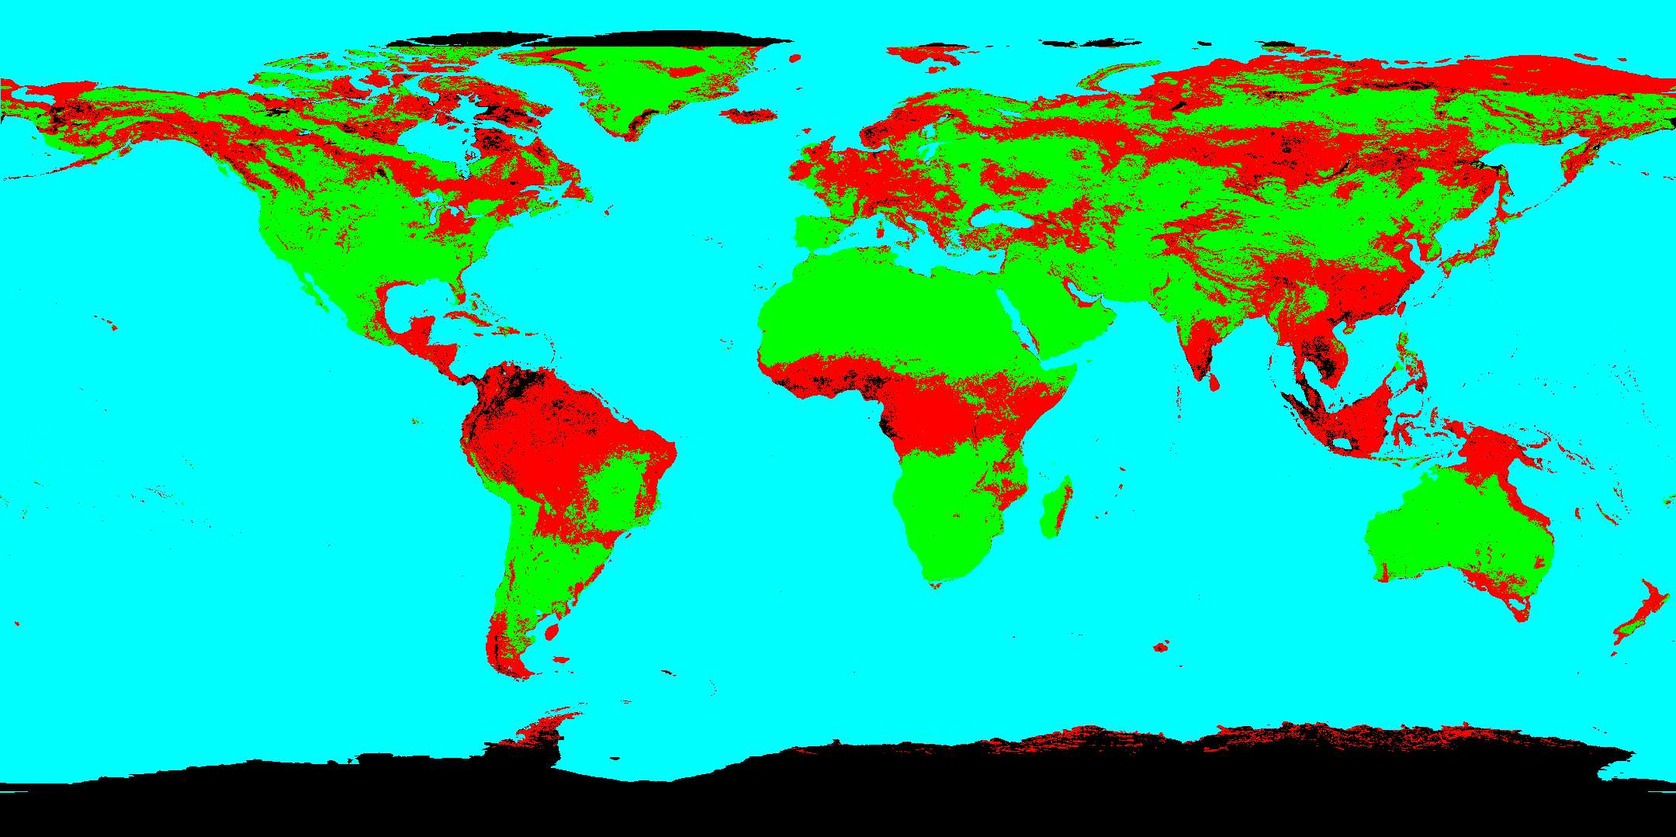
Maintenance and Continuity of MODIS, SNPP, and JPSS BRDF, NBAR Albedo products PI: C. Schaaf, CoIs: Z. Wang, I. Paynter, Collaborators: D. Hall, G. Riggs, X. Zhang
MODIS, SNPP, JPSS-1 NBAR
Comparisons
MCD43A42019172h08v05
MCD43
VNP43
VJ143
MCD43A42019172h11v09
MCD43 currently relies on both Aqua and Terra observations. Loss of one satellite does not affect the absolute values of the retrievals flagged as high quality, but it does reduce the number of high quality observations possible. Combined use of SNPP and VJ1 mitigates this impact.
Terra alone
Terra+Aqua
MCD43A4A2019172h11v09
Difference in MCD43 quality globally where green is high quality, red is poorer quality

