Slide 1
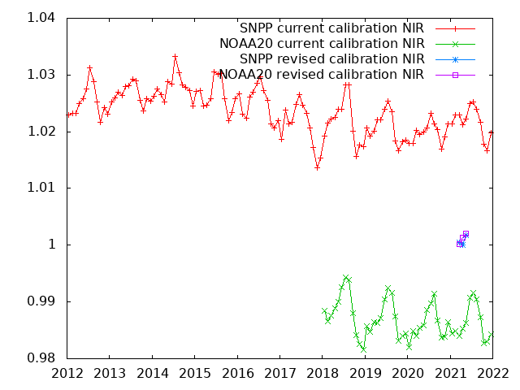
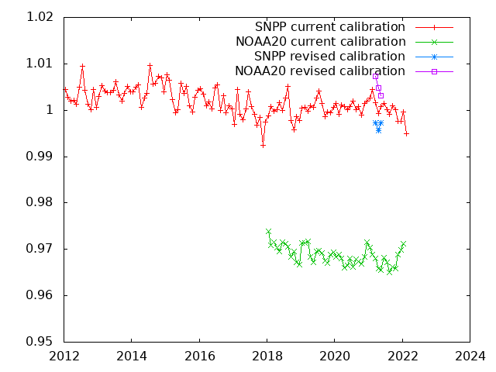
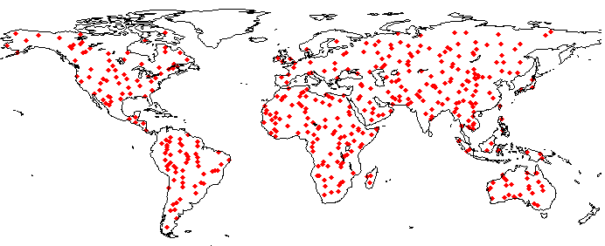
MODIS/VIIRS Surface Reflectance Maintenance and Long Term Continuity
MODIS SR Product suite (Aqua/Terra)
Collection 6.1
Bands 1 through 7 (0.47mic-2.13mic)
Level2, 2G,3 250m, 500m, 0.05 deg.
Daily, 8 days
Status and Updates:
MODIS SR collection 6 ( LaSRC: Land Surface Reflectance Code) is the basis for a variety of SR product (VIIRS, AVHRR, Landsat, Sentinel 2) assuring consistency and traceability in the SR products from multiple satellites/instruments.
Validation stage IV (AERONET) and BELMANIP ananlysis is on-going. ACIX-I-II (Landsat 8/ S2) is completed, ACIX-III,CMIX-II starting in June 2022
VIIRS is cross-calibrated with MODIS to ensure optimal consistency using Aqua (NIR), Deep Convective Clouds (VIS) and Sunglint (SWIR)
NIR, analysis over BELMANIP (ref Aqua)
Band | NOAA20 | SNPP
M1 | 1.0213+0.001292x(Year-2018) | 0.9652-0.000235x(Year-2012)
M2 | 1.0276+0.001683x(Year-2018) | 0.9799+0.000179x(Year-2012)
M3 | 1.0260+0.001680x(Year-2018) | 0.9850-0.000579x(Year-2012)
M4 | 1.0264+0.001605x(Year-2018) | 0.9827-0.000125x(Year-2012)
M5 | 1.0201+0.000917x(Year-2018) | 0.9806+0.000243x(Year-2012)
M7(I2)* | 1.0068+0.000814x(Year-2018) | 0.9724+0.000862x(Year-2012)
M7(M5) | 1.0080+0.000834x(Year-2018) | 0.9723+0.000821x(Year-2012)
I1 | 1.0333+0.001299x(Year-2018) | 0.9948+0.000433x(Year-2012)
I2 | 1.0121+0.000514x(Year-2018) | 0.9731+0.000760x(Year-2012)
Results of SIPS
(3 months test)
Red, analysis over BELMANIP (ref Aqua)
VIIRS SR Product suite (SNPP/NOAA20)
Collection 1
Bands M1-M11, I1-I3 (0.42mic-2.25mic)
375m, 500m,750m,1km, 0.05 deg.
Daily, 8 days
Status and Updates:
Adapted from MODIS LaSRC (Land Surface Reflectance Code)
Validation stage IV (AERONET) and cross-comparison with MODIS is on-going (BELMANIP).
Consistency with NOAA products is being work in collaboration with NOAA/STAR team.
M5,I1 were combined to spectrally match Aqua band 1
BELMANIP SITES
Eric Vermote NASA/GSFC

Slide 2
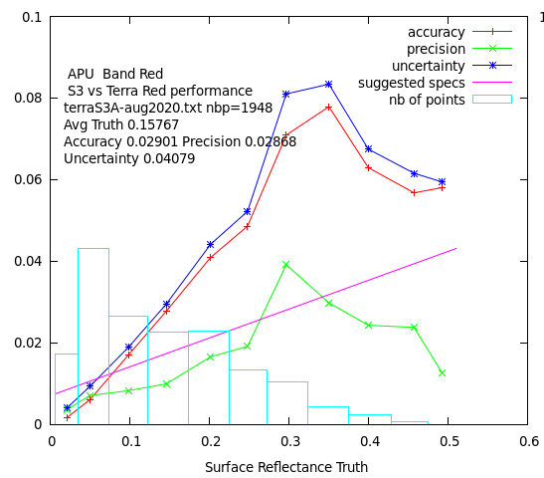
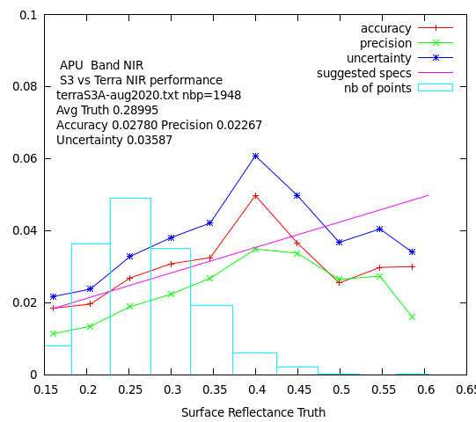
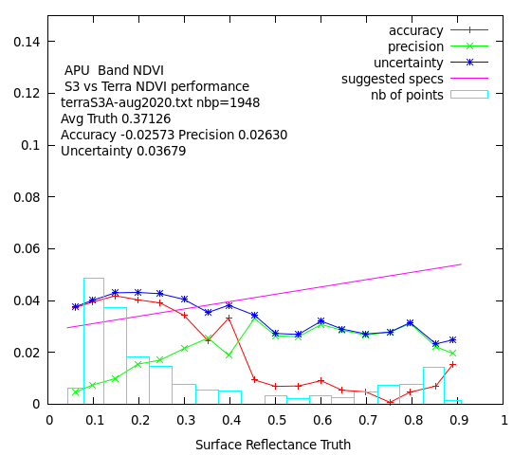
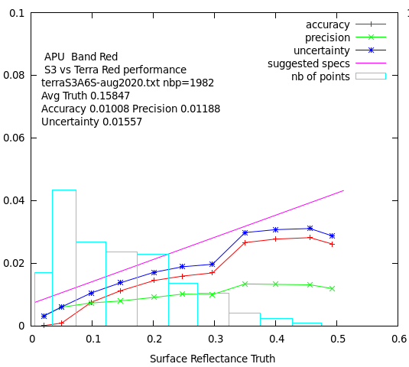
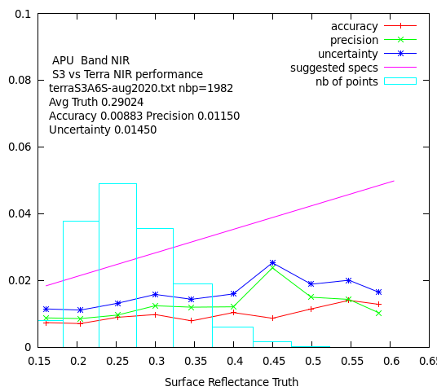
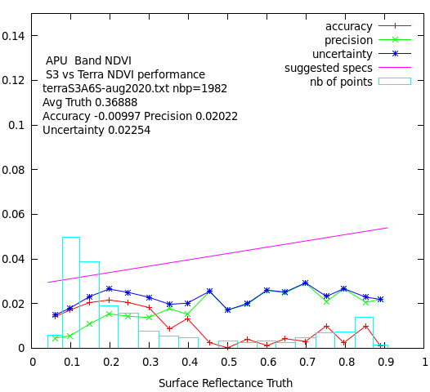
Beyond Terra MODIS…
Sentinel 3 official ESA SR versus Terra (APU) Aug 2020
Sentinel 3 Synergy (OLCI/SLSTR) 10:00am orbit
Covers MODIS spectral range including thermal (cloud screening)
Spatial resolution from 300m to 1km
S3A (2016), S3B(2018), S3C,D (TBL), S3-NG (planned)
Level 1,2 archive in MODAPS
Status and Updates:
Evaluation of L2 (surface reflectance) official ESA product shows room for improvement.
Development of a simple LaSRC prototype on the Level1 data shows promising results.
We are part of the ESA Expert working group on S3-NG
Sentinel 3 prototype LaSRC style SR versus Terra (APU) Aug 2020
Eric Vermote NASA/GSFC

