Slide 1
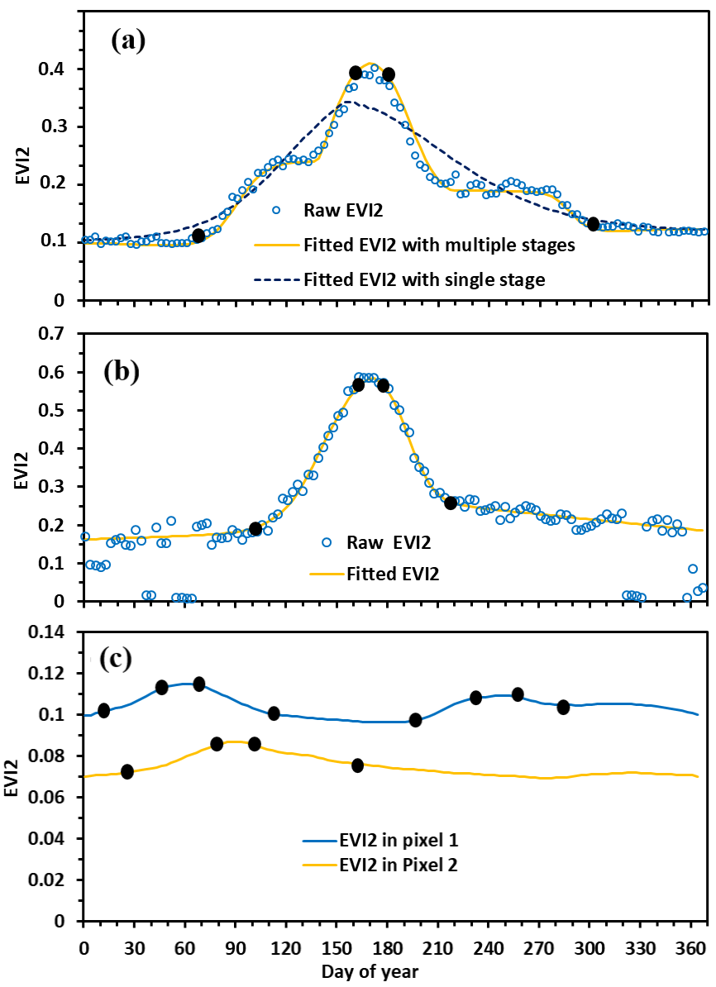
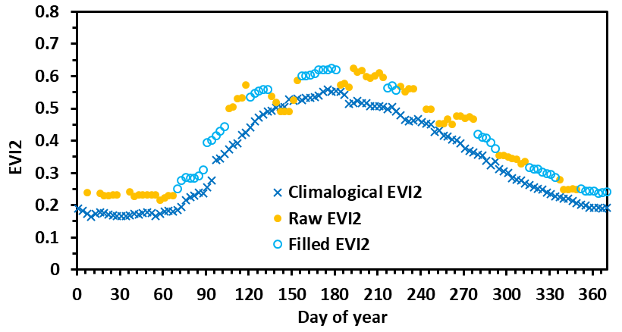
Maintenance, Evolution, and Validation of the Global Land Surface Phenology Product from Suomi NPP and JPSS VIIRS Observations
Principal Investigator: Xiaoyang Zhang; Co-Investigator: Geoffrey M. Henebry; Collaborators: Mark A. Friedl, Crystal Schaaf
Summary
1. Maintain and refine the algorithm for implementing the VIIRS Global Land Surface Phenology (GLSP) product generation
Evaluate VIIRS C2 GLSP products. Once the GLSP products (at both 500-m pixels and 0.05-degree grids) available from 2013-2022, we will compare the GLSP with observations from national phenology networks, PhenoCam networks, and finer resolution satellite observations.
Update algorithm for the generation of VIIRS C3 GLSP products.
Enhance the algorithm of phenology detections in arid and semiarid ecosystems.
Update climatology of EVI2 time series by blending VIIRS EVI2 climatology and geostationary satellite observations (particularly in tropical rainforests and monsoon regions) in order to fill the gaps with persistent cloud cover in VIIRS time series
Temporal EVI2 trajectories in arid and semiarid ecosystems. The solid dots are the key phenological transition dates.
2. Generate temporal continuity of C3 GLSP products from SNPP and JPSS-1 VIIRS observations at both 500-m pixels and 0.05-degree Climate Modeling Grid (CMG)
Investigate the temporal EVI2 trajectories observed from SNPP and JPSS-1 VIIRS data.
Investigate and calibrate the phenological difference or uncertainty between SNPP and JPSS-1 data at the scales of pixels and ecoregions.
Filling consecutive gaps in an EVI2 time series using climatology EVI2 and SSMM approach

Slide 2
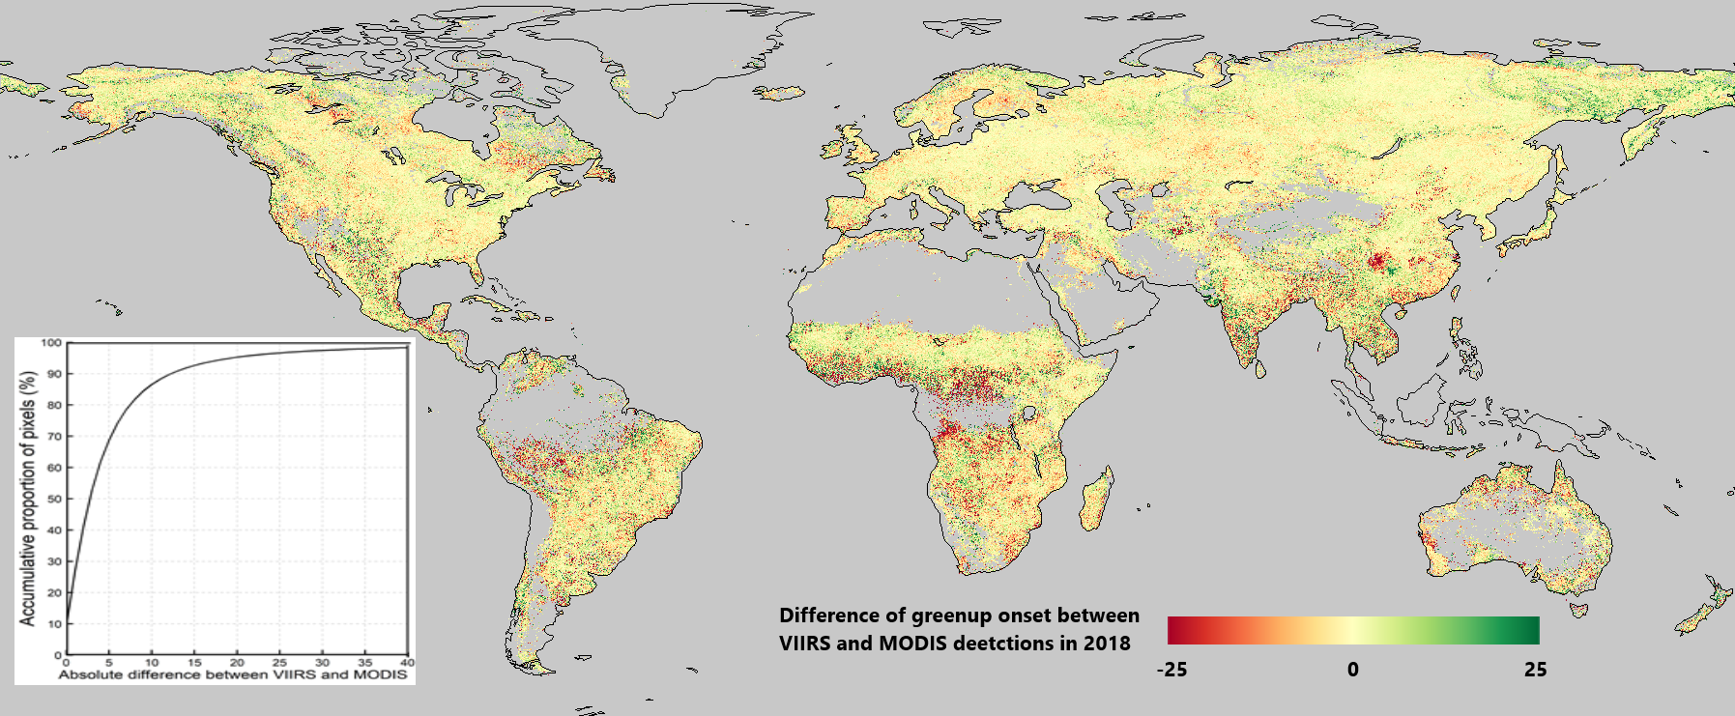
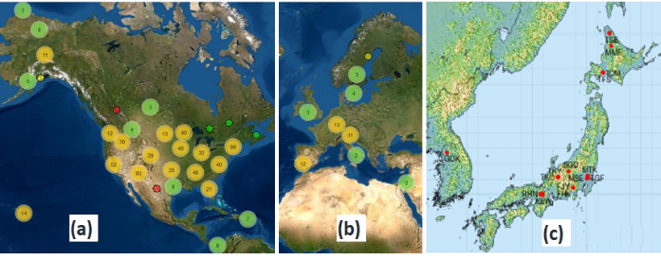
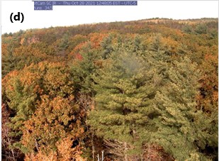
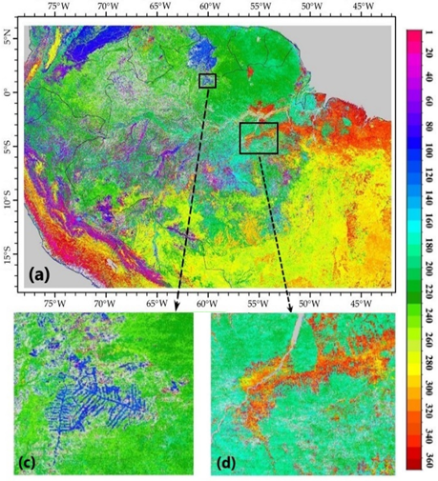
Maintenance, Evolution, and Validation of the Global Land Surface Phenology Product from Suomi NPP and JPSS VIIRS Observations
Investigate the continuity between VIIRS and MODIS GLSP detections.
Phenocam network in (a) North America, (b) Europe, and (c) Japan. (d) Phenocam imagery
(3) Validate and evaluate the stability, precision, uncertainty, accuracy, and spatial and temporal continuity of the SNPP and JPSS-1 GLSP products using multiple reference data sources
Develop standard phenological reference by fusing gap-free (poor geolocation accuracy) Phenocam time series with frequently cloud-contaminated (high geolocation accuracy) Landsat-Sententile-2 time series across the phenocam sites.
Calculate phenometrics from VENµS times series and PlanetScope time series, separately, with a spatial resolution of 3-5 m.
Generate phenological references from geostationary satellite observations in cloud-persistent regions (such as Amazon region and Southeast Asia).

