Slide 1

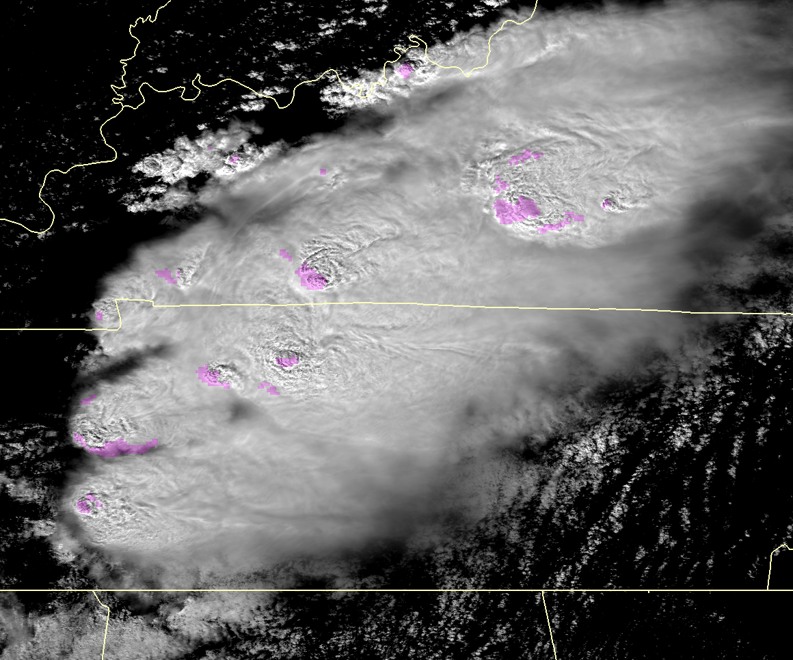
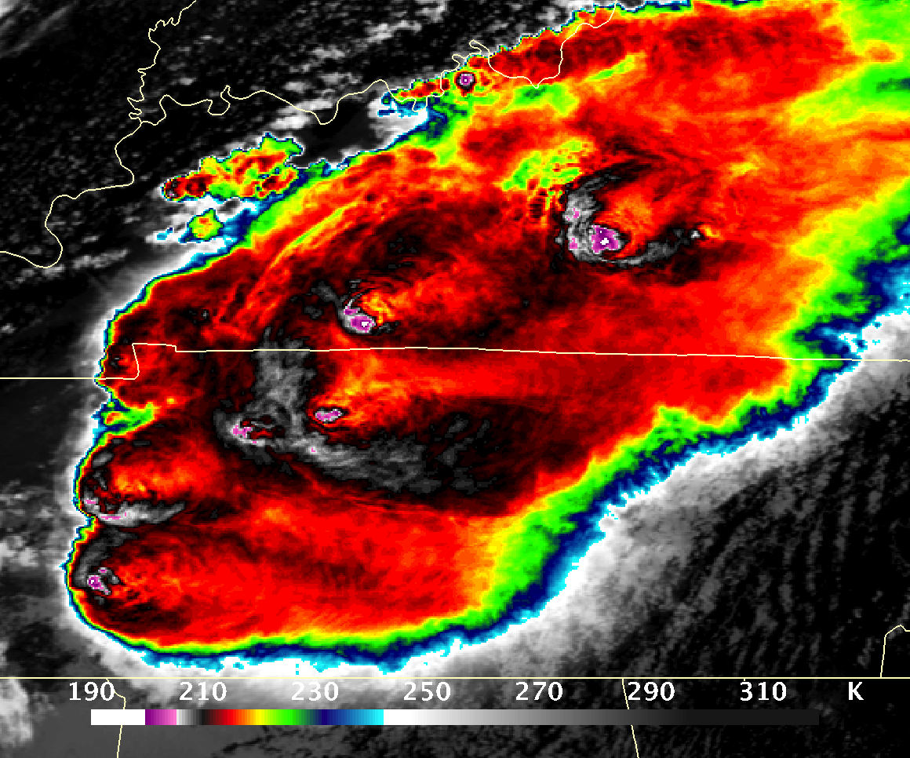
Severe thunderstorms from [nearly simultaneous]
microwave, visible, and IR perspectives
Sarah Bang, Daniel Cecil (NASA MSFC), Kristopher Bedka (NASA LaRC)
Collabs: John Allen (Central Michigan Univ.), Cameron Homeyer (Univ. of Oklahoma)
Severe weather (hail, damaging wind, tornadoes) poses threats to society and challenges to precipitation retrieval. Severe convection exhibits distinct signatures in visible/IR [very cold/textured cloud-top, overshooting tops] and passive-microwave [deep T_{b} depressions from hail and graupel ice scattering]. But, passive-microwave channels have large footprint sizes and non-uniform beam filling. Visible/IR has finer resolution but is limited to cloud top.
Aqua’s nearly simultaneous and colocated MODIS (visible/IR) and AMSR-E (passive-microwave) provide an opportunity to leverage the strengths of one instrument to fill in the gaps where the other shows weaknesses.
1. Characterize storms observed by Aqua MODIS and AMSR-E, in terms of the passive microwave and VIS/IR, paired with ground-based radar, MESH, severe reports, and environmental reanalysis data over CONUS.
2. Investigate how passive-microwave and VIS/IR may be used together: relationships between MODIS and AMSR-E signatures and how they vary geographically.
3. Expand insights based on MODIS and ASMR-E to VIIRS and AMSR2 and explore the capabilities of ATMS for detecting severe convection.
MODIS VIS
MODIS IR
AMSR-E PMW T_{b}
April 7, 2006

Slide 2
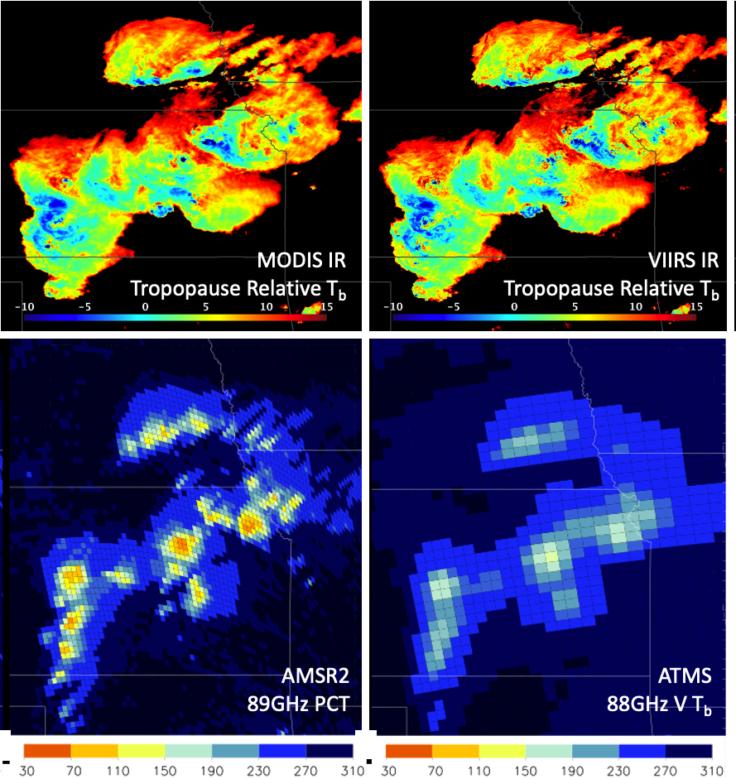
Severe thunderstorms from [nearly simultaneous]
microwave, visible, and IR perspectives
Sarah Bang, Daniel Cecil (NASA MSFC), Kristopher Bedka (NASA LaRC)
Collabs: John Allen (Central Michigan Univ.), Cameron Homeyer (Univ. of Oklahoma)
Status/Updates
Currently working on matching up ground reports of hail events, NEXRAD convective cell identifications and hail size estimates, and Aqua overpasses with MODIS & AMSR-E sampling [Objective 1]
Needed Satellite Products
Objectives 1 & 2: MODIS, AMSR-E (2002-2011)
Objective 3: VIIRS, AMSR2
  The OT/cloud-top detection algorithm as applied to MODIS can be applied to VIIRS, the necessary channels (~0.65 𝜇m visible and ~11 𝜇m IR) are onboard.
  Finer resolution is expected to refine OT detection. Lower T_{b} due to finer resolution will require adjustment of any absolute thresholds.
Known Issues or Concerns
Objective 1 & 2: analysis limited by AMSR-E data availability (died in 2011), mitigated by using AMSR2 (onboard GCOM-W1, also in the A-Train).
Objective 3: VIIRS data analysis should be translatable, passive-microwave (ATMS) is the main limitation
Severe Hailstorm in KS & NE May 26, 2016

