Slide 1
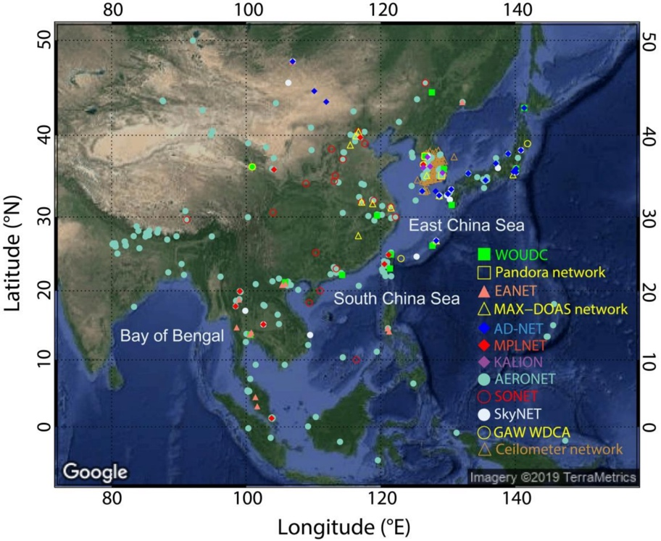
Generation of Integrated Aerosol Fine-Mode Fraction and Surface Particulate Matter from LEO- and GEO Satellites in Asia Using Machine-Learning Models
Zhanqing Li and Jing Wei, University of Maryland
Project summary
Acquire and quality-check a large number of input variables needed for the ML models from as many countries as possible in Asia;
Refine the AOD, FMF, PM₁, and PM_{2.5} retrieval algorithms adapted to the four sensors;
Develop integrated products of FMF, PM₁, and PM_{2.5} from these multi-national satellite datasets together with a large set of ancillary input variables;
Use of the new PM products, meteorological data and chemical transport model to analyze and understand the spatiotemporal variations of fine-mode aerosols in Asia.
Objectives: generate integrated aerosol and air quality products (AOD, FMF, PM₁, and PM_{2.5}) using ML methods by merging data from both polar (MODIS and VIIRS) and geostationary (AHI and GEMS) sensors in Asia and analyze their variations.

Slide 2
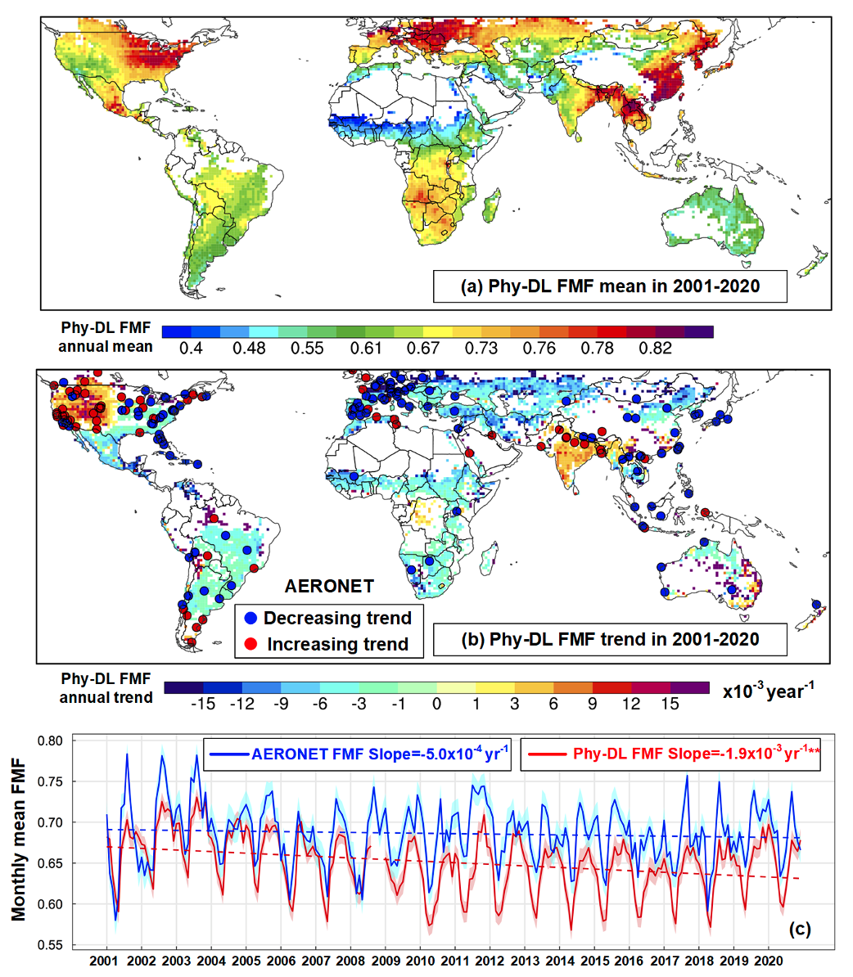
Generation of Integrated Aerosol Fine-Mode Fraction and Surface Particulate Matter from LEO- and GEO Satellites in Asia Using Machine-Learning Models
Status/Updates
Reconstruct long-term PM_{2.5} records in Eastern Asia (China) using MODIS and VIIRS using ML (Wei et al., 2022)
Estimated global daily 1-deg aerosol fine-mode fraction from MODIS over land, including Asia, using a new hybrid Physical and Deep Learning (DL) method (Yan et al., 2022)
Needed Satellite Products
MODIS, VIIRS, AHI, and GEMS
Known Issues or Concerns
Sparse distributions of ground monitoring stations
Strong Spatiotemporal heterogeneities of air pollution.
Recent/Relevant Publications
Wei, J., Li, Z., et al. 2022, Extending the EOS long-term PM_{2.5} data records since 2013 in China: application to the VIIRS Deep Blue aerosol products, IEEE Trans. Geosci. Remote Sens., https://doi.org/10.1109/TGRS.2021.3050999
Yan, X., Z. Zang, Z. Li, et al., 2022: A global land aerosol fine-mode fraction dataset (2001–2020) retrieved from MODIS using hybrid physical and deep learning approaches, Earth Syst. Sci. Data, doi:10.5194/essd-2021-326.

