Slide 1
MAIAC Update
Alexei Lyapustin (PI), Yujie Wang, Sergey Korkin, Sujung Go, Myungje Choi (co-Is)
Status
MAIAC MODIS C6.1 re-processing to start shortly;
MAIAC VIIRS is in integration and testing for C2;
We cross-calibrated SNPP and N20 VIIRS to MODIS Aqua for continuity of CDRs – used in MAIAC;
MAIAC VIIRS (MOD C7) features Rotated Sin Projection.
MAIAC Products
- Atm.: Cloud/Shadow/Snow Mask, AOD, FMF (over water), CWV_{MODIS}, Smoke Plume Injection Height
- Surf.: BRF (M: 0.5, 1km; V: 0.375, 0.75km);
- Surf. Daily Gap-Filled: BRDF, NDVI (1/0.75km); Snow grain size and fraction (1/0.75km); NBAR_{MODIS} (0.25km)
- CMG Daily: most of the above + additional VIs

Slide 2
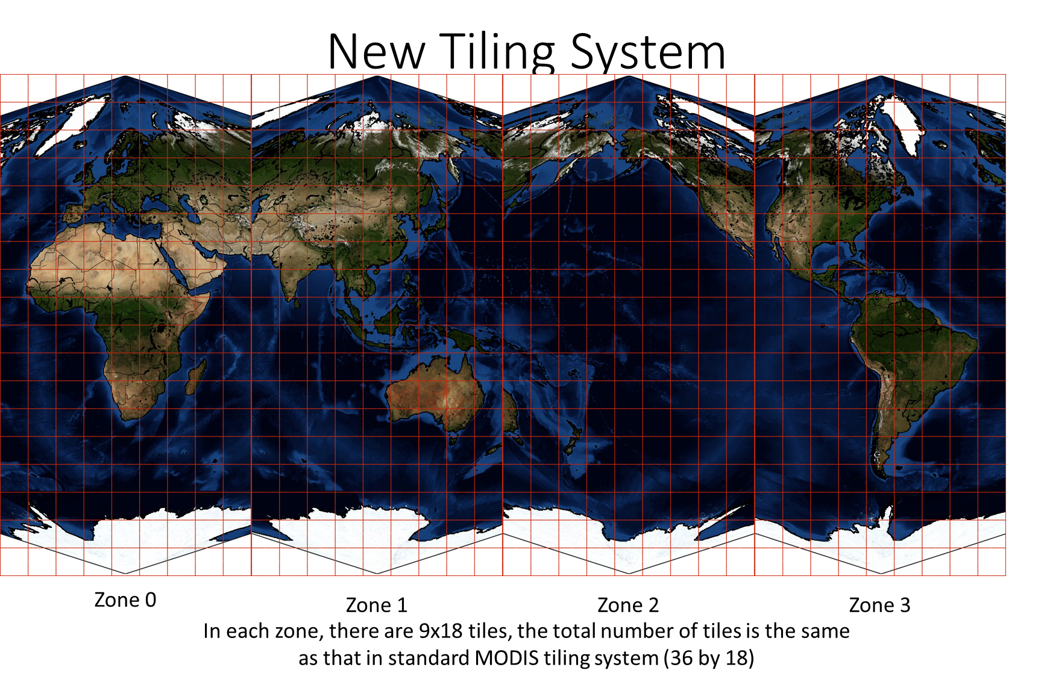
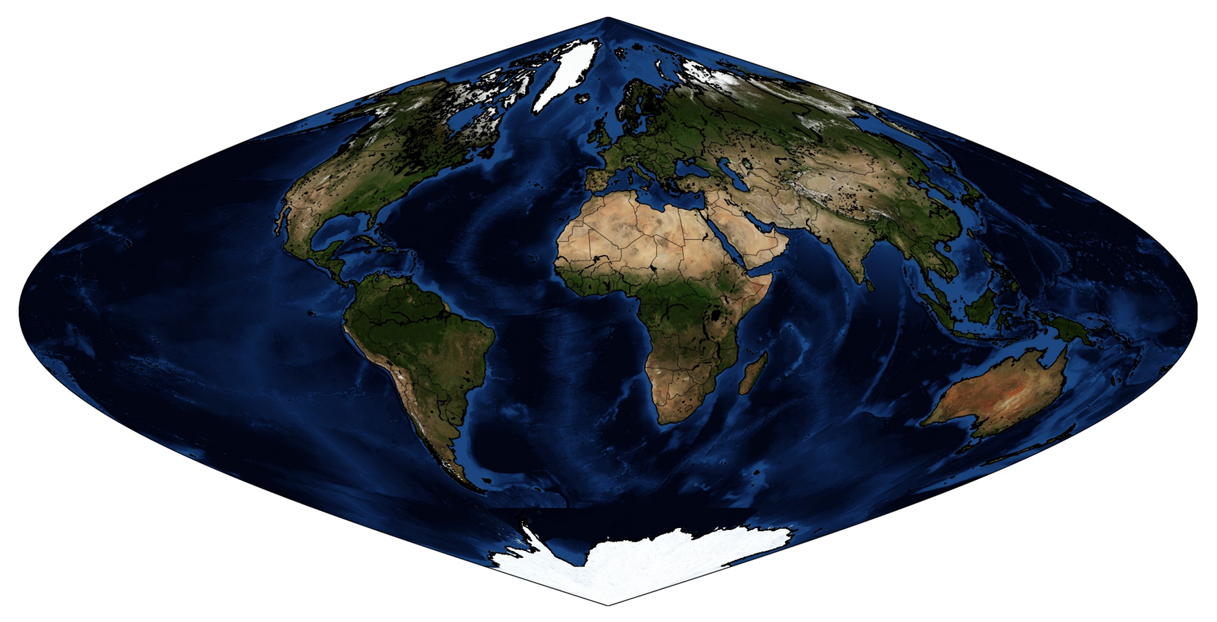
MAIAC Update
Rotated Sin Projection
Standard Global Sin
We will provide re-projection tools for users.

Slide 3
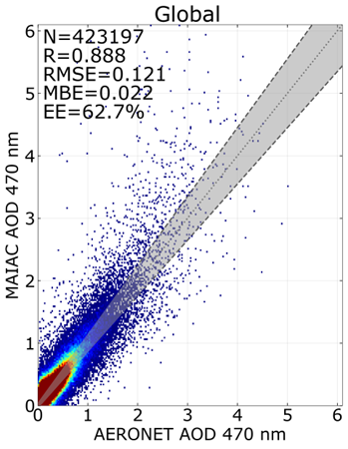
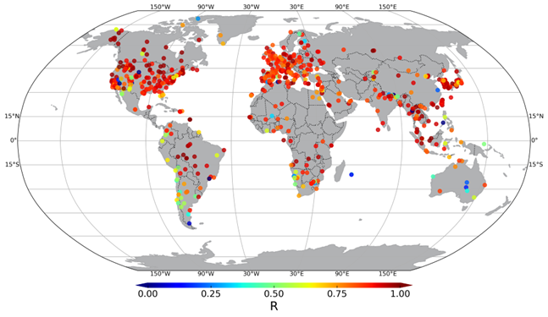
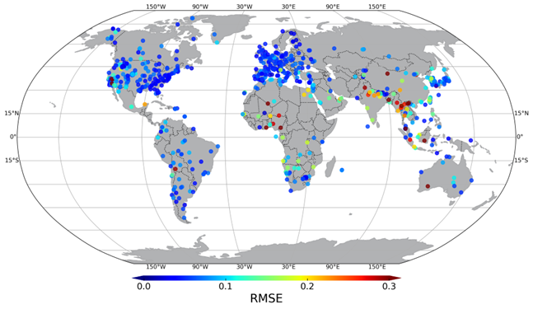
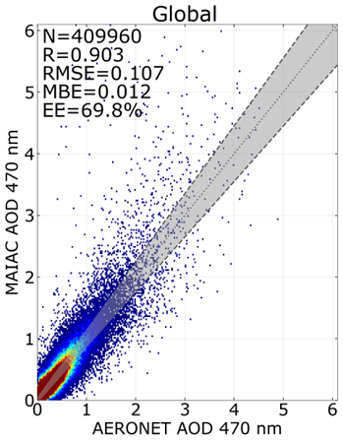
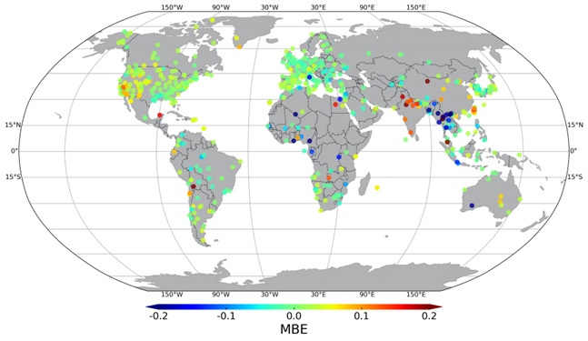
MAIAC Algorithm Updates vs C6
Developed new regional aerosol models based on AERONET climatology → improves AOD and AC under smoke and dust conditions;
Sept. 2020, Western USA
A single 1km pixel
C6
21x21 km² (50% coverage), 0.47µm
C6.1
R
RMSE
Courtesy: X. Ye, P. Saide (UCLA)
MAIAC C6 C6.1 C6.1 1km
N 304553 409960 423197
%EE 66% 69.8% 62.7%
R 0.84 0.903 0.888
RMSE 0.12 0.107 0.121
MBE 0.01 0.012 0.022
MBE
C6 EE =±0.05 ±0.1τ_{0.47}

Slide 4
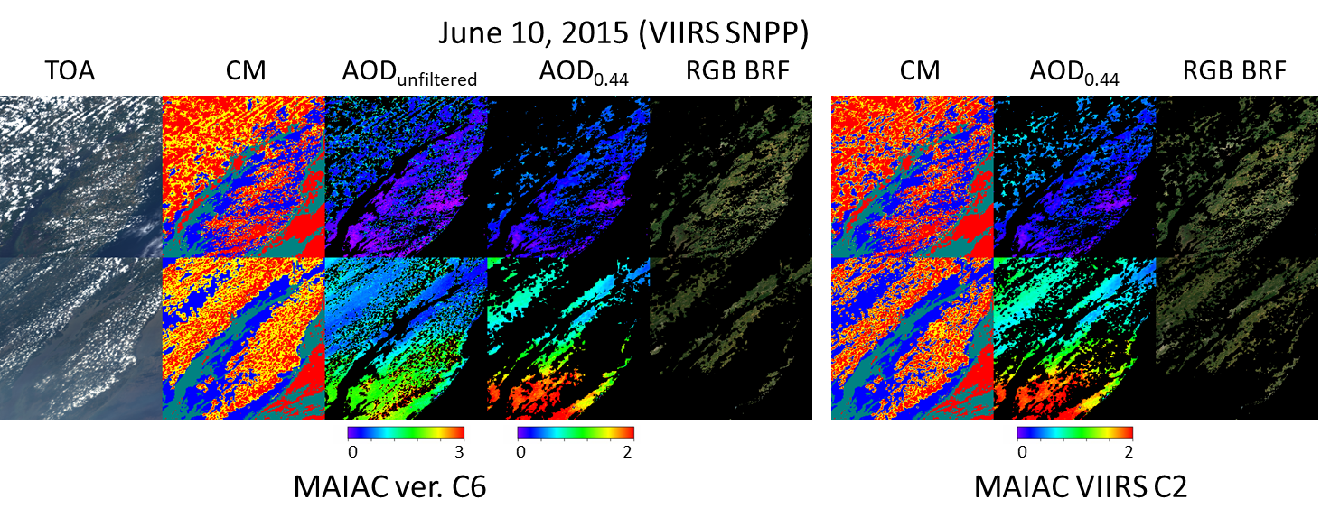
MAIAC Algorithm Updates vs C6
Relaxed cloud adjacency analysis → increase in AOD and SR coverage
From Lyapustin et al. (2021): MAIAC C6 has 5-25% more high-quality data than MOD09 annually. This difference will further increase in MAIAC MODIS C6.1 and VIIRS C2;
Improved snow detection;
Aerosol retrievals and AC over high sediment (brown) waters;
Amended RTLS BRDF model to work at high SZA, VZA>60° - important for VIIRS, EPIC, geo … and at high latitudes (in preparation)
Lyapustin A, Zhao F and Wang Y (2021) A Comparison of Multi-Angle Implementation of Atmospheric Correction and MOD09 Daily Surface Reflectance Products From MODIS. Front. Remote Sens. 2:712093. doi: 10.3389/frsen.2021.712093

Slide 5
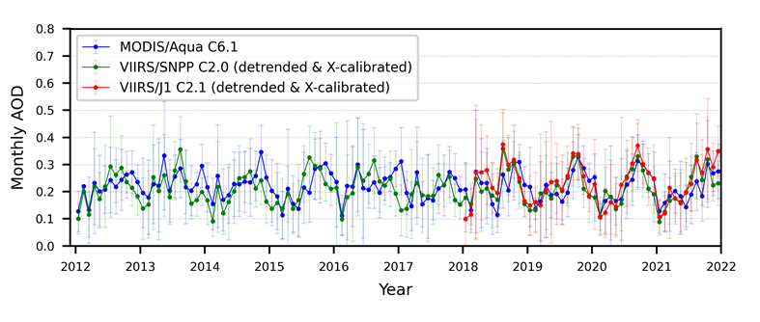
VIIRS Cross-Calibration to MODIS Aqua
DESIS
SCIAMACHY
MAIAC AOD Before X-Cal (Libya 4)
MAIAC AOD After X-Cal

Slide 6
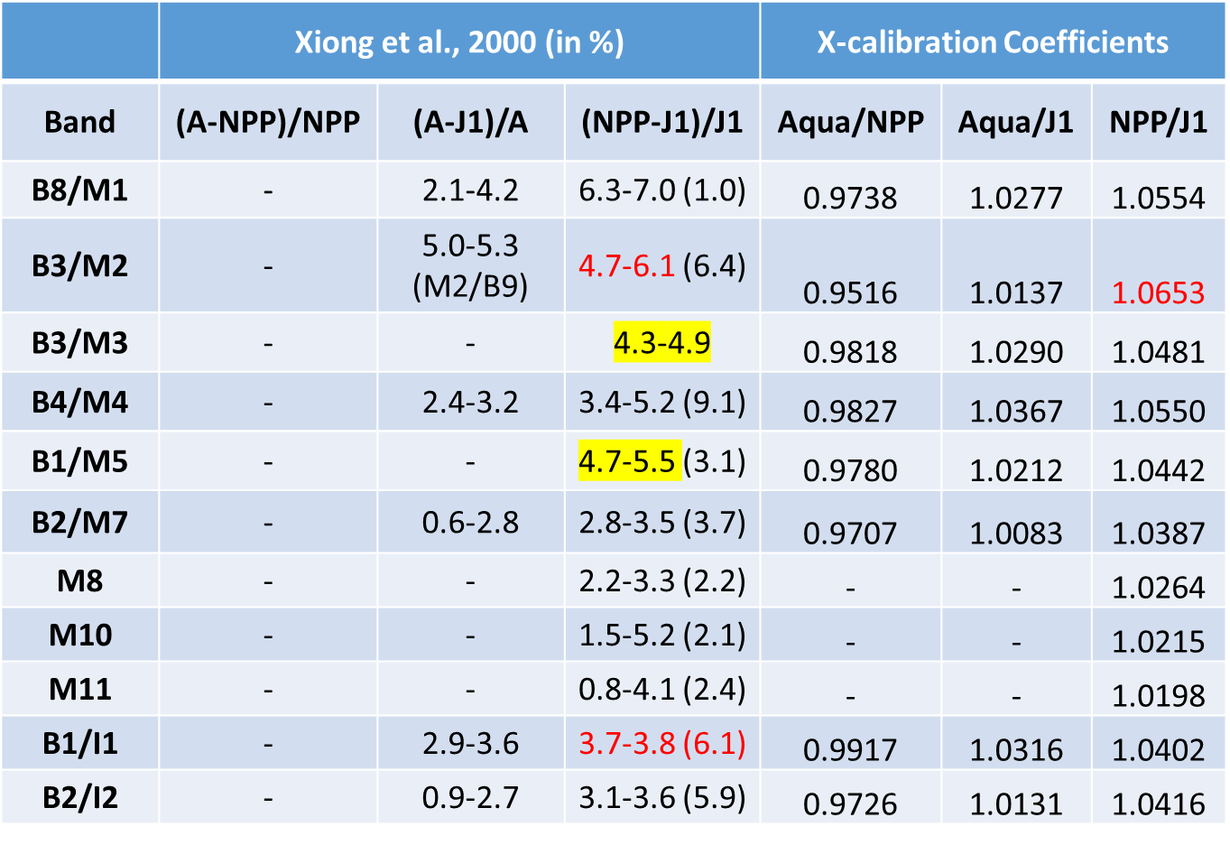
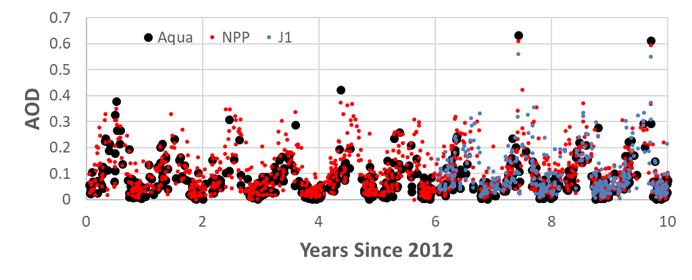
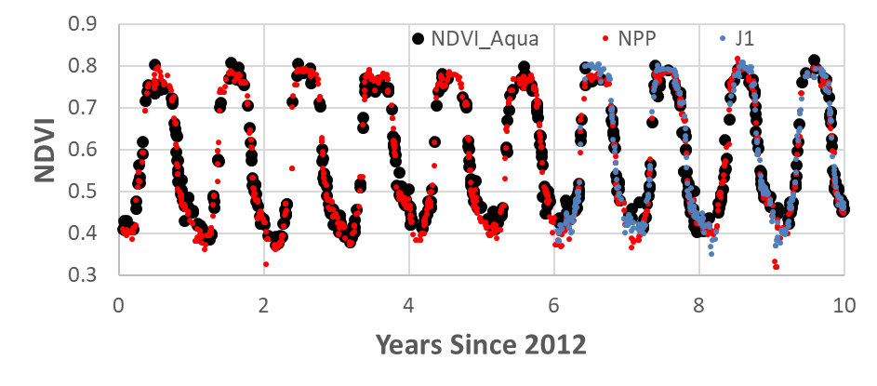
Dome C, Deserts (DCC) This Study
MAIAC: Appalachian_state
Xiong X, Angal A, Chang T, Chiang K, Lei N, Li Y, Sun J, Twedt K, Wu A. MODIS and VIIRS Calibration and Characterization in Support of Producing Long-Term High-Quality Data Products. Remote Sensing. 2020; 12(19):3167. https://doi.org/10.3390/rs12193167

