Slide 1
Investigating the influence of volcanic sulfate aerosol on cloud properties using MODIS data along A-Train tracks.
Jay Mace
Sally Benson, Peter Gombert
Cloud Droplet number High AOD (red)
Methodology: During A-Train overpasses near volcanic islands, identify back trajectories that pass close to the volcano.
Divide A-Train overpasses into high aerosol optical depth (i.e. active SO₂ release) and low aerosol optical depth…
Finding: In high AOD volcanic plumes:
Clouds are also deeper and have higher cloud fraction.
higher cloud droplet numbers
smaller precipitation effective radius.
Objectives: Quantify the differences in shallow convective cloud properties downstream of subtropical volcanic island using A-Train data when volcanoes are and are not emitting SO₂
Precip Efffective Radius - High AOD (red)
Density plot of overpasses that pass within 100 km of Kilauea within 24 hours of an A-Train overpass
Mace et al. 2022 (in prep)

Slide 2
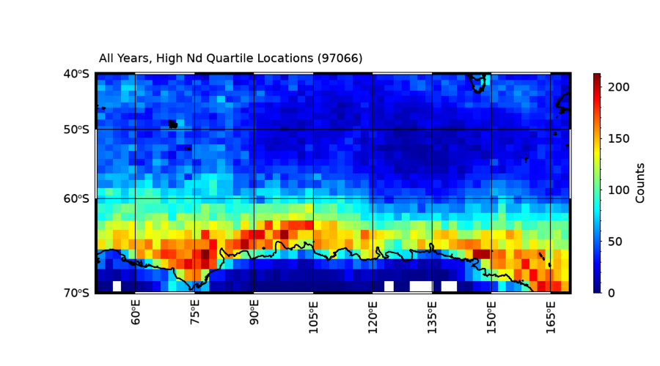
Exploring Cloud Droplet Number Variability in the High Latitude Oceans
data along A-Train tracks.
Jay Mace
Sally Benson, Peter Gombert, Elizabeth Sterner
Objectives: Use MODS L2 to quantify the statistics of Cloud Droplet Number Concentration (Nd) seasonally in the high latitude Southern Ocean.
Explore processes behind these statistics using A-Train data
Methodology:
Identify non-precipitating low level liquid phase clouds scenes in MODIS L2 data.
A scene is a 1x2 lat/lon region with primarily low non-precipitating liquid clouds
Construct the geographic distribution of high and low Nd cloud scenes in the Summertime Southern Ocean..
Finding: the highly biogenic productivity regions near Antarctica have an anomalously high occurrence of high Nd clouds
Geographic Distribution of High Nd scenes in the summer Southern Ocean

