Slide 1

Cloud Mask and Cloud-Top/Optical Properties:
MODIS Standard & MODIS/VIIRS Continuity Products
PI: Meyer (cont.), Platnick (standard); Co-Is: Holz, Wang; Team: Amarasinghe, Wind, Miller, Hubanks, Veglio, Dutcher
Multiple Ongoing Efforts
Trending analysis of MOD/MYD06 C6.1 (Standard) and CLDPROP v1.1 (Continuity)
  Evaluating algorithm and sensor consistency
  Evaluating approaches for sensor data record “stitching”
Science tests for CLDMSK/CLDPROP v2 and MODIS Standard C7 algorithm updates
Engagement in community efforts:
  Contributed to GEWEX cloud assessment (CLDMSK/CLDPROP and MODIS Standard)
  Developed/released new COSP datasets for model evaluation (CLDMSK/CLDPROP; MODIS Standard in prep)
  Maintain Atmosphere Discipline website (https://atmosphere-imager.gsfc.nasa.gov/)
Objectives:
To continue maintaining the C6.1 MODIS standard cloud optical property products and to prepare and implement key advancements for C7 reprocessing
To continue advancing the common CLDPROP algorithm designed to provide continuity between EOS MODIS and the VIIRS imagers on SNPP and NOAA-20+
To coordinate the LEO continuity efforts with parallel advanced Geostationary imager algorithm efforts to achieve an internally consistent NASA Program of Record for clouds that is expected to support upcoming Designated Observables missions (e.g., AOS)

Slide 2
Cloud Mask and Cloud-Top/Optical Properties:
MODIS Standard & MODIS/VIIRS Continuity Products
MODIS Standard C6.1 reprocessing occurred in 2017, forward processing ongoing
MODIS/VIIRS Continuity processing history (at right)
Known Issues or Concerns
https://atmosphere-imager.gsfc.nasa.gov/continuity/issues
Recent/Relevant Publications
  Frey, R. A., et al. (2020), The continuity MODIS-VIIRS cloud mask, Remote Sens., 12, 3334, doi:10.3390/rs12203334.
  Meyer, K., et al. (2020), Derivation of shortwave radiometric adjustments for SNPP and NOAA-20 VIIRS for the NASA MODIS-VIIRS continuity cloud products, Remote Sens., 12, 4096, doi:10.3390/rs12244096.
  Platnick, S., et al. (2020), Sensitivity of multispectral imager liquid water cloud microphysical retrievals to the index of refraction, Remote Sens., 12, 4165, doi:10.3390/rs12244165.
  Platnick, S., et al. (2021), The NASA MODIS-VIIRS continuity cloud optical properties products, Remote Sens., 13, 2, doi:10.3390/rs13010002.

Slide 3
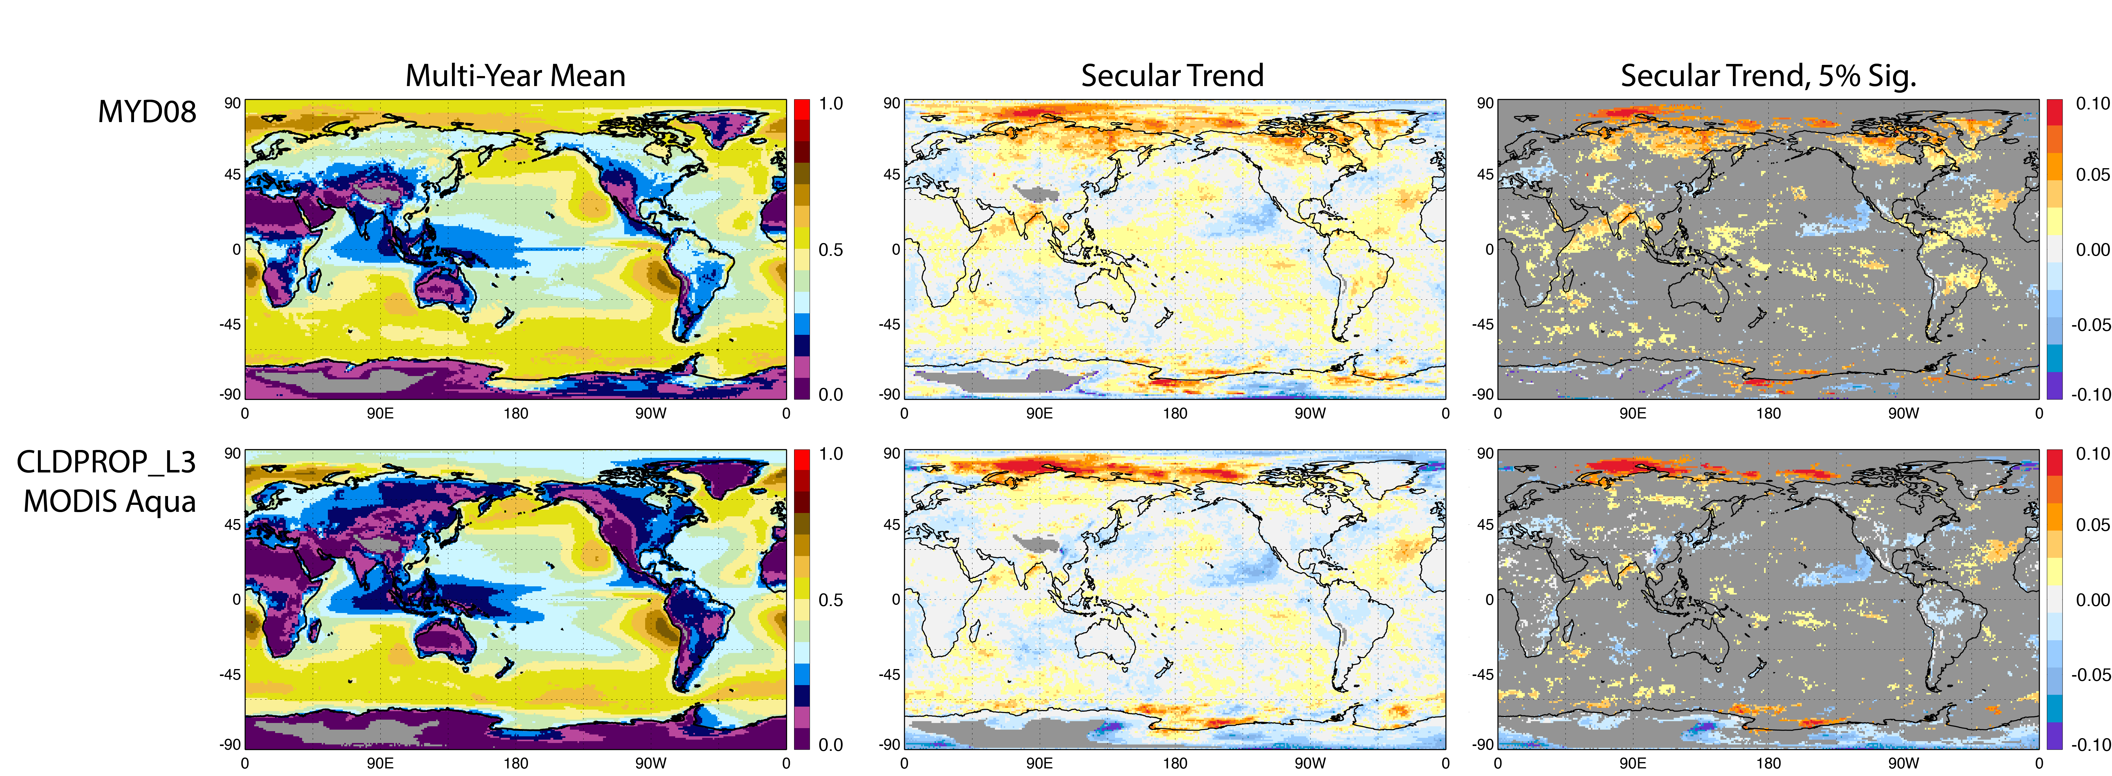
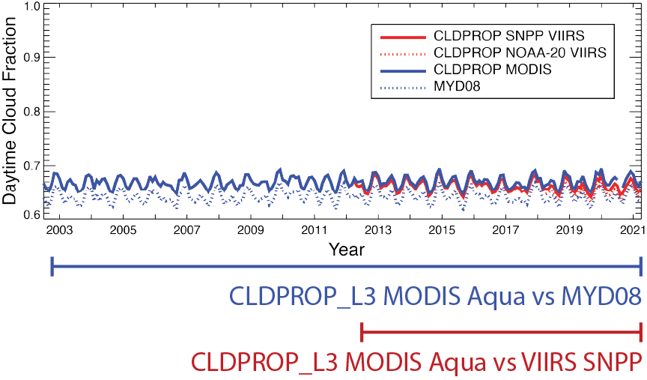
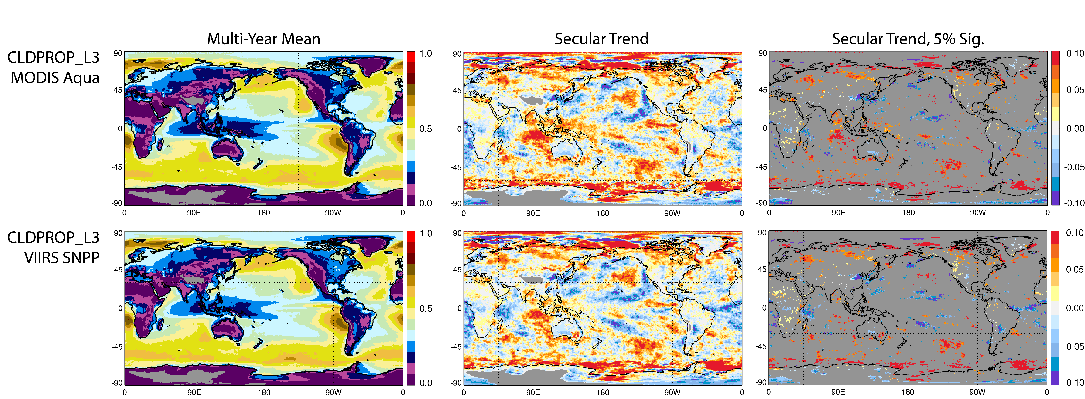
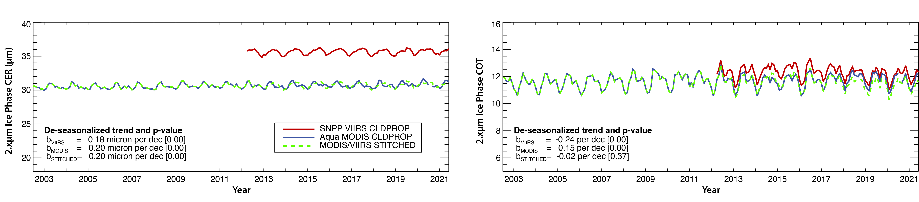
Cloud Mask and Cloud-Top/Optical Properties:
MODIS Standard & MODIS/VIIRS Continuity Products
Trending Analysis
Example: Daytime Low Cloud Fraction
(CTP ≥ 800mb) Example
Approach
Inter-Algorithm (Same Sensor) Trends:
CLDPROP_L3 MODIS Aqua = MYD08
Inter-Sensor (Same Algorithm) Trends:
Aqua MODIS = SNPP VIIRS
Merging MODIS/VIIRS Data Records
Approach at right: Compute mean VIIRS – MODIS difference over 2013, subtract from VIIRS

Slide 4
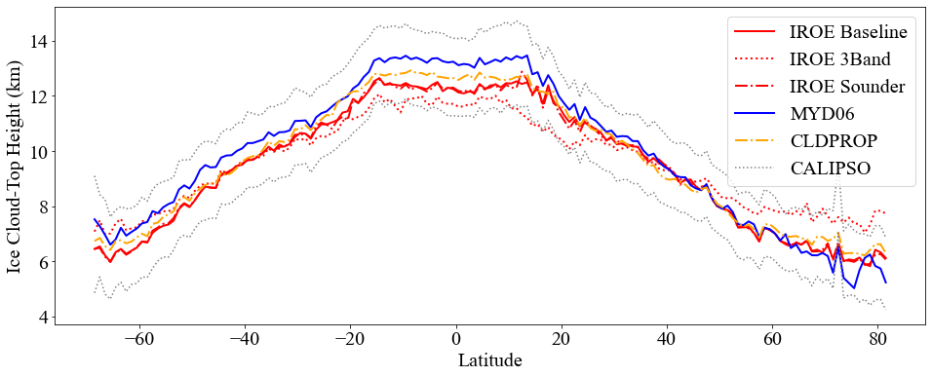
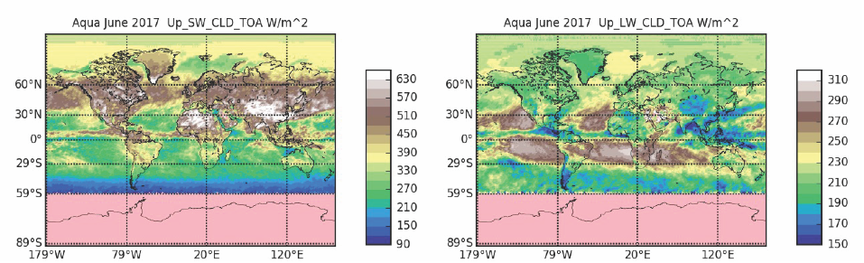
Cloud Mask and Cloud-Top/Optical Properties:
MODIS Standard & MODIS/VIIRS Continuity Products
Key Updates for CLDMSK/CLDPROP v2:
New cloud-top properties algorithm (IROE) that also provides day/night ice cloud optical properties and enables leveraging AIRS and CrIS sounder absorption channels
Pixel-level SW and LW broadband radiative flux calculations (TOA, sfc) using cloud property retrievals as input
Other Science Updates:
Machine learning algorithm for cloud thermodynamic phase classification (liquid, ice) based on Random Forest approach (Wang et al., 2020)
Leverage high-resolution VIIRS I-bands for sub-pixel information
Complementary thin cirrus optical thickness retrievals using 1.38µm water vapor absorption channel (Meyer & Platnick, 2010)

Slide 5
Cloud Mask and Cloud-Top/Optical Properties:
MODIS Standard & MODIS/VIIRS Continuity Products
Key Updates for MODIS Standard C7:
Same science updates as for CLDMSK/CLDPROP v2 (IROE, flux, etc. on previous slide)
Will also leverage key continuity algorithms/code to ease maintenance
  CLDMSK code base for MOD/MYD35 (all MOD/MYD35 tests and thresholds retained) – same code that is used for parallel imager efforts (e.g., GEO)
  Yori algorithm developed by A-SIPS to replace current MOD/MYD08 algorithm for L3 gridded aggregations
    Provides scalar/multi-dimensional statistics consistent with current MOD/MYD08
    But with some consequences:
      Separate L3 daily and monthly product files for each L2 Atmosphere science product (e.g., cloud, aerosol, etc.)
      Same internal variable formatting as CLDPROP_L3
File format change to netCDF-4 for all Atmosphere products

Slide 6
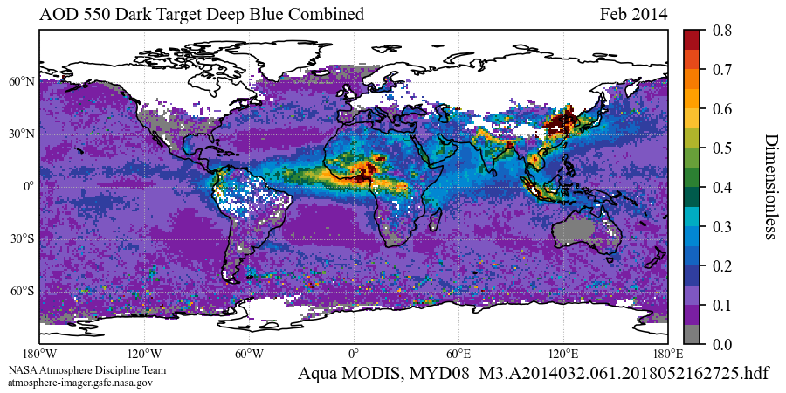
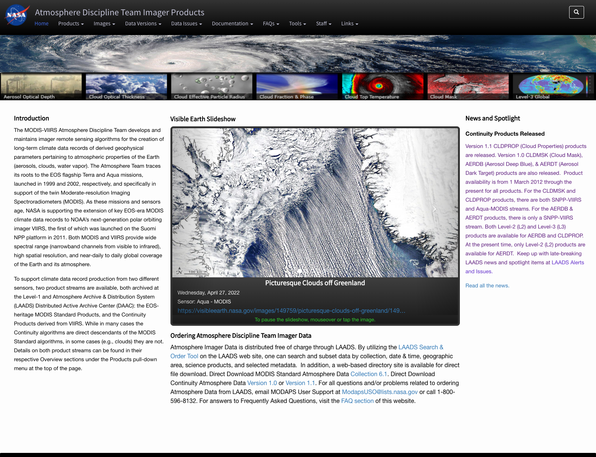
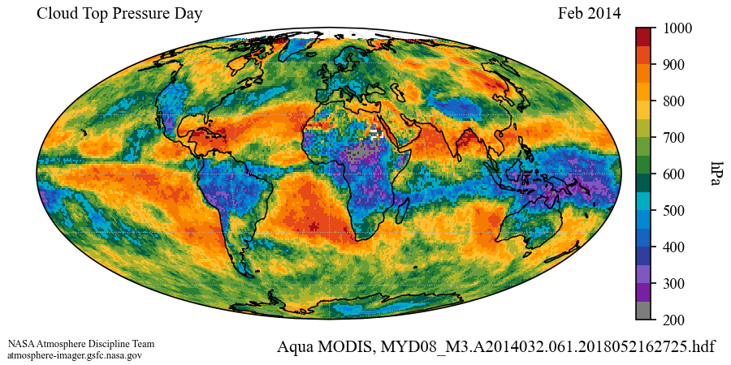
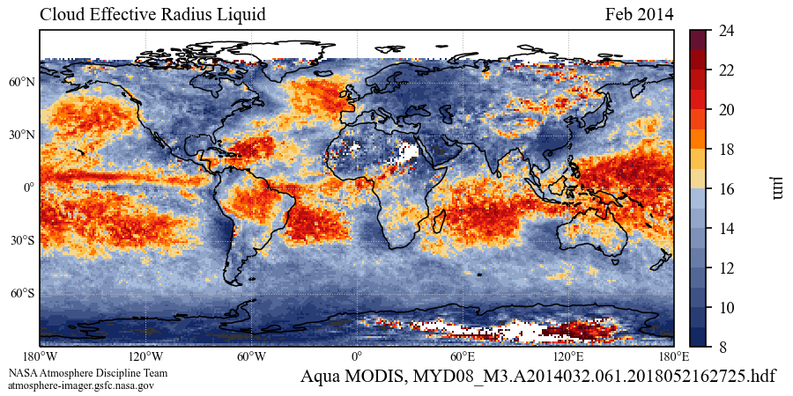
Cloud Mask and Cloud-Top/Optical Properties:
MODIS Standard & MODIS/VIIRS Continuity Products
Atmosphere Discipline Team Imager Products Website
Documentation, known issues, browse imagery, and much more…
New Python-based L3 browse imagery under development
Platte Carrée and Mollweide projections
Rainbow and colorblind friendly color bars
https://atmosphere-imager.gsfc.nasa.gov/

