Slide 1
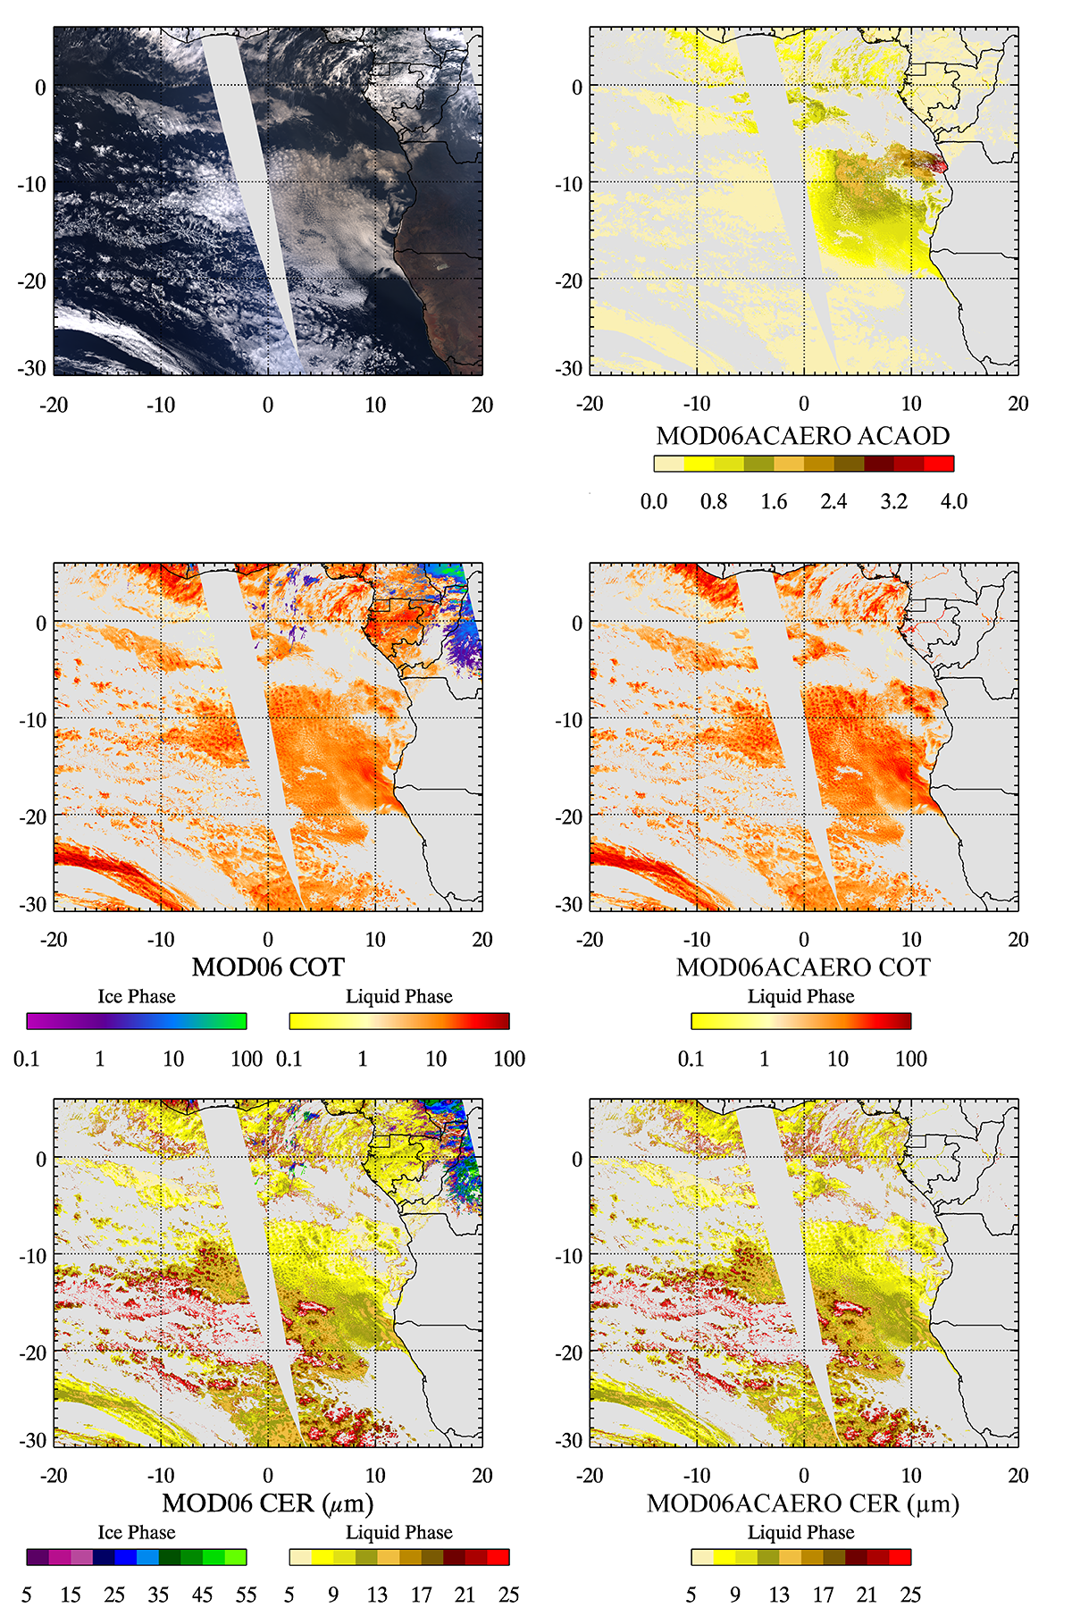
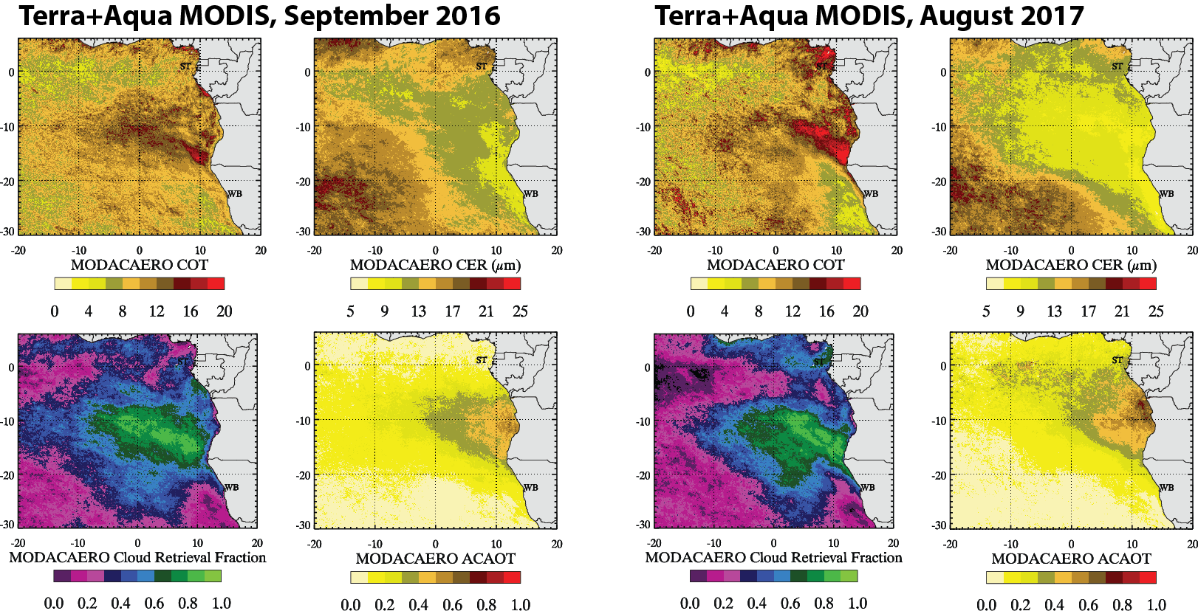
Transitioning an existing near real-time MODIS cloud and above-cloud absorbing aerosol retrieval algorithm into a new MODIS/VIIRS continuity product
PI: Kerry Meyer; Co-Is: Sam LeBlanc, Kristina Pistone; Team: Nandana Amarasinghe, Gala Wind
ACAERO: Retrieval algorithm using multiple spectral channels in the VNIR/SWIR (0.47, 0.55, 0.66, 0.87, 1.24, 2.xµm) to simultaneously retrieve cloud optical/microphysical properties and above-cloud absorbing aerosol optical thickness
Objectives:
To transition a MODIS cloud and above-cloud absorbing aerosol retrieval algorithm (MOD06ACAERO), currently in LANCE NRT processing, into a NASA MODIS/VIIRS Standard Continuity product (CLDPROPACAERO)
Monthly statistics for ORACLES 2016/2017 deployment periods

Slide 2
Transitioning an existing near real-time MODIS cloud and above-cloud absorbing aerosol retrieval algorithm into a new MODIS/VIIRS continuity product
Status/Updates
MODIS “Standard” algorithm running since 2016 in LANCE NRT (integrated in support of ORACLES)
Currently updating forward LUTs to accommodate SNPP/NOAA-20 VIIRS and updated liquid cloud radiative model assumptions (consistent with CLDPROP)
Working with Co-Is from 4STAR team on new aerosol radiative models derived from ORACLES
Needed Satellite Products
MYD03, MYD021KM, VNP03_MOD, VNP02_MOD, CLDMSK_MODIS/VIIRS, CLDPROP_MODIS/VIIRS, various ancillary
Known Issues or Concerns
No logistical concerns – strong working relationship with A-SIPS
Recent/Relevant Publications
Methodology described in:
Meyer, K., Platnick, S., & Zhang, Z. (2015). Simultaneously inferring above‐cloud absorbing aerosol optical thickness and underlying liquid phase cloud optical and microphysical properties using MODIS. JGR, doi:10.1002/(ISSN)2169-8996.

