Slide 1
Survey of environmental cloud controlling factors for the extratropical oceans
Catherine Naud, Greg Elsaesser and Jimmy Booth
Project summary
Unlike for the tropics and and subtropics, cloud controlling factors in the extratropics are less quantified, notably for low-level clouds. Our project aims to fill this gap by addressing the following questions:
- Are the same factors controlling low level clouds in the more dynamically active extratropics?
- What are the most impactful factors controlling high-level clouds in the extratropics?
- How does the radiative response of clouds change if the environmental cloud controlling factors change in future climate?
- How do all relationships vary across observational platforms, temporal periods and averaging timescales?
Objectives:
Determine the environmental variables that show strong relationships with low and high-level clouds in the extratropical oceans
Use TERRA/AQUA, MODIS/AMSR-E/AIRS/VIIRS observations to estimate observational uncertainties in these relationships
Using collection of same satellites, determine sensitivity and variability of relationships to spatial and temporal averaging domain and instrument platform

Slide 2
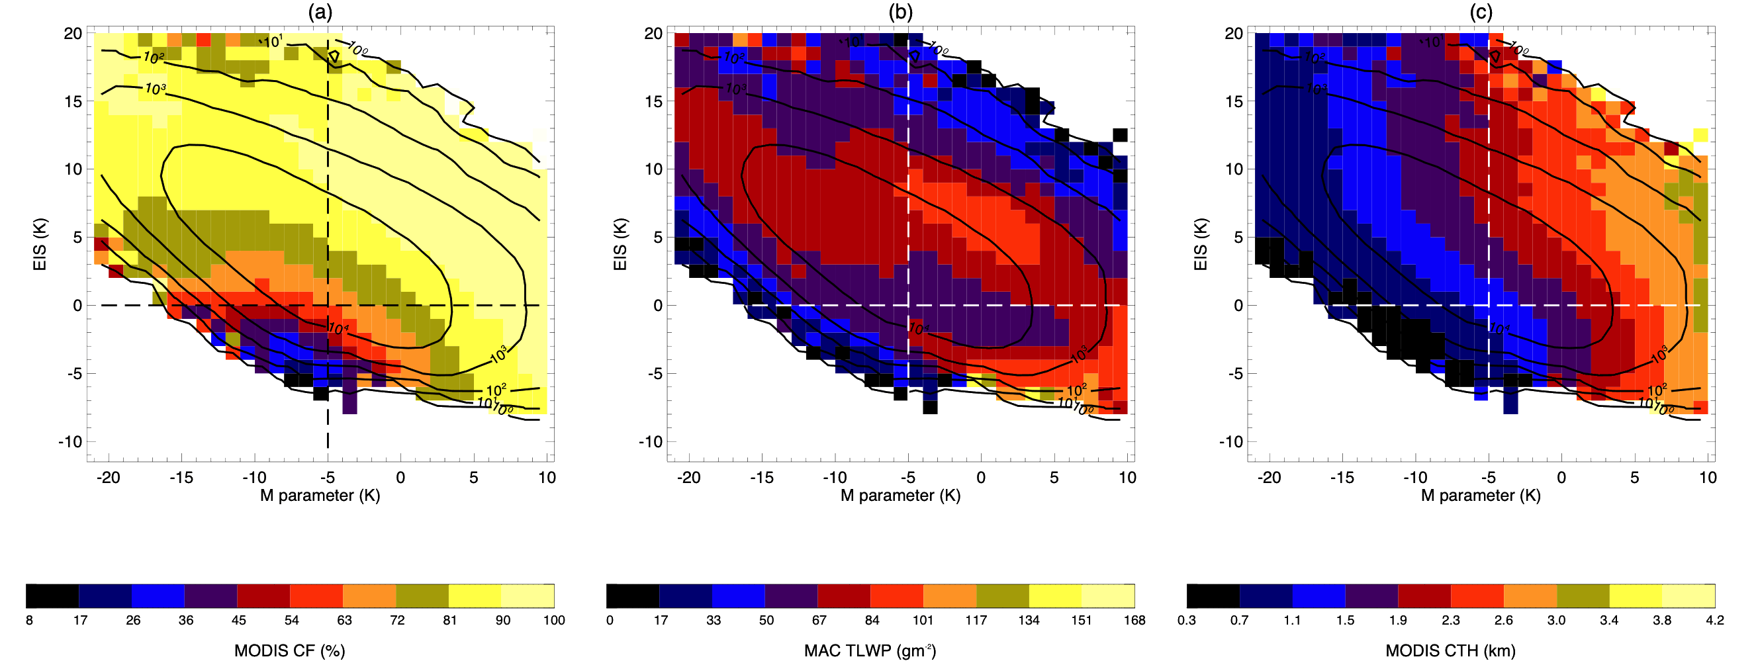
Survey of environmental cloud controlling factors for the extratropical oceans
Status/Updates
Analysis of low-level clouds using daily MODIS and MAC-LWP products undergoing
Most low-level clouds occur in conditions of subsidence and equatorward winds
Different regimes identified depending on other metrics, here exploring PBL characteristics: M & EIS (see figure)
Needed Satellite Products
MODIS L2 and L3 daily, AIRS cloud properties, VIIRS, AMSR-E (processed through MAC-LWP), CERES.
Known Issues or Concerns
N/A for now
Recent/Relevant Publications
• Naud et al. JGR 2020/McCoy et al JGR 2017/Wood and Bretherton 2006
5 years, all seasons, daily mean, low level clouds with CTP > 500 hPa, subsidence (at 500 hPa), equatorward winds, both hemispheres:
2D histograms of a) MODIS cloud fraction, b) MAC total liquid water path, and c) MODIS cloud top height (CTH) as a function of
M (=𝜃_{skin}- 𝜃_{800hPa}), a good predictor of CTH (Naud et al. 2020) and
EIS (estimated inversion strength of Wood and Betherton 2006), a good predictor of cloud fraction
Inversion strength increases =>
More and more unstable =>
Main key points: 1) EIS/M space helps delineate different cloud regimes,
2) LWP also impacted by both EIS and M

