Slide 1
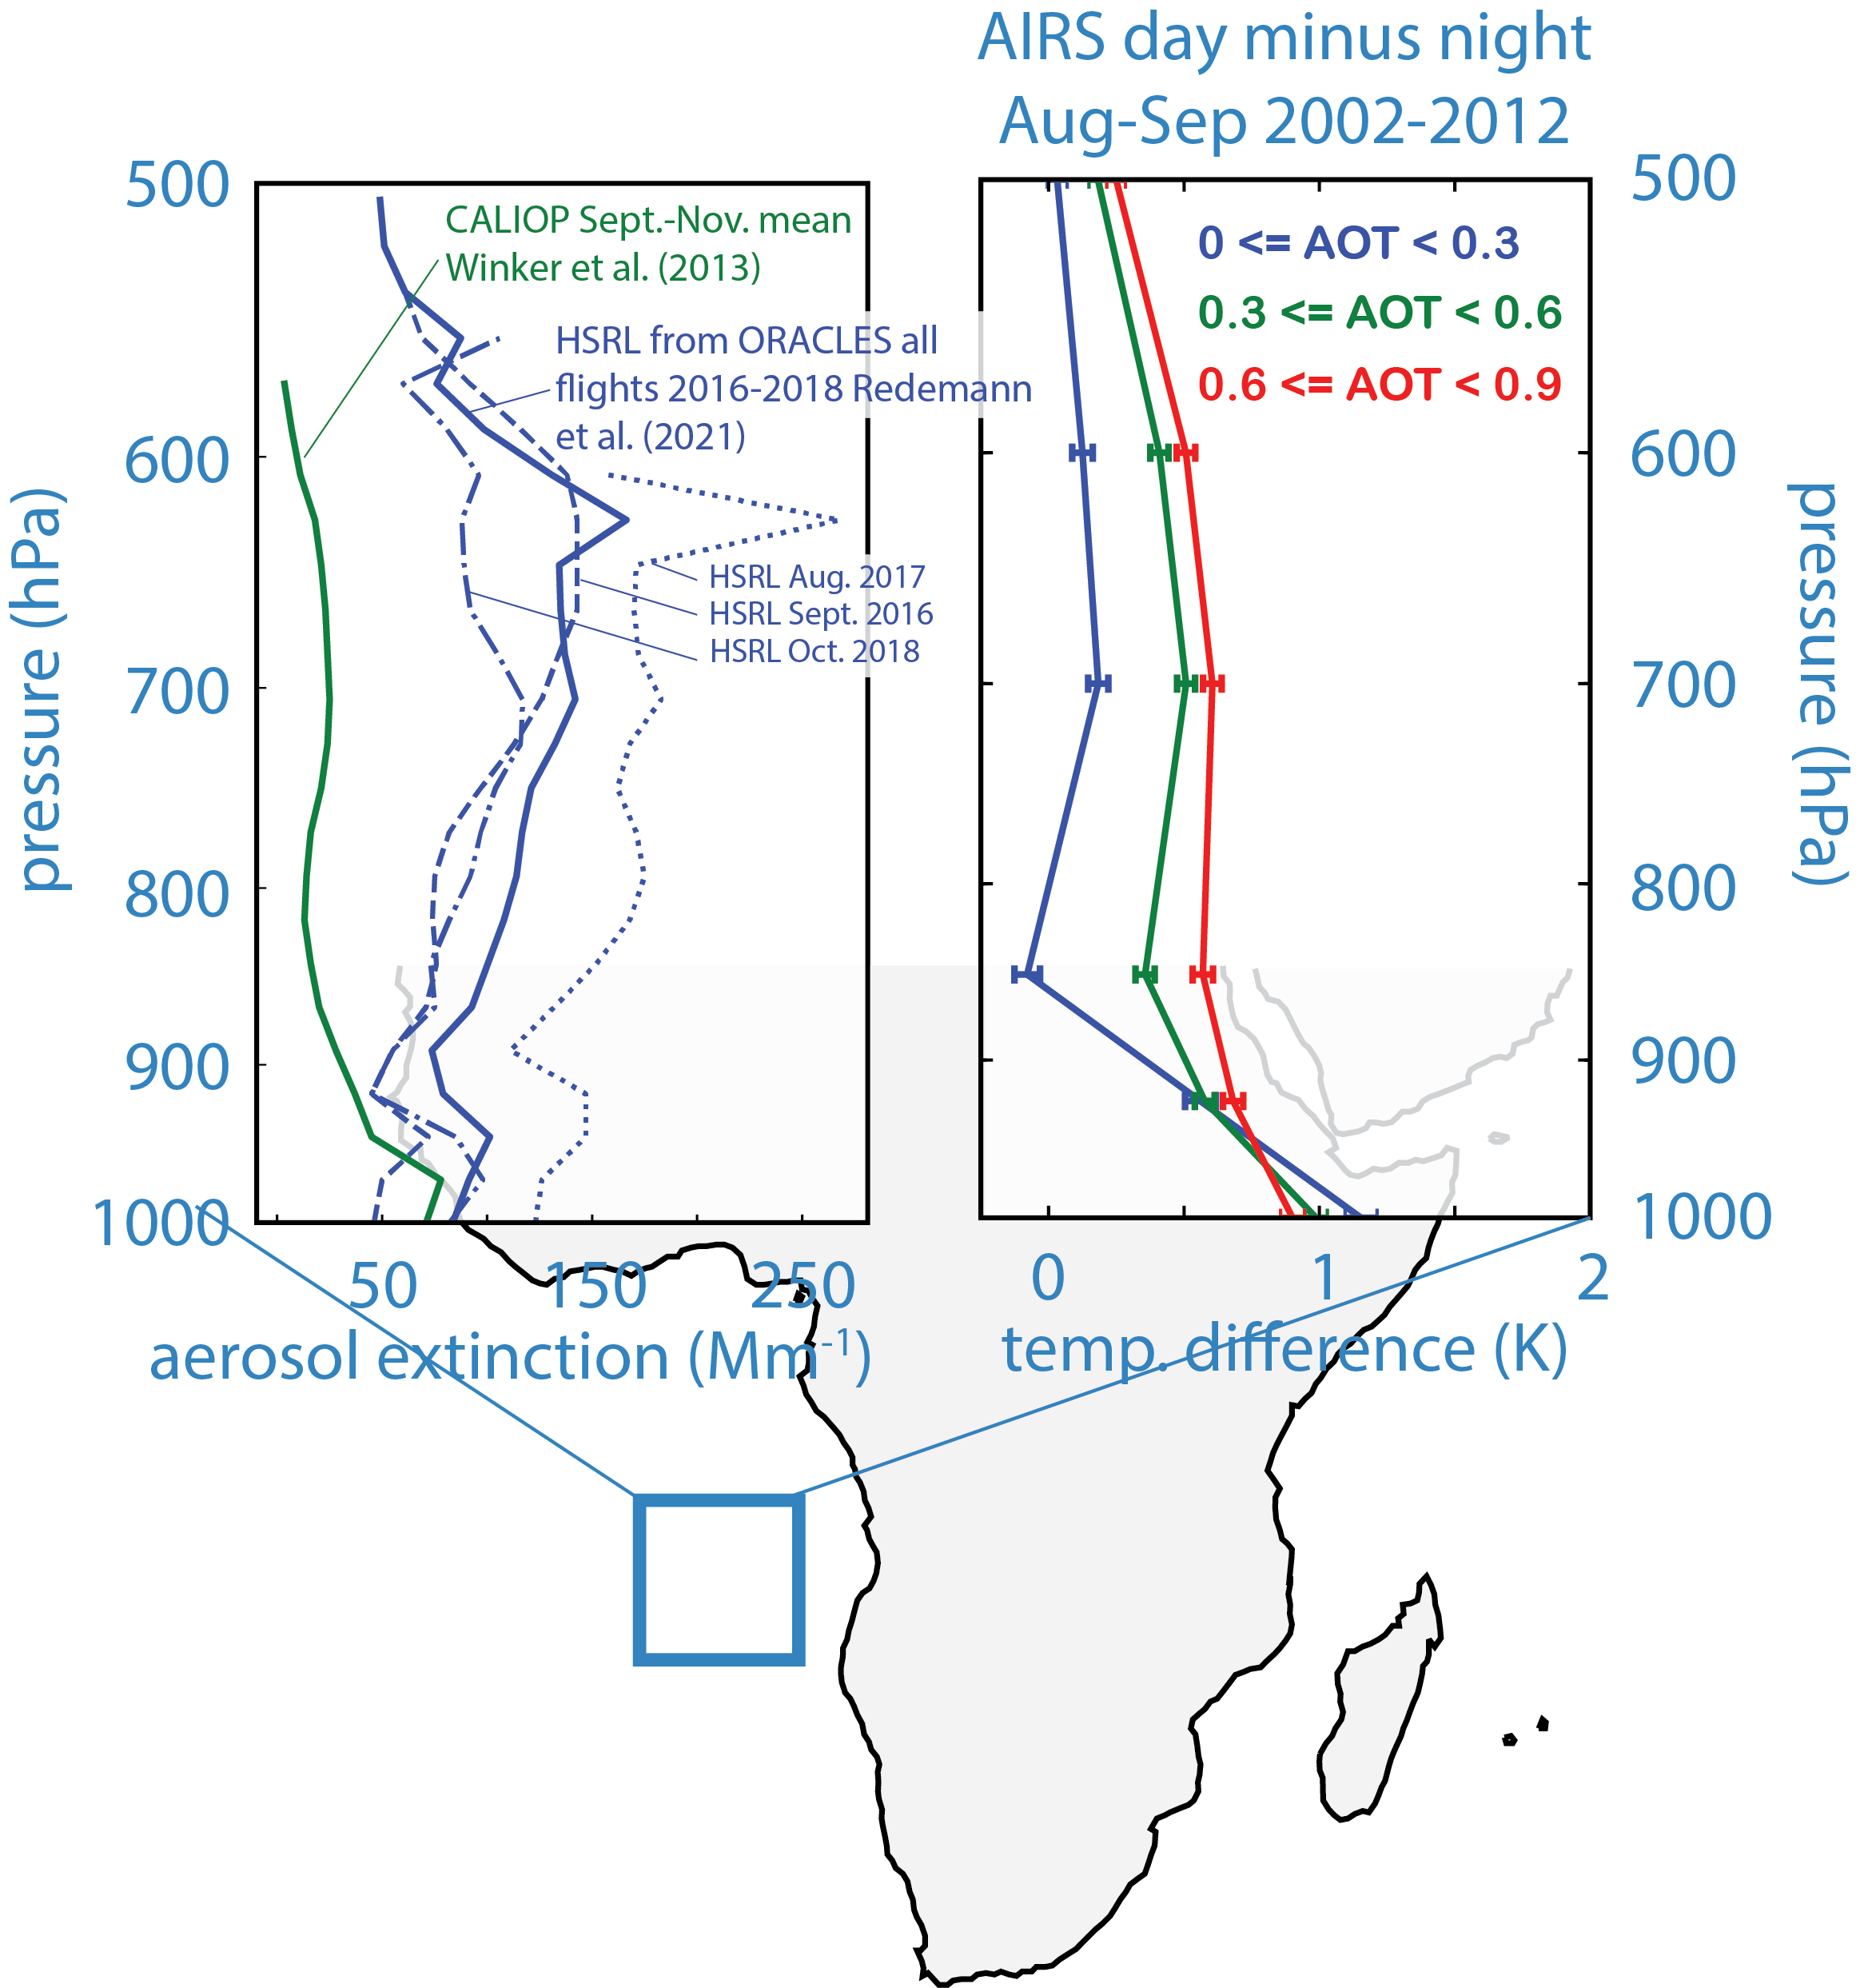
Quantifying variations in atmospheric temperature from light-absorbing aerosols
Eric Wilcox, Division of Atmospheric Sciences Desert Research Institute (DRI),
Jun Wang, College of Engineering, University of Iowa
Marco Giordano, DRI
Build on our prior results finding that the day-night contrast in AIRS air temperature retrievals systematically increases with MODIS AOD.
Objectives:
• Identify where aerosol absorption is detectible in satellite air temperature retrievals.
• Describe principal modes of correlated variability.
• Investigate surface temperature responses to aerosol radiative forcing.
• Relate empirical signatures of light-absorbing aerosols to results from published modeling studies

Slide 2
Quantifying variations in atmospheric temperature from light-absorbing aerosols
Status/Updates
Dependence of air temperature on AOD characterized for locations where light-absorbing aerosols are known to be important.
Responses of clouds in these areas has also been characterized.
Needed Satellite Products
MODIS AOD/Cloud/land surface temperature, AIRS T/q, AMSR-E LWP, Calipso AOD profiles.
Known Issues or Concerns
Current satellite data sets do not discriminate light-absorbing from scattering aerosols. Exploring use of MERRA-2 to help.
Recent/Relevant Publications
• Lu, Z., et al., Hourly mapping of the layer height of thick smoke plumes over the Western U.S. in 2020 severe fire season. doi:10.3389/frsen.2021.766628, 2021.
Overarching challenge is identifying longer-term, larger-scale co-variability of light-absorbing aerosols and temperature without unambiguous aerosol typing.
Will be leveraging localized studies, reanalysis and published modeling results to aid in the interpretation of broader analysis with global data sets.

