Slide 1
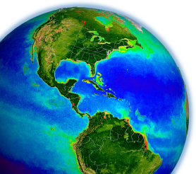
Ocean Discipline
Bryan Franz
Ocean Discipline Leader
MODIS/VIIRS Science Team
with input from the PACE Science Team
and Ocean Science Community
Terra/Aqua/Aura Drifting Orbits Workshop
1-2 November 2022
Virtual

Slide 2
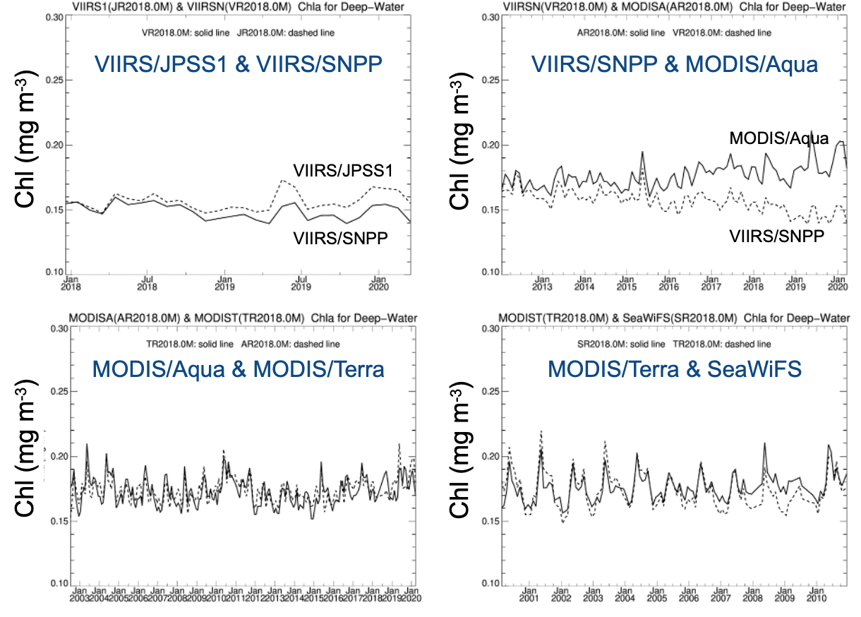
MODIS/Aqua is the international gold standard for global ocean color
Understanding impacts of climate change requires robust and consistent measurements spanning multiple decades.
MODIS/Aqua provides the “glue” to hold together data from 1997 to the future, providing the longest consistent data record from a single satellite mission to tie SeaWiFS, MERIS, VIIRS, and OLCI to PACE
MODIS/Aqua enables detection of suspect trends in ocean color data records from these other domestic and international missions.
This is a critical service that will have widespread impact when Aqua is terminated.
J1/VIIRS may eventually fill this role, after a few more years of on-orbit calibration and validation (albeit for limited spectral sampling), but equivalent confidence has not yet been reached.

Slide 3
Extension of MODIS/Aqua will enable continuity of the global ocean color timeseries into the PACE era
PACE will launch in Jan 2024, and OCI will collect global hyperspectral measurements of Earth over the full VIS/NIR range of MODIS (5nm @2.5nm).
Extension of Aqua (and Terra) to end of 2025 would provide two years of overlap with PACE (two full seasonal cycles).
Mission overlap will enable assessment of combined bias in PACE ocean color retrievals due to sensor and algorithm differences, relative to a very well validated (20+ year) time-series.
Further, PACE/OCI hyperspectral sampling can be used to mimic the spectral bandpasses of multi-spectral sensors, enabling direct application of MODIS-specific algorithms to PACE observations to the extend MODIS timeseries to the PACE era.
and overlap of Aqua and VIIRS with PACE will provide quantitative assessment of biases in multi-spectral algorithms as applied to SeaWiFS, MODIS, and VIIRS, to enable improved data merging of the multi-sensor ocean color time-series back to 1997.

Slide 4
Excerpted letter from Dariusz Stramski, Scripps Institution of Oceanography, on science enabled by overlap of Aqua with PACE
(1) Development of high-quality multi-decadal climate data records from multiple multispectral ocean color missions from SeaWiFS through MODIS-Aqua to VIIRS-JPPS requires merging of ocean data products that exhibit high degree of quantitative consistency across different satellite missions.
(2) Current merging approaches are unavoidably subject to uncertainties and methodological challenges which are unrelated to environmental changes, such as differences in the design and characteristics of the past, current, and future multispectral satellite sensors (e.g., radiometric and spectral characteristics including selection of spectral bands, calibration procedures and stability over time), differences in the associated data acquisition and processing procedures for different satellite missions, and the generation of any given ocean product from different missions using sensor-specific algorithms that are different. These factors can (and do) make unwanted contribution to differences that are observed between the sensor-specific products obtained from different missions during a period of mission overlap.
(3) To maximize the ability to discern the actual presence or absence of long-term environmental trends in key ocean biogeochemical and optical products derived from merged multi-mission data records, there is a need to ensure that the merging approach eliminates or minimizes the unwanted methodological effects on derived products across different satellite missions.
(4) Owing to hyperspectral capabilities, PACE-OCI will provide an unprecedented opportunity to facilitate and improve the merging process for ocean color products from multiple multispectral missions which is addressed in more detail below.
(5) For the first time since the start of satellite ocean-color era in 1978, PACE-OCI will allow simultaneous application of different multispectral sensor-specific algorithms (e.g., SeaWiFS-, MODIS-, VIIRS-specific algorithms) to satellite measurements made with a single ocean color (OCI) sensor. This analysis will provide unique quantitative insights into intrinsic uncertainties associated with different multispectral sensor-specific algorithms on derived data products because the unwanted effects of differences in the characteristics of multispectral sensors and associated satellite missions will be eliminated from these intercomparisons.
(6) Given the capability of PACE-OCI described in (5), it is critical to have an overlap between PACE and MODIS-Aqua, at least 1 year to acquire global data over full seasonal cycle. This is because this overlap will allow application of the same multispectral MODIS-specific algorithms to measurements made in parallel with MODIS-Aqua and PACE-OCI. This analysis will provide unique quantitative insights into effects of the same multispectral MODIS-specific algorithms on derived data products when the algorithms are applied to different ocean color sensors (MODIS-Aqua and OCI) simultaneously (nearly the same location and time). In parallel, similar analysis will be also available for VIIRS-JPSS1 (and SNPP) and OCI as these missions will overlap.
(7) The analyses described in (5) and (6) are expected to provide a basis for formulation of an improved, quantitatively more rigorous, merging approach for ocean products from different multispectral missions. Owing to comparative analyses enabled by parallel acquisition of hyperspectral data with PACE-OCI and multispectral data with MODIS-Aqua and VIIRS, an improved merging approach can be expected with reduced assumptions and degree of arbitrariness present in current merging approaches. Specifically, the OCI-derived products obtained by using the MODIS-specific and VIIRS-specific multispectral algorithms have uniquely great potential for providing the best quantitative “bridge” for merging ocean color products from past and current multispectral missions (SeaWiFS, MODIS-Aqua, VIIRS-JPSS1) and future multispectral missions (VIIRS-JPSS) with an ultimate goal of producing the best possible quality of multi-decadal climate data records.
(8) The importance of overlap between MODIS-Aqua and PACE is reinforced by the fact that MODIS-Aqua provides the longest record (~20 years) of ocean color products from a single mission which also provides a bridge to earlier SeaWiFS mission going back to 1997. MODIS-Aqua is also considered a gold standard for past and current ocean color observations. If MODIS-Aqua has no overlap with PACE, it will be impossible to develop and apply an improved merging approach for past data from MODIS-Aqua (and SeaWiFS) with future data from VIIRS-JPSS based on availability of parallel measurements collected with MODIS-Aqua, VIIRS-JPPS1, and PACE-OCI. Missing on such unique opportunity to improve the merging approach for multispectral missions can impact the quality and quantitative consistency of long-term record of ocean color products.
submitted for the record

Slide 5
Additional Thoughts
Until the launch of PACE, MODIS on Aqua and Terra is the only ocean color sensor providing global measurements of phytoplankton chlorophyll fluorescence: a valuable indicator of phytoplankton physiology (see presentation by Lorraine Remer).
A multitude of applications currently rely on MODIS data, including harmful algal bloom (HAB) alerts and red tide monitoring systems, and nuisance macroalgae sargassum warning systems. A gap between Aqua/Terra and PACE will threaten data continuity of these important systems.
Termination in FY23 will have impact to previously-scheduled field campaigns: BioSCape, or the “Biodiversity Survey of the Cape”, is a NASA biodiversity focused field campaign taking place in South Africa in October - November 2023, that has planned activities based on MODIS-Aqua.
The drifting orbit period for MODIS can uniquely enable studies of diurnal variability in sea surface temperature, as mean time of day for a given geographic region changes systematically from its 20-year reference (see presentation by Peter Minnett).

Slide 7
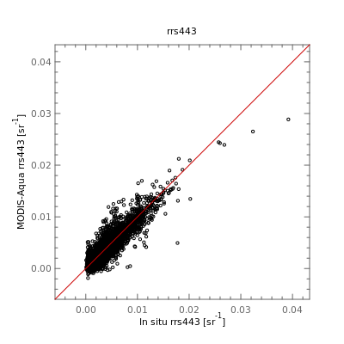
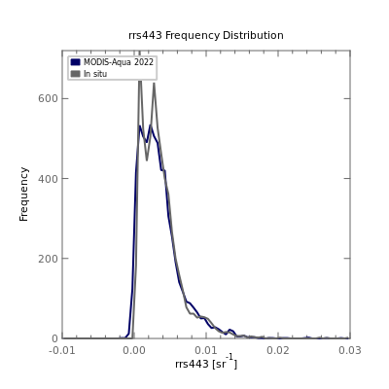
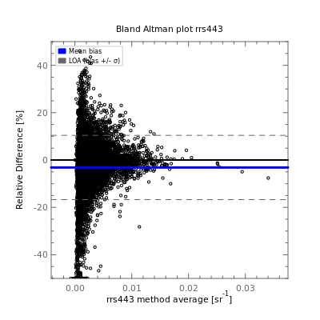
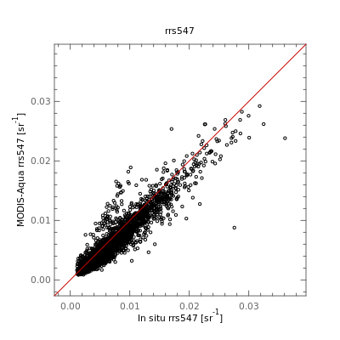
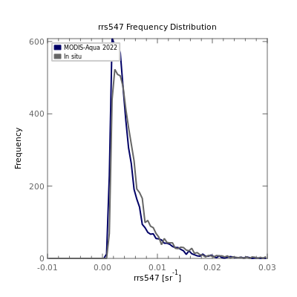
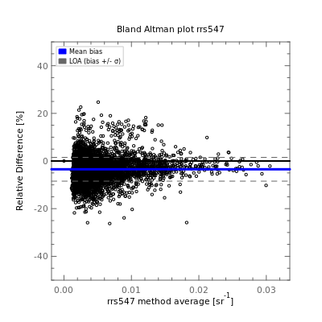
MODIS-Aqua R2022 Rrs Validation
Rrs (443) Scatter
Rrs (443) Freq. Dist.
Rrs (443) Bland Altman
Comparison against AERONET-OC and SeaBASS in situ measurements.
Very good agreement in most bands.
Negative mean relative bias of < 5% in most bands (Bland Altman).
Rrs (547) Scatter
Rrs (547) Freq. Dist.
Rrs (547) Bland Altman
https://seabass.gsfc.nasa.gov/search_results/val

Slide 8
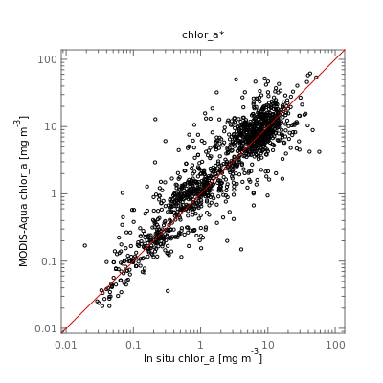
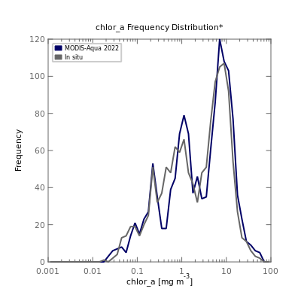
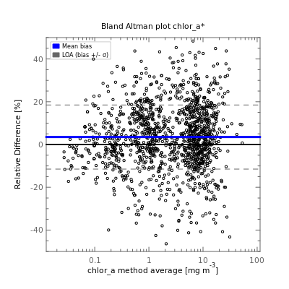
MODIS-Aqua R2022 Chl Validation
Chl Scatter
Chl Freq. Dist.
Chl Bland Altman
MODIS-Aqua Chlorophyll in good agreement with in situ measurements
Mean relative bias < 5%
https://seabass.gsfc.nasa.gov/search_results/val

Slide 9
Maintaining the Ocean Color Climate Data Record
MODIS has enabled establishment of a long-term (22+ year), consistent data record of the ocean's biological response to major climatic events.
Global mean mid-latitude (+/- 40) chlorophyll concentration and deseasonalized anomaly.
Global mean mid-latitude (+/- 40) phytoplankton carbon concentration and deseasonalized anomaly.
SeaWiFS
Combined
MODIS
Multivariate Enso Index (MEI)
SeaWiFS
Combined
MODIS
Multivariate Enso Index (MEI)

