Slide 1
Exploiting local time distributions to understand sensitivities of MODIS cloud retrievals to pixel size/solar geometry
RFI Response to Theme 1
Kerry Meyer (NASA GSFC), Chenxi Wang (GESTAR-II/UMBC, NASA GSFC)
NASA Terra, Aqua, Aura Drifting Orbits Workshop
November 1, 2022

Slide 2
Two Considerations Posed
On data record continuity
A subset of local time (LT) sampling is preserved within the MODIS swath even as the Terra and Aqua orbits drift. The orbital mean local time (MLT) equatorial crossing is not a particularly useful metric for understanding temporal sampling for wide swath sensors.
On a unique science opportunity
The preserved LT sampling during orbit drift occurs increasingly towards MODIS swath edge, enabling explorations of the impacts of sun/satellite view geometries and pixel size on reflectance-based retrievals having sensitivities to these parameters (e.g., cloud optical properties, aerosol optical properties, etc.)

Slide 3
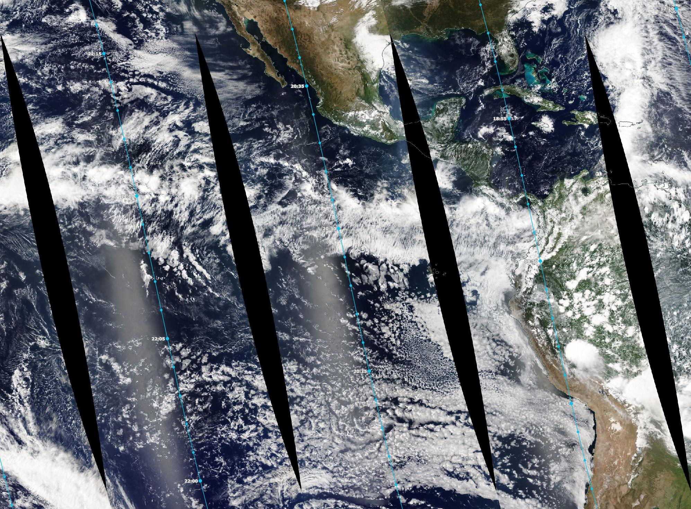
MLT
LT ≈ MLT – 45min
LT ≈ MLT + 45min

Slide 4
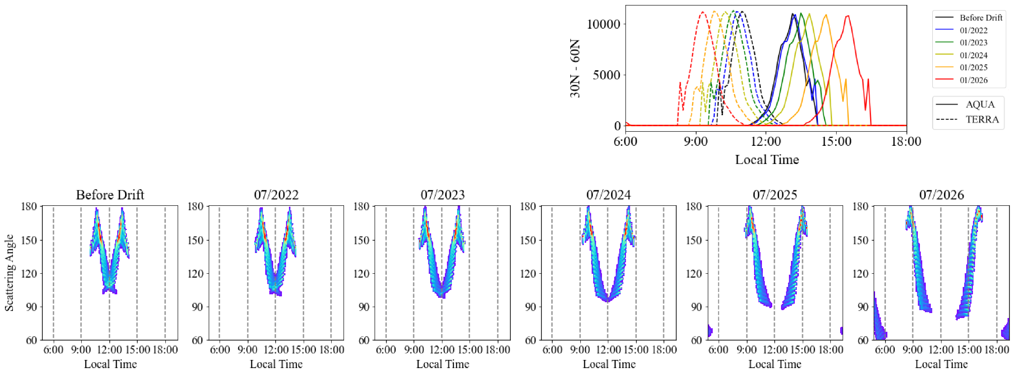
Preservation of Local Time (LT) Sampling
Mean Local Time (MLT) is only directly relevant for a sensor’s nadir observations at the equator.
Sensors with a significant across-track swath will sample a relatively broad range of Local Times (LTs), including at the equator
Thus, as Terra and Aqua drift, we expect MODIS will continue sampling a fixed local time for a subset of observations
Predicted July Local Time (LT) and Scattering Angle Sampling for Terra and Aqua MODIS in the 30N-60N Latitude Band

Slide 5
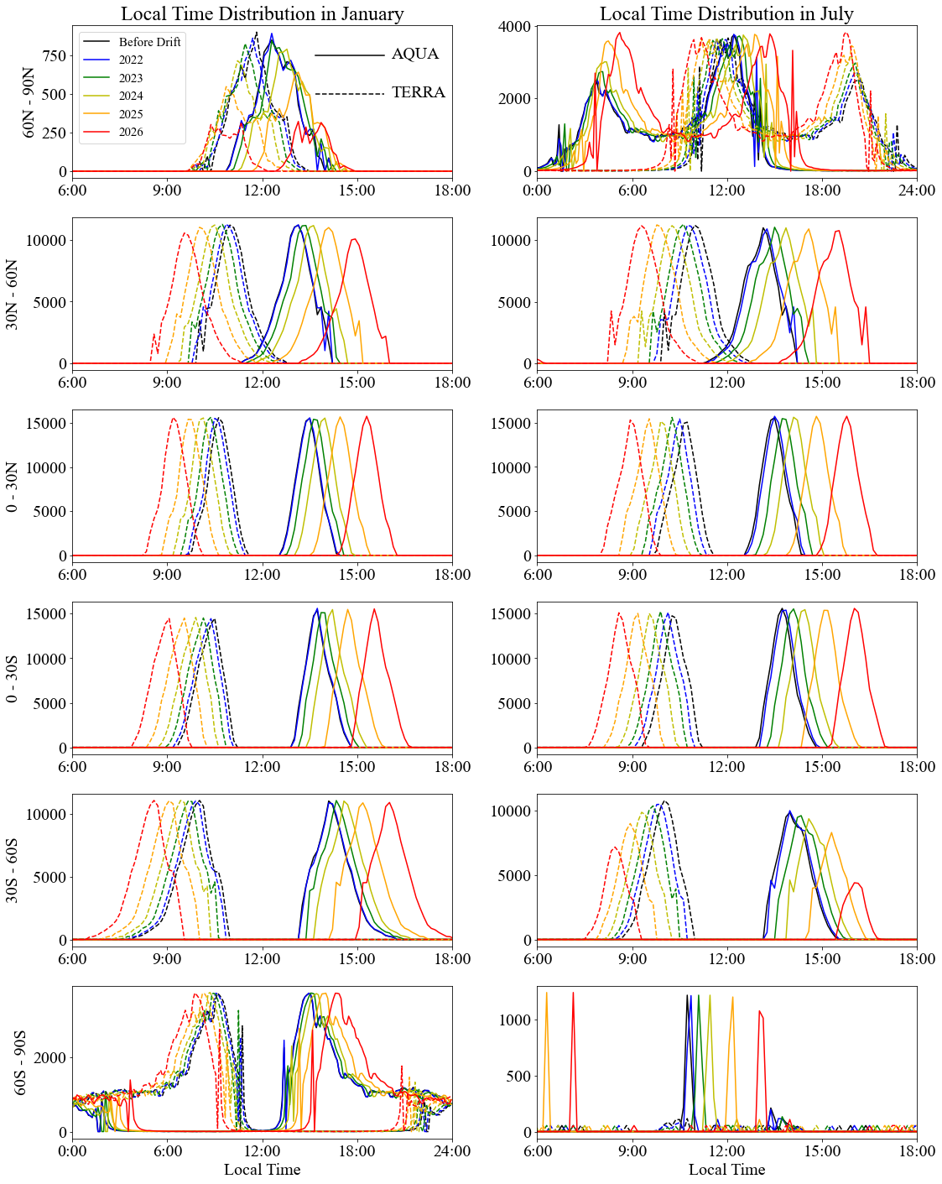
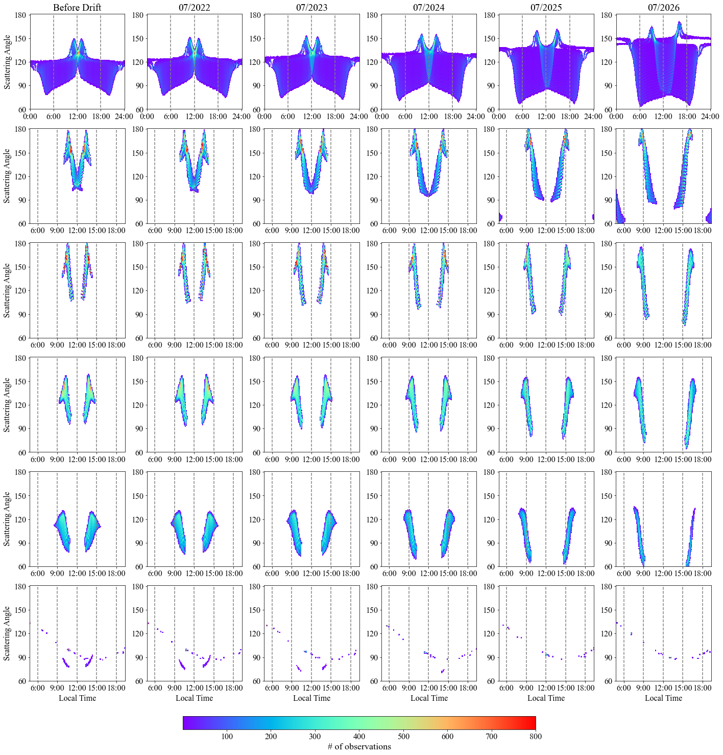
Predicted MODIS LT Sampling
Predicted MODIS LT Sampling vs Scattering Angle Sampling
60°N – 90°N
30°N – 30°N
0° – 30°N
0° – 30°S
30°S – 60°S
60°S – 90°S

Slide 6
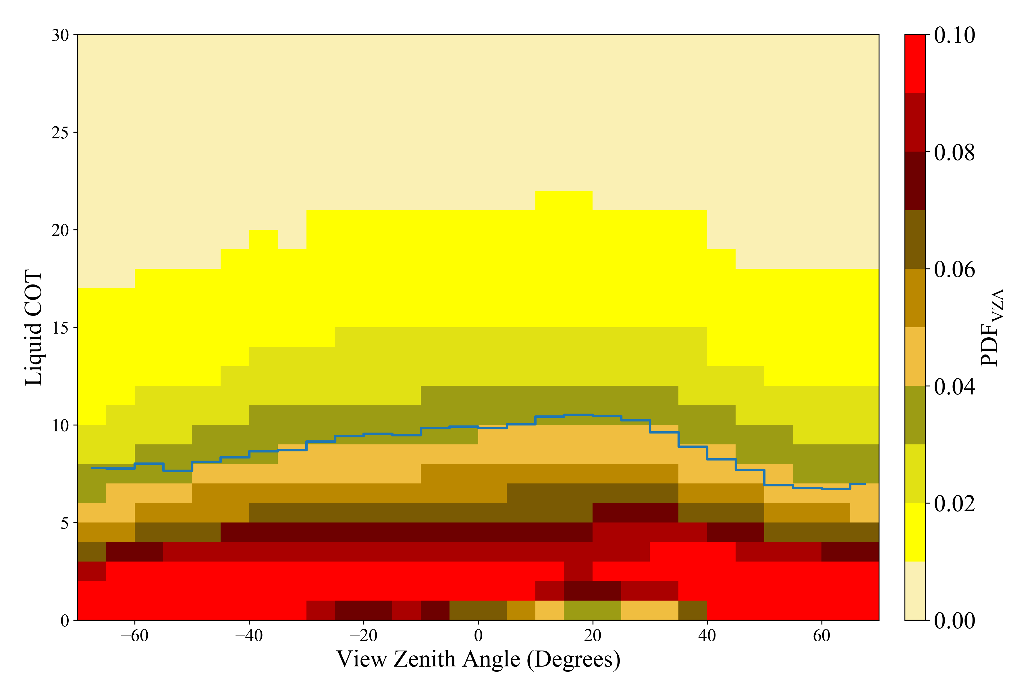
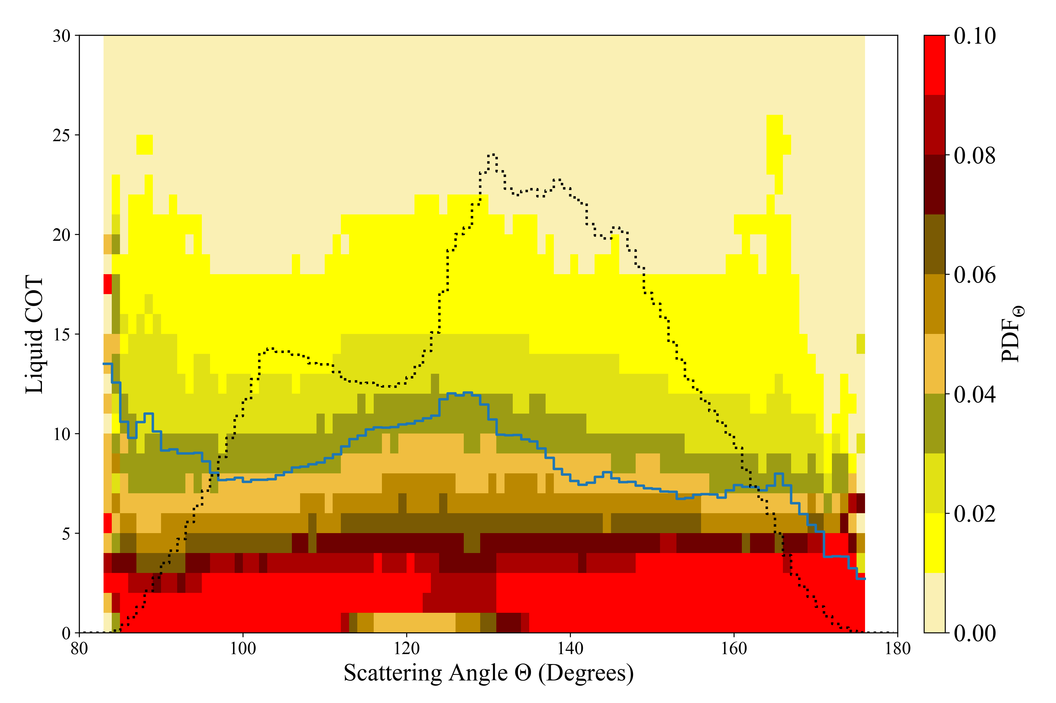
Unique Science Opportunity
MODIS
N. Pacific Region, Lon = [-180°, 128°], Lat = [0°, 50°], Feb. 2014
As Terra and Aqua drift, the subset of observations having fixed LT sampling will preferentially orient towards one side of the MODIS swath
Thus distributions of view/scattering angles and pixel sizes change
Unique opportunity to decouple the impacts of pixel size and sun/satellite view geometry from the diurnal cycle
Cannot be replicated with other instruments
VIIRS – similar instrument and pre-drift MLT equatorial crossing – mitigates across-swath pixel growth via onboard detector aggregation
GEO imagers (ABI, etc.) observe all LTs at a given location but at geographically fixed pixel sizes

