Slide 1
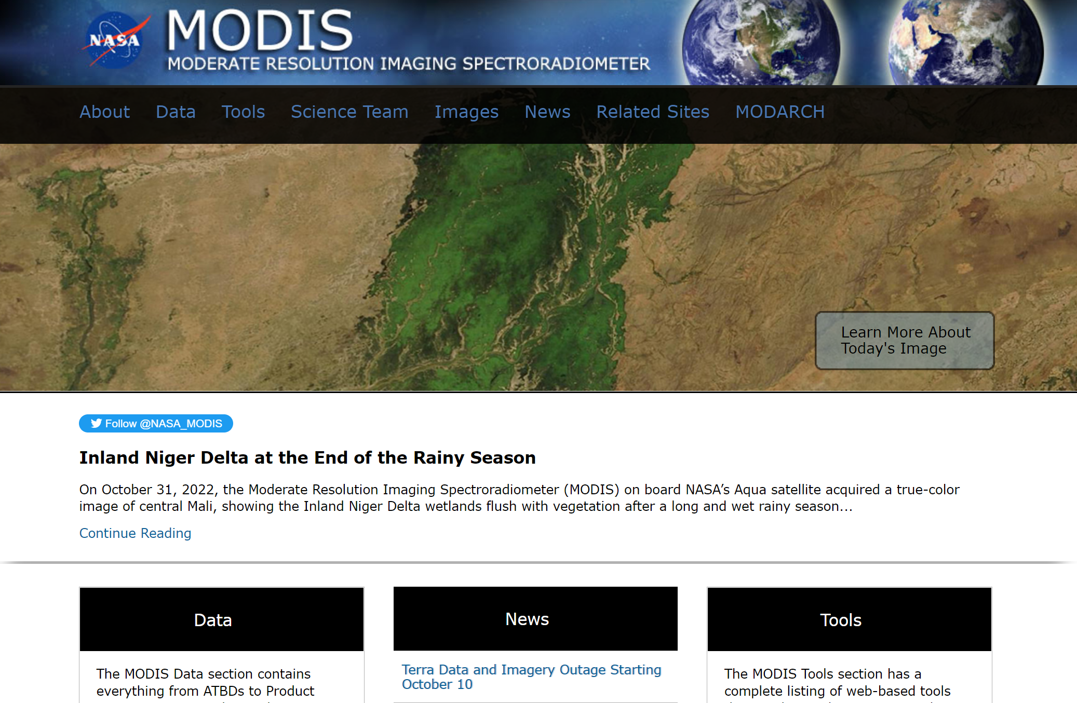
Notes:
MODIS (or Moderate Resolution Imaging Spectroradiometer) is a key instrument aboard the Terra (originally known as EOS AM-1) and Aqua (originally known as EOS PM-1) satellites.
Terra MODIS and Aqua MODIS are viewing the entire Earth's surface every 1 to 2 days, acquiring data in 36 spectral bands.

Slide 2
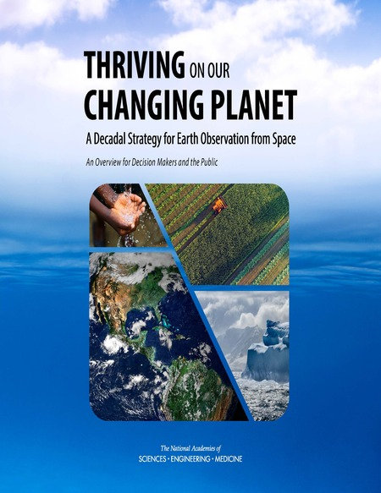
Decadal Strategy for Earth Observation from Space
Cites Terra/Aqua MODIS contributions to NASA’s program of record (n=162)
Does not call (either implicitly or explicitly) for the cancellation of Terra/Aqua/Aura missions.

Slide 3
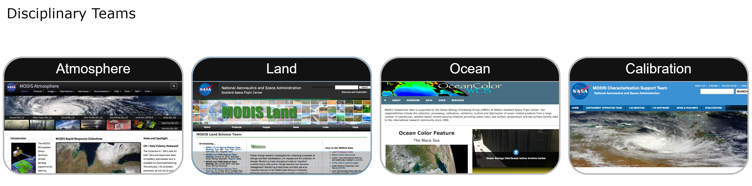
Notes:
For almost two decades now, MODIS has improved our understanding of global dynamics and processes occurring on the land, in the oceans, and in the lower atmosphere. MODIS is playing a vital role in the development of calibrated, validated, global, interactive Earth system models able to predict global change accurately enough to assist policy makers in making sound decisions concerning the protection of our environment.

Slide 4




Terra/Aqua MODIS Contribution Goes Beyond Science
Notes:
Currently the MODIS publications database houses 21515 unique publications, with 20879 related abstracts.

Slide 5

Terra/Aqua MODIS Contribution Goes Beyond Science
Notes:
Currently the MODIS publications database houses 21515 unique publications, with 20879 related abstracts.

Slide 6
