Slide 1
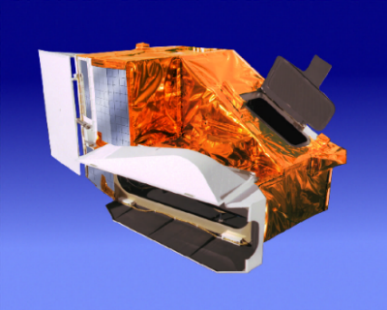
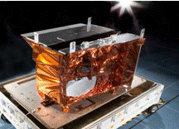
MODIS and VIIRS Calibration Workshop
MODIS
VIIRS
MODIS and VIIRS Science Team Meeting, The Hotel at the University of Maryland, College Park, MD, May 1, 2023

Slide 2
Welcome Remark
Last “In-Person” MODIS and VIIRS STM and Calibration Workshop in Nov 2019
“Virtual” MODIS and VIIRS STM (Plenary Session) in Nov 2020
“Virtual” MODIS and VIIRS CAL Workshop in Feb 2021
NASA Terra, Aqua, and Aura Drifting Orbits Workshop in Nov 2022
Senior Review Proposals for Mission Extension (Terra and Aqua) in April, 2023
JPSS-3 VIIRS Completed the TVAC Testing (PSR in June, 2022)
JPSS-2 (NOAA-21) Launch on Nov 10, 2022
JPSS-4 VIIRS TVAC Testing in Aug – Dec, 2023
MODIS C7 L1B/LUTs Initial Delivery in March 2021 (updated through Dec 2022)

Slide 3
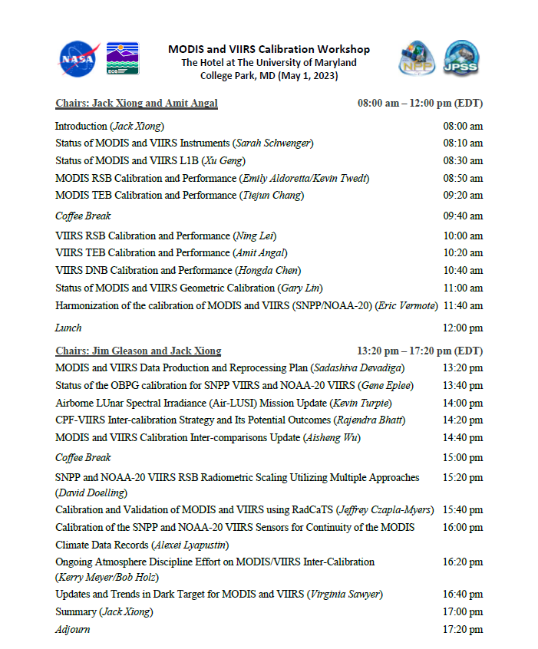
Agenda
  A minor adjustment with 1 talk moved from PM to AM session
  2 additional poster presentations from MCST/VCST
Coffee Breaks
  Contribution from SSAI
Conference Room
  7:00 AM – 6:00 PM
Wi-Fi
  Check with registration desk
Virtual Option
  WebEx link available via registration
Workshop Presentations
  To be posted at MODIS website
https://modis.gsfc.nasa.gov/sci_team/meetings/

Slide 4
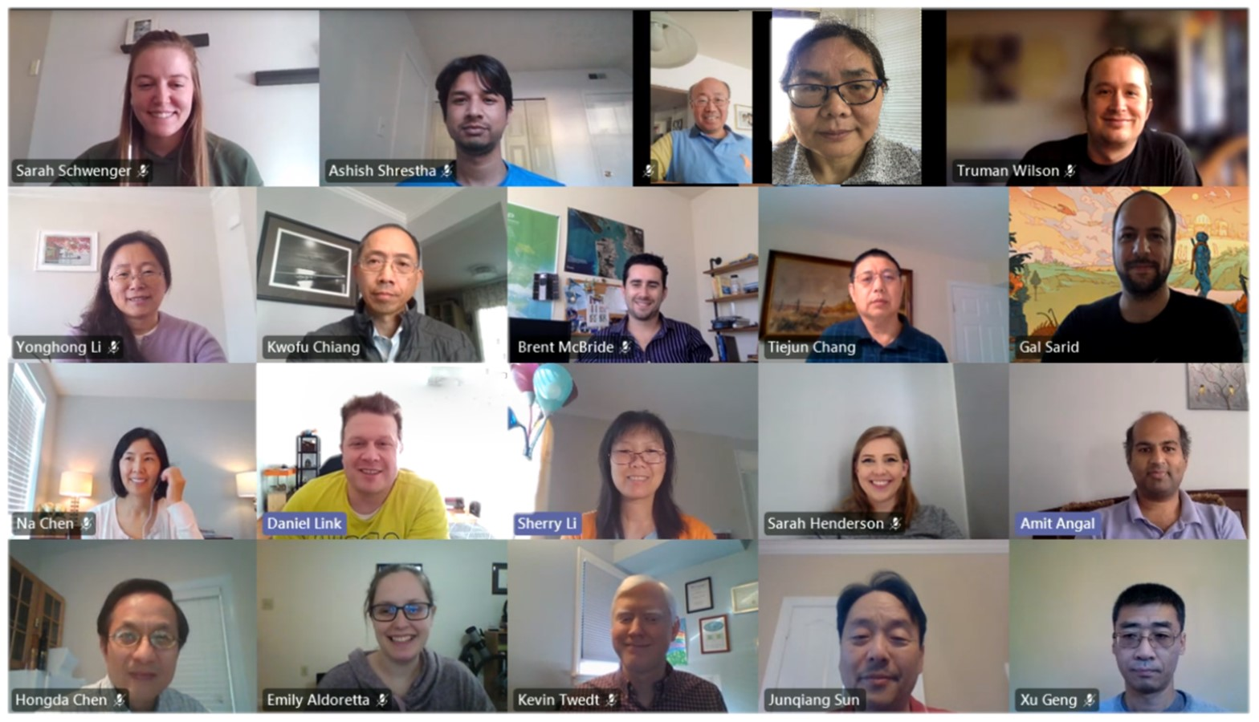
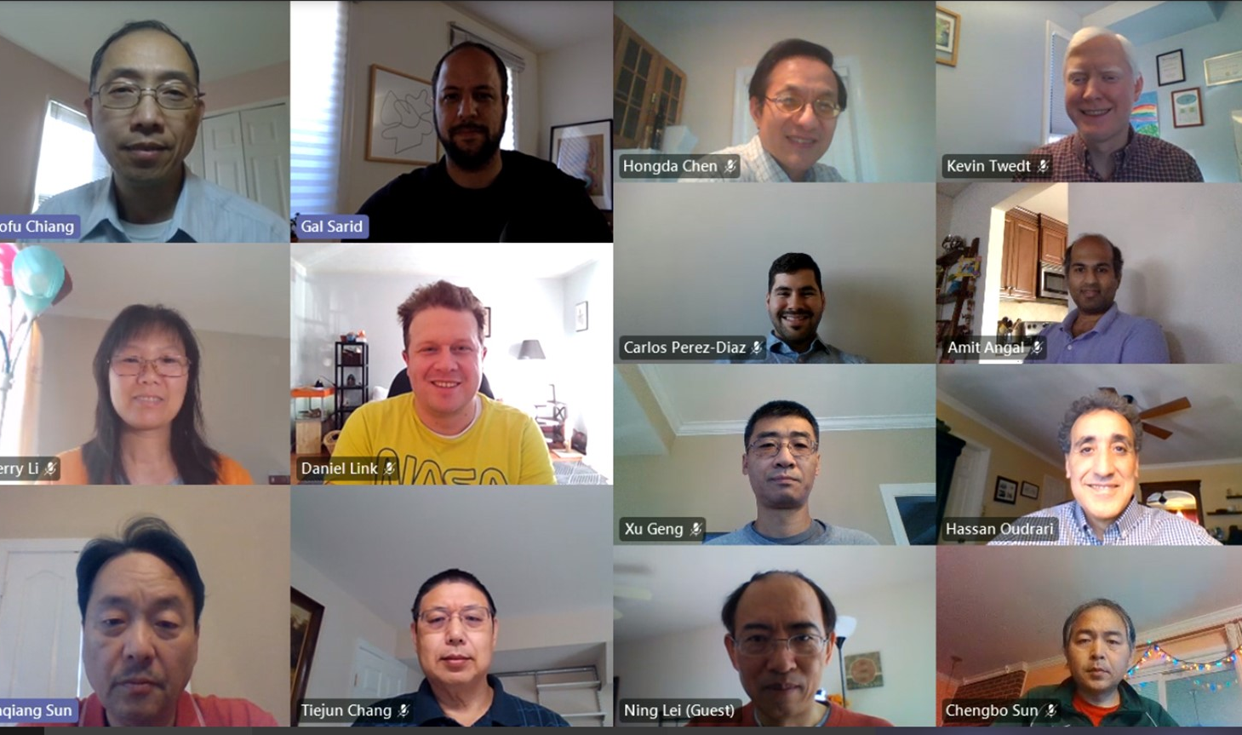
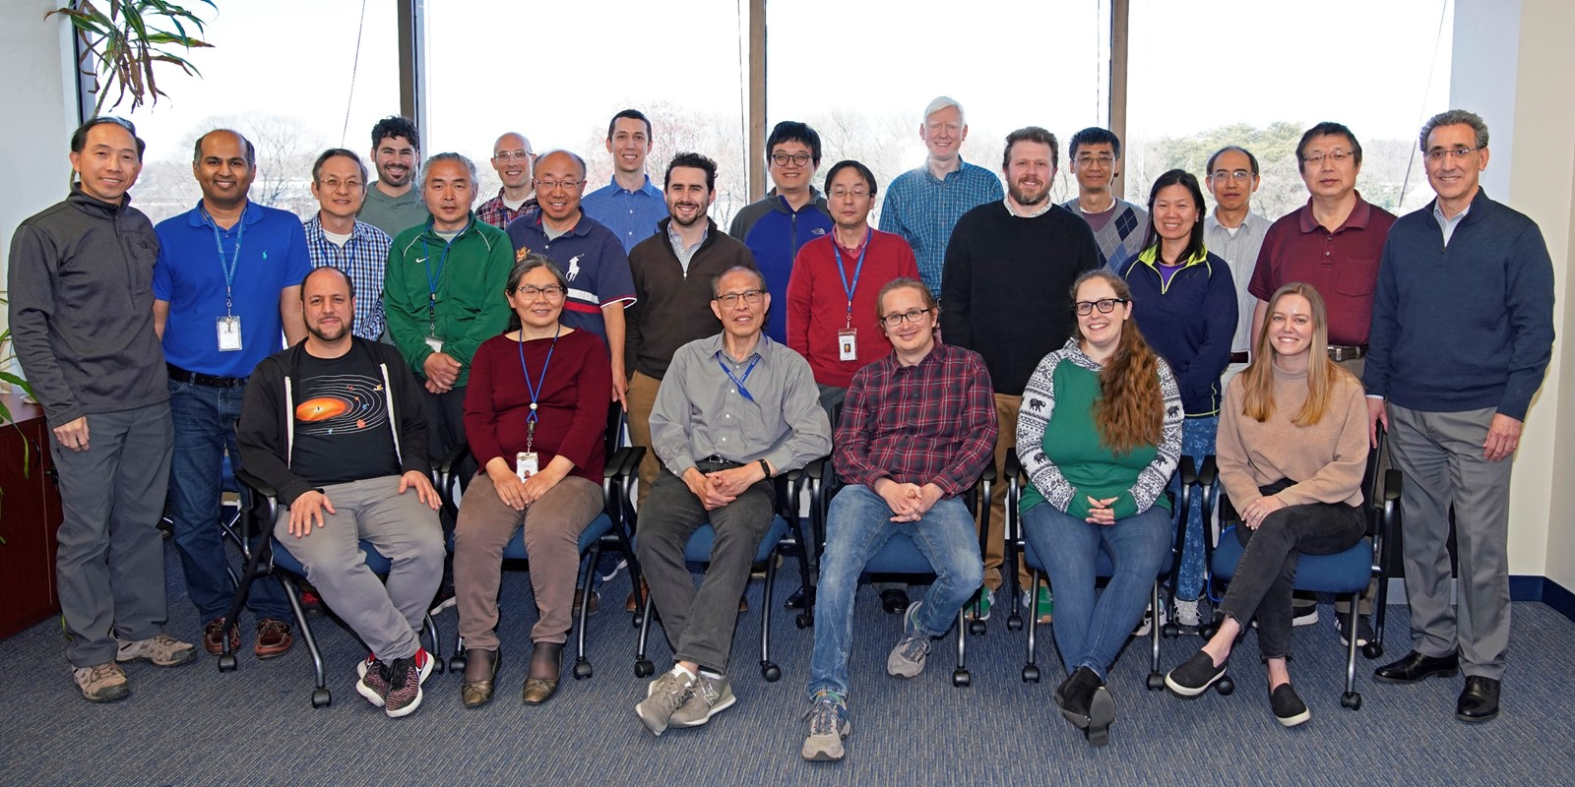
Acknowledgements
MCST
VCST
Contributions:
MODIS and VIIRS Characterization Support Team (MCST and VCST)
MODIS and VIIRS Science Teams
Support:
Terra, Aqua, S-NPP, and JPSS Projects
Mission/Flight Operation Team (MOT/FOT)
Instrument Vendor (Raytheon)
NOAA JPSS Program and VIIRS SDR Team
November 16, 2020
March 30, 2023

