Slide 1
MODIS and VIIRS Instrument Operations Status
MODIS and VIIRS Characterization Support Teams, NASA GSFC
(presented by Sarah Schwenger)
MODIS/VIIRS Calibration Workshop (May 01, 2023)
Notes:
1

Slide 2
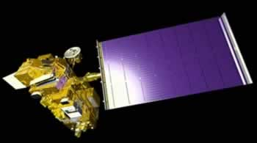
Terra Flight Operations
Terra Spacecraft Status
23+ years of successful operation. Since the last STM, the MODIS instrument has continued to operate nominally.
Solid State Recorder – Full data allocation following successful SSR Reset on September 22, 2021.
Orbit Maneuvers: final Drag Make-up July 28, 2022 (2022/209), final Inclination Adjustment February 27, 2020 (2020/058).
Constellation Exit Maneuvers October 12, 2022 (2022/285) and October 19, 2022 (2022/292)
Page 2
Notes:
2

Slide 3
MODIS Instrument Operations (Terra)
Terra MODIS is healthy and operating nominally
Operational Configuration
A-side: launch to Oct. 30, 2000
B-side: Oct. 30, 2000 to June 15, 2001
A-side: July 02, 2001 to Sept. 17, 2002
A-side electronics and B-side formatter: Sept. 17, 2002 to present
Cold FPA (SMIR and LWIR) controlled at 83K
SD door fixed to “open” position since July 2003
BB temperatures set at 285K since April 25, 2020
Events
Terra CP/FP Reset March 15, 2022 sent MODIS to Standby Mode, fully recovered to Science March 16, 2022
Terra MODIS in non-standard CEM configuration October 10-21, 2022
Special Operations
Preparation for Decommissioning
Page 3
Notes:
3

Slide 4
Terra Constellation Exit Maneuvers
Terra Constellation Exit Maneuvers were successfully executed on 10/12/22 and 10/19/22.
Total altitude lowered by ~5.5 km
MODIS was transitioned into the following CEM configuration on 10/10/22 (2022/283):
Abnormal Science Flag (set via real-time commanding on 10/9/2022)
SV and EV doors closed
Blackbody off
SMIR and LWIR focal planes/heaters off
Formatter set to Night Mode
Following the completion of the CEMs, MODIS recovery began with an Outgas on 10/20/22.
MODIS was fully transitioned to Science Mode on 10/21/22 (2022/294).
Science data outage: 2022/283 03:01:00 – 2022/296 22:30:00
To prevent risk to the door motors, the SV and EV doors were opened using revised commanding following signs of door switch degradation.
Cold focal plane temperatures returned to their set points by 22:30 UTC on 10/23/22.
Page 4
Notes:
4

Slide 5
Terra Constellation Exit Maneuvers
ABNORM flag from 283/00:12:04 to 294/19:59:49 denotes when MODIS in a non-standard configuration
Instrument temperature during operations. Highest temperatures caused by outgas operations.
SMIR cold focal plane temperature. Similar to LWIR focal plane temperature.
This telemetry point saturates at 118 K
Page 5
Notes:
5

Slide 6
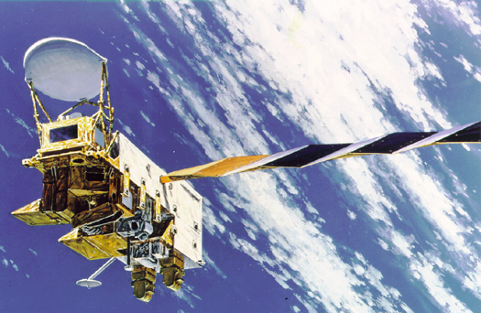
Aqua Flight Operations
Aqua Spacecraft Status
21+ years of successful operations. Since the last STM, the MODIS instrument continues to operate nominally.
Solid State Recorder – Full data allocation
Orbit Maneuvers: final Drag Make-up December 1, 2021 (2021/335), final Inclination Adjustment March 18, 2021 (2021/077).
In free drift, orbit no longer maintained
Aqua experienced a Formatter-Multiplexer Unit (FMU) anomaly on February 22, 2022 (2022/053). The spacecraft was recovered to nominal operation following an FMU Reset on March 23, 2022 (2022/082)
Aqua transitioned to Safe on March 31, 2022, recovery and Power Controller swap was successfully executed on April 13, 2022
Page 6
Notes:
6

Slide 7
MODIS Instrument Operations (Aqua)
Aqua MODIS is healthy and operating nominally
Operational Configuration (No change since last STM)
Same B-side configuration since launch
BB temperatures set at 285K
Cold FPA (SMIR and LWIR) controlled at 83K - recovered cooler margin post outgas
Events
Deep Space Calibration (September 2021)
FMU Anomaly Recovery – No impact on MODIS health, in STANDBY during recovery period. A portion of lost MODIS data has been recovered using direct broadcast data.
Safe Mode triggered by spacecraft transition to Safe (March 31, 2022 – April 15, 2022)
Concerns
Passed projected lifetime limit on SD door movements (July 2012)
Special Operations
Preparation for Decommissioning
Page 7
Notes:
7

Slide 8
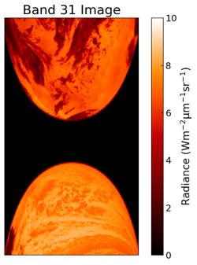
Aqua Deep Space Calibration
Aqua FOT prepared and executed a pitch maneuver to allow for deep space calibrations.
MODIS requested a calibration that includes a view of the Moon at a near-nadir angle.
The Deep Space Lunar Calibration was executed successfully on September 23, 2021 (2021/266).
Pitch slew began 2021/266 09:12:28z and completed 2021/266 09:55:13z.
Cold focal plane temperatures increased while warm focal plane temperatures decreased as expected during pitch maneuver. All focal planes returned to pre-maneuver temperatures by 2021/267 18:00:00z.
Page 8
Notes:
8

Slide 9
Aqua Safe Mode Event
An Aqua spacecraft anomaly occurred on 2022/090 (March 31, 2022)
“Unexpected Power Controller Swap”
A controller swap results in a spacecraft transition to SAFE, which triggers MODIS to transition to SAFE.
When in SAFE mode, all MODIS doors are closed, the scan mirror assembly stops, and the blackbody is turned off.
Following the completion of the spacecraft recovery, MODIS recovery to nominal Science Mode began on 4/13/2022 with an Outgas procedure.
MODIS was successfully transitioned to Science on 4/15/2022 (2022/105).
Cold focal plane temperatures returned to their set points by 03:00 UTC on 04/17/2022

Slide 10
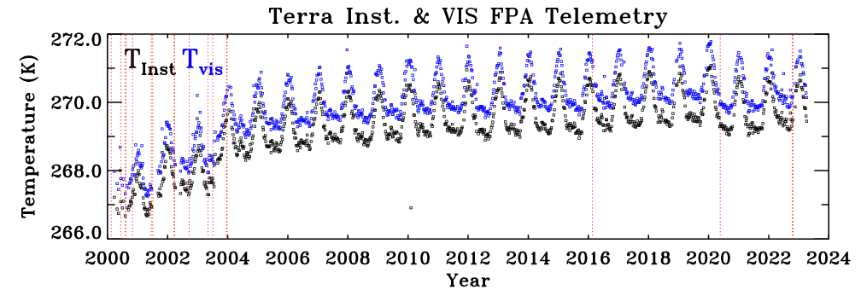
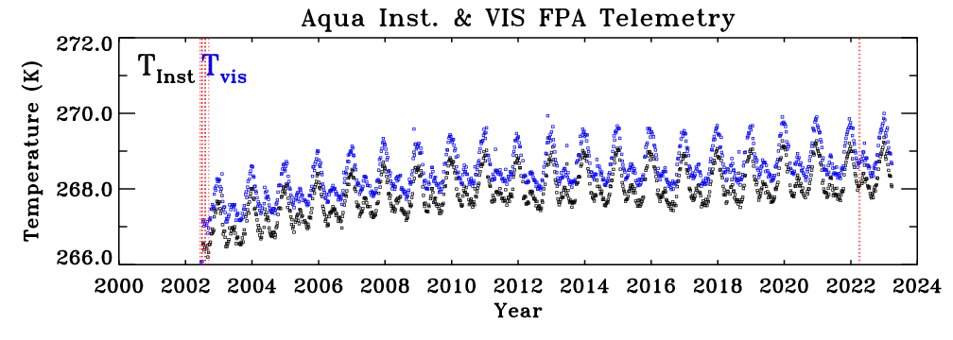
Instrument Temperature Trends
3.5K increase
< 2K increase
Page 10
Notes:
10

Slide 11
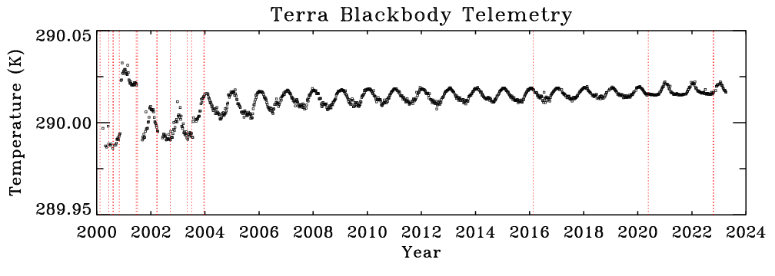
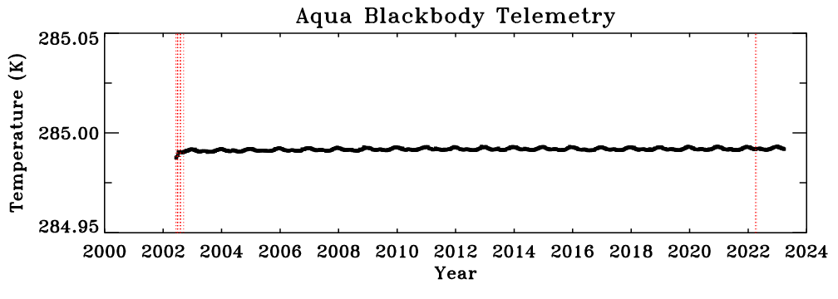
BB Temperature Trends
4.96K added to values after April 25, 2020 to match trend after setpoint change from 290K to 285K
< 30 mK increase
Excellent stability over mission lifetime
Page 11
Notes:
11

Slide 12
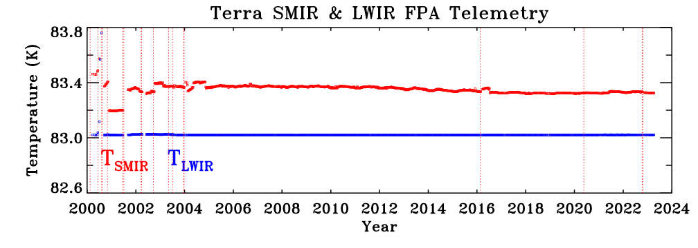
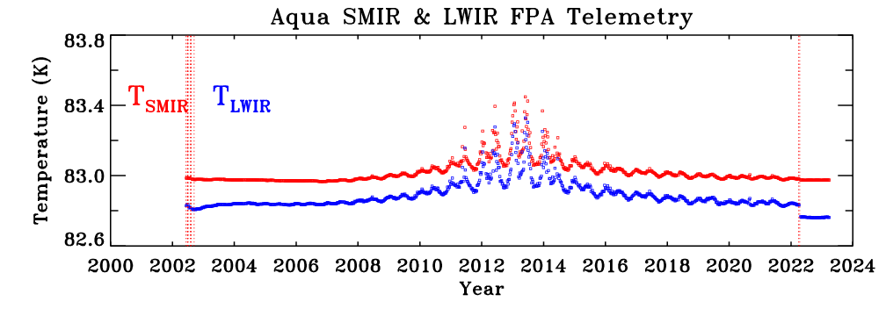
CFPA Temperature Trends
Very stable over lifetime
Improved performance in recent years, especially after the 2022 outgas operation
Page 12
Notes:
12

Slide 13
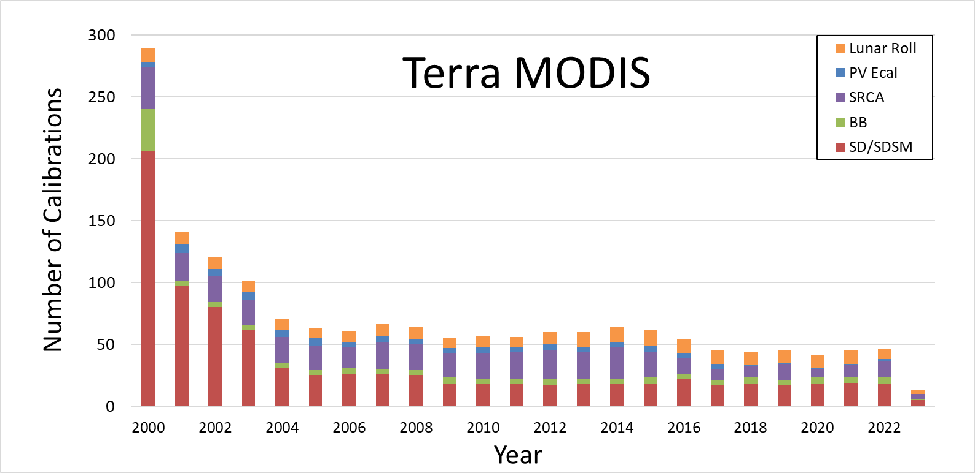
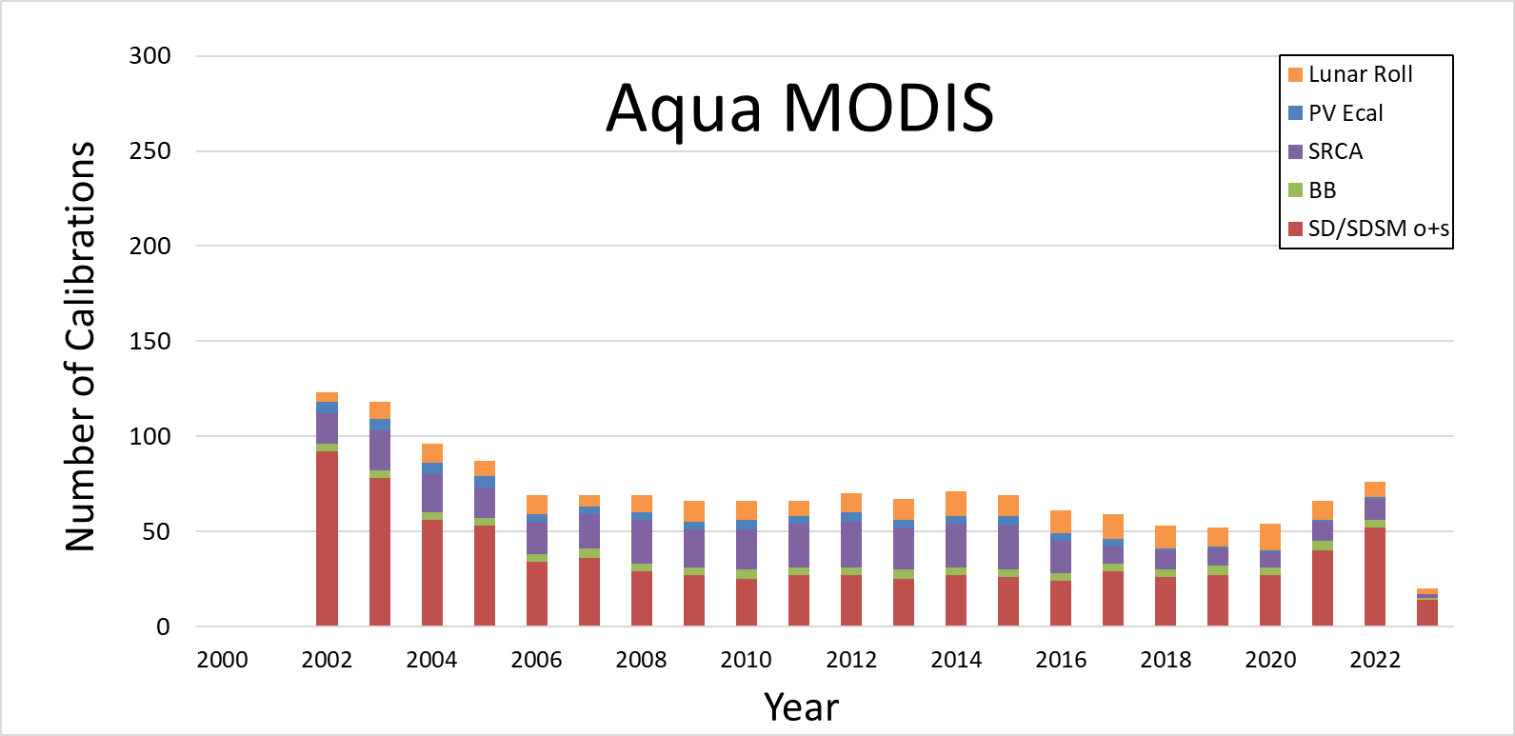
MODIS Calibration Operations
Page 13

Slide 14
VIIRS Instrument Operations (SNPP)
SNPP VIIRS is healthy and operating nominally
Operational Configuration
B-side: launch to date
Cold FPA (SMIR and LWIR) nominally controlled at 80K
BB controlled at 292.5 K. Annual warm-up cool down events. 32 since launch, most recent on 3/14/2023
SD calibration every orbit. SDSM operated weekly since 5/13/2019
Regular lunar roll maneuvers for RSB stability monitoring. 98 Lunar observations since launch, most recent on May 1, 2023
Monthly DNB VROP calibrations
Events since the last STM (Feb 2021)
S-NPP: Safe mode on 8/3/2021 after Star Catalog V1.09 upload
S-NPP: Safe mode from 7/26 to 8/10/2022.
VIIRS Single Board Computer (SBC) Lock-up (“Petulant Mode”): 16 since launch, most recent on 6/28/2022. No impact on instrument performance, 2-4 hours to return to science mode (improved design in N20 and N21 VIIRS to prevent lockups)
Scan sync loss: 136 since launch, most recent on 9/17/2022
Operations led by JPSS MOST / MOT and NOAA STAR SDR Team
Page 14
Notes:
14

Slide 15
VIIRS Instrument Operations (NOAA-20)
NOAA-20 VIIRS is healthy and operating nominally
Operational Configuration
A-side: launch to date
Cold FPA (SMIR and LWIR) nominally controlled at 80K
BB controlled at 292.5 K. Annual warm-up cool down events. 9 since launch, most recent on 3/28/2023
SD calibration every orbit. SDSM operated weekly since 3/4/2019
Regular lunar roll maneuvers for RSB stability monitoring. 46 Lunar observations since launch, on the same day as S-NPP.
Monthly DNB VROP calibrations
Events since the last STM (Feb 2021)
NOAA-20: VIIRS RTA stop due to single upset event for 6 hours on 2/14/2021.
Scan sync loss: 136 since launch, most recent on 9/17/2022
Operations led by JPSS MOST / MOT and NOAA STAR SDR Team
Page 15
Notes:
15

Slide 16
VIIRS Instrument Operations (NOAA-21)
NOAA-21 VIIRS launched on Nov 10, 2022. VIIRS operating nominally.
Operational Configuration
A-side: launch to date
Cold FPA (SMIR and LWIR) controlled at 80K (Operated at 82K from Feb 8 to March 3, 2023)
BB controlled at 292.5 K. 2 warm-up cool down events since launch, most recent on 3/12/2023
SD calibration every orbit. SDSM operated once per day since February 14, 2023
Regular lunar roll maneuvers for RSB stability monitoring. 3 Lunar observations since launch, on the same day as S-NPP and N20 VIIRS.
Monthly DNB VROP calibrations
Notable events
NOAA-21: S/C primary Ka-Transmitter (KATX-1) anomaly on 12/16/2022 without science data for all instruments onboard via KATX. The secondary transmitter (KATX-2) activation on 2/2/2023 after 48 days of data gap.
NOAA-21 early mission TEB gain decrease has recovered after MMOG. However, the RSB SWIR and TEB MWIR gains continue to show degradation
Scan sync loss: 5 since launch, most recent on 4/17/2023
Operations led by JPSS MOST / MOT and NOAA STAR SDR Team
Page 16
Notes:
16

Slide 17
IOT Backup Slides
Page 17

Slide 18
Future Operational Considerations
Aqua MODIS CFPA temperature control
Currently set at 83K
Minimal impact on science data
SRCA Lamps
Aqua currently has 1 working 10 W lamp
No change in frequency since last STM (decreased in 2017)
Aqua SD door movements
Passed projected lifetime limit on movements
No reduction in frequency of SD calibration activities planned
SD Door Movements | PL to 11/2019 | 11/2019 to present | Total | Design Lifetime | % Used
Terra* | 2146 | 0 | 2146 | 3022 | 71.01
Aqua⁺ | 3574 | 376 | 3950 | 3022 | 130.71
* As of 07/02/2003, SD Door in fixed ‘open’ position with screen in place
⁺ Aqua reached designed lifetime of door movement on DOY 2012/191 (July 2012).
Page 18

Slide 19
Terra/Aqua MODIS OBC Operations
Activity | PL to 03/2021 | 03/2021 – present | Total
SD/SDSM# | 797 | 40 | 837
BB WUCD | 120 | 10 | 130
SRCA* | 480 | 24 | 504
Electronic Cal | 102 | 3 | 105
Lunar Roll | 215 | 18 | 233
T
E
R
R
A
Activity | PL to 03/2021 | 03/2021 - present | Total
SD/SDSM# | 701 | 100 | 801
BB WUCD | 81 | 9 | 90
SRCA* | 361 | 21 | 382
Electronic Cal | 80 | 2 | 82
Lunar Roll | 195 | 18 | 213
A
Q
U
A
# Open & Screened Activities counted independently
* Includes Spatial, Spectral, and Radiometric
11/2019 = last Science Team Meeting
Page 19

Slide 20
SRCA Calibrations
Terra – 504 SRCA Calibrations
Aqua – 382 SRCA Calibrations
Lamps well within lifetime usage margins
Aqua Lamp #4 Failure - 2016
Lamp Power
10W
1W
Lamp #
1
2
3
4
1
2
Terra
Usage (hr)
400.0
172.1
190.3
152.0
596.9
327.0
Life (hr)
500
500
500
500
4000
4000
percent
80.0%
Failed on
11-20-2004
Failed on
2-18-2006
30.4%
14.9%
8.2%
Aqua
Usage (hr)
390.2
188.1
205.7
135.0
533.8
320.1
Life (hr)
500
500
500
500
5000
5000
percent
78.0%
Failed on
4-14-2003
Failed on
6-28-2005
Failed on
6-30-2016
10.7%
6.4%
Page 20
Notes:
20

Slide 21
Terra CP/FP Reset
An on-orbit anomaly occurred on 3/15/22 (2022/074) at 08:54, causing the Terra MODIS format processor (FP) and command processor (CP) to reset and send MODIS to Standby Mode.
No indication from MODIS telemetry on what caused the reset. The reset information showed an Auxil_Reset, which is only used during hardware testing.
Because the CP and FR reset, MODIS IOT needed to send commands to bring MODIS back to nominal Science configuration in addition to re-uploading all CP and FP patches which were in place before the resets.
Due to the large number of patches, those that were deemed important for instrument safety were executed on 3/15/22 and those important for science continuity were executed on 3/16/22.
Page 21
Notes:
21

Slide 22
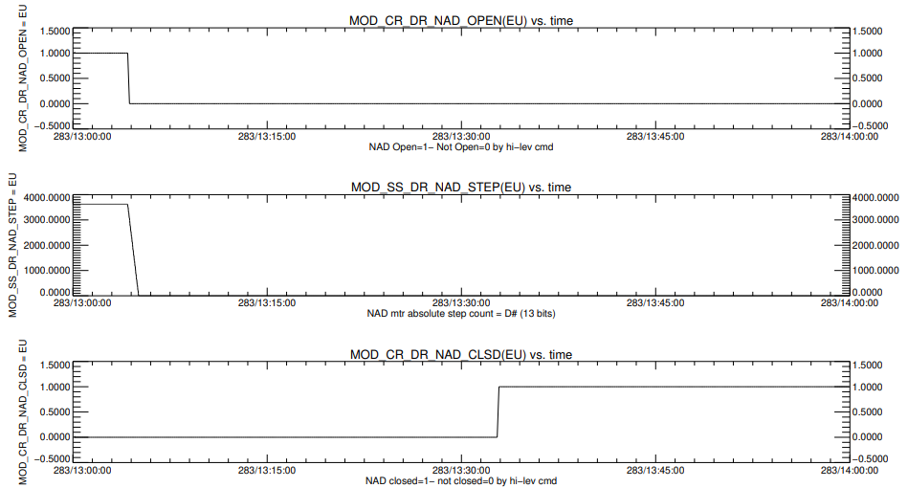
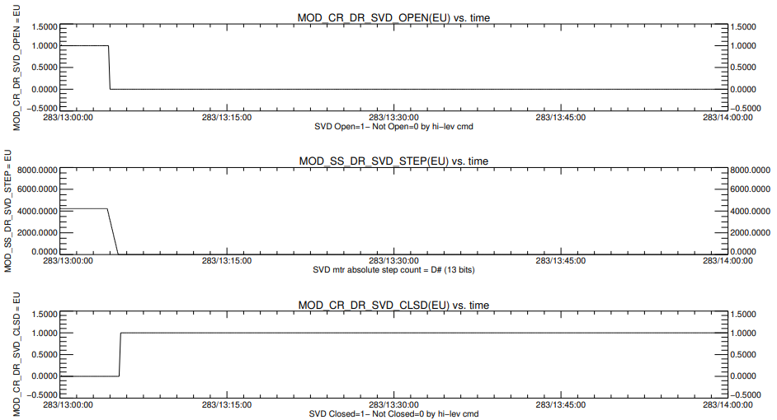
Terra Constellation Exit Maneuvers - Doors
As part of MODIS pre-CEM operations, the Nadir and SV doors were commanded to be closed at 2022/283 13:04:00.
Both door open switches read NOT_OPEN as the motors began stepping down. The SVD CLOSED switch read CLOSED within 14 seconds of the door step count reaching 0, while the Nadir door CLOSED switch read CLOSED 27 minutes after the door step count reached 0.
During the door closure, the CP registered two events indicating that the SVD and NAD triggers had not been found. MODIS software handled this properly by stepping the doors the set amount.
Page 22
Notes:
22

Slide 23
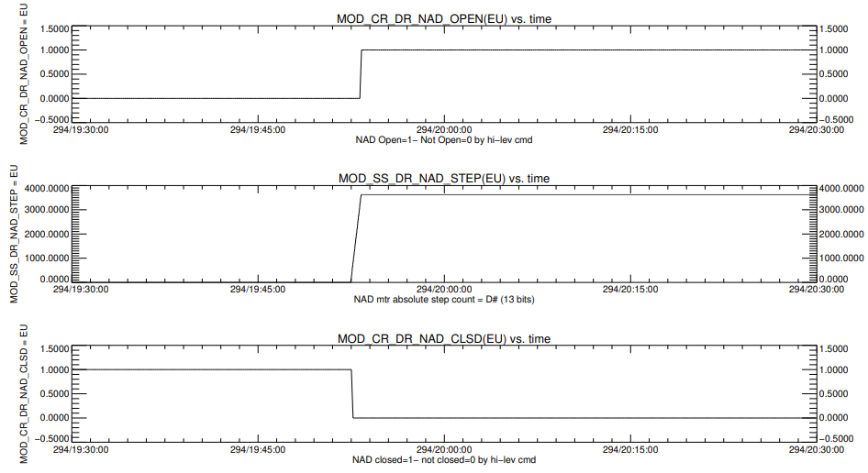
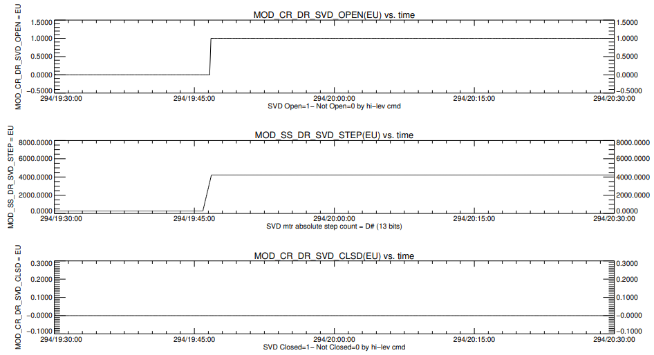
Terra Constellation Exit Maneuvers - Doors
Because the door closed switches did eventually change as expected, it was deemed the doors had moved properly and the delay in door switch telemetry was the result of the switches getting older.
There is a concern that the door switch delay could result in stepping the doors beyond their limits and overdriving the door motors.
Following the CEMs, MODIS IOT, in close co-ordination with the MODIS Software Engineer, Raytheon, decided it would be safer to replace the door-opening commands, MOD_SVD_TO_OPEN and MOD_NAD_TO_OPEN, that depend on the door switches with a command that step the doors a fixed amount, MOD_STEP_DOOR, and does not depend on door switches.
MODIS IOT intends to use these step commands to move the doors moving forward.
Page 23
Notes:
23

Slide 24
Decommissioning Plans
Aqua
Expected End of Mission:
December 2023 (possible extension to September 2026)
Perigee Lowering Maneuvers performed 1 month prior
MODIS Decommissioning Configuration:
Command to Standby Mode (Blackbody off)
Command to Safe Mode (NADIR and SV doors closed)
Command MODIS off
Terra
Expected End of Mission:
February 2024 (possible extension to April 2027)
Perigee Lowering Maneuvers performed 1 month prior
MODIS Decommissioning Configuration:
Command to Safe Mode (Blackbody off, NADIR and SV doors closed)
Page 24
Notes:
24

