Slide 1
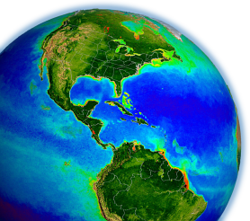
Status of the OBPG Calibration for
SNPP VIIRS and NOAA-20 VIIRS
Gene Eplee, Gerhard Meister, Fred Patt, Shihyan Lee
NASA Ocean Biology
Processing Group
MODIS/VIIRS Calibration Workshop
May 1, 2023
Notes:
1
On-Orbit calibration group for the OBPG

Slide 2
SNPP On-Orbit
Calibration

Slide 3
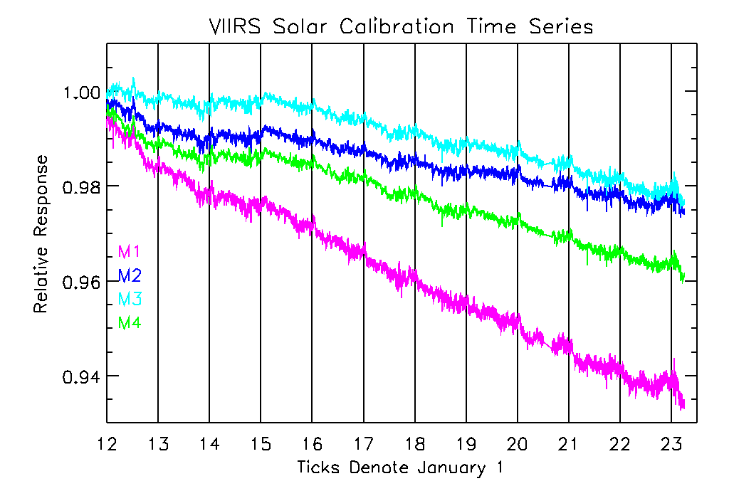
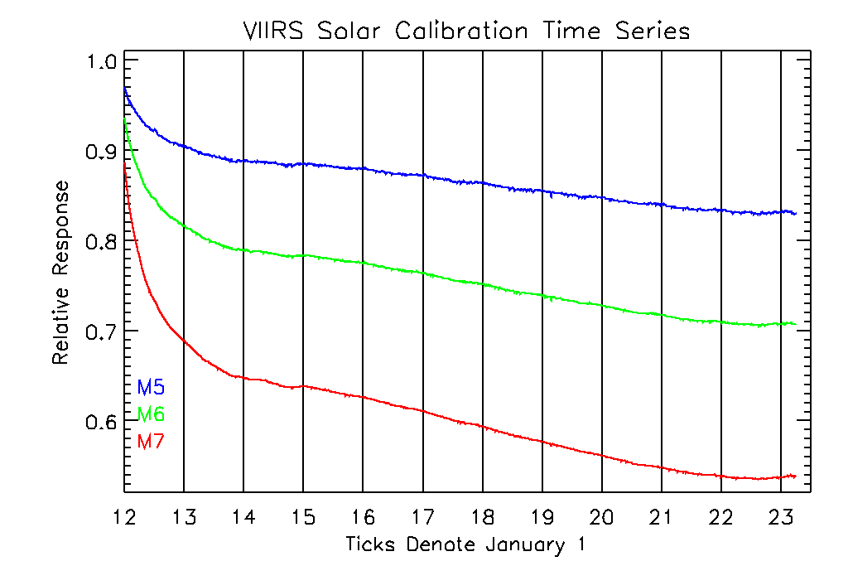
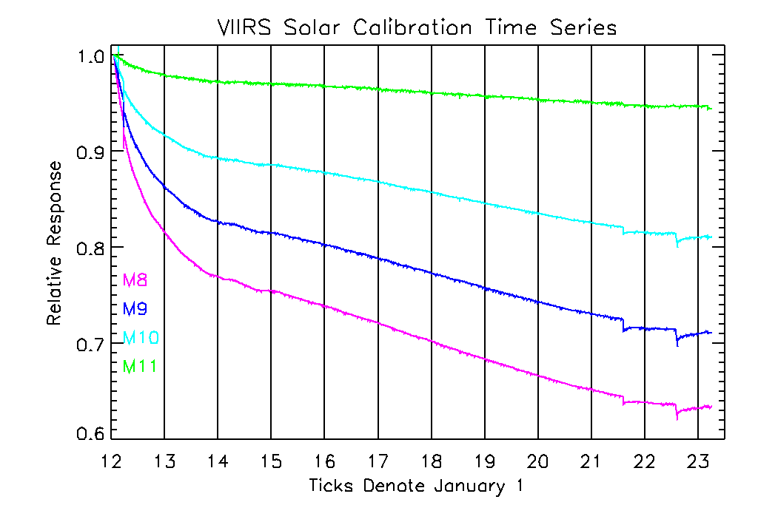
SNPP Solar Time Series
The slopes of the radiometric trends change over 2014.
There is a change in the radiometric trends in 2023.
3

Slide 4
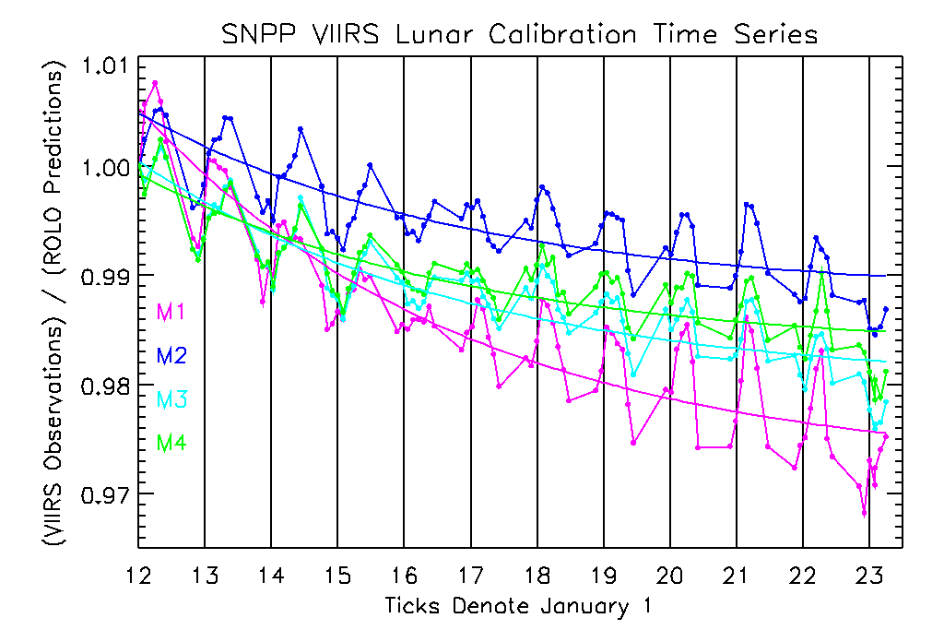
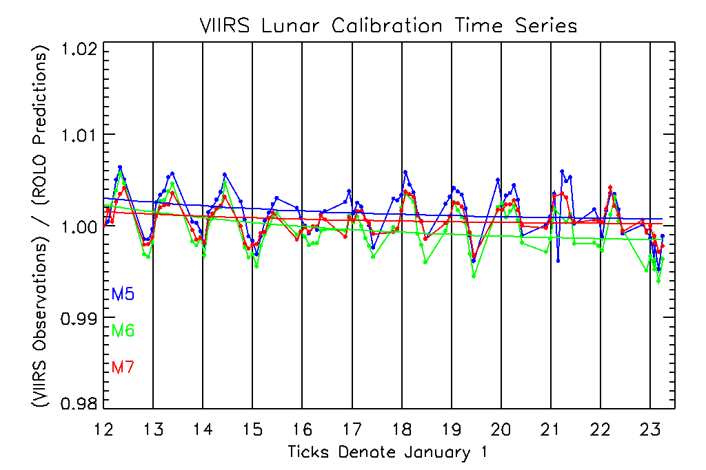
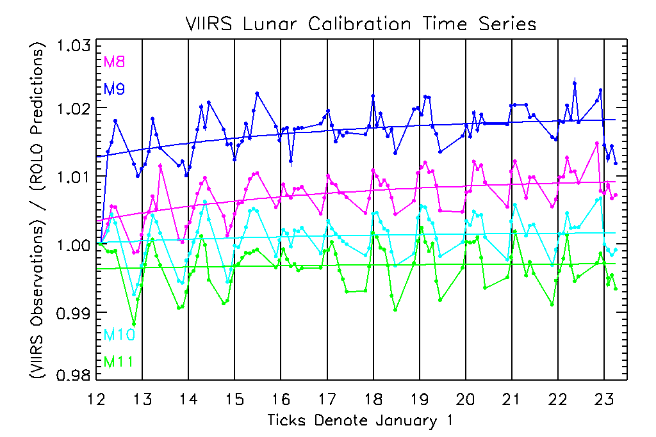
SNPP Lunar Time Series
The lunar observations have been corrected by the solar f-factors.
4

Slide 5
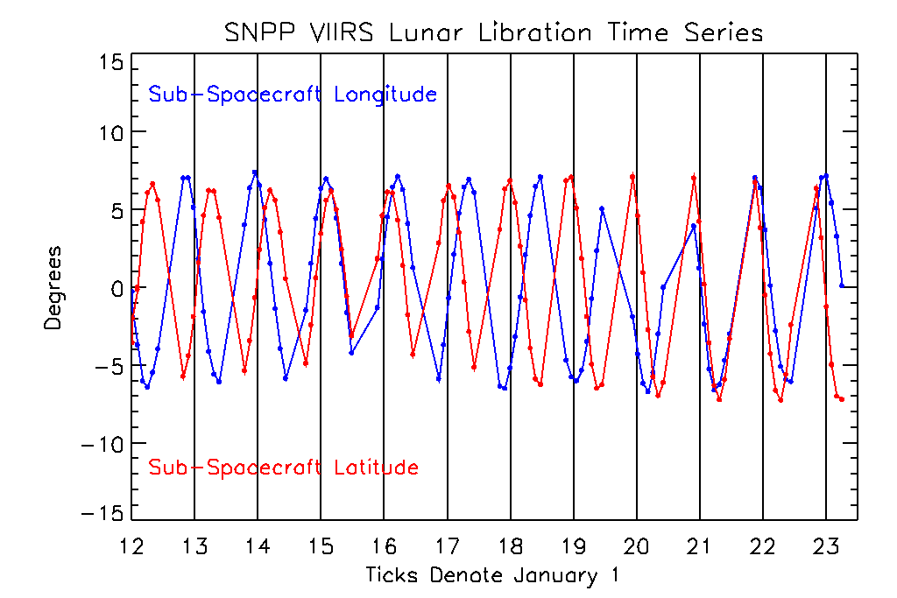
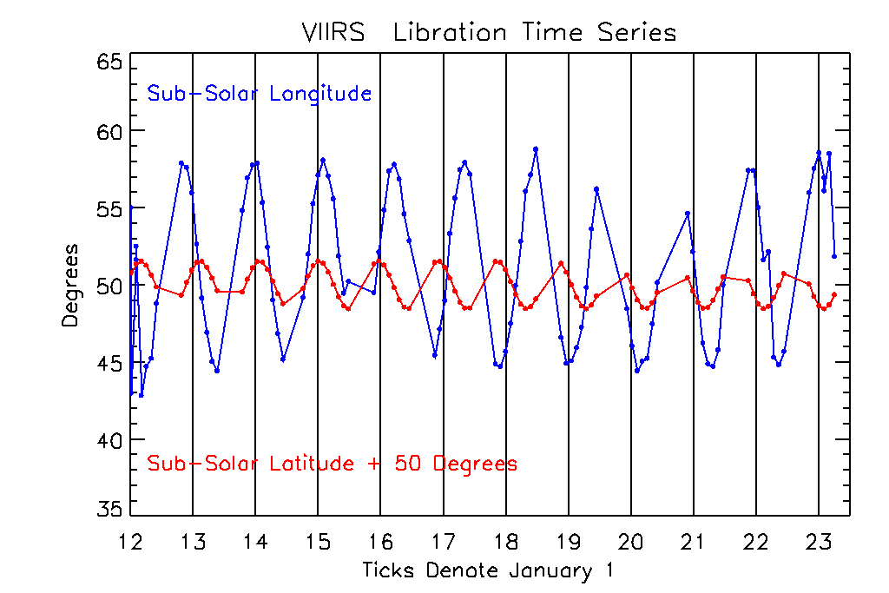
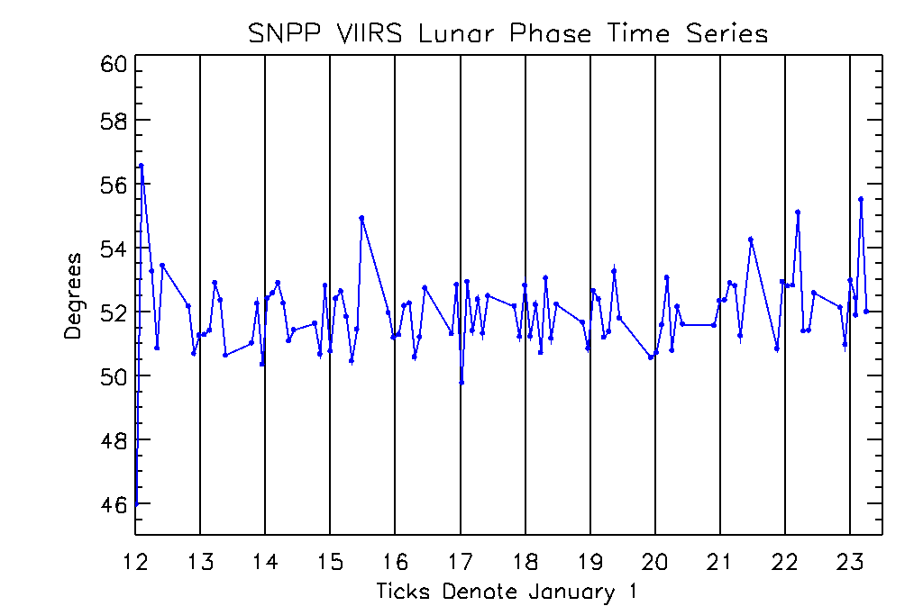
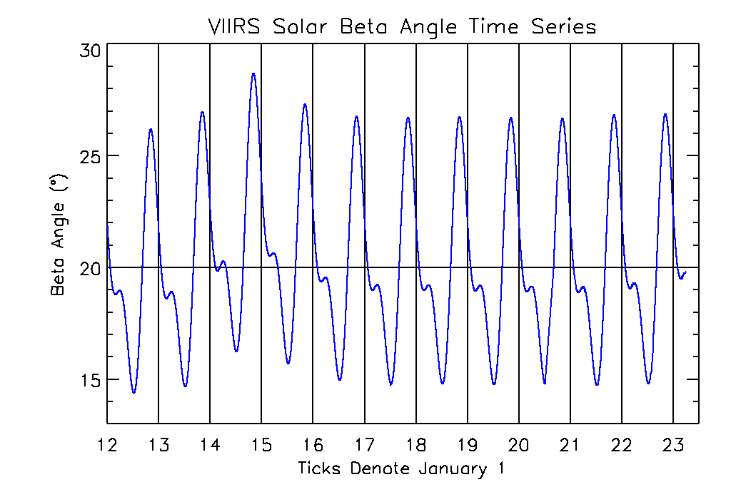
SNPP Lunar Time Series
5

Slide 6
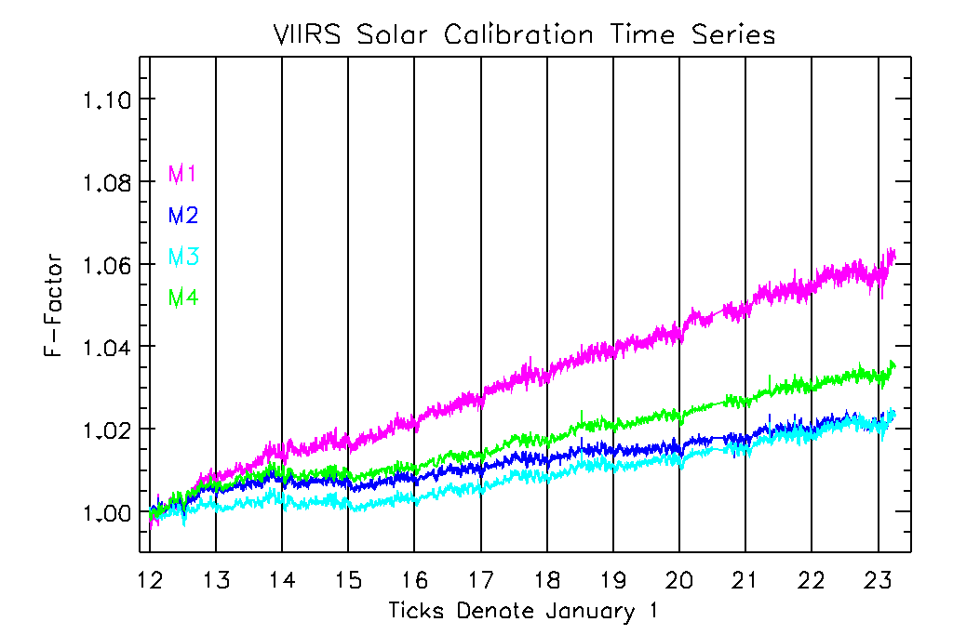
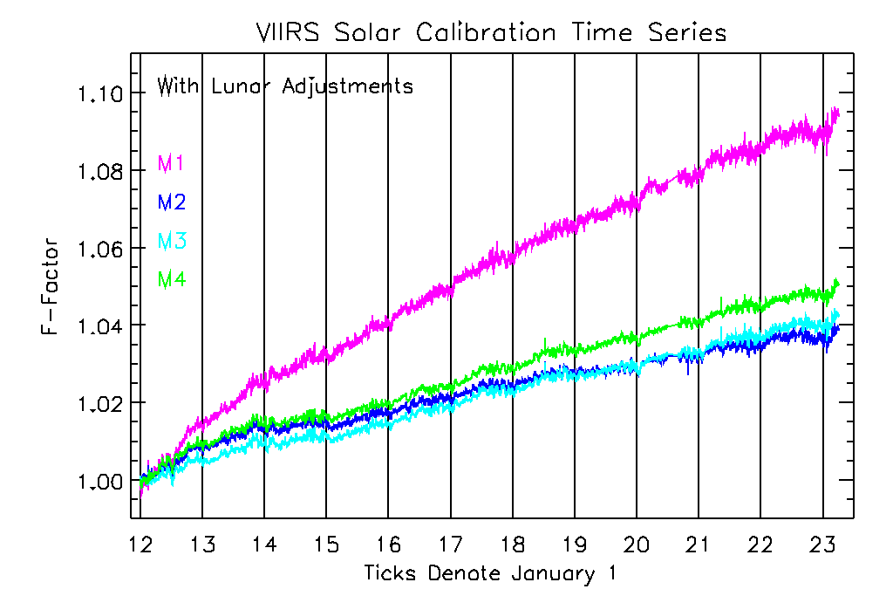
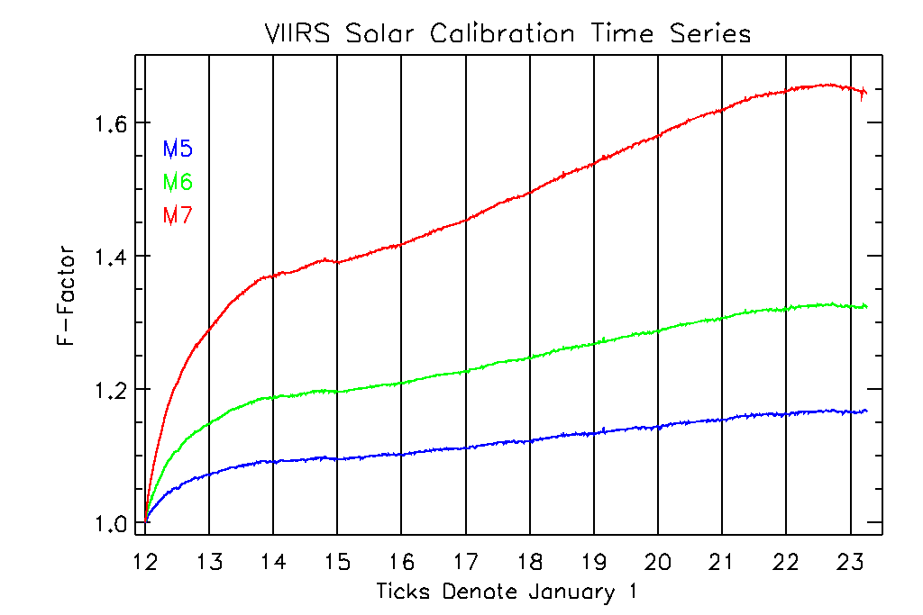
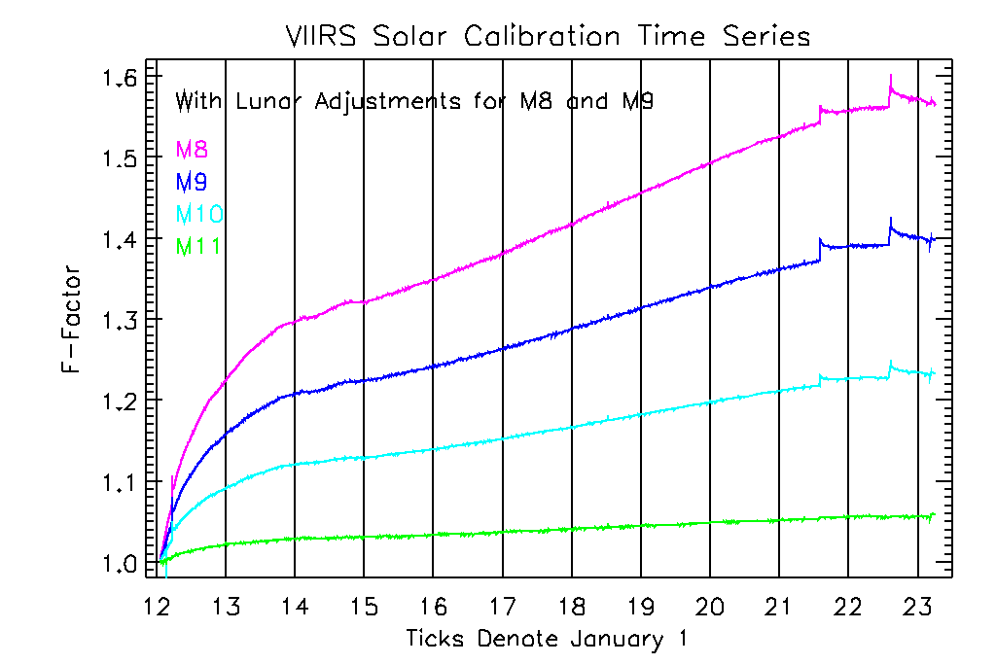
SNPP F-factors
6

Slide 7
NOAA-20 On-Orbit
Calibration

Slide 8
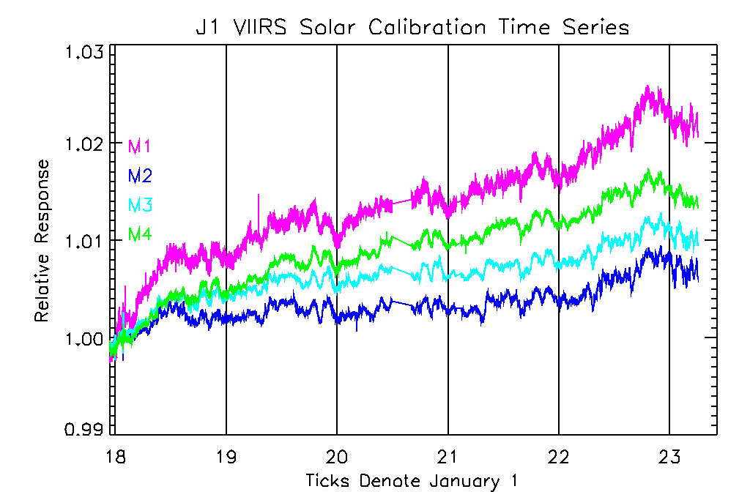
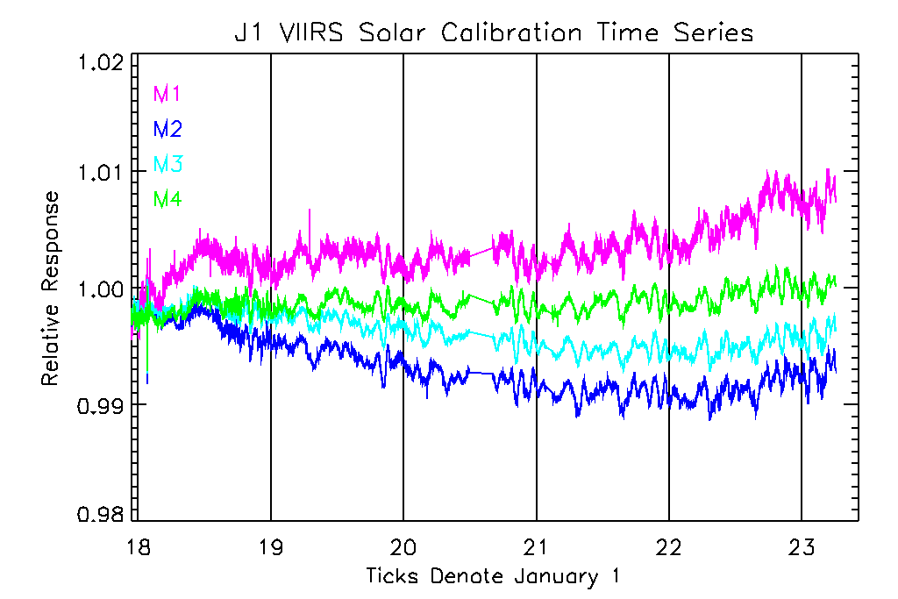
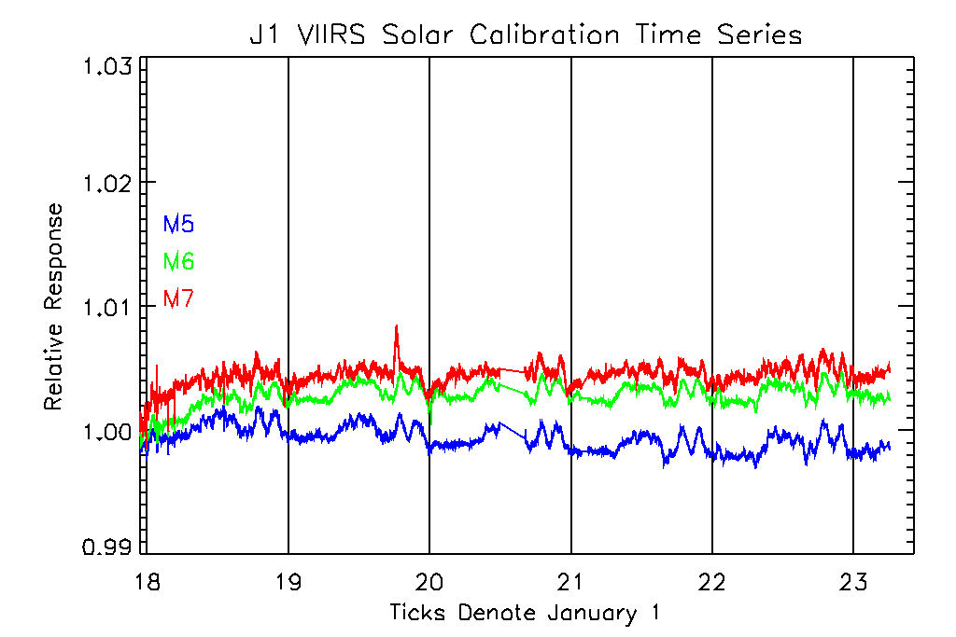
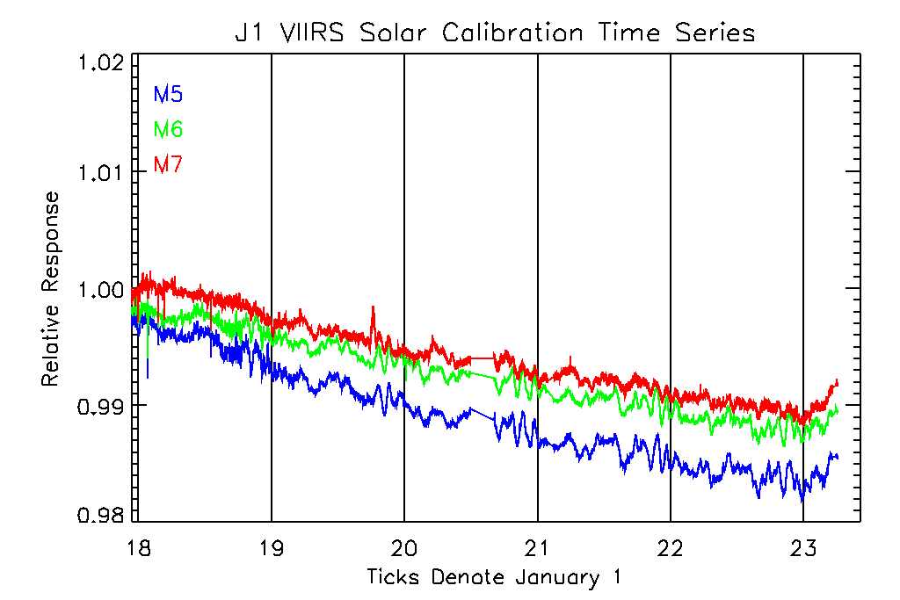
JPSS1 Solar Observations
Detrended H-factors
Detrended H-factors
8

Slide 9
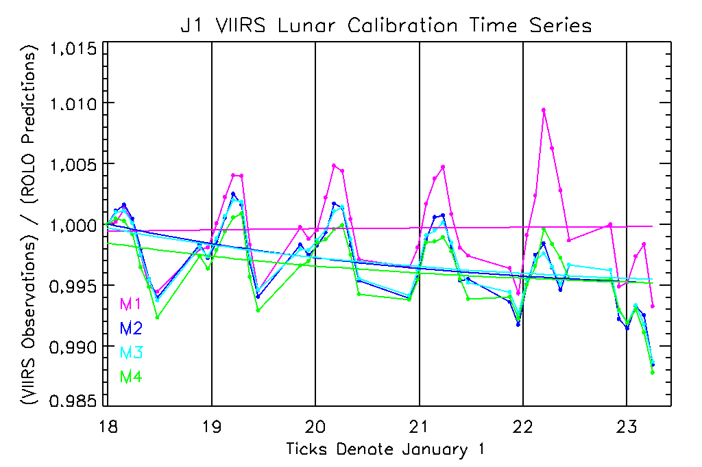
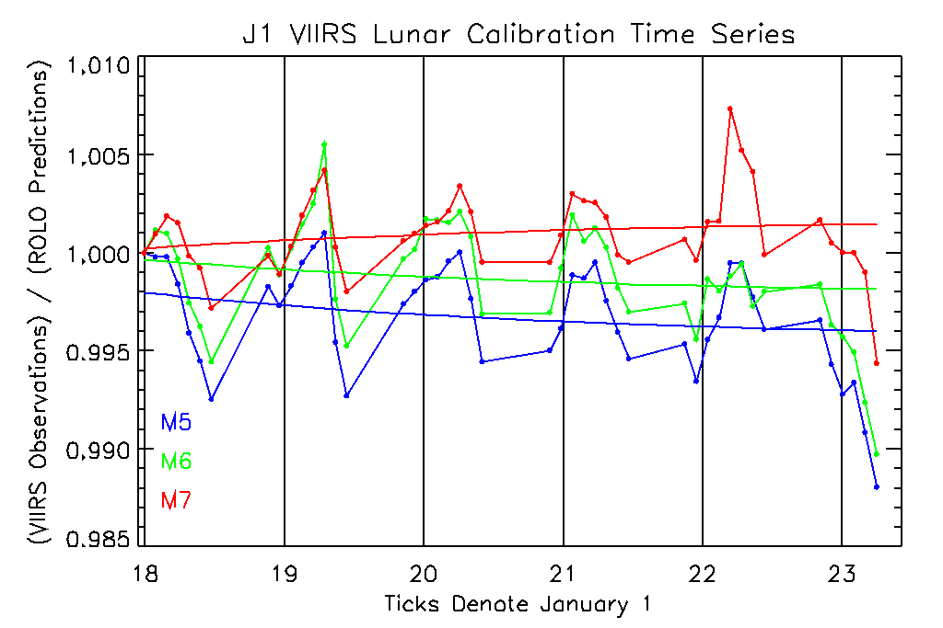
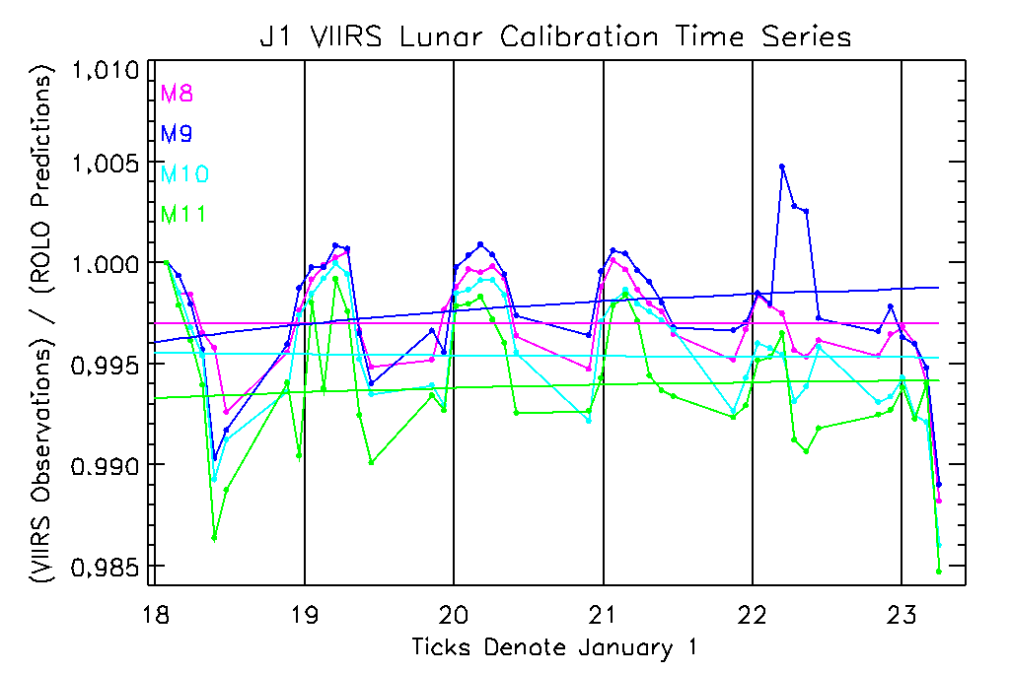
JPSS1 Lunar Observations
The lunar observations have not been corrected by the solar f-factors.
Lunar time series for bands M1-M4 are consistent with solar time series derived using detrended H-factors .
Lunar time series for bands M5-M7 are consistent with solar time series derived using default H-factors.
9

Slide 10
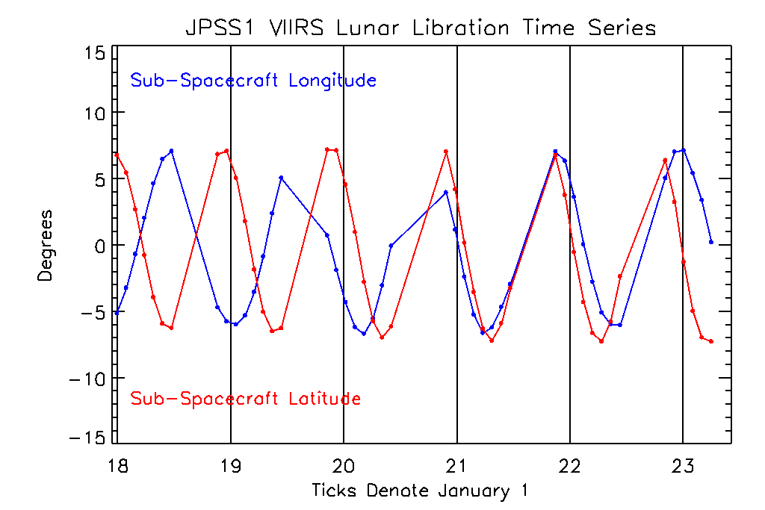
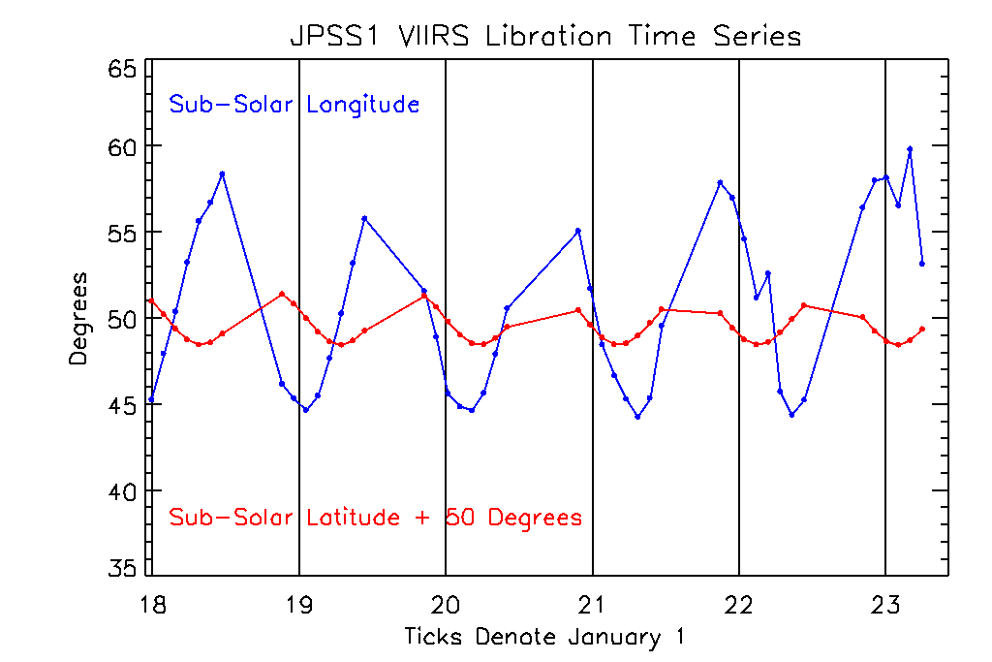
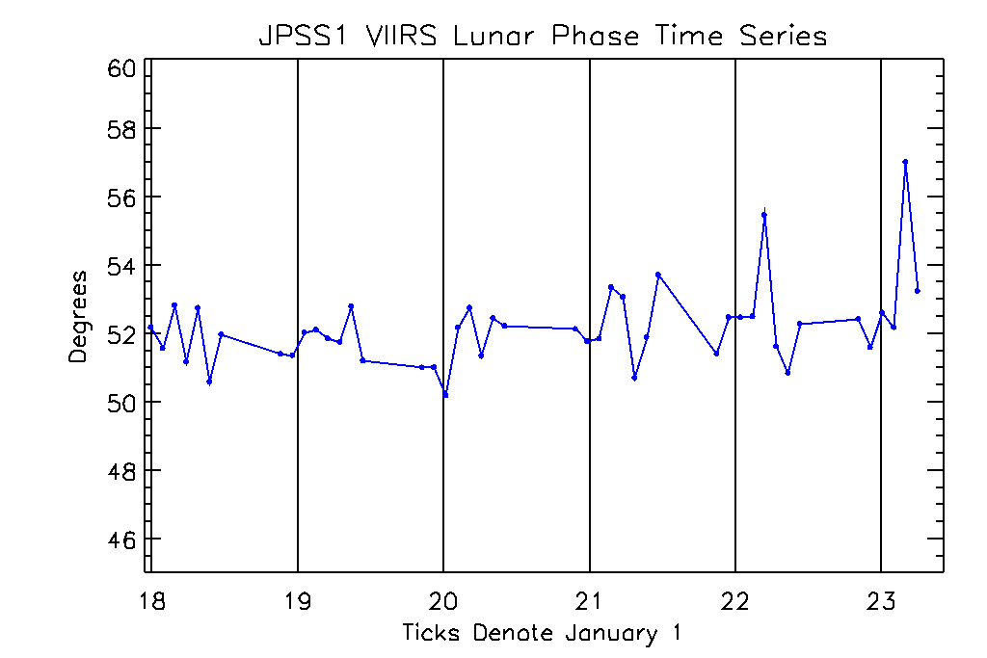
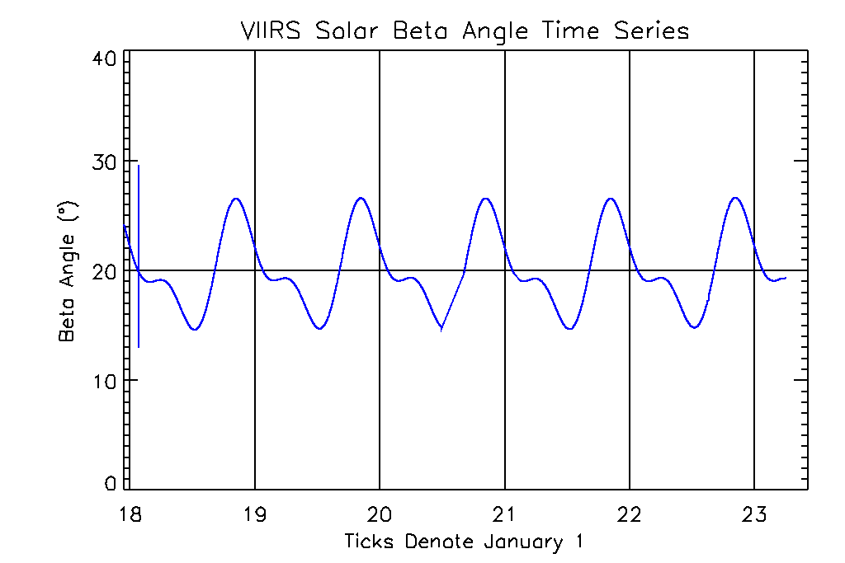
JPSS1 Lunar Observations
10

Slide 11
SNPP and NOAA-20
Solar Calibration Anomalies

Slide 12
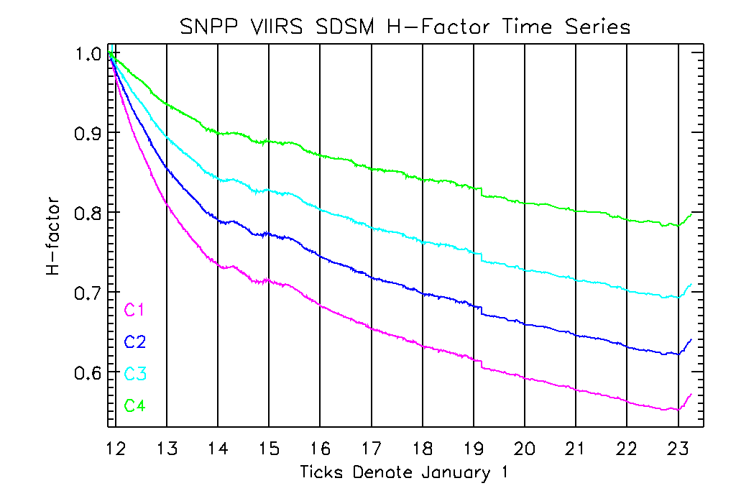
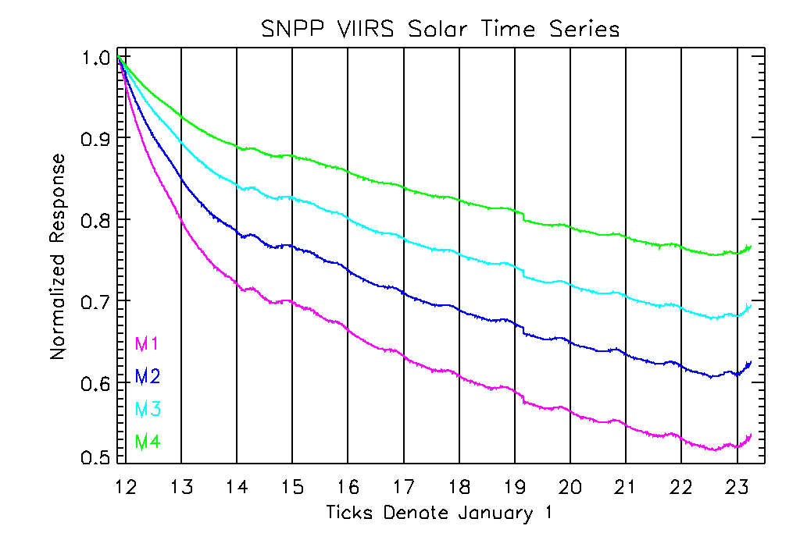
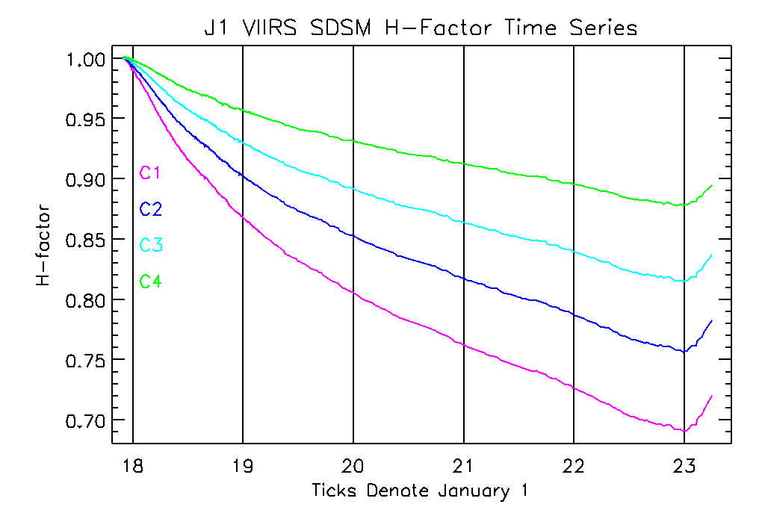
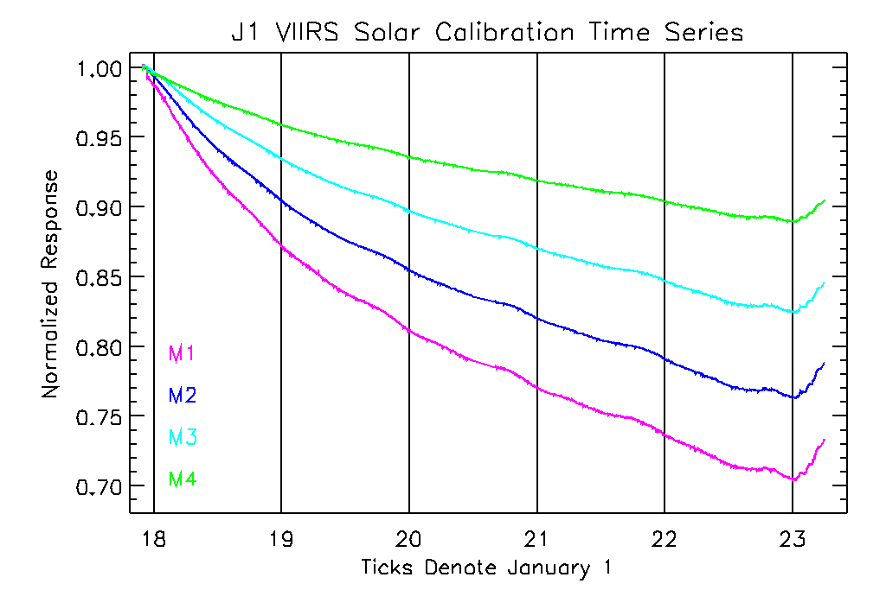
SNPP and NOAA-20 Solar Time Series
12

Slide 13
NOAA Solar Cycle Progression

Slide 14
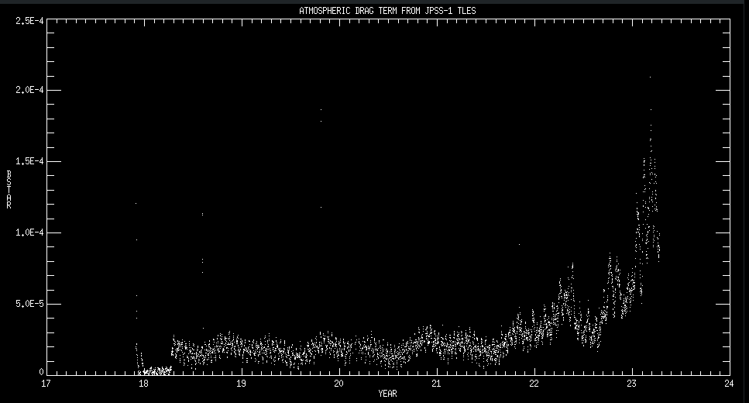
NOAA-20 Atmospheric Drag

Slide 15
SNPP and NOAA-20 Solar Time Series
We are still using static F-factors for NOAA-20 VIIRS.

Slide 16
Solar Trend Anomalies
The solar trend anomalies are observed by both VIIRS and the SDSM on both spacecraft, so the anomalies are real.
The 2014 anomalies for SNPP VIIRS correspond to the Solar Cycle 24 solar maximum:
The SDSM H-factors mitigate, but do not fully correct, the anomalies.
The slopes of the radiometric trends in the solar time series change from exponential to linear functions during this time.
The lunar adjustments mitigate the anomalies for bands M1-M4.
The 2023 anomalies for SNPP VIIRS and NOAA-20 VIIRS correspond to the start of the Solar Cycle 25 maximum:
The size of the anomalies correspond to NOAA measurements of solar activity.
The anomalies correspond to an increase in atmospheric drag on the NOAA-20 satellite due to the solar maximum.
The use of measured solar diffuser observations to track instrument radiometric responses has additional sources of uncertainty.
Notes:
Petulant mode event for SWIR bands: lunar time series starts after event.
Solar time series: Nov 2011 (Jan 2012). Lunar time series (Jan 2012)

