Slide 1


MODIS RSB Calibration and Performance
MODIS Characterization Support Team, NASA GSFC
(presented by Emily Aldoretta and Kevin Twedt)
MODIS/VIIRS Calibration Workshop (May 1, 2023)
Notes:
1

Slide 2
Recent MODIS RSB highlights
(since last calibration workshop in Feb 2021)
Terra CP/FP reset on March 15, 2022
  Notable changes in the mirror side ratio of SWIR crosstalk coefficients and SD-derived gain. Algorithm change put in place to mitigate these effects.
Aqua in safe mode from March 31 – April 13, 2022
  RSB performance mostly stable following safe mode. Some gain changes seen in SWIR bands. One new inoperable detector in band 6.
Terra Constellation Exit Maneuvers from October 10-21, 2022
  RSB performance mostly stable following CEM. Some gain changes seen in SWIR bands. One new noisy detector in band 6.
Collection 7 L1B LUTs delivered for testing initially in March 2021
  Merging of primary C7 RSB algorithm changes into C6.1 forward LUTs (starting March 2023)
Both Terra and Aqua orbits have begun to drift away from historically maintained orbit tracks.

Slide 3
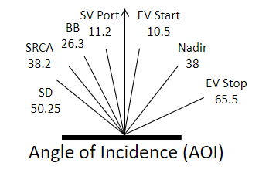
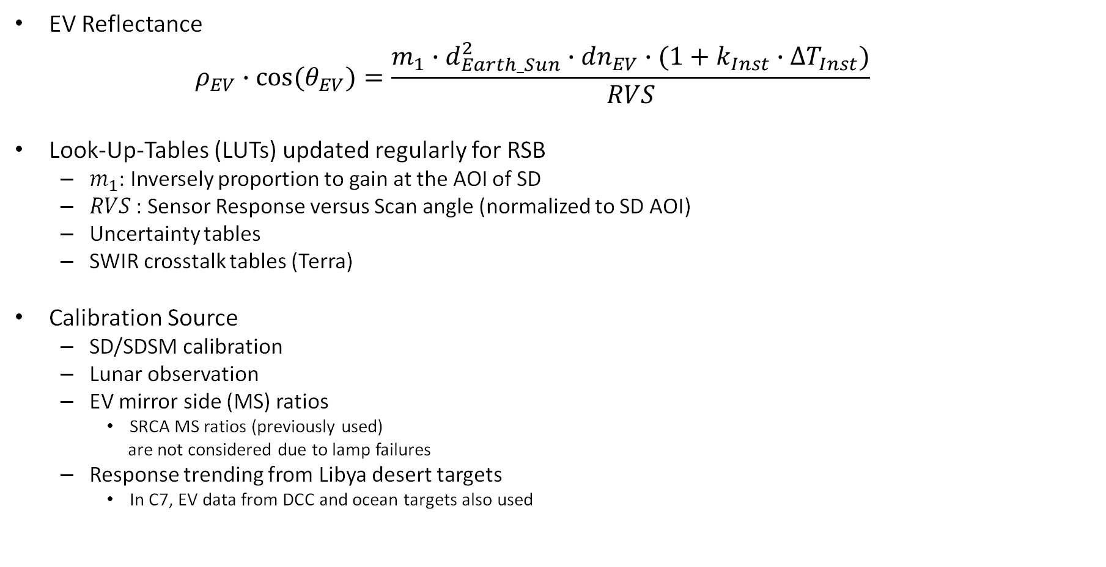
RSB Calibration
EV Reflectance
  $$ρ_{EV}∙\cos{{(θ}_{EV})}=\frac{m_{1}∙d_{Earth_Sun}^{2}∙{dn}_{EV}∙(1+k_{Inst}∙{∆T}_{Inst})}{RVS}$$
Look-Up-Tables (LUTs) updated regularly for RSB
  $m_{1}$: Inversely proportion to gain at the AOI of SD
  $RVS$: Sensor Response versus Scan angle (normalized to SD AOI)
  Uncertainty tables
  SWIR crosstalk tables (Terra)
Calibration Source
  SD/SDSM calibration
  Lunar observation
  EV mirror side (MS) ratios
    SRCA MS ratios (previously used)
    are not considered due to lamp failures
  Response trending from Libya desert targets
    In C7, EV data from DCC and ocean targets also used
SV Port 11.2
EV Start 10.5
BB 26.3
SRCA 38.2
Nadir 38
SD 50.25
EV Stop 65.5
Angle of Incidence (AOI)

Slide 4
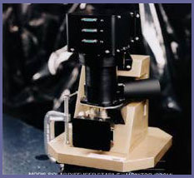
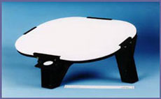
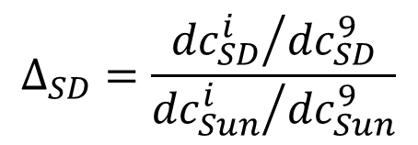
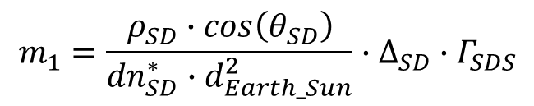
RSB SD Calibration
Sun
1.44 % screen
Optional 7.8 % screen (SD)
Terra: SD screen in permanent down position since July 2, 2003
SDSM
SD degradation
$$Δ_{SD}=\frac{{{dc}_{SD}^{i}}/{{dc}_{SD}^{9}}}{{{dc}_{Sun}^{i}}/{{dc}_{Sun}^{9}}}$$
Scan mirror
$$m_{1}=\frac{ρ_{SD}∙\cos\left(θ_{SD}\right)}{{dn}_{SD}^{∗}∙d_{Earth_Sun}^{2}}∙∆_{SD}∙Γ_{SDS}$$
SD
$ρ_{SD}∙\cos\left(θ_{SD}\right)=BRF, {dn}_{SD}^{∗}$ = Signal from SD (temperature and background corrected), $∆_{SD}=SD degradation, Γ_{SDS}=screen attenuation$

Slide 5
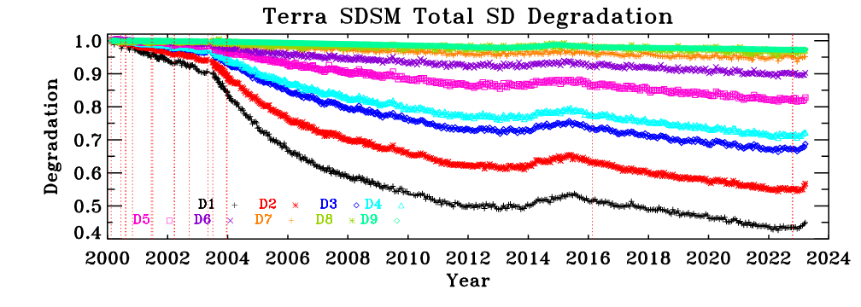
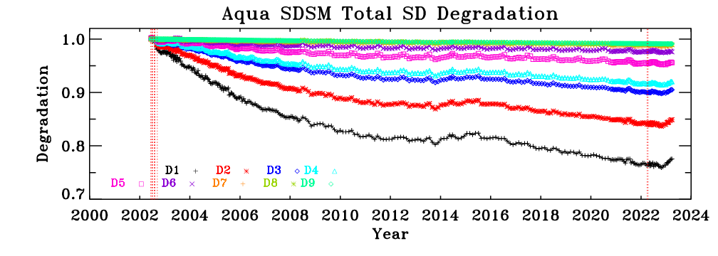
MODIS SD Degradation
Terra SD Degradation
Increased degradation after Terra SD door anomaly on July 2, 2003.
Larger SD degradation at shorter wavelengths for both instruments
Recently (starting early 2023), both Terra and Aqua SD have seen a reversal in degradation trend.
Aqua SD Degradation

Slide 6
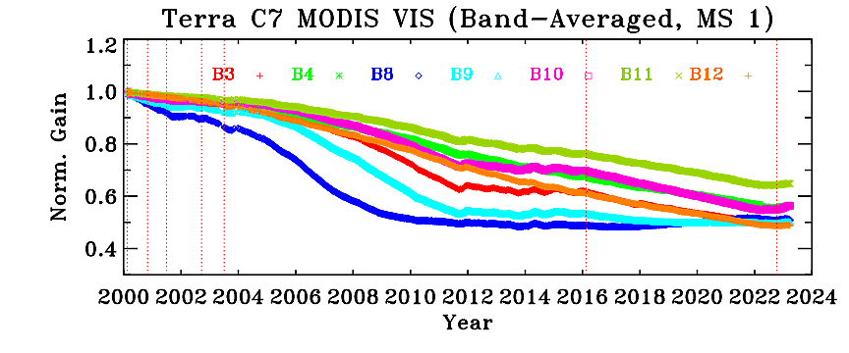
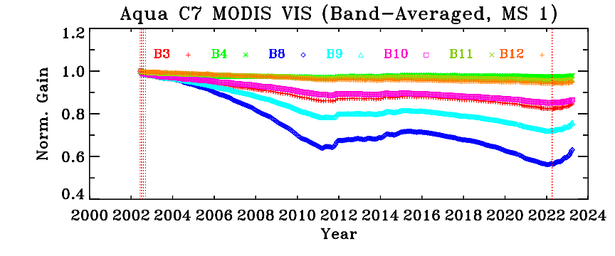
VIS Gain Trending from SD
Terra
Most change observed for short-wavelength bands
Gain drops by up to 50% for B8, B9, B3, B12
Terra VIS bands have a maximum mirror-side difference of about 11% at the SD AOI
Aqua
Most change observed for short-wavelength bands
Band 8 (.412 µm) maximum change is ~40%
Aqua VIS bands have a maximum mirror-side difference of about 4% at the SD AOI (Band 8)

Slide 7
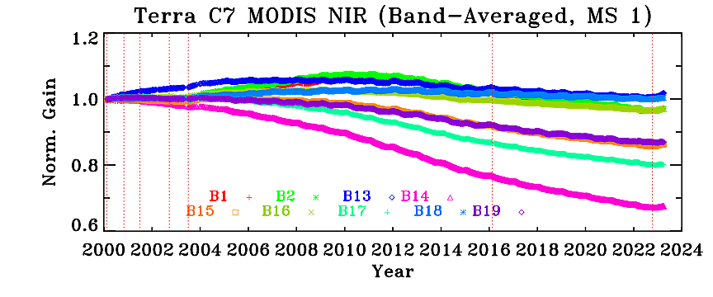
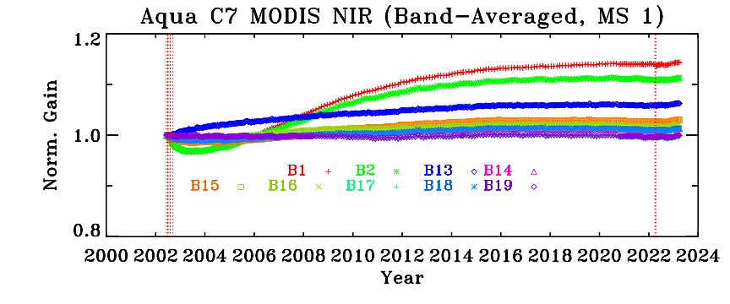
NIR Gain Trending from SD
Terra
Changes for most NIR bands are within 15%
Mirror-side differences are <1%
Aqua
Changes for most NIR bands are within 6%
Mirror-side differences are <1%

Slide 8
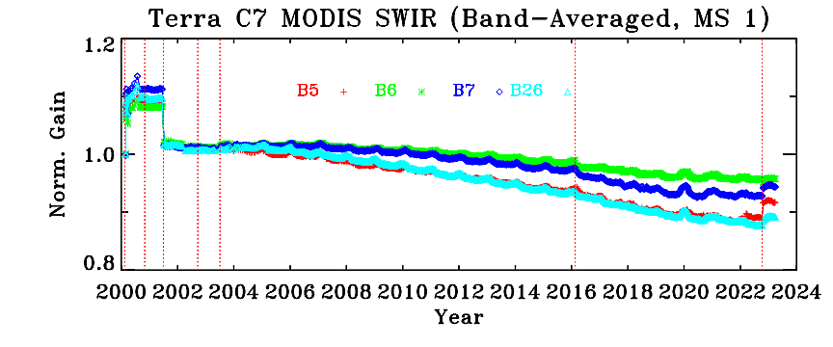
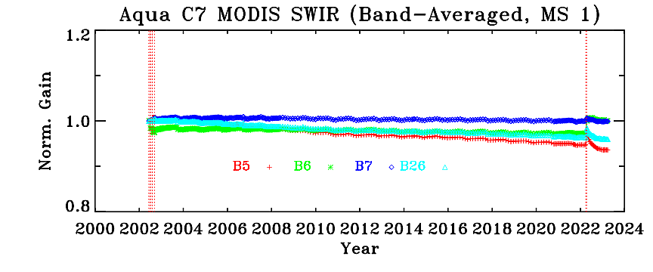
SWIR Gain Trending from SD
Terra
All SWIR bands change by < 12%
Mirror-side differences are <1%
* Noisy and inoperable detectors excluded
Jump in gain following Terra CEM (Oct 2022)
Aqua
All SWIR bands change by < 7%
Mirror-side differences are <1%
* Noisy and inoperable detectors excluded
Jump in gain following safe mode (April 2022)

Slide 9
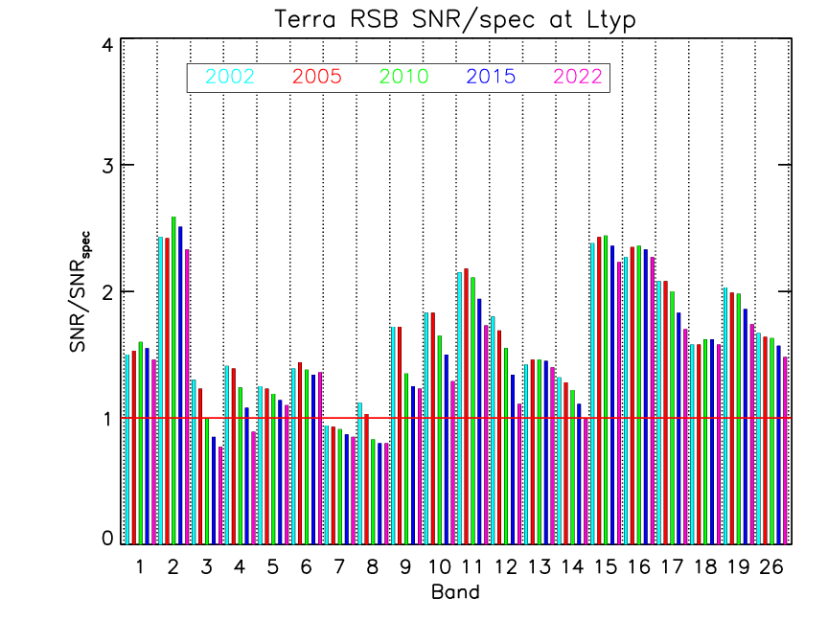
MODIS RSB SNR Bar-Charts
Most bands continue to meet the specification.
Decreased responsivity for some short wavelength RSB (Terra bands 8, 9, 3, 4)
Terra band 7 SNR known to be below specification since launch
Since Feb 2021 calibration workshop
No new inoperable detectors
One new noisy detector: band 6 detector 13 flagged as noisy starting 2022/296 (CEM)

Slide 10
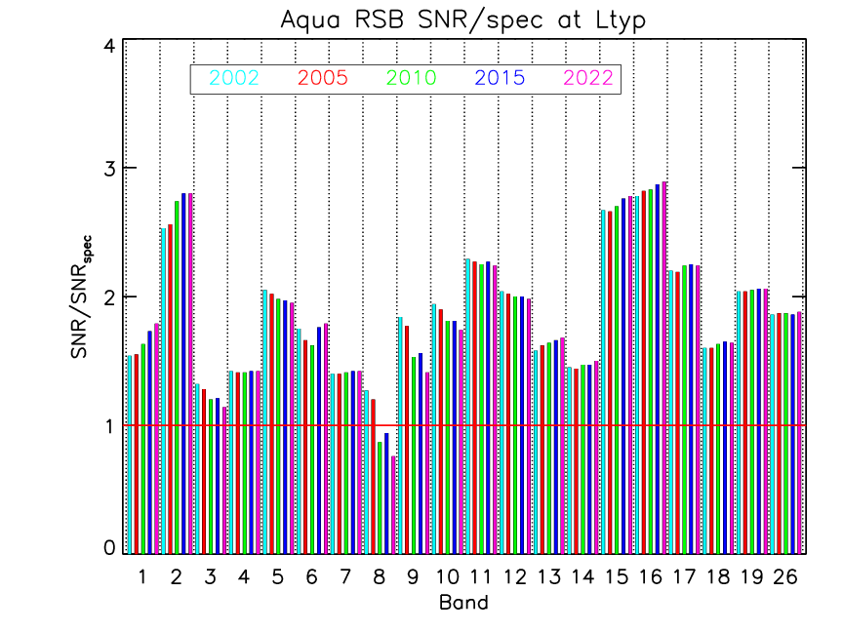
MODIS RSB SNR Bar-Charts
Most bands continue to meet the specification.
Decreased responsivity for some short wavelength RSB (Aqua band 8)
Known issues with the inoperable/noisy detectors in Aqua band 6.
Since Feb 2021 calibration workshop
One new inoperable detector: band 6 detector 4 flagged as inoperable starting 2022/090 (safe mode)
No new noisy detectors

Slide 11
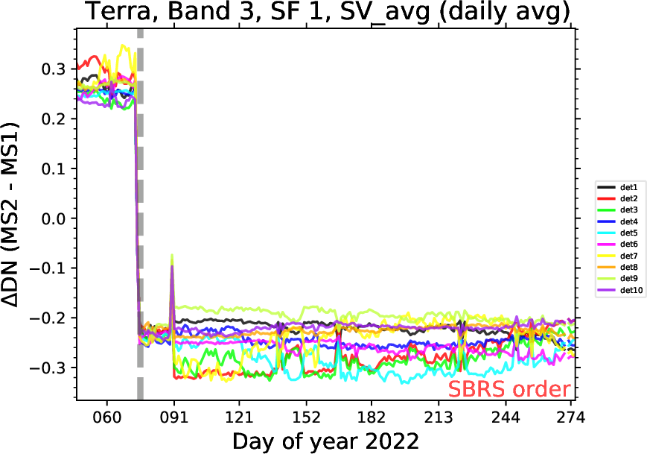
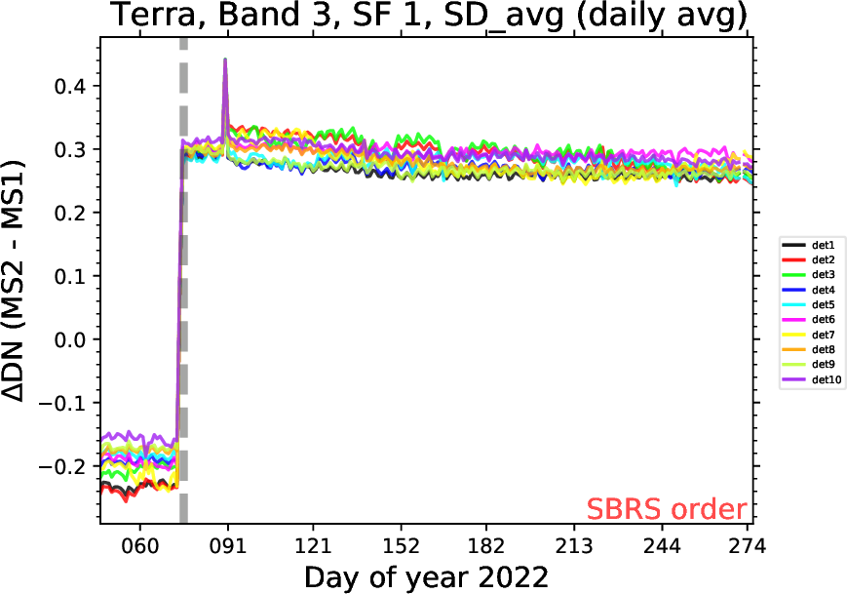
Terra CP/FP reset (March 2022)
Terra experienced a CP/FP reset on March 15, 2022.
After the reset, there was a very small (less than 1 count) change in in the MS difference (MS2-MS1) of both SV and SD DN, but in opposite directions.
The SD-derived gain had corresponding jumps in the MS gain ratio
  The impact is largest for scenes with low signal, e.g. bands 3 and 4 when viewing the SD.
  Other calibration sources – lunar, desert, DCC – are not affected.

Slide 12
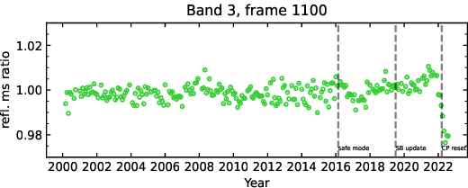
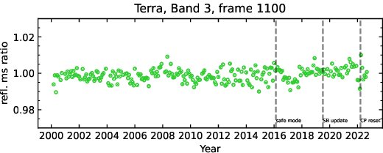
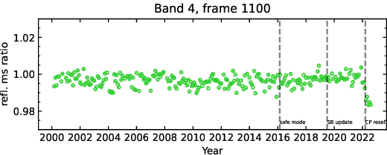
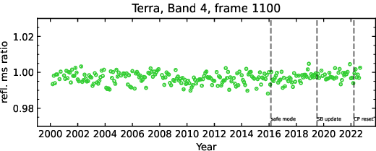
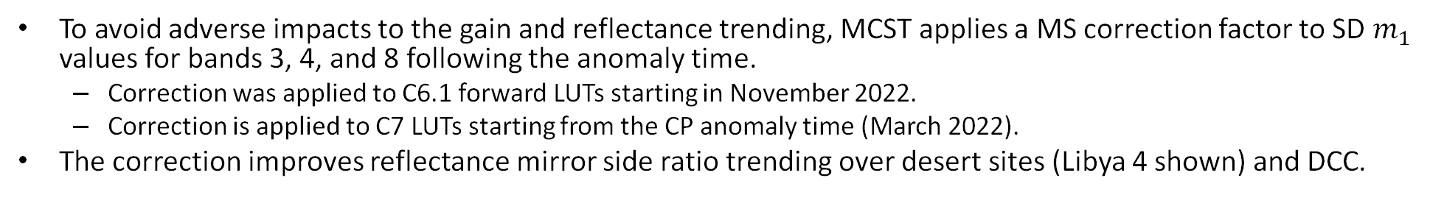
Terra CP/FP reset (March 2022)
To avoid adverse impacts to the gain and reflectance trending, MCST applies a MS correction factor to SD $m_{1}$ values for bands 3, 4, and 8 following the anomaly time.
  Correction was applied to C6.1 forward LUTs starting in November 2022.
  Correction is applied to C7 LUTs starting from the CP anomaly time (March 2022).
The correction improves reflectance mirror side ratio trending over desert sites (Libya 4 shown) and DCC.
Without SD MS correction
With SD MS correction

Slide 13
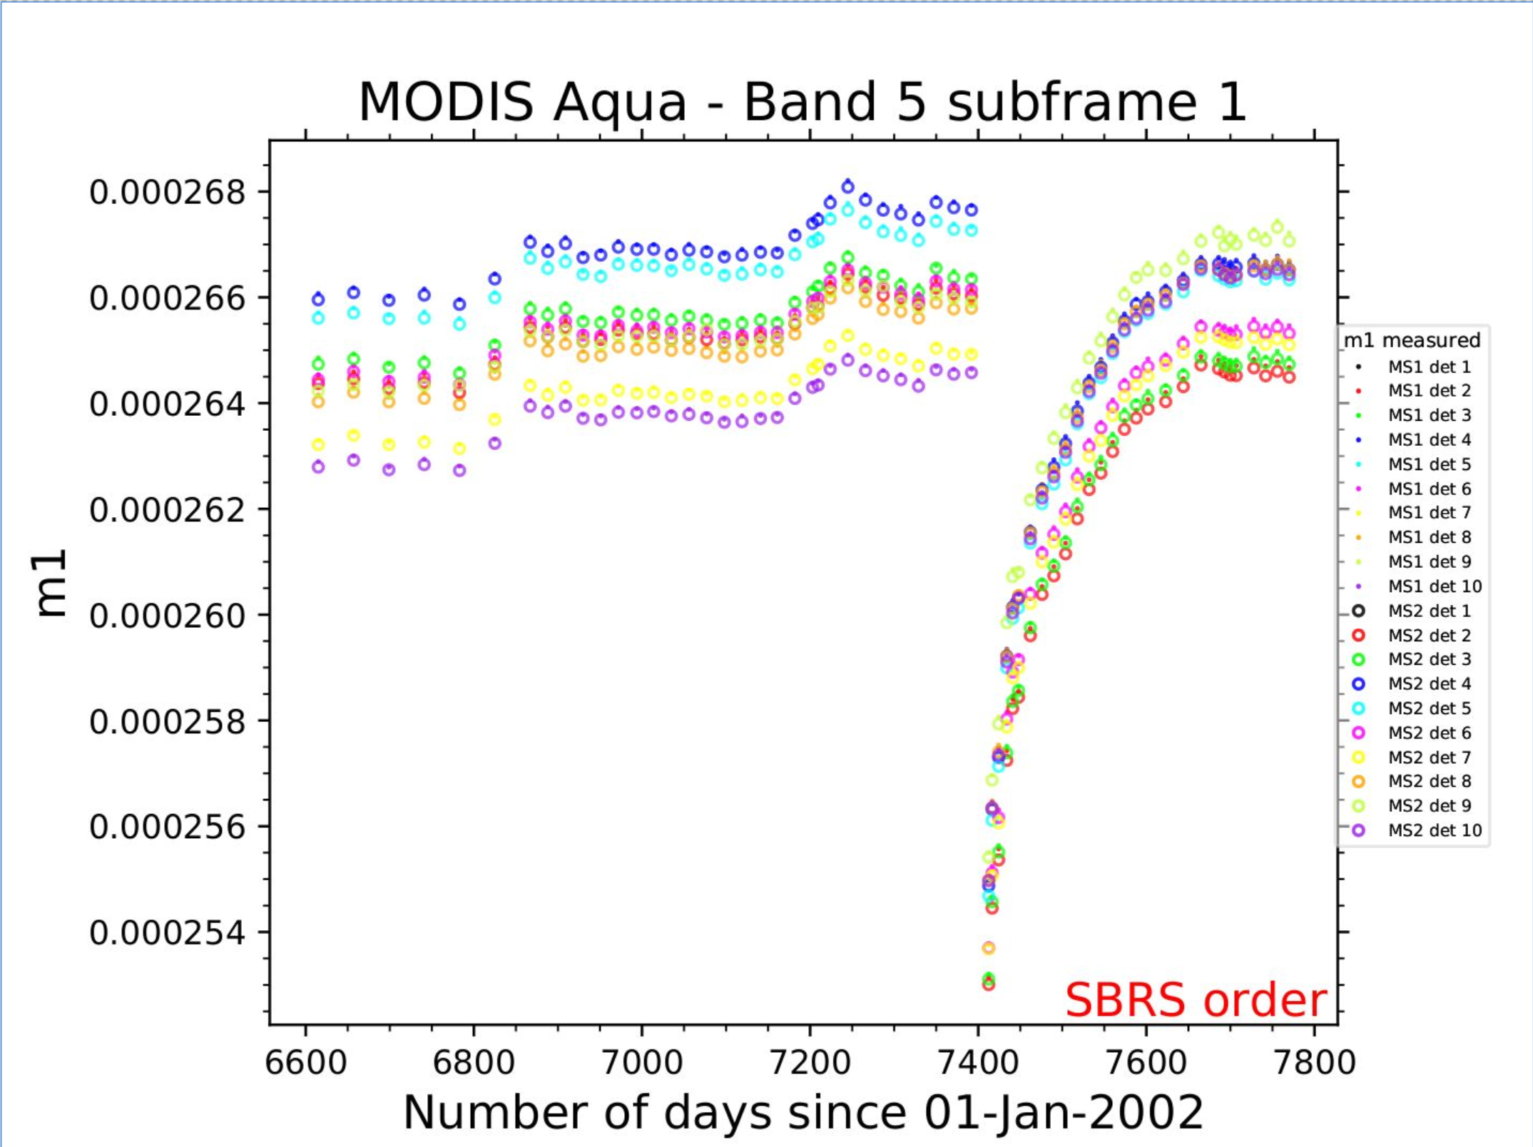
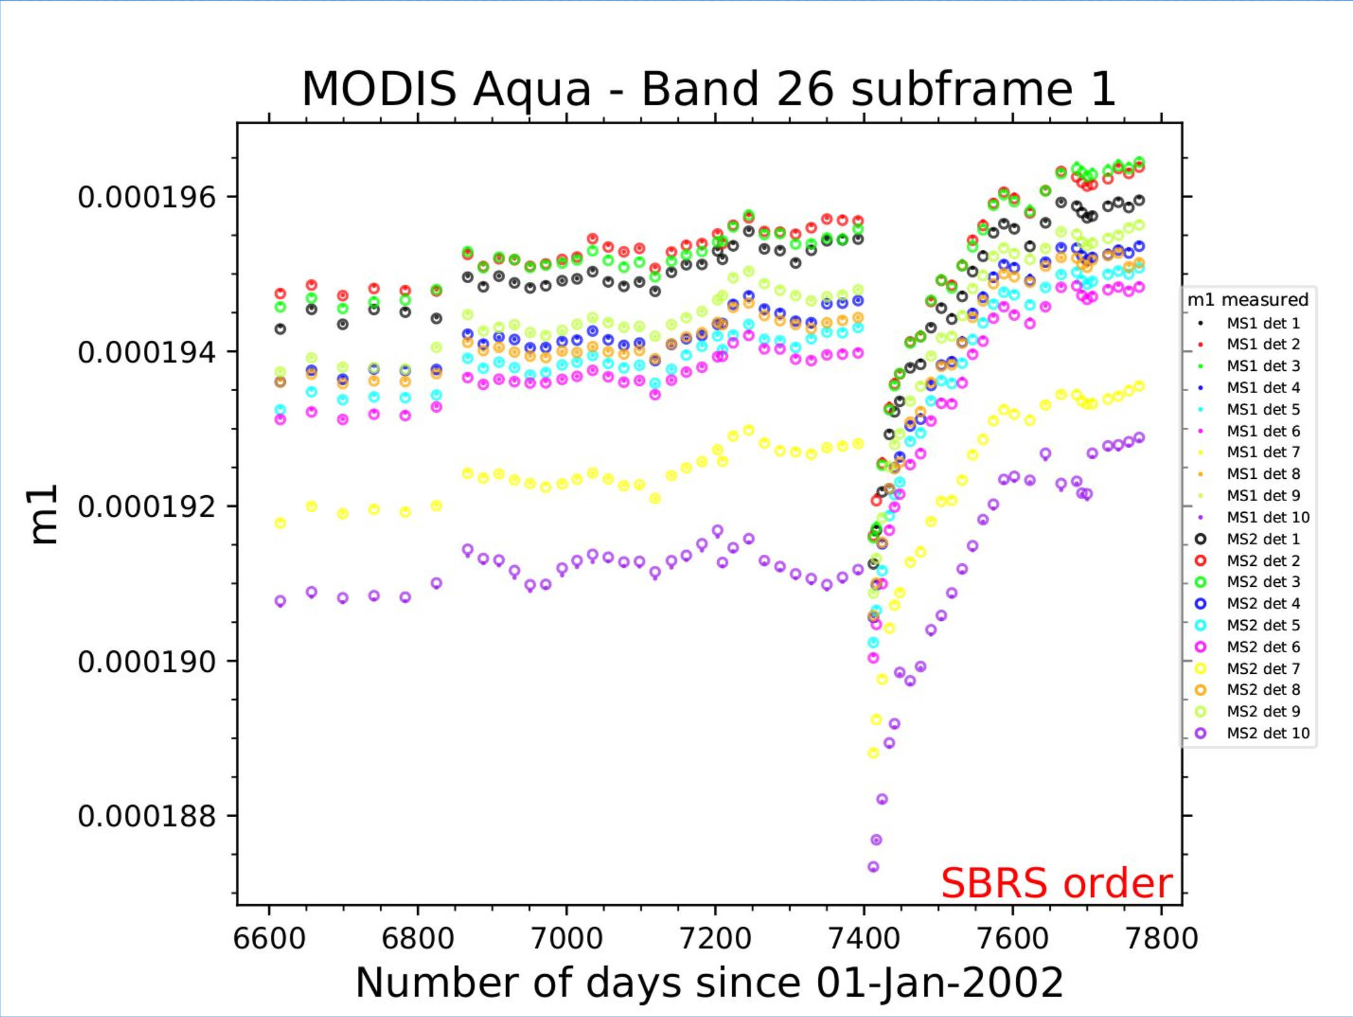
Aqua safe mode (April 2022)
After Aqua safe mode, most SWIR band detectors saw gain changes of a few percent (up to 5%) initially, but have gradually stabilized back to near their pre-safe mode values.
  MCST has been delivering frequent LUT updates to follow these gain changes, so there should be minimal impact on L1B products.
One detector in band 6 – detector 4 (product order) – had abnormal behavior following the safe mode, with the signal levels in both SD calibrations and Earth view being much lower than nominal and unstable.
  This detector is now flagged as inoperable in both C6.1 and C7 starting from safe mode.
  Note that the aggregated 1KM detector 2 (aggregate of HKM dets 3 and 4) will continue to have valid data since the HKM detector 3 is still good.

Slide 14
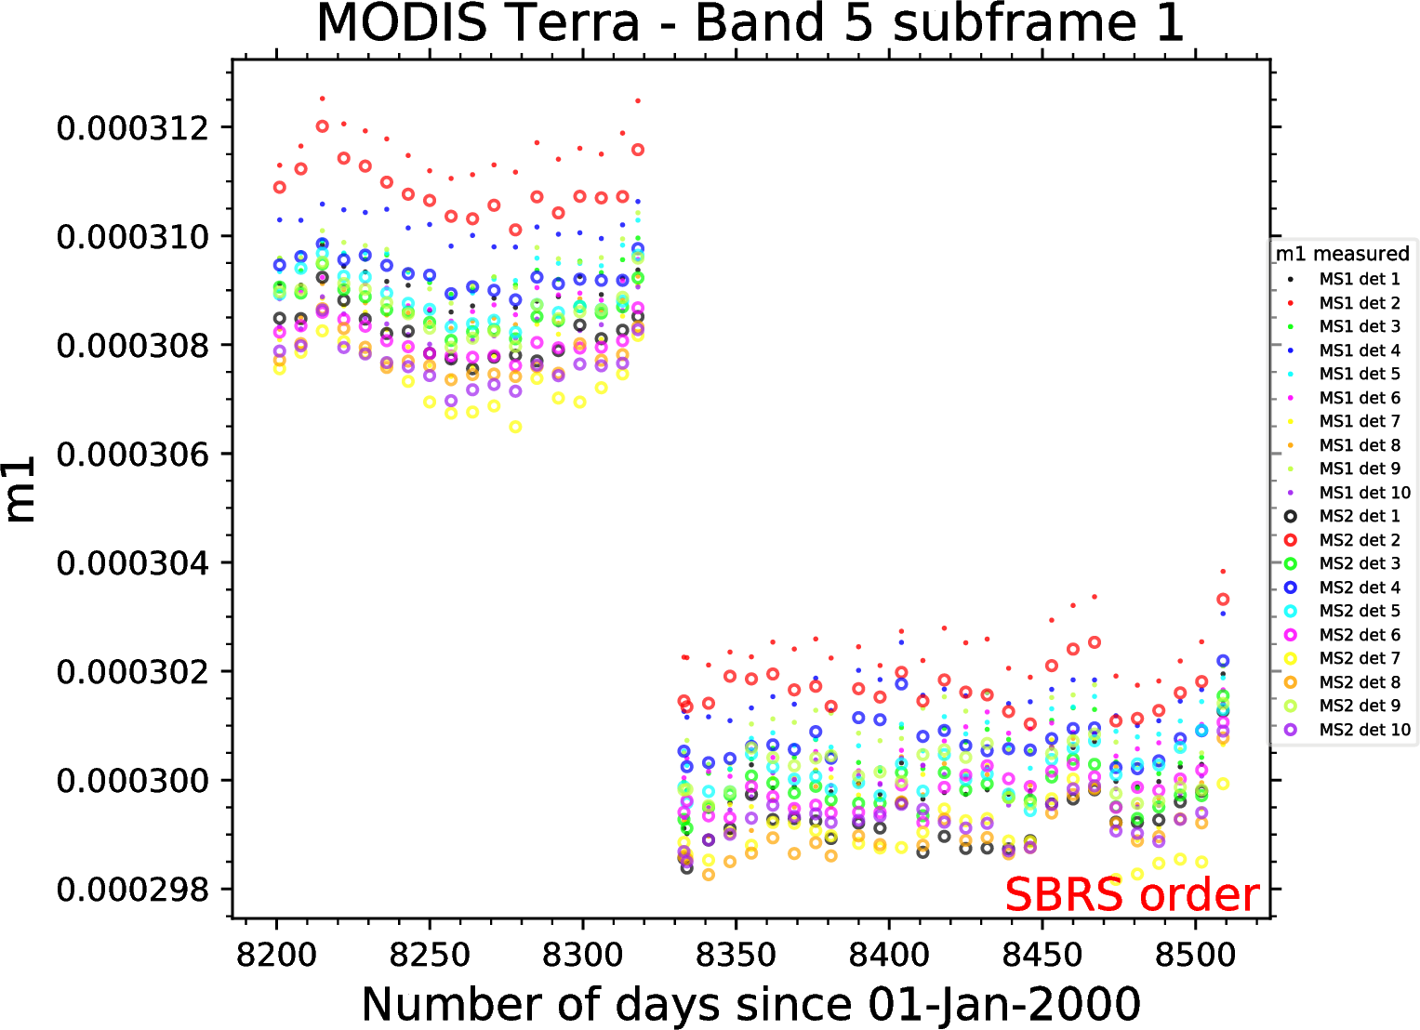
Terra constellation exit maneuvers (October 2022)
Terra RSB overall returned to nominal performance following the CEMs, with minimal impact.
Some jumps in gain seen in SWIR bands (up to 3%), but trends have been stable in the six months post-CEM.
One new noisy detector in band 6 (HKM detector 13).
After CEM, Terra’s historic ground track no longer repeats, which impacts the desert observations used in calibration (later slides).

Slide 15
Status of C7 RSB algorithms and LUTs
C7 mission-reprocessed LUTs initially delivered in March 2021 and updated a few times since then. Most recently delivered versions (Terra V7.0.16.1 and Aqua V7.0.15.2) are valid through October 2022 for Terra and January 2023 for Aqua.
Summary of algorithm changes from C6.1 to C7:
Bands where algorithm change applies; ordered by wavelength
Larger impact
Smaller impact
K. Twedt et al., Proc. SPIE, 11858, 118580S (2021). doi: 10.1117/12.2597551

Slide 16
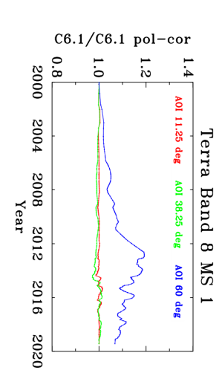
Review major C7 algorithm changes
Use of polarization-corrected desert data for Terra VIS bands
The changing polarization sensitivity of the scan mirror has impacted performance of Terra MODIS short-wavelength RSB, including derivation of calibration coefficients for C6.1 L1B.
Current mitigation strategy for C6.1 L2 products
  NASA OBPG has derived polarization correction coefficients from a cross-cal with SeaWIFS/Aqua MODIS over ocean targets
  For land products, use the OBPG polarization coefficients followed by de-trending and other corrections to adjust the calibration.
Collection 7
  MCST will apply polarization correction prior to derivation of gain from desert sites for Terra bands 8, 9, 3, 4, and 10.
  Will improve L1B product and significantly reduce the magnitude of downstream gain (M11) and de-trending corrections. Therefore, the downstream corrections will need to be re-derived for C7 mission LUTs.
  These changes will improve the instrument gain calibration only; there will still be scene-dependent impacts from polarization in the L1B product.
A. Angal et al., IEEE Trans. Geosci. Remote Sensing 58(8), 5428–5439 (2020)

Slide 17
Review major C7 algorithm changes
Terra SWIR bands
Band 25 will be used as the reference band for SWIR crosstalk correction consistently over the entire mission. In C6.1, band 28 was used as the reference band for most of mission, switching to band 25 in 2019.
  More stable gain and reflectance trending
  Significantly reduced detector and subframe striping
Deep convective clouds (DCC) used to correct for long-term drift in the SD-based reflectance trends for all SWIR.
DCC data also used to derive on-orbit changes in RVS for band 5 (up to 2% impact) and band 26 (up to 1% impact).
X. Xiong, A. Angal, Y. Li, and K. Twedt, J. Appl. Remote Sens. 14(4), 047503 (2020)
Q. Mu, et. al., J. Appl. Rem. Sens., 16(2), (2022)

Slide 18
Changes to C6.1 forward RSB algorithm
Many of the minor C7 algorithm changes have already been placed into forward C6.1 LUT generation. MCST is currently in the process of implementing the more major changes into forward C6.1 as well.
  For Terra SWIR bands, began using EV data (from DCC) to correct for drifts in m1 and RVS calibration.
  For Terra bands 11 and 12, began using EV data (from ocean scenes) to correct for drifts in m1 and RVS calibration.
  For bands that rely on desert data, switched to improved data processing strategy (and use polarization-corrected data for Terra).
  Little or no impact for other bands.
Motivation for these changes
  Correct continuing reflectance drifts observed in Terra MODIS VIS and SWIR bands L1B.
  The processing of desert data in our C6.1 algorithm is impacted by the orbit drifts, making the data less frequent and increasing the uncertainty of calibration.
Gradual phase-in
  The algorithm changes will be phased-in gradually over many months to avoid any sharp changes in L1B reflectance values.

Slide 19
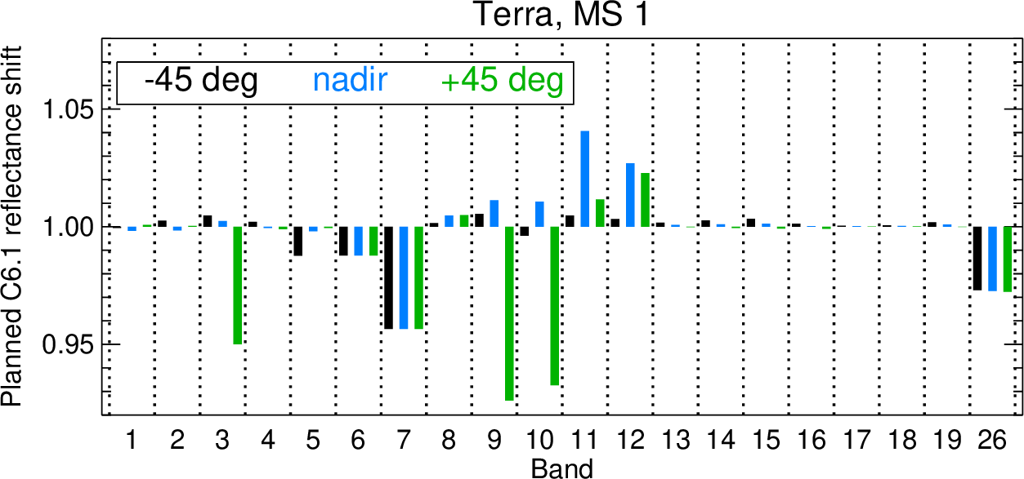
Changes to C6.1 forward RSB algorithm
Terra: These are the planned changes in C6.1 gain (reflectance) due to the switch to C7-based algorithms. The changes will be gradually phased-in to the forward L1B product starting in March 2023 and extending through January 2024 (approximately).
Results for mirror side 2 are similar.
Example: B26 reflectance in C6.1 is currently too high by 2%-3% (based on our DCC trending), so it will be gradually reduced by this amount over the next year.
Downstream corrections, e.g. for Terra VIS bands, need to continue to be updated to adapt to these changes.

Slide 20
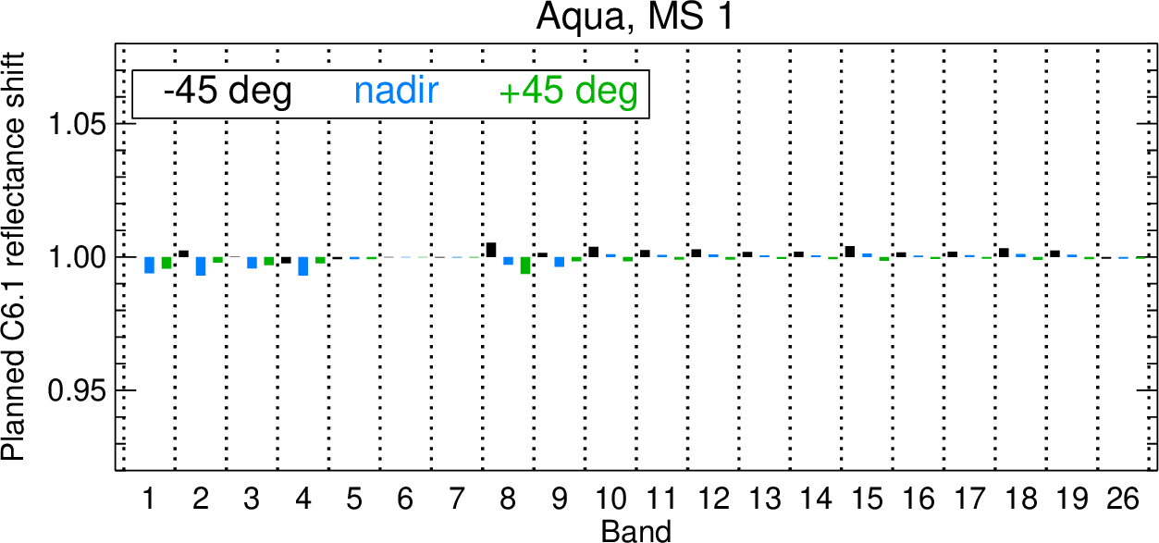
Changes to C6.1 forward RSB algorithm
Aqua: These are the planned changes in C6.1 gain (reflectance) due to the switch to C7-based algorithms. The changes will be gradually phased-in to the forward L1B product starting in March 2023 and extending through May 2023.
Results for mirror side 2 are similar.

Slide 21
Orbit drift status
Terra
  February 2020 – End of regular IAMs
  October 2022 – Constellation exit maneuvers, end of regular DMUs, and start of free orbit drift
Aqua
  March 2021 – End of regular IAMs
  January 2022 – End of regular DMUs and start of free orbit drift
Since regular IAMs stopped, the inclination of the orbital plane has been slowly drifting, affecting the equatorial crossing time and the solar angles at times of SD, Moon, and EV observations. Gradual drift over many years.
Since regular DMUs stopped, the satellite ground track drifted away from its historic 16-day repeat cycle, affecting view angles of EV observations. Happened quickly (< a few months).
Terra and Aqua flight operations teams have simulated the future orbits through 2026, which we use for predicting the impact on MODIS calibration.

Slide 22
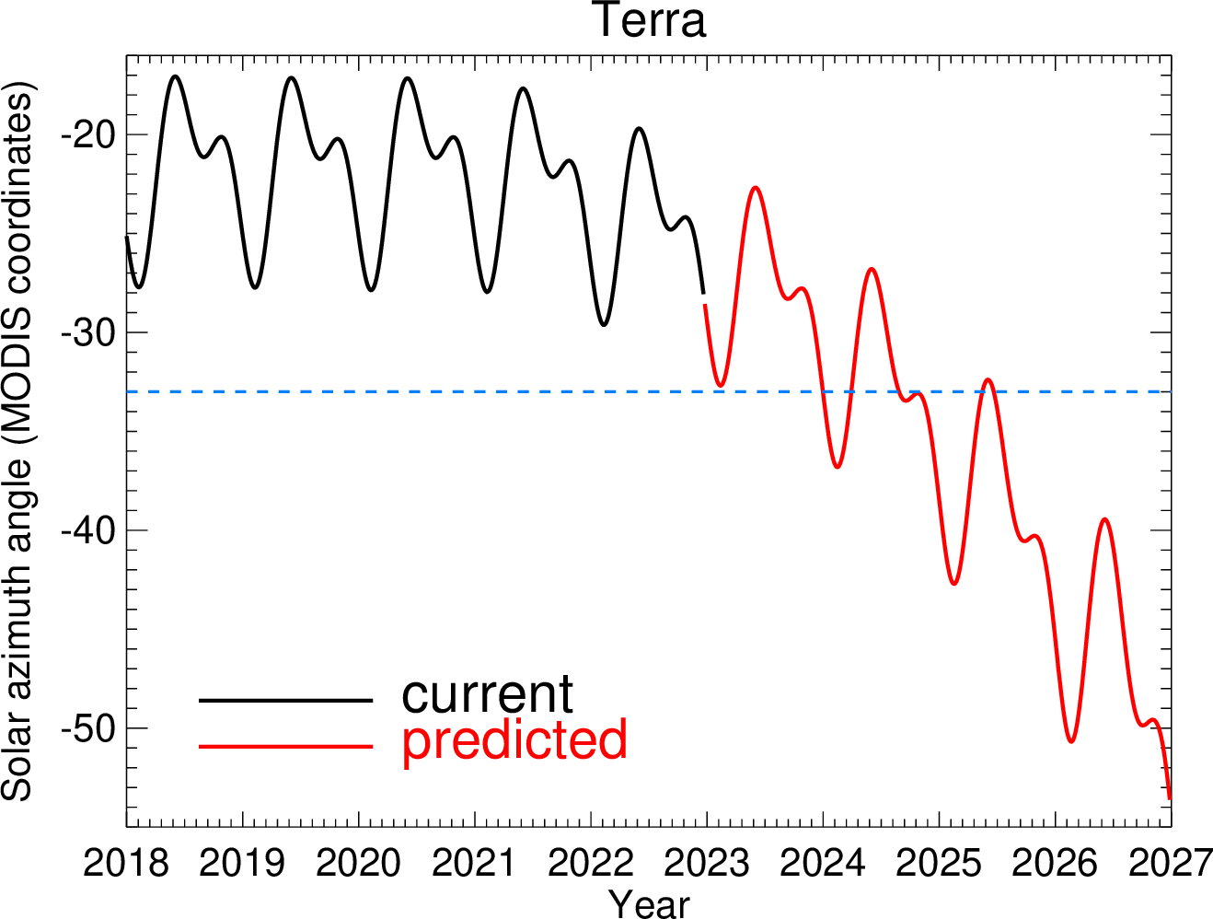
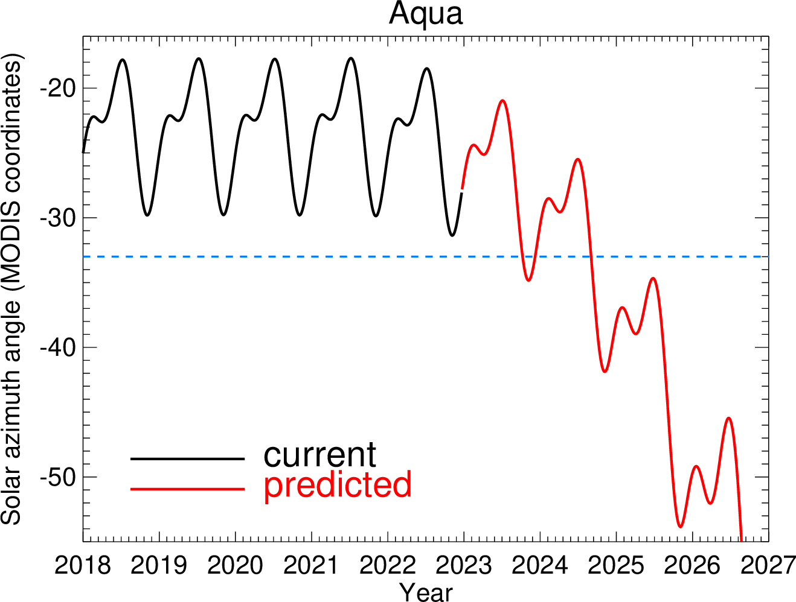
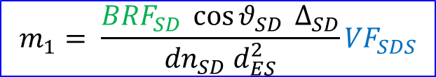
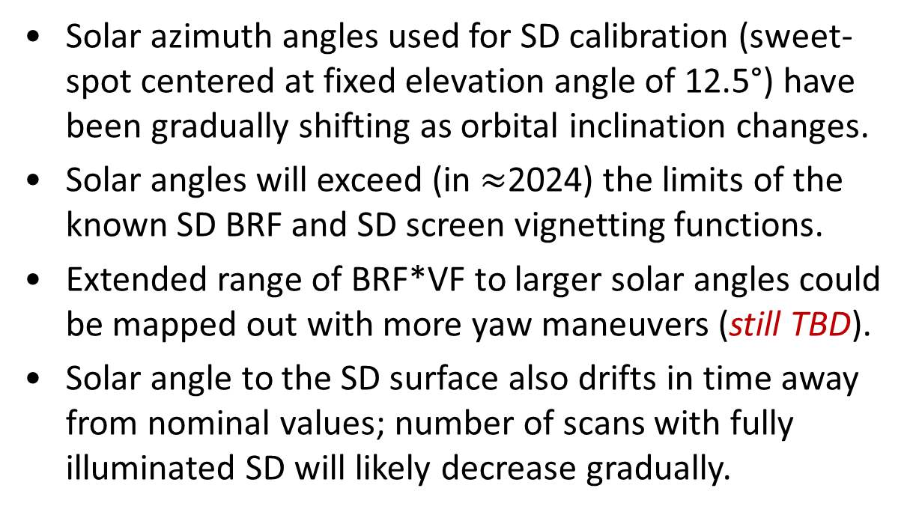
Orbit drift impact - SD
RSB Calibration Coefficients (m₁)
$$m_{1}= \frac{{BRF}_{SD} \cos{θ_{SD} }Δ_{SD}}{{dn}_{SD} d_{ES}^{2}}{VF}_{SDS}$$
SD BRF characterized during pre-launch testing and screen VF characterized during yaw maneuvers.
Limit of pre-launch and yaw measurements
Solar azimuth angles used for SD calibration (sweet-spot centered at fixed elevation angle of 12.5°) have been gradually shifting as orbital inclination changes.
Solar angles will exceed (in $≈$2024) the limits of the known SD BRF and SD screen vignetting functions.
Extended range of BRF*VF to larger solar angles could be mapped out with more yaw maneuvers (still TBD).
Solar angle to the SD surface also drifts in time away from nominal values; number of scans with fully illuminated SD will likely decrease gradually.

Slide 23
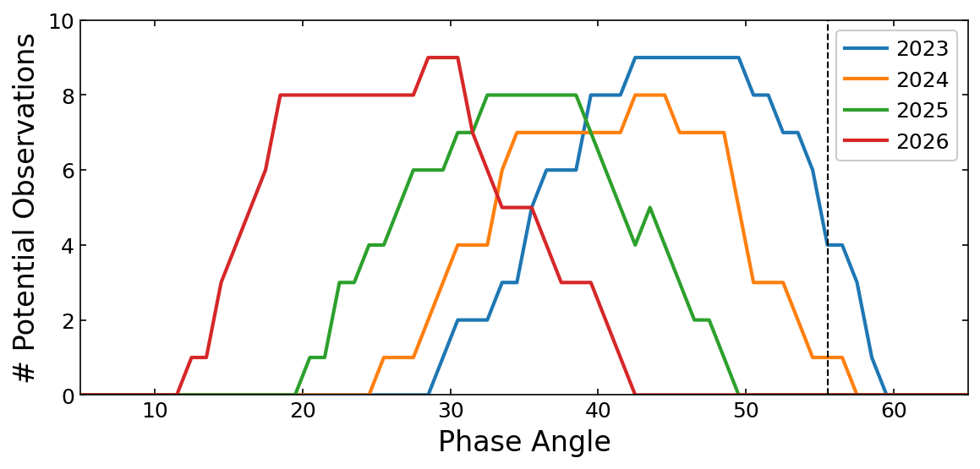
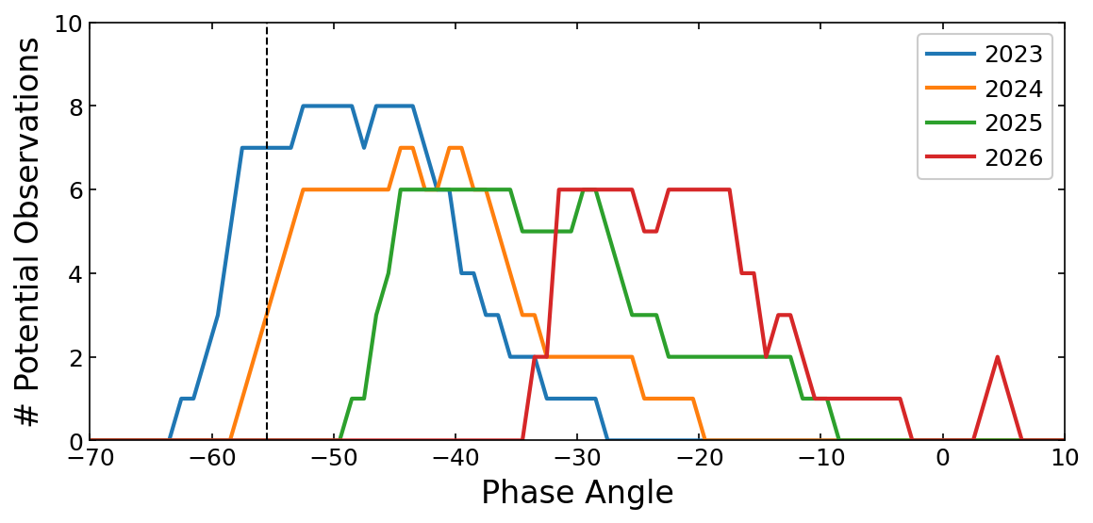
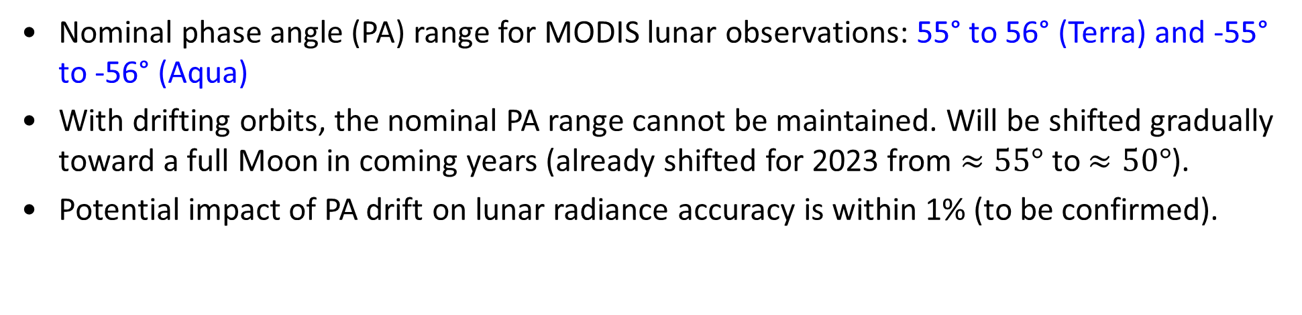
Orbit drift impact - Lunar
Nominal phase angle (PA) range for MODIS lunar observations: 55° to 56° (Terra) and -55° to -56° (Aqua)
With drifting orbits, the nominal PA range cannot be maintained. Will be shifted gradually toward a full Moon in coming years (already shifted for 2023 from $≈55°$ to $≈50°$).
Potential impact of PA drift on lunar radiance accuracy is within 1% (to be confirmed).
Terra MODIS
Aqua MODIS
The histograms are grouped into 1-degree bins and show the number of lunar cycles with observations in that phase angle range

Slide 24
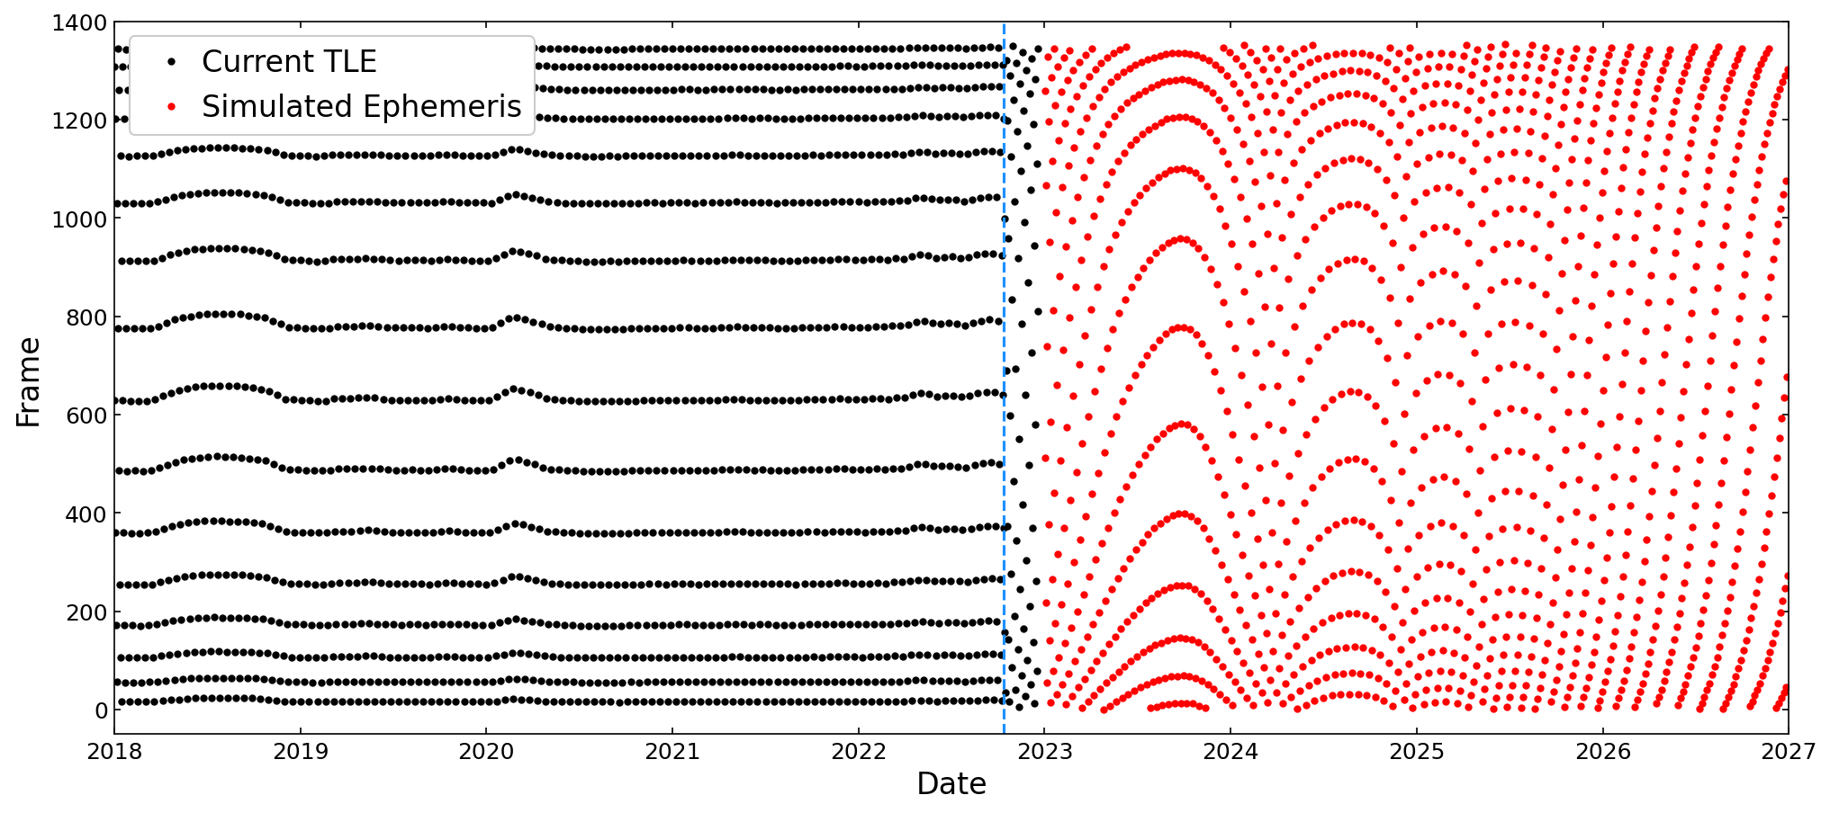
Orbit drift impact - Desert
Immediate impact: Frames (view angles) of desert observations no longer repeat.
  Changes made to use of desert data in RVS algorithm to accommodate continued use of all observations
Gradual impact: Solar angles at times of desert observations also slowly drift with orbit inclination drift.
  Need to verify the accuracy of semi-empirical BRDF model at these extended solar angles.
Frames of desert observations (historical and predicted) are no longer recorded at the historic fixed frames for
Terra (shown): Starting after Oct 2022 CEM
Aqua: Starting Feb 2022

Slide 25
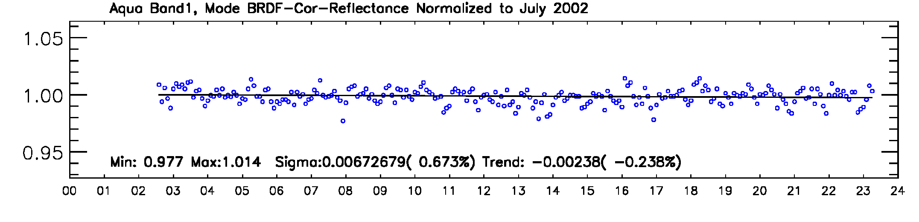
Orbit drift impact – Other EV trends
Use of Deep Convective Clouds (DCC)
  Aggregation of data over lat: [30S, 30N], lon: [95E, 175E]; not sensitive to changes in ground track. However, gradual changes in solar zenith angle may require re-assessment of DCC BRDF impact.
  DCC reflectance data already tracked at multiple AOI and used to apply RVS corrections for calibration of Terra SWIR bands 5, 6, 7, and 26.
  Could also be used to aid future calibration for bands 1, 3, 4, and 18 of both MODIS (other bands are saturated).
Dome C
  Frequency of observations and range of solar angles not predicted to change significantly during orbit drift. Could be a back-up option for RVS characterization.
Last 15 months of Aqua ground track drift had no impact on number or accuracy of DCC observations.

Slide 26
RSB Summary
SD/SDSM and lunar observations are used to track RSB on-orbit gain change
  Additional information from EV response from desert sites are used for select RSB (Terra 1-4, 8-10 and Aqua 1-4, 8-9)
  Use of EV data extended in Terra C7 to include ocean data for bands 11-12 and DCC data for SWIR bands
RSB performance is stable. Only minor changes in instrument behavior following recent events.
  Shorter wavelength VIS Bands show larger degradation (strong wavelength, mirror-side, and scan-angle dependence). Gain changes up to 50% seen in several Terra VIS bands at the AOI of SD (50.25°).
  NIR bands gain change mostly within 15%
  SWIR bands gain change within 10%
Collection 7
  Mission LUTs initially delivered in March 2021 and updated a few times since then.
  Several algorithm improvements included for RSB, mostly impacting Terra MODIS VIS and SWIR bands. These algorithm changes are also being implemented gradually into forward C6.1 LUTs.
Orbit drift
  Orbit maintenance has stopped for both Terra and Aqua. All calibration data sources are impacted in different ways. MCST is preparing strategies to maintain the calibration throughout the rest of Terra and Aqua missions.

Slide 27
BACKUP
Page 27

Slide 28
RSB Design Specifications
Band | CW* | Ltyp⁺ | SNR | Primary Use
1 | 0.645 | 21.8 | 128 | Land/cloud/aerosol boundaries
2 | 0.858 | 24.7 | 201
3 | 0.469 | 35.3 | 243 | Land/cloud/aerosol properties
4 | 0.555 | 29.0 | 228
5 | 1.24 | 5.4 | 74
6 | 1.64 | 7.3 | 275
7 | 2.13 | 1.0 | 110
8 | 0.412 | 44.9 | 880 | Ocean color, phytoplankton & biogeochemistry
9 | 0.443 | 41.9 | 838
10 | 0.488 | 32.1 | 802
11 | 0.531 | 27.9 | 754
12 | 0.551 | 21.0 | 750
13 | 0.667 | 9.5 | 910
14 | 0.678 | 8.7 | 1087
15 | 0.748 | 10.2 | 586
16 | 0.869 | 6.2 | 516
17 | 0.905 | 10.0 | 167 | Atmospheric water vapor
18 | 0.936 | 3.6 | 57
19 | 0.940 | 15.0 | 250
26 | 1.37 | 6.0 | 150 | Cirrus cloud water vapor
*μm
⁺W/m²/sr/μm

Slide 29
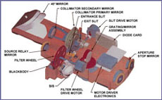
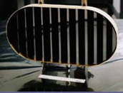
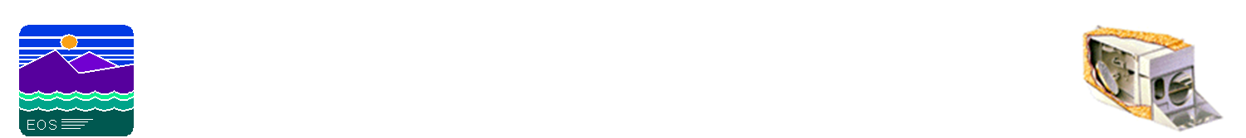
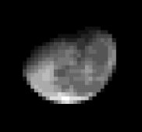
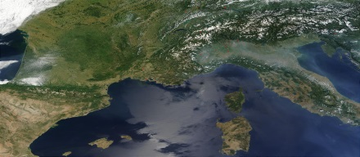
On-orbit Calibration Activities
SRCA:
Radiometric: monthly
Spatial: quarterly
Spectral: tri-annual
SD/SDSM:
Weekly to tri-weekly
Solar Diffuser
SRCA
SDSM
Blackbody
Scan Mirror
Space View
BB: quarterly
Spacecraft maneuvers:
Yaw (SD BRF, VF)
Roll (Moon)
Pitch (with Moon) for RSB RVS validation
Moon: monthly (nighttime orbits)
0-20° spacecraft roll maneuvers
55° phase angle
Notes:
Summary of the MODIS on-orbit calibration activities
MODIS scan-mirror is constantly rotating at 20.3 rpm to provide complete global coverage in less than 2 days
As the scan mirror rotates it is also able to sample the on-board calibrators
The primary calibrators for Reflective Solar Bands are the Solar diffuser and SD Stability Monitor
And space view port where the MODIS detectors can image the moon after a spacecraft roll maneuver

Slide 30
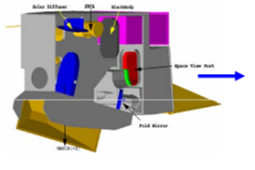
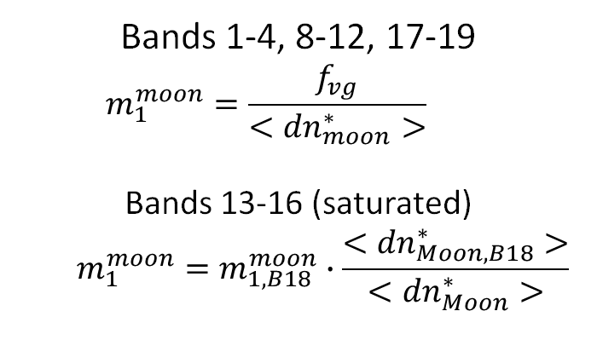
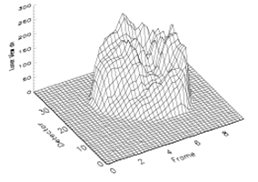
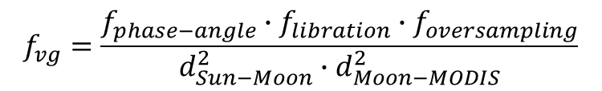
RSB Lunar Calibration
MODIS
Lunar calibration coefficients
Moon
Bands 1-4, 8-12, 17-19
  $$m_{1}^{moon}=\frac{f_{vg}}{<{dn}_{moon}^{∗}>}$$
Bands 13-16 (saturated)
  $$m_{1}^{moon}=m_{1,B18}^{moon}∙\frac{<{dn}_{Moon, B18}^{∗}>}{<{dn}_{Moon}^{∗}>}$$
MODIS Response
View geometry correction
$$f_{vg}=\frac{f_{phase−angle}∙f_{libration}∙f_{oversampling}}{d_{Sun−Moon}^{2}∙d_{Moon−MODIS}^{2}}$$
Near-monthly calibration
Phase angles between 55°- 56°
Oversampling effect also needs to be corrected if multiple scans are used

Slide 31
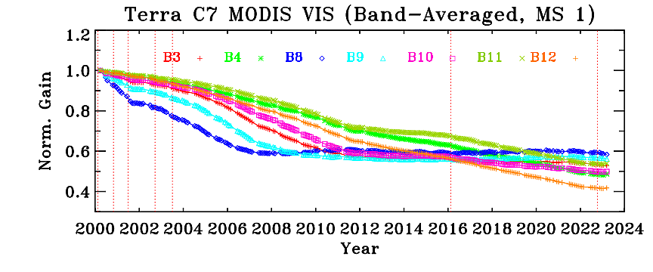
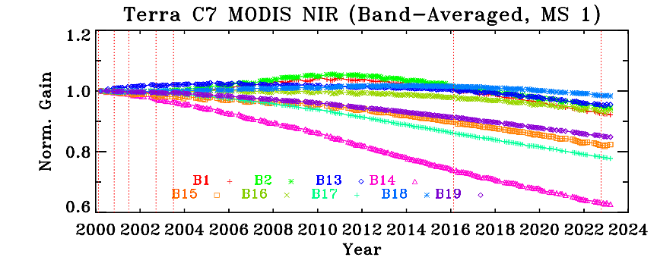
Terra MODIS
Gain Trending from SD and Lunar
SD
SD
Lunar
Lunar
SD & Lunar measurements used to derive the on‐orbit RVS change
SD AOI = 50.25° Lunar (SV Port) AOI = 11.2°

Slide 32
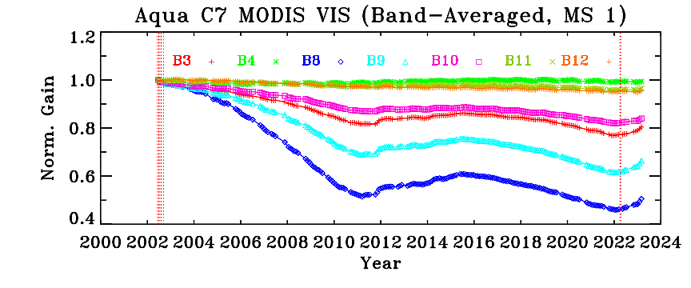

Aqua MODIS
Gain Trending from SD and Lunar
SD
SD
Lunar
Lunar
SD & Lunar measurements used to derive the on‐orbit RVS change
SD AOI = 50.25° Lunar (SV Port) AOI = 11.2°

Slide 33

MODIS RSB Uncertainty Trends
Most bands continue to meet the specification.
Additional uncertainty associated with the bands that employ EV-based RVS characterization approach (Terra bands 1-12 and 26)

Slide 34

MODIS RSB Uncertainty Trends
Most bands continue to meet the specification.
Additional uncertainty associated with the bands that employ EV-based RVS characterization approach (Aqua bands 1-4, 8, and 9)

