Slide 1
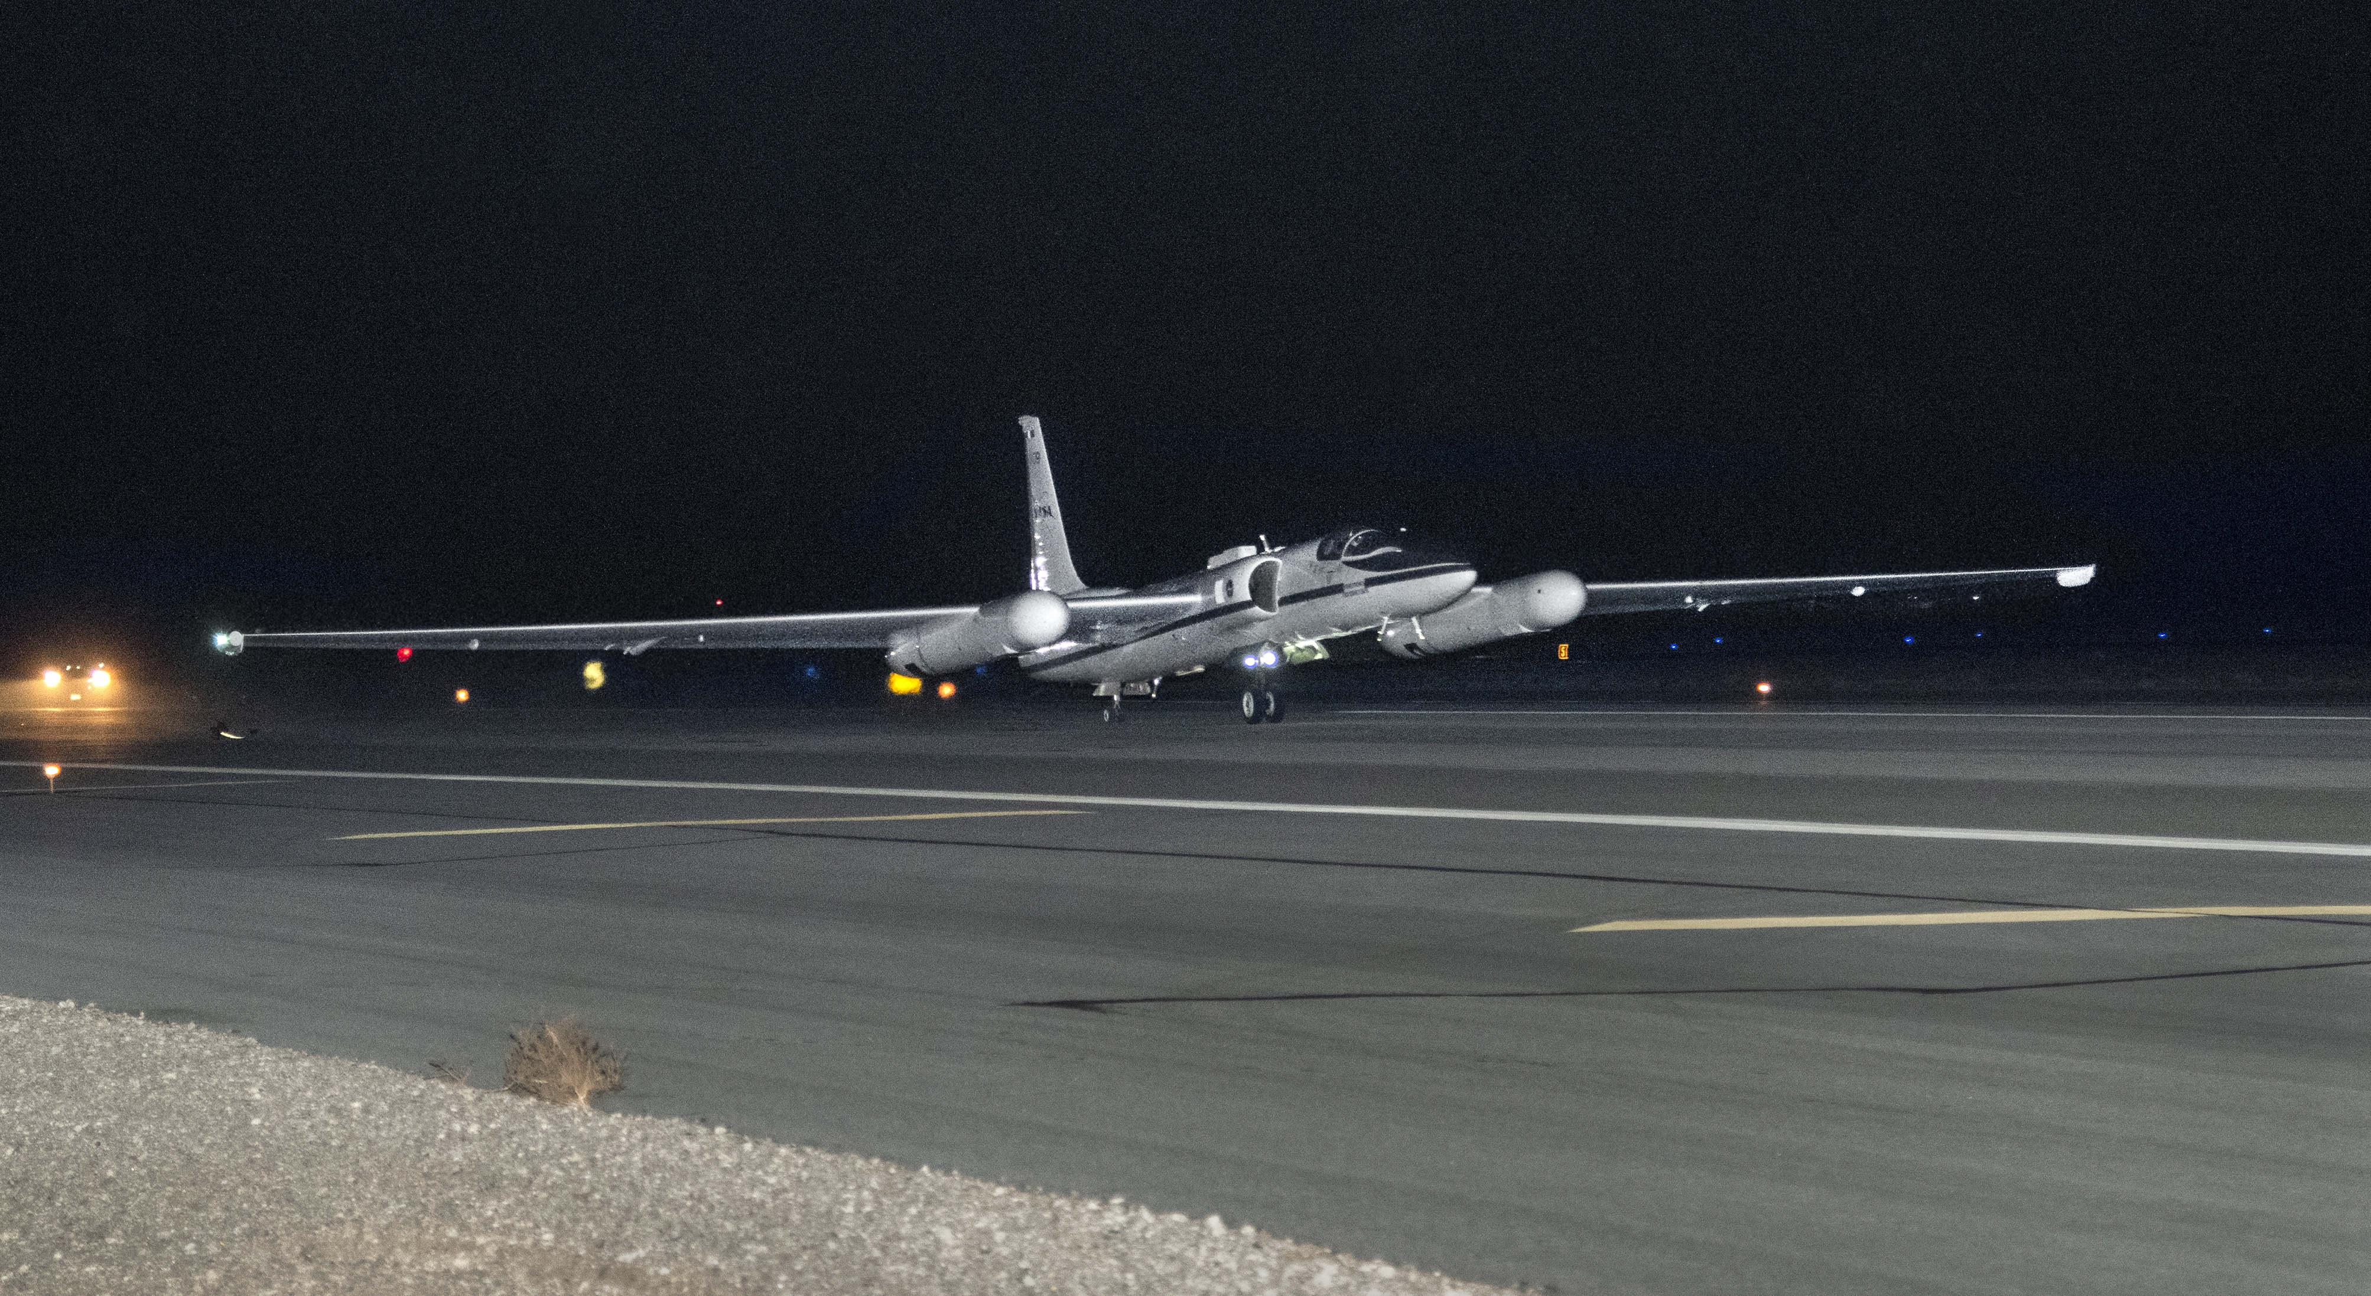
airborne Lunar Spectral Irradiance (air-LUSI)
Mission Update
K. Turpie (kturpie@umbc.edu)
UMBC | NASA Goddard Space Flight Center
MODIS and VIIRS Calibration Workshop
1 May 2023
College Park, Maryland USA
Notes:
Hi. I am Kevin Turpie from the University of Maryland Baltimore County and the PI on the air-LUSI mission.
I'm here to provide the latest update on the air-LUSI mission, specifically the outcome of our recent capability demonstration flights.

Slide 2
air-LUSI Team
Kevin Turpie, PI
Steve Grantham
Tom Larason
Stephen Maxwell
John Woodward, Co-I
Franzeska Becker
Samuel Choi
Gary Hoffman
Tyler Latsha
Timothy Williams
Robert York
Andrew Gadsden, Co-I
Andrew Newton
Tom Stone, Co-I
Notes:
First, I'd like to acknowledge my current team, starting my Co-Investigators:
Steve Brown and John Woodward from NIST
Andrew Gadsden from University of Guelph, and
Tom Stone from USGS.
The greater air-LUSI team also includes more members from NIST, including Steve Grantham, Stephen Maxwell, Tom Larason, and their Group Leader Joe Rice.
and Andrew Newton, a master’s student from the U of Guelph.

Slide 3
Operational Flight Campaign – 01: Time Line
Dec 2019 - Feb 2022: Updates to air-LUSI after Demonstration Campaign
02 Mar – Deployed to AFRC, successful collection four out of five nights:
12 Mar – Flight 1: Successful collection, uneventful.
13 Mar – Flight 2: Scrubbed because of high winds.
14 Mar – Flight 3: Successful collection, uneventful.
15 Mar – Flight 4: Successful collection, altitude drop at first station.
16 Mar – Flight 5: Successful collection, stratospheric turbulence.
22 Mar – Returned air-LUSI to NIST
3

Slide 4
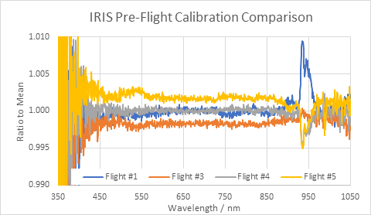
CALIBRATION PERFORMANCE
4

Slide 5
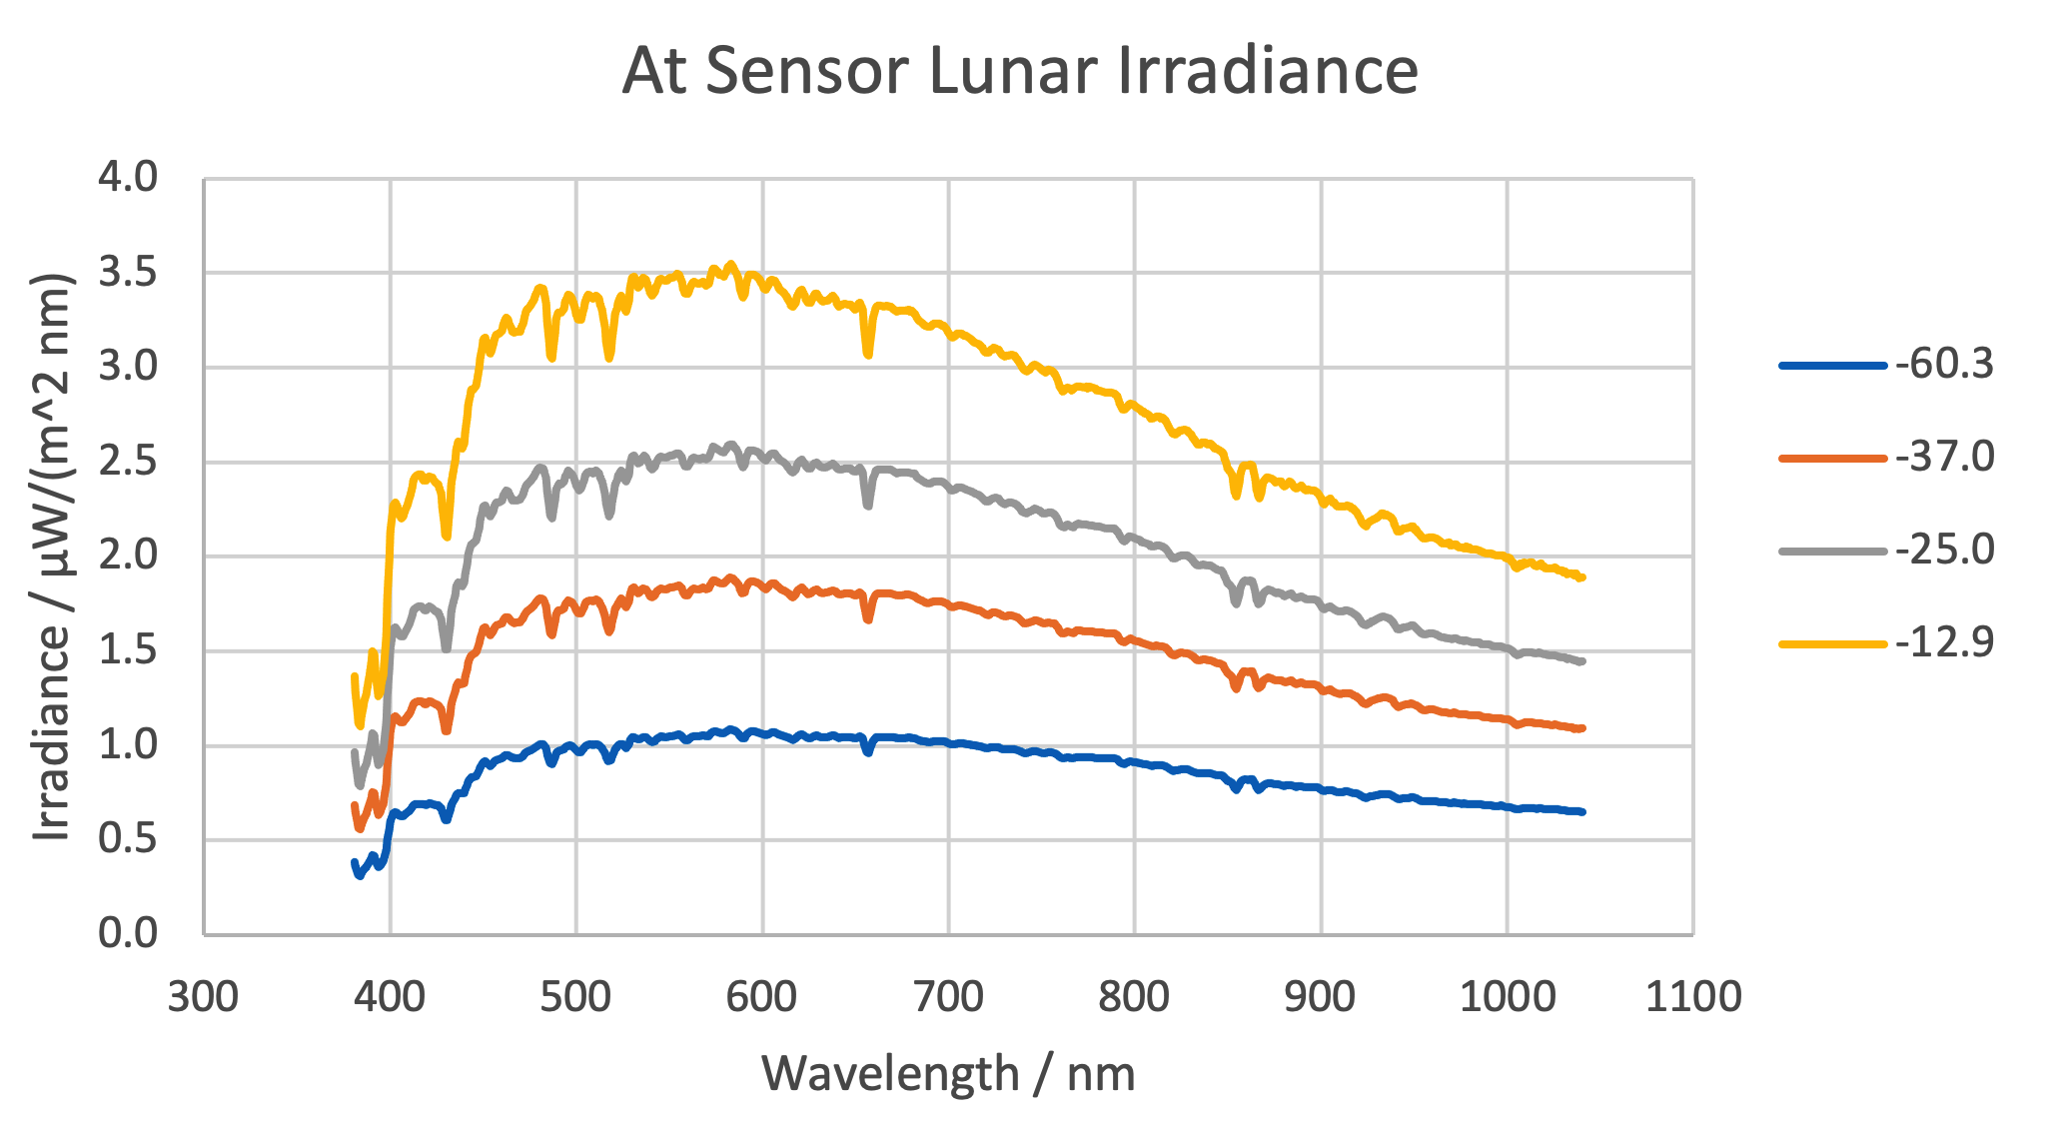
Flight 5
Flight 4
Flight 3
-60.3°
-37.0°
Flight 1
lunar phase angle
-25.0°
-12.9°
5

Slide 6
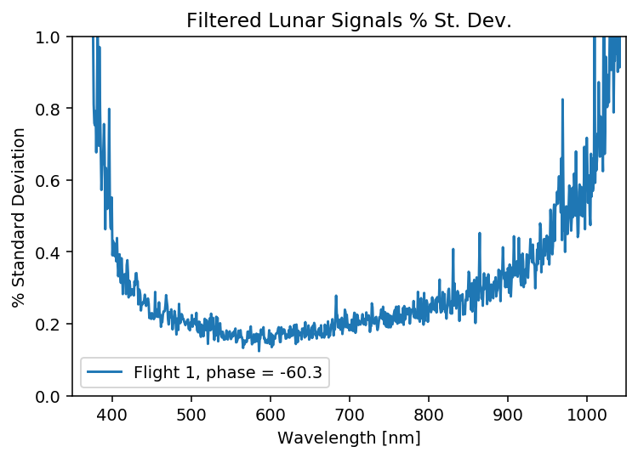
Flight 1 is the largest SD of all flights (less signal).
Cosmic ray spikes were culled with a median filter
(r₁ = 0.025, r₂ = 0.975).
Includes variation in Moon over collect, causing some overestimate.
Moon usually changes on order of a few tenths of a percent over collect at this phase angle.
We will remove the secular change with ROLO later.
6

Slide 7
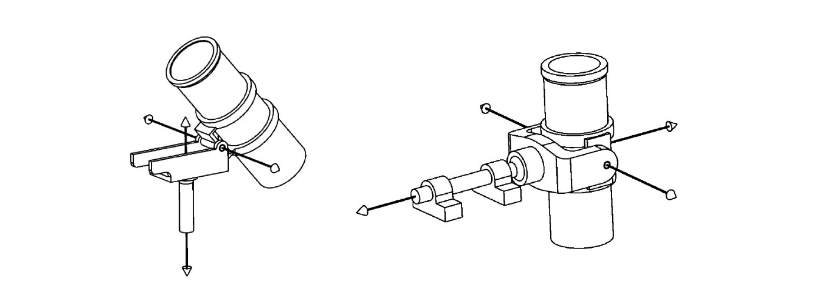
air-LUSI Future Efforts
Improvements
Telescope robotics (durability, performance, range); spare actuators.
Cable management.
Reduce noise in validation system.
Temperature control (airborne and ground).
N2 purge system (new bottle size; optimize flow rates).
Comparisons
Complete processing for Operational Campaign–01 and error budget.
Continue collaboration with ESA LIME team.
Compare processed data to Demonstration Campaign data and ROLO.
Compare processed data to MLO-LUSI data.
7

Slide 8
air-LUSI Future Efforts
Lunar Calibration
Public access to air-LUSI data and code (initially NIST data portal).
air-LUSI hosted a small lunar calibration workshop with satellite cal teams.
Follow up work leading to a public report or peer-review publication.
Discussion will open up to broader venue (e.g., GSICS).
Apply air-LUSI results towards ROLO improvement.
8

Slide 9
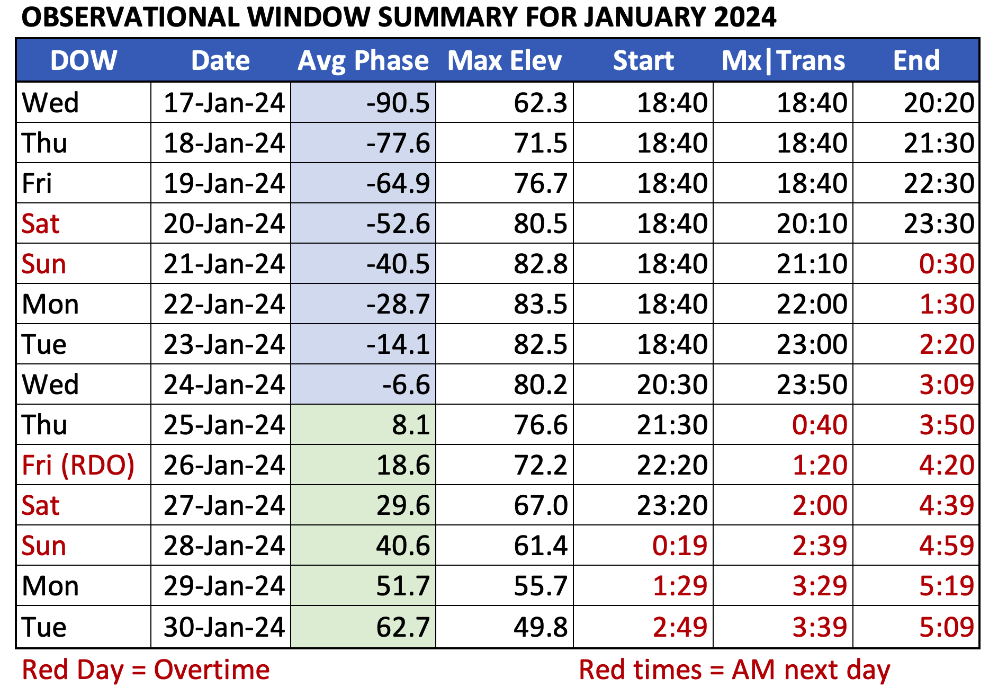
air-LUSI Future Efforts
Future Campaigns
Targeting observation window: Jan 2024.
Wish to validate and further sample lunar phases.
Consider other airframes (e.g., WB-57); high alt (above tropo-pause).
Funding is greatest challenge.
9

Slide 10
THANK YOU
Notes:
Hi. I am Kevin Turpie from the University of Maryland Baltimore County and the PI on the air-LUSI mission.
I'm here to provide the latest update on the air-LUSI mission, specifically the outcome of our recent capability demonstration flights.

Slide 11
Pre-Campaign Updates to air-LUSI
Built and tested new telescope integrating sphere with improved temperature control.
Replaced broken shutter for in-flight LED validation source.
Replaced in-flight validation source with broader spectrum LED.
Repaired pressure seals on throughputs in environmental enclosure.
Performed power conditioning sensitivity tests.
Added new thermal sensors; updated throughputs, cabling, DAQ.
Improved some avionics and component interfaces.
Performed last-minute repair for elevation actuator burnout.
Adjusted elevation pins on telescope mount to reduce binding.
11

Slide 12
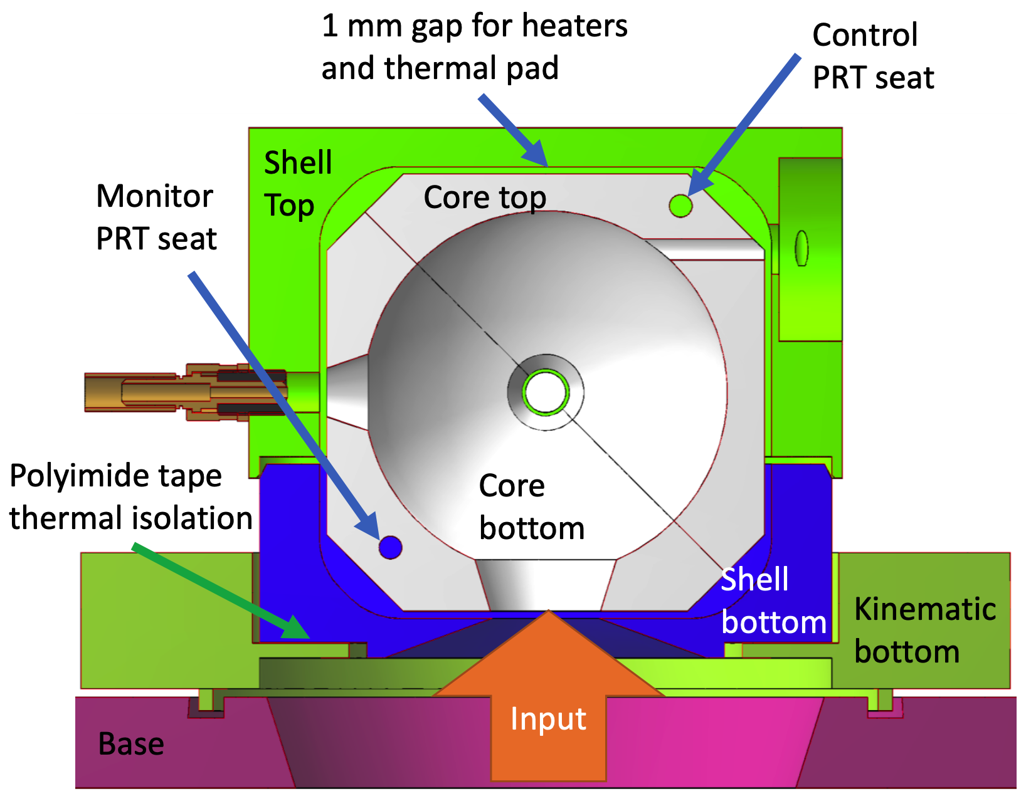
Telescope
Integrating
Sphere
Assembly
UPDATED air-LUSI TELESCOPE INTEGRATING SPHERE ASSEMBLY (TISA)
12

