Slide 1
MODIS TEB Calibration and Performance
MODIS Characterization Support Team, NASA GSFC
(Presented by Tiejun Chang)
MODIS/VIIRS Calibration Workshop (May 1, 2023)
Notes:
1

Slide 2
MODIS TEB Design Specifications
Band | CW | Ttyp | NEdT | UC (%) | UC (K) | Primary Use
20 | 3.75 | 300 | 0.05 | 0.75 | 0.18 | Surface/cloud temperature
21 | 3.96 | 335 | 0.20 | 1 | 2.97
22 | 3.96 | 300 | 0.07 | 1 | 0.25
23 | 4.05 | 300 | 0.07 | 1 | 0.25
24 | 4.47 | 250 | 0.25 | 1 | 0.19 | Atmosphere temperature
25 | 4.52 | 275 | 0.25 | 1 | 0.24
27 | 6.72 | 240 | 0.25 | 1 | 0.27 | Water vapor
28 | 7.33 | 250 | 0.25 | 1 | 0.32
29 | 8.55 | 300 | 0.05 | 1 | 0.53 | Cloud properties
30 | 9.73 | 250 | 0.25 | 1 | 0.42 | Ozone
31 | 11.03 | 300 | 0.05 | 0.5 | 0.34 | Surface/cloud temperature
32 | 12.02 | 300 | 0.05 | 0.5 | 0.37
33 | 13.34 | 260 | 0.25 | 1 | 0.62 | Cloud top altitude
34 | 13.64 | 250 | 0.25 | 1 | 0.59
35 | 13.94 | 240 | 0.25 | 1 | 0.55
36 | 14.24 | 220 | 0.35 | 1 | 0.47
CW: center wavelength in micron;
Ttyp: typical scene temperature in K;
NEdT: noise equivalent temperature difference in K
MWIR: 20-25
PV LWIR: 27-30
PC LWIR: 31-36
Notes:
2

Slide 3
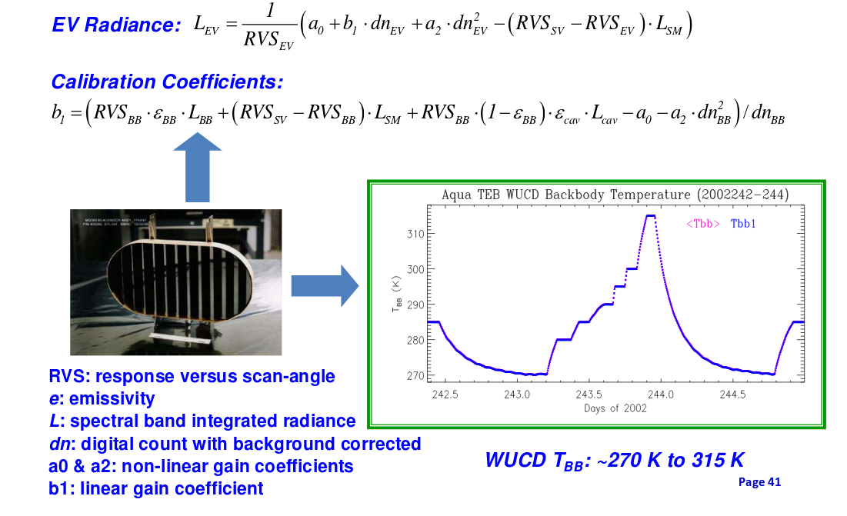
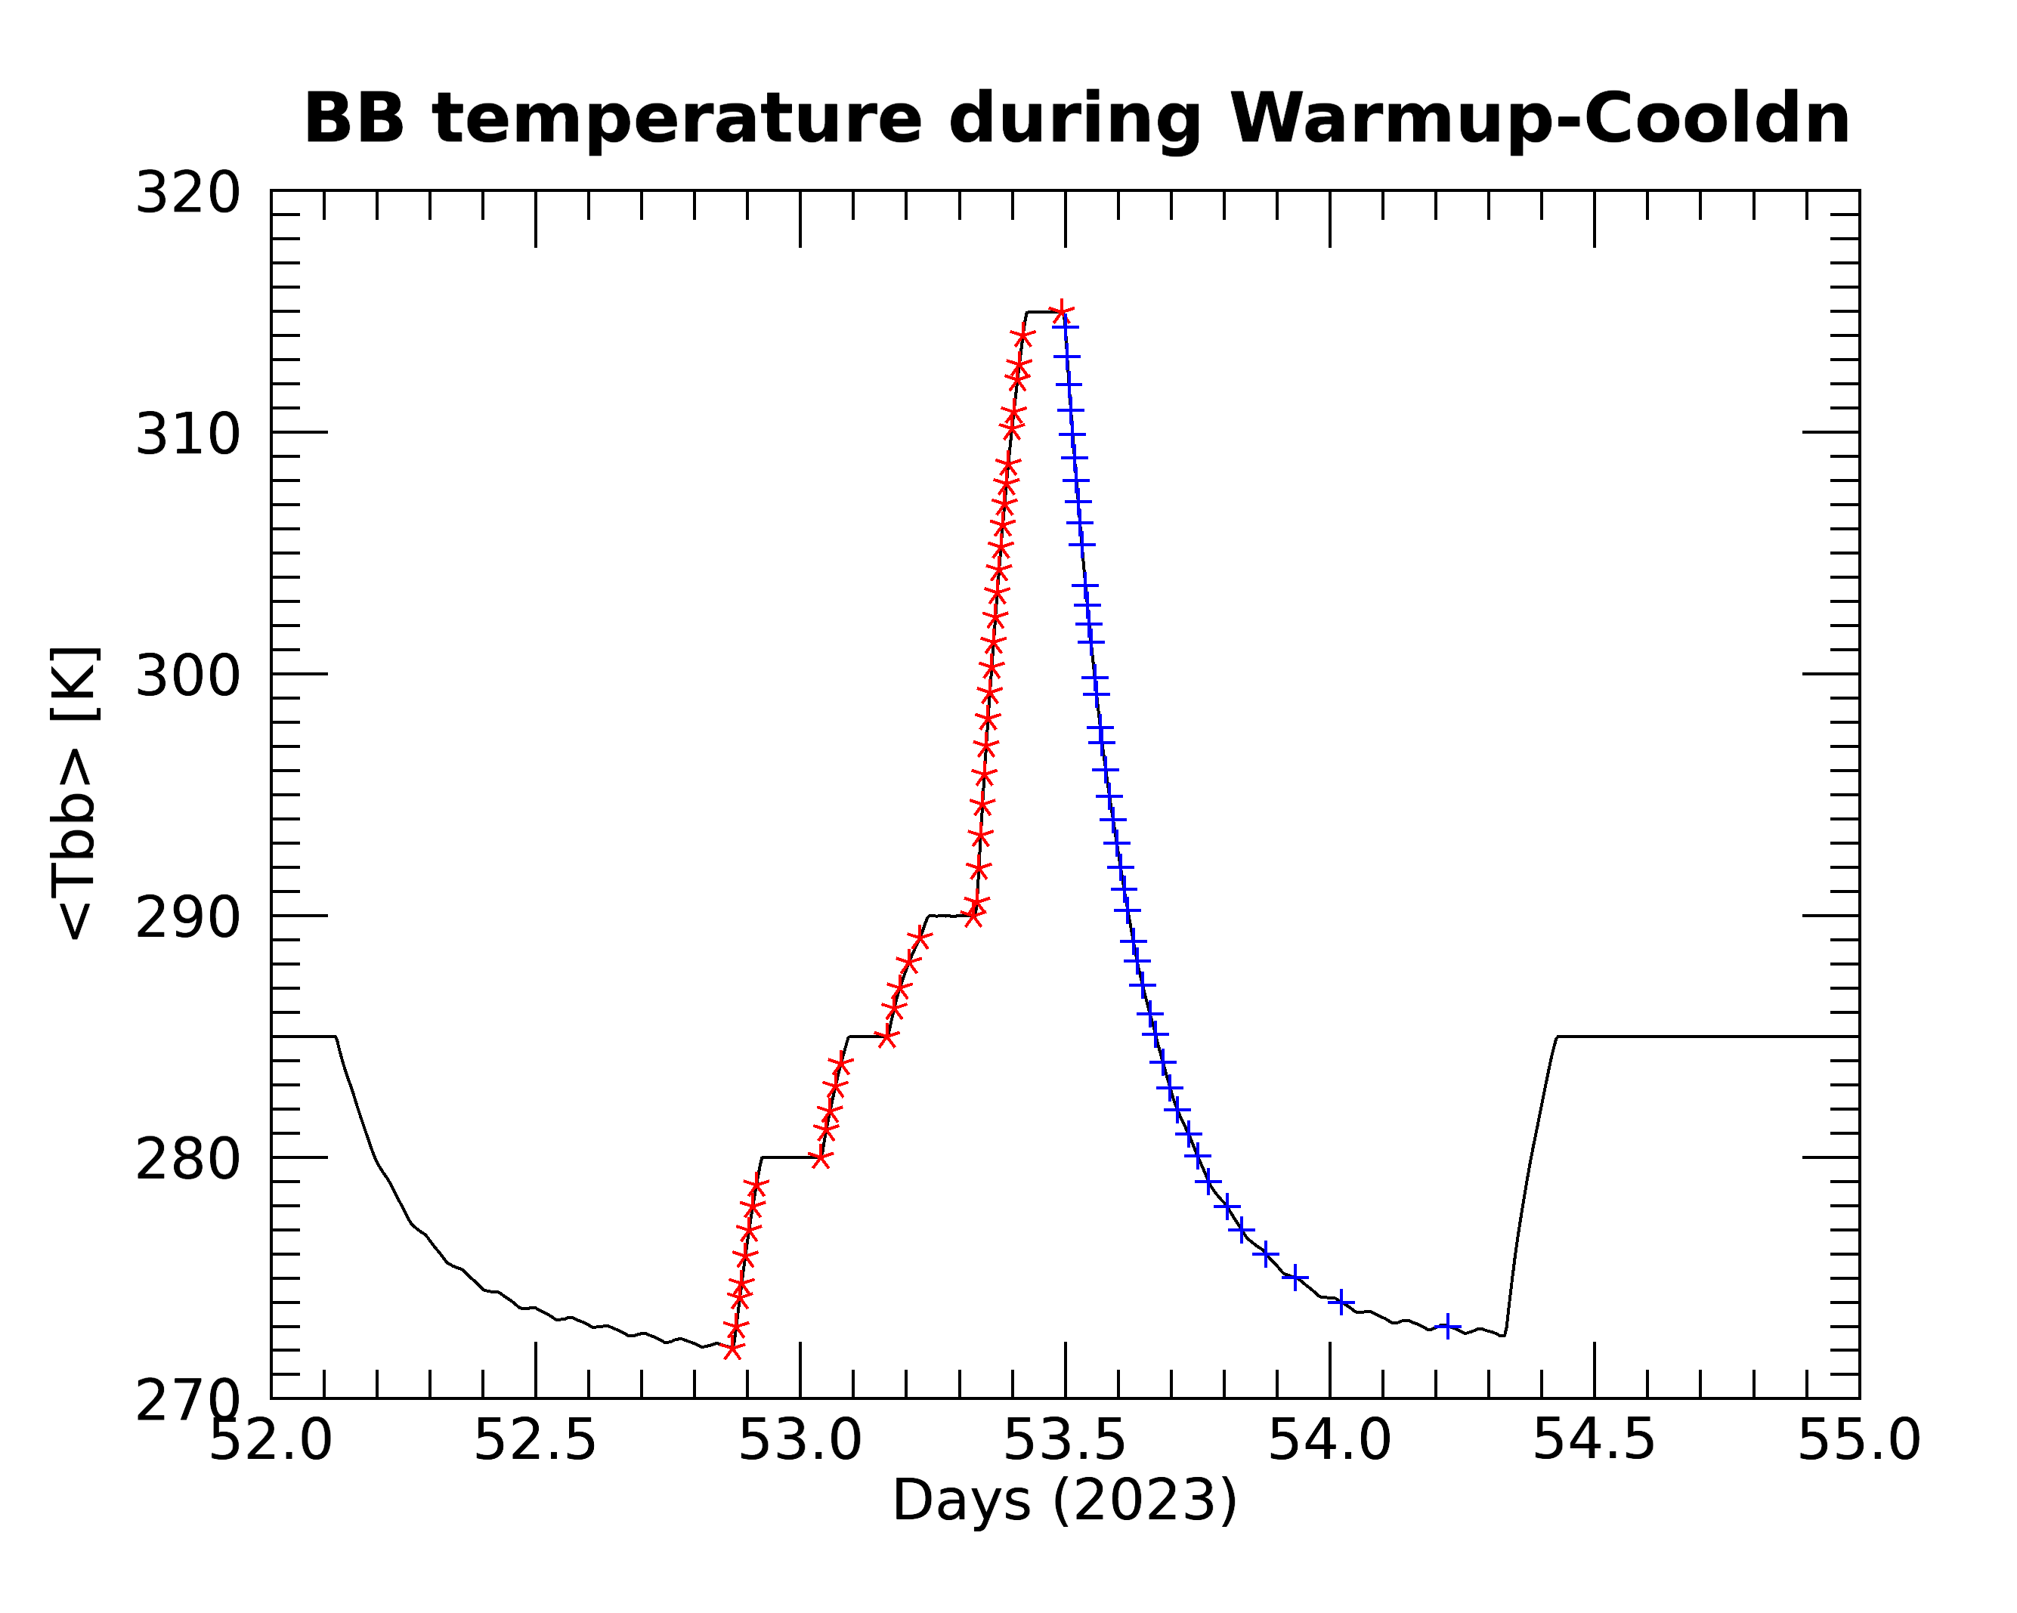
MODIS TEB On-orbit Calibration and Methodologies
Regular BB Calibration
Linear gain coefficient b1 on a scan-by-scan basis
40-scan running average b1 for L1B product
Quarterly BB Warm-up and Cool-down (WUCD)
Nonlinear gain coefficients a0 and a2
Fixed linear coefficients for band 21
Special Calibration Issues
PV LWIR bands and MWIR detector electronic crosstalk
Terra PC bands 32-36 optical cross-talk
Response versus scan angle (RVS)
Aqua CFPA temperature fluctuation (till March 2022)
Uncertainty and QA
Calibration Assessments and Monitoring
Gain, NEdT, uncertainty, and telemetry temperature trending monitoring
Ecal and saturation monitoring
EV scene (Dome-C, Ocean, qDCC) trending
Inter-comparisons with IASI, AIRS, CrIS, and VIIRS
Terra/MODIS with Aqua/MODIS,
Aqua WUCD 2023052
Need update
Notes:
3

Slide 4
Terra MODIS TEB calibration performance
Calibration performance
Overall performance is stable.
PV LWIR bands 27-30 electronic crosstalk increasing.
MWIR band select detector electronic crosstalk show slight downward trend.
NEdT and uncertainty meet specifications, except band 36.
No noisy detector added since last STM. Currently total 19 noisy and 1 inoperable TEB detectors
Recent events and impacts on calibration
Terra CP/FP reset (March 2022)
-- No significant changes to telemetry, gain, noise, and crosstalk contamination
-- Mirror side difference inverted; calibration offset changes made
Terra CEM (October 2022)
-- Gain changes up to 1%
-- PV LWIR bands crosstalk slight increase
-- No change in QA
(https://mcst.gsfc.nasa.gov/calibration/time-dependent-list-non-functional-or-noisy-detector)
CP/FP: Command and format processors CEM: Constellation Exit Maneuvers

Slide 5
Aqua MODIS TEB calibration performance
Calibration performance
Overall performance is stable.
PV LWIR bands 27-30 electronic crosstalk is increasing, especially in recent three years
MWIR band select detector electronic crosstalk show slight downward trend.
NEdT and uncertainty meet specifications.
Three noisy detectors added since last STM. Currently total 7 noisy and 1 inoperable TEB detectors
Aqua safe mode (March 2022) impacts
-- Gain changes: MWIR bands within 1%; PV LWIR and PC bands 2-3%
-- PV LWIR bands crosstalk contamination saw significant increase
-- B27(1, 3) and B30(1) (P.O.) added as noisy detectors to QA
-- Aqua MODIS CFPA temperatures are fully controlled after outgassing
(https://mcst.gsfc.nasa.gov/calibration/time-dependent-list-non-functional-or-noisy-detector)

Slide 6
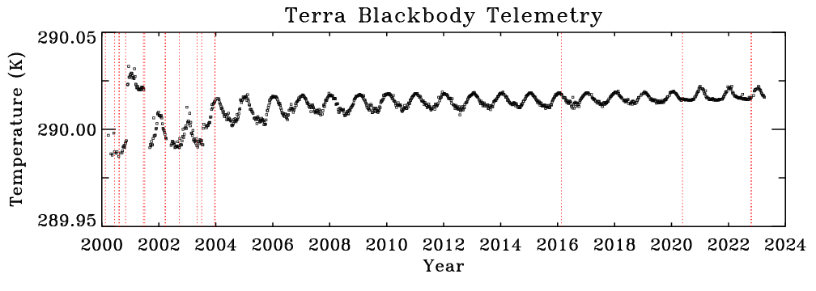
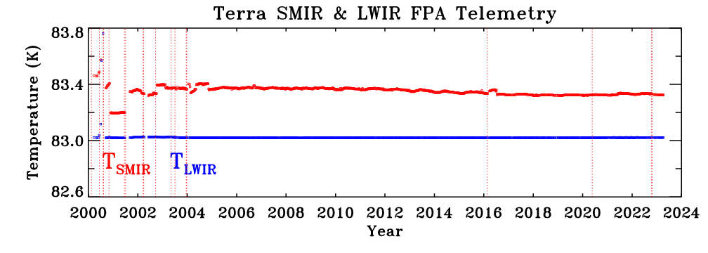
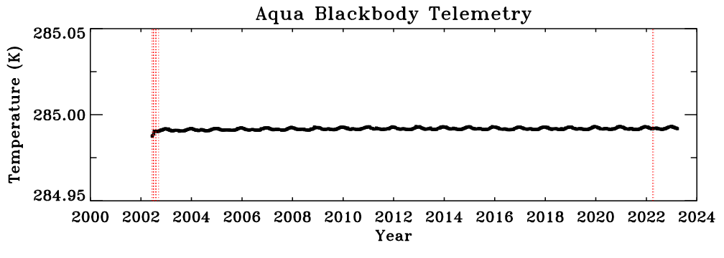
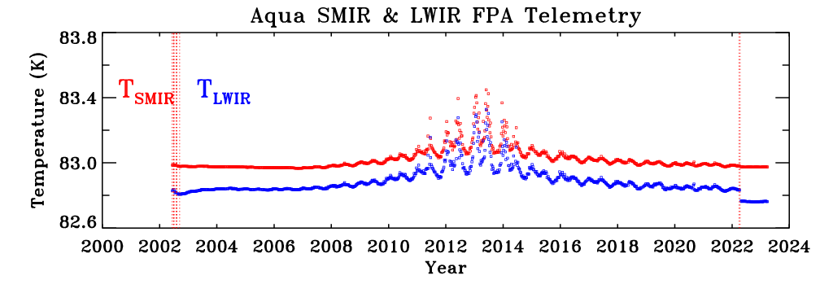
Key Telemetry Temperatures
Terra BB temperature setting is changed to 285K in April 2020. In the Terra BB temperature trending plot, the temperature is shifted 4.96K for matching the temperature trending.
Aqua SMIR CFPA actively controlled (83K), insufficient radiative cooler margin starting ~2006.
-- Increase of radiative cooler margin and improvement of temperature control since 2013
-- After outgassing following safe mode, CFPA temperature is fully controlled.
Notes:
There is a dot in the Aqua BB temperature plot
6

Slide 7
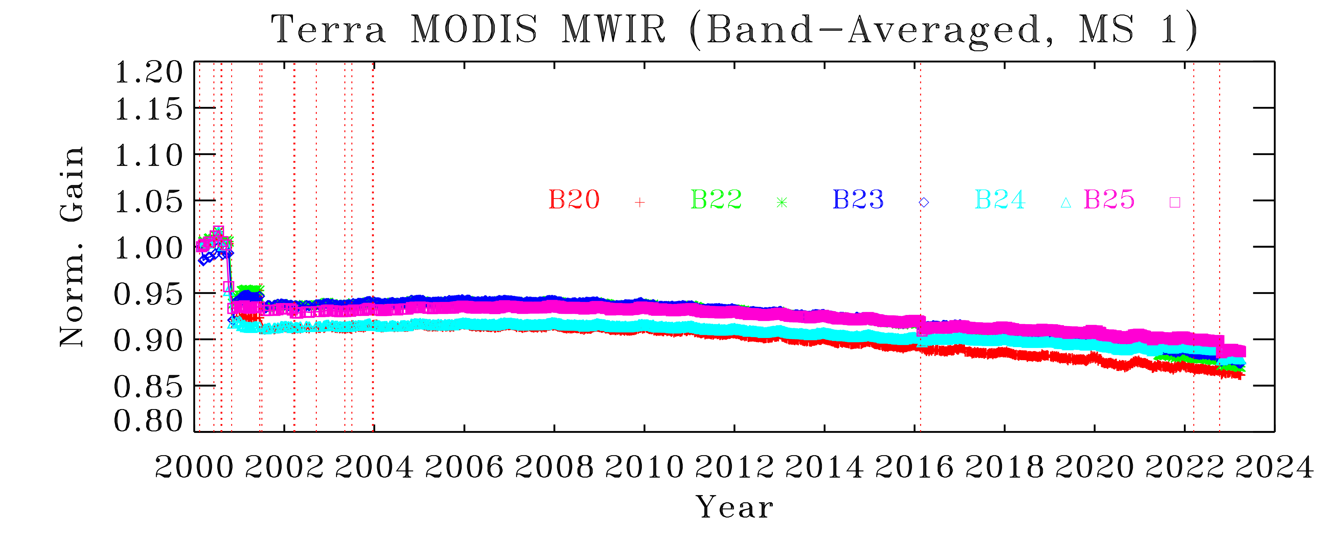
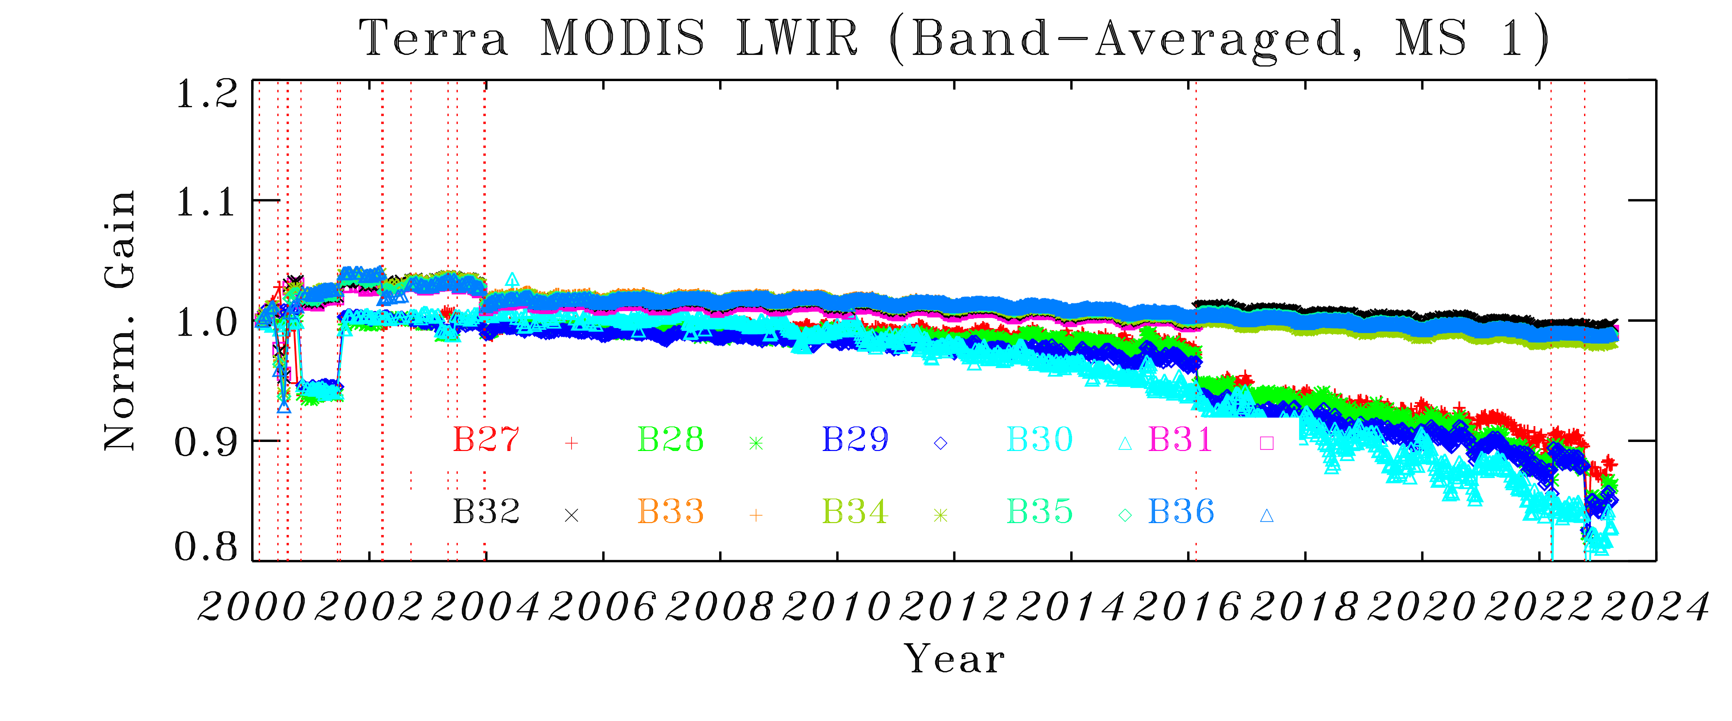
Terra TEB Gain Trending
Safe mode event of Feb 2016 caused gain changes for some bands, especially for PV LWIR bands.
Slight gain change after CEM.
Notes:
How the good detectors are defined data source
7

Slide 8
Aqua TEB Gain Trending
CFPA temperature impacts on gain for LWIR bands around 2013.
Safe mode (March 2022) impacts on gains for LWIR bands
Notes:
Terra plot and Aqua plot have inconsistent fonts
8

Slide 9
Terra TEB NEdT and uncertainty
Safe mode event of Feb 2016 caused NEdT changes for some bands, especially for PV LWIR bands.
No impact from Terra 2022 CP/FP reset and CEM
Band 36 NEdT and uncertainty are above the specification
Page 9

Slide 10
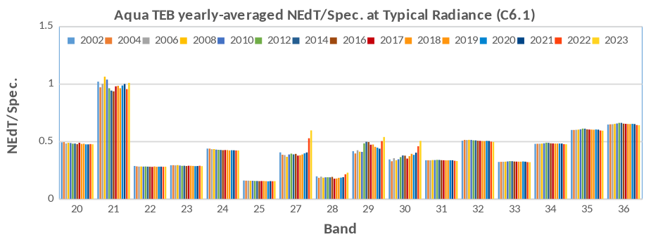
Aqua TEB NEdT and uncertainty
NEdT meets the specification and stable over the mission
Band 21 NEdT is close to the specification and overall meet the specification.
No significant impact from Aqua 2022 safe mode
Page 10

Slide 11
MODIS TEB C6.1 and C7 algorithms
Terra C7 improvements
MWIR crosstalk correction – Crosstalk correction applied to selected detectors calibration and EV measurements.
PC bands mirror side difference reduction – Early mission calibration offset a0 correction to reduce mirror side difference.
Bands 20 and 29 cold scene biases reduction – Calibration offset a0 adjustments to reduce cold scene bias
Band 30 calibration stability – Improvement of nonlinear a0 and a2 coefficient algorithm.
MWIR and LWIR crosstalk uncertainty – Improvement on crosstalk uncertainty calculation and propagation to L1B data.
Aqua C7 improvements
MWIR crosstalk correction – Crosstalk correction applied to selected detectors calibration and EV measurements.
LWIR crosstalk correction – Crosstalk correction applied to calibration and EV measurements.
Calibration stability improvement – Application of nonlinear a2 using BB CD data to all bands and a2 adjustment for PV LWIR bands.
Mirror-side consistency - Application of mission-long a0 correction to reduce mirror side difference.
MWIR and LWIR crosstalk uncertainty – Improvement on crosstalk uncertainty calculation and propagation to L1B data.

Slide 12
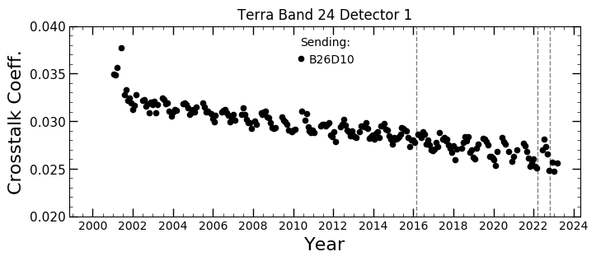
Terra MWIR bands cross-talk corrections
MWIR bands crosstalk correction for selected detectors applied to Terra MODIS C7.
The table lists the receiving band/detector and contamination impact
Band 24 detector 1 (sending from band 26 detector 10) shows the largest contamination for daytime measurements
The MWIR crosstalk coefficients are gradually decreasing. The chart shows band 24 detector 1 crosstalk trending.
Band | Det | Contamination Impact
22 | 8 | Striping over ice cloud scenes and water scenes (~0.5K).
23 | 1,10 | Striping over ice cloud scenes and water scenes (~0.5K).
24 | 1 | Striping over ice cloud scenes; 0.5 -1 K change over ocean scenes
Reference:
(1) Wilson, T., A. Shrestha, and X. Xiong, "Electronic crosstalk impact assessment in the Terra MODIS midwave infrared bands", Proceedings Volume 10423, Sensors, Systems, and Next-Generation Satellites XXI; 104231Z, 2017
(2) https://mcst.gsfc.nasa.gov/sites/default/files/meetings_files/2018_mcst_xtalk_workshop.pdf.

Slide 13
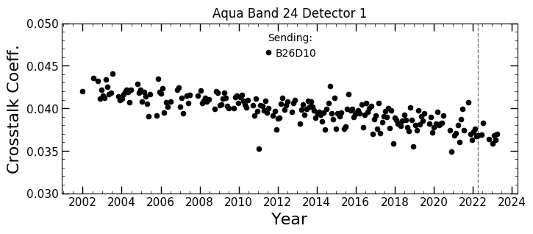
Aqua MWIR bands cross-talk corrections
MWIR bands crosstalk correction for selected detectors applied to Aqua MODIS C7.
The table lists the receiving band/detector and contamination impact
Band 24 detector 1 (sending from band 26 detector 10) shows the largest contamination for daytime measurements
The MWIR crosstalk coefficients are gradually decreasing. The chart shows band 24 detector 1 crosstalk trending.
Band | Det | Contamination Impact
20 | 1 | Striping over some scenes (~0.15K).
22 | 1 | Striping over some scenes (~0.20K).
23 | 1 | Large striping over ice cloud and water scenes (~0.5K).
24 | 1 | Striping over low BT scenes during daytime.
25 | 1 | Striping over some scenes (~0.20K).
Reference:
(1) Keller, G. R., T. Wilson, X. Geng, A. Wu, Z. Wang and X. Xiong, "Aqua MODIS Electronic Crosstalk Survey: Mid-Wave Infrared Bands," IEEE Transactions on Geoscience and Remote Sensing, vol. 57, no. 3, pp. 1684-1697, 2019
(2) https://mcst.gsfc.nasa.gov/sites/default/files/meetings_files/2018_mcst_xtalk_workshop.pdf.

Slide 14
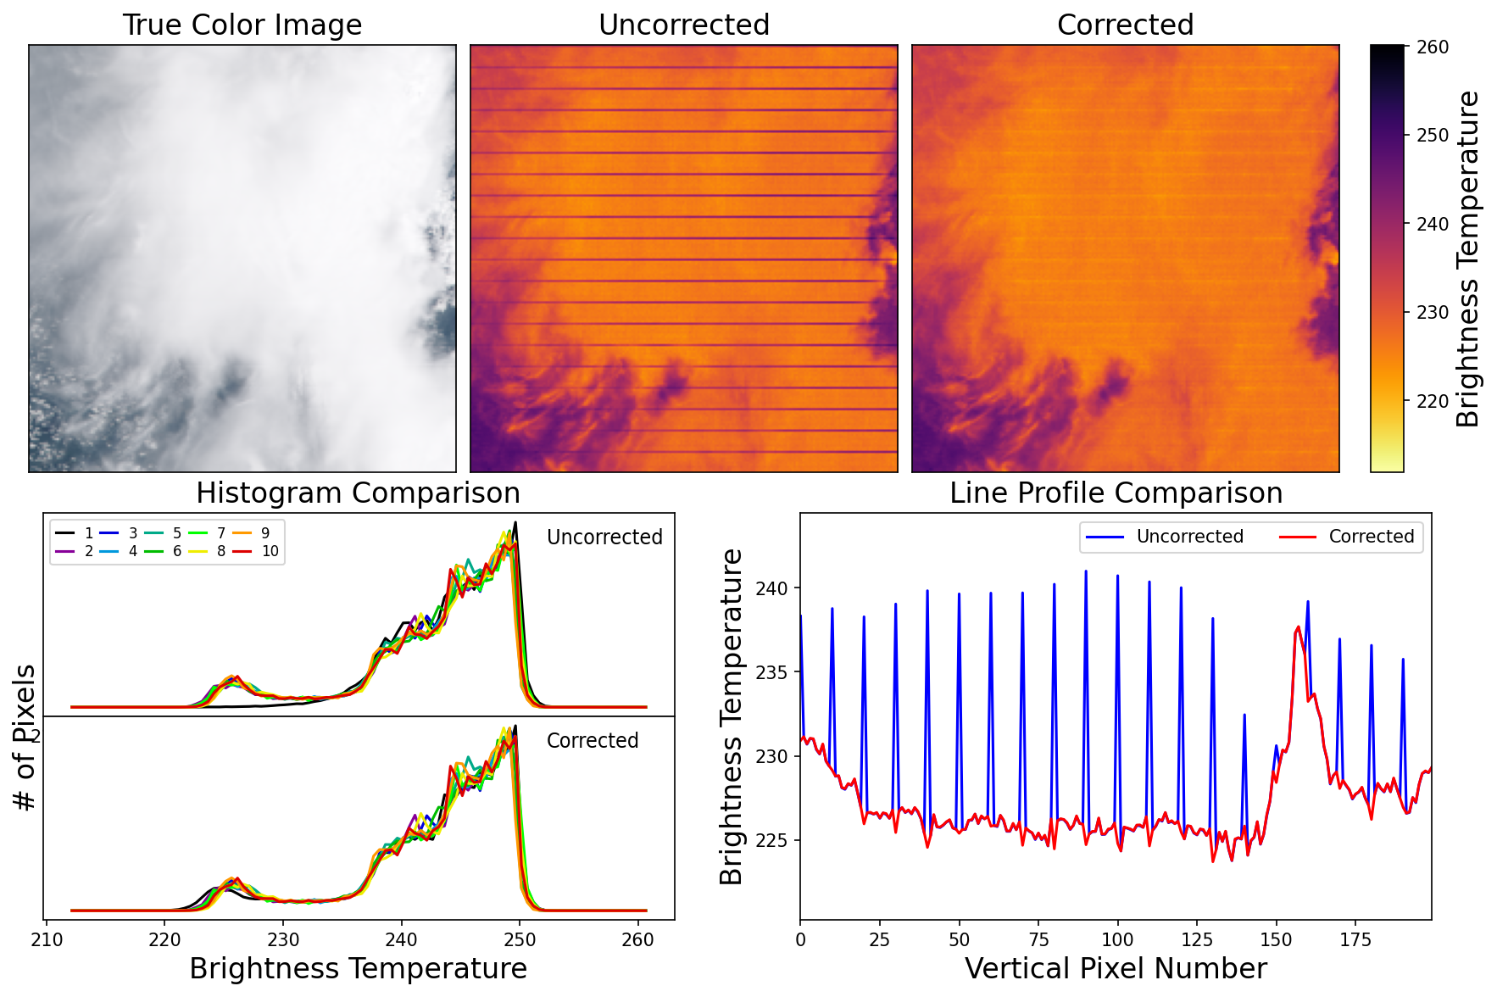
Aqua band 24 cross-talk correction
The cross-talk correction has been tested for multiple granules. The L1B data changes are as expected.
Band 24 detector 1 displays the largest image striping impact for cold scenes. The striping is greatly reduced after correction. Histograms and BT profile show detector back in-family after correction.
2022227.1710

Slide 15
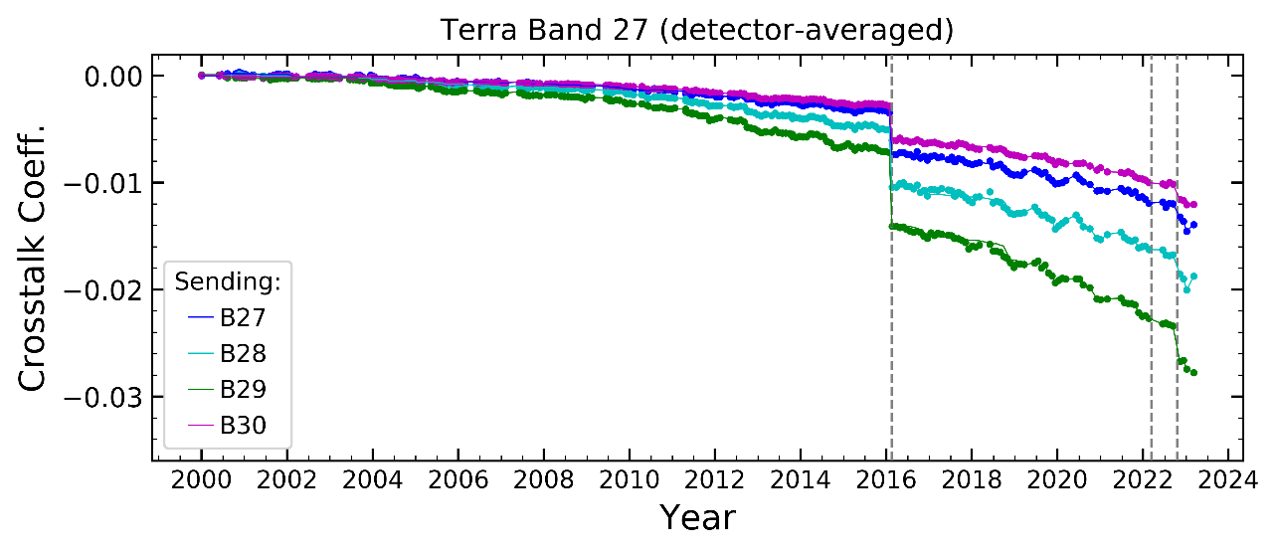
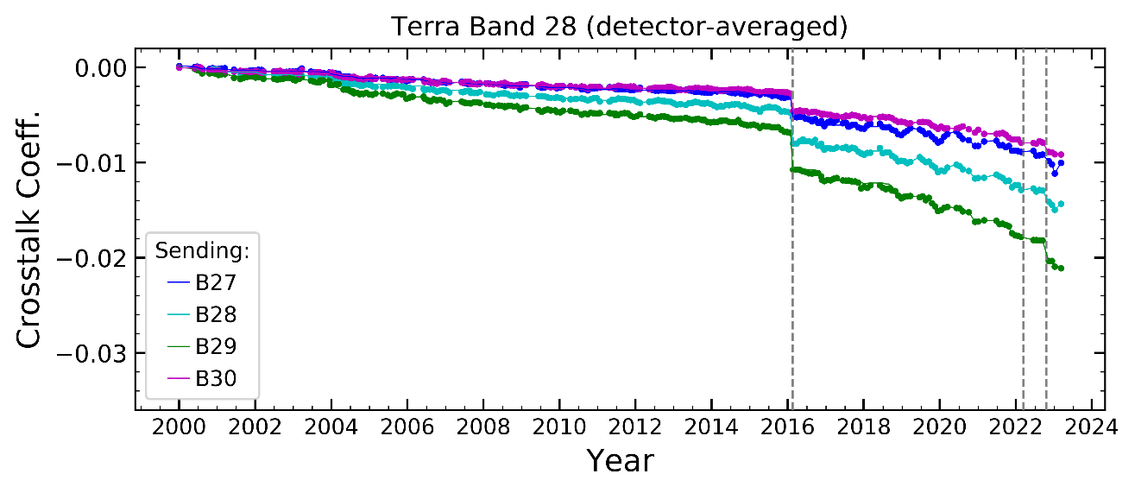
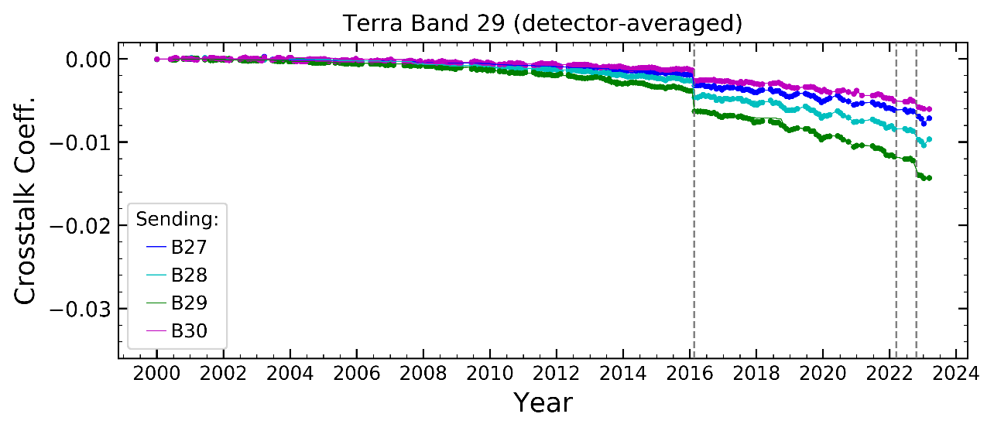
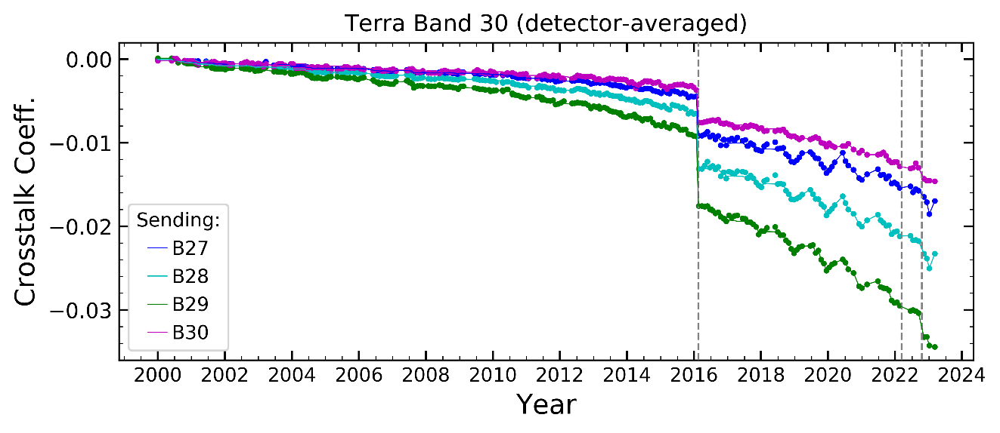
Terra PV LWIR Bands Cross-talk for C6.1/C7
These plots are sending band averaged coefficients
Dots are coefficients from scheduled lunar observation and the lines are the LUT coefficients
Safe mode (Feb 2016) caused the jump of the cross-talk.
Slightly drop after CEM Oct 2022

Slide 16
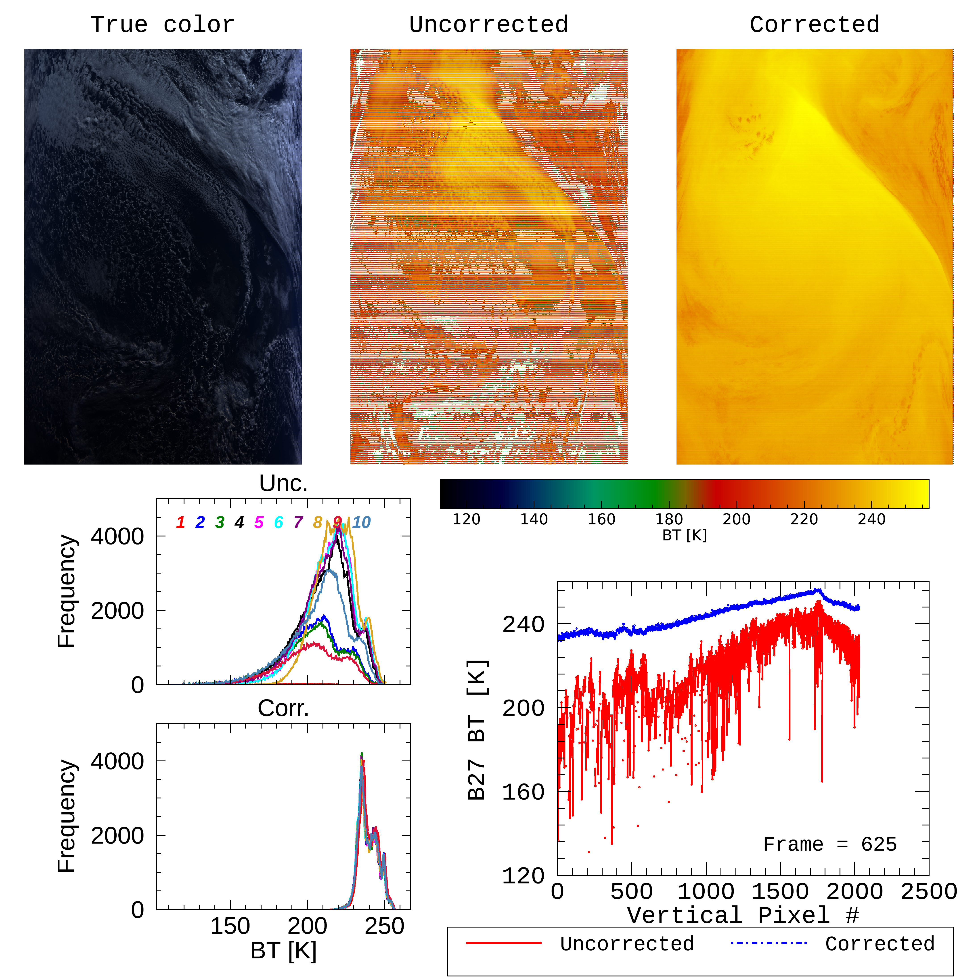
MODIS TEB electronic cross-talk corrections
Cross-talk corrections have been implemented in C6.1/C7 for Terra entire mission.
Correction example for Terra MODIS band 27 on 2022349.1145.
https://mcst.gsfc.nasa.gov/sites/default/files/meetings_files/2018_mcst_xtalk_workshop.pdf.

Slide 17
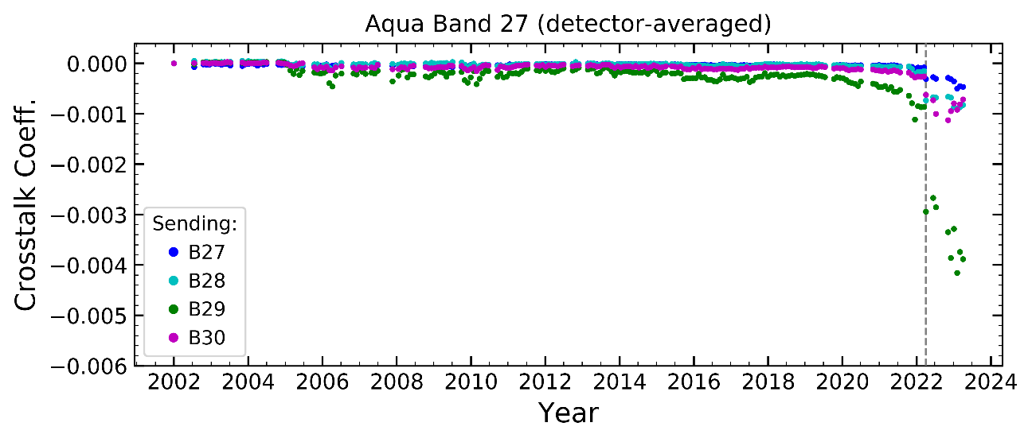
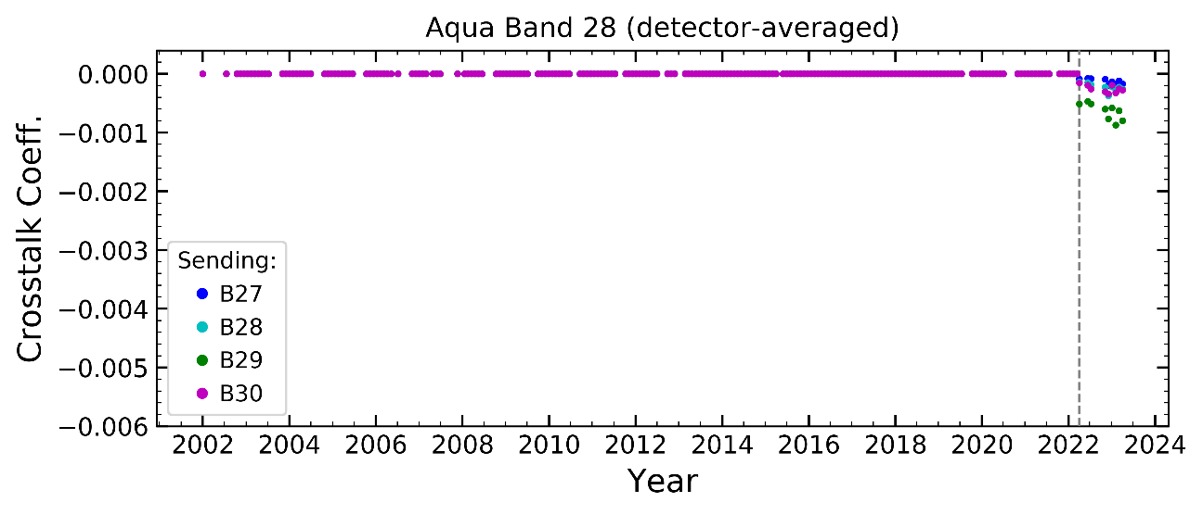
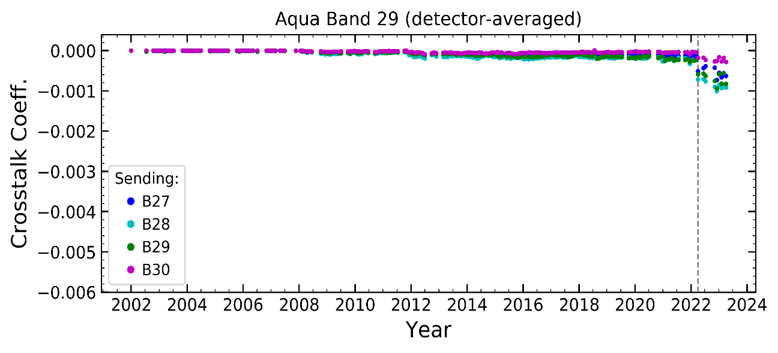
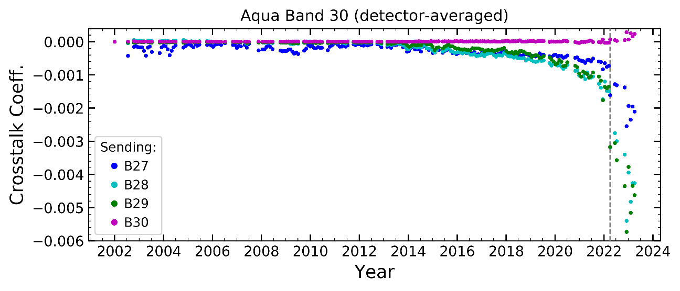
Aqua PV LWIR Bands Cross-talk
These plots are sending band averaged coefficients
Crosstalk correction applied to entire mission for C7 and to after safe mode for C6.1
Safe mode (March 2022) caused the changes of the cross-talk.

Slide 18
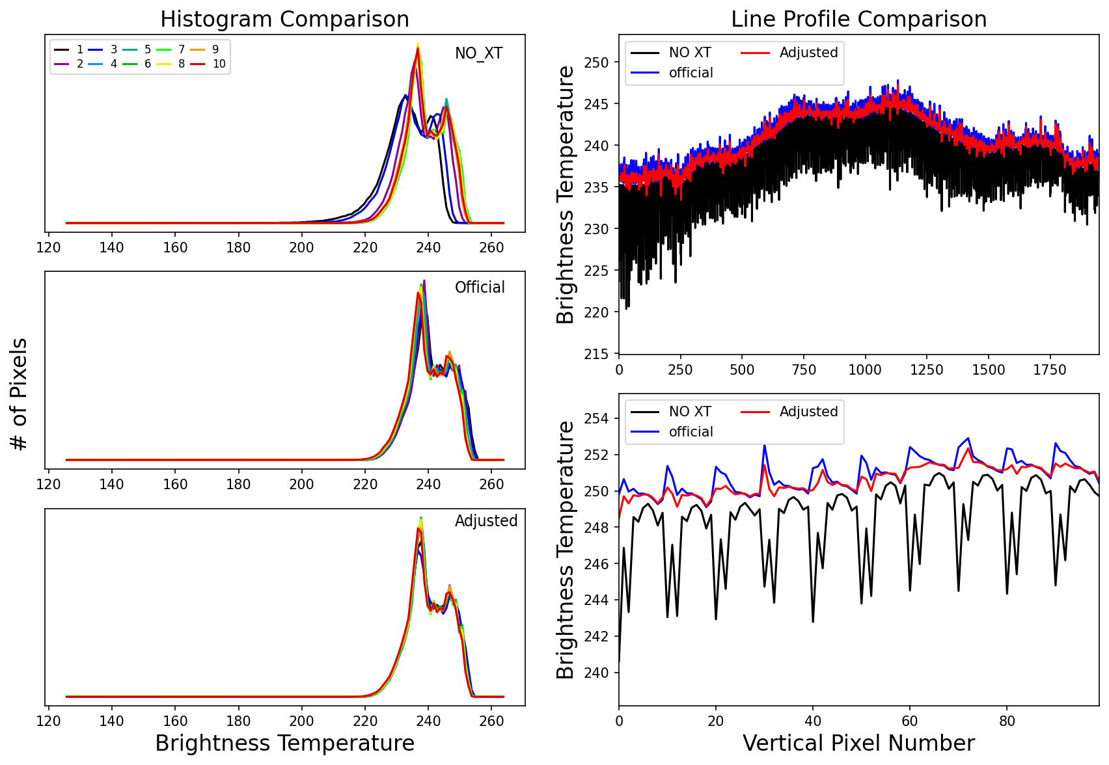
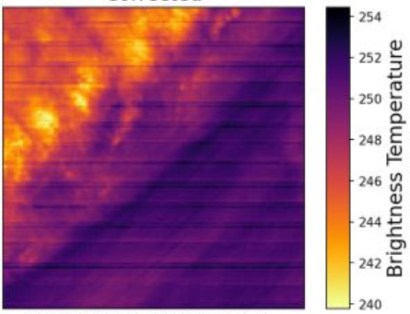
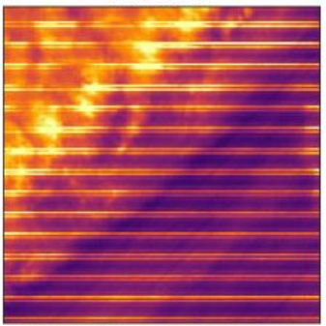
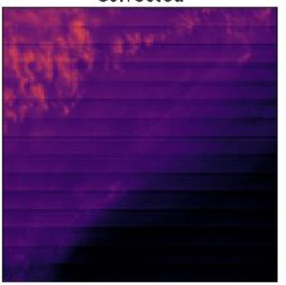
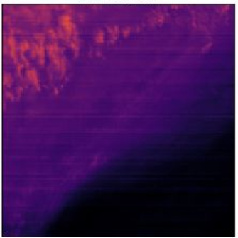
Aqua crosstalk coefficient adjustment and image quality
No correction
with correction with adjusted correction
No corr
w adj corr
w corr
No corr
w adj corr
w corr
No correction
With correction
With adjusted correction
Aqua PV LWIR crosstalk correction is applied to C7 and C6.1 for band 27 after safe mode March 2022.
The adjustment of the crosstalk correction using Earth measurement assessment enhance the L1B image quality
For details, see the poster “Aqua-MODIS TEB C7 electronic crosstalk correction and image quality enhancement”

Slide 19
C7 algorithm example (Terra trending)
a0 and a2 correction applied to Terra MODIS C7 for improvement on long-term stability
The qDCC (~200K) trending assessment for the mirror side difference for C6.1 (top) and C7 (bottom) for bands 29 and 30.
C6.1 C6.1
C7 C7

Slide 20
C7 algorithm example (Aqua mirror side difference)
Mission-long a0 correction applied to Aqua MODIS C7 for improvement on mirror side consistence
The qDCC (~200K) trending assessment for the mirror side difference for C6.1 (top) and C7 (bottom) for bands 20 and 27.
C6.1 C6.1
C7 C7
Reference: Chang, T., X. Xiong, A. Shrestha, and P. C. Diaz, "Methodology development for calibration assessment using quasi‐deep convective clouds with application to Aqua MODIS TEB", Earth and Space Science, vol. 7, issue 1, pp. 1-15, 2020.

Slide 21
Backup

Slide 22
MODIS TEB C6.1 and C7 algorithms comparison
MODIS TEB C6.1 calibration algorithm
MODIS TEB C7 calibration algorithm
Band | Aqua | Terra
 | Calibration algorithm | Calibration algorithm | Cross-talk correction
20 | PL a₀ PL adjusted CD a₂ (CD: cooldown). | a_{0_ms1} = 0 a_{0_ms2} = a_{0_ms2}^{free-fit} – a_{0_ms1}^{free-fit} CD a₂
22
23
24
25
27 |  |  | PV LWIR electronic cross-talk
28
29
30
31 | a₀=0, CD a₂ | a₀ = 0 CD a₂
32 |  |  | PC LWIR optical cross-talk
33 | a₀=0 PL adjusted CD a₂
34
35
36
Band | Aqua |  | Terra
 | Calibration algorithm | Cross-talk correction | Calibration algorithm | Cross-talk correction
20 | PL a₀ with MS correction CD a₂ | Electronic cross-talk corrections for selected detectors | Corrected a₀; CD a₂ | Electronic cross-talk corrections for selected detectors
22 |  |  | a_{0_ms1} = 0 a_{0_ms2} = a_{0_ms2}^{free-fit} – a_{0_ms1}^{free-fit} CD a₂
23
24
25
27 | PL a₀ with MS correction 2012 CD a₂ | Electronic cross-talk corrections for all detectors with additional adjustment |  | PV LWIR electronic cross-talk
28
29 | Corrected a₀; CD a₂ |  | Corrected a₀; CD a₂
30 | MS Corrected a₀ ; 2012 a₂ |  | 2003 a₀a₂; a_{0_ms1} = 0
31 | Entire mission MS corrected a₀ CD a₂ |  | a₀ =0 CD a₂
32 |  |  |  | PC LWIR optical cross-talk
33 |  |  | Early mission: MS corrected a₀ Since 2003: a₀ =0 CD a₂
34
35
36

