Slide 1
S-NPP, N-20, and N-21 VIIRS Reflective Solar Bands
On-orbit Radiometric Calibration and Performance
VIIRS Characterization Support Team (VCST), NASA GSFC
(presented by Ning Lei)
May 1, 2023
1

Slide 2
Objectives
Radiometric calibration improvements since last STM (Feb. 2021)
RSB radiometric performance update
Future works
2

Slide 3
What happened since STM 2021
Safe mode occurred in July 2022 led to F-factor trending change for many
RSBs
Developed TOA reflectance factor uncertainty algorithm
Improved L1B pixel saturation detection
S-NPP
Sliding window (in time) approach, using F(moon): same approach employed by S-NPP
Improved L1B pixel saturation detection
N-20
N-21
Launched on Nov. 10, 2022
First mission RSB F-factor LUTs delivered with screen functions derived
from calibration data collected on yaw maneuver orbits
3

Slide 4
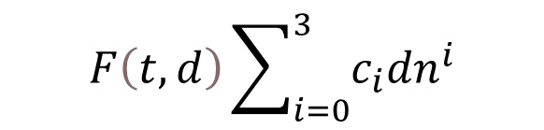
VIIRS RSB calibration
Spectral radiance
$$F\left(t,d\right)\sum_{i=0}^{3}{c_{i}{dn}^{i}}$$
on-orbit calibrated
SDSM screen
RTA
SDSM
sunlight
Space view
SD screen
Solar Diffuser (SD)
Solar Diffuser (SD): a calibration source; its BRDF change (H-factor) measured by the SD stability monitor (SDSM)
4

Slide 5
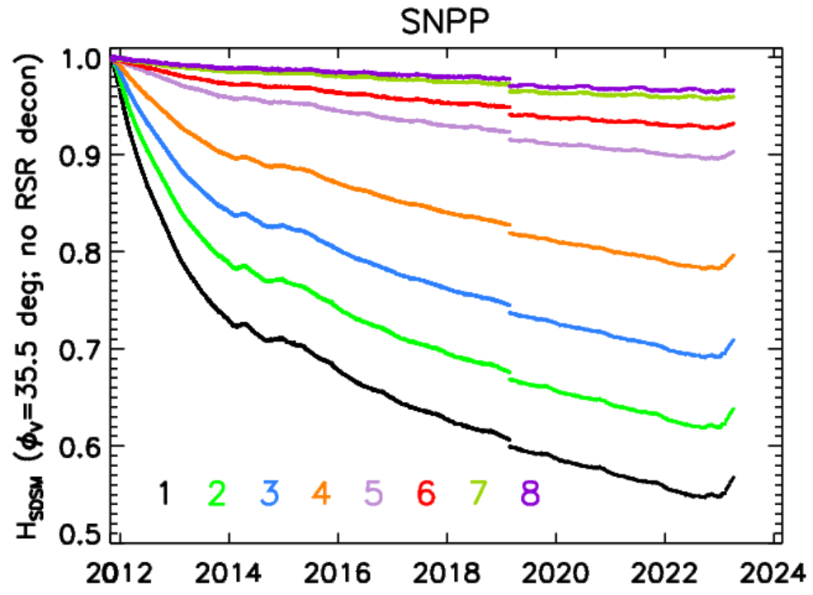
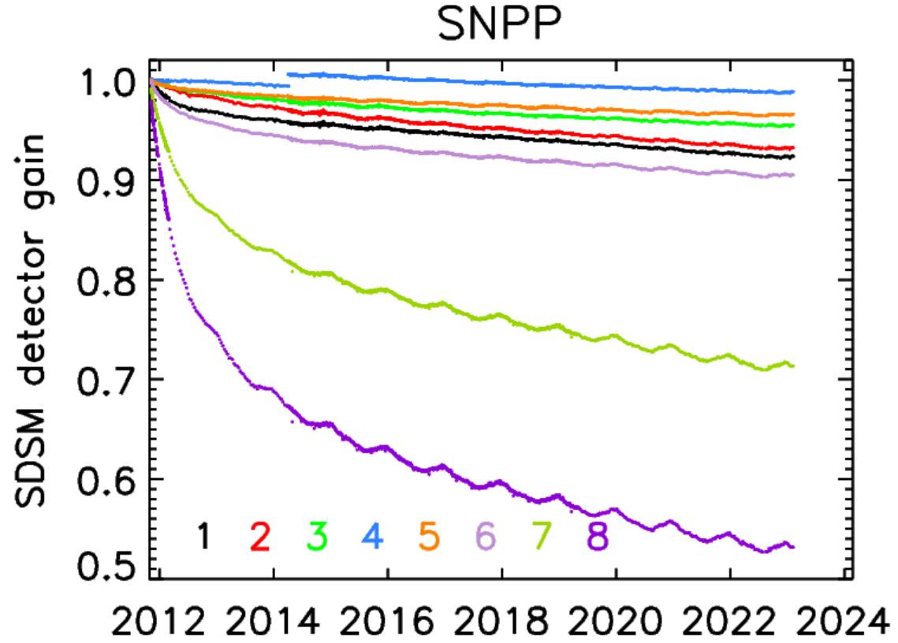
Performance of S-NPP SD and SDSM
SDSM detector gains trend normally
H-factors dropped by about 1% due to the Feb. 24, 2019 event
Recently, H-factors trend upwards (det 1-5), because of unusual solar activity impact on SD, also occurring for N20 and MODIS SDs
5

Slide 6

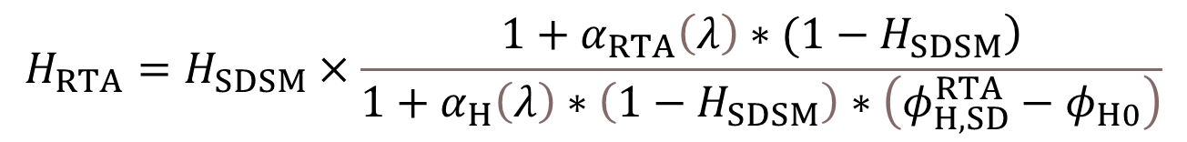



Calculate F(SD)
S-NPP and N-20
$$H_{RTA}=H_{SDSM}×\frac{\left.1+α_{RTA}\left(λ\right)∗(1−H_{SDSM}\right)}{1+α_{H}\left(λ\right)∗\left(1−H_{SDSM}\right)∗\left(φ_{H,SD}^{RTA}−φ_{H0}\right)}$$
Solar azimuth angle
$$α_{RTA}$$
and
$$α_{H}$$
obtained from fitting F(SD) to F(Moon)
Use a sliding window (in time) approach, fit F(H_{RTA}) to F(Moon) to find
$α_{RTA}$
$${and α}_{H}$$
N-21
Not enough F(Moon) available to fit; choose to use the measured H_{SDSM} (no deconvolution)
6

Slide 7
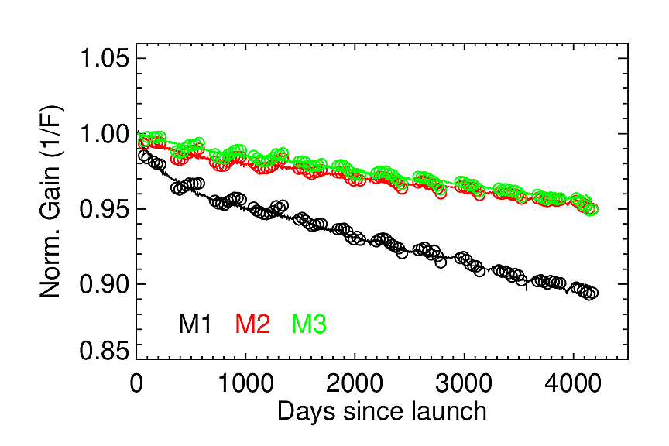
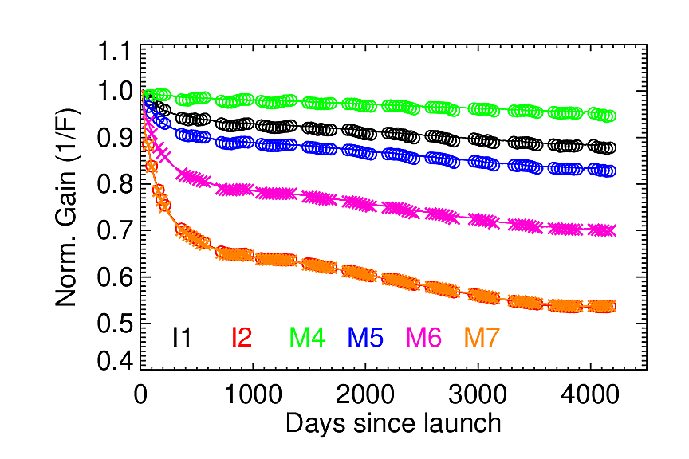
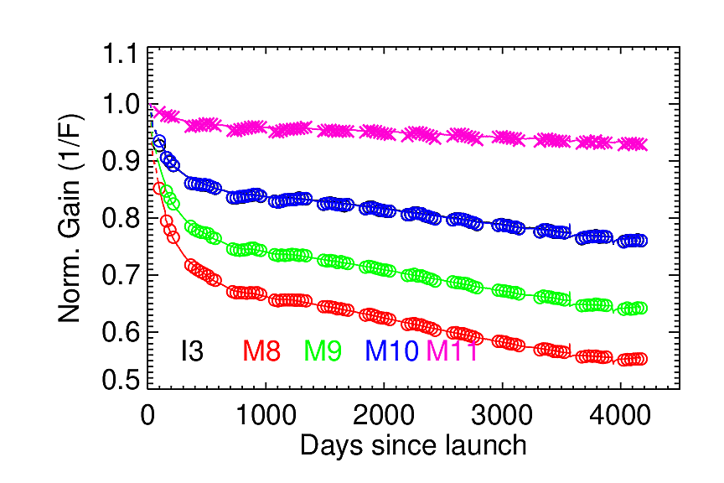
S-NPP RSB 1/F-factors
Solid lines: 1/F(SD); Circles: 1/F(Moon)
F decreases with time, because of telescope mirror surface tungsten oxide contamination

Slide 8
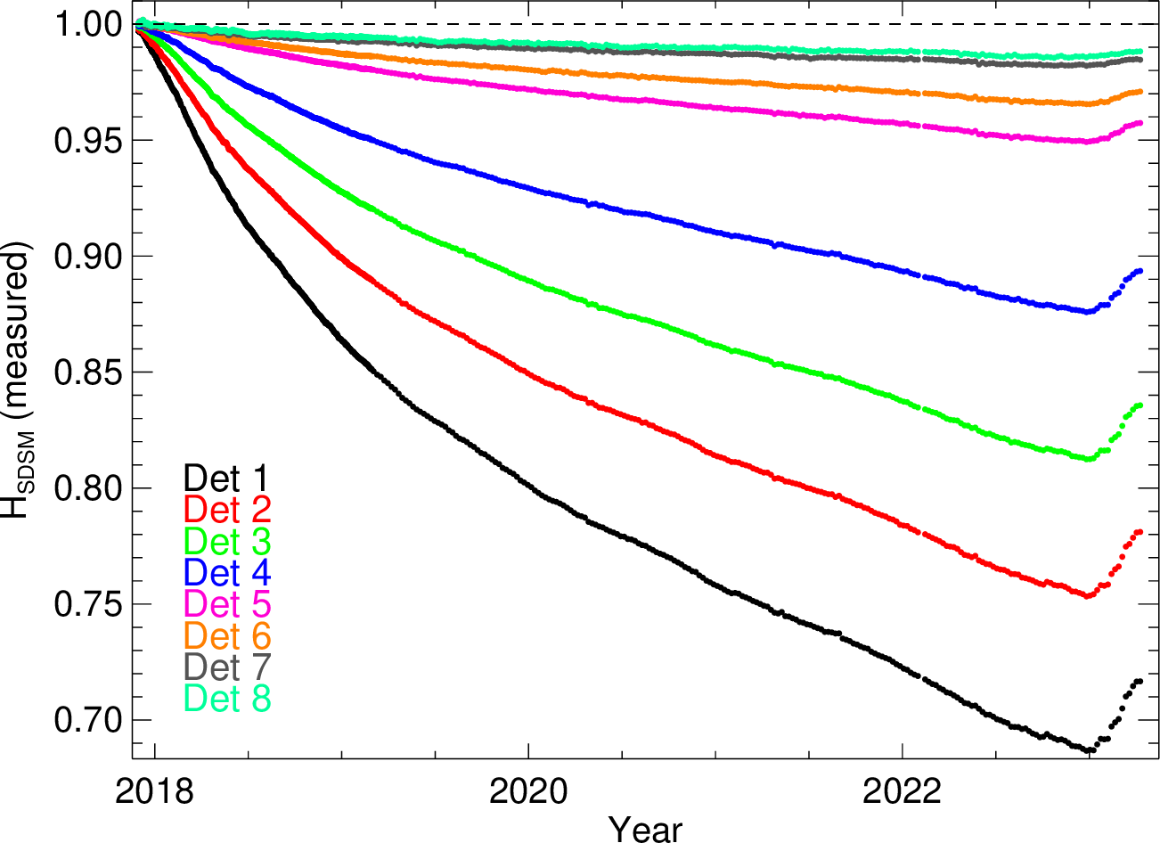
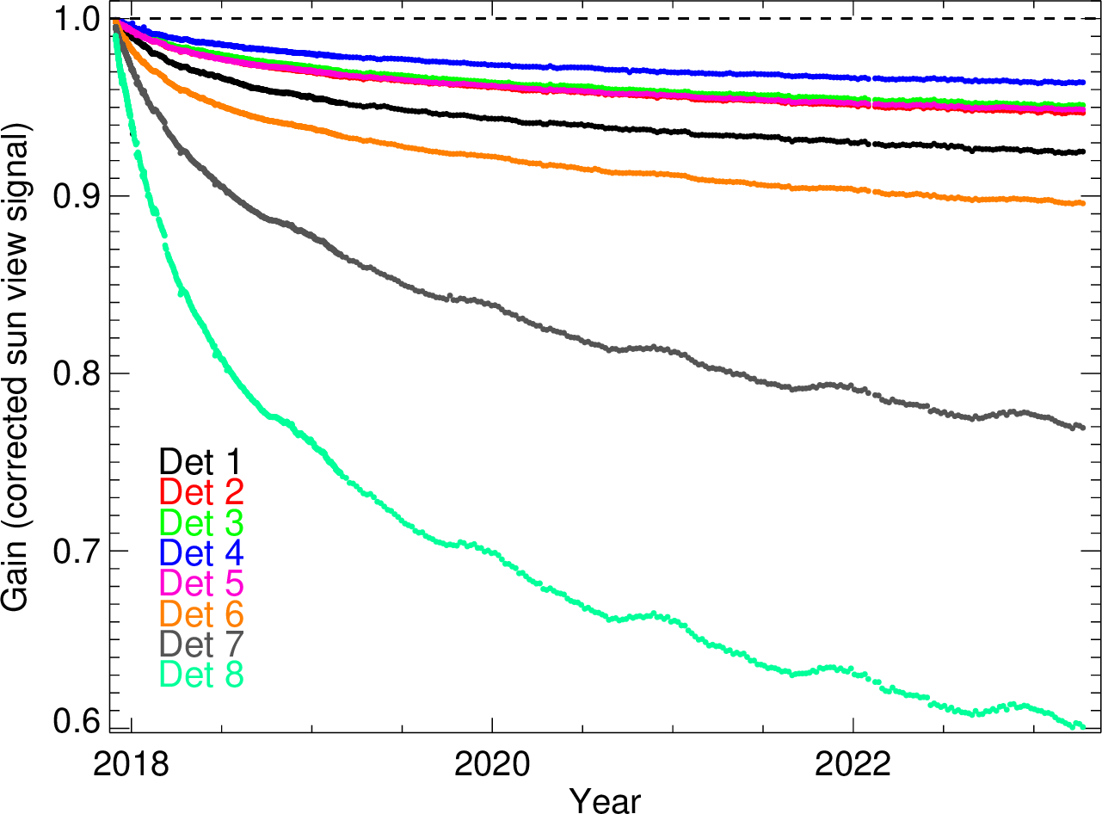
Performance of N-20 SD and SDSM
N-20 H-factors
N-20 SDSM Detector Gains
H-factors decrease at smaller rates than S-NPP H-factors
SDSM gains decrease similarly to S-NPP
Notes:
8
SDSM_Hplot_V4aeroX.20150629

Slide 9
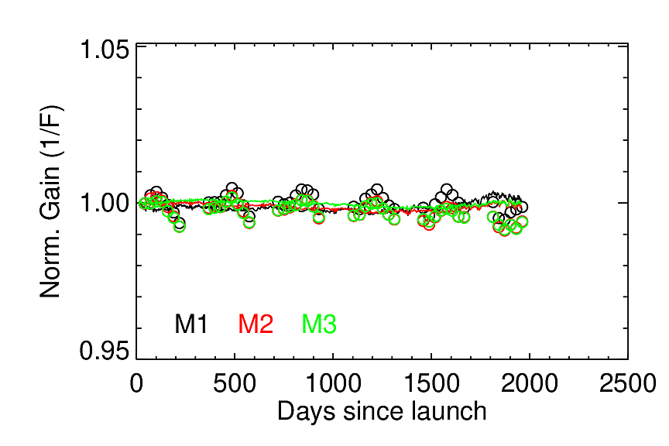
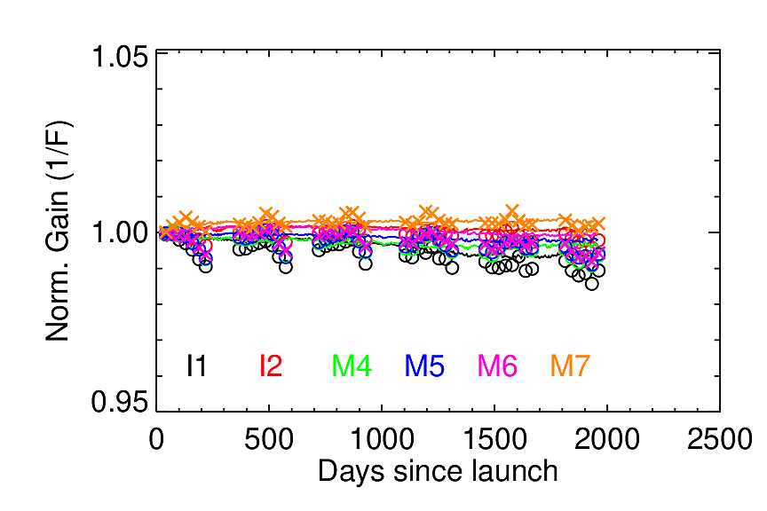
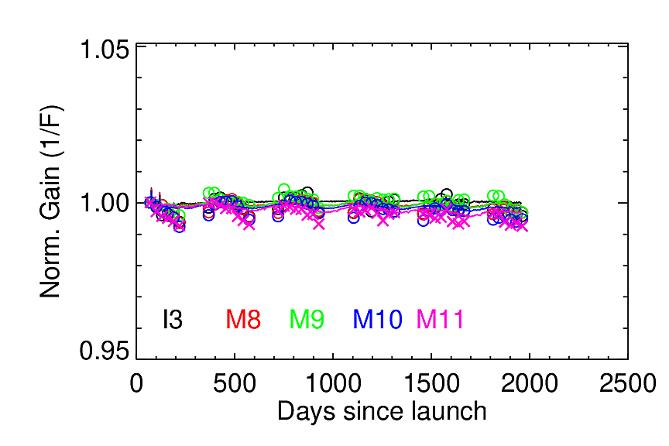
N-20 RSB 1/F-factors
Solid lines: 1/F(SD); Circles: 1/F(Moon)
F-factors are very stable over mission

Slide 10
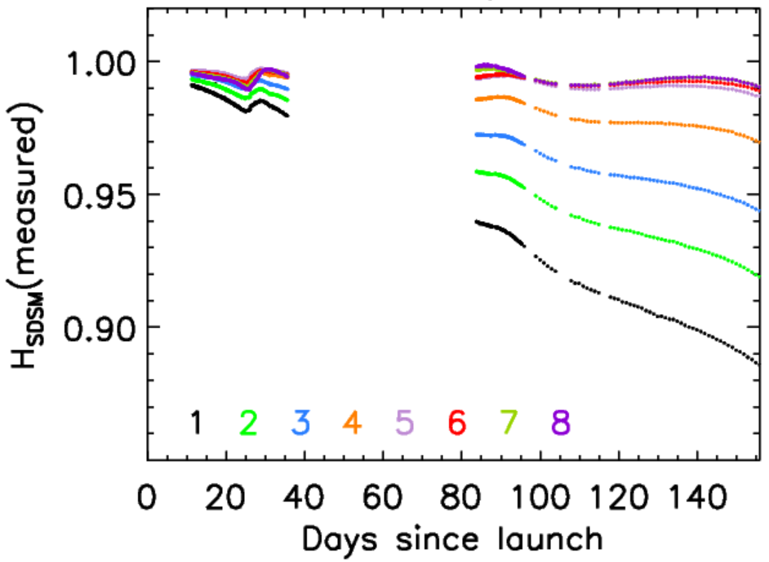
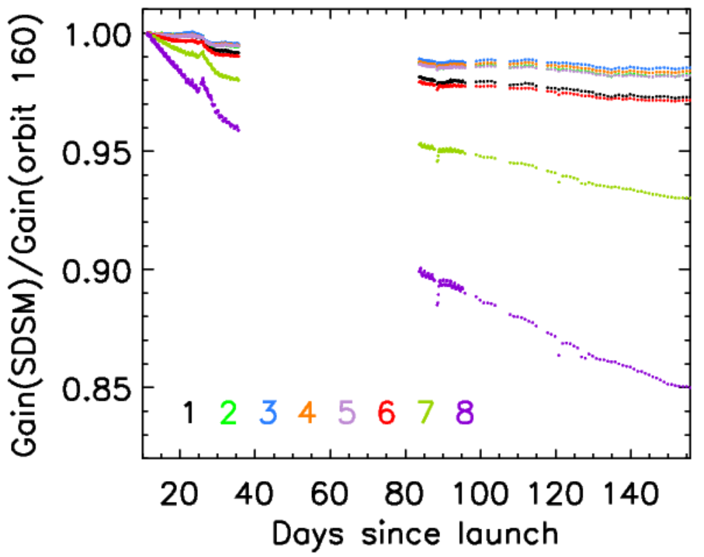
Performance of N-21 SD and SDSM
N-21 H-factors
N-21 SDSM Detector Gains
H-factors decrease faster than N-20 and similarly to S-NPP H-factors
SDSM gains decrease similarly to S-NPP and N-21
Undulation in the H mainly from screen function errors (will be improved
later this year)
Notes:
10
SDSM_Hplot_V4aeroX.20150629

Slide 11
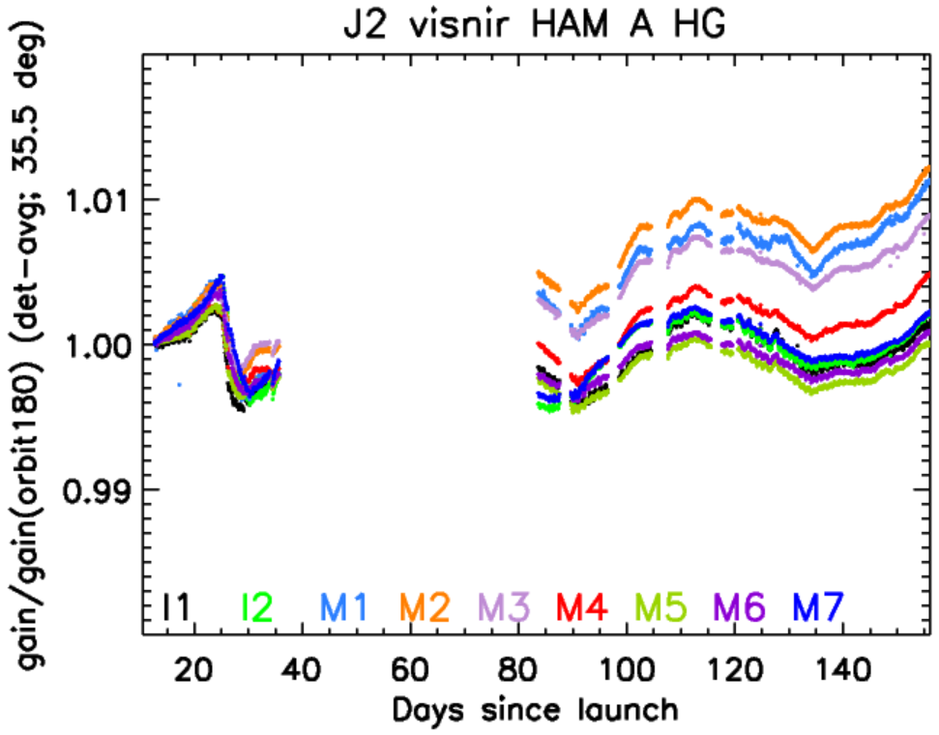
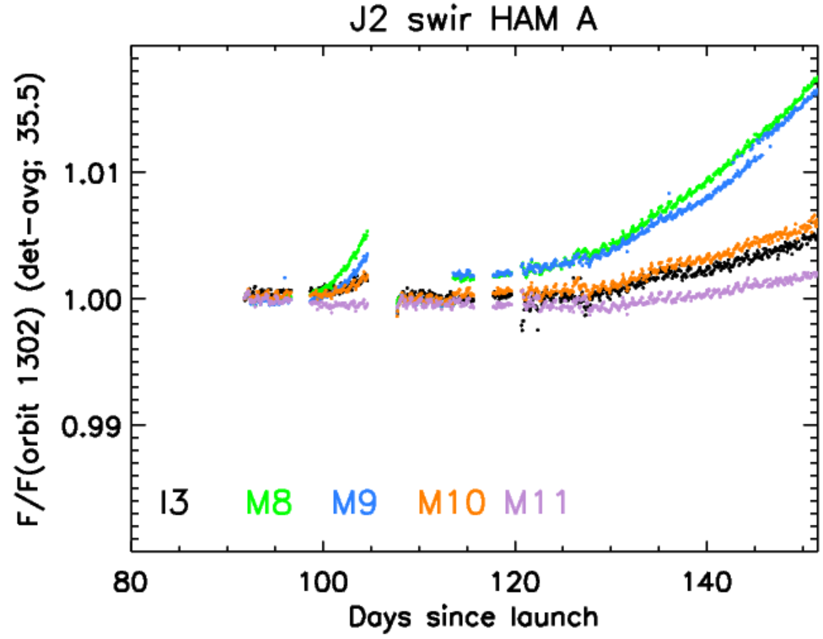
Performance of N-21 RSBs: F-factors
Mid-mission outgassing
VISNIR bands: F(SD, with measured H_{SDSM} ) has a downward trend
SWIR bands: F(H=1) trends upwards, likely because of ice accumulation on focal plane

Slide 12
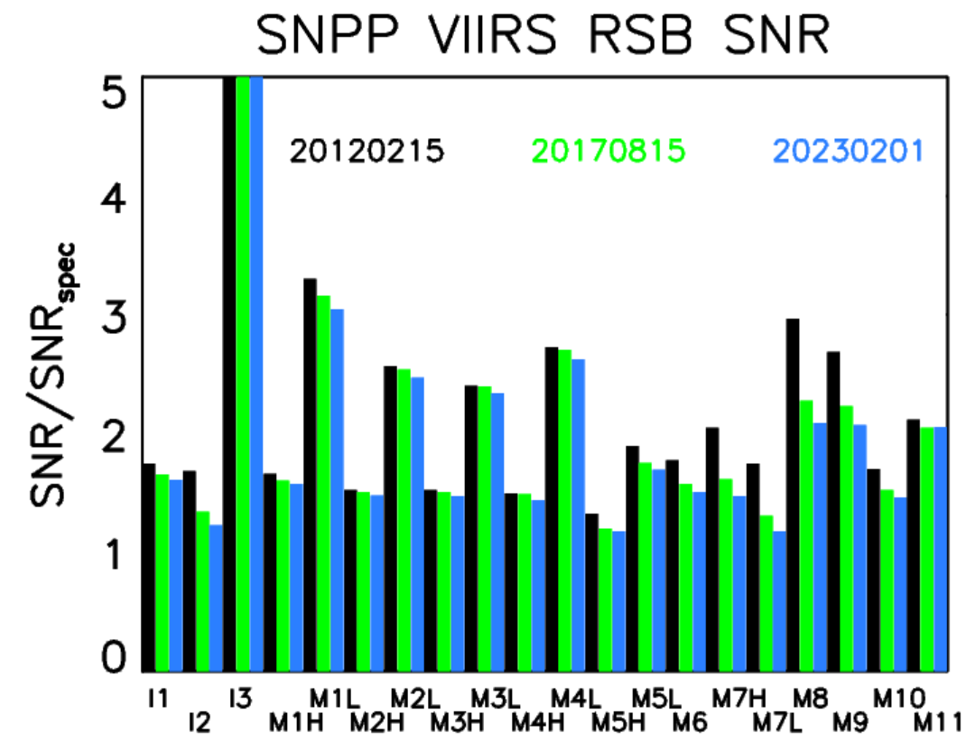
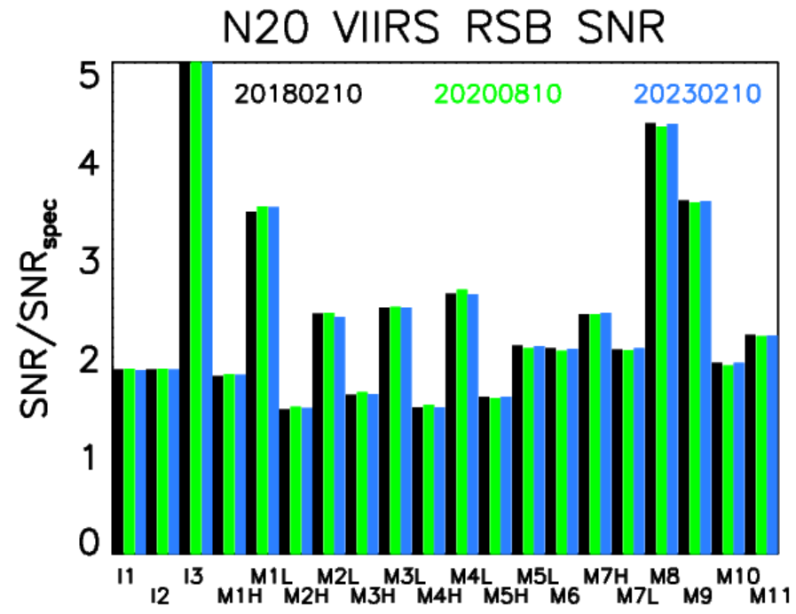
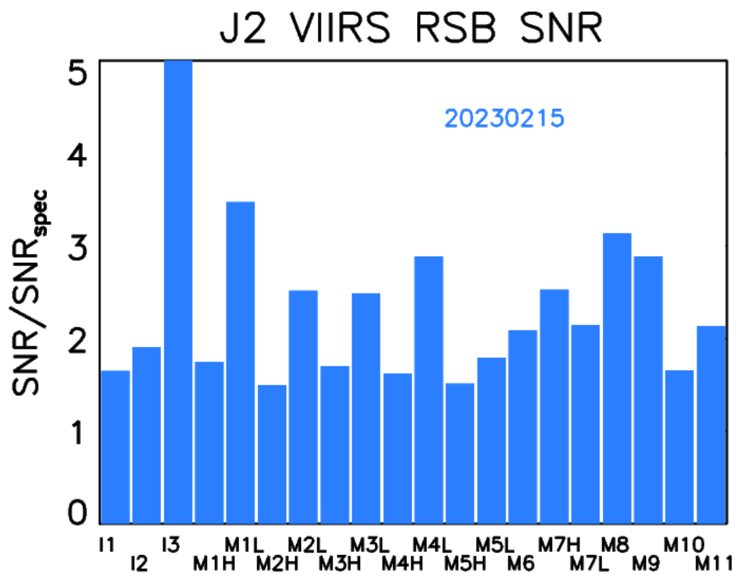
SNRs
All SNRs satisfy requirements, except N-20 I3 band detector 29 (noisy detector)

Slide 13
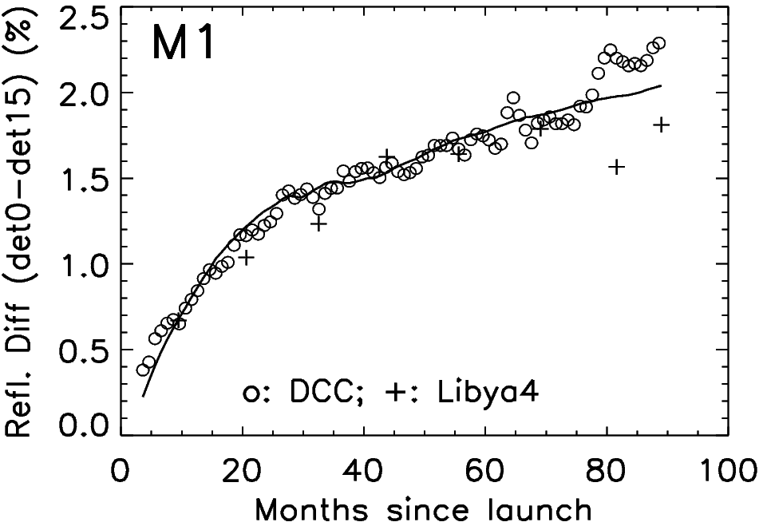

S-NPP H-factor SD positional dependence
SD BRDF change factor (H-factor) can depend on SD position
model parameters
$$H_{RTA}\left(λ, t, φ_{H,SD}^{RTA},{\vec{r}}_{d}\right)=$$
$$H_{RTA}\left(H_{SDSM}\left(λ,t\right),φ_{H,SD}^{RTA}\right)×\left[1+c_{d,1}\left(d−d_{mid}\right)+c_{d,2}\left(d−d_{mid}\right)×\left(1−H_{SDSM}\left(λ,t\right)\right)\right]$$
detector array
13

Slide 14
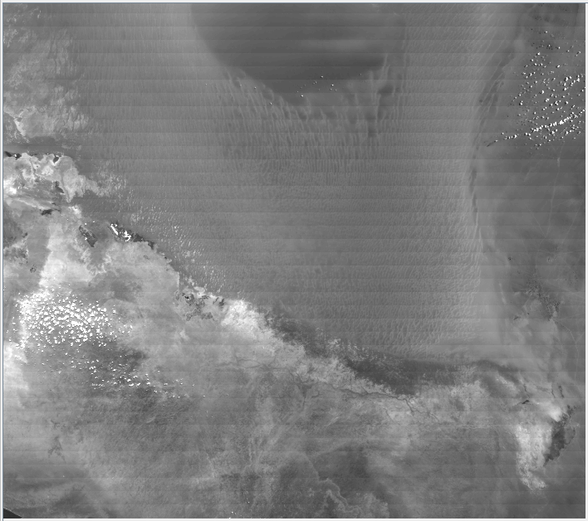
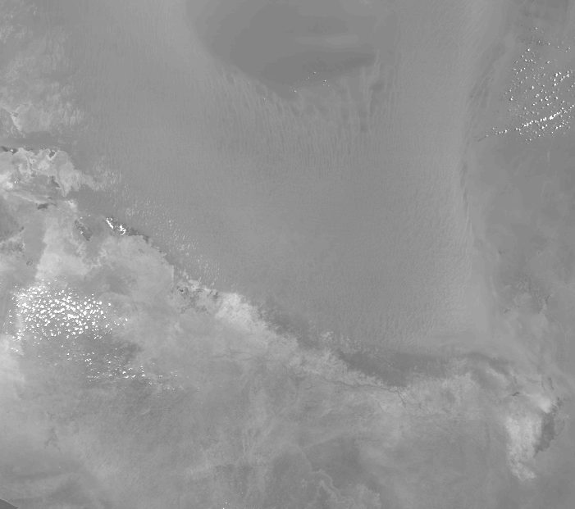
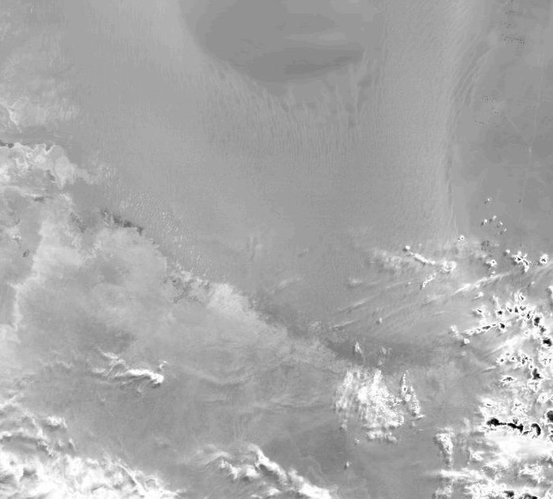
S-NPP TOA images
2019229
2019229
March 2023
M1 striping (C1.1)
M1 striping gone (C2.0)
No striping seen (C2.0)
H-factor SD positional dependence algorithm (2017) and results (2018) are still good

Slide 15
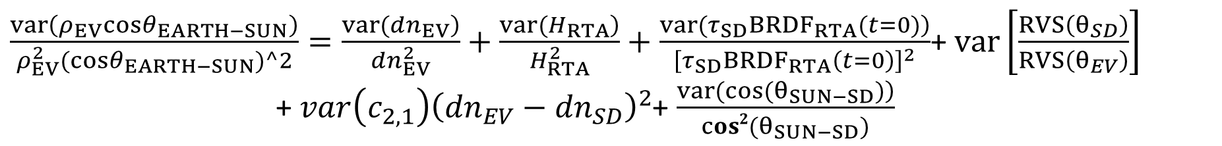
Uncertainty of TOA reflectance factor
Derive reflectance factor uncertainty from definition
$\frac{var\left(ρ_{EV}cosθ_{EARTH−SUN}\right)}{ρ_{EV}^{2}(cosθ_{EARTH−SUN})^2}=\frac{\left.var({dn}_{EV}\right)}{{dn}_{EV}^{2}}+\frac{\left.var(H_{RTA}\right)}{H_{RTA}^{2}}+\frac{\left.var(τ_{SD}{BRDF}_{RTA}(t=0)\right)}{{\left[τ_{SD}{BRDF}_{RTA}\left(t=0\right)\right]}^{2}}$+ $var\left[\frac{RVS\left(θ_{SD}\right)}{RVS\left(θ_{EV}\right)}\right]$
+ $var\left(c_{2,1}\right){\left({dn}_{EV}−{dn}_{SD}\right)}^{2}$+ $\frac{\left.var(cos⁡(θ_{SUN−SD})\right)}{cos2(θ_{SUN−SD})}$
Uncertainty LUTs are generated for L1B code for S-NPP and N-20
Reference: VCST_TECH_REPORT_2022_009

Slide 16
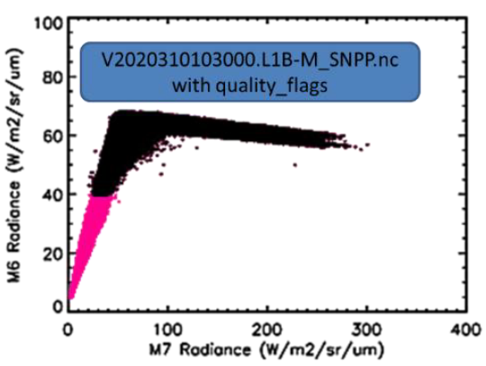
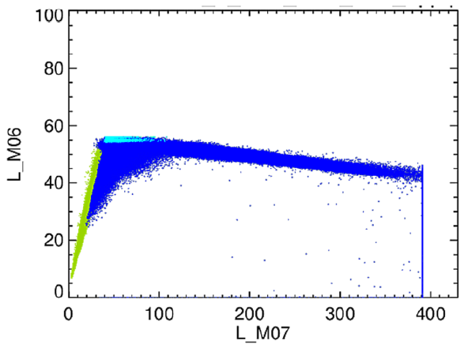
Improvement in detecting saturation/rollover
Original rollover flagging (black dots)
Current rollover flagging (black dots)
Use neighboring band radiance as a reference, in additional to its own radiance
Reference: A. Angal et al., SPIE Proc. Vol. 12232 (2022)

Slide 17
Future works
  1. N-20 RSB striping mitigation
  2. Improve N-21 screen functions with data collected at both yaw
  maneuvers and regular orbits
  3. S-NPP M6 saturation flagging

Slide 18
Summary
S-NPP, N-20, and N-21 VIIRS RSBs perform normally with SNRs satisfying specifications (except N-20 I3 detector 29) and will remain above specifications for the foreseeable future
Used N-20 RSB F(moon) to find H_{RTA} from H_{SDSM}, instead of using S-NPP H_{RTA} results, a sliding window approach
Developed L1B reflectance uncertainty algorithm, delivered uncertainty LUTs
Improved saturation detection algorithm

