Slide 1
SNPP, NOAA20 and 21 VIIRS RSB calibration performance and inter-comparison assessment
VIIRS Characterization Support Team, NASA GSFC
(presented by Aisheng Wu)
MODIS and VIIRS Calibration Workshop, College Park, MD, May 1, 2023

Slide 2
VIIRS RSB
Band | CW (nm) | BW (nm)
M1 | 412 | 20
M2 | 445 | 18
M3 | 488 | 20
M4 | 555 | 20
M5 | 672 | 20
M6 | 746 | 15
M7 | 865 | 39
M8 | 1240 | 20
M9 | 1378 | 15
M10 | 1610 | 60
M11 | 2250 | 50
I1 | 640 | 80
I2 | 865 | 39
I3 | 1610 | 60
Introduction
Methodology
Vicarious approaches (SNO, desert, Dome C and DCC)
Data: NASA SLIPS C2 L1B for SNPP and NOAA21
Results
Stability and inter-comparison
Summary

Slide 3
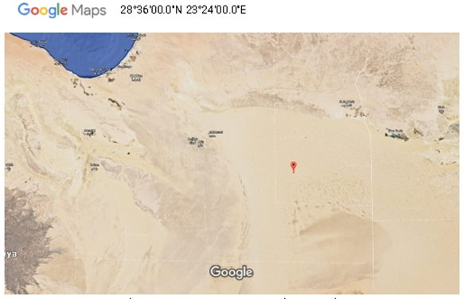
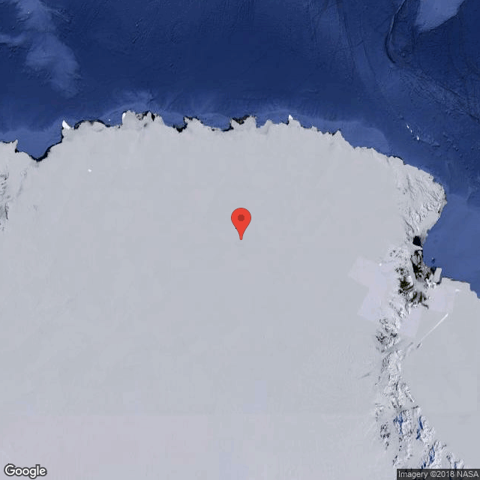
Vicarious approaches
Pseudo-Invariant Calibration Sites (PICS):
PICS approaches include desert (Libya 4) and Dome C
Near-nadir, 16-day repeatable orbits for Libya-4, daily overpasses for Dome C in Antarctic summer.
Target area of 25 x 25 km. Employ semi-empirical (desert) and empirical (Dome C) BRDF correction. BRDF coefficients derived initial years of on-orbit measurements
DCC approach
DCC pixels collected over western tropical Pacific. Mu et al. "Optimization of a Deep Convective Cloud Technique in Evaluating the Long-Term Radiometric Stability of MODIS Reflective Solar Bands", Remote Sensing, vol. 9 (6), issue 535, 2017.
Impact due to RSR differences: Correction applied based on SBAF derived using historic SCIAMACHY hyperspectral data
Libya 4
25 x 25 km
Dome C
3

Slide 4
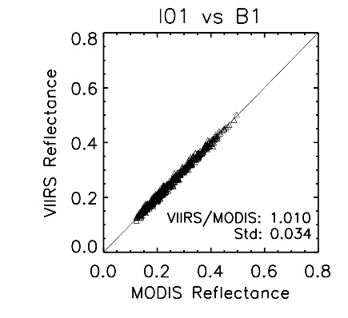
Vicarious approaches
Simultaneous Nadir Overpasses (SNO)
Aqua MODIS used as a transfer radiometer for SNPP, NOAA20/21 intercomparison. TOA reflectance ratio between VIIRS/MODIS from high-latitude SNO (<3 minutes, two-line element), one SNO every 3-4 days
No BRDF correction applied
Correction for RSR mismatch based on a scene-averaged SCIAMACHY hyperspectral profile over typical high-latitude
Larger uncertainties in some SWIR bands (compared to the VIS/NIR bands) likely due to their high sensitivity to atmospheric conditions
Pixel-by-pixel match from SNO on Oct 8, 2019

Slide 5
Spectral band adjustment factor (SBAF)*
SBAF between NOAA20 and 21 RSB
Band | M1 | M2 | M3 | M4 | M5 | M7 | I1 | I2 | M8 | M10 | I3
Desert | 0.9966 | 0.9987 | 0.9995 | 0.9933 | 1.0073 | 0.9957 | 0.9983 | 0.999 | 0.9892 | 0.9925 | 0.9947
Snow | 0.9974 | 0.9999 | 1.0009 | 1.0018 | 1.0009 | 0.9923 | 1.0001 | 0.9988 | 1.0029 | N/A** | N/A
Ocean | 0.9969 | 0.9987 | 1.0033 | 1.008 | 0.9901 | 0.9902 | 1.0056 | 0.9959 | 0.9997 | N/A | N/A
Cloud | 0.9974 | 0.9996 | 1.0011 | 1.0043 | 1.0034 | 0.9954 | 0.9986 | 0.999 | 0.9944 | 0.9787 | 0.9763
*The SBAF correction is determined using historic hyperspectral observations from SCIAMACHY, one of ten instruments aboard of ESA's Environmental Satellite, ENVISAT
** Large variations (>3%) in SBAF for different scene types

Slide 6
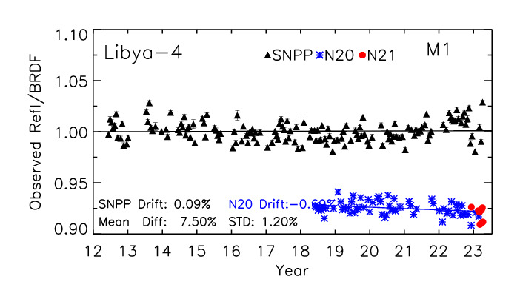
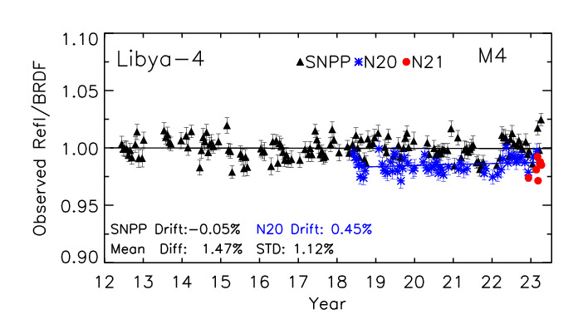
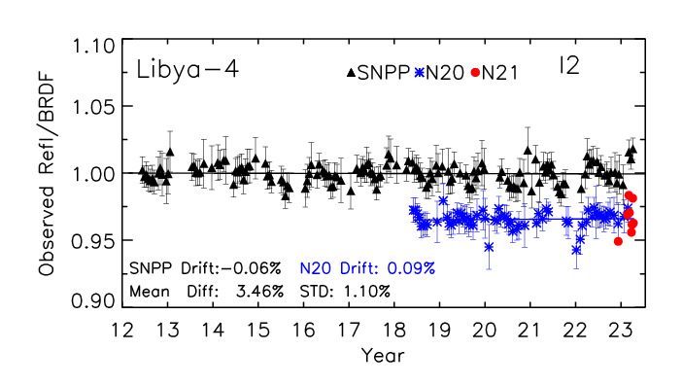
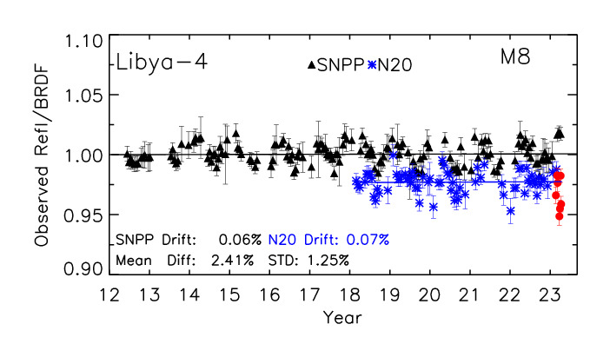
Reflectance trends over desert site
SNPP-based BRDF applied to both sensors
6

Slide 7
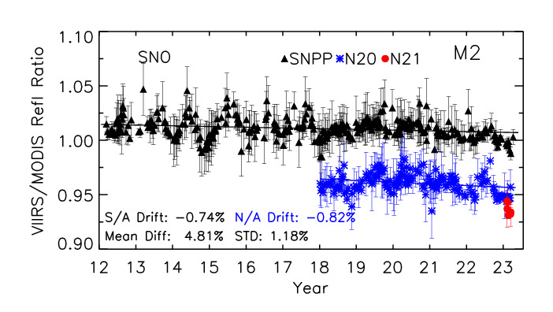
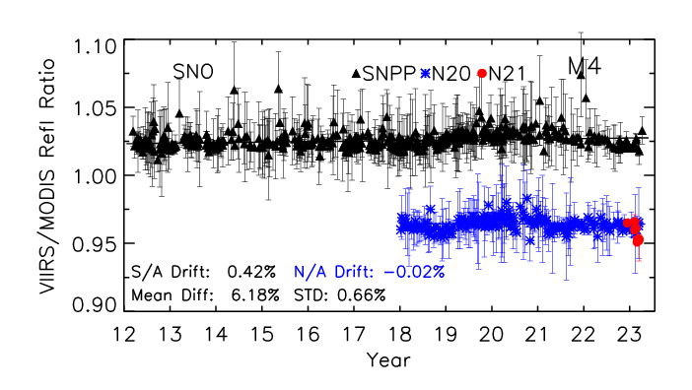
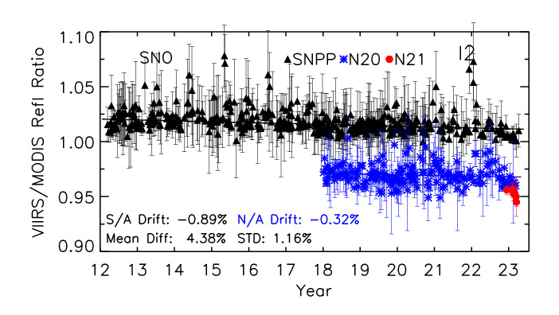
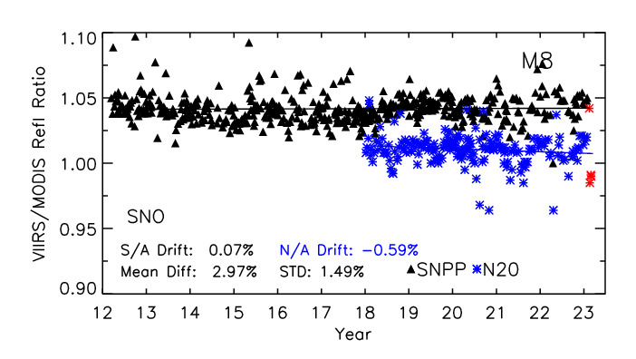
Reflectance ratio trends (VIIRS/Aqua MODIS)
7

Slide 8
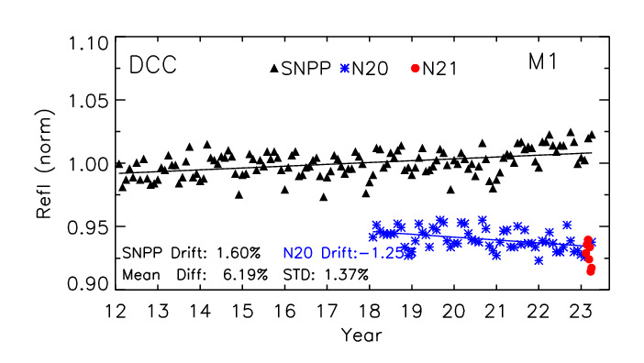
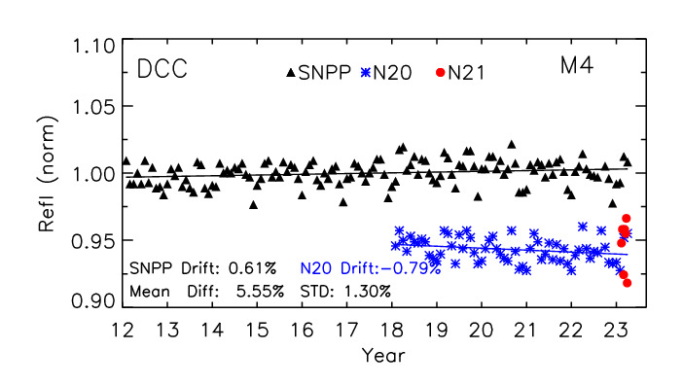
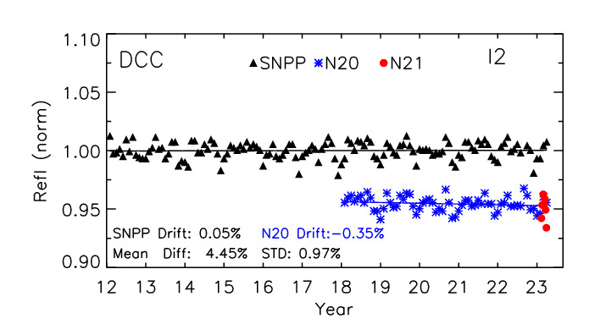
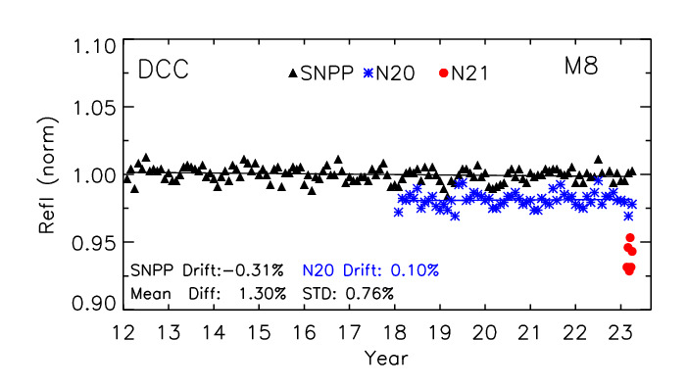
Reflectance trends over DCC
8

Slide 9
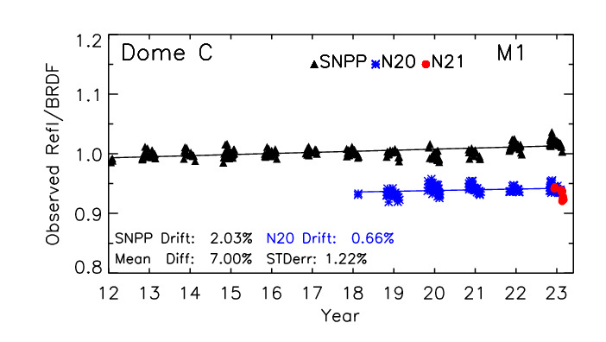
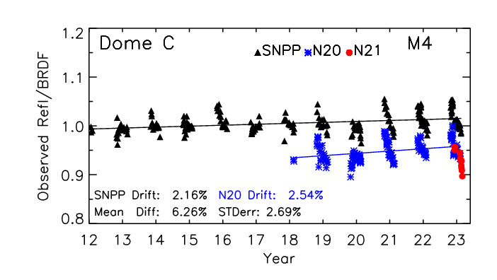
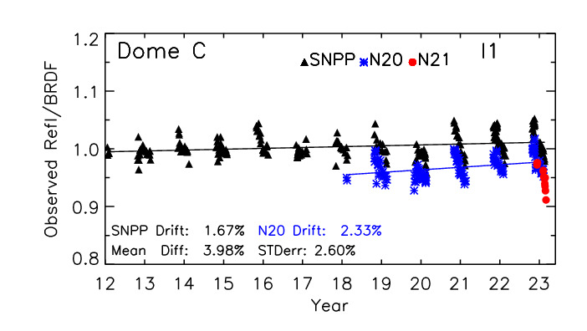
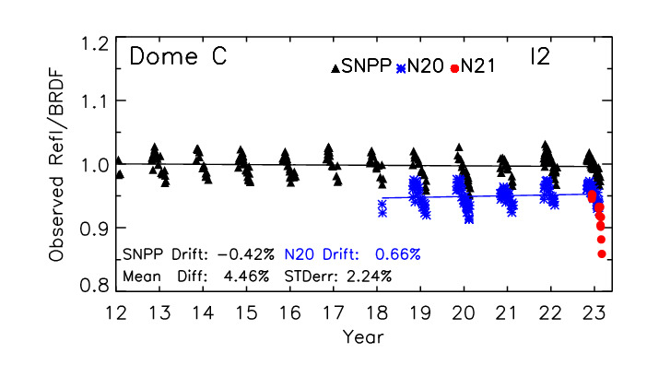
Reflectance trends over Dome C
SNPP-based BRDF applied to both sensors
9

Slide 10
SNPP, NOAA20 and NOAA21 VIIRS RSB comparison
SNPP-NOAA20 (black), NOAA20-NOAA21 (red), Results provided in percentage (%)
Band (µm) | M1 0.41 | M2 0.45 | M3 0.49 | M4 0.56 | M5 0.67 | M7 0.87 | M8 1.24 | M9 1.38 | M10 1.61 | M11 2.25 | I1 0.64 | I2 0.87 | I3 1.61
Libya4 | 7.5 1.0 | 6.3 1.6 | 4.4 0.0 | 3.3 2.1 | 4.5 -1.7 | 2.7 -0.3 | 2.4 0.9 |  | 1.8 3.1 | 1.7 2.3 | 2.9 -1.1 | 2.6 -1.0 | 3.0 0.5
DCC | 6.7 1.3 | 5.3 1.6 | 5.6 2.5 | 6.8 -0.4 | 5.0 -0.1 | 4.8 0.8 | 1.8 4.3 | 0.6 7.4 | 0.3 0.4 | 1.9 5.5 | 4.4 -0.3 | 5.4 0.4 | 2.5 -0.5
Dome C | 8.3 2.1 | 6.7 2.4 | 5.0 0.9 | 4.7 0.1 | 5.1 2.0 | 2.4 0.9 |  |  |  |  | 3.3 0.9 | 2.6 1.2
Aqua SNO | 6.6 1.2 | 5.9 1.7 | 4.3 1.6 | 5.2 0.6 | 4.9 -0.3 | 3.2 0.8 | 2.9 0.9 |  | 3.0 1.7 | 4.6 5.1 | 3.2 0.9 | 3.0 0.8 | 3.9 1.2
*Results from NOAA21 VIIRS are preliminary based on Libya 4, Dome C and SNO approaches
RSR correction for NOAA21 is based on those from NOAA20
10

Slide 11
Summary
Assessment of calibration consistency among SNPP, NOAA20 and 21 VIIRS RSB is based on vicarious approaches (SNO, desert, Dome C and DCC)
While SNPP and NOAA20 have a stability within 2% over the mission, it shows that the NOAA20 reflectances are systematically lower than SNPP by about 4 to 7% for bands M1 to M3 (shortest wavelengths) and 2-4% for the rest bands.
Initial comparison shows that the NOAA21 VIIRS reflectances are consistent with NOAA20 to within 2% for VIS/NIR. Impacts of the spectral differences based the SBAF analysis indicate they are within 0.5% (VIS/NIR) for most scene types. For SWIR bands, large inconsistent (>5%) results are observed.
Comparison results indicate that agreement among the different approaches are up to 2.0%, indicating errors due to limitation of each approach.
11

