Slide 1
VIIRS TEB Calibration and Performance
VIIRS Characterization Support Team, NASA GSFC
(presented by Amit Angal)
MODIS/VIIRS Calibration Workshop (May 1, 2023)
Notes:
1

Slide 2
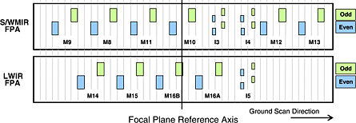
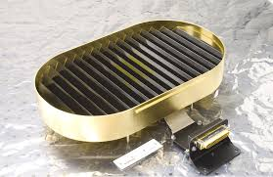
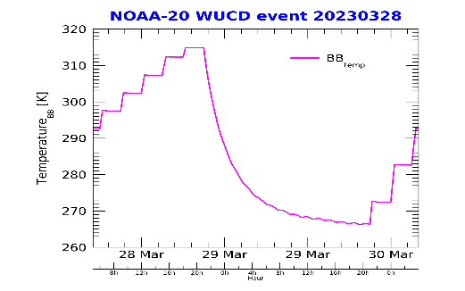
Overview
TEBs are calibrated using on-board calibrator (OBC) black body (BB)
Calibration performed on a per-scan basis using the OBC-BB
Nominal temperature maintained at 292.5 K
Warm-up and cooldown (WUCD) events are performed to fully characterize TEBs detector response and derive the offset and non-linear terms in the calibration algorithm
WUCD temperature range: ambient to 315 K
Stable trends observed in the derived offset and non-linear coefficients on-orbit
Event frequency:
Launch → 06/2018 (quarterly) [SNPP-VIIRS]
06/2018 → present (annually) [applies to each VIIRS]
Number of WUCD events to date: 32 (S-NPP) , 9 (N20), and 2 (N21)
TEB | 375 m |  | 750 m
 | I4 | I5 | M12 | M13 (D.G.) | M14 | M15 | M16
λ [μm] | 3.74 | 11.45 | 3.70 | 4.05 | 8.55 | 10.76 | 12.01
OBC-BB and an example of the WUCD cycle
2

Slide 3
TEB Calibration Methodology
VIIRS Earth view (EV) radiance is retrieved following the ATBD,
where the $ΔL_{bg}\left(B,θ\right)$ is the background difference between the EV and space view (SV) path:
The F-factor is derived on a scan-by-scan basis and is band-, detector-, and HAM side-dependent:
$$L_{EV}\left(B,θ\right)=\frac{F\left(B\right)\sum_{i=0}^{2}{c_{i}}\left(B\right){dn}^{i}\left(B\right)−ΔL_{bg}\left(B,θ\right)}{RVS\left(B,θ\right)},$$
B: band θ : angle-of-incidence dn: detector response c_{i}: calibration coeffs derived from prelaunch characterization.
$$ΔL_{bg}\left(B,θ\right)=\left(RVS\left(B,θ\right)−{RVS}_{SV}\left(B\right)\right)\left[\frac{\left(1−ρ_{RTA}\left(B\right)\right)}{ρ_{RTA}\left(B\right)}L_{RTA}−\frac{1}{ρ_{RTA}\left(B\right)}L_{HAM}\right].$$
ρ: reflectance
L_{ap}: aperture radiance
RTA: rotating telescope assembly
HAM: half-angle mirror
RVS: response-versus-scan-angle
$$F\left(B\right)=\frac{{RVS}_{BB}\left(B\right)L_{ap}\left(B\right)+ΔL_{bg}\left(B,θ_{BB}\right)}{\sum_{i=0}^{2}{c_{i}{dn}_{BB}^{i}}}.$$
Same calibration approach used for three VIIRS instruments
5

Slide 4
Key instrument events summary since last workshop (Feb, 2021)
S-NPP spacecraft and VIIRS safe mode on Aug 3, 2021 when the S/C tripped to Earth point (from mission point) after reenabling the star trackers during the star catalog V1.09 upload process.
Copied previous star catalog (v1.08) and recovered on Aug 4 (15:51z)
Discontinuities can be seen in the F-factors (and noise) for all TEB. Magnitude of the discontinuities increases with wavelength. Maximum change in the gain of about 0.6% (LWIR)
SNPP SBC Lock up occurred on 6/28/2022 03:41z in the SAA region during orbit #55271. Recovered at 16:38:36z, to nominal state
No impact on the TEB gains and noise performance
S-NPP spacecraft entered a non-nominal state at ~16:24:49 UTC on Jul 26, 2022, after which the spacecraft and all instruments were in a safe mode state. VIIRS recovered to operational mode at 15:50 UTC on August 10.
LWIR bands I5, M14-M16 F-factors showed an increased by up to 0.7% after recovery and quickly settled in a few days; the MWIR have less changes. No major changes observed in the NEdT after the anomaly.
N20 VIIRS rotating telescope assembly (RTA) anomaly Feb 14, 2021 20:07 where the RTA did not recover after a sync error. Data outage for about 6 hours. No TEB performance impacts

Slide 5
Key instrument events in N21 VIIRS
VIIRS cryo radiator door (CRD) opening: 2/8/2023 ~15:50 UTC
Starting 2/10/2023 ~14:00 UTC, CFPA temps kept dropping much more than expected and as a result at about 18:12 UTC, the SMIR CFPA heater was also turned on.
Discontinuity in the F-factor trends across all bands as a result
LWIR gain degradation observed that prompted a mid-mission outgas (MMOG) was performed (Feb 23-26, 2023)
Similar activity also performed on N20 VIIRS
LWIR gains have been restored to at-launch levels post the MMOG
Set CFPA 80K - Started cool down from 82K @19:33z on 3/3 and stabilized at 80K @20:29z.
Operations continue to be performed using the LWIR heater only (nominal operational configuration)
Improved NEdT performance in the LWIR bands - expected changes in the LWIR gains after switch to 80K. All data reprocessed using VCST 82K and 80K LUTs.
No changes observed in the dynamic range (I4) after switch to 80K.
Pitch maneuver performed to validate the TEB RVS (March 10, 2023)
Results show good agreement with prelaunch characterized TEB RVS
Post the WUCD, MWIR bands show a gain degradation of about 0.2%. Larger degradation observed in the SWIR bands (as shown earlier)

Slide 6
OBC-BB Performance
Avg. temp. variations ~ 20 mK
30 mK uniformity req. met
6

Slide 7
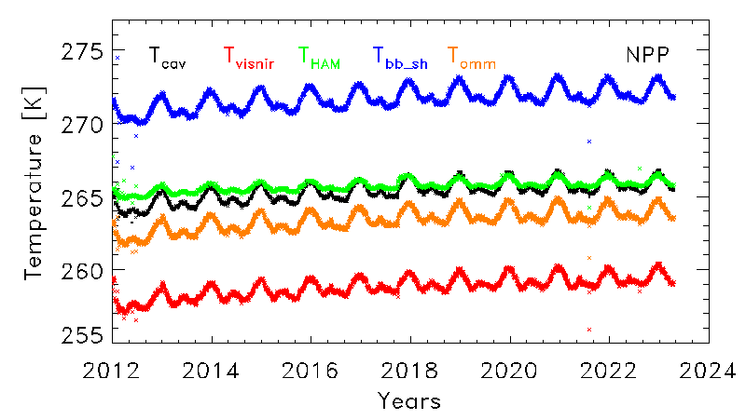
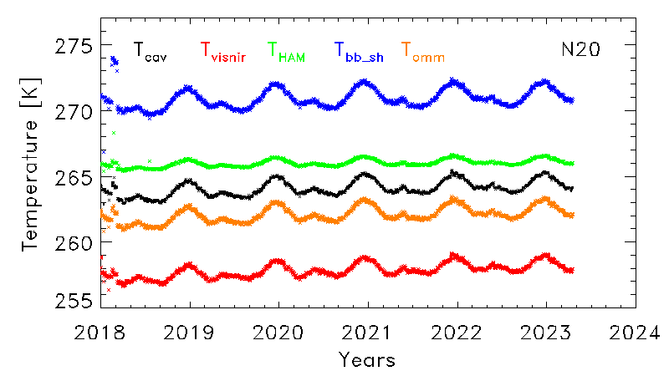
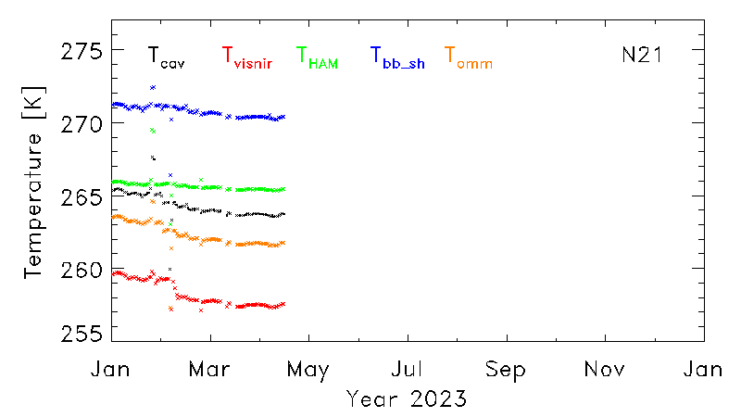
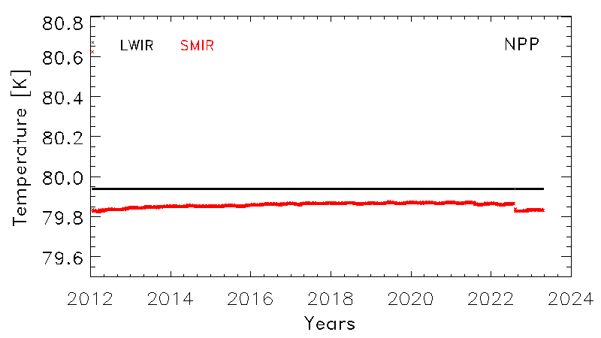
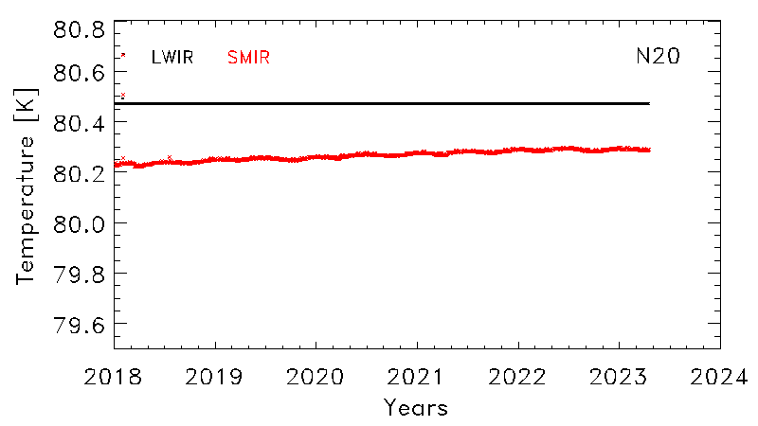
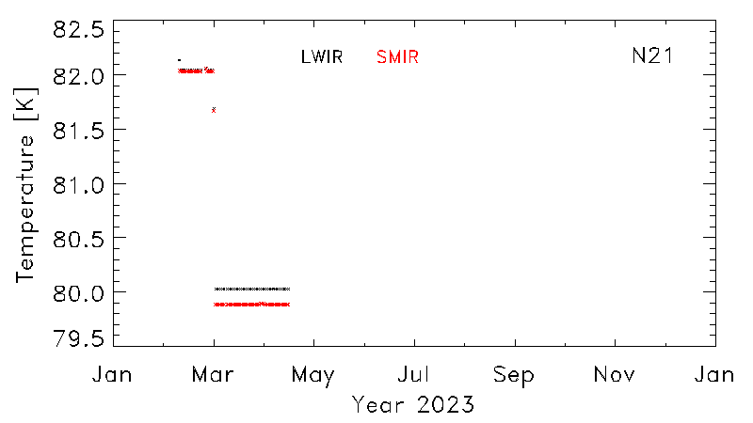
Telemetry Performance
80K CFPA setpoint switch
Starting 2/10/2023 ~14:00 UTC, CFPA temps kept dropping much more than expected and as a result at about 18:12 UTC, the SMIR CFPA heater was also turned on.
Small change in the SMIR FPA temperature after the Aug 2022 safe mode
7

Slide 8
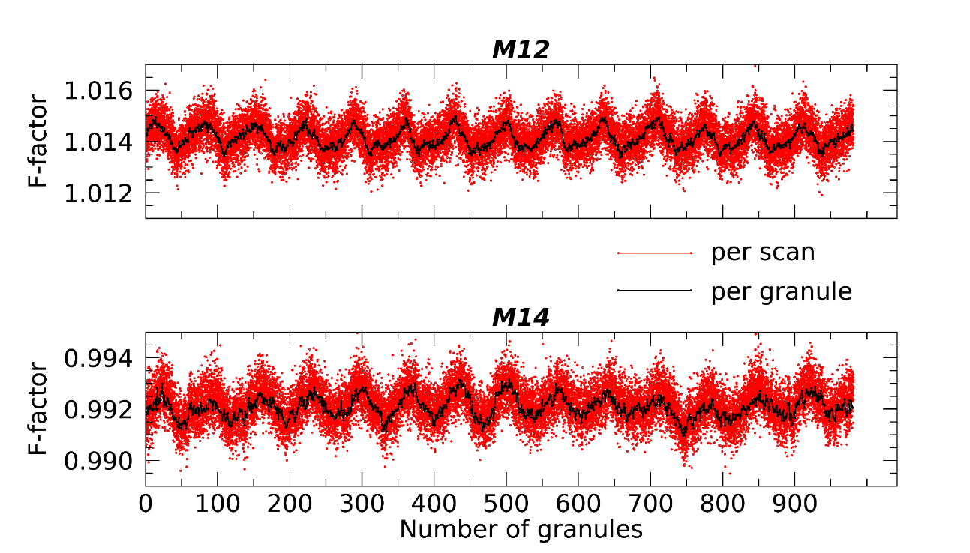
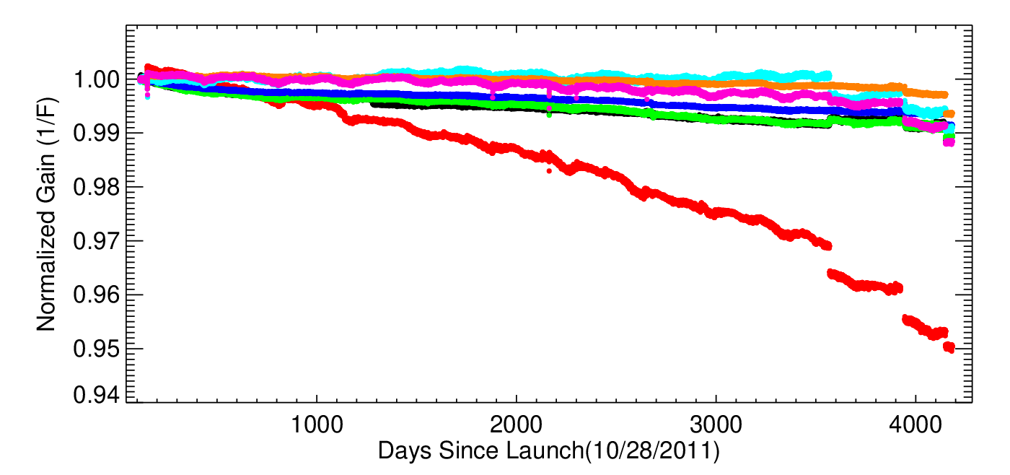
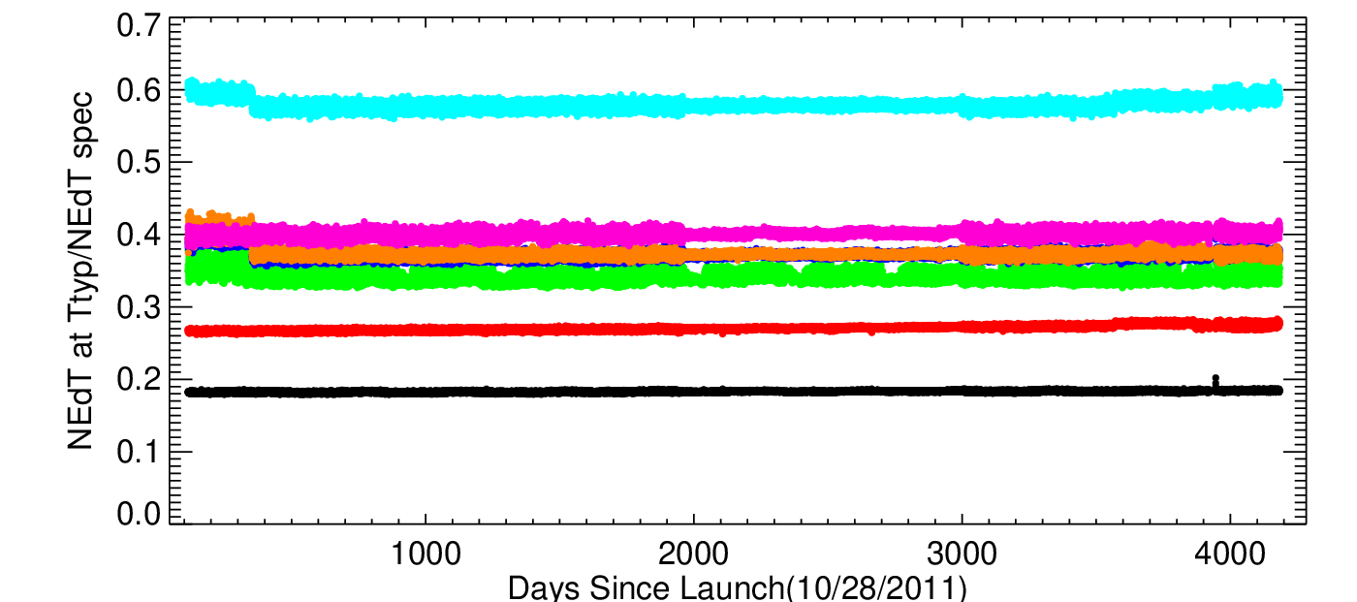
SNPP VIIRS TEB performance
Aug 2022 safe mode
Aug 2021 safe mode
Detector responses show small orbital variations.
± 0.2 % or less on a scan-by-scan basis
± 0.1 % or less on a per granule basis
F-factor fluctuations can be correlated to T_{BB} and instrument temperature variations
NEdT for all detectors continues to meet the specification. No noisy/inoperable detectors
8
Notes:
Carlos produced updated short-term stability plots (in red)

Slide 9
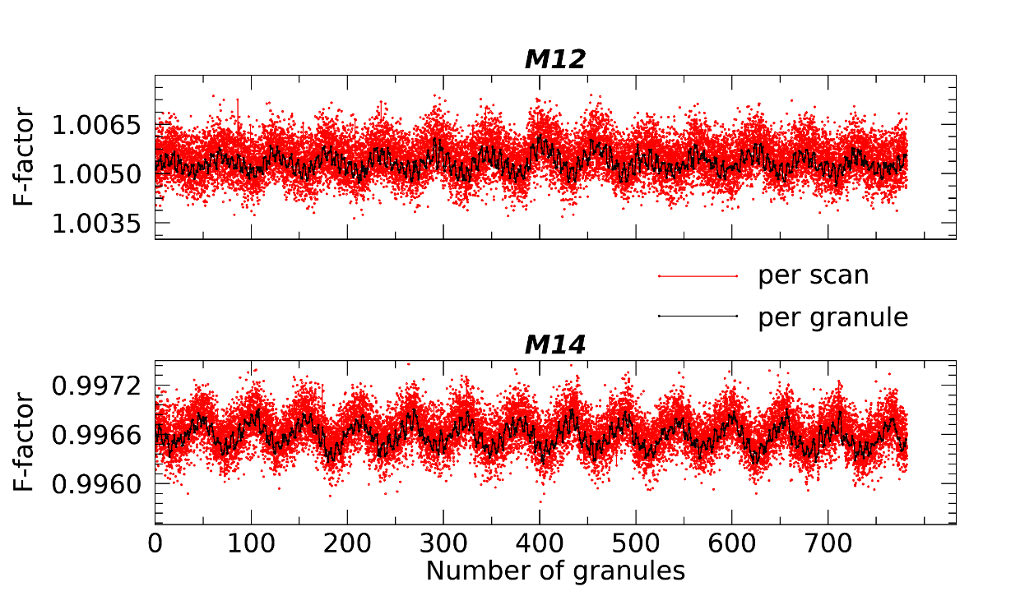
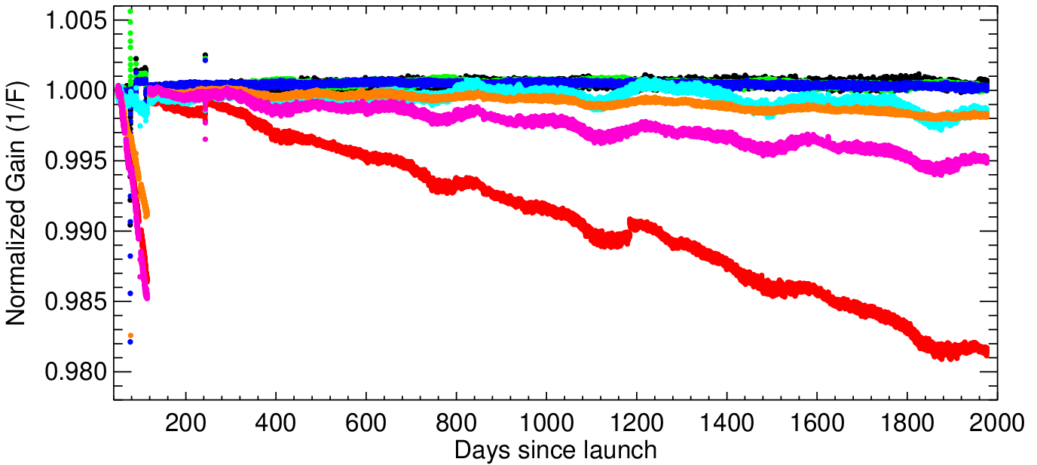
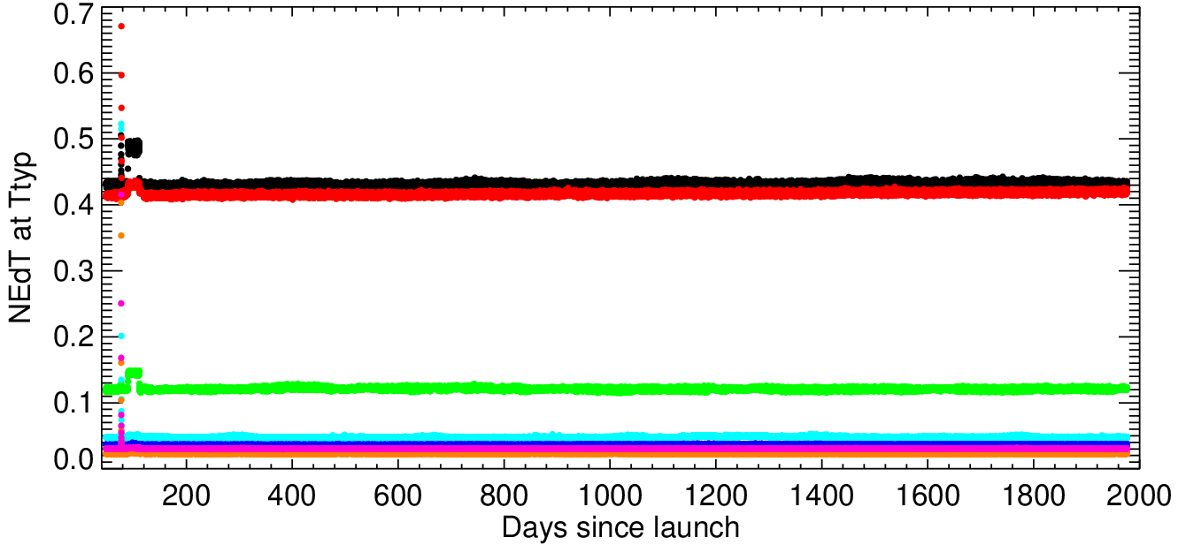
N20 VIIRS TEB performance
Early mission LWIR degradation restored after MMOG
NEdT for all detectors continues to meet the specification. No noisy/inoperable detectors
Detector responses show small orbital variations.
± 0.2 % or less on a scan-by-scan basis
± 0.1 % or less on a per granule basis
Performance similar to SNPP VIIRS TEB. Largest gain degradation observed in I5 (~0.4%/year)
9

Slide 10
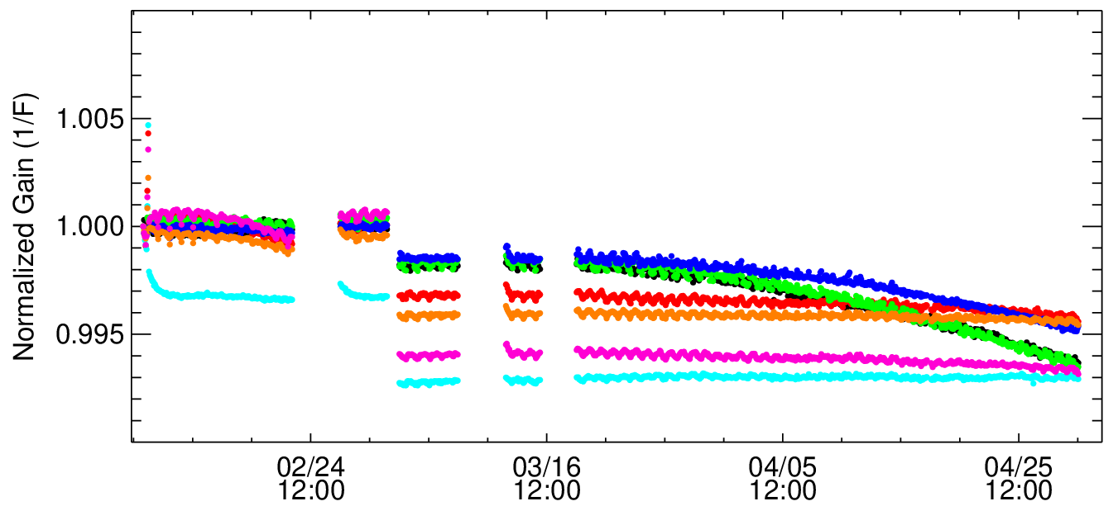
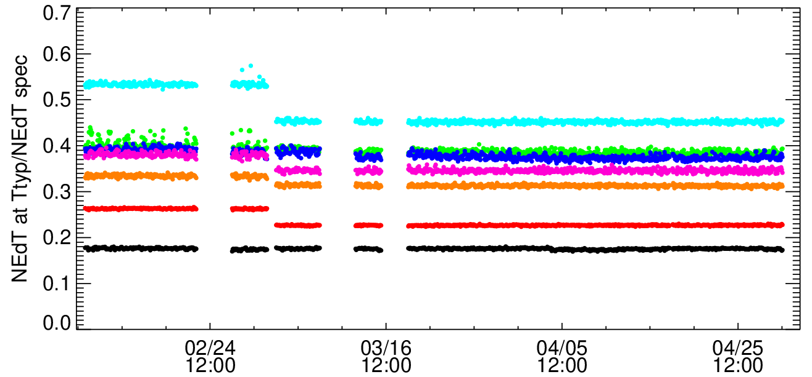
N21 VIIRS TEB performance
D1-D8
D9-D16
80K CFPA setpoint switch
MWIR gain degradation
MMOG
Larger degradation in the higher number of detectors. Similar trend, attributed to possible icing, in the early days of J1 VIIRS. Per-scan calibration of the TEB mitigates the impacts due to this degradation
Improved NEdT performance in the LWIR bands after CFPA switch to 80K
Short-term stability comparable with SNPP and J1 VIIRS
Continued monitoring of the MWIR gain degradation is required, currently impacting bands I4, M12, M13. Minimal impact on the L1B product as per-scan calibration is used
10

Slide 11
Summary
On-orbit BB short- and long-term performances for S-NPP (~12 years) and NOAA-20 (~5 years) VIIRS are quite stable. Recently launched NOAA-21 VIIRS also showing stable performance with the exception of some MWIR bands
Detector response (F-factor) trending is stable for both S-NPP and NOAA-20 VIIRS. S-NPP VIIRS TEB I5 shows the maximum band-averaged trend of 3.1 %, followed by M12 and I4. NOAA-20 VIIRS TEB I5 displays a maximum trend of 0.9 %.
Early mission LWIR degradation corrected after MMOG. Signs of gain degradation evident in the MWIR bands
The TEBs detector noise characteristics are stable for all instruments. The NEdT at T_{TYP} is compliant with the requirements.
Improved NEdT performance for N21 VIIRS TEB after the CFPA switch to 80K
L1B Earth view trending over ground targets for S-NPP and N20 VIIRS demonstrates all TEBs are well-calibrated. N21 VIIRS TEBs will be monitored in the future using same methodology.
Recent calibration improvements include the development of a TEB uncertainty algorithm that can provide per-pixel uncertainty and improved flagging for the rollover pixels in the L1B products (to be included in a future reprocess)
11

Slide 12
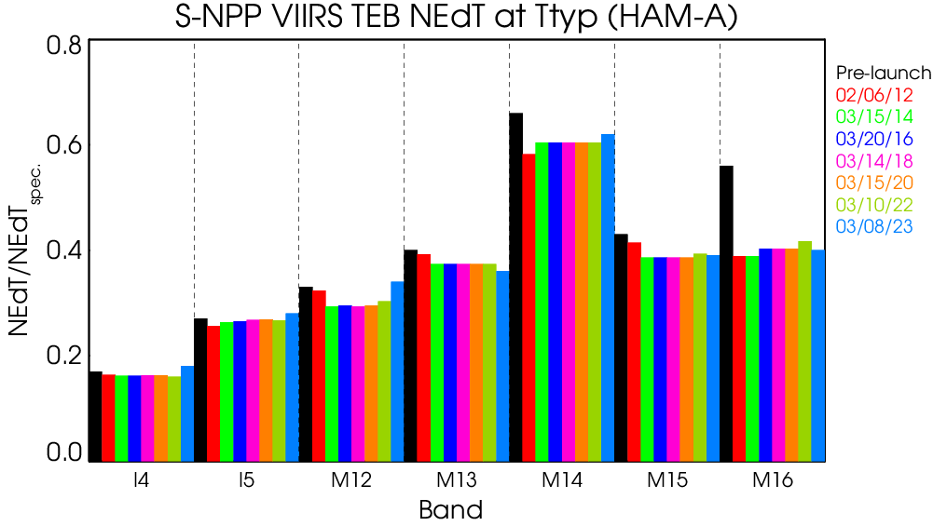
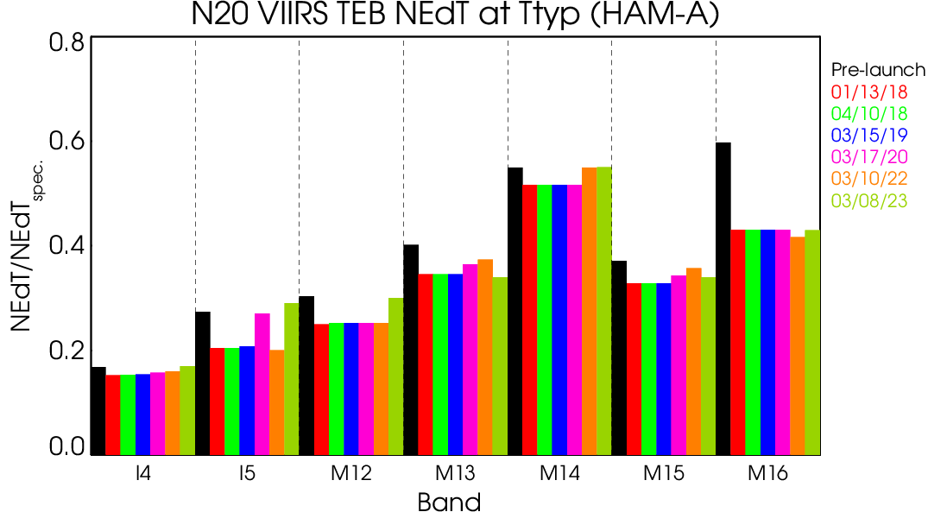
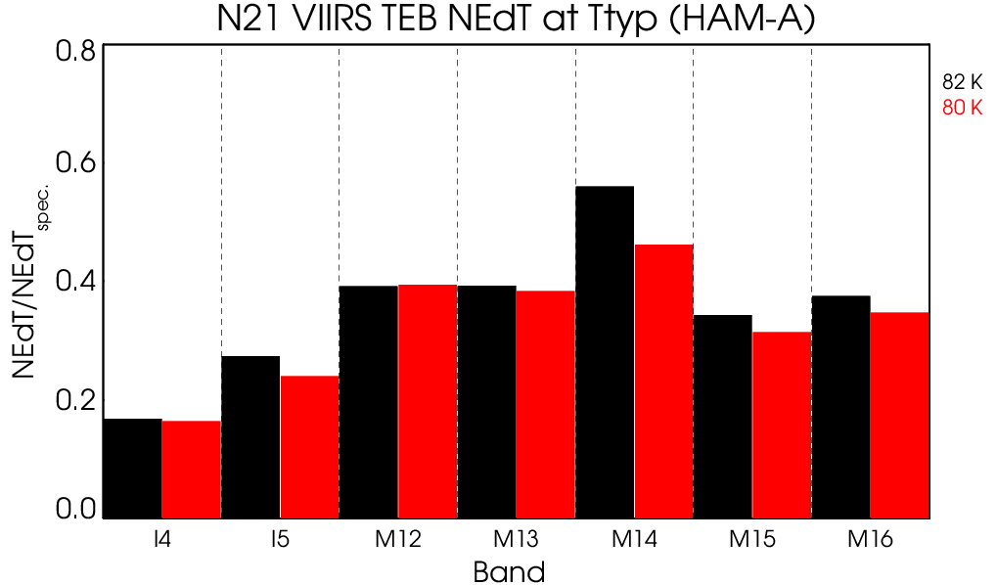
Backup
Notes:
Carlos produced this using your data.

Slide 13
Calibration coefficients (c₀)
S-NPP
N20
Band-avg. c₀ calibration coeffs.
Derived from 32 (S-NPP) and 9 (N20) WUCD operations through March 2023.
All other bands display similar trends.
S-NPP and N20 VIIRS TEBs exhibit similar trends for offset coefficients.
13

Slide 14
Calibration coefficients (c₁)
S-NPP
N20
S-NPP and N20 VIIRS TEBs display similar trends for linear calibration coefficients.
All other bands exhibit similar trends.
14

Slide 15
Calibration coefficients (c₂)
S-NPP
N20
S-NPP and N20 VIIRS TEBs exhibit similar trends for non-linear coefficients.
All other bands display similar trends.
15

