Slide 1
NPP and NOAA-20 VIIRS RSB radiometric scaling utilizing multiple approaches
David Doelling, Rajendra Bhatt, Conor Haney, Benjamin Scarino, Prathana Khakurel, and Arun Gopalan
CERES Imager and Geostationary Calibration Group
May 1, 2023
MODIS/VIIRS Calibration Workshop

Slide 2
Outline
Background
CERES EBAF flux product requirements
CERES Imager and Geostationary Calibration Group
Radiometric scaling of VIIRS instruments
Methods:
All-sky tropical ocean ray-matching (ATO-RM) Aqua-MODIS/VIIRS
Polar SNO with Aqua-MODIS/VIIRS
PICS approach (Libya-4)
Deep-convective clouds invariant target approach
Spectral differences and SBAF
Results
Conclusions

Slide 3
CERES EBAF product
The CERES EBAF monthly product provides observed broadband fluxes needed to monitor the Earth’s energy balance and validate climate models
The stability of the EBAF fluxes relies on the
The CERES onboard calibration systems
The well-maintained sun-synchronous orbits
The cloud retrieval continuity between MODIS and VIIRS imagers designed to identify the angular directional model (ADMs) scene types to convert CERES observed radiances into fluxes
The diurnal models to estimate the regional flux variability between CERES measurements, which are a combination of geostationary derived broadband fluxes and constant meteorology models
The CERES EBAF product has transitioned from Terra and Aqua inputs to a N20 only input beginning with the data month of April 2022
The Terra and Aqua orbits have drifted outside of their mean local time window
The Aqua spacecraft anomaly accelerated the transition
The seamless transition was accomplished using regional climatology adjustment factors based on the 5-year Terra and Aqua overlap period that adjusts for the Terra morning observations and the MODIS and VIIRS cloud property induced flux differences

Slide 4
CERES EBAF product
CERES utilizes their own cloud retrieval algorithm designed to minimize the number pixels with unretrieved cloud properties identified by the cloud mask
MODIS and VIIRS cloud retrieval continuity requires
MODIS and VIIRS on orbit calibration stability
Consistent MODIS and VIIRS analogous channel calibration
Accounting for spectral band differences
Using MODIS and VIIRS channels common to both
Accounting for MODIS and VIIRS pixel size differences
CERES incorporates 22 geostationary imager derived clouds and fluxes
The GEO channel radiances are scaled to the Aqua-MODIS C6.1 calibration reference to retrieve GEO clouds consistent the MODIS
The GEO derived fluxes are carefully normalized to the CERES observed fluxes to estimate the regional diurnal flux using the same ADMs

Slide 5
CERES imager and geostationary calibration group (IGCG)
The group performs calibration assessment of MODIS, VIIRS, and GEO imagers in real-time using multiple approaches
The calibration group provides the GEO visible radiometric scaling factors referenced to the MODIS C6.1 calibration metric for CERES Edition 4 products (MODIS C7 for Edition 5)
Three independent reflective solar bands (RSB) cross-calibration approaches are used to estimate radiometric SNPP and NOAA-20 VIIRS biases
All-sky tropical ocean ray-matching (ATO-RM) between Aqua-MODIS and VIIRS
DCC invariant target
Pseudo-invariant ground site (Libya-4 PICS)
Datasets used are
Aqua-MODIS Collection 6.1 level 1B product
SNPP VIIRS V2 and NOAA-20 VIIRS V2.1 datasets generated by the NASA VIIRS Land Science Investigator-led Processing System (Land SIPS).

Slide 6
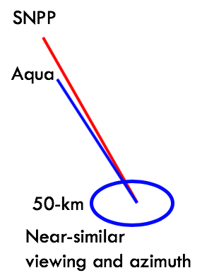
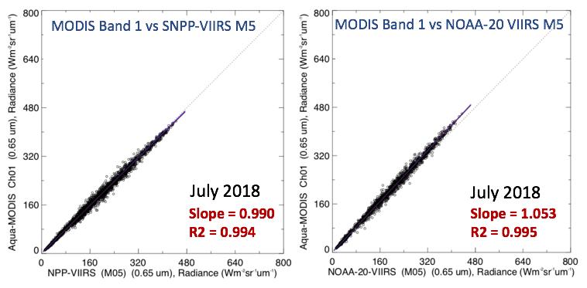
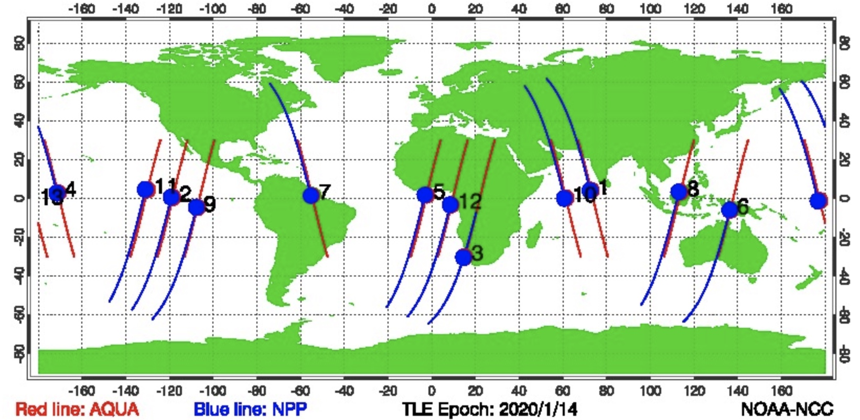
Ray-matching with Aqua-MODIS
Coincident, co-located, and co-angled radiance pairs for all comparable channels of Aqua-MODIS and SNPP/NOAA-20 VIIRS are acquired between 30 °N and 30 °S.
Ray-matching is performed over all-sky tropical ocean (ATO-RM) scenes
pixels averaged within a shared 50-km diameter constitutes one ray-matched radiance pair
VZA/SZA differences < 3°, RAZ difference <10°
A linear regression forced through zero is fitted to the radiance pairs on a monthly basis and the forced-slope is used as the cross-calibration ratio.
Tropical SNO, Jan 14, 2020
NOAA-20 VIIRS M5
radiances are darker
compared to SNPP-VIIRS

Slide 7
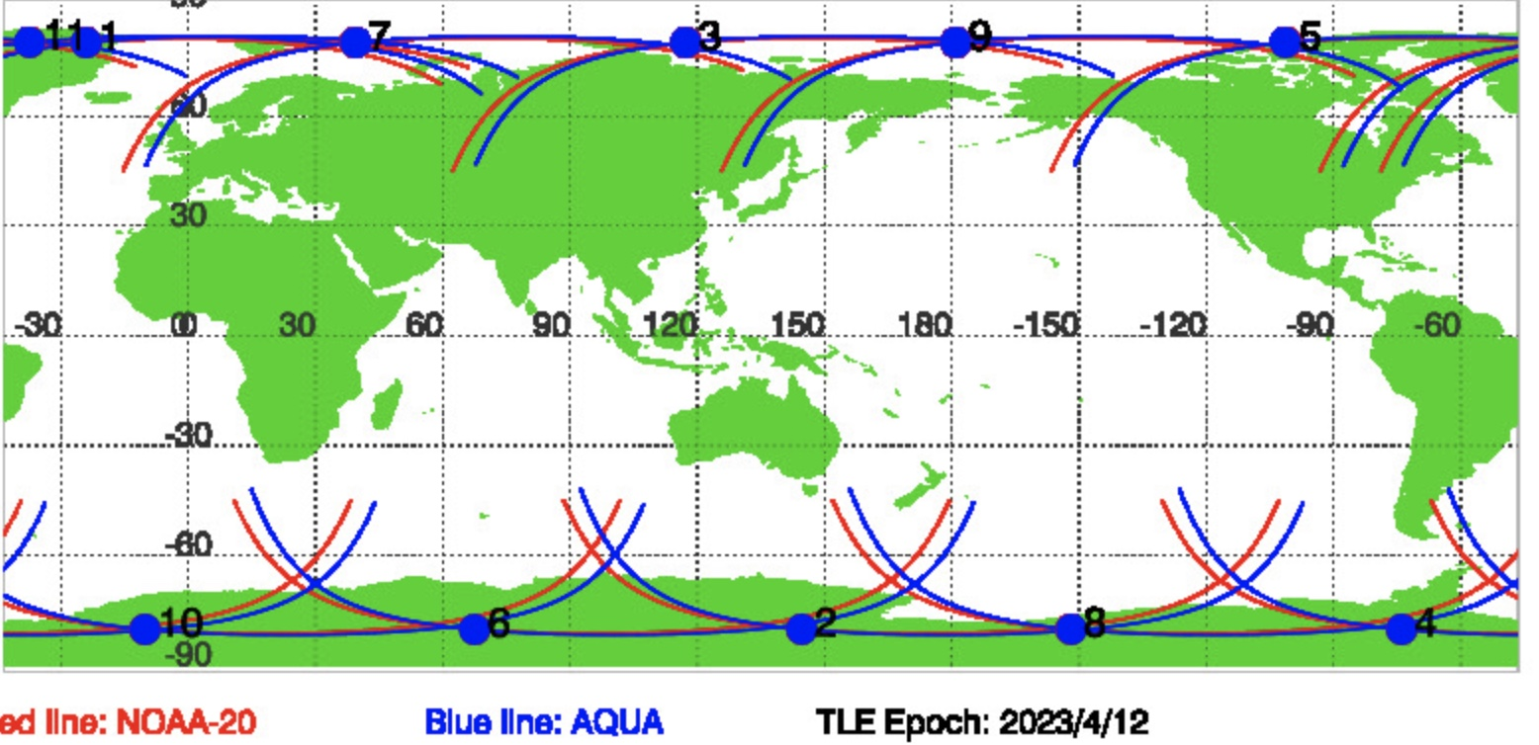
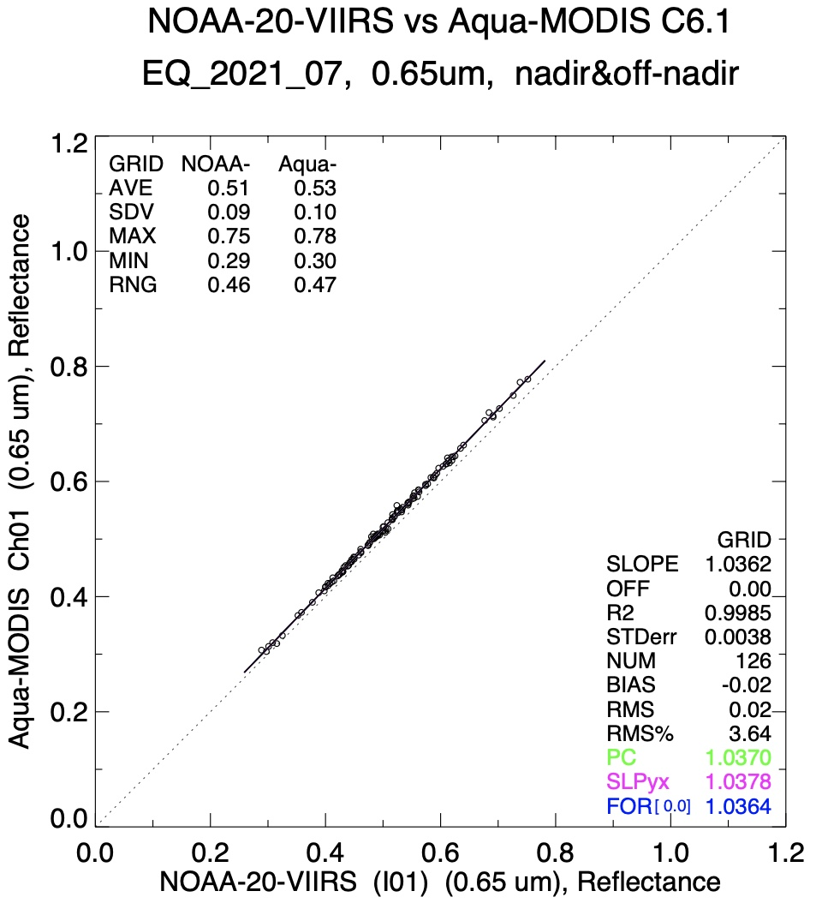
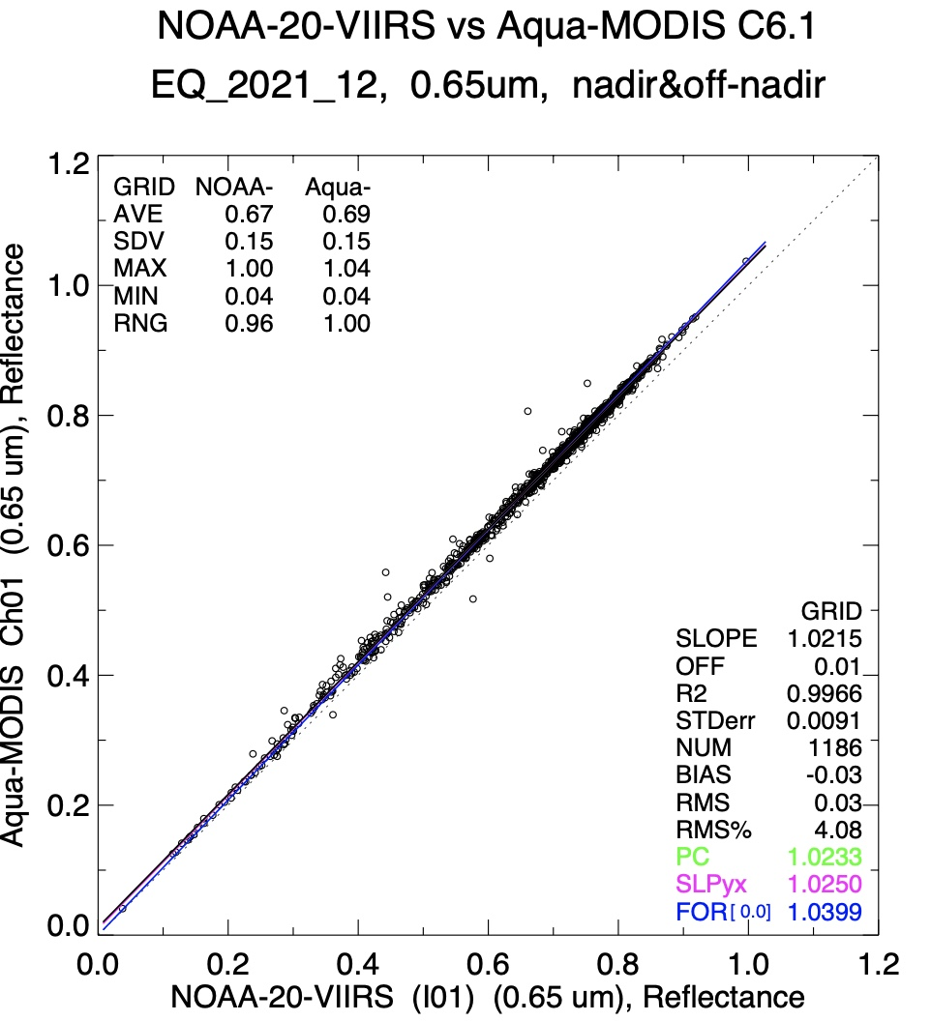
Ray-matching with Aqua-MODIS
Polar SNO, Apr 12, 2023
North Pole, 2021_07
South Pole, 2021_12
Aqua/N20 ratio = 1.036
Aqua/N20 ratio = 1.040
Coincident, co-located, and co-angled radiance pairs for all comparable channels of Aqua-MODIS and SNPP/NOAA-20 VIIRS are acquired poleward of 60° across all surface types.
Other wise same as ATO-RM approach

Slide 8
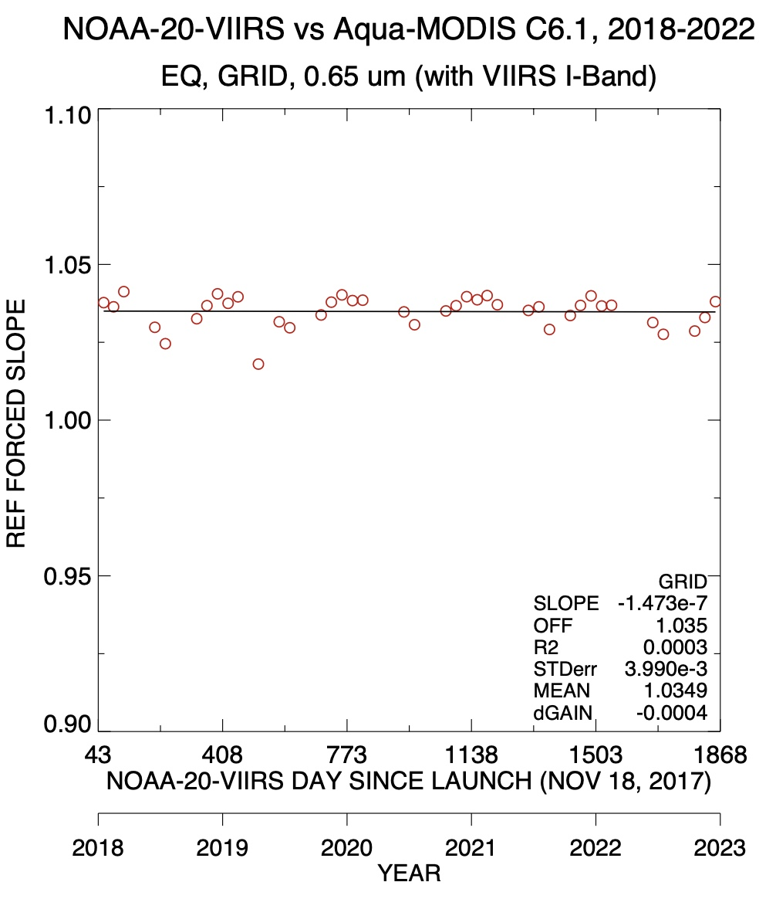
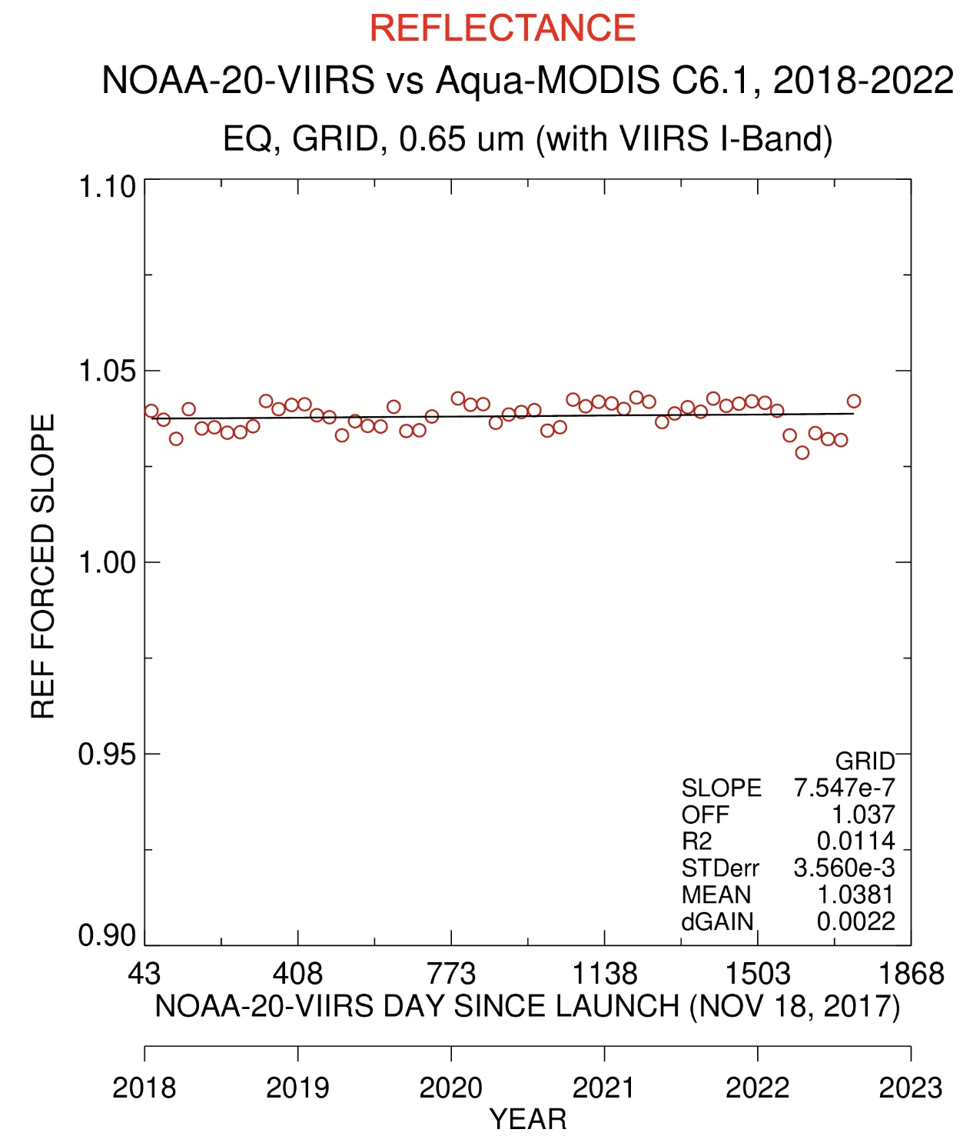
Ray-matching with Aqua-MODIS
Poles, 2018-2022
All-sky Tropical Ocean, 2018-2022
Aqua/N20 mean ratio = 1.035
Aqua/N20 mean ratio = 1.038

Slide 9
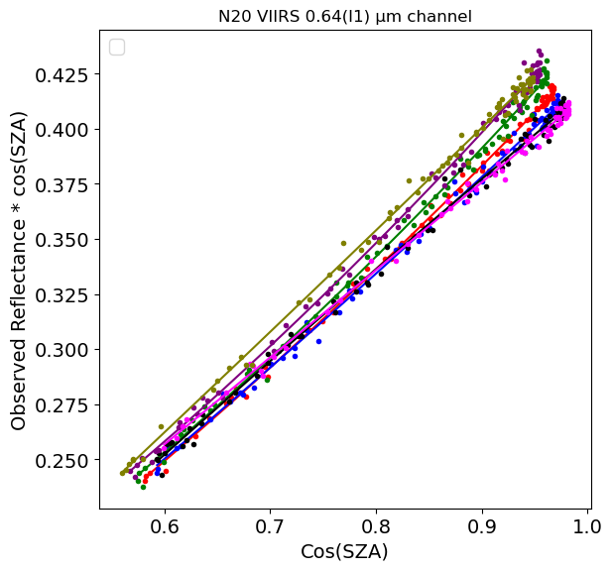
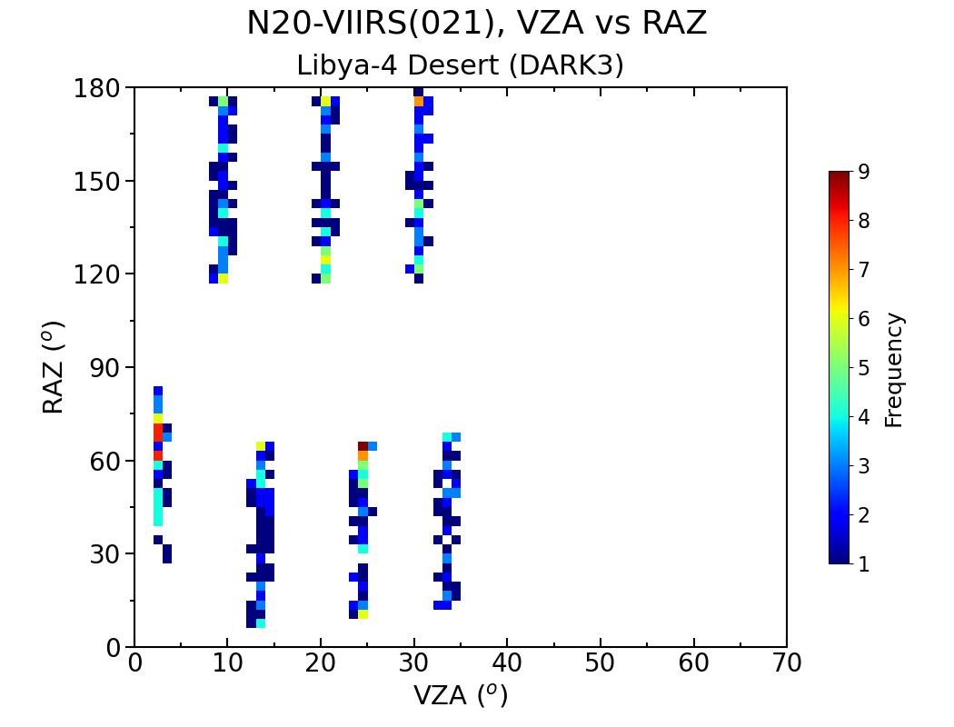
Libya4 Directional Models
DM reflectances
Libya-4 PICS (28.6°N, 23.4°E, 0.5°x0.5°) VZA observations < 35°are considered
Libya TOA reflectance is modeled as a function of SZA (2nd order regression) and with atmospheric parameters
Libya-4 SZA directional models (DM) stratified by back and forward scattering and by VZA
Ozone, PW, Wind Speed, Surface pressure
DM predict the TOA reflectance to monitor the sensor stability
Sensor pair reflectance ratios are computed from the DMs using the mean conditions of Libya-4
SZA= 28.0°, Ozone=292 DOB, PW=1.74 cm, WS=3.9 m/s, Psurf 1003.2 hpa
showing the 7 DM

Slide 10
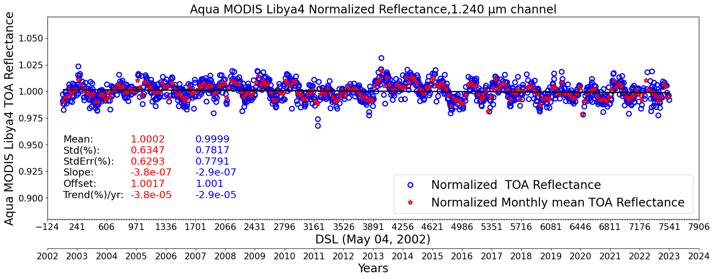
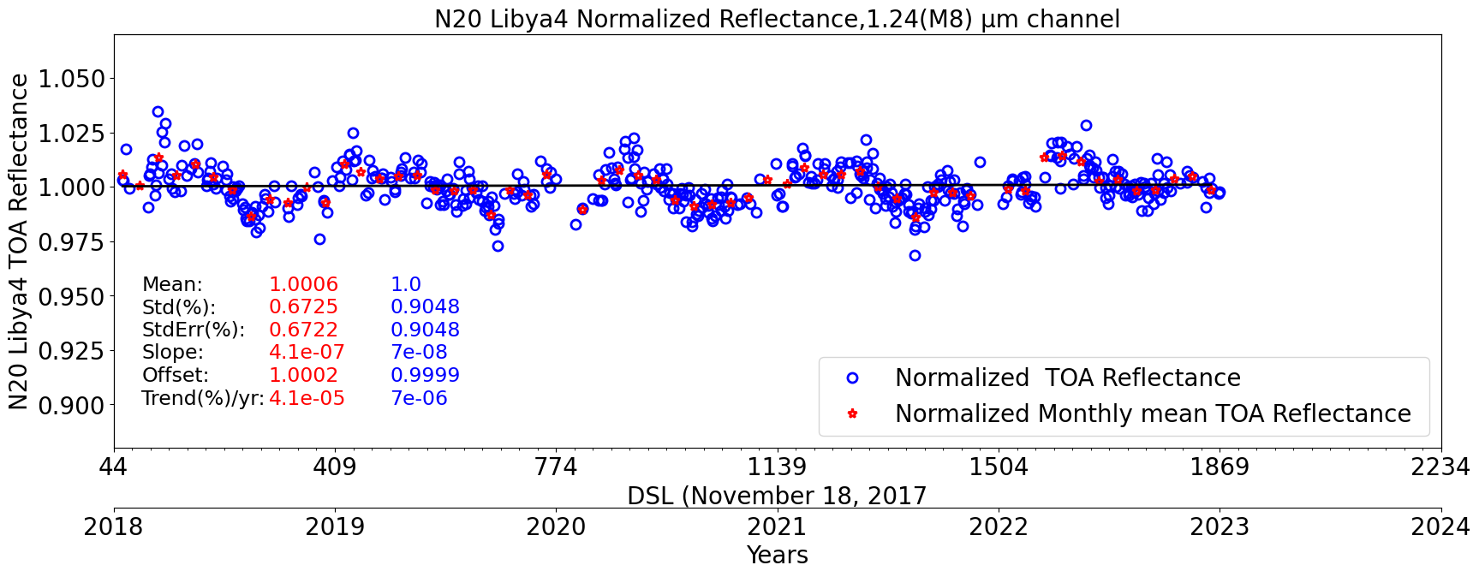
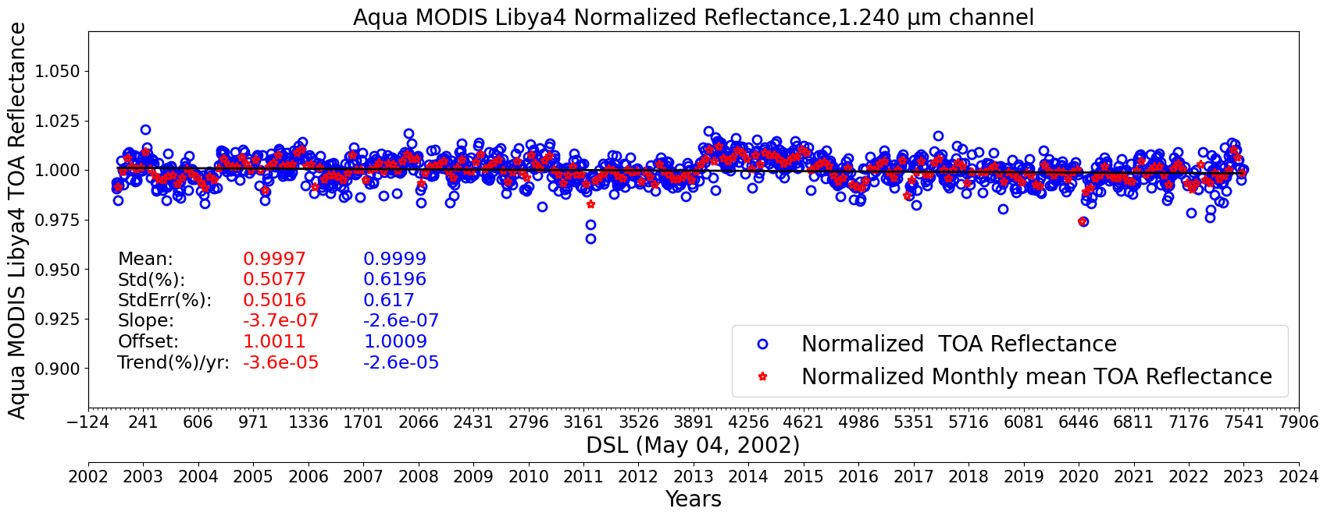
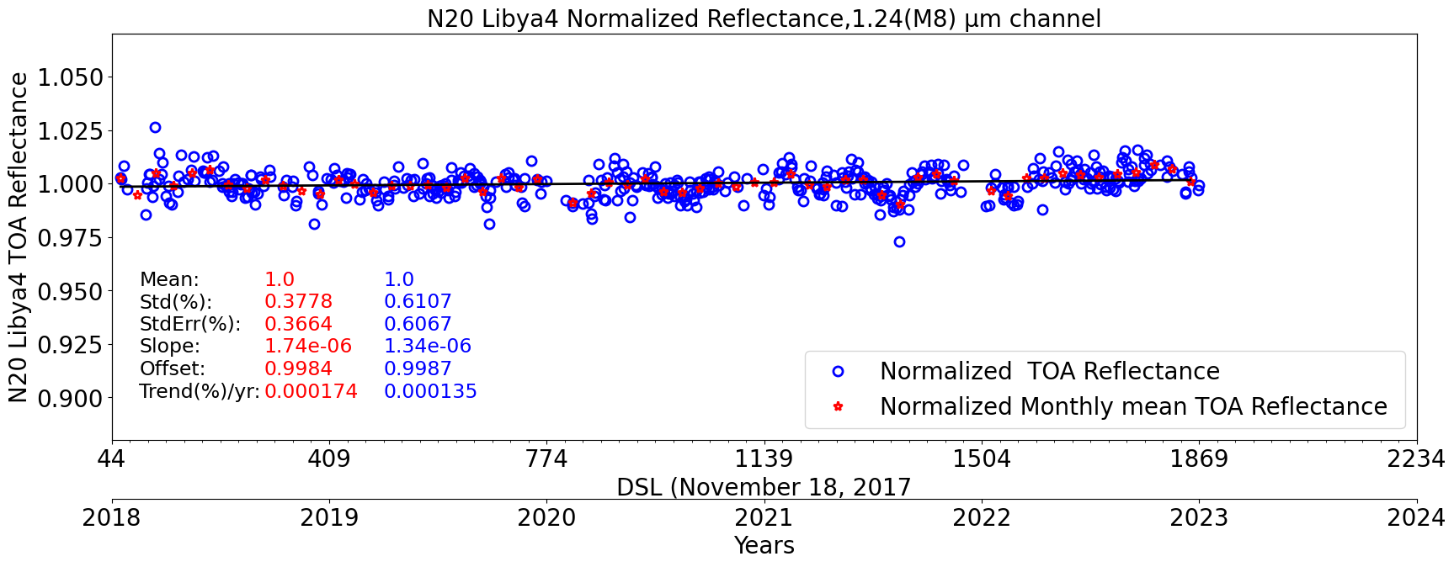
Comparison of Libya-4 1.24µm stability with and without atmospheric parameters
Aqua-MODIS
Before atmospheric correction
N20-VIIRS
After atmospheric correction
21% sigma reduction for Aqua utilizing atmospheric correction
33% sigma reduction for N20 utilizing atmospheric correction

Slide 11
Libya-4 temporal stability table
monthly Libya-4 reflectance linear regression standard errors in (%)
SAT/BANDS |  | 0.64 (%) | 0.87 (%) | 0.46 (%) | 0.55 (%) | 1.24 (%) | 1.629 (%) | 2.10 (%) | (%) | (%)
Aqua | SZA+${SZA}^{2}$ | 0.8328 | 0.873 | 0.9791 | 0.8999 | 0.7791 | 0.657 | 1.793
 | SZA+${SZA}^{2}$+atm par | 0.7031 | 0.6578 | 0.9542 | 0.8346 | 0.617 | 0.6323 | 0.9144
 |  | 15.6 | 24.7 | 2.5 | 7.3 | 20.9 | 3.8 | 49
Terra | SZA+${SZA}^{2}$ | 0.8997 | 0.9887 | 1.193 | 0.9728 | 0.979 | 0.6538 | 2.0208
 | SZA+${SZA}^{2}$+atm par | 0.7832 | 0.7384 | 1.1724 | 0.928 | 0.8656 | 0.6198 | 1.1937
 |  | 13.01 | 25.43 | 2.03 | 4.75 | 12.40 | 5.43 | 40.90
SAT/BANDS |  | 0.67 (M5) | 0.87 (M7) | 0.49 (M3) | 0.55 (M4) | 1.24 (M8) | 1.629 (M10) | 2.10 (M11) | 0.64 (I1) | 1.61 (I3)
N20 | SZA+${SZA}^{2}$ | 0.6741 | 0.6487 | 0.9682 | 0.8688 | 0.9048 | 0.5673 | 1.5368 | 0.8442 | 0.6506
 | SZA+${SZA}^{2}$+atm par | 0.612 | 0.5688 | 0.8791 | 0.7849 | 0.6067 | 0.5084 | 0.8286 | 0.7466 | 0.5876
 |  | 9.21 | 12.32 | 9.20 | 9.66 | 32.95 | 10.38 | 46.08 | 11.56 | 9.68
NPP | SZA+${SZA}^{2}$ | 0.6072 | 0.6733 | 0.8817 | 0.8146 | 0.8809 | 0.5381 | 1.5139 | 0.7203 | 0.5412
 | SZA+${SZA}^{2}$+atm par | 0.5448 | 0.5403 | 0.7912 | 0.7079 | 0.5736 | 0.4859 | 0.8083 | 0.6001 | 0.4906
 |  | 10.27 | 19.75 | 10.26 | 13.09 | 34.88 | 9.70 | 46.60 | 16.69 | 9.34
The Libya-4 reflectance is correlated with SZA + SZA² + Ozone, PW, Wind Speed, Surface pressure
The red values represent the reduction of the standard error by using atmospheric parameters
PW was the dominant atmospheric parameter

Slide 12
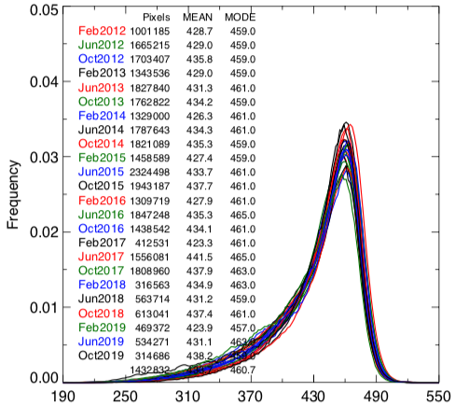
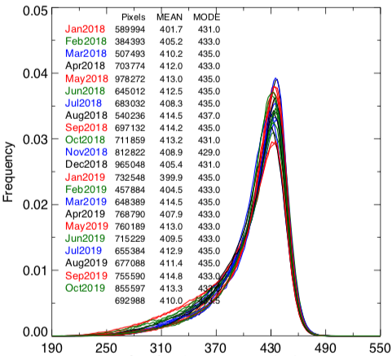
Baseline DCC method
SNPP-VIIRS
DCC pixel selection criteria:
BT11μm < 205.0°K, SZA < 40°, VZA < 40°, 10° < RAA < 170°, σ(BT11μm) < 1.0° K, and σ(VIS) <3%
DCC pixels are compiled into monthly probability distribution functions (PDFs) and their modes are tracked over time.
Anisotropic correction using the angular distribution model by Hu et al [3].
Suitable for wavelengths <1 μm
At SWIR wavelengths,
DCC reflectivity is affected by ice particle size
larger ice particles are more absorbing
results in large seasonal cycles
DCC response is highly dependent on the IR BT threshold
Frequency
NOAA-20 VIIRS
Frequency
DCC radiance (M5)

Slide 13
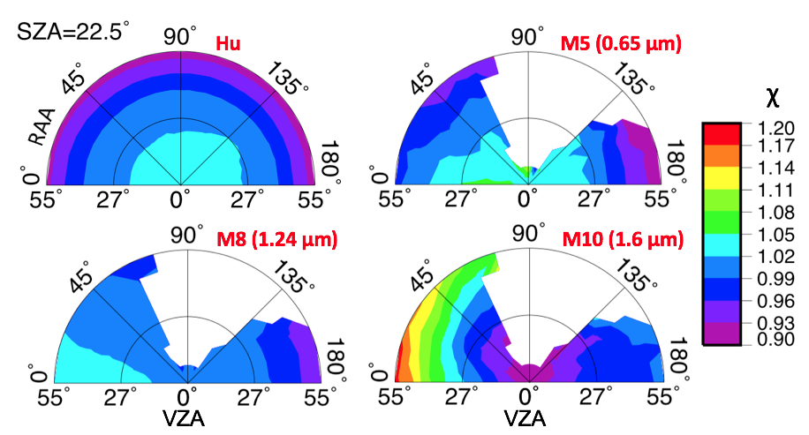
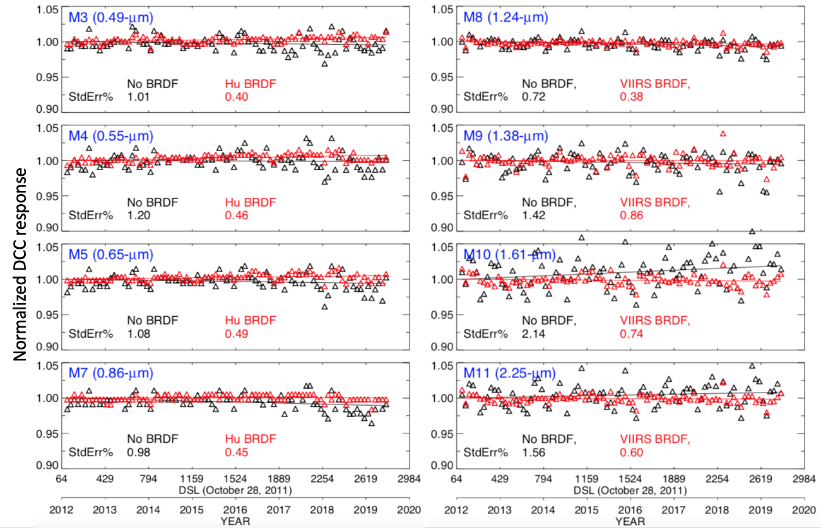
Improved DCCT for SWIR bands
Proper seasonal characterization of DCC allows the extension of DCC method to calibrate SWIR channels.
Channel-specific BRDFs are constructed using the SNPP-VIIRS DCC samples from 2012-2016
Pixel-level DCC reflectance values are partitioned into angular bins
Angular discretization:
VZA and SZA range from 0-55° with a 5° step size
RAA varies from 0-180° at 10° intervals
VIS-NIR BRDFs are similar to Hu model
Cirrus Channel (1.38 μm)
Ground PICS are inapplicable for vicarious calibration
Radiation is mostly absorbed by atmosphere, except in the case of high-altitude ice clouds
SWIR band BRDFs reduces temporal variability of DCC response by up to 65%.
By implementing similar DCC thresholds and BRDF normalizations, inter-sensor comparison using mean and mode statistics is feasible.

Slide 14
Radiance and Reflectance biases
Reference Solar Spectrum | Impact on M4 band calibration
VIIRS instruments are calibrated on Reflectance scale $Radiance=Reflectance×E_{SUN}×\cos{(SZA)/d^{2}}$ SNPP and NOAA-20 VIIRS use different solar irradiance models Biases are different for radiance and reflectance Difference in reference solar spectra can induce additional (+/-) radiance bias
SNPP-VIIRS
NOAA-20 VIIRS
~2% difference in E_{sun} for M4 (0.55 µm) band
Solar constant tool: https://cloudsway2.larc.nasa.gov/cgi-bin/site/showdoc?mnemonic=SOLAR-CONSTANT-COMPARISONS

Slide 15
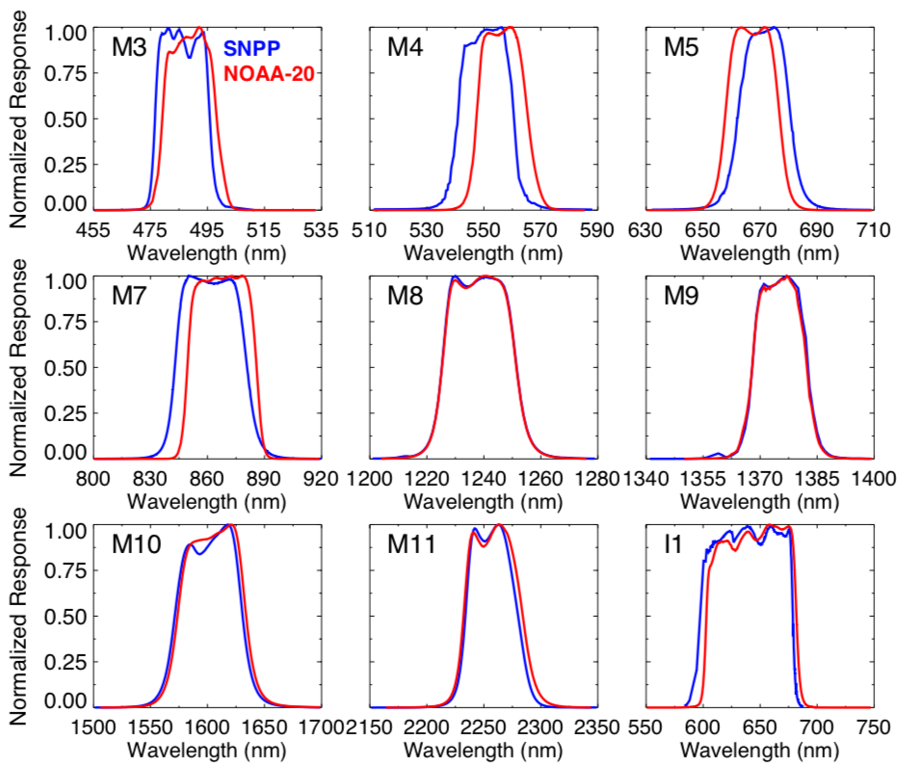
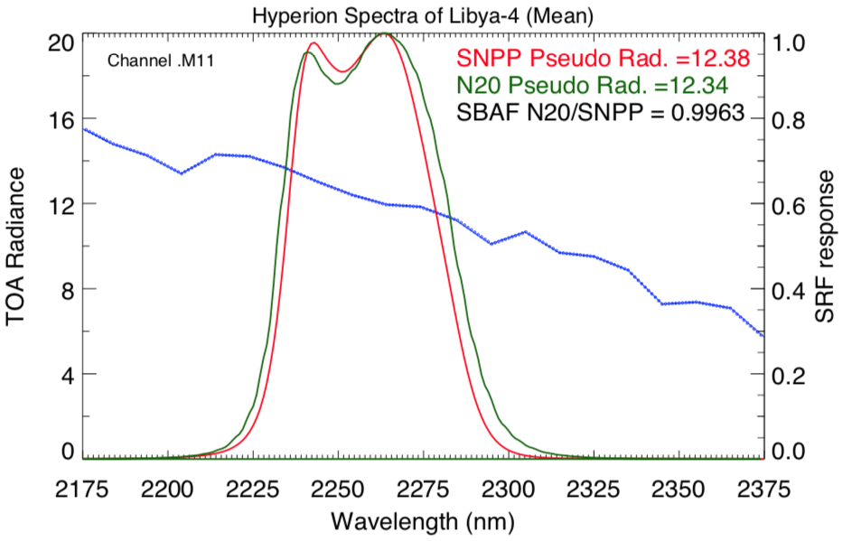
SRF differences and SBAF
SCIAMACHY-based SBAF
M4 channel
ATO scene
Hyperion-based SBAF
M11 channel (2.25µm)
Libya-4
SRFs are similar for most of the bands
SBAF correction are within 2% for all scene types

Slide 16
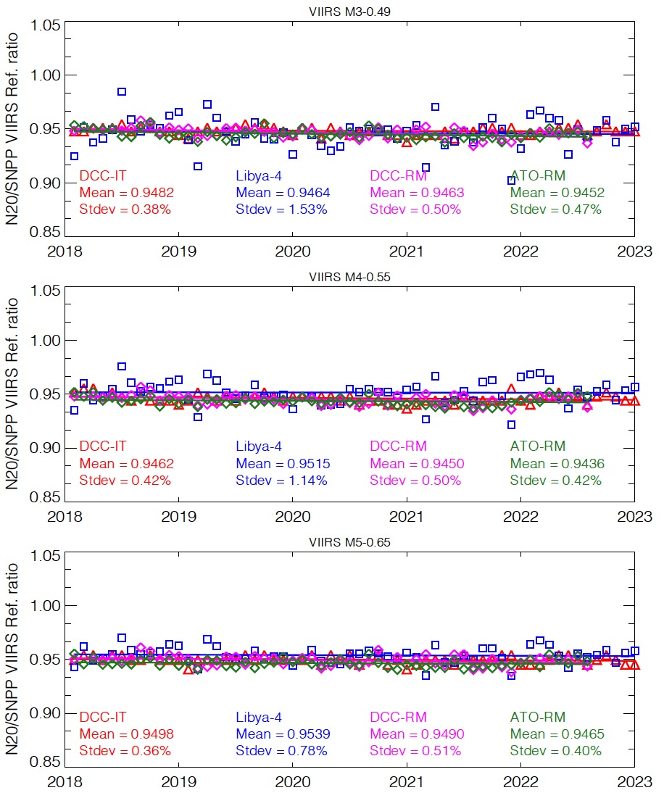
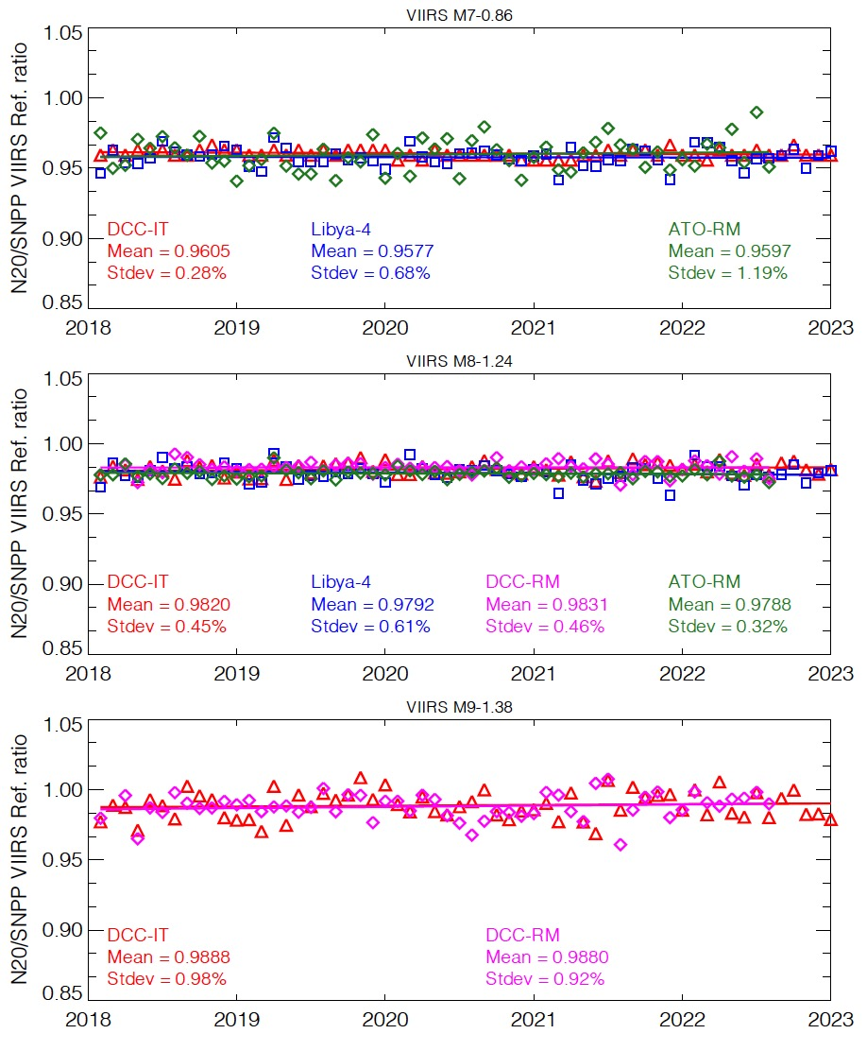
N20/SNPP reflectance ratios
M3
M7
M4
M8
M5
M9

Slide 17
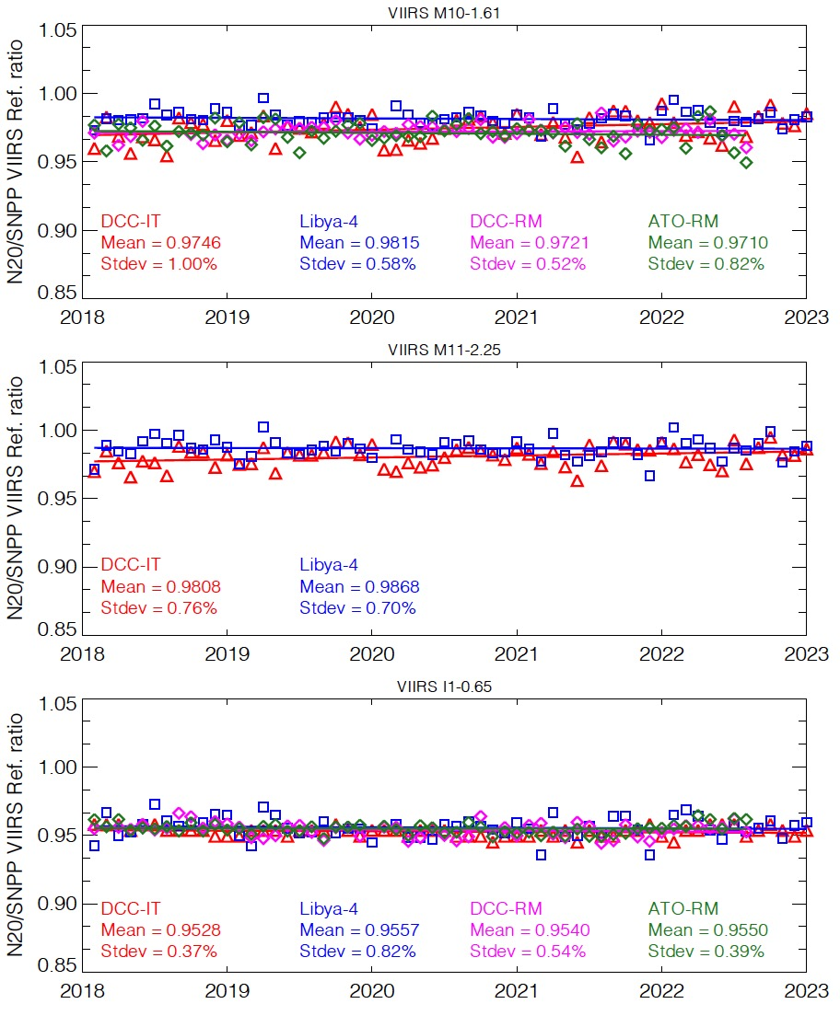
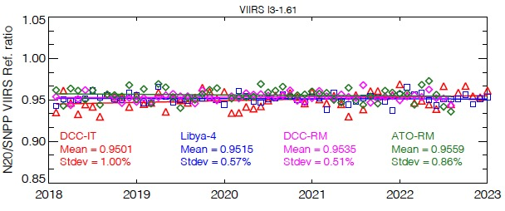
N20/SNPP reflectance ratios
M10
M11
I1
I3

Slide 18
NPP-N20 Bias Table
Band | Radiometric bias 100% x (1-NOAA-20/SNPP)
 | Aqua-MODIS ATO-RM | Aqua-MODIS DCC-RM | Libya-4 PICS | DCC IT | Approach consistency
M3 (0.48µm) | 5.5 | 5.4 | 5.4 | 5.2 | 0.3
M4 (0.55µm) | 5.6 | 5.5 | 4.9 | 5.4 | 0.7
M5 (0.65µm) | 5.3 | 5.1 | 4.6 | 5.0 | 0.7
I1 (0.65µm) | 4.5 | 4.6 | 4.4 | 4.7 | 0.3
M7 (0.86µm) | 4.0 |  | 4.2 | 3.9 | 0.3
M8 (1.24µm) | 2.1 | 1.7 | 2.1 | 1.8 | 0.4
M9 (1.38µm) |  | 1.2 |  | 1.1 | 0.1
M10 (1.6µm) | 2.9 | 2.8 | 1.9 | 2.5 | 1.0
I3 (1.6µm) | 4.4 | 4.7 | 4.9 | 5.0 | 0.6
M11 (2.25µm) |  |  | 1.3 | 1.9 | 0.7
Reflectance biases are provided in parenthesis
‘+’ indicates SNPP-VIIRS is brighter
I1 bias from multiple approaches are more consistent than M5, since I1 and B1 SRFs are more similar

Slide 19
NPP-N20 Bias Table (%)
Band | CERES-Libya | MAIAC | CERES combined | VCST
M3 | 5.4 | 4.8 | 5.6 | 4.8
M4 | 4.9 | 5.5 | 5.8 | 4.5
M5 | 4.6 | 4.4 | 5.4 | 4.4
M7 | 4.2 | 3.8 | 4.2 | 3.3
M8 | 2.1 | 2.6 | 2.0 | 2.4
M10 | 2.5 | 2.2 | 2.5 | 0.9
M11 | 1.3 | 2.0 | 1.6 | 1.7
I1 | 4.4 | 4.0 | 4.8 | 3.9
I3 | 4.9 | 5.4 | 5.0 | 3.5
CERES Libya-4 and MAIAC within 0.8%
CERES combined and MAIAC agree within 0.8%
CERES combined and VCST agree within 1.7%
Calibration of the SNPP and NOAA 20 VIIRS Sensors for Continuity of the MODIS Climate Data Records, Lyapustin et al. 2023, submitted RSE

Slide 20
Conclusions
The CERES EBAF product relies on Terra/Aqua MODIS and SNPP/N20 VIIRS cloud retrieval continuity
The CERES imager and geostationary calibration group (IGCG) utilized ATO-RM, DCC-RM using Aqua-MODIS as a transfer radiometer, Libya-4 and DCC-IT to determine the NPP and N20 radiometric scaling factors
All approaches were within 0.8% across all VIIRS channels
The combined CERES approaches were within 0.8% and 1.7% of the MAIAC and VCST
Aqua-MODIS can no longer be used as transfer radiometer to determine the SNPP and N20 VIIRS RSB radiometric scaling
The Terra and Aqua orbits are drifting outside of their mean local time windows
The CERES project will use the Libya-4 and DCC-IT as well Aqua-MODIS/VIIRS polar-RM approaches to determine the SNPP and N20 VIIRS RSB radiometric scaling

