Slide 1
VIIRS DNB Calibration and Performance
VIIIRS Characterization Support Team (VCST), NASA GSFC
(Presented by Junqiang Sun)
MODIS/VIIRS Calibration Workshop
(Presented by Junqiang Sun)
May 1, 2023
1
Notes:
1
1

Slide 2
VIIRS DNB
  VIIRS DNB Calibration
    The day-night band (DNB) is a RSB.
    It is a unique panchromatic band, 0.5 to 0.9 mm, M4-M7
    Three gain stages: High gain (HG), middle gain (MG), low gain (LG),
    A radiometric dynamic range that spans over seven orders of magnitude
    Multiple aggregation mode (AM) in EV
  DNB Background Response (DN0)
    OBC and EV DN0 Offsets
    DN0 Offsets Changes
  Straylight Correction
    Poster, Hongda Chen et al
  Summary
2
Notes:
2

Slide 3
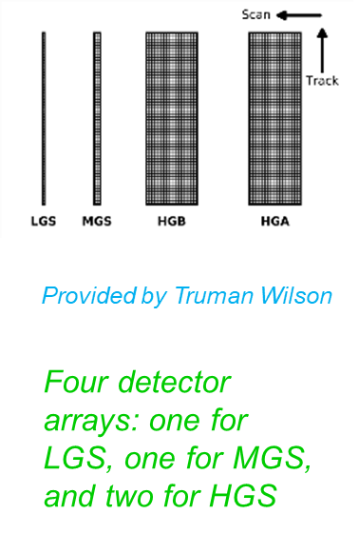
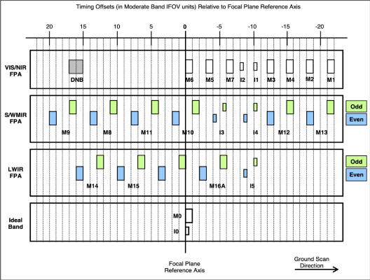
VIIRS DNB Calibration
3
Notes:
3

Slide 4
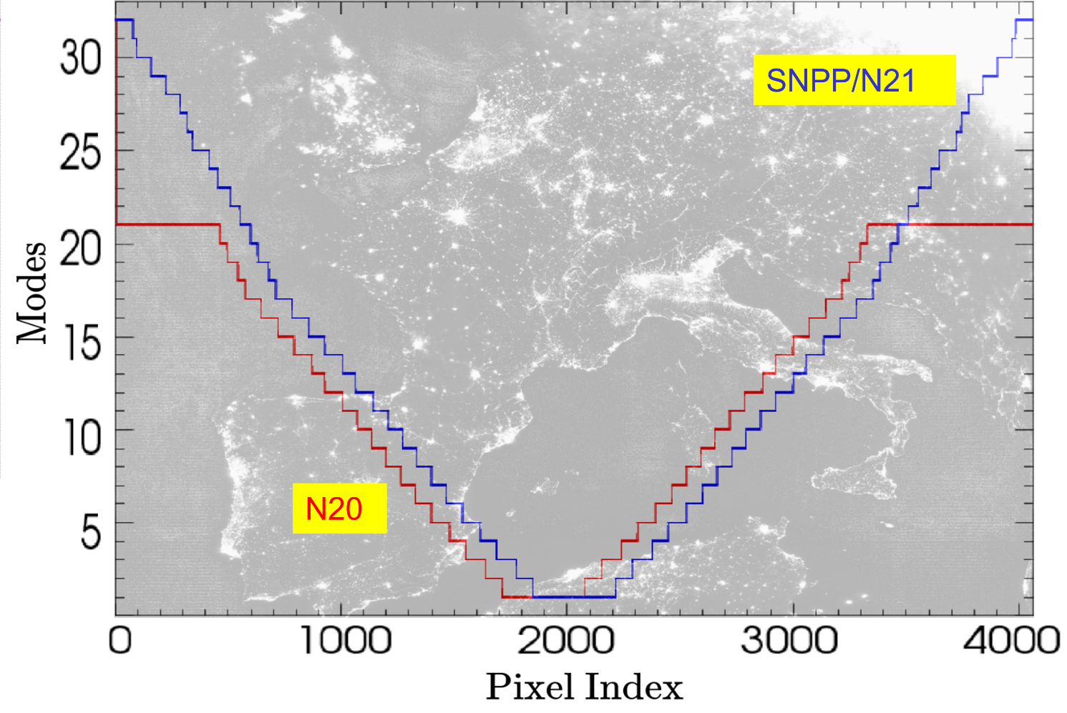
VIIRS DNB Calibration
Aggregation Modes (AM)
  In view of OBCs: SV, SD, and BB, the DNB AM changes sequentially every two scans
The three gain stages are all active in OBCs
SNPP and J2
DNB Earth view is divided into multiple aggregation Zones, each corresponding to one Aggregation mode (AM)
  SNPP and J2, 32; NOAA-20, 22
  Each of them needs to be calibrated independently
4
Notes:
4

Slide 5

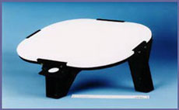
Calibration Algorithm
LGS Gain Calculation
  SD radiance:
    SD-SUN angle, HAM relative response at SD AOI, transmittance of pinhole screen, SD degradation index, relative spectral response, solar spectral power distribution.
  Calculate LGS gain coefficient:
MGS and HGS Gain Calibration
  Compute daily average gain ratio: MGS/LGS, HGS/MGS
  MGS gain = LGS gain * MGS/LGS
  HGS gain = MGS gain * (HGA/MGS +HGB/MGS)/2
SD
5
Notes:
5

Slide 6
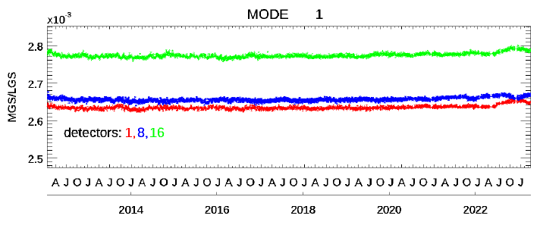
SNPP Calibration Performance
SNPP LGS calibration coefficients trends (Mode/Detector/HAM) are stable.
SNPP LGS calibration coefficients show a large increase in the early mission.
Calibration coefficients ratios are comparably stable
Anomalies have negligible impacts on the calibration coefficients
6
Notes:
6

Slide 7
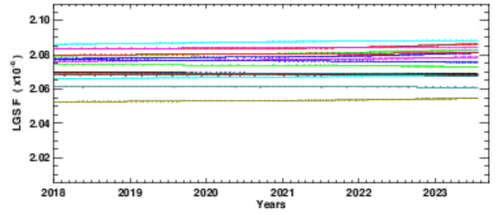
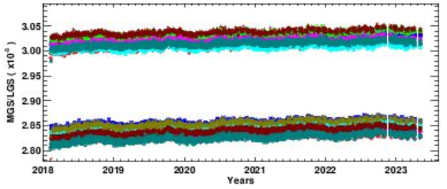
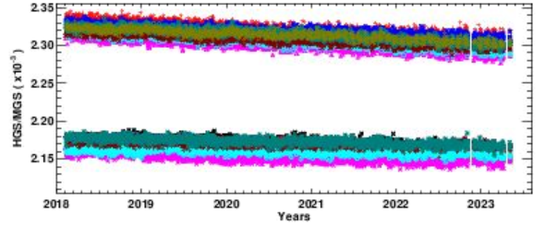
N20 Calibration Performance
N20 LGS calibration coefficients trends (Mode/Detector/HAM) are very stable in entire mission
Two families are observed in the ratios of MGS/LGS and HGS/MGS, mainly depending on detector locations.
Gain ratios of HGS-to-LGS are roughly in one family for all detectors
7
Notes:
7

Slide 8
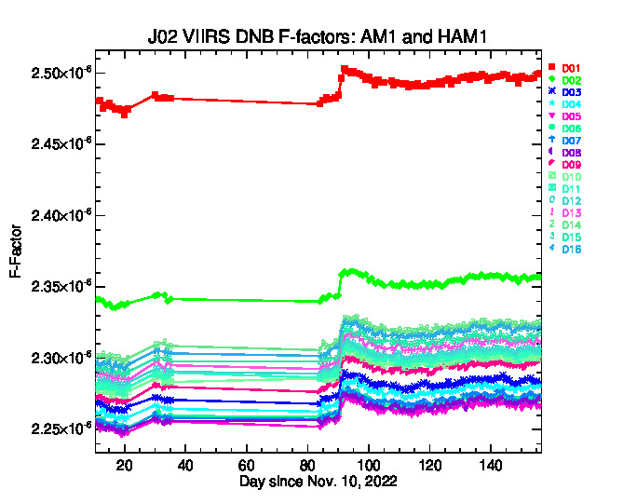
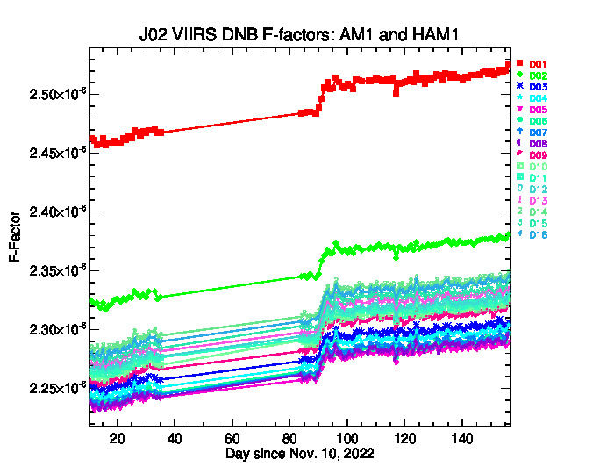
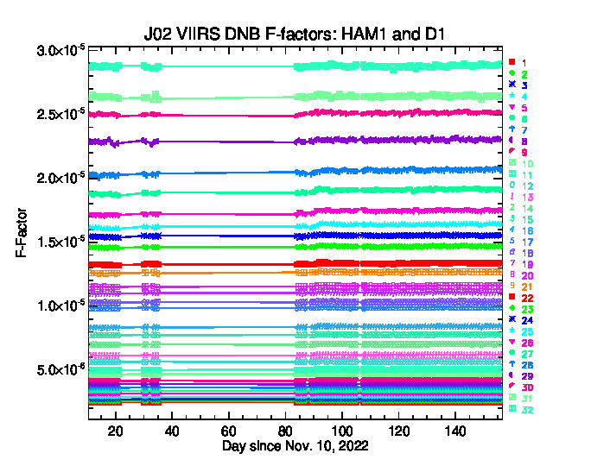
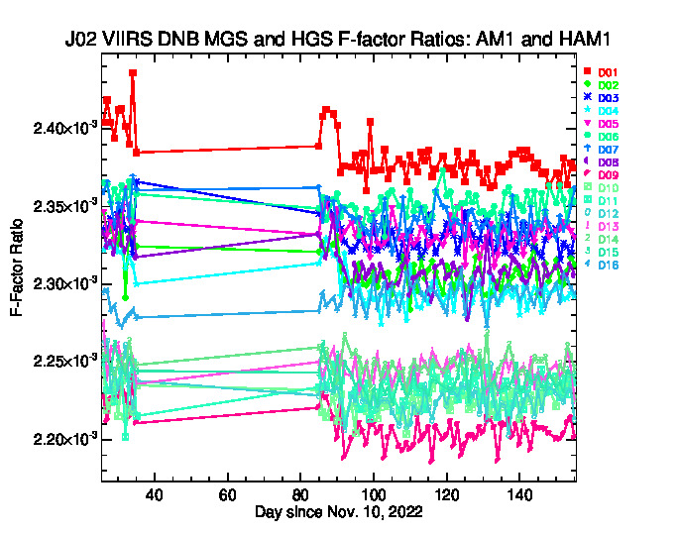
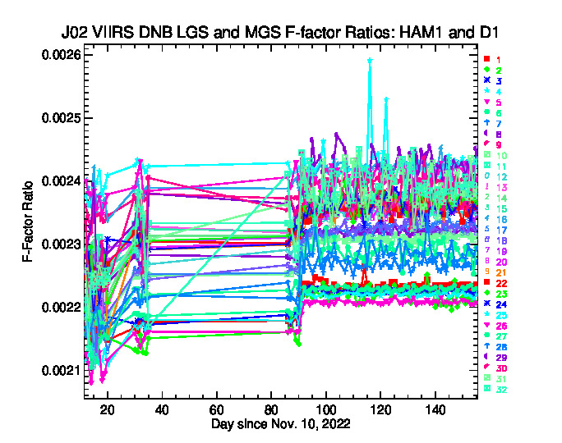
J2 DNB Calibration Performance
With H-Factors applied
Without H-Factors applied
J2 LGS/MGS/HGS F-factor trends (Mode/Detector/HAM) are stable.
Small oscillations in LGS F-factor were mainly due to the oscillations in H-factors.
8
Notes:
8

Slide 9
VIIRS DNB Dark Offset Determination Algorithms
Dark Offset
  Calculate dark trend using the minimum of SV/BB/SD data in the sun declination angle range, 40~140 degree.
  Normalize dark trend at the pitch maneuver value (Mode, Det, HAM, Gain) for each instrument.
  VROP data are used for SNPP DN0 after safe mode anomaly in 2021.
9
Notes:
9

Slide 10
SNPP Dark Offsets
Dark offsets are tracked using minimal values from OBC data, and then normalized to pitch maneuver values (February 20, 2012).
Dark offsets show gradually increased for HGS and MGS.
Dark offsets in LGS are relatively small, and the changes are in 0.5 digital count.
10
Notes:
10

Slide 11
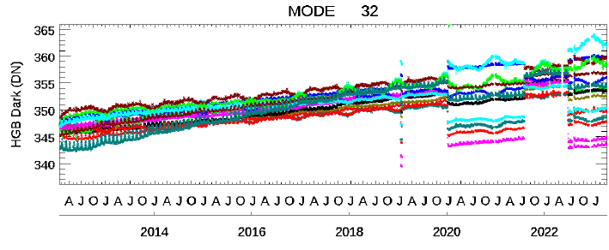
SNPP Dark Offsets
The DN0 changes after each anomaly, especially in HGS large aggregation mode.
The changes for HGA and HGB may be different.
11
Notes:
11

Slide 12
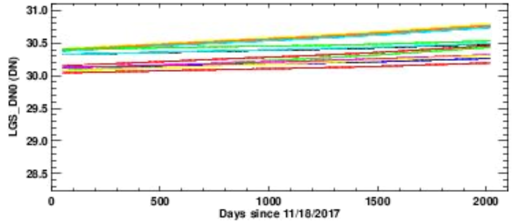
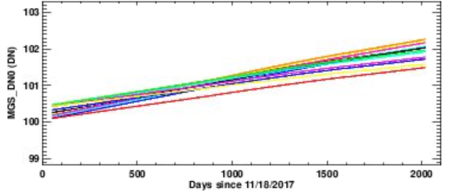
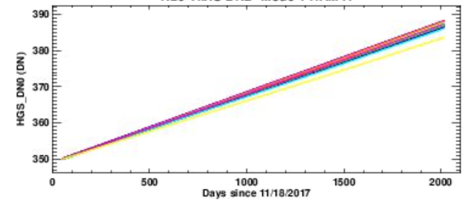
N20 Dark Offsets
Dark offsets are tracked using minimal values from OBC data, and then normalized to pitch maneuver values (January 31, 2018).
Dark offsets show gradually increased for all gain stages
12
Notes:
12

Slide 13
J2 Dark Offsets
Ndir-Door
Cryol-Door
Dark offsets are tracked using minimal values from OBC data, and then normalized to pitch maneuver values (2023).
Dark offsets are stabilized after Feb. 9, 2023
13
Notes:
13

Slide 14
Summary
  SNPP/N20/J2 VIIRS DNB are in normal operations, and on-orbit calibration has been successfully performed.
  The DNB calibration coefficients for all detectors, HAM sides, gain stages, aggregation modes, and the three instruments, are stable and perform well.
  The DNB dark offsets perform well but may have discontinuities due to the instrument anomalies, especially for HGS.
14
Notes:
14

