Slide 1



(Terra, Aqua)
MODIS Geometric Calibration Status
NASA MODIS Characterization Support Team (MCST)
Geometric Calibration Group
Guoqing (Gary) Lin, Robert E. Wolfe, NASA/GSFC Code 619
Ping Zhang, Bin Tan, Apexa Patel, SSAI/GSFC Code 619
John Dellomo, GST/GSFC Code 619
NASA MODIS-VIIRS Calibration Workshop
5/1/2023, in-person
(last one, 2/25/2021,virtual)

Slide 2
Outline
Changes since last STM in February 2021
Geolocation performance for MODIS on Terra and Aqua
  Overall performance
  Trends & details
Terra and Aqua orbit drifts and geometric effects
C7 readiness, with improvements
Conclusions

Slide 3
Changes since last STM in February 2021
Terra and Aqua satellites have drifted out of the constellation
Ground control point (GCP) library was refreshed with Landsat-8 sub-images
MODIS C6 was de-commissioned in February 2023
Prepared for C7 updates
  Updated LWM (year by year)
  Added a solar eclipse data field
  Generated “C6.2” CP residuals using refreshed GCP library with C6.1 input, the results of which will be used to update geolocation LUTs for C7

Slide 4
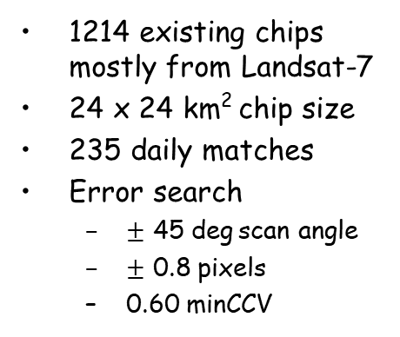
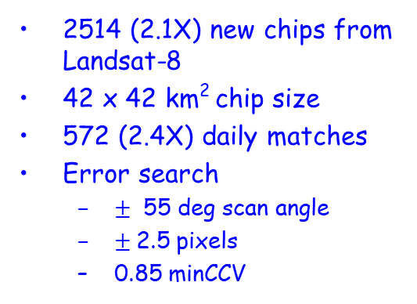
GCP refresh & match improvements
1214 existing chips mostly from Landsat-7
24 x 24 km² chip size
235 daily matches
Error search
  $±$ 45 deg$\text{scan} \text{angle}$
  $±$ 0.8 pixels
  0.60 minCCV
Tropic of Cancer
Tropic of Capricorn
New ground control points (GCPs) are used in “C6.2” with input from C6.1.
2514 (2.1X) new chips from Landsat-8
42 x 42 km² chip size
572 (2.4X) daily matches
Error search
  $±$ 55 deg scan angle
  $±$2.5 pixels
  0.85 minCCV
Tropic of Cancer
Tropic of Capricorn
GCPs within tropics seasonally switch side in the satellite mornings/afternoons

Slide 5
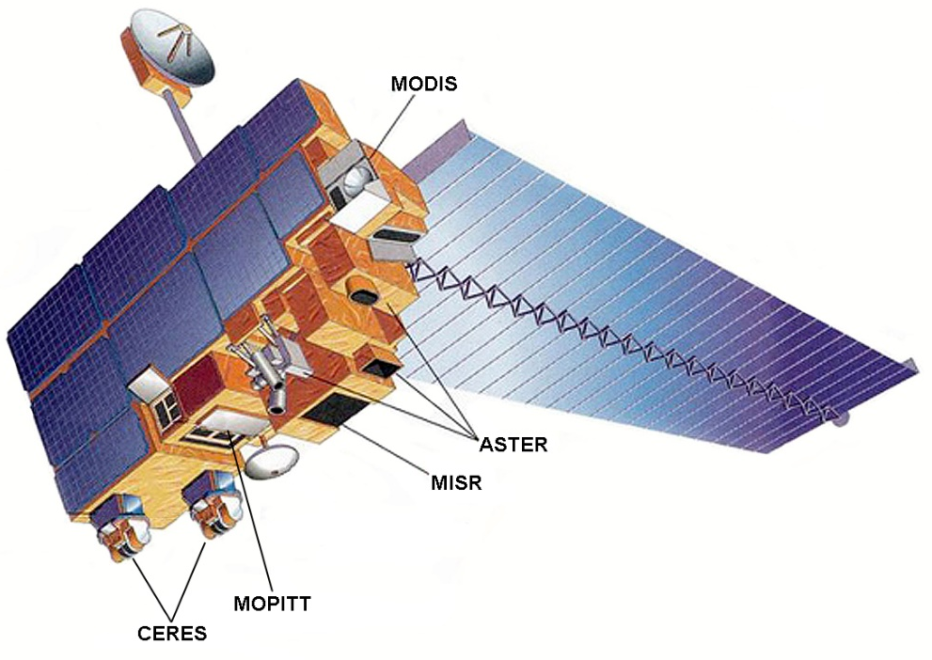
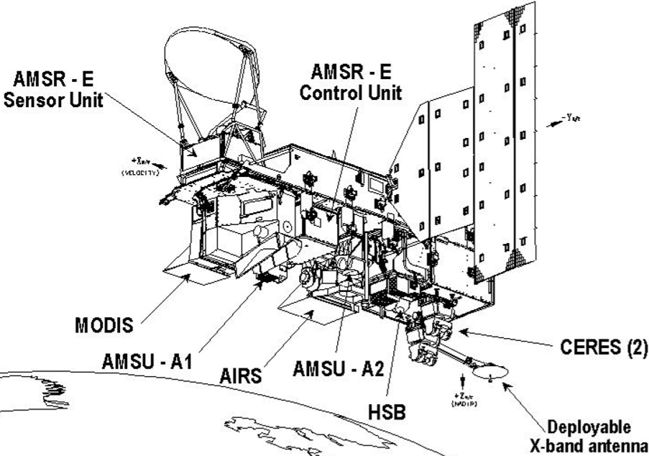
MODIS Collections timeline
Terra
Aqua
MODIS
MODIS
L=1999-12-18
L=2002-05-04
LTDN=10:30am
LTAN=13:35pm
C7
2/24/2000
re-processing
Terra Re-&Forward-Processing
C6
C6.1
21 22 23 24
7/4/2002
re-processing
Aqua Re-&Forward-Processing
C6 de-commissioned Feb 2023

Slide 6
Overall Geolocation performance
Residuals | Terra C6 | Aqua C6 | Terra C6.1 | Aqua C6.1 | Terra “C6.2” | Aqua “C6.2”
Track mean | 0 m | 3 m | -1 m | 2 m | 6 m | -5 m
Scan mean | -1 m | 1 m | 0 m | 0 m | -7 m | -6 m
Track RMSE | 43 m | 46 m | 43 m | 46 m | 44 m | 47 m
Scan RMSE | 45 m | 54 m | 45 m | 54 m | 45 m | 50 m
Data-days | 8316 (22.8 yrs) | 7500 (20.5 yrs) | 8366 (22.9 yrs) | 7558 (20.7 yrs) | 8367 (22.9 yrs) | 7554 (20.7 yrs)
Missing days | 74 | 37 | 72 | 26 | 71 | 30
Daily matched GCPs w/ B1 | 255 | 219 | 254 | 219 | 568 | 576
New Chip Library
Nadir equivalent accuracy (RMSE = Root Mean Square Error)
  Mostly within 20% band B1 HSI (250 m) = 50 m @ nadir;
  Within 10 % for HKM bands and 5% for KM bands
    Band-to-band mis-registration to other bands adds bias to RMSE :
Other features for MODIS geolocation
  Aqua uses definitive ephemeris data → 27 hour latency (Terra uses TDRSS-based on-board ephemeris)
  Aqua C6.1 corrected pointing variations (most of them) caused by AMSR_E stop - go slow – full stop activities → new trend in annual cycle

Slide 7
Terra trend and update details

Slide 8
Terra C6.1 long-term trend (uncorrected)
Final IAM, 2020-02-27
RMSE with no correction: Track: 49 m (+6 m vs C6.1) Scan: 48 m (+3 m vs C6.1)

Slide 9

Actual Terra C6.1 residuals
Final IAM, 2020-02-27
$±$20% 250m-band pixel size
C6.1 RMSE Track: 43 m Scan: 45 m, nadir equivalent

Slide 10
Actual Terra “C6.2” residuals w/ new GCPs
Final IAM, 2020-02-27
$±$20% 250m-band pixel size
C6.1 RMSE Track: 44 m Scan: 45 m, nadir equivalent

Slide 11
Terra scan profiles
C6.1 results
C6.2 results

Slide 12
Aqua trend and update details

Slide 13
Aqua C6.1 Long-term Trend (uncorrected)
AMSR-E
0->2 rpm
2013-12-5
AMSR-E
40->0 rpm
2011-10-4
AMSR-E
2->0 rpm
2015-12-4
Final IAM, 2021-03-18
RMSE with no correction: Track: 75 m (+29 m vs C6.1) Scan: 56 m (+2 m vs C6.1)

Slide 14

Actual Aqua C6.1 residuals
AMSR-E stops for good
Thermal conditions altered
$±$20% 250m-band pixel size
Final IAM, 2021-03-18
C6.1 RMSE Track: 46 m, Scan: 54 m, nadir equivalent

Slide 15
Actual Aqua “C6.2” residuals w/ new GCPs
AMSR-E stops for good
Thermal conditions altered
$±$20% 250m-band pixel size
Final IAM, 2021-03-18
“C6.2” RMSE Track: 47 m, Scan: 50 m, nadir equivalent

Slide 16
Aqua scan profiles
C6.1 results
C6.2 results

Slide 17
Terra & Aqua orbit drifts
Terra & Aqua satellites have exited the constellation
  Terra had final inclination adjust maneuver (IAM) on 2020-02-27and final drag make-up (DMU) on 2022-07-28
    Local time at descending node (LTDN) is gradually drifting to earlier morning
    Ground track repeatability has already drifted out of 0±20 km box
    Active constellation exit maneuvers (CEMs) on 12th & 19th in 2022-10
      The orbit altitude was lowered by ~ 5.5 km
      The orbit period was shortened by ~ 7.0 seconds
  Aqua had final IAM on 2021-03-18 and final DMU on 2021-12-01.
    Local time at ascending node (LTAN) is gradually drifting to later afternoon
    Ground track repeatability has already drifted out of 0±20 km box
    The orbit altitude is gradually lowered, and orbit period is gradually shortened
  The Flight Dynamics Support (FDS) team provided predicted ephemeris
    planned Perigee Lowering Maneuvers (PLMs) in 2026-07 for Aqua, and in 2027 for Terra.
    Aqua LTAN drifts from nominal 13:30 to 15:30 in July 2026 before PLMs
    Terra LTDN drifts from nominal 10:30 to 08:30 in December 2026 before PLMs
    MODIS maximal scan gaps at nadir widen from ~1/2 to ~1 ¼ QKM pixels (out of 40 QKM pixels per scan) in December 2026 for Terra and in July 2026 for Aqua before PLMs

Slide 18
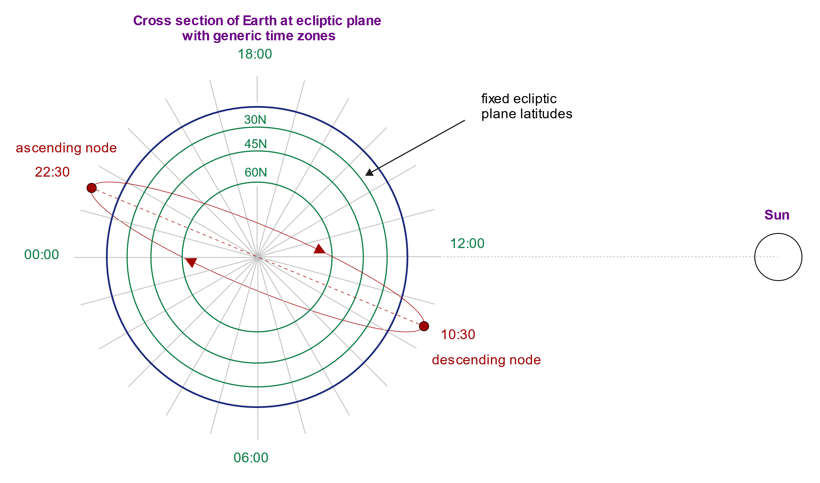
Terra & Aqua orbiting planes
15:30 Aqua 2026-07 before PLMs
13:30 Aqua L:2002-05-04
Ascending node
Sun
Terra L:1999-12-18
1:30
descending node
08:30 Terra 2026-12 before PLMs
https://upload.wikimedia.org/wikipedia/commons/2/25/Sun-Synchronous_Orbit_with_LST_Zones.svg
Diagram showing a Sun-synchronous orbit from a top view of the ecliptic plane with Local Solar Time (LST) zones for reference and a descending node of 10:30 am. The LST zones show how the local time beneath the satellite varies at different latitudes and different points on its orbit.

Slide 19
Drifts of Terra LTDN, orbital period and MODIS scan gaps
CEMs, 2022-10-12,19
Final IAM, 2020-02-27
After ceasing IAM, LTDN drifts to earlier morning time (the CEMs did not have obvious effect)
The CEMs reduced mean radius ~ 5.5 km from ~ 7082 km and orbital period ~ 7s from 5933 s.
The maximal scan-to-scan underlap (gap) at nadir increased from ~90 m before CEMs to ~200m (out of 10 km per scan, 40x250m pixels in QKM bands)
Final DMU, 2022-07-28
Constellation Exit Maneuvers, 2022-10-12,19

Slide 20
Drifts of Aqua LTAN, orbital period and MODIS scan gaps
Final IAM, 2021-03-18
After ceasing IAMs, LTAN drifts to later afternoon time
After ceasing DMUs, orbital period drifts shorter while mean radius and altitude drift lower
The maximal scan-to-scan underlap (gap) at nadir gradually increases to ~140m (out of 10 km per scan and 40x250m pixels in QKM bands)
Final DMU, 2021-12-01

Slide 21

Scan-to-scan underlap w/ nominal EFL
$Overlap=n\frac{p}{F}h−[V_{ECI}−V_{earth0}\cos{i} ]T$, if < 0 → underlap
where F = effective focal length = Mag x aft optic focal length, p = detector “pitch” interval in the track direction, n = # detectors, h = range from satellite to earth terrain surface altitude, T = scan period, i=inclination angle (in ECI) < 90 deg for J1, V_{ECI} = spacecraft ground speed in the inertial frame, Vearth0 = speed of earth rotation at equator, Overlap < 0 indicates underlap.
Underlap 150m
Underlap 100m
Underlap 200m
Underlap 200m
2023-04-02
2023-03-15
underlap
MODIS has maximum underlaps ~ 15ºN at nadir with limited off-scan angles
After A-train exit ~2022 with a few km lowering, underlaps widen from ~ 100 m to ~ 200m

Slide 22
Predictions of orbit drifts
The Flight Dynamics Support (FDS) team provided predicted ephemeris data with planned Perigee Lowering Maneuvers (PLMs) for Aqua in 2026-07, and PLMs for Terra in 2027 after instruments passivation.
  Aqua LTAN drifts from nominal 13:30 to 15:30 before PLMs in July 2026
  Terra LTDN drifts from nominal 10:30 to 08:30 in December 2026 before PLMs
  MODIS maximal scan gaps at nadir widen from ~1/2 to ~1 ¼ QKM pixels (out of 40 QKM pixels per scan) in December 2026 for Terra and in July 2026 for Aqua before PLMs

Slide 23
Predicted Terra LTDN, orbital period and MODIS scan gaps
PLMs planned in early 2027
CEM 2022-10
After ceasing IAM, LTDN drifts to earlier morning time (the CEMs did not have significant effect)
After ceasing DMUs, orbital period becomes shorter while mean radius and altitude drift lower
The maximal scan-to-scan underlap (gap) at nadir gradually increases to ~300m (out of 10 km per scan, 40x250m pixels in QKM bands)
Constellation Exit Maneuvers, 2022-10-12,19

Slide 24
Predicted Aqua LTAN, orbital period and MODIS scan gaps
PLMs, 2026-07
After ceasing IAMs, LTAN drifts to later afternoon time
After ceasing DMUs, orbital period becomes shorter while mean radius and altitude drift lower
The maximal scan-to-scan underlap (gap) at nadir gradually increases to ~300m (out of 10 km per scan and 40x250m pixels in QKM bands) before PLMs in July 2026
Perigee lowering maneuvers (PLMs), 2026-07

Slide 25
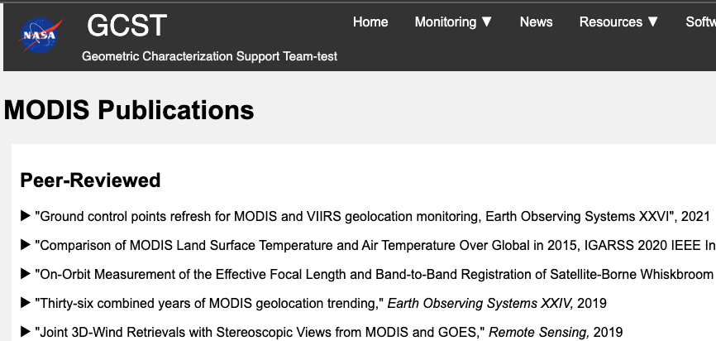
Future work (C7 is on the way!)
Routine monitor and LUTs update as needed
LUT updates from errors measured by new chips
Update LWM (year by year)
Add a solar eclipse data field
Create GCST (Geometric Characterization Support Team) website
Add geolocation offsets @QKM levels (currently @HKM level)
Update DEM, to better than HKM and remove 1KM DB
Automate GEO LUT updates
Anything Else?
Any change in priority order?

Slide 26
Concluding Remarks
Geolocation performance for MODIS on Terra and Aqua is good
  mean errors for band B1 near 0 and uncertainties are ~ 50 m at nadir for the missions, statistically
  C6.1 corrected for artifacts in C6 by LUT updates
    C6 was decommissioned in February 2023
  AMSR_E stop-go-stop activities on Aqua induced MODIS geolocation errors, which were corrected for in C6.1. C7 will correct for more.
GCP refresh
  Denser global distribution helps monitoring geolocation accuracy
  “C6.2” CP residuals are computed for better C7
Analysis of orbit lowering
  No impact on geolocation accuracy is expected
  Swath width are slightly narrower
  Scan-to-scan gaps are slightly wider to ~ QKM (2.5% of 10 km scan width)

