Slide 1
(SNPP + J1/N20 + J2/N21 + J3 + J4)
VIIRS Geometric Calibration Status
NASA VIIRS Characterization Support Team (VCST)
Geometric Calibration Group
Guoqing (Gary) Lin, Robert E. Wolfe, NASA/GSFC Code 619
Ping Zhang, Bin Tan, Apexa Patel, SSAI/GSFC Code 619
John Dellomo, GST/GSFC Code 619
NASA MODIS/VIIRS Calibration Workshop
1 May 2023, In-person
(last in-person Nov 2019; last one on 25 Feb 2021, virtual)

Slide 2
Outline
Changes since STM in Feb 2021
SNPP VIIRS Geolocation in C1.1, C2
J1/N20 VIIRS Geolocation in C2, C2.1
J2/N21 VIIRS initial Geolocation in “C2”
Expectations for J3, J4 VIIRS
Plan in future work
Conclusions
VCST/GEO 2

Slide 3
Changes since last STM
Refreshed ground control point (GCP) chip library from Landsat-8 images, generating ~ 4X as many daily matches as in the existing GCP library
  fully utilized in SNPP C2
  J1/N20 C2.1 (in L1, but used to generate C2 in L2+ products)
  J2/N21 “C2”, test archive
SNPP C2 also implemented
  Kalman Filter for attitude improvement
  VIGMU (VIIRS instrument geometric model update)
  Temporal pointing correction
J2 launched on 11/10/2022, became NOAA-21
J3 VIIRS is in I&T with spacecraft
J4 VIIRS completed ambient tests
VCST/GEO 3

Slide 4
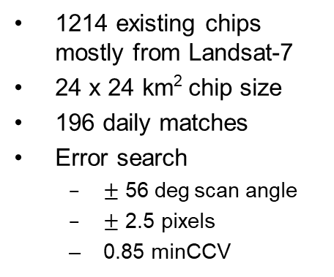
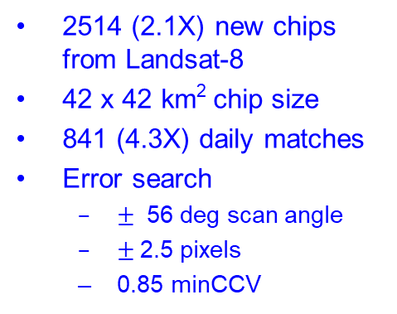
GCP refresh & match improvements
The existing GCP library is still used in SNPP C1.1, and J1 C2 (L1 only)
1214 existing chips mostly from Landsat-7
24 x 24 km² chip size
196 daily matches
Error search
  $±$ 56 deg$\text{scan} \text{angle}$
  $±$ 2.5 pixels
  0.85 minCCV
Tropic of Cancer
Tropic of Capricorn
New ground control points (GCPs) are used in SNPP C2, J1 C2.1, and J2 “C2”.
2514 (2.1X) new chips from Landsat-8
42 x 42 km² chip size
841 (4.3X) daily matches
Error search
  $±$ 56 deg scan angle
  $±$2.5 pixels
  0.85 minCCV
Tropic of Cancer
Tropic of Capricorn
GCPs within tropics seasonally switch side in the satellite mornings/afternoons
VCST/GEO 4

Slide 5
VIIRS Geolocation Performance
Residuals | SNPP C1.1 | SNPP C2 | J1/N20 C2 | J1/N20 C2.1 | J2/N21 “C2”
Track mean | 14 m | 2m | 2m | -4 m | -8 m
Scan mean | 5 m | 5 m | -2 m | 5 m | 2 m
Track RMSE | 59 m | 59 m | 55 m | 57 m | 60 m
Scan RMSE | 53 m | 48 m | 50 m | 47 m | 48 m
Data-days | 4081 (11.2 yrs) | 4081 (11.2 yrs) | 1917 (5.2 yrs) | 1917 (5.2 yrs) | 73 (0.2 yrs)
Missing days | 16 | 16 | 3 | 3 | 1
Daily matched GCPs w/ I1 | 199 | 845 | 194 | 838 | 846
New Chip Library
Nadir equivalent accuracy (RMSE – Root Mean Square Error)
  Meet Spec: 125 m (1σ); within 20% I1 HSI (375 m) = 75 m @ nadir
  Band-to-band mis-registration to other bands adds bias to RMSE to :
SNPP C2 uses Kalman filter for attitude improvement, VIGMU to remove oscillations in scan direction, and time-dependent instrument-to-spacecraft interface angles to remove temporal pointing variations
New chip library is used in SNPP C2 and J1/N20 C2.1 re-processing
J2/N21 data archive is currently in test archive, “C2”, and using the new chip library
VCST/GEO 5

Slide 6

SNPP C1.1 geolocation errors
$±$20% I-band pixel size
Temporal variations are corrected in C2
C1.1 RMSE Track: 53 m Scan: 48 m, nadir equivalent
VCST/GEO 6

Slide 7

SNPP C2 geolocation errors
New Chip Library
$±$20% I-band pixel size
Errors in forward-processing will be corrected in future re-processing
C2 RMSE Track: 59 m Scan: 48 m, nadir equivalent
VCST/GEO 7

Slide 8
Time series for SNPP VIIRS pointing correction
A B C D E F G H I
Events:
2012-11-22, side switch of VIIRS scan control electronics
2013-4-25, erroneous star trackers realignment
2015-8-19, 1-second time error onboard of SNPP (213 arcsec pitch error) for 7 hours
2019-3-22, Star Tracker-2 reset
2021-2-8, LUTs updates for forward processing in constant values
2021-8-3, safe hold and sun pointing
2021-11-27, Global Positioning System (GPS) had issued a "0" leap second
2022-1-13, LUTs updates for forward processing in constant values
2022-7-26, safe hold and sun pointing
These are corrected for in C2.
VCST/GEO 8

Slide 9
SNPP scan profiles
C1.1 results (old chip lib)
C2 results (new chip lib)
Strange pattern is corrected in C2
VIGMU (VIIRS instrument geometric model update) is implemented in C2
Tilt and curvature will be corrected in the future
VCST/GEO 9

Slide 10
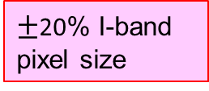
J1/N20 C2.1 geolocation errors
Uncorrected
Corrected for temporal variation
$±$20% I-band pixel size
C2.1 RMSE Track: 57 m Scan: 47 m, nadir equivalent
VCST/GEO 10
VCST/GEO 10

Slide 11
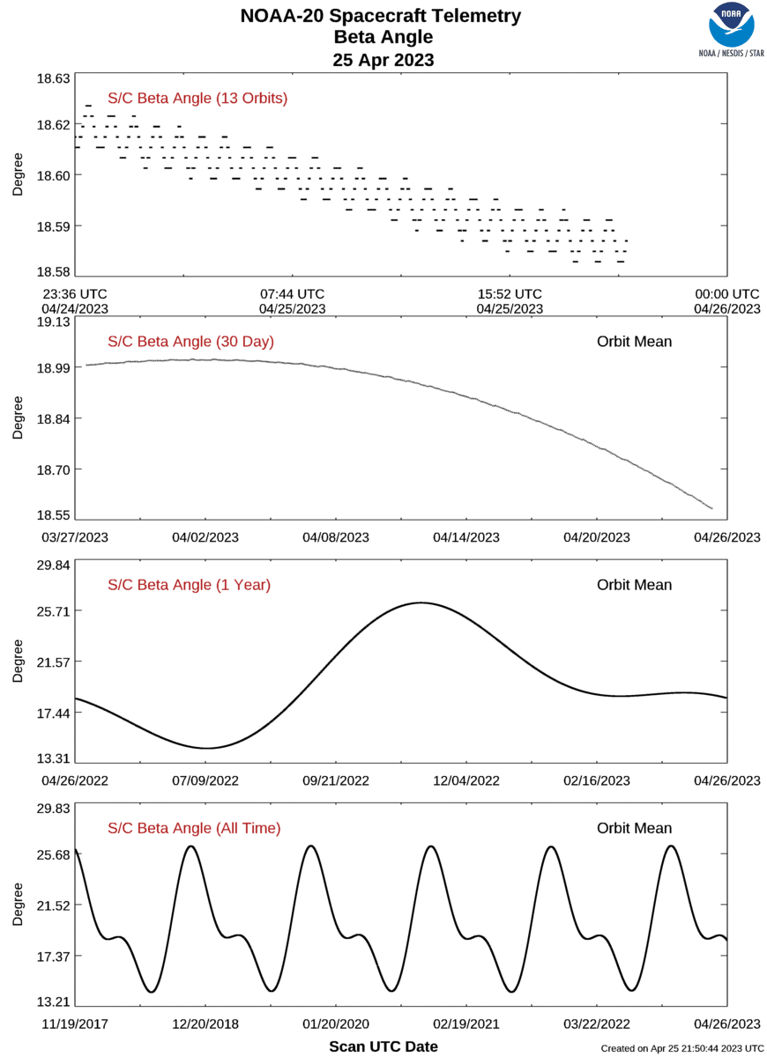

J1/N20 C2 geolocation errors
Pointing correction
Old Chip Library
$±$20% I-band pixel size
Pointing variation is likely related to beta angle
Courtesy: https://www.star.nesdis.noaa.gov/icvs/status_N20_sc.php
C2 RMSE Track: 55 m Scan: 50 m, nadir equivalent
VCST/GEO 11
VCST/GEO 11

Slide 12
J1/N20 scan profiles
C2 results (old chip lib)
C2.1 results (new chip lib)
VIGMU (VIIRS instrument geometric model update) implemented in J1 C2+
VCST/GEO 12

Slide 13

J2/N21* “C2” geolocation errors
After first on-orbit correction
Scan angle profiles
cryo door open
2/8/2023
$±$20% I-band pixel size
* J2 launched: 11/10/2022; Nadir door opened 12/5/2022; Geolocation LUTs updated 12/22/2022.
* Ka antenna transmitter failed 12/16/2022; Redundant Ka antenna activated 2/2/2023.
* J2 “C2” is currently in a test archive.
“C2” RMSE Track: 61 m Scan: 48 m, nadir equivalent
VCST/GEO 13
VCST/GEO 13

Slide 14
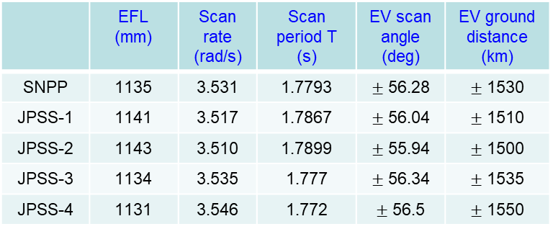
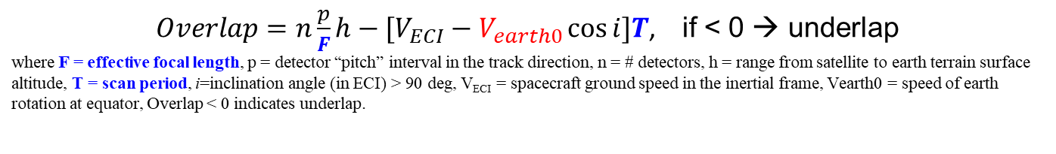
Expectations for J3, J4 VIIRS
J3 is in I&T with SC while J4 completed ambient tests
J3, J4 Geolocation – should be good with on-orbit calibration
J3, J4 Effective Focal Length (EFL) & scan period are shortened to mitigate scan-to-scan underlaps →Swath width increases
As-built VIIRS EFLs and scan rates and EV coverages
 | EFL (mm) | Scan rate (rad/s) | Scan period T (s) | EV scan angle (deg) | EV ground distance (km)
SNPP | 1135 | 3.531 | 1.7793 | $±$ 56.28 | $±$ 1530
JPSS-1 | 1141 | 3.517 | 1.7867 | $±$ 56.04 | $±$ 1510
JPSS-2 | 1143 | 3.510 | 1.7899 | $±$ 55.94 | $±$ 1500
JPSS-3 | 1134 | 3.535 | 1.777 | $±$ 56.34 | $±$ 1535
JPSS-4 | 1131 | 3.546 | 1.772 | $±$ 56.5 | $±$ 1550
Initial design
Mitigated
fabrication
target
$Overlap=n\frac{p}{F}h−[V_{ECI}−V_{earth0}\cos{i}]T$, if < 0 → underlap
where F = effective focal length, p = detector “pitch” interval in the track direction, n = # detectors, h = range from satellite to earth terrain surface altitude, T = scan period, i=inclination angle (in ECI) > 90 deg, V_{ECI} = spacecraft ground speed in the inertial frame, Vearth0 = speed of earth rotation at equator, Overlap < 0 indicates underlap.
VCST/GEO 14

Slide 15
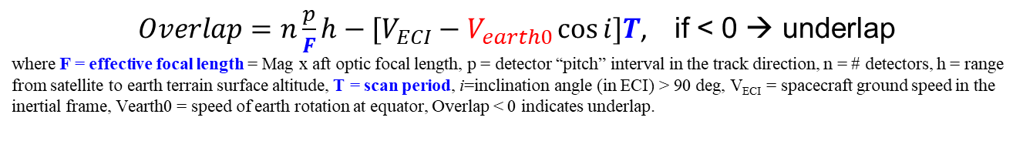
Scan-to-scan underlaps
$Overlap=n\frac{p}{F}h−[V_{ECI}−V_{earth0}\cos{i}]T$, if < 0 → underlap
where F = effective focal length = Mag x aft optic focal length, p = detector “pitch” interval in the track direction, n = # detectors, h = range from satellite to earth terrain surface altitude, T = scan period, i=inclination angle (in ECI) > 90 deg, V_{ECI} = spacecraft ground speed in the inertial frame, Vearth0 = speed of earth rotation at equator, Overlap < 0 indicates underlap.
Terrain effect
Inter-HAM-sides
Terrain effect
Inter-scan
Inter-scan
J1 Underlap
80m
J2 underlap
110m
Within scan
Within scan
Within scan
Underlaps occur near 15ºN, close off going north and south and off-nadir scan angles.
High terrain widens/creates the underlaps.
J2 has most of this issue
SNPP has almost none of the issue because of its shorter focal length (~0.5%).
J3, J4 mitigate the issue by shortening EFL & scan period
Inter-scan
NPP overlap
VCST/GEO 15

Slide 16
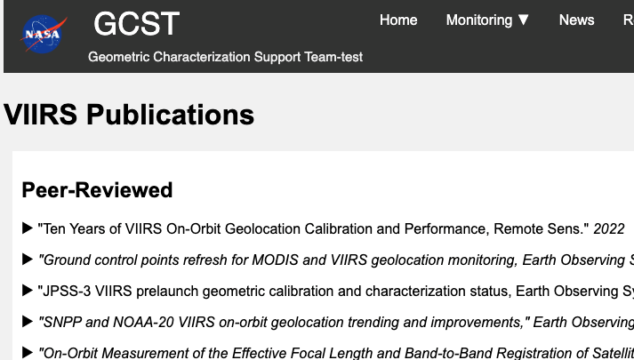
Future work
Routine monitor and LUTs update as needed
Update LWM (year by year)
Create GCST (Geometric Characterization Support Team) website
Create ground control point chip library in multi-spectral bands and implement in geolocation monitoring system (Landsat-8 band B6 chips available now for VIIRS band I3 geolocation error detection)
Update DEM from 1 km to 500m or finer resolution
Refine LUTs to correct for scan angle dependent biases
Replace SNPP and J1 ephemeris in SC diary with GPS data
Automate GEO LUT updates
Anything else?
Any change in priority order?
VCST/GEO 16

Slide 17
Conclusions
SNPP VIIRS geolocation performance is good
  Mean errors for I- & M-bands are ~ 10 m and uncertainties @1-σ are ~ 60 m at nadir, statistically.
  C2 perform better after implementing: 1) Kalman Filter for attitude; 2) VIGMU (VIIRS instrument geometric model update); 3) temporal pointing correction; 4) new GCP library.
J1/N20 VIIRS geolocation performance is good
J2/N21 VIIRS initial on-orbit geolocation is good
J3 VIIRS is being integrated with SC and J4 VIIRS completed ambient tests
  Shorter EFL and scan period mitigate scan-to-scan underlaps
VCST/GEO 17

Slide 18
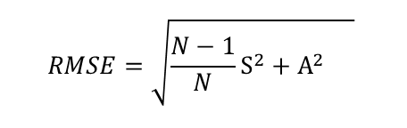

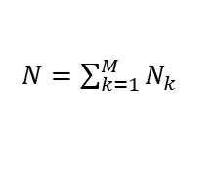

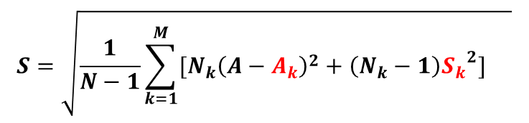



Questions?
$$S_{k}=\sqrt{\frac{1}{N_{k}−1}\sum_{i=1}^{N_{k}}{{\left(x_{ki}−A_{k}\right)}^{2}} }$$
Local arithmetic mean Local Stdev
Global arithmetic mean ,
Global Stdev
Root-mean-square-error (1-σ)
3-σ error bound
Some short-term anomalous A_{k} , $S_{k}$may be buried in long-term A, S.
$A_{k}=\frac{1}{N_{k}}\sum_{i=1}^{N_{k}}{x_{ki}}$
$$A=\frac{1}{N}\sum_{k=1}^{M}{{(N}_{k}A_{k}})$$
$N=\sum_{k=1}^{M}{N_{k}}$
$$S=\sqrt{\frac{1}{N−1}\sum_{k=1}^{M}{[N_{k}{\left({A−A}_{k}\right)}^{2}+\left(N_{k}−1\right){S_{k}}^{2}]} }$$
$$RMSE=\sqrt{\frac{N−1}{N}S^{2}+A^{2} }$$
$$E=\left|A\right| +3S$$
Thank you !
VCST/GEO 18

Slide 19
Backup Slides
VCST/GEO 19

Slide 20
VIGMU:
VIIRS instrument geometric model update
Puzzle: ground geolocation SW is supposed to correct RTA/HAM motion non-linearity
Long term trend from SNPP VIIRS still shows the pattern, but in the opposite direction
Answer:
Lsight = Ltel - 1/M ( Ltel – Lhamvector)
where M = -4 (not +4 as we are currently using), which affects line of sight due to the parts of RTA/HAM motion non-linearity (non-synchronization), which are relatively small

Slide 21
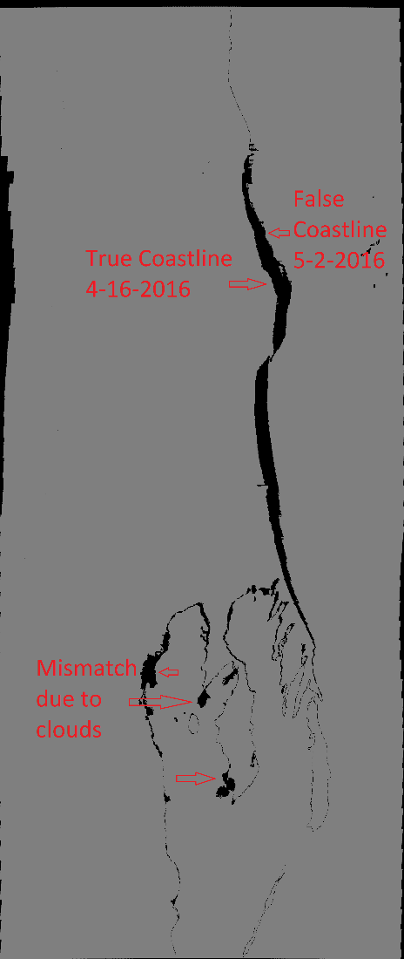
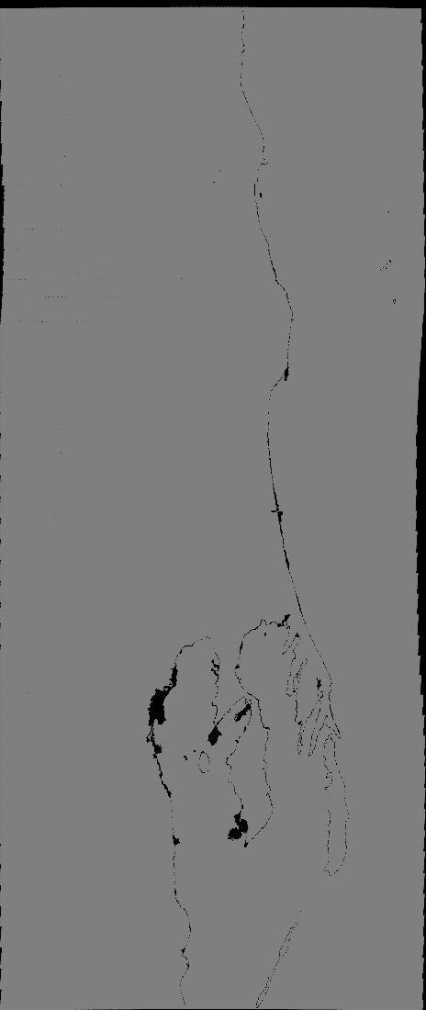
SNPP Attitude control & knowledge errors
2016-05-02 06:48:50 – 06:50:40z
with correction
Knowledge error
0 line
Control (to 0) error
Western Australian coast (south up)
Difference in “land”/”Water” masks from data 16 days earlier

Slide 22
SNPP SC attitude performance
- - Spec outage and trend
using ~90% data
Large circles for control spec outage; Small dots hint knowledge spec outage
Star tracker cooling improved SNPP attitude performance
We are seeking for further improvements¹
SW with Kalman filter to refine the attitude for NASA SIPSs is implemented in C2
J1 is performing better
1. My eRooms > S-NPP Flight Operations and Support > FARB > All Discussion Topics--Artifacts and Minutes > DR 6348--SNPP STAR TRACKER DEGRADATIONS OVER MISSION LIFE: ATTITUDE EXCURSIONS AND LUNAR INTRUSIONS > SNPP ADCS and Geolocation Report
VCST/GEO 22

Slide 23
Sun angle dependence
SNPP C1.1 (old chip lib)
SNPP C2 (new chip lib)
VCST/GEO 23

Slide 24
Sun angle dependence
J1/N20 C2 (old chip lib)
J1/N20 C2.1 (new chip lib)
VCST/GEO 24

Slide 25
J2 VIIRS Scan-to-scan underlaps
2023-02-10 19:30z - 20:20z
Terrain effects
Inter-scan
underlap
Widest underlaps occur at nadir near 15ºN at ~100 m in this case. They narrow down as N21 goes north or south due to increasing altitude.
High terrain widens the underlaps.
N20 VIIRS has smaller underlap (next chart)
SNPP VIIRS has less of this issue because of its shorter focal length and faster scan speed (~0.5%) than N20 VIIRS
Within scan
underlap
overlap
Inter-scan
VCST/GEO 25

Slide 26
J1 VIIRS Scan-to-scan underlaps
$Overlap=n\frac{p}{F}h−[V_{ECI}−V_{earth0}\cos{i}]T$, if < 0 → underlap
where F = effective focal length = Mag x aft optic focal length, p = detector “pitch” interval in the track direction, n = # detectors, h = altitude, T = scan period, i=inclination angle (in ECI) < 90 deg for J1, V_{ECI} = spacecraft ground speed in the inertial frame, Vearth0 = speed of earth rotation at equator, Overlap < 0 indicates underlap.
Inter-HAM-sides
Underlap
Terrain effects
Inter-scan
Underlap
Within scan
Widest underlaps occur at nadir near 15N at ~ 70 m in this case. They narrow down as J1 goes north or south due to increasing altitude. They also close in off nadir angles (@ ~10 deg) due to bowtie effects
High terrain widens the underlaps.
SNPP VIIRS has less of this issue because of its shorter focal length and faster scan speed (~0.5%)
overlap
VCST/GEO 26

Slide 27
SNPP C1 NRT as5000 geolocation errors
$±$20% I-band pixel size
Temporal variations are corrected in C2
C1 RMSE Track: 51 m Scan: 46 m, nadir equivalent minCCV=0.90
VCST/GEO 27

