Slide 1
Calibration of the SNPP and NOAA 20 VIIRS Sensors for Continuity of the MODIS Climate Data Records
MAIAC: A. Lyapustin, Y. Wang, M. Choi
with contributions from
MCST/VCST: X. Xiong, A. Angal, A. Wu
LaRC: D. R. Doelling, R. Bhatt
DB, Cloud groups: A. Sayer; K. Meyer

Slide 2
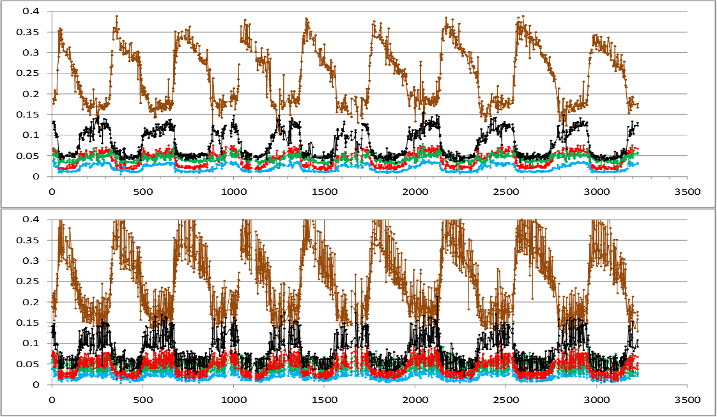
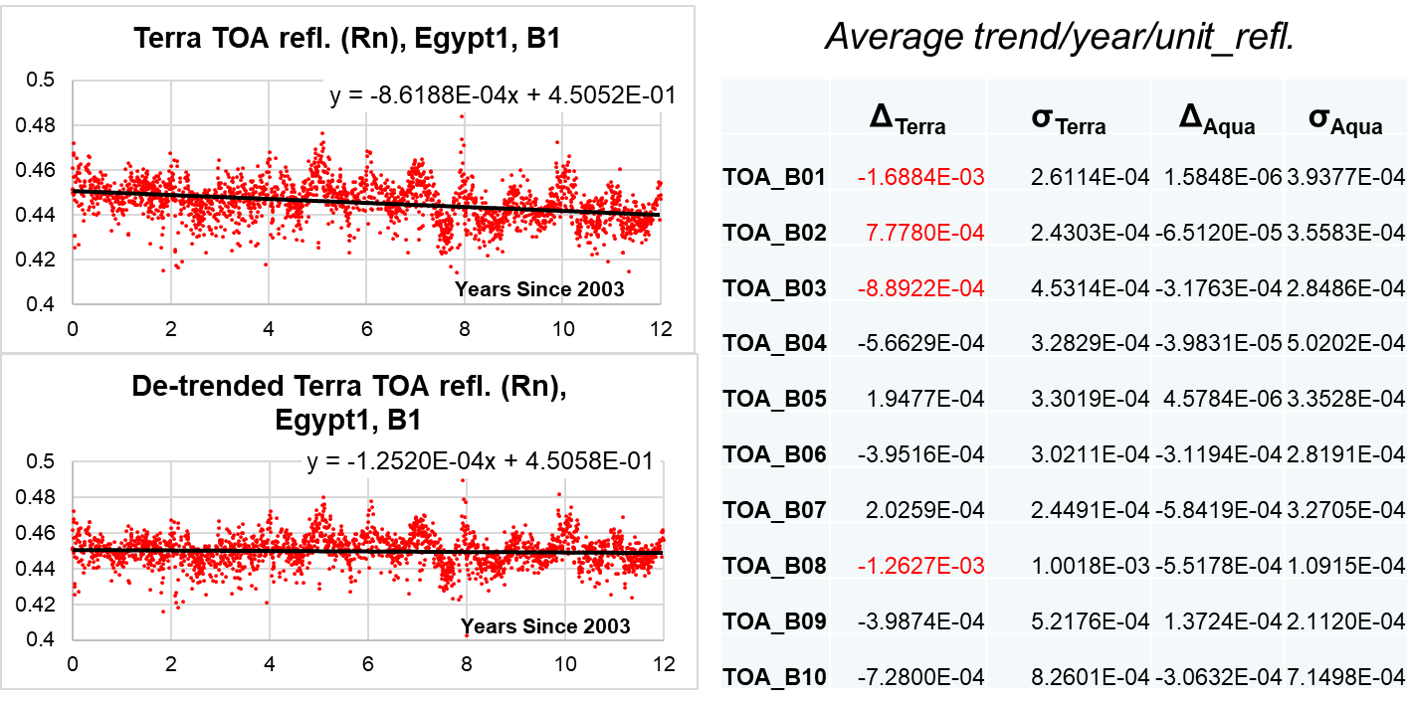
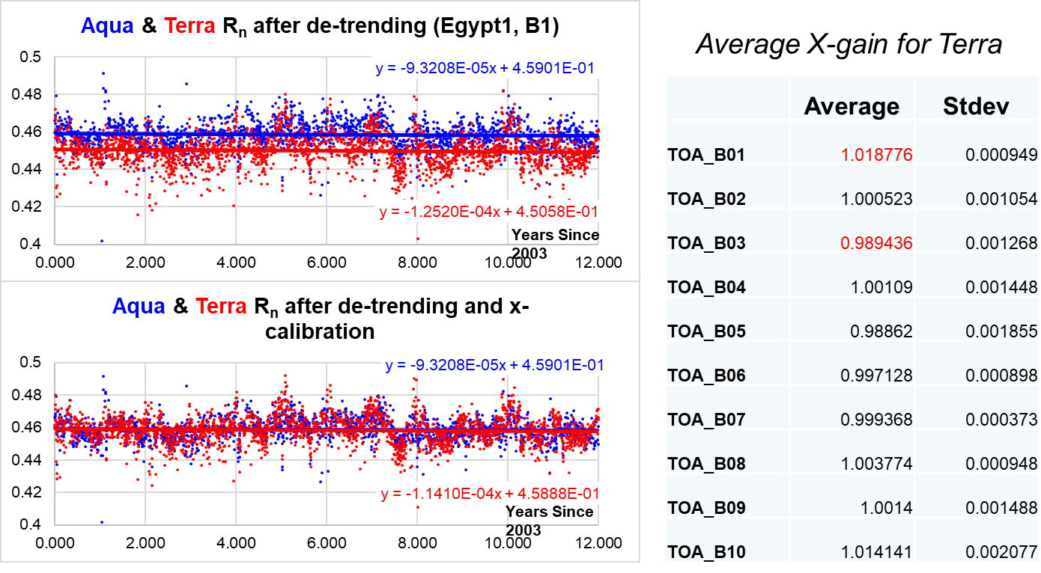
MODIS Calibration Over CEOS Desert Sites
Method:
1) Perform MAIAC retrievals (CM, AOT, WV, BRDF etc.);
2) Compute TOA reflectance (R_{n}) for a fixed view geometry (VZA=0°, SZA=30°) and evaluate trends in both Terra and Aqua;
3) Apply de-trending and compute Terra-Aqua X-calibration factor (gain correction for Terra)
(Lyapustin et al., AMT, 2014)
Lyapustin et al., 2012, RSE
BRDF normalization reduces variability by a factor of ~3-5!
Normalized BRF_{n}
Original BRF
(Red, Green, Blue, NIR, SWIR)
Developed calibration became a standard part of MODIS Land Discipline Processing in Collections C6 and C6.1.

Slide 3
Trend Analysis
Use the latest versions of L1B data:
MODIS C6.1 with polarization correction, de-trending and Terra-to-Aqua cross-calibration;
VIIRS SNPP C2.0
VIIRS N20 C2.1

Slide 4
VIIRS SNPP Normalized TOA Radiance Time Series

Slide 5
VIIRS J1 Normalized TOA Radiance Time Series

Slide 6
VIIRS Calibration Trends
Band | Intercept |  | Slope |  | Slope/Intercept (Trend/year/unit of refl.)
 | SNPP | N20 | SNPP (× 10⁻³) | N20 (× 10⁻³) | SNPP | N20
M1 | 0.224 | 0.209 | -0.016 ± 0.027 | -1.12 ± 0.16/-0.8 | -7.16E-05 | -5.35E-03
M2 | 0.230 | 0.219 | -0.13 ± 0.033 | -0.98 ± 0.15/-1.3 | -5.55E-04 | -4.47E-03
M3 | 0.251 | 0.240 | -0.055 ± 0.027 | -0.98 ± 0.12/-2 | -2.20E-04 | -4.08E-03
M4 | 0.340 | 0.336 | -0.063 ± 0.029 | -1.24 ± 0.15/-1.4 | -1.84E-04 | -3.67E-03
M5 | 0.499 | 0.476 | -0.073 ± 0.034 | -0.53 ± 0.17/-0.7 | -1.47E-04 | -1.11E-03
M7 | 0.586 | 0.565 | -0.31 ± 0.043 | -0.26 ± 0.22/-0.8 | -5.31E-04 | -4.64E-04
M8 | 0.662 | 0.645 | -0.44 ± 0.052 | -0.11 ± 0.28/0.9 | -6.57E-04 | -1.74E-04
M10 | 0.696 | 0.681 | -0.39 ± 0.046 | 0.81 ± 0.29/0.0 | -5.61E-04 | 1.19E-03
M11 | 0.587 | 0.576 | -0.59 ± 0.063 | -1.49 ± 0.35 | -1.00E-03 | -2.59E-03
I1 | 0.463 | 0.451 | -0.31 ± 0.071 | -0.82 ± 0.28/-1.5 | -6.70E-04 | -1.83E-03
I2 | 0.585 | 0.563 | -0.37 ± 0.070 | 0.004 ± 0.26/-0.5 | -6.28E-04 | 7.03E-06
I3 | 0.706 | 0.670 | -0.59 ± 0.085 | 0.71 ± 0.30/~0.0 | -8.43E-04 | 1.07E-03
Table 1. Results from trend analysis of SNPP and N20 VIIRS including slope and intercept of linear regression, and ratio slope/Intercept in units of reflectance (change)/unit reflectance/year. For N20, a second value separated by ‘/’ gives the VCST trend (Twedt et al., 2022).

Slide 7
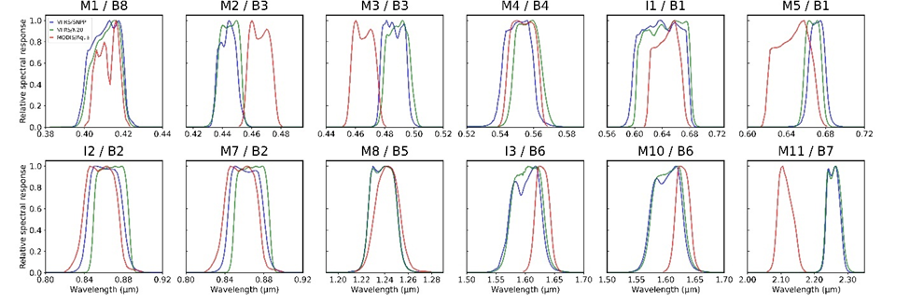
VIIRS X-Cal to MODIS Aqua
Because bands are different, sensors measure different reflectance over the same targets (with spectral dependence), we need to account for the RSR differences

Slide 8
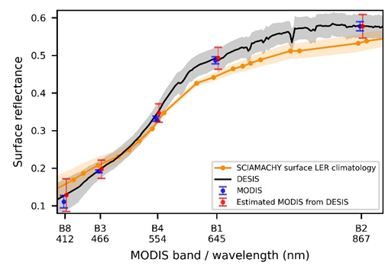
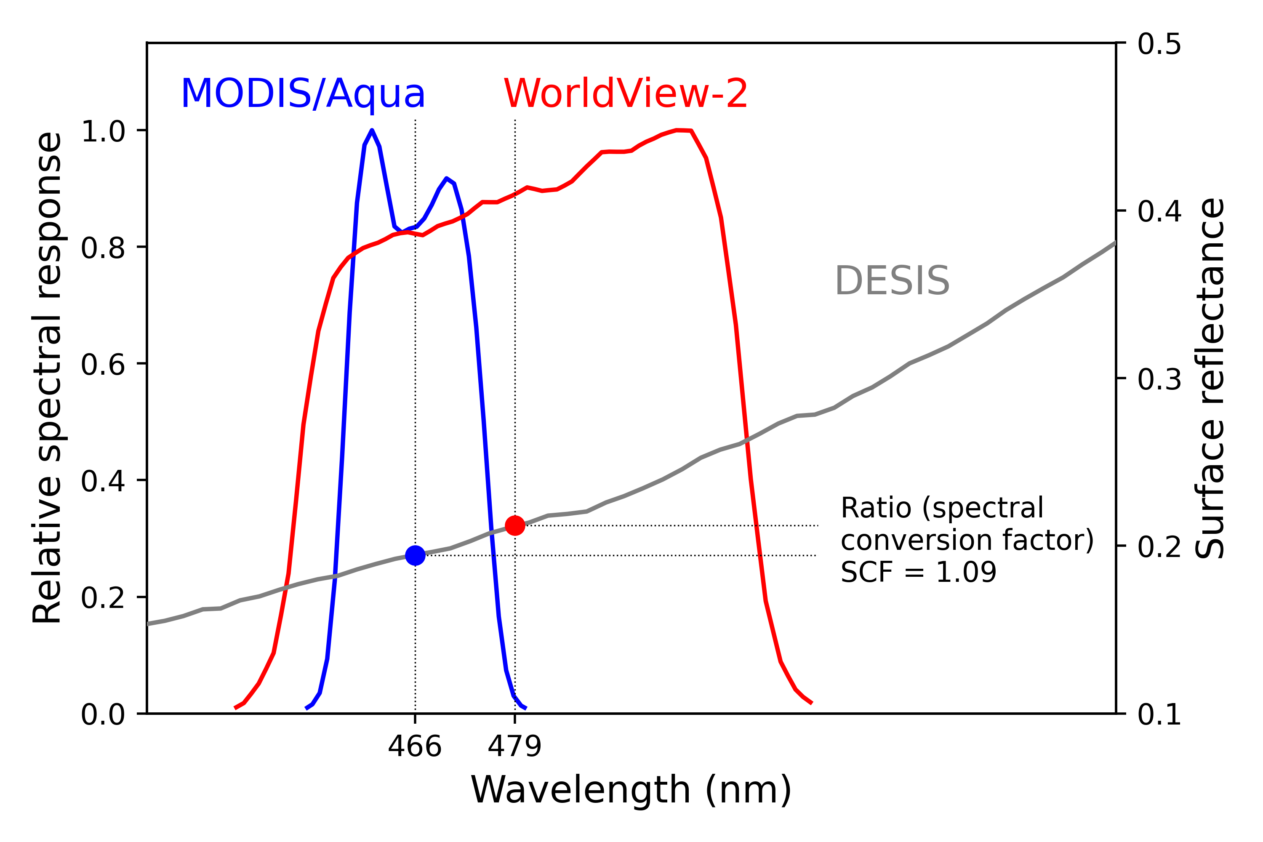
Spectral Conversion Factor
DESIS - DLR Earth Sensing Imaging Spectrometer, on ISS since 2018 (400-1000nm, spectral sampling at 2.55 nm and res. of 3.5 nm; 30m spatial resolution and ~ 30km swath). By our request, 97 DESIS measurement granules were collected over Libya-4 during 2018−2021. 12 are good.
Spectral convolution of surface reflectance
$ρ_{simulated}=\frac{\sum{ρ_{λ}E_{λ}RSR_{λ}dλ}}{\sum{E_{λ}RSR_{λ}dλ}}$
$ρ_{λ}$: DESIS surface reflectance with high spectral resolution
$E_{λ}$: solar irradiance
$RSR_{λ}$: spectral response function
BRDF normalization factor
$c(λ)=\frac{\begin{aligned}BRF from fixed view geometry \\ (SZA 20°, VZA 0°, RAA 0°)\end{aligned}}{BRF from various DESIS view geometries}$
BRDF from MODIS MAIAC
$ρ_{simulated}^{n}(λ)=ρ_{simulated}(λ)∗c(λ)$
Spectral conversion factor (SCF)
SCF = $\frac{ρ_{simulated \left(DG sensors\right)}^{n}}{ρ_{simulated \left(MODIS/Aqua\right)}^{n}}$
DESIS
SCIAMACHY
MODIS A
5×5 M-pixels,
10×10 I-pixels
~4×4km² area

Slide 9
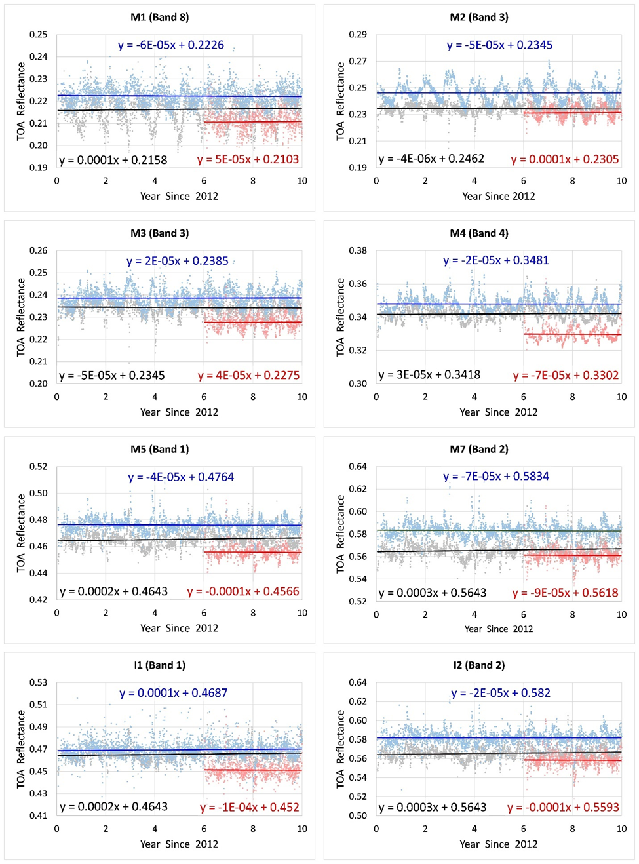
VIIRS X-Calibration to MODIS Aqua
VIIRS BRDF is multiplied by the Spectral Conversion Factor (this effectively “shifts” the VIIRS band to the MODIS reference band), and VIIRS normalized TOA reflectance is computed at the MODIS wavelength. This way, both surface and atmospheric RT computations are done at the same wavelength ensuring 1:1 comparison.

Slide 10
Aqua/VIIRS NPP/VIIRS J1 X-calibration Summary
Band | SBAF |  | X-calibration Coefficients
 | Aqua/SNPP | Aqua/N20 | Aqua/SNPP | Aqua/N20 | SNPP/N20
B8/M1 | 0.960 | 1.001 | 0.974 ± 0.033 | 1.028 ± 0.034 | 1.055 ± 0.028
B3/M2 | 1.197 | 1.191 | 0.952 ± 0.031 | 1.014 ± 0.026 | 1.065 ± 0.034
B3/M3 | 0.889 | 0.882 | 0.982 ± 0.023 | 1.029 ± 0.021 | 1.048 ± 0.021
B4/M4 | 1.026 | 0.978 | 0.983 ± 0.018 | 1.037 ± 0.018 | 1.055 ± 0.018
B1/M5 | 0.959 | 0.962 | 0.978 ± 0.017 | 1.021 ± 0.017 | 1.044 ± 0.016
B2/M7 | 1.001 | 0.999 | 0.971 ± 0.017 | 1.008 ± 0.017 | 1.039 ± 0.017
M8 | - | - | - | - | 1.026 ± 0.017
M10 | - | - | - | - | 1.022 ± 0.016
M11 | - | - | - | - | 1.020 ± 0.040
B1/I1 | 1.016 | 1.004 | 0.992 ± 0.023 | 1.032 ± 0.021 | 1.040 ± 0.026
B2/I2 | 1.001 | 0.998 | 0.973 ± 0.018 | 1.013 ± 0.018 | 1.042 ± 0.019
I3 | - | - | - | - | 1.054 ± 0.018
Table 2. Spectral Band Adjustment Factor (SBAF) for SNPP and N20 VIIRS to MODIS Aqua, and pair-wise cross-calibration coefficients among the three sensors.

Slide 11
Aqua/VIIRS NPP/VIIRS J1 X-calibration Summary
Band Pair | This work |  |  | MCST/VCST (Wu et al., 2022) |  |  | CERES-IGCG (LaRC) |  |  | Meyer et al (2020) |  | Sayer et al (2017)
 | A/S | A/N | S/N | A/S | A/N | S/N | A/S | A/N | S/N | A/S | A/N | A/S
B8/M1 | -2.6 | 2.8 | 5.5 | -5.0 - -3.8 | 2.6-4.8 | 5.9-7.9 | - | - | - | - | - | -0.5
B3/M2 | -4.8 | 1.4 | 6.5 | B9: -0.5 - -1.5 | 5.4-6.2 | 5.8-6.6 | - | - | - | - | - | B9: 0
B3/M3 | -1.8 | 2.9 | 4.8 | B10: -5.5 - -3.2 | -1.1-1.7 | 4.4-5.2 | -1.8 | 3.7 | 5.6±0.2 | - | - | -0.8
B4/M4 | -1.7 | 3.7 | 5.5 | -0.3 - -2.6 | 1.9-3.6 | 3.4-5.5 | -2.8 | 2.9 | 5.8±0.2 | - | - | -4.4
B1/M5 | -2.2 | 2.1 | 4.4 | -2.0 - 0.6 | 2.4-6.0 | 3.4-5.4 | -3.1 | 2.4 | 5.4±0.2 | -5.0 | 0 | -5.9
B2/M7 | -2.9 | 0.8 | 3.8 | -1.1 - 0.0 | 0.7-3.1 | 2.5-4.0 | -2.1 | 2.3 | 4.2±0.2 | -3.0 | 1.0 | -4.0
B5/M8 | - | - | 2.6 | -3.4 - 1.9 | -1.4-0.5 | 1.8-2.9 | -3.1 | -1.0 | 2.0±0.2 | -1.0 | 2.0 | 1.0
B6/M10 | - | - | 2.2 | -3.5 - -1.3 | - | 1.2-2.9 | -1.5 | 1.4 | 2.5±0.3 | -2.0 | 2.0 | -2.0
B7/M11 | - | - | 2.0 | - | - | 1.2-2.1 | - | - | 1.6±0.5 | -3.0 | -1.0 | -7.0
B1/I1 | -0.8 | 3.2 | 4.0 | -0.6 - 1.3 | 2.7-4.2 | 3.0-4.8 | -1.0 | 3.8 | 4.8±0.2 | - | - | -
B2/I2 | -2.7 | 1.3 | 4.2 | -1.0 - -0.1 | 1.1-3.0 | 2.6-3.1 | - | - | - | - | - | -
B6/I3 | - | - | 5.4 | -3.5 - -1.8 | -0.3-2.1 | 3.1-3.9 | -2.2 | 2.4 | 5.0±0.3 | - | - | -
Table 3. Cross-calibration biases (%) among MODIS Aqua (A), VIIRS SNPP (S) and VIIRS N20 (N) from different sources. VCST – Desert, Dome C, SNO, DCC (Wu et al., 2022); LaRC - Desert, Dome C, Ray Matching, DCC.

Slide 12
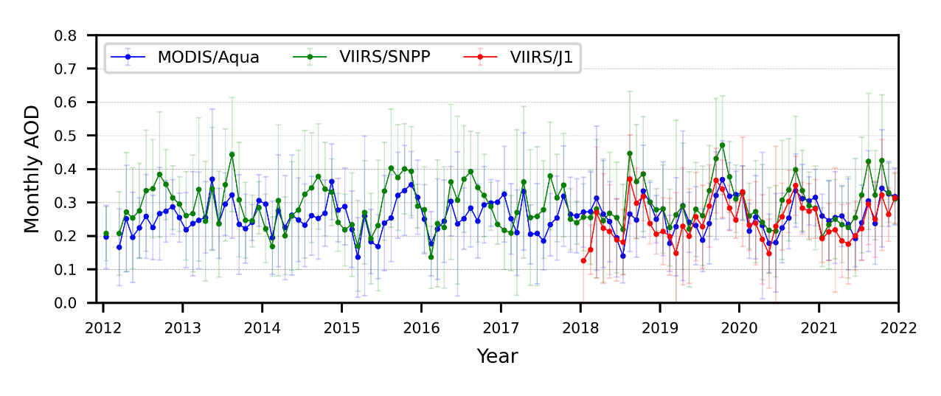
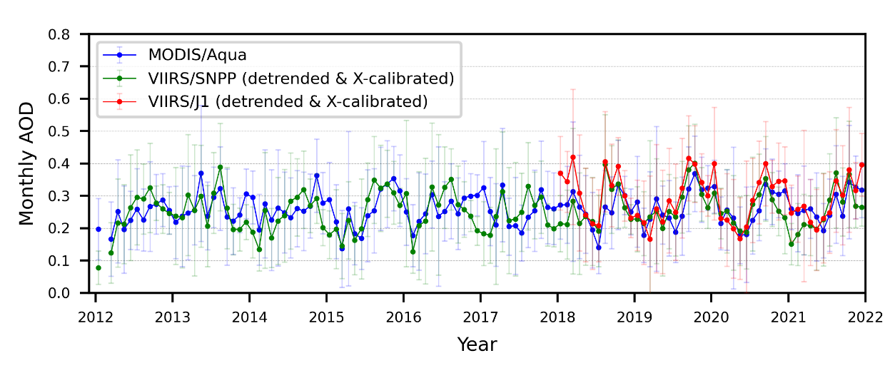
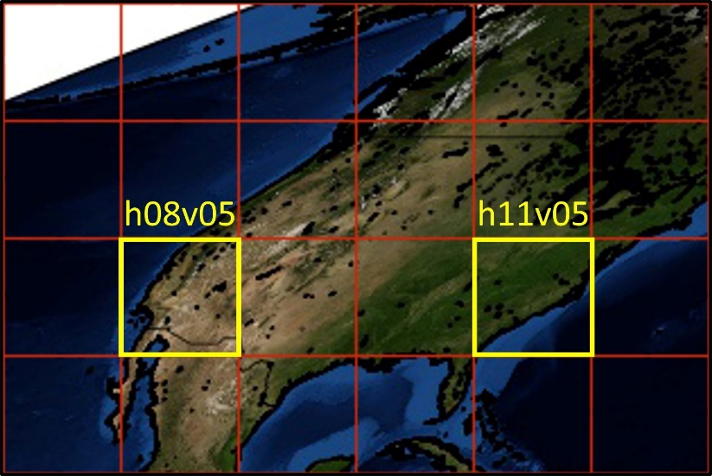
MAIAC MODIS-VIIRS Continuity Analysis
AOD over Libya-4 Before and After X-Calibration
2 tiles, 4 years of data (2018-2021)

Slide 13
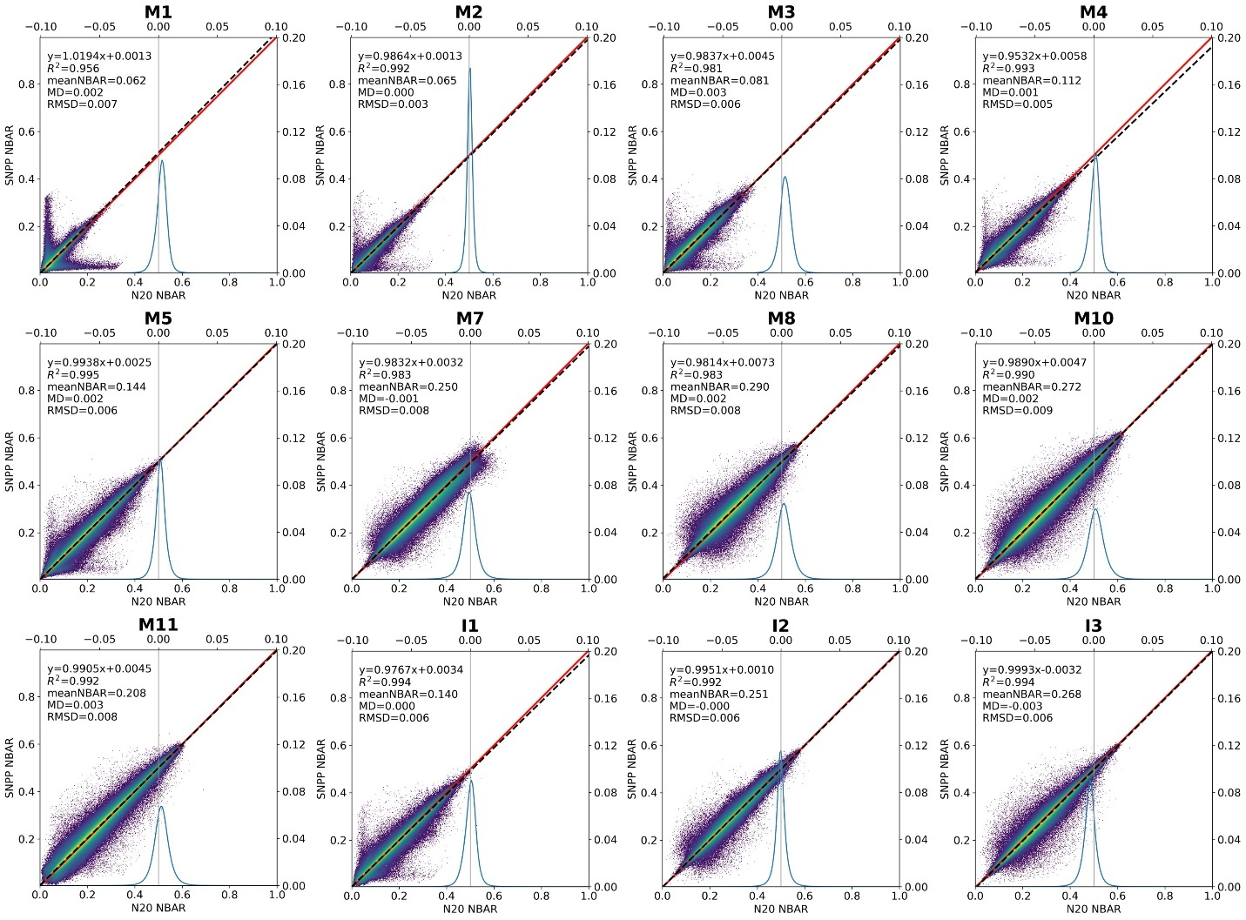
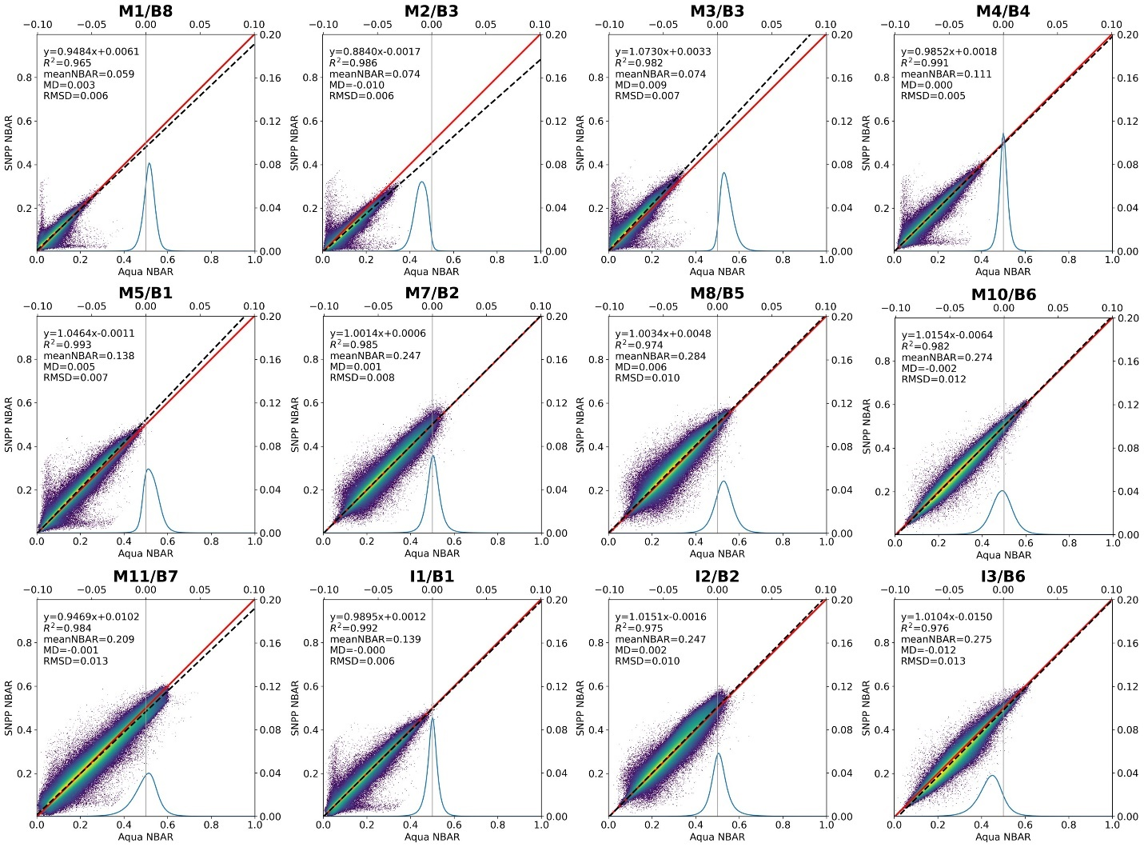
Spectral NBAR Comparison
NBAR – nadir BRDF-adjusted reflectance (nadir + local sun at 1:30pm)
SNPP vs NOAA 20
SNPP vs Aqua
RMSD of 0.005-0.007 in the darker visible and of 0.008-0.013 in brighter NIR-SWIR bands

Slide 14
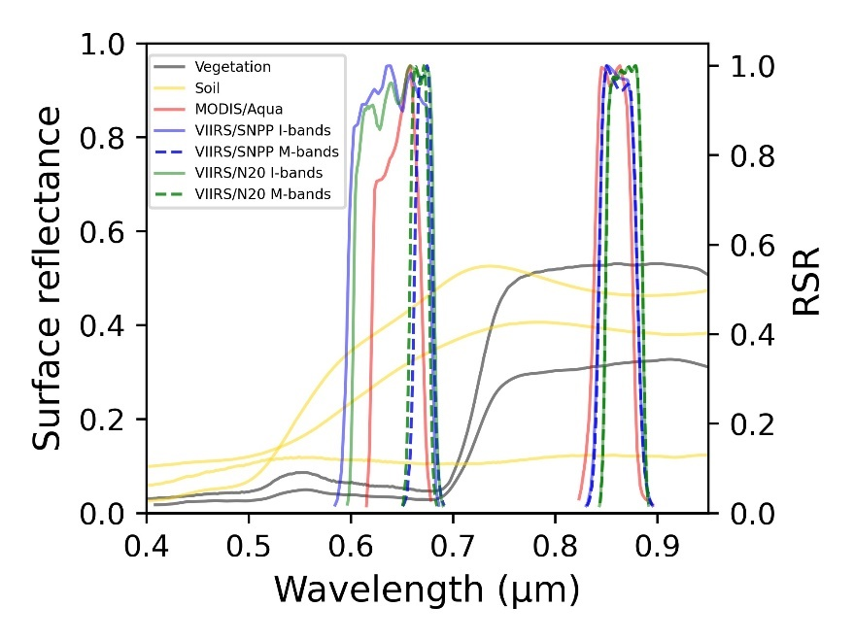
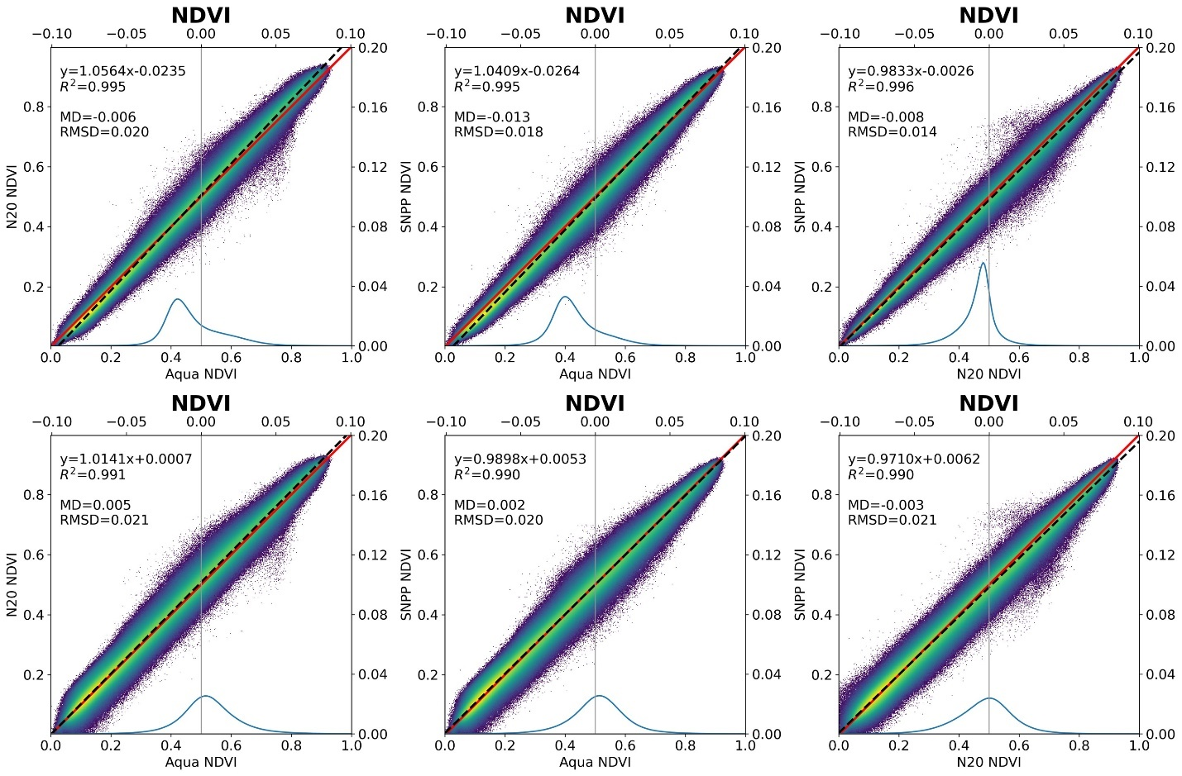
NDVI Analysis
Center Wavelength (nm)
SNPP (M/I) N20 A
Red 671/638 668/643 646
NIR 861/861 868/867 856
M5/M7
I1/I2
The MODIS – VIIRS NDVIs agree within rmsd~0.02 and an average MD -0.01 for NDVI_{M} and 0.003 for NDVI_{I}.

