Slide 1
Atmosphere Discipline’s Efforts on MODIS/VIIRS Inter-Calibration
NASA GSFC: Kerry Meyer, Steven Platnick, Gala Wind,
Nandana Amarasinghe, Paul Hubanks
U. Wisconsin Atmosphere SIPS: Bob Holz, Steve Dutcher, Zach Griffith, Greg Quinn
MODIS/VIIRS Calibration Workshop, College Park, 1 May 2023

Slide 2
Agenda
Brief refresher on Atmosphere Discipline approaches to MODIS/VIIRS inter-sensor relative radiometric evaluation and adjustments
  Cloud Team (Meyer et al., 2020)
  Deep Blue Aerosol Team (Sayer et al., 2016)
Analysis tools developed in collaboration with the U. Wisconsin Atmosphere Science Investigator-led Processing System (A-SIPS)
  VIIRS Atmosphere Discipline production center

Slide 3
Background
With the operational lives of the Terra and Aqua satellites nearing their end, successors to key EOS-era sensors are essential to achieve multi-decadal climate data records
For the imager aerosol and cloud data records of MODIS, the SNPP and JPSS series (NOAA-20+) VIIRS is the natural successor. NASA is currently funding multiple algorithm teams for MODIS/VIIRS Atmosphere Discipline continuity product work:
  Aerosols: VIIRS ”Dark Target” AERDT and “Deep Blue” AERDB (MODIS MOD04 heritage)
  Clouds: MODIS/VIIRS CLDMSK, CLDPROP (parallel to MODIS standard products MOD35, MOD06) – common algorithm using common subset of channels

Slide 4
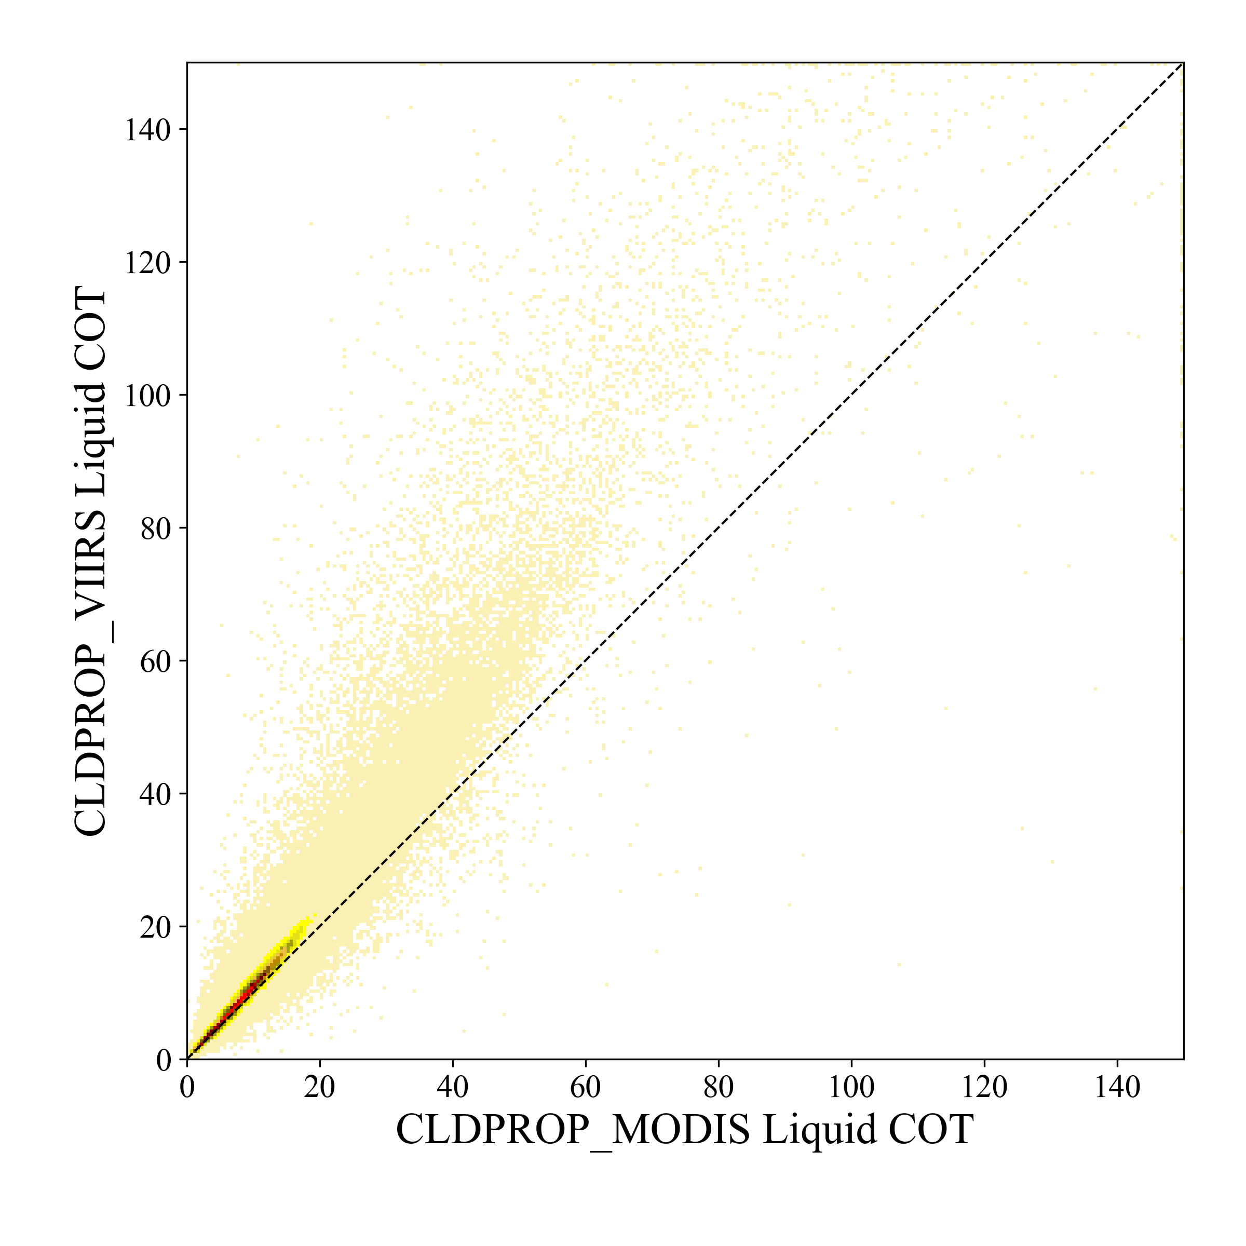
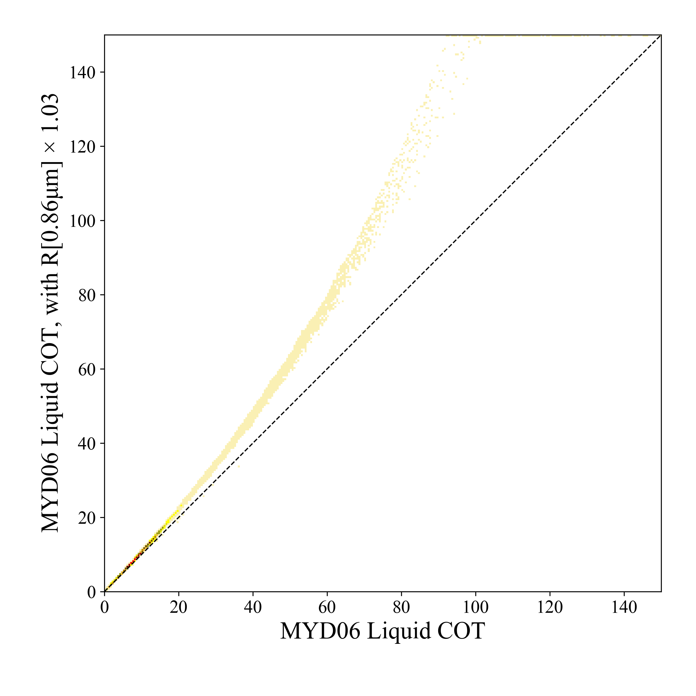
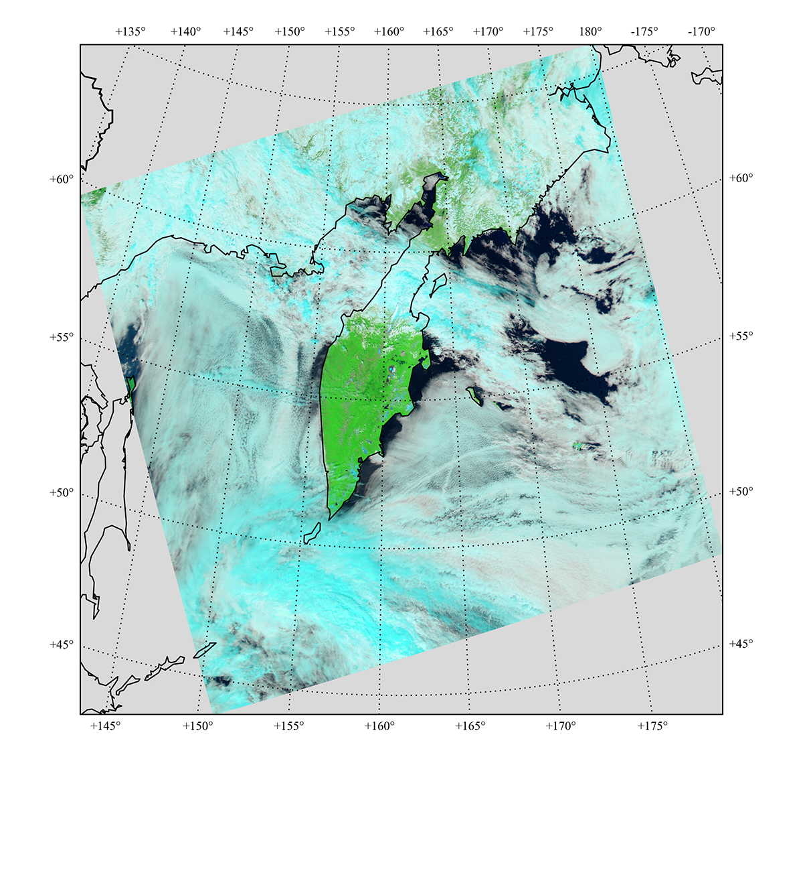
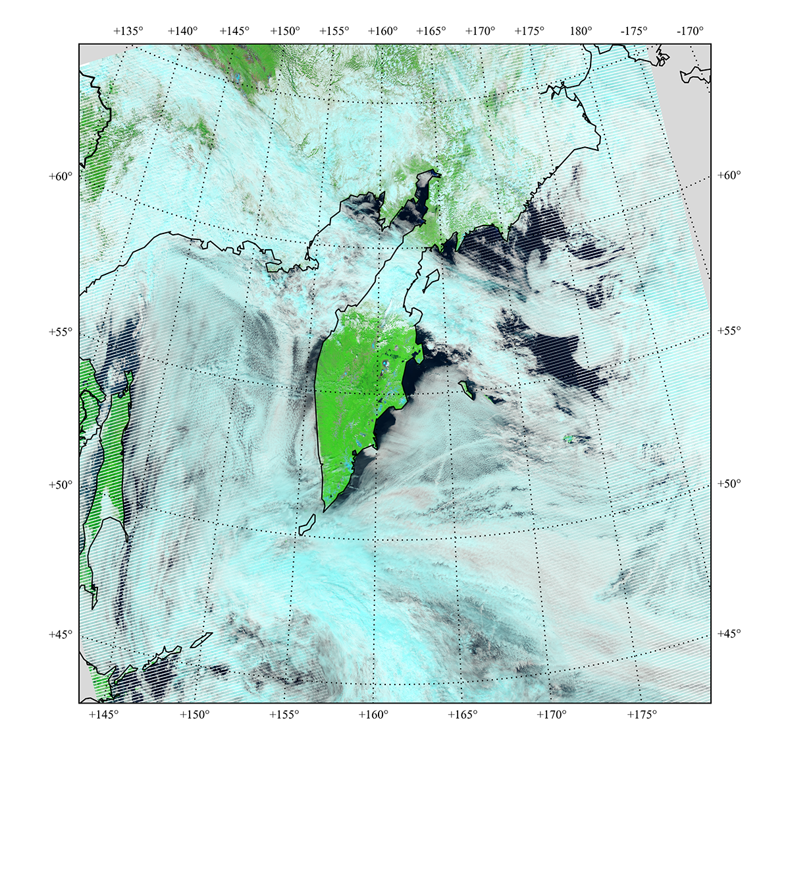
Background
Initial implementation of the continuity cloud optical properties algorithm (CLDPROP) showed large differences between Aqua MODIS and SNPP VIIRS cloud optical thickness (COT) retrievals
Liquid COT retrievals from 0.87µm channel (MODIS B2, VIIRS M7)
Imposed +3% bias in MODIS B2 reflectance
Retrieval differences linked to radiometric differences in analogous Aqua MODIS and SNPP VIIRS spectral channels
Aqua MODIS
6 July 2014 (0200 UTC)
SNPP VIIRS
6 July 2014 (0154, 0200 UTC)

Slide 5
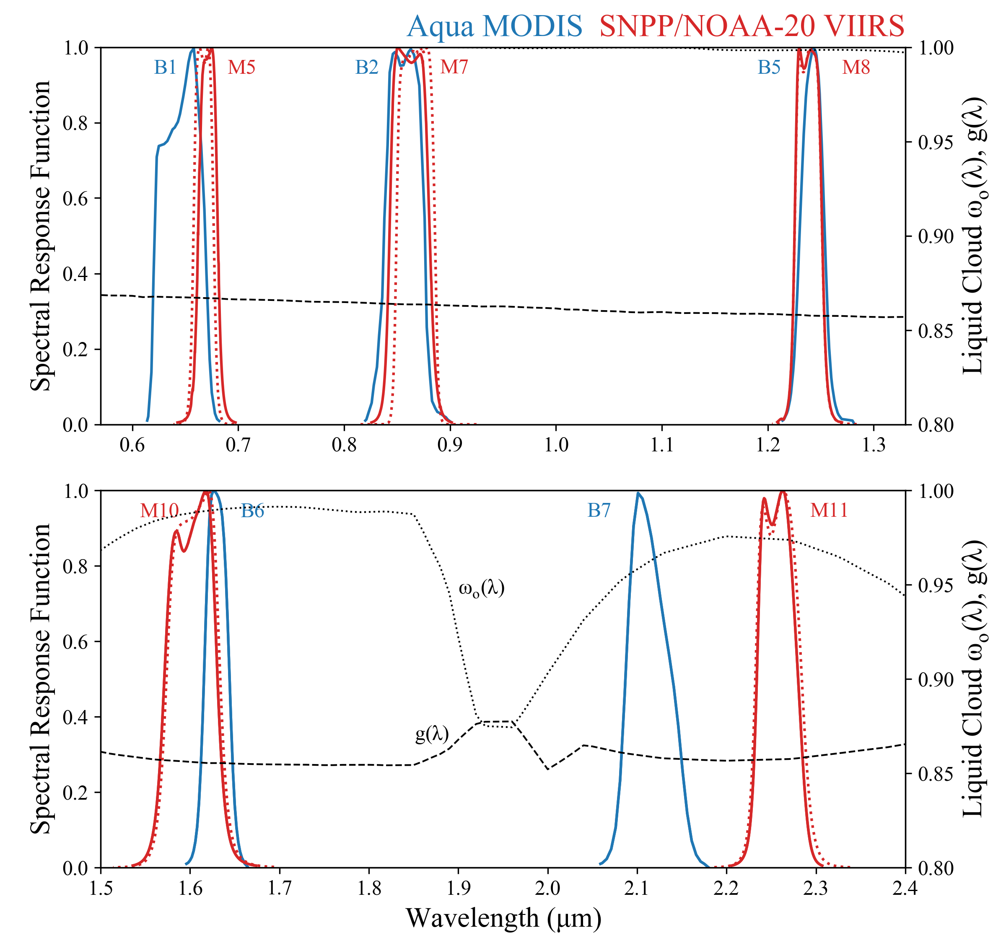
Goal
Use Aqua MODIS as a reference imager to derive spectral radiometric adjustments for SNPP and NOAA-20 VIIRS
Challenge
The analogous spectral channels on both imagers used for aerosol and cloud optical property retrievals in some cases still are quite different, particularly in spectral regions where single scattering properties vary strongly, e.g., for liquid clouds at right
ω_{o}: single-scattering albedo
g: asymmetry parameter

Slide 6
Starting Point: Radiometric Match Files
Developed and processed by the A-SIPS
Files include co-located Aqua MODIS and SNPP/NOAA-20 VIIRS L1B and L2 datasets
  MYD02 L1B vs NASA VIIRS L1B (all M-band spectral channels)
    Aqua MODIS C6.1; SNPP VIIRS v2.0.2 (“C1”) and NOAA-20 VIIRS v3.0.0 (“C2”)
  Key MYD35 and MYD06 geophysical datasets (cloud mask, cloud-top/optical)
  Includes only pixels meeting angle and temporal matching requirements
The co-location and match software are designed to support future instruments including NOAA-21 and advanced GEO (AHI/ABI/AMI)
  Note: The cloud and aerosol teams currently are funded to develop GEO products

Slide 7
Analysis Approach
Cloud Team (Meyer et al., 2020)
  Homogeneous liquid phase clouds over oceans, ±60º latitude
    Bright scenes
    Bore confidence in forward modeling liquid clouds (v. ice) to account for spectral mismatch
  Temporal matching: Δt < 10min
  Strict angle matching: view zenith and scattering angle differences < 1º
Deep Blue Aerosol Team (Sayer et al., 2017)
  Clear sky scenes over oceans , ±60º latitude
    Total column H₂O < 3 cm
    Computed sunglint contribution to reflectance < 0.01
  Temporal matching: Δt < 10min
  View zenith and scattering angle differences < 3º
Both use Aqua MODIS as the reference, i.e., scale VIIRS to match MODIS

Slide 8
Cloud Team Methodology
MODIS cloud optical/microphysical retrievals + VIIRS reflectance LUT => VIIRS expected top-of-cloud reflectance at pixel level
MODIS (MYD06) cloud-top pressure + VIIRS L1B + atmospheric correction => VIIRS observed top-of-cloud reflectance at pixel level
Aggregate pixel-level expected/observed reflectance into monthly joint histograms => monthly VIIRS radiometric adjustment factors
Final VIIRS (SNPP or NOAA-20) radiometric adjustment factors derived from time series of monthly values
$$VIIRS Radiometric Adjustment(λ)=\frac{VIIRS Expected TOC Refl.(λ)}{VIIRS Observed TOC Refl.(λ)}$$
$$λ=\left[0.67μm \left(M5\right), 0.87μm \left(M7\right), 1.24μm \left(M8\right), 1.61μm \left(M10\right), 2.25μm (M11)\right]$$

Slide 9
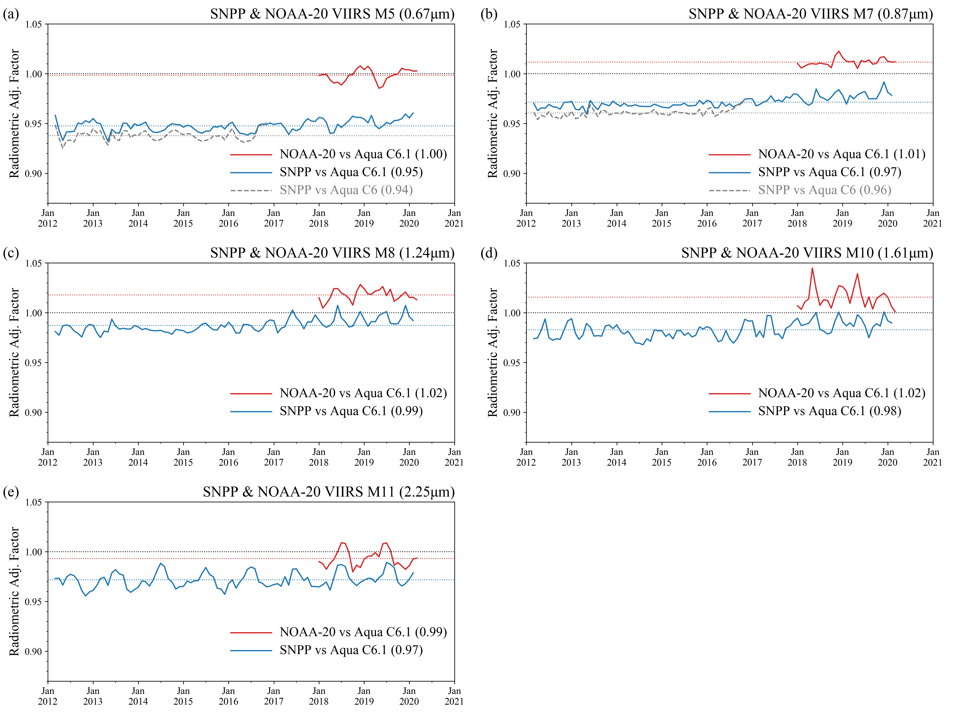
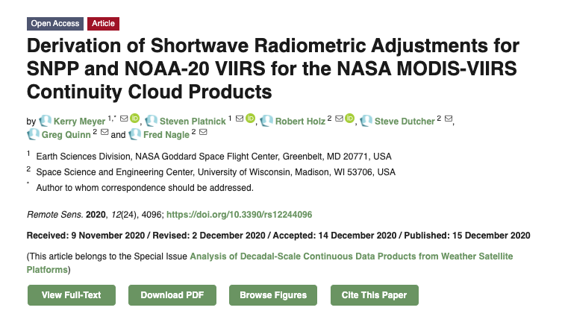
Radiometric adjustments applied to VIIRS L1B prior to ingestion into CLDMSK and CLDPROP algorithms.
  Both SNPP and NOAA-20
  Defined as time series (left) means
Values are reported in CLDPROP L2 global metadata
VIIRS Wavelength (Band Designation) |  |  | 0.67 µm (M5) | 0.87 µm (M7) | 1.24 µm (M8) | 1.61 µm (M10) | 2.25 µm (M11)
Radiometric Adjustment Factor | NOAA-20 | vs MODIS C6.1 | 1.0 | 1.01 | 1.02 | 1.02 | 0.99
 | SNPP | vs MODIS C6.1 | 0.95 | 0.97 | 0.99 | 0.98 | 0.97
 |  | vs MODIS C6 | 0.94 | 0.96 | 0.98 | 0.98 | 0.97
 |  | Deep Blue Gain Factors | 0.941 | 0.963 | 1.011 | 0.981 | 0.931

Slide 10
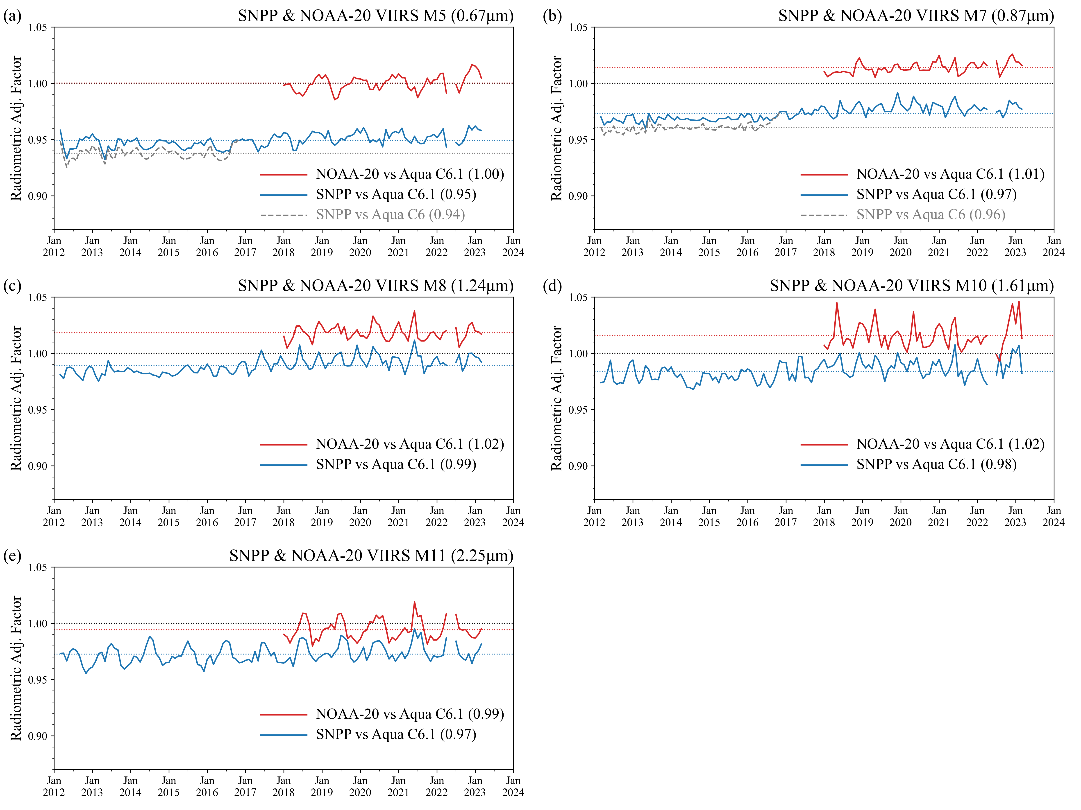
Radiometric adjustments applied to VIIRS L1B prior to ingestion into CLDMSK and CLDPROP algorithms.
  Both SNPP and NOAA-20
  Defined as time series (left) means
Values are reported in CLDPROP L2 global metadata
VIIRS Wavelength (Band Designation) |  |  | 0.67 µm (M5) | 0.87 µm (M7) | 1.24 µm (M8) | 1.61 µm (M10) | 2.25 µm (M11)
Radiometric Adjustment Factor | NOAA-20 | vs MODIS C6.1 | 1.0 | 1.01 | 1.02 | 1.02 | 0.99
 | SNPP | vs MODIS C6.1 | 0.95 | 0.97 | 0.99 | 0.98 | 0.97
 |  | vs MODIS C6 | 0.94 | 0.96 | 0.98 | 0.98 | 0.97
 |  | Deep Blue Gain Factors | 0.941 | 0.963 | 1.011 | 0.981 | 0.931

Slide 11
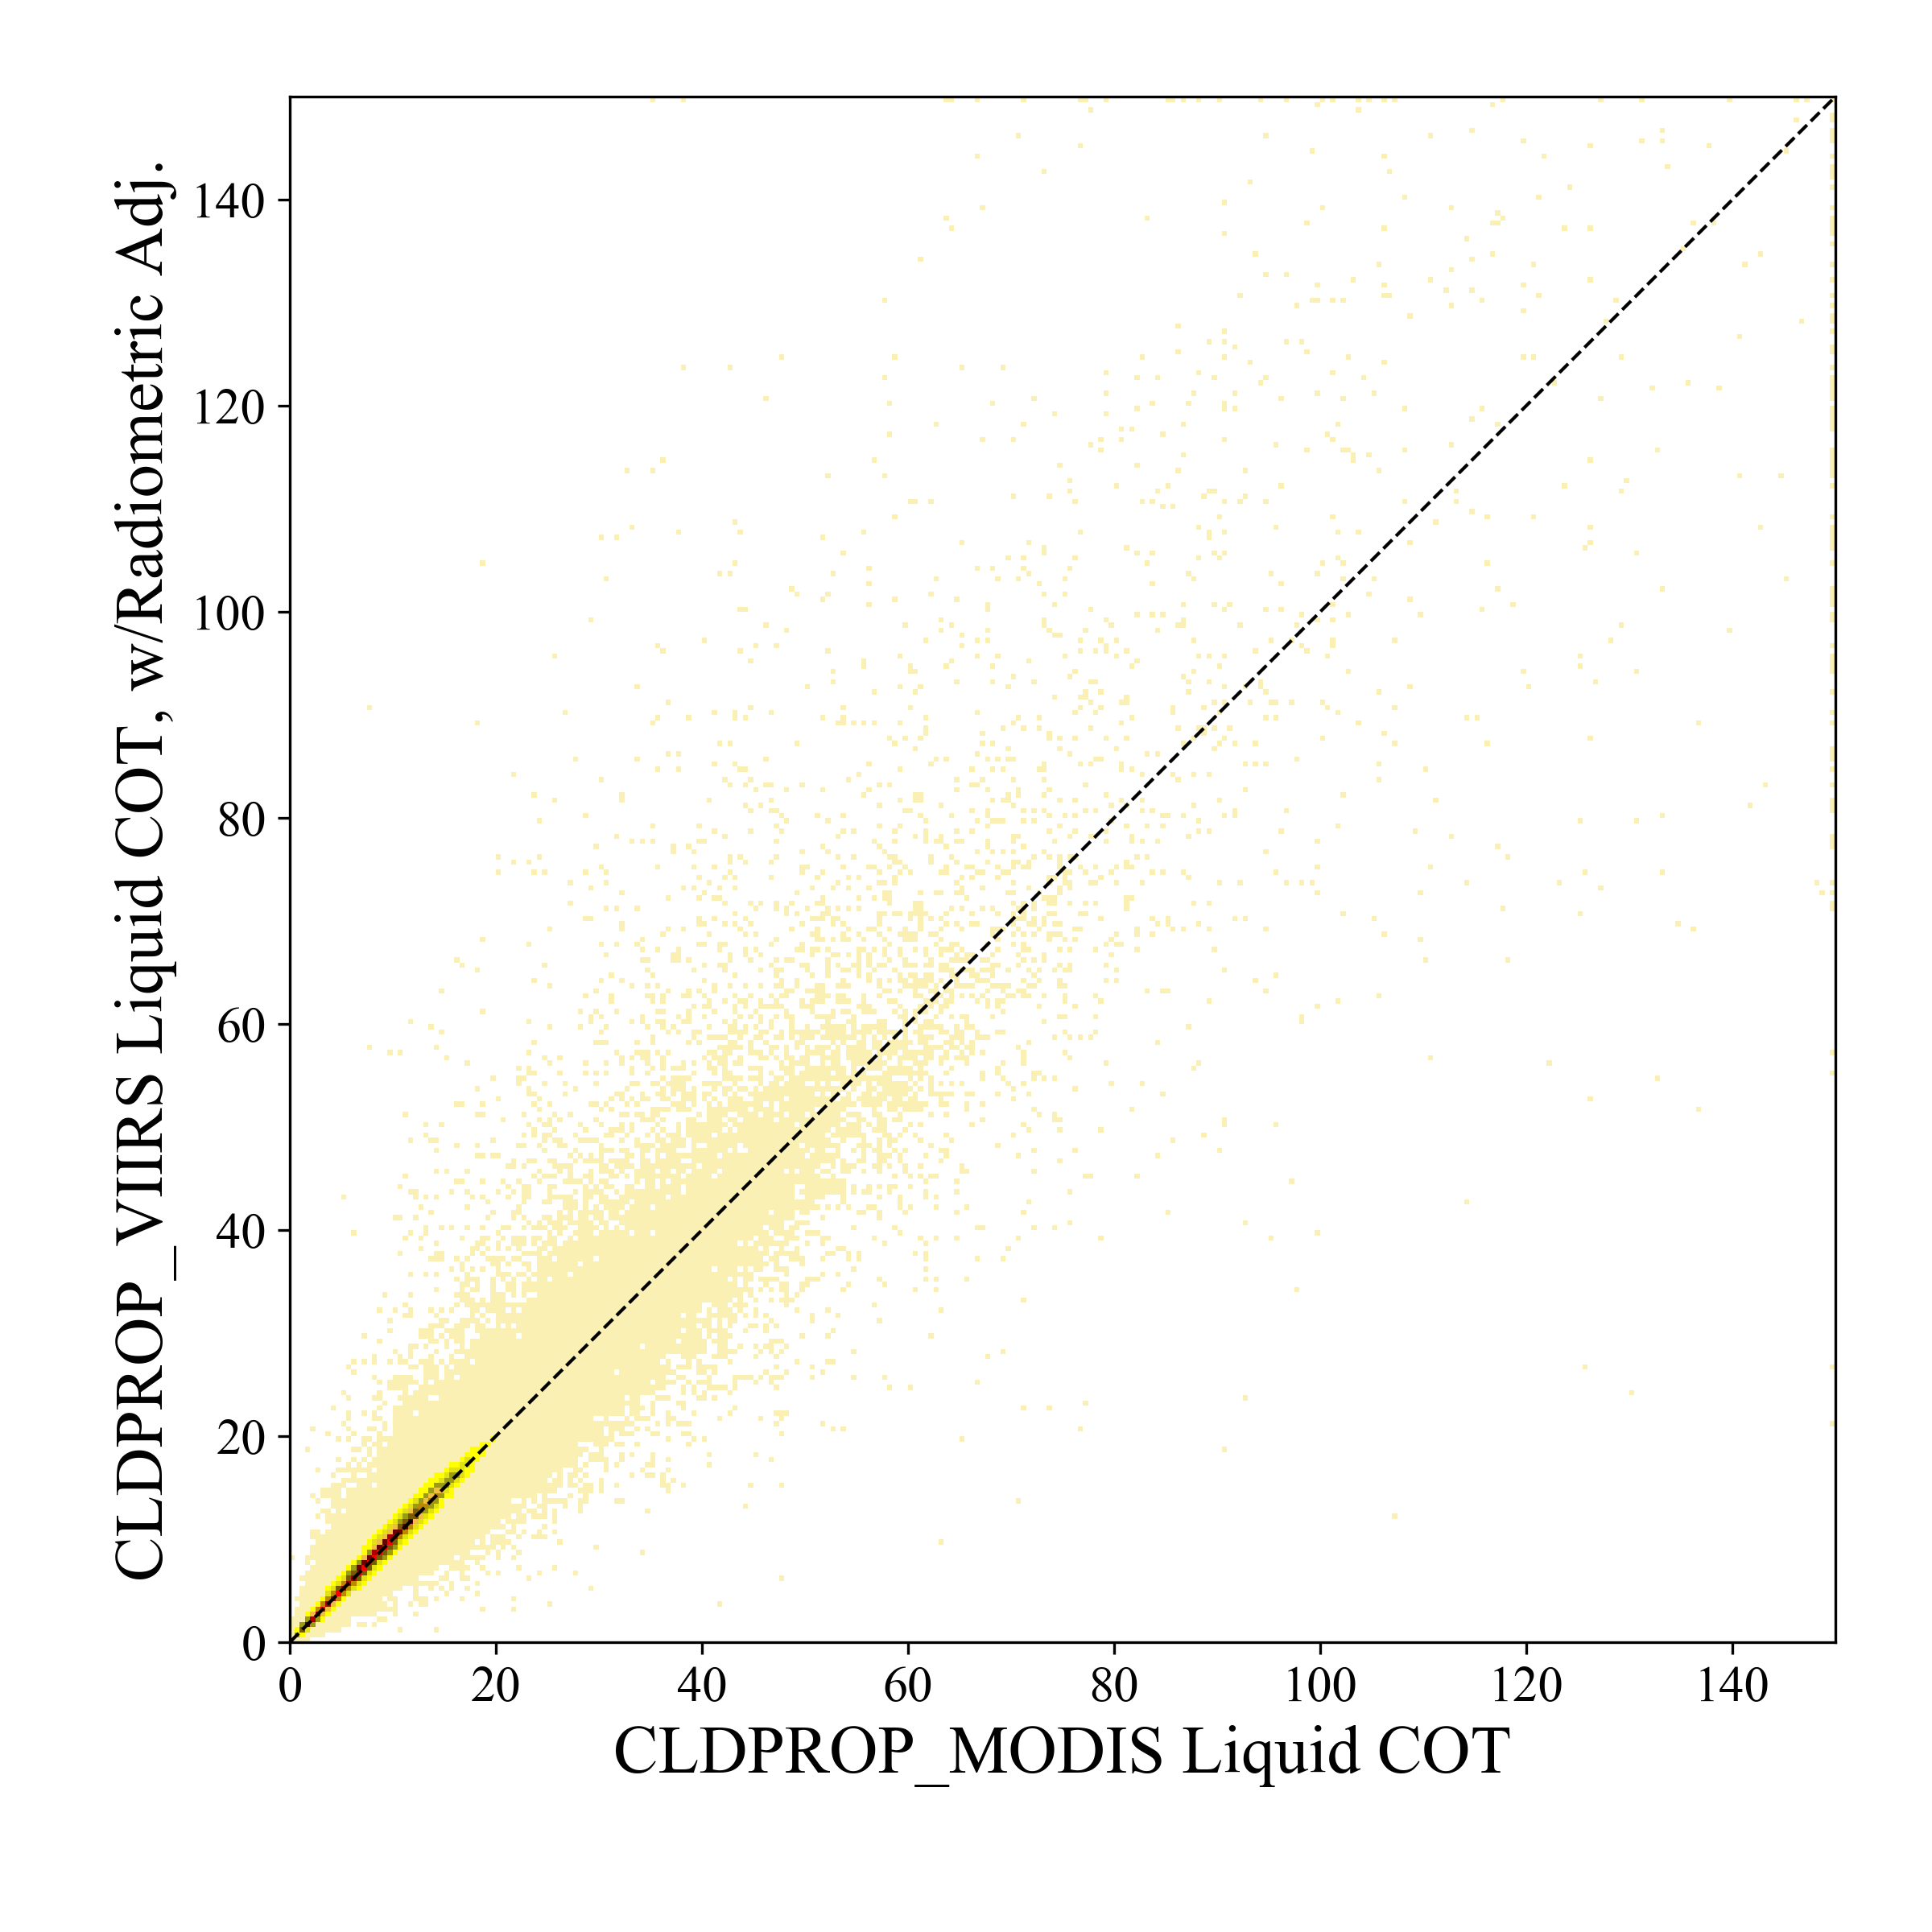
End Results
Applying derived radiometric adjustments to VIIRS yields improved retrieval agreement with MODIS, here for liquid cloud optical thickness
Liquid COT retrievals from 0.87µm channel (MODIS B2, VIIRS M7)
-3% adjust. applied to VIIRS M7 reflectance
Aqua MODIS
6 July 2014 (0200 UTC)
SNPP VIIRS
6 July 2014 (0154, 0200 UTC)

Slide 12
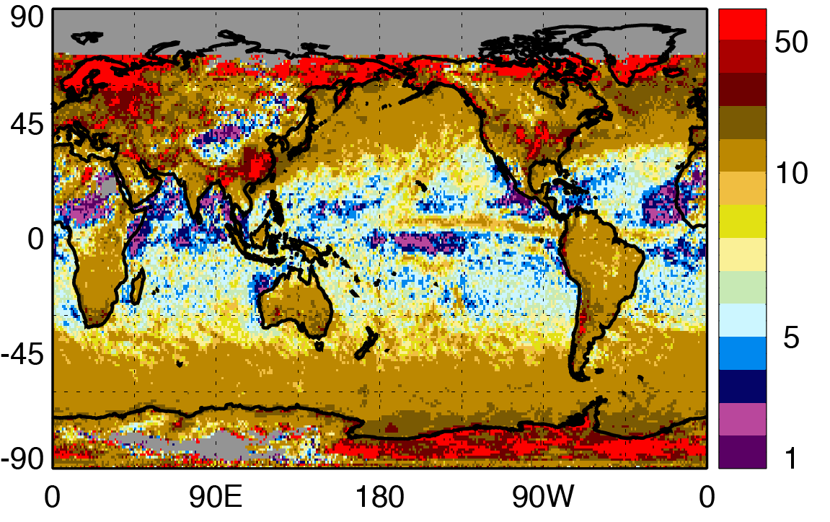
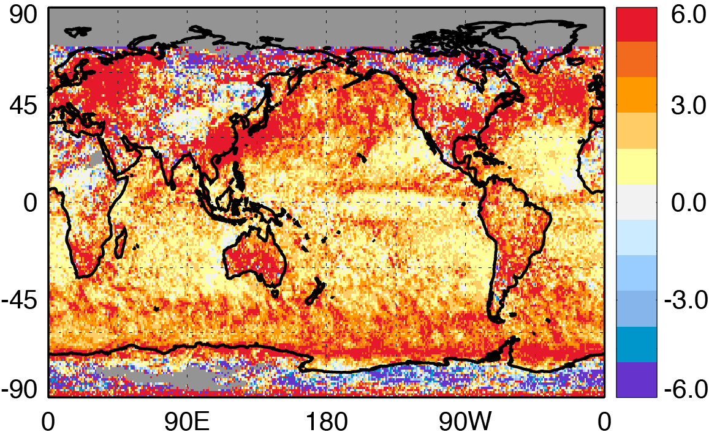
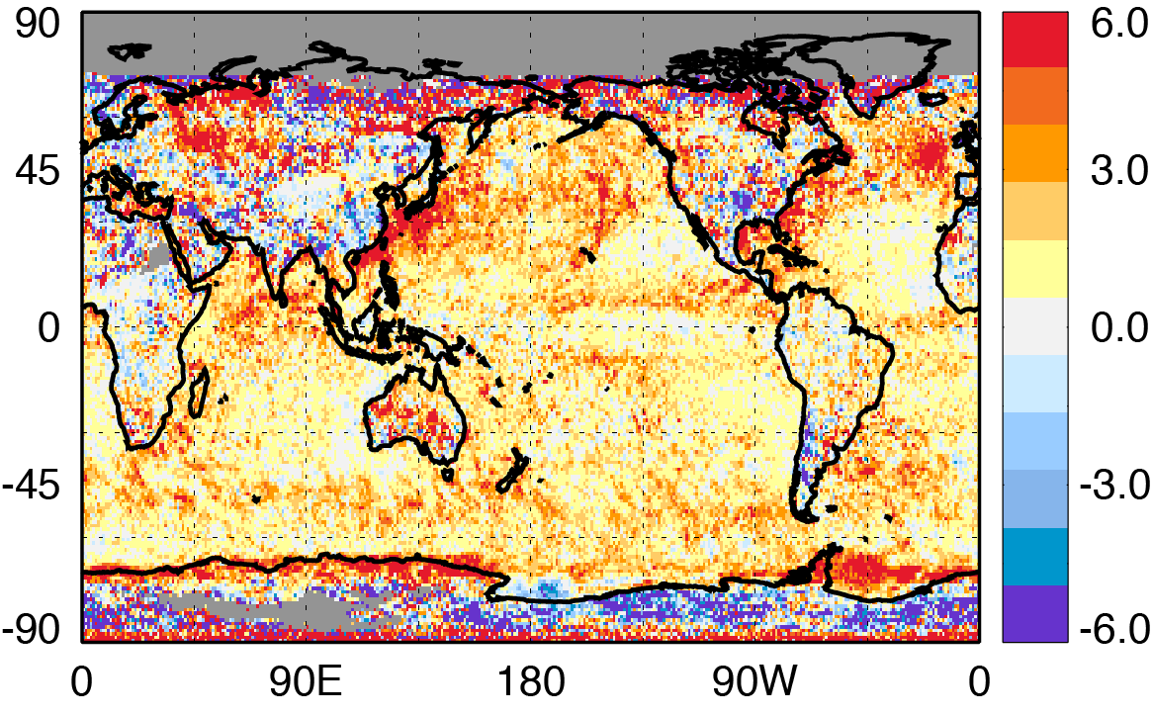
Global Impacts of Adjustments
CLDPROP Liquid Phase
Cloud Optical Thickness (COT)
February 2014
Aqua MODIS, SNPP VIIRS
CLDPROP MODIS
VIIRS - MODIS
VIIRS_{adj} - MODIS

Slide 13
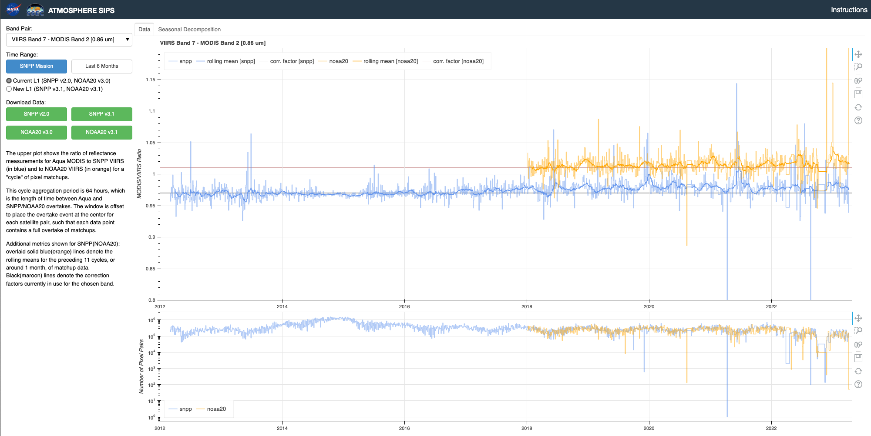

VIIRS SNPP/NOAA 20 UW A-SIPS Monitoring Tool
The cloud team’s Aqua MODIS – VIIRS (SNPP and NOAA-20) radiometric analysis code is implemented at A-SIPS and running in NRT
Public web “dashboard” developed by A-SIPS (Z. Griffith) to facilitate monitoring by team
  ”Per cycle” (64 hrs) and rolling (~monthly) means, seasonal decomposition for trends
  Automated alert system to identify drifts/outliers
SNPP (Blue)
NOAA-20 (Orange)
Ratio of Aqua MODIS B2 to VIIRS M7
https://sips.ssec.wisc.edu/intercalibration/intercalibration

Slide 14
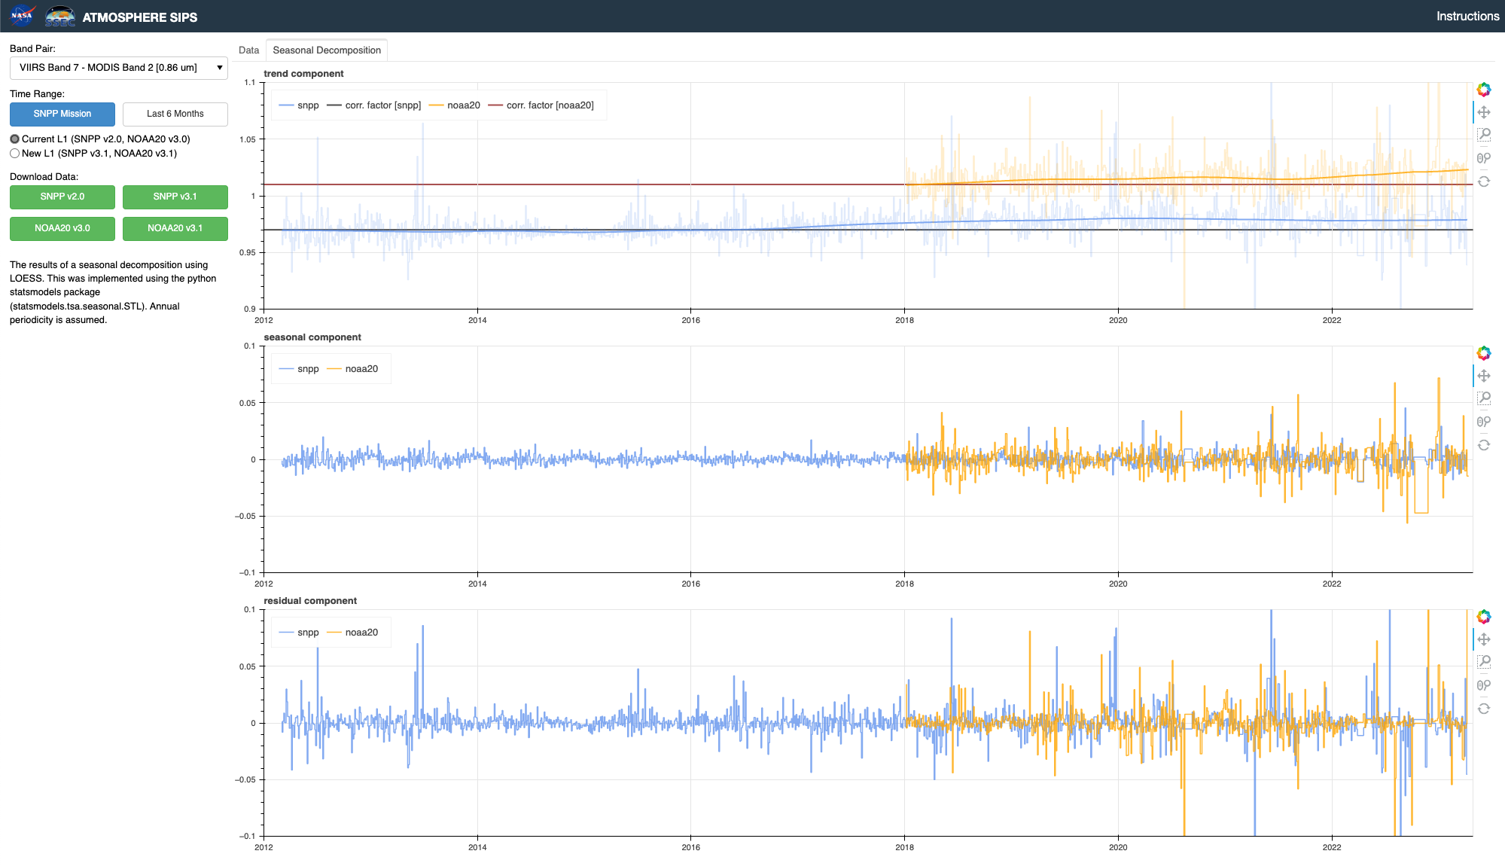
VIIRS SNPP/NOAA 20 UW A-SIPS Monitoring Tool
Example: SNPP VIIRS M7 vs Aqua MODIS B2 Drift
SNPP (Blue)
NOAA-20 (Orange)
MODIS/SNPP VIIRS calibration ratio for the 0.87µm channel begins to increase starting in 2016, from 0.97 to ~0.98 by Dec 2020

Slide 15
Is this ~1% drift in 0.87µm relative radiometry important?
SNPP VIIRS Ice COT, Dec 2020
ΔCOT_{VIIRS} after 1% adjustment to 0.87µm (M7)
SNPP VIIRS Archived v1.1
V1.1 + 1% Rad. Adj.
Count
Ice COT
SNPP VIIRS Aqua MODIS
ΔCOT_{VIIRS} (Dec 2020)
~8% increase

Slide 16
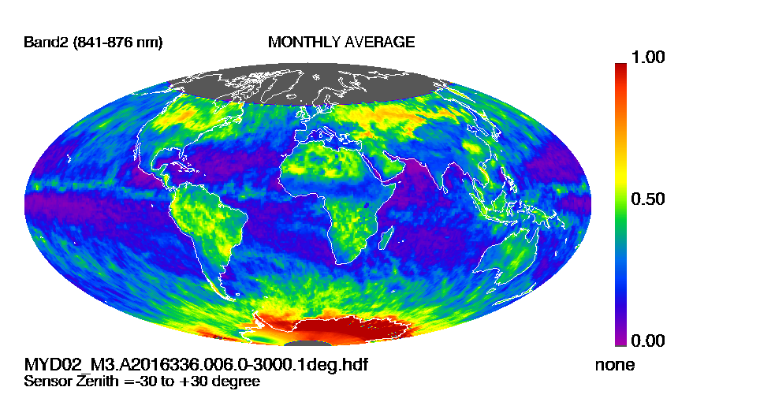
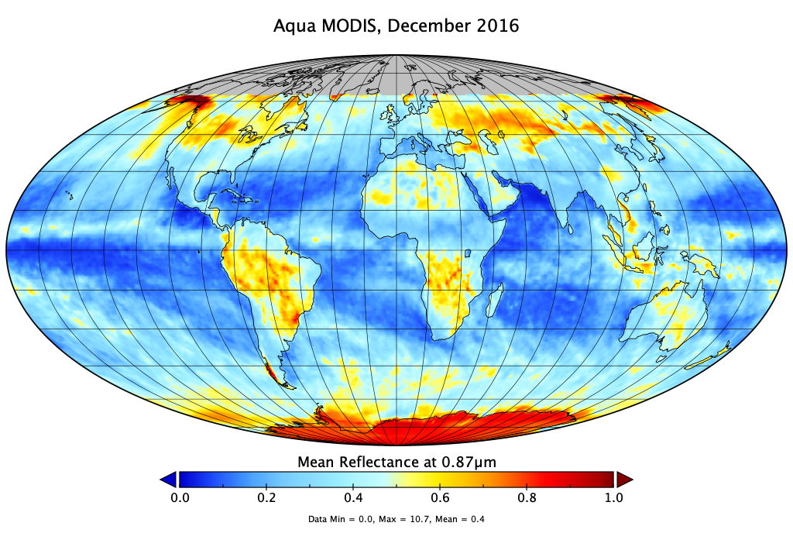
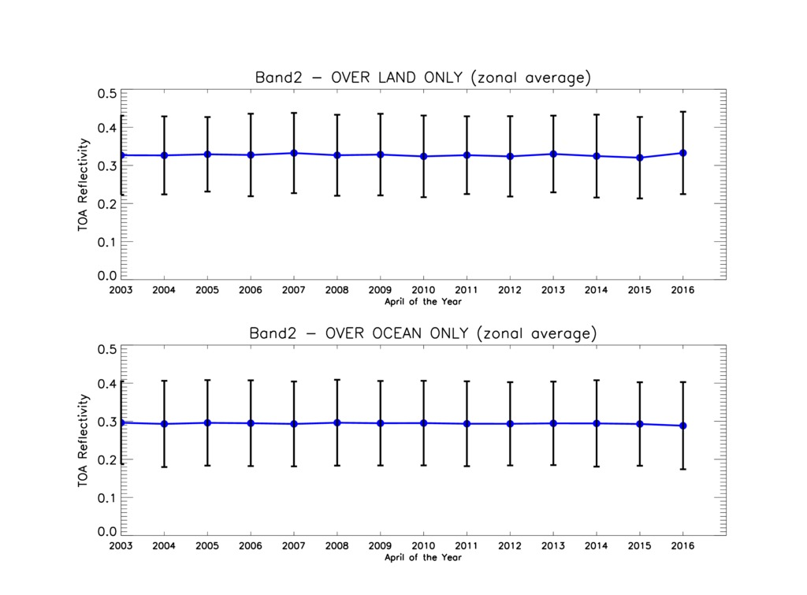

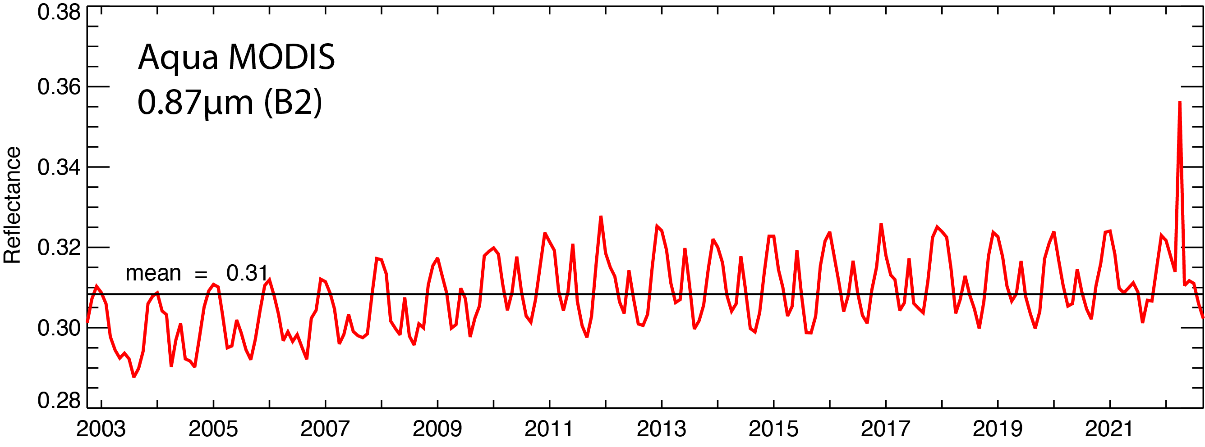
Additional Tools: L1B Aggregations
Current Atmosphere Discipline Team Website:
Daily/monthly gridded aggregation imagery
Yearly time series imagery (through 2016)
Updated L1B aggregation capabilities in development:
Leverages A-SIPS Yori L3 code
Daily/monthly gridded aggregations over entire Terra/Aqua MODIS and SNPP/NOAA-20+ VIIRS data records
Examples from science test runs.
New imagery capabilities under development, will replace existing website browse.
https://atmosphere-imager.gsfc.nasa.gov/images/l1b-aggregation

Slide 17
Summary
Radiometric adjustment factors to key solar reflectance channels are necessary to reconcile observed MODIS/VIIRS retrieval differences
  Important to note that both instruments can be within their absolute calibration specifications yet still exhibit a radiometric offset that can impact inter-sensor geophysical product continuity
The Atmosphere Discipline teams have derived SNPP and NOAA-20 VIIRS adjustment factors using Atmosphere SIPS-produced match files
  Adjustments generally consistent between the Cloud and Deep Blue Aerosol teams for overlapping channels
  Applied to SNPP/NOAA-20 VIIRS since Aqua MODIS is the reference record
The Atmosphere Discipline and the A-SIPS have leveraged these efforts to develop tools to monitor relative radiometry in near real-time
  Web-based interface displaying Cloud team’s intercalibration
  L1B aggregation tools.

Slide 18
Challenges Moving Forward
Considering multi-imager climate data records, calibration stability cannot be assessed for each imager independently, as changes to one or both instruments can adversely affect product continuity
  Updates to relative radiometric adjustments should be derived and applied as necessary.
Potential disconnects between different L2 algorithm teams who are applying independent radiometric adjustments
For the Atmosphere products, processing paradigm may need rethinking
  Forward processing near real-time (NRT) only, climate archive processing replacing NRT following periodic radiometric assessments?
How do we continue these efforts after the loss of our Aqua MODIS reference imager?

