Slide 1
Harmonization of the calibration of MODIS and VIIRS (SNPP/NOAA-20)
Eric Vermote et al. Code 619/UMD
Aisheng Wu (MCST/VCST SSAI)

Slide 2
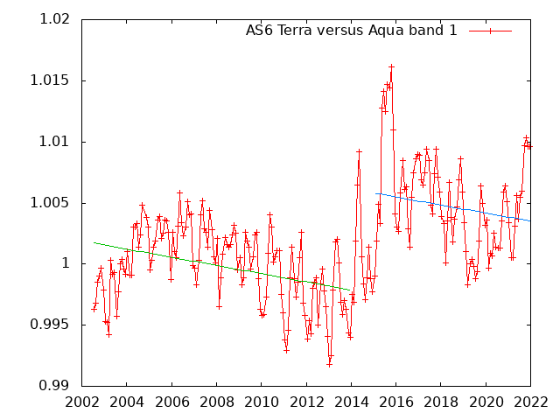
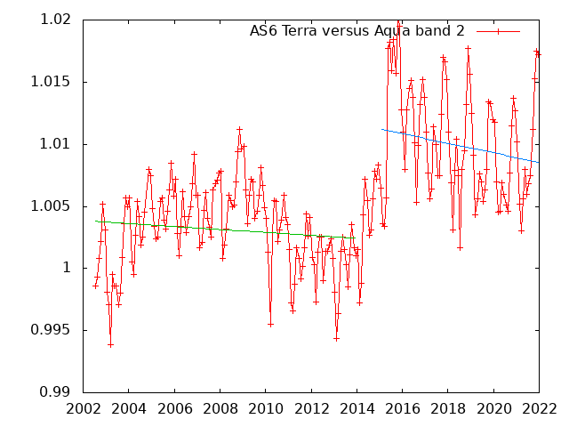
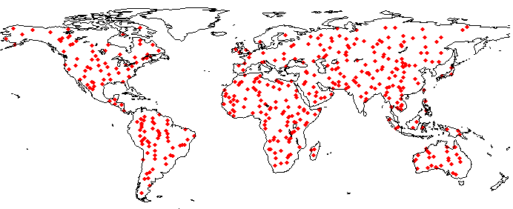
Cross-Calibration over BELMANIP Sites (Terra/Aqua AS6)
Terra vs Aqua (AS6) band 1
Terra vs Aqua (AS6) band 2
Distribution of the BELMANIP2 sites.

Slide 3
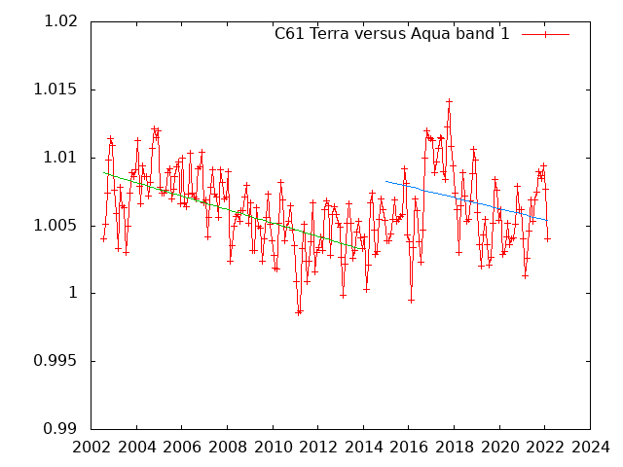
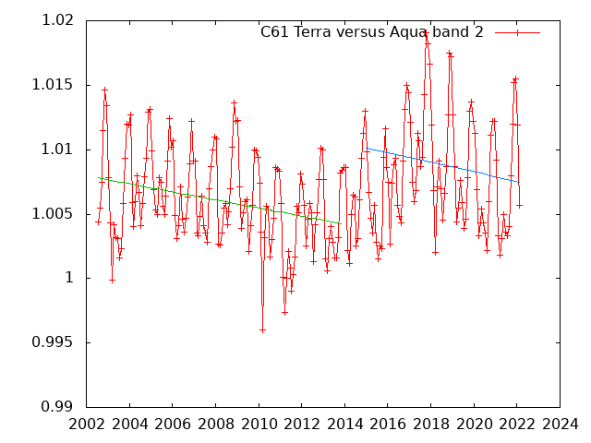
Cross-Calibration over BELMANIP Sites (Terra/Aqua)
Terra vs Aqua (C6.1) band 1
Terra vs Aqua (C6.1) band 2

Slide 4
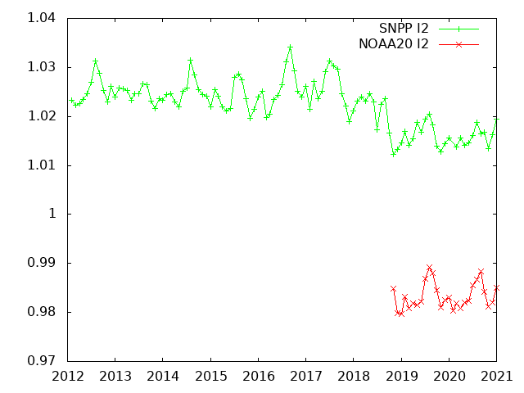
VIIRS Cross-Calibration I2/ MODIS Band 2

Slide 5
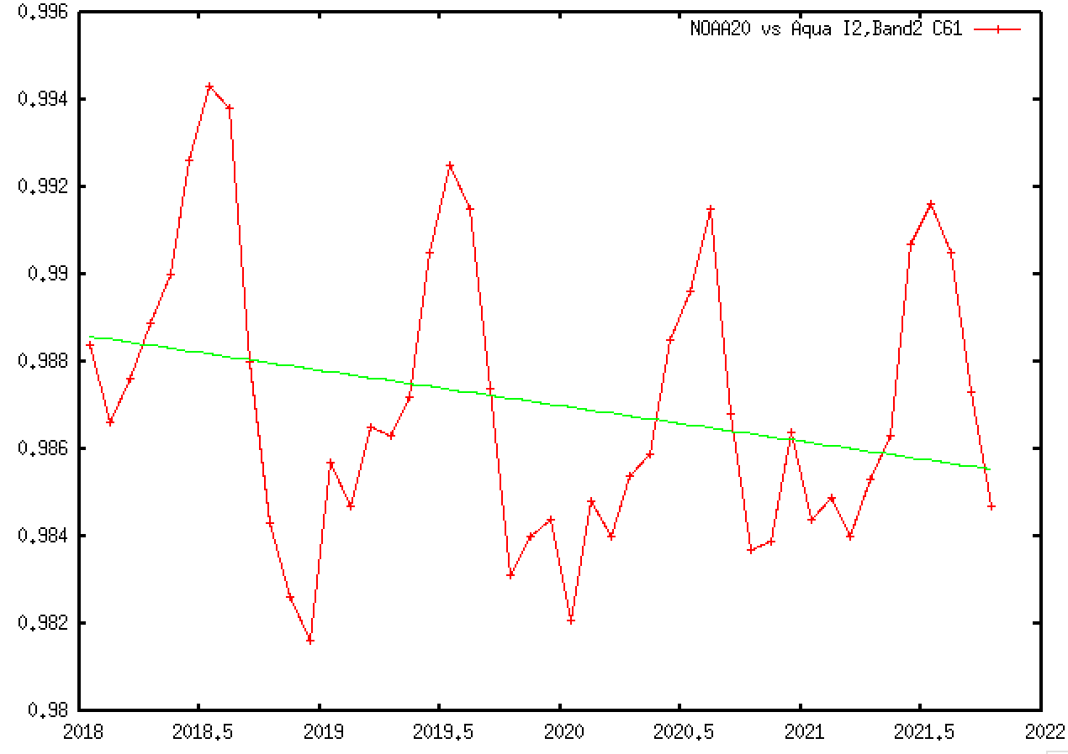
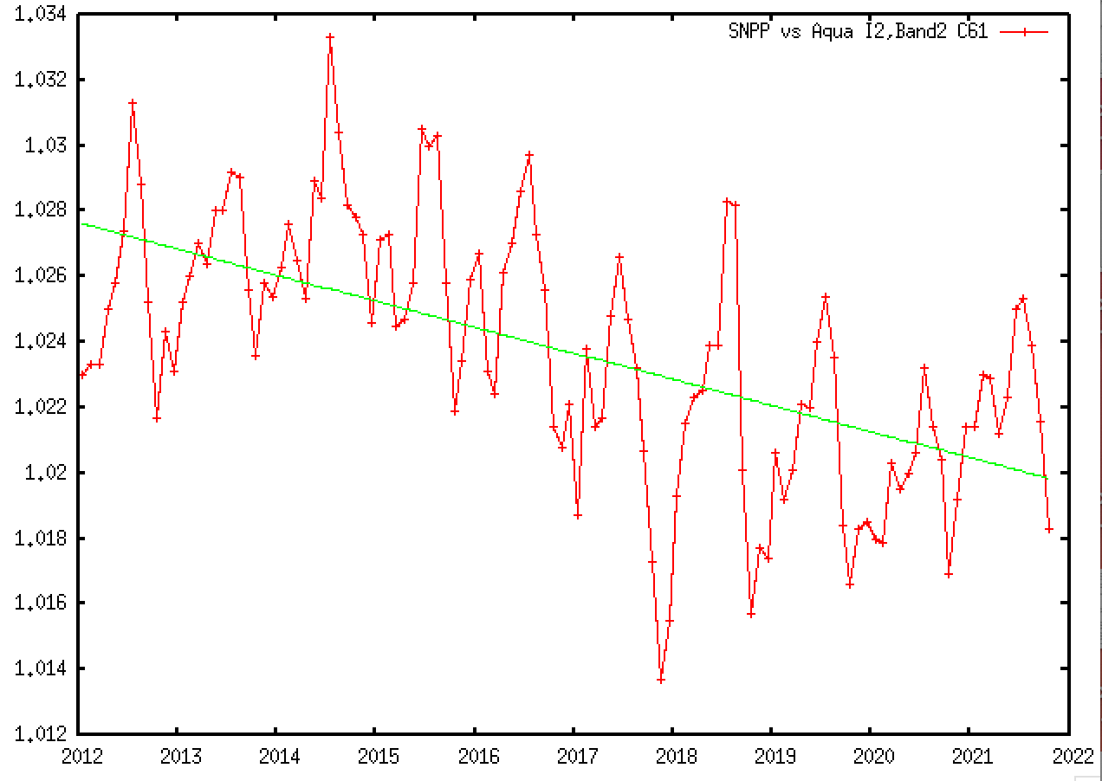
Cross-Calibration over BELMANIP Sites (VIIRS/Aqua I2)
NOAA20 vs Aqua (C6.1) I2 vs band 2
SNPP vs Aqua (C6.1) I2 vs band 2

Slide 6
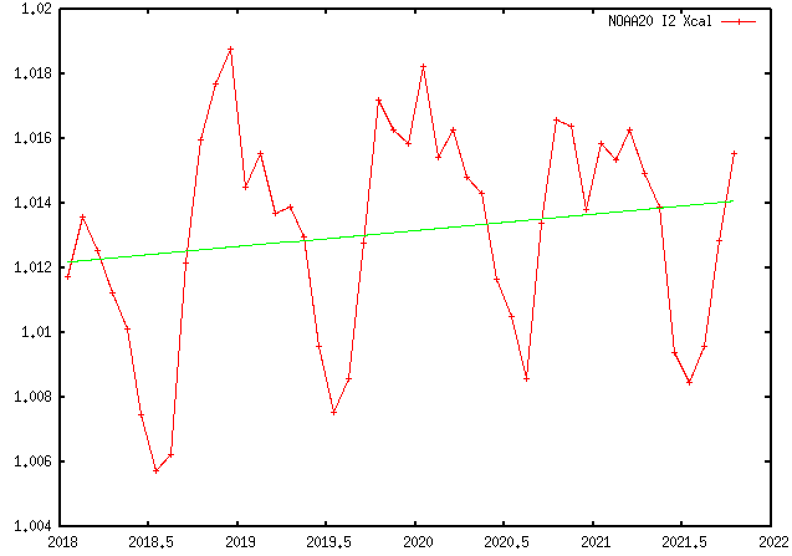
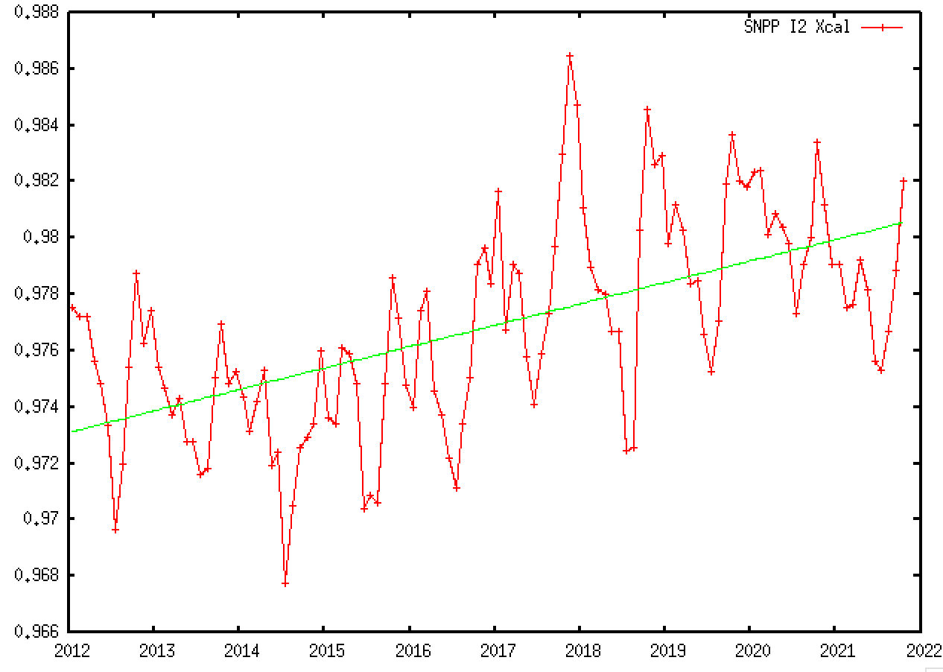
Cross-Calibration coefficients VIIRS – I2
NOAA20-I2
SNPP-I2
Xcal=1.0121+0.000514x(Year-2018)
Xcal=0.9731+0.000760x(Year-2012)

Slide 7
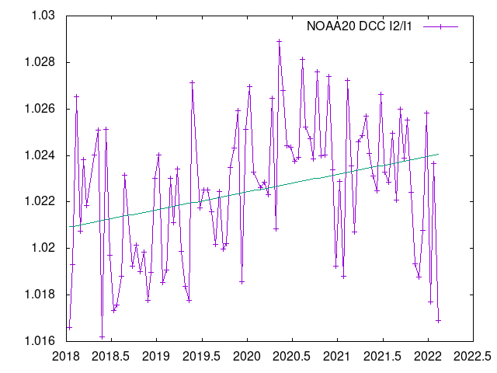
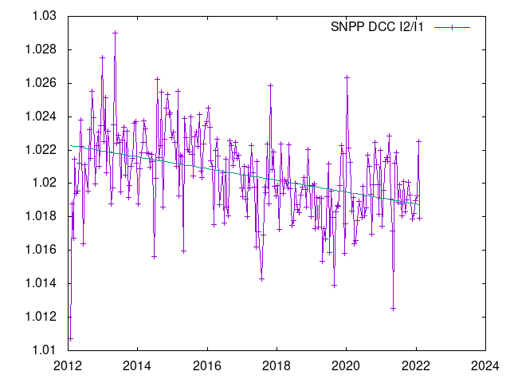
Ratio over Deep Convective Clouds (VIIRS I2/I1)
NOAA20 DCC I2/I1
SNPP DCC I2/I1

Slide 8
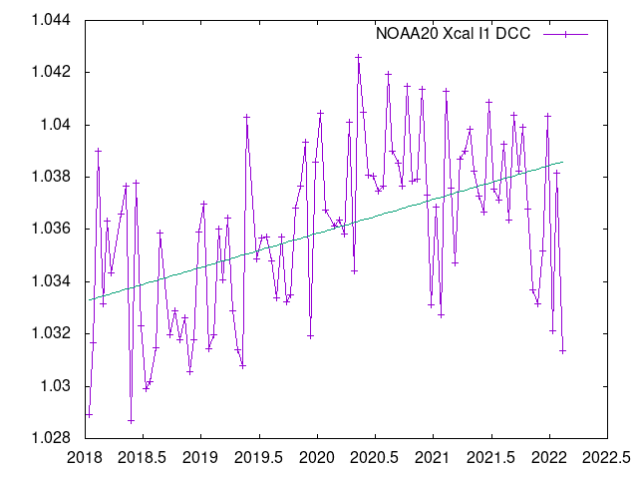
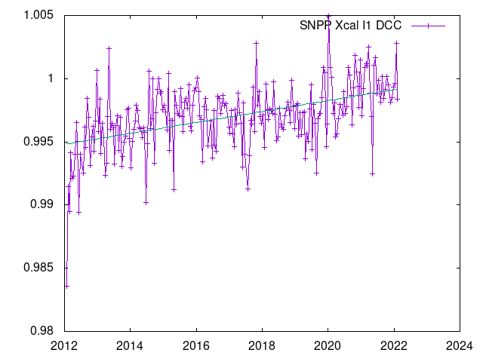
Cross Calibration coefficient Deep Convective Clouds (VIIRS I1)
NOAA20 I1
SNPP I1
Xcal=1.0333+0.001299x(Year-2018)
Xcal=0.9948+0.000433x(Year-2012)

Slide 9
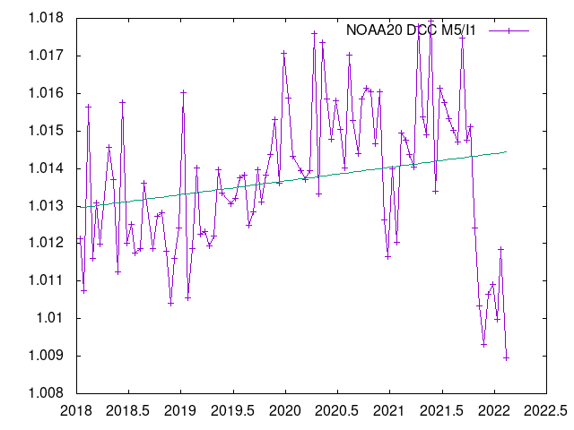
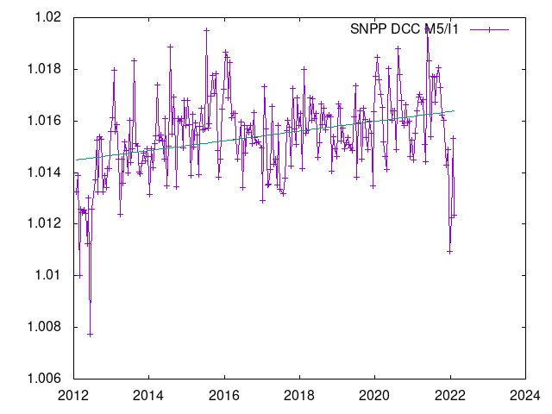
Ratio over Deep Convective Clouds (VIIRS M5/I1)
NOAA20 DCC M5/I1
SNPP DCC M5/I1

Slide 10
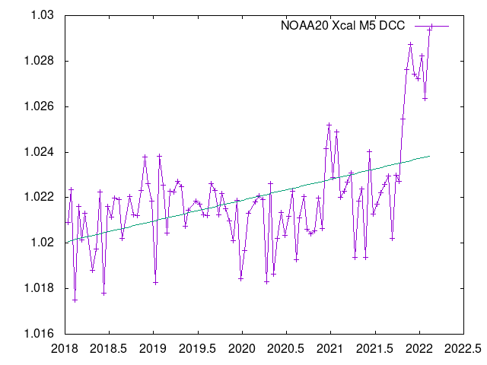
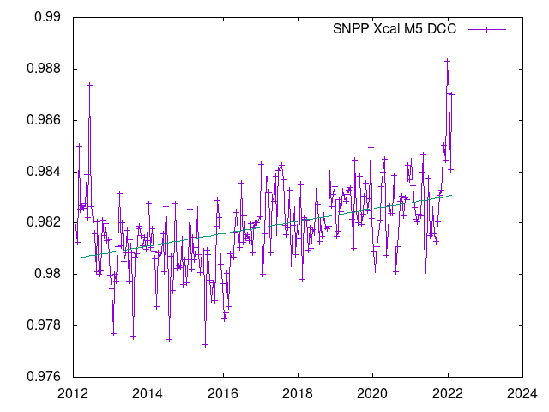
Cross Calibration coefficient Deep Convective Clouds (VIIRS M5)
NOAA20 M5
SNPP M5
Xcal= 1.0201+0.000917x(Year-2018)
Xcal=0.9806+0.000243x(Year-2012)

Slide 11
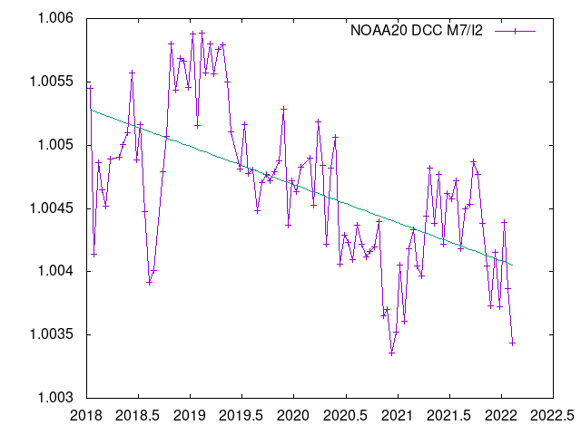
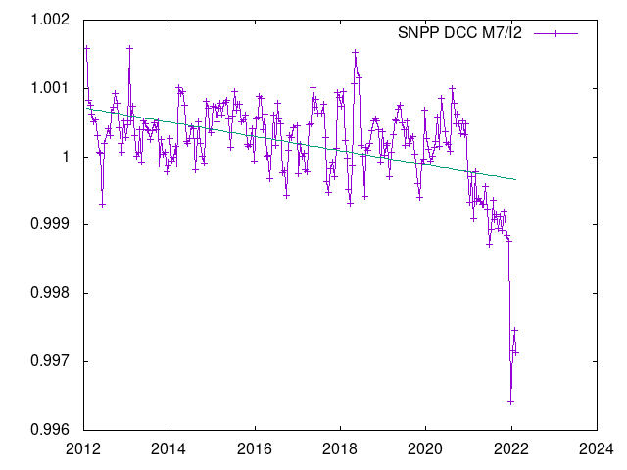
Ratio over Deep Convective Clouds (VIIRS M7/I2)
NOAA20 DCC M7/I2
SNPP DCC M7/I2

Slide 12
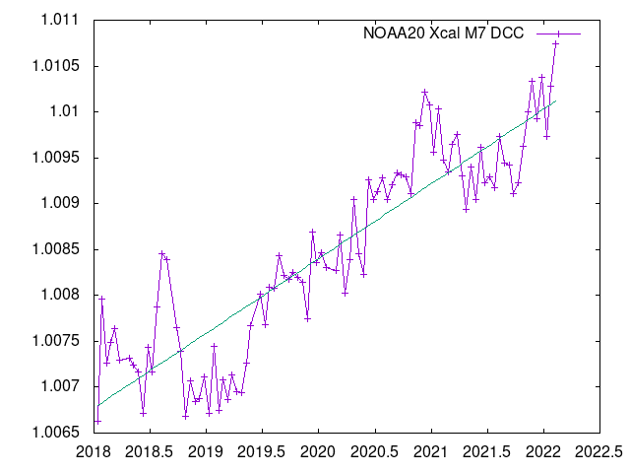
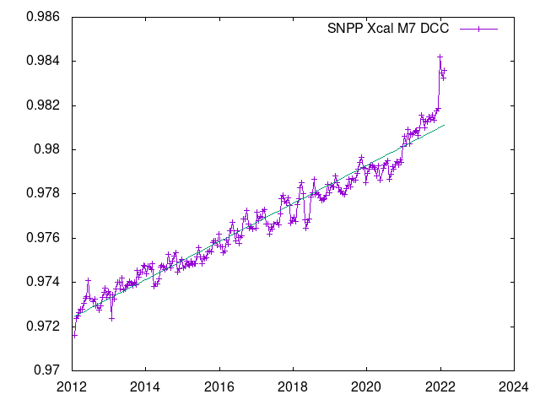
Cross Calibration coefficient Deep Convective Clouds (VIIRS M7)
NOAA20 M7
SNPP M7
Xcal=1.0068+0.000814x(Year-2018)
Xcal= 0.9724+0.000862x(Year-2012)

Slide 13
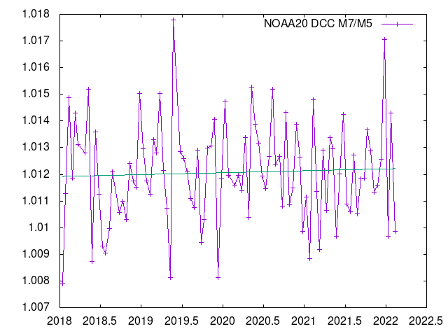
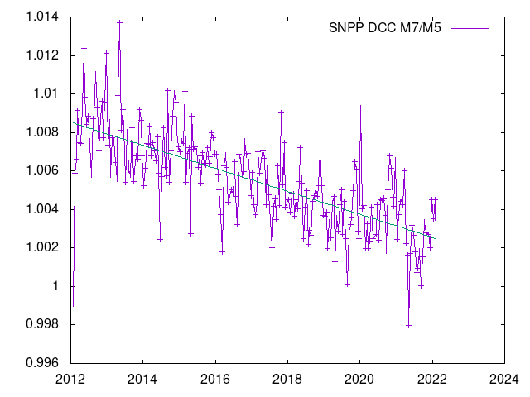
Ratio over Deep Convective Clouds (VIIRS M7/M5)
NOAA20 DCC M7/M5
SNPP DCC M7/M5

Slide 14
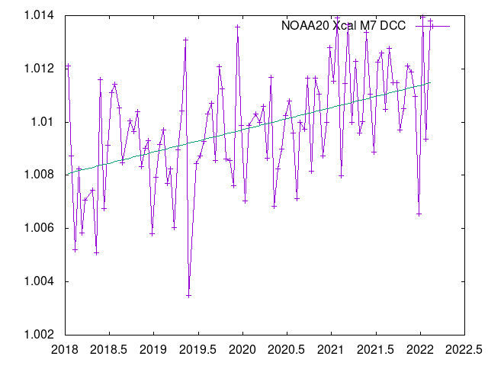
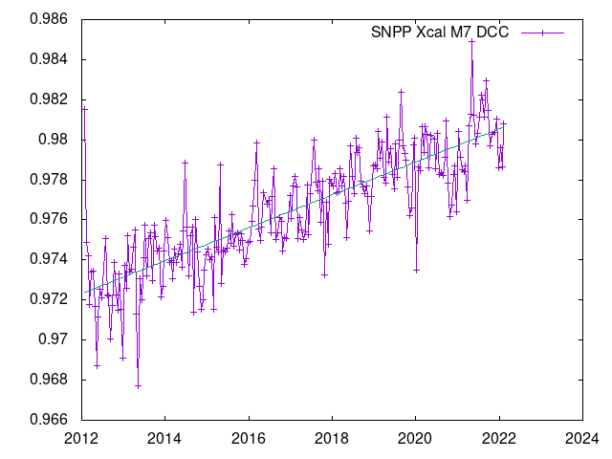
Cross Calibration coefficient Deep Convective Clouds (VIIRS M7)
NOAA20 M7
SNPP M7
Xcal= 1.0080+0.000834x(Year-2018)
Xcal=0.9723+0.000821x(Year-2012)

Slide 15
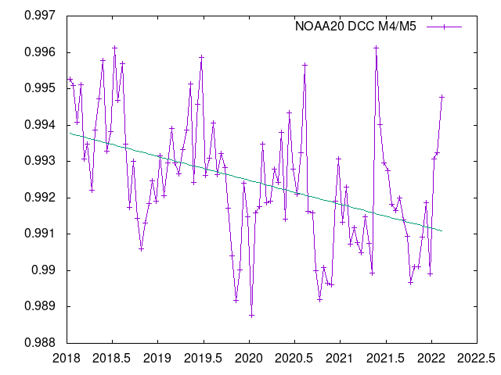
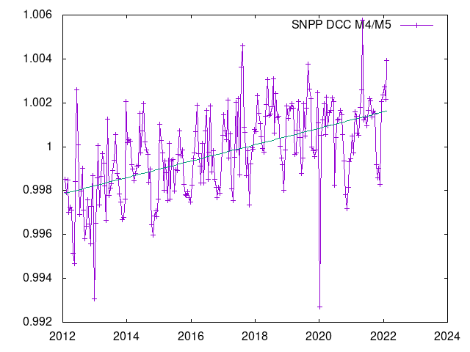
Ratio over Deep Convective Clouds (VIIRS M4/M5)
NOAA20 DCC M4/M5
SNPP DCC M4/M5

Slide 16
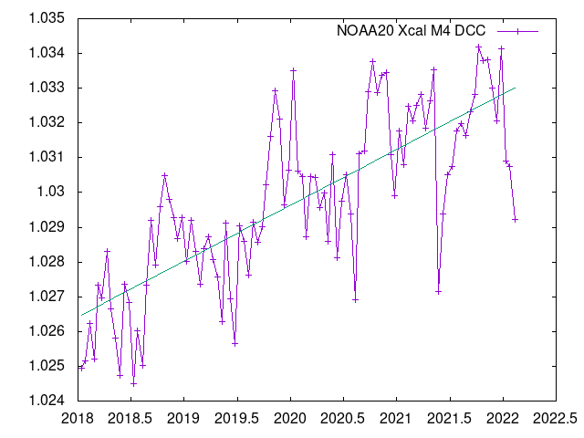
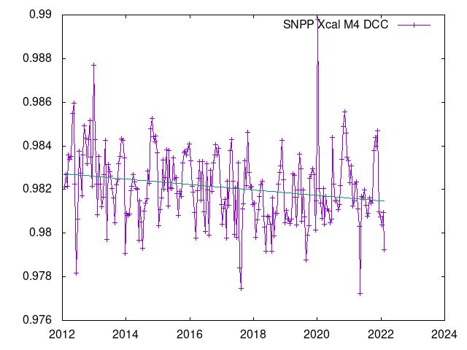
Cross Calibration coefficient Deep Convective Clouds (VIIRS M4)
NOAA20 M4
SNPP M4
Xcal=1.0264+0.001605x(Year-2018)
Xcal=0.9827-0.000125x(Year-2012)

Slide 17
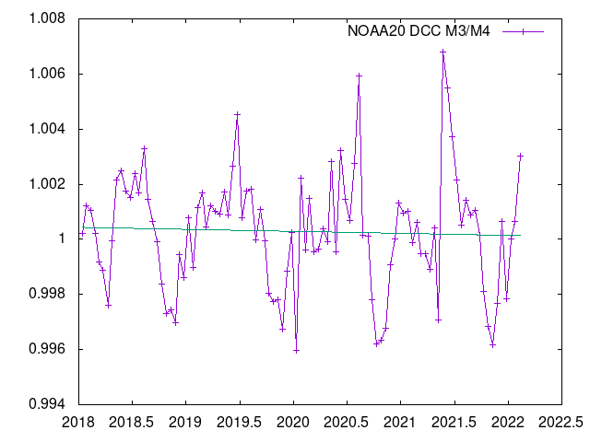
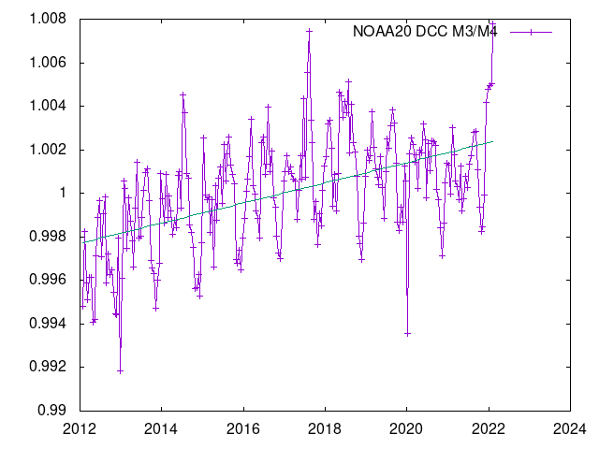
Ratio over Deep Convective Clouds (VIIRS M3/M4)
NOAA20 DCC M3/M4
SNPP DCC M3/M4

Slide 18
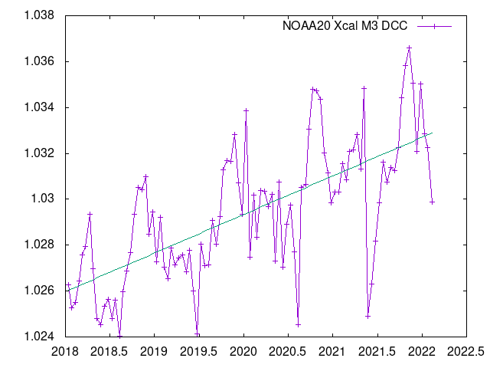
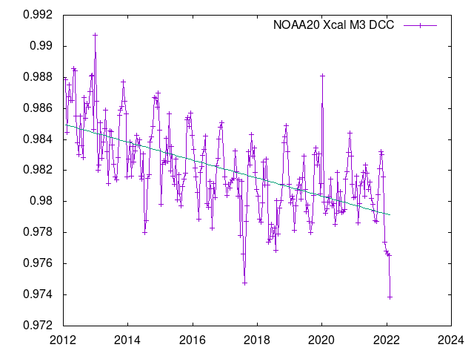
Cross Calibration coefficient Deep Convective Clouds (VIIRS M3)
NOAA20 M3
SNPP M3
Xcal=1.0260+0.001680x(Year-2018)
Xcal=0.9850-0.000579x(Year-2012)

Slide 19
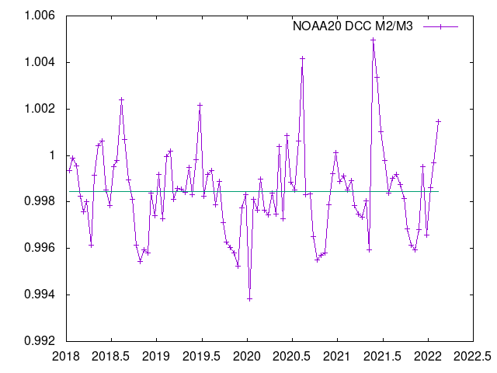
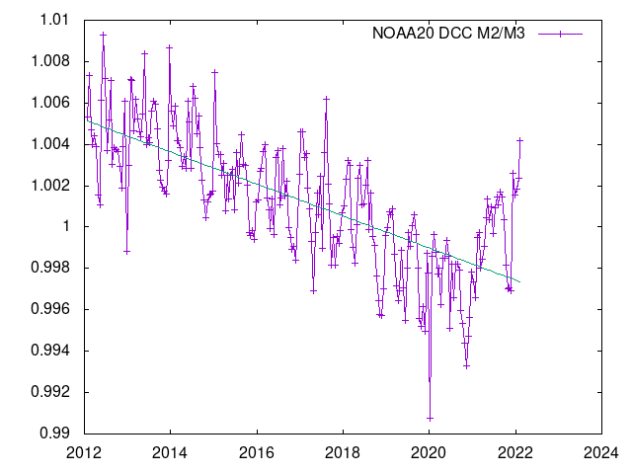
Ratio over Deep Convective Clouds (VIIRS M2/M3)
NOAA20 DCC M2/M3
SNPP DCC M2/M3

Slide 20
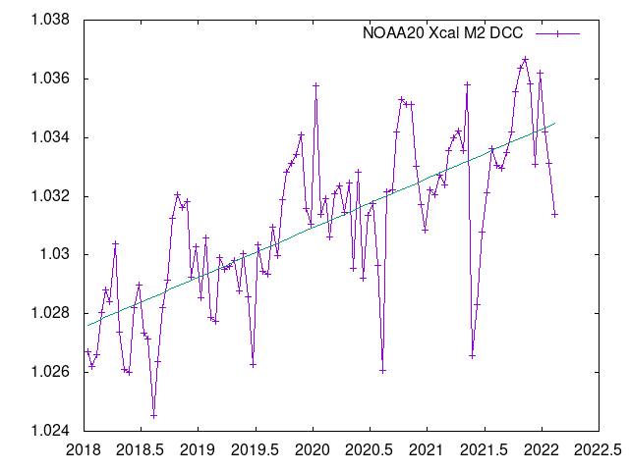
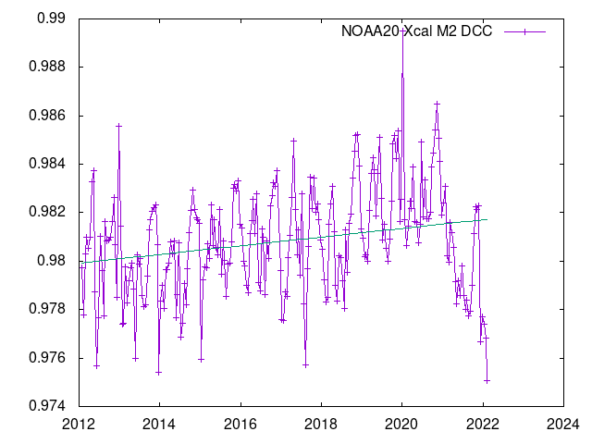
Cross Calibration coefficient Deep Convective Clouds (VIIRS M2)
NOAA20 M2
SNPP M2
Xcal=1.0276+0.001683x(Year-2018)
Xcal=0.9799+0.000179x(Year-2012)

Slide 21
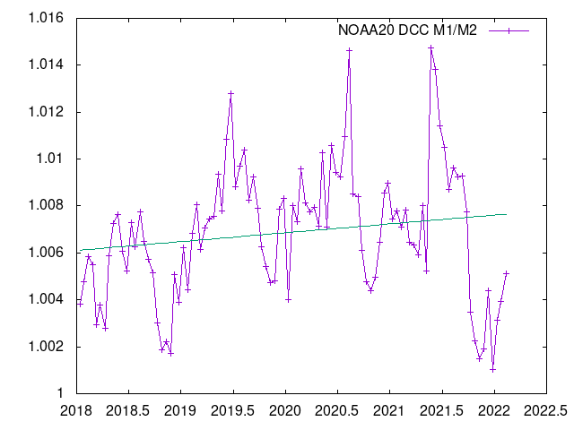
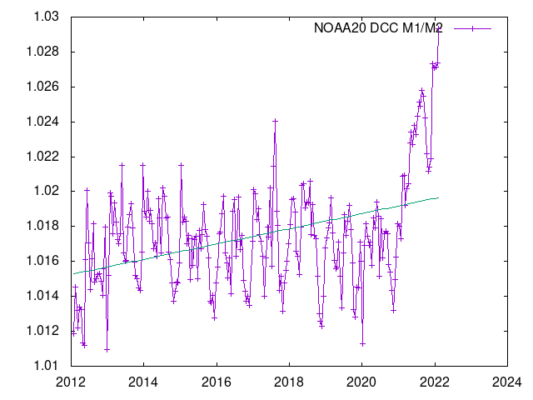
Ratio over Deep Convective Clouds (VIIRS M1/M2)
NOAA20 DCC M1/M2
SNPP DCC M1/M2

Slide 22
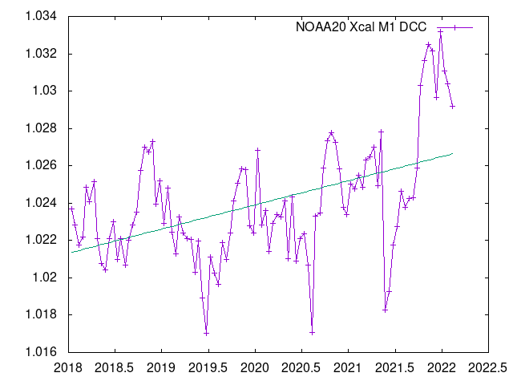
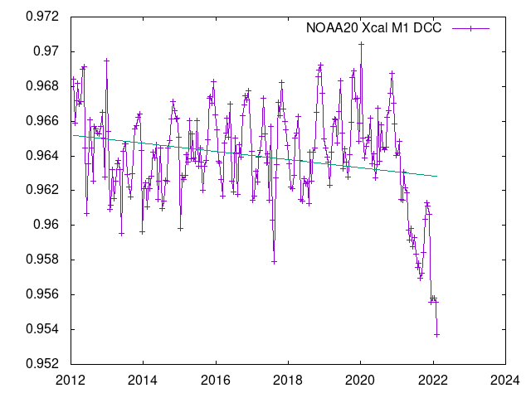
Cross Calibration coefficient Deep Convective Clouds (VIIRS M1)
NOAA20 M1
SNPP M1
Xcal=1.0213+0.001292x(Year-2018)
Xcal=0.9652-0.000235x(Year-2012)

Slide 23
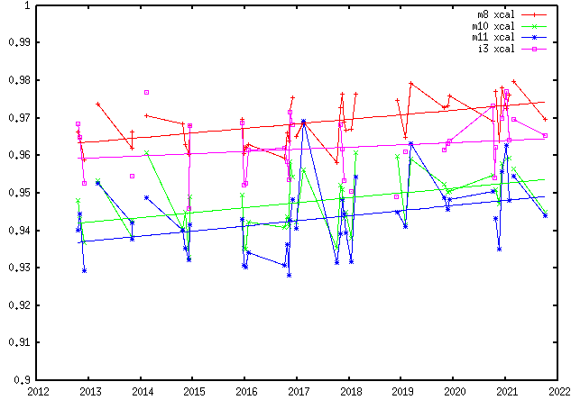
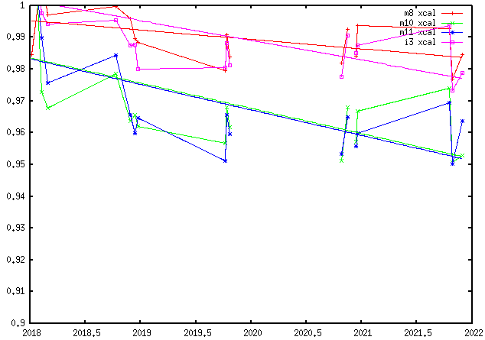
VIIRS SWIR/NIR spectral Intercalibration over Sunglint (Lake Titicaca)
SNPP
NOAA 20

Slide 24
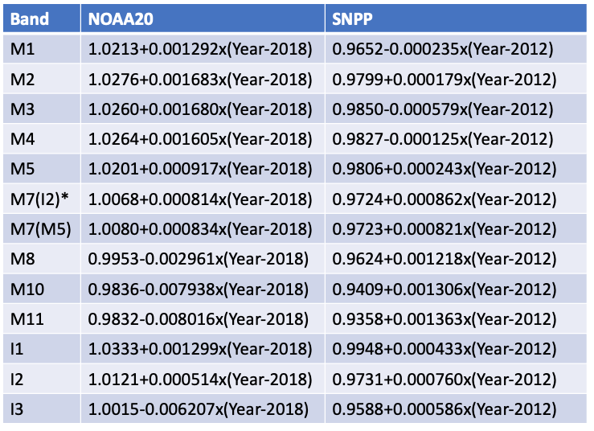
Xcal coefficients table summary
M7(I2)* is recommended for use.

Slide 25
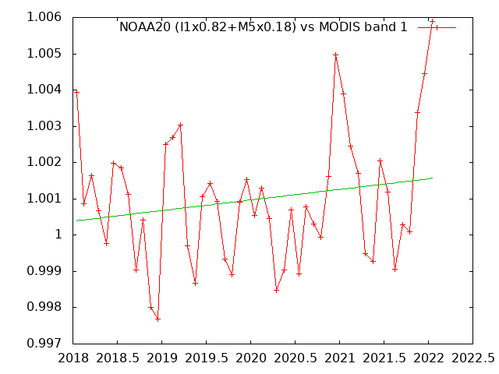
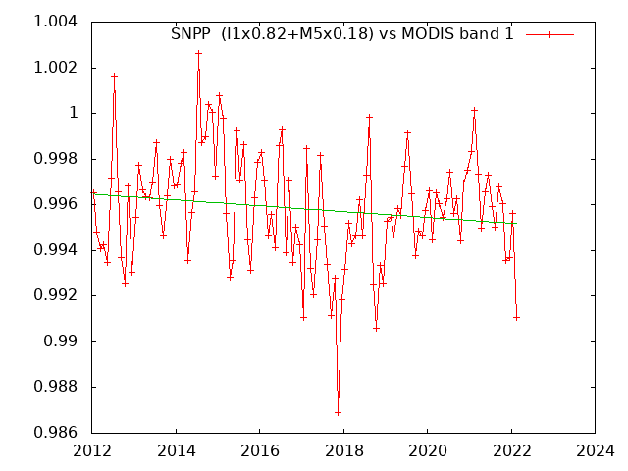
Verification (I1,M5) vs Aqua MODIS band1 (BELMANIP)

Slide 26
Conclusions
A complete approach for harmonization of sensors across visible, NIR and SWIR has been developed
The approach uses globably distributed representative sites (BELMANIP2), Deep Convective Clouds and Sunglint.
This combination of methods minimize the problem of spectral responses differences between sensors

