Slide 1






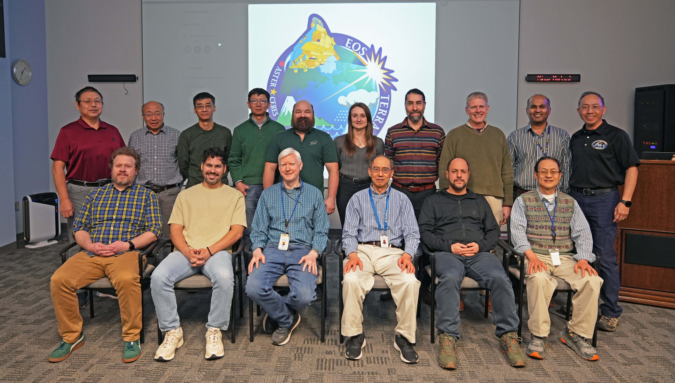

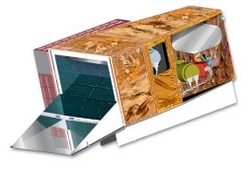
Acknowledgements
Contributions:
MODIS Characterization Support Team (MCST)
VIIRS Characterization Support Team (VCST)
Support:
Terra, Aqua, S-NPP, and JPSS Projects
Mission/Flight Operation Teams (MOT/FOT)
MODIS and VIIRS Science Teams
Instrument Vendor (Raytheon)
NOAA JPSS Program and VIIRS SDR Team
February 26, 2026
MODIS and VIIRS Calibration Workshop, NASA Goddard Space Flight Center, Greenbelt, MD, March 11, 2026

