Slide 1


Introducing MODIS Collection 7
Deep Blue Aerosol Products
Deep Blue Aerosol Project team:
Jaehwa Lee^{1,2}, N. Christina Hsu^{2,3} , and W. Vincent Kim^{1,2}
¹University of Maryland College Park
²NASA Goddard Space Flight Center
³University of Maryland Baltimore County

Slide 2
Status of Deep Blue Aerosol Products
MODIS Collection 7
Algorithm based on VIIRS Version 2 production code, with major upgrades relative to Collection 6.1
Standalone source code integrated into the production system, tested, and currently in production
Level 2 production completed for the “Tier 1” period (2008 – 2018) for both Terra and Aqua; Level 3 in test production
Additional refinements beyond VIIRS Version 2 to be incorporated into the VIIRS Version 3
Performance improvements vs. C6.1:
Over high-elevation regions
Over bright and heterogeneous surfaces
For mineral dust and fine-dominated aerosol cases
Overall improvements due to calibration updates
VIIRS Version 2.1
Expanded to include NOAA-21 VIIRS, in addition to SNPP and NOAA-20
Data sets produced at A-SIPS and approved by LAADS
Partial implementation of MODIS C7 updates to improve data continuity
Full algorithm consistency with MODIS C7 planned for Version 3

Slide 3
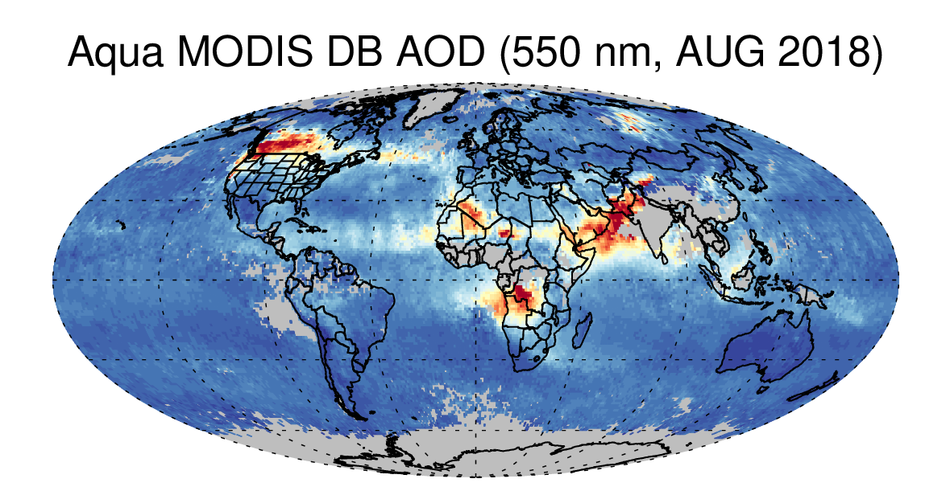
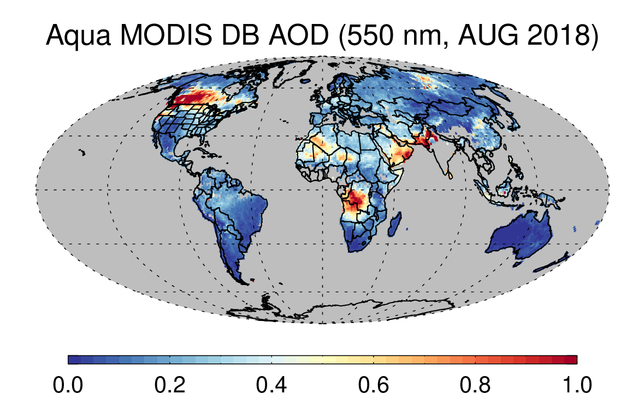
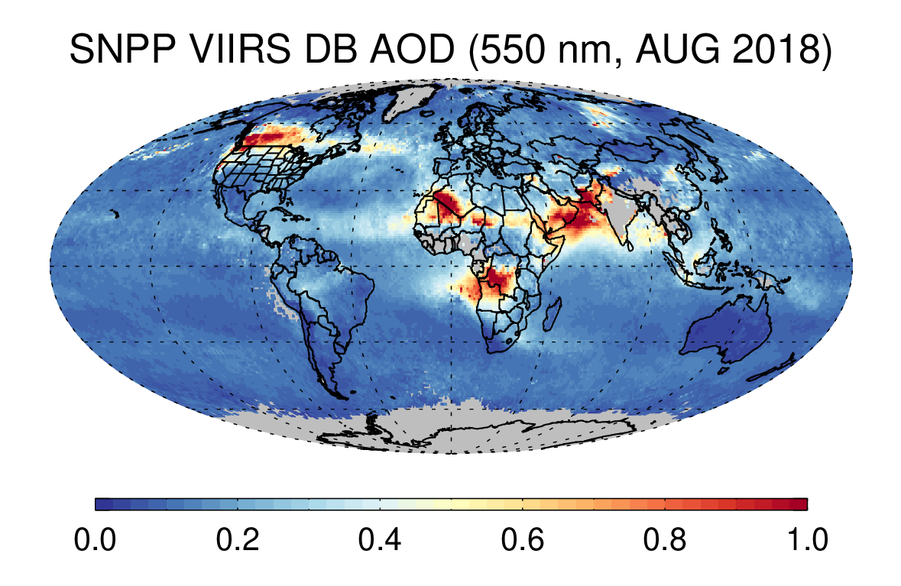
MODIS C7 Aerosol Product
MODIS C7
MODIS C6.1
VIIRS V2
MODIS C7 algorithm
Based on VIIRS V2 algorithm
New over-water retrievals using DB/SOAR algorithm
Better consistency with VIIRS V2 data sets
C7 updates have been partially transferred to VIIRS V2.1 and will be fully implemented in V3

Slide 4
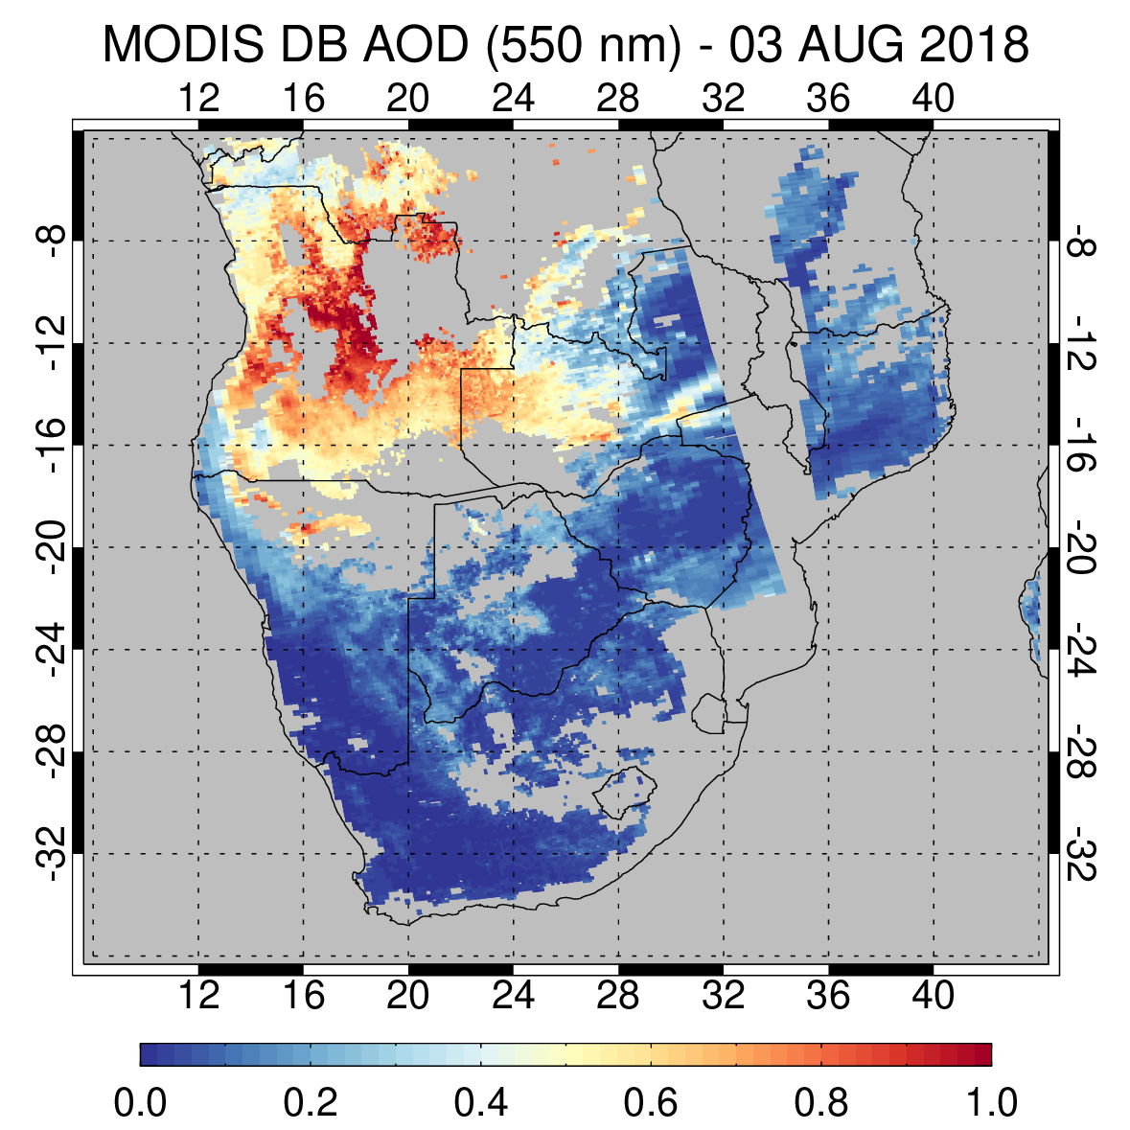
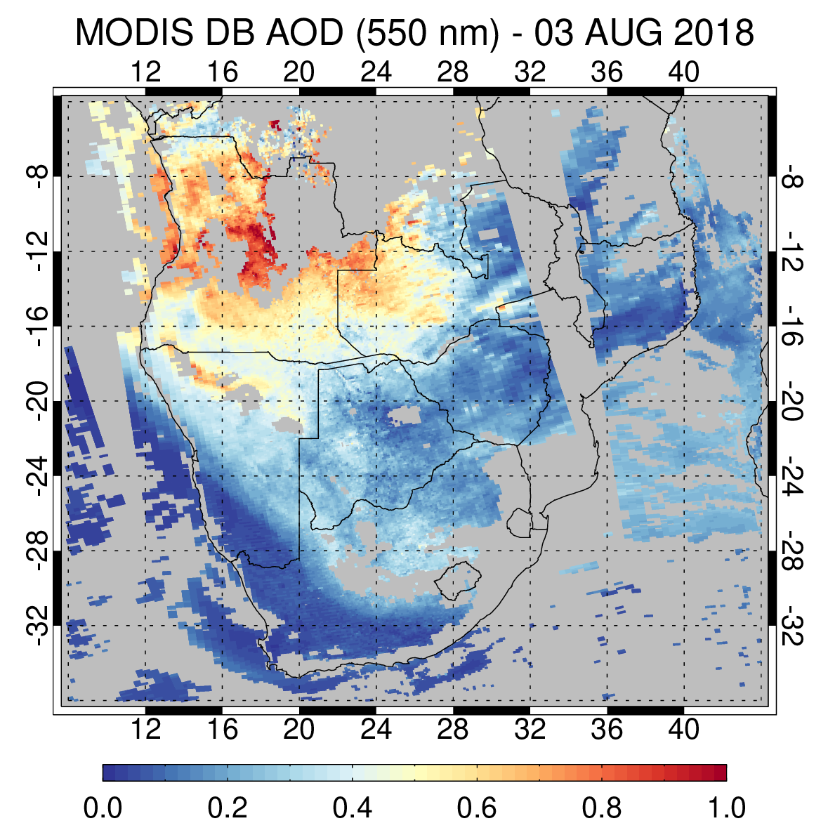
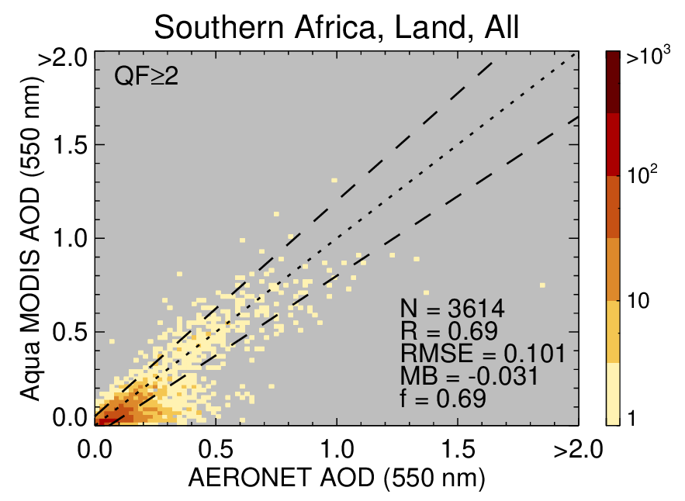
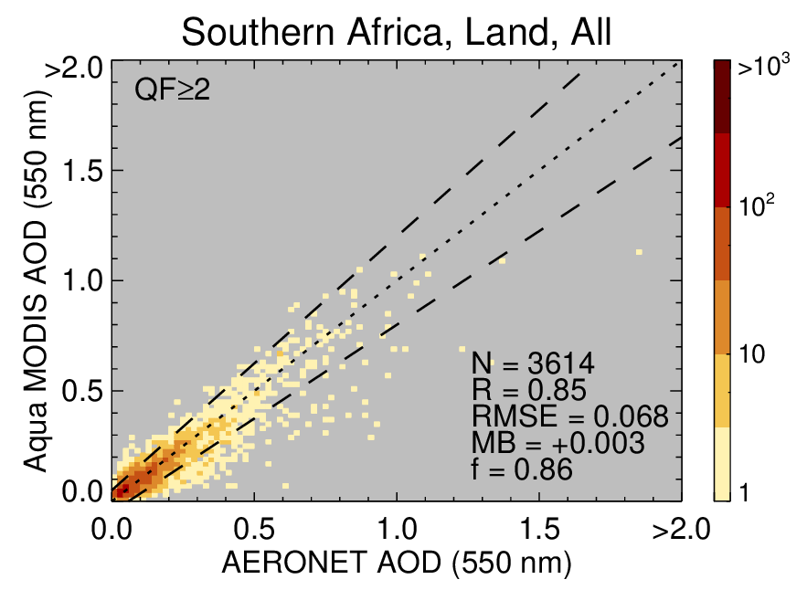
Southern Africa (high-elevation terrain)
C6.1
C7
Improved AOD retrievals over high-elevation regions
Accounting for surface pressure over both land and ocean
Mitigated a significant negative bias over high-elevation terrain
Increased spatial coverage
Improved land-ocean continuity
Significantly improved validation statistics

Slide 5
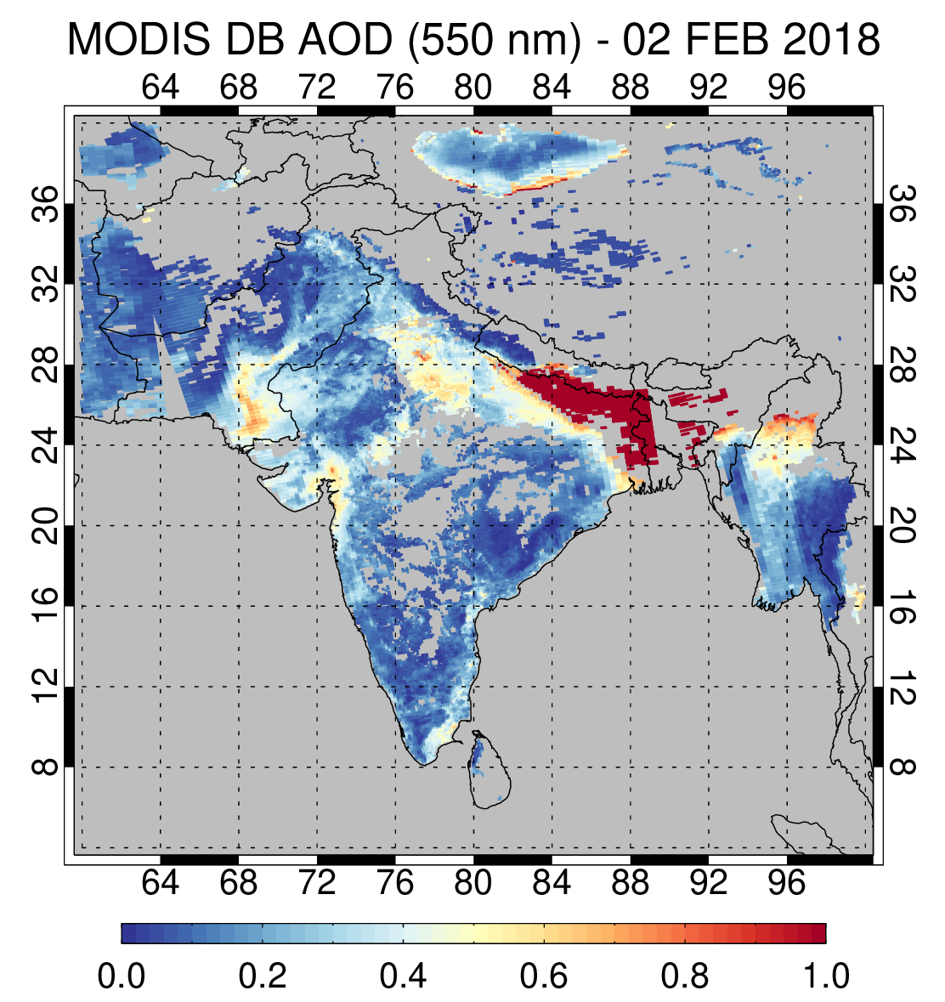
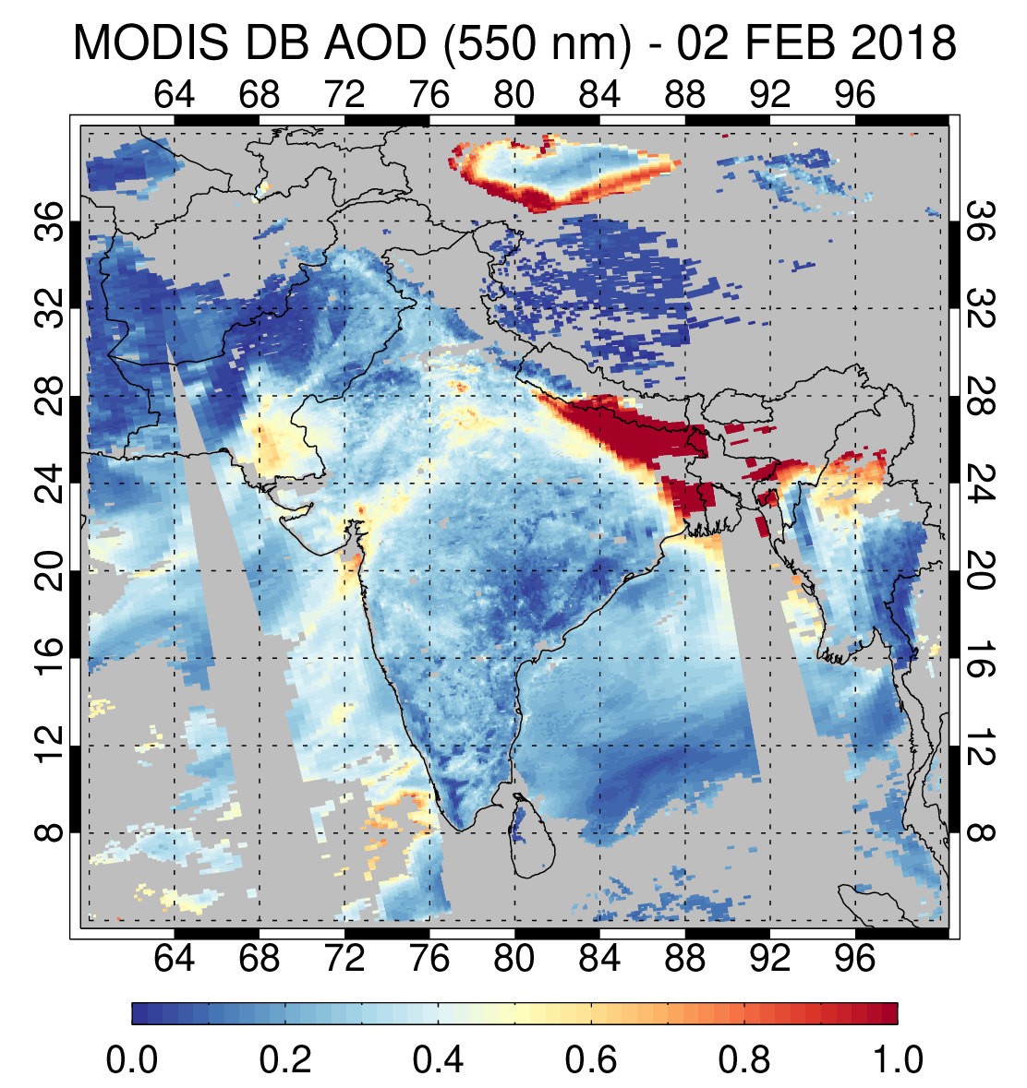
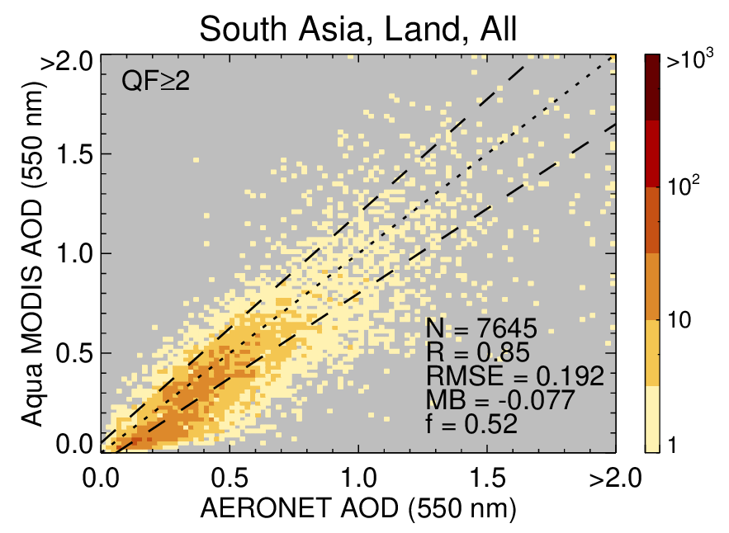
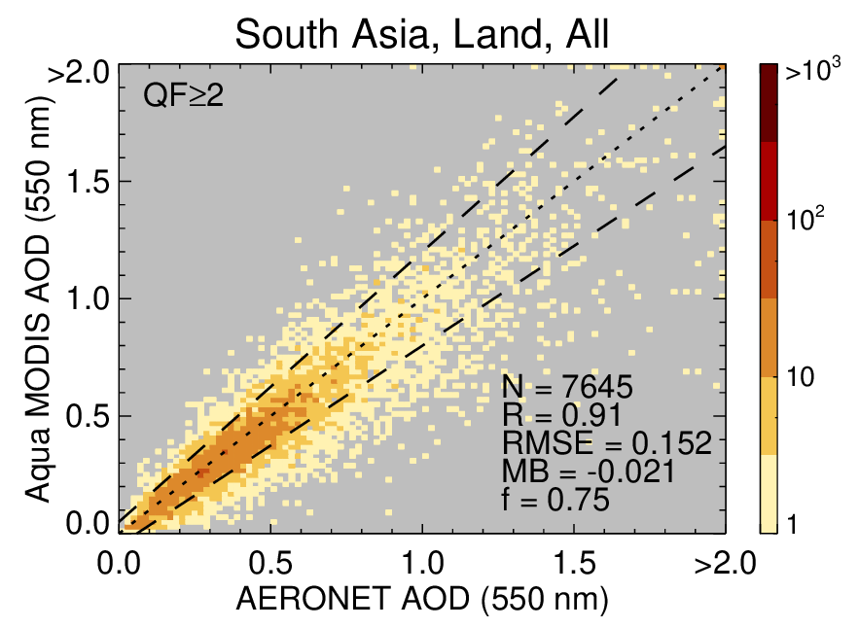
India (inhomogeneous surface + fine-dominated aerosols)
C6.1
C7
Improved AOD retrievals over heterogeneous surfaces (croplands)
Improved surface reflectance characterization
Implemented a fine-dominated anthropogenic aerosol optical model with a bimodal lognormal size distribution
Increased spatial coverage
Improved land-ocean continuity
Significantly improved validation statistics

Slide 6
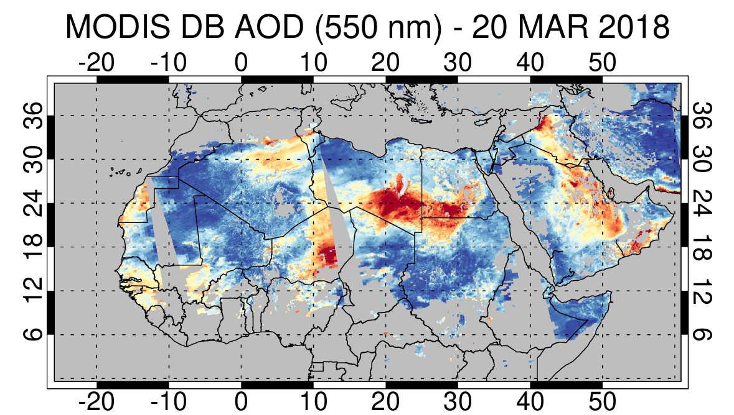
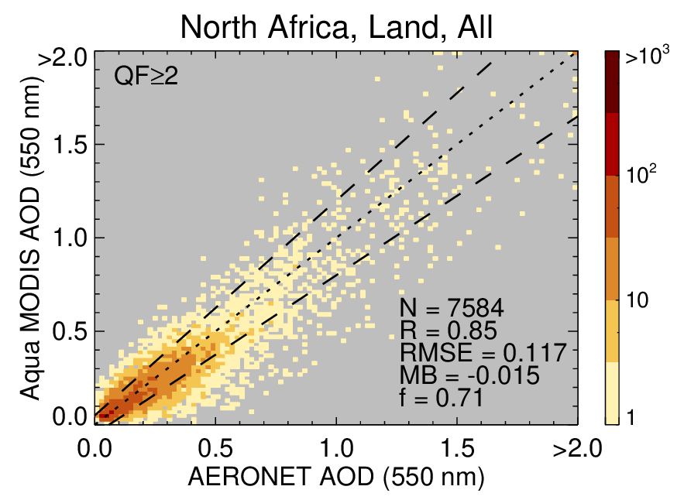
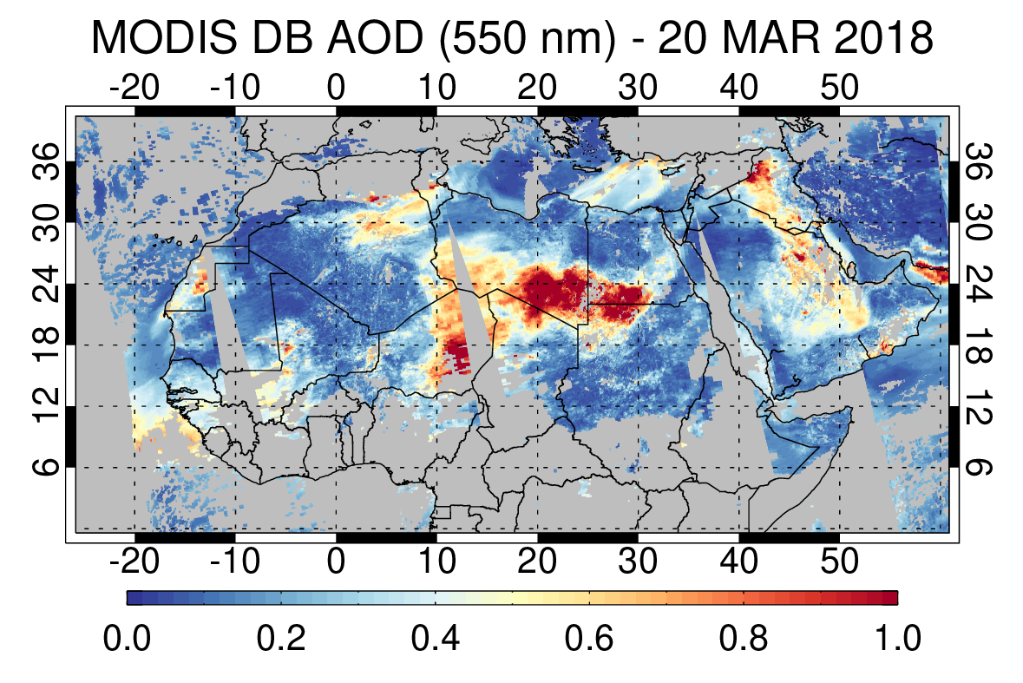
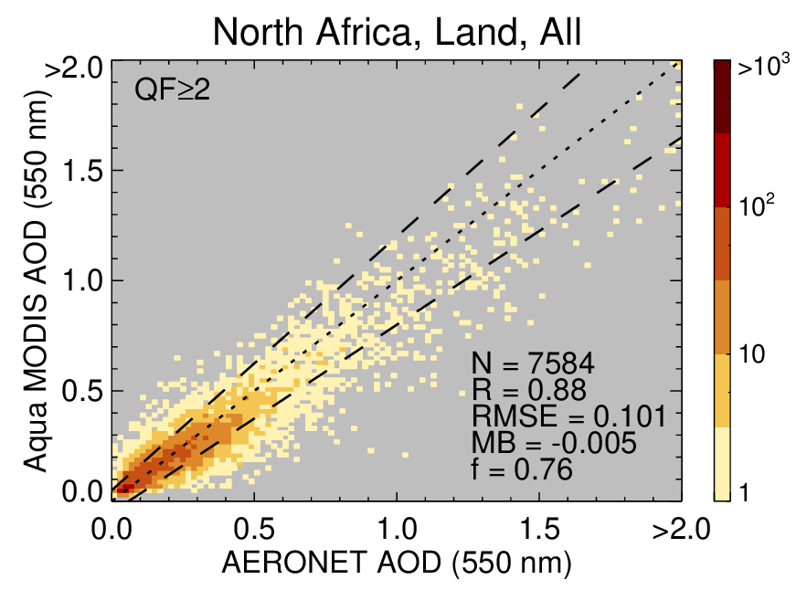
North Africa (bright surface + nonspherical dust)
C6.1
C7

Slide 7
Cross-Calibration Across Sensors
Terra against Aqua MODIS
Terra MODIS is cross-calibrated against Aqua MODIS using RadCalNet data (caveats: gain factors were derived for C6.1 L1b).
Over land, NOAA-20/21 VIIRS is cross-calibrated against SNPP VIIRS using matchup data over Dome-C cal/val site.
Aqua MODIS serves as bridge between SNPP and NOAA-20/21.
Over water, SNPP VIIRS is cross-calibrated against MODIS using multi-sensor co-location files generated by A-SIPS.
This significantly reduces algorithm maintenance effort across multiple sensors.
Open to other approaches in the later versions.
Calibration gain factors for Terra | 410 nm | 470 nm | 550 nm | 650 nm | 860 nm | 1240 nm | 1610 nm | 2130 nm
Angal et al. (2020) | N/A | 0.979 | 0.992 | 0.997 | 0.983 | 0.956 | N/A | 0.969
NOAA-20 and 21 against SNPP over land
Calibration gain factors | 410 nm | 490 nm | 550 nm | 670 nm | 860 nm | 1240 nm | 1610 nm | 2250 nm
SNPP/NOAA-20 | 1.059 | 1.052 | 1.069 | 1.054 | 1.052 | 1.026 | 1.036 | 1.008
SNPP/NOAA-21 | 1.075 | 1.067 | 1.074 | 1.058 | 1.058 | 1.044 | 1.013 | 1.104
Meyer et al. (2020) over clouds (SNPP/NOAA-20) |  |  |  | 1.053 | 1.041 | 1.030 | 1.041 | 1.021
SNPP VIIRS against Aqua MODIS over water
Calibration gain factors for SNPP | 410 nm | 490 nm | 550 nm | 670 nm | 860 nm | 1240 nm | 1610 nm | 2250 nm
Aqua/SNPP | 0.995 | 0.992 | 0.956 | 0.941 | 0.963 | 1.011 | 0.981 | 0.931
Meyer et al. (2020) over clouds |  |  |  | 0.95 | 0.97 | 0.99 | 0.98 | 0.97

Slide 8
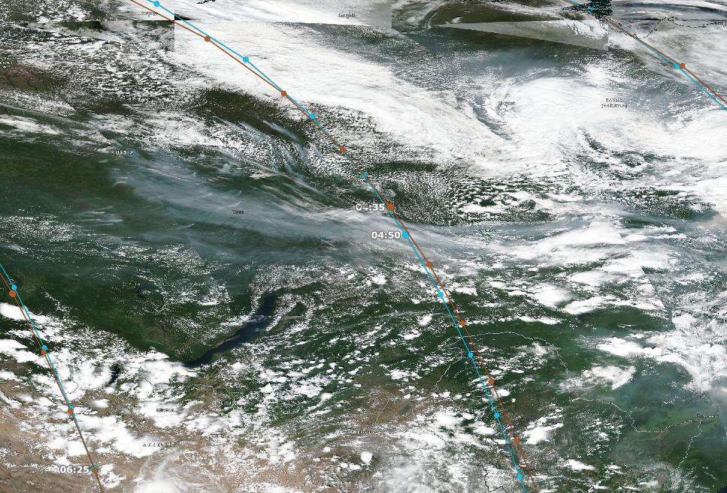
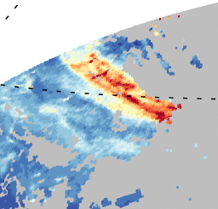
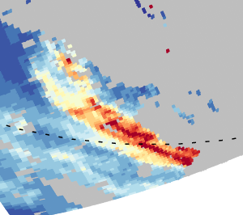
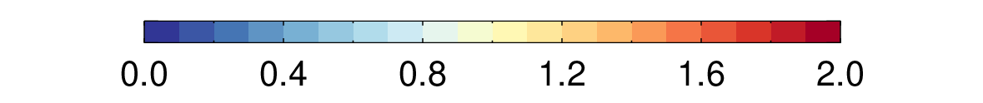
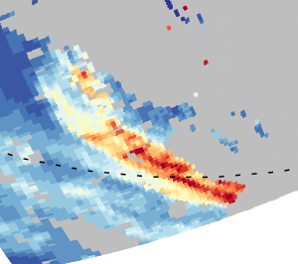
Aerosol Model Adjustments
VIIRS V2.1
MODIS C7 original
MODIS C7 SSA adjusted
Differences in spectral characteristics between MODIS and VIIRS
Use of original SSA optimized for VIIRS results in slight differences in AOD
Adjustments to the predefined single-scattering albedo values to improve consistency
Adjustments within the expected range (<0.01-0.02)

Slide 9
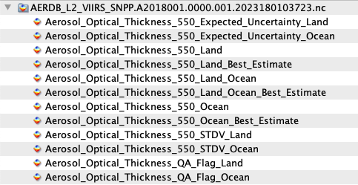
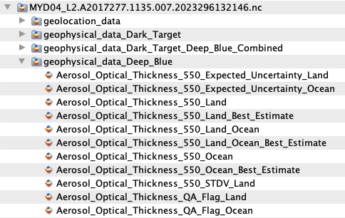
MODIS vs. VIIRS File Formats
VIIRS Version 2
MODIS Collection 7
…
…

Slide 10
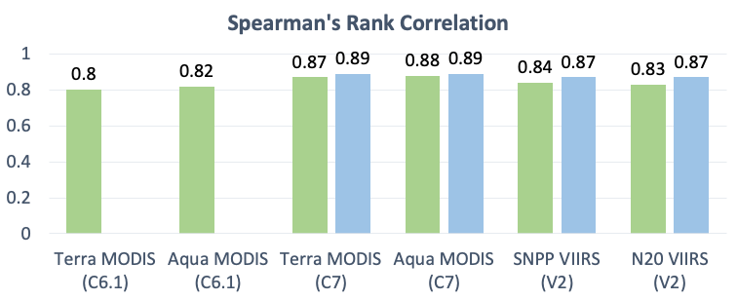
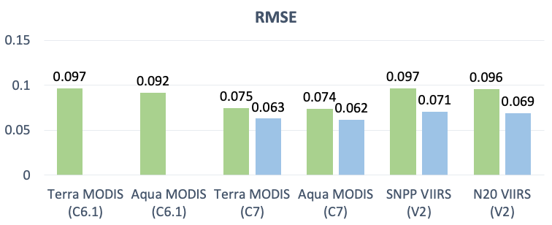
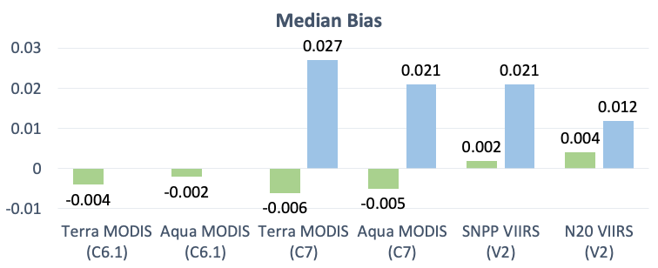
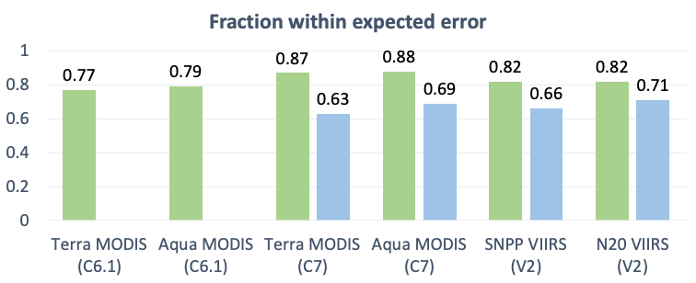
AOD Validation Against AERONET
Land
Water
EE (land) = ±(0.05+15%)
EE (water) = ±(0.03+10%)

Slide 11
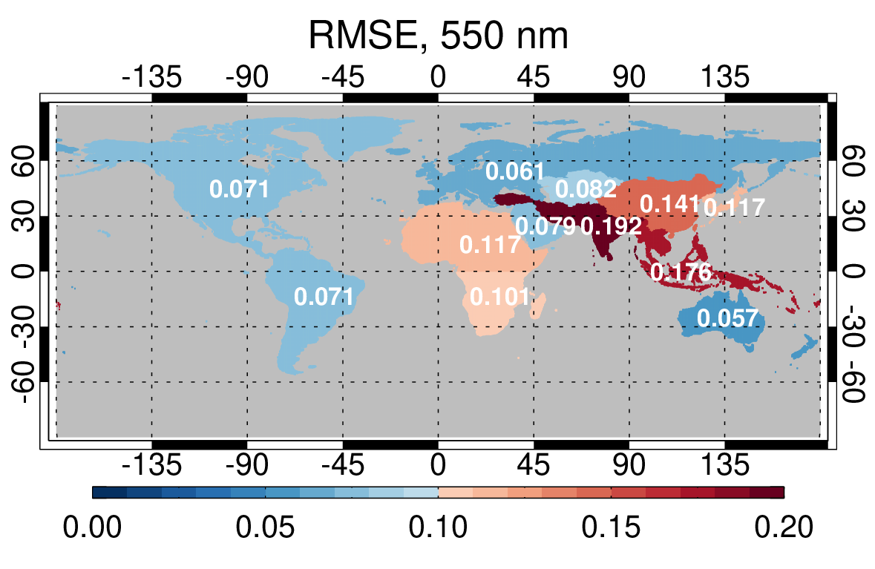
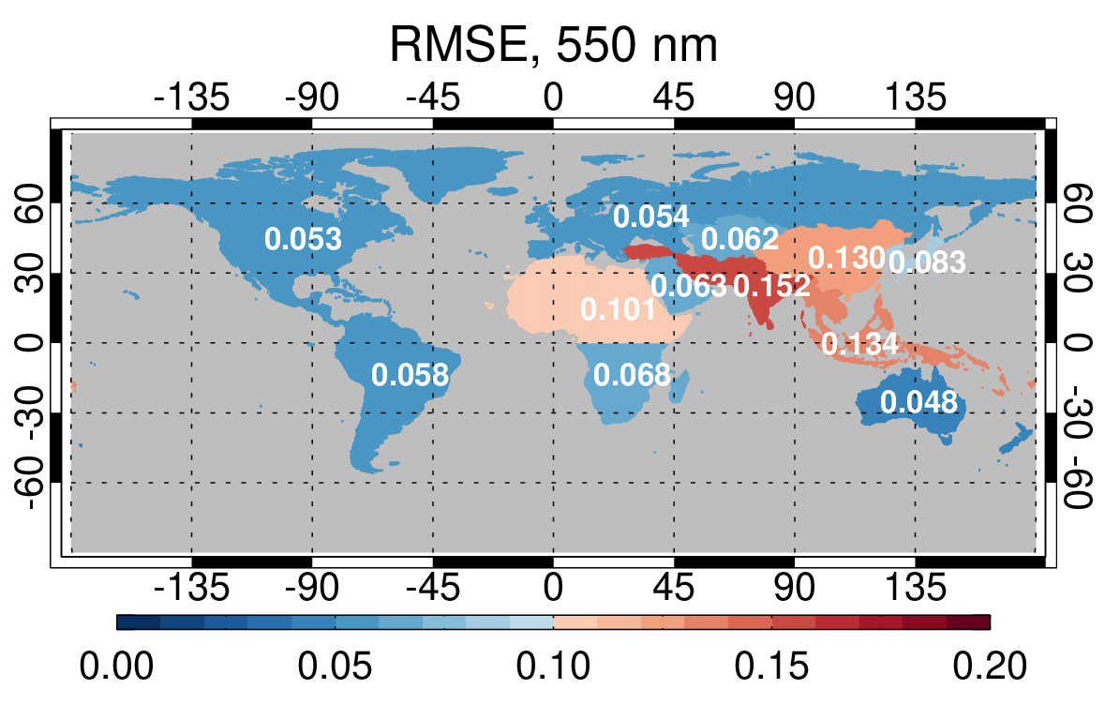
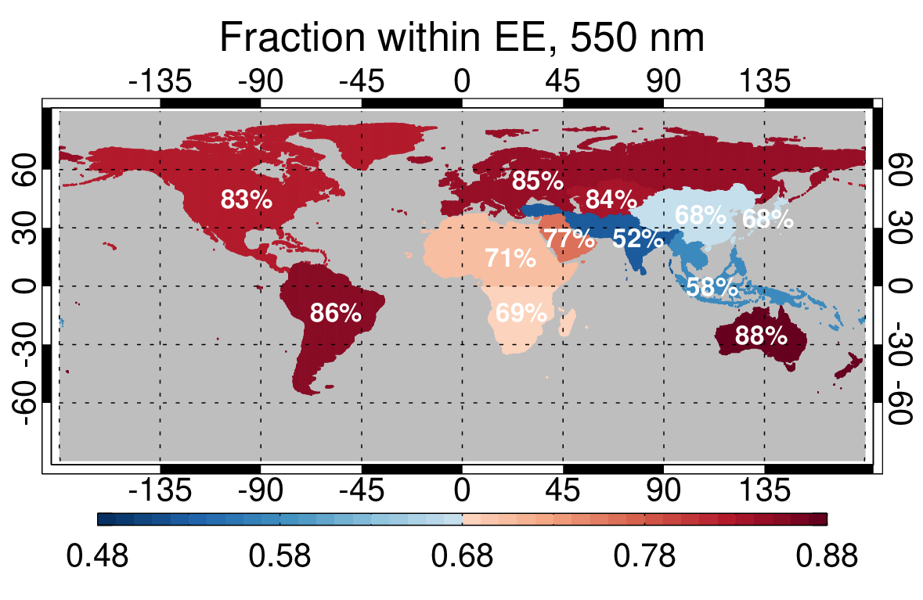
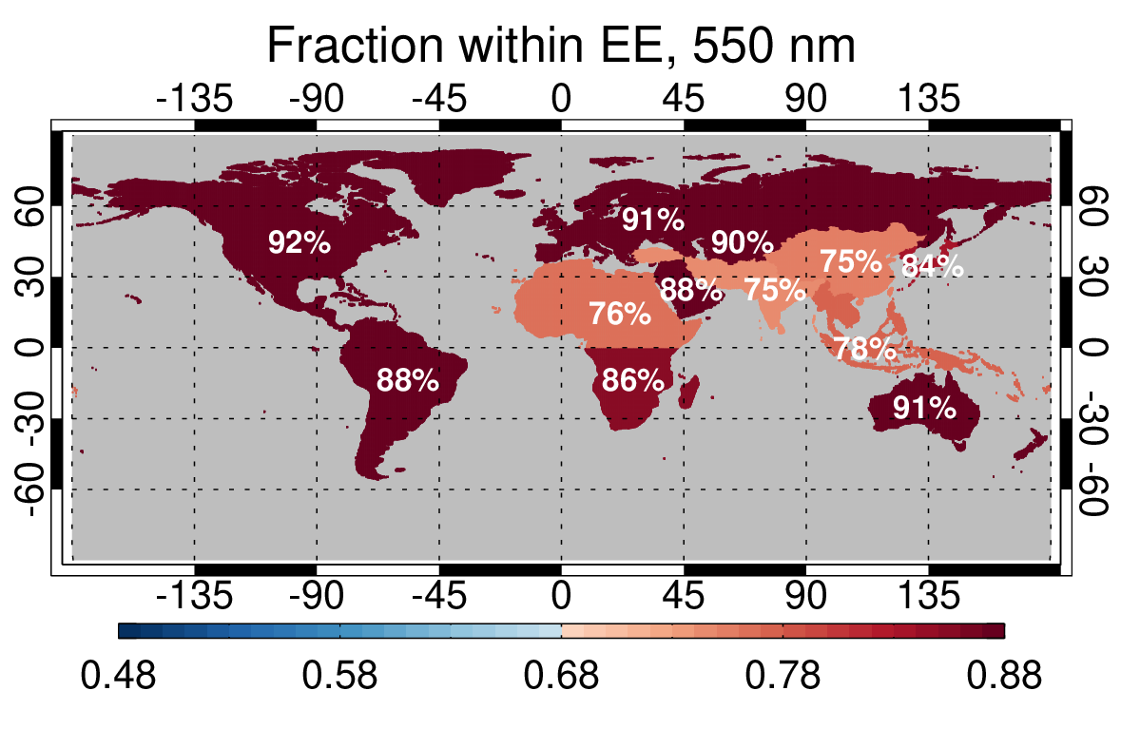
AOD Validation Against AERONET (Aqua MODIS C6.1 vs. C7; 2008-2018)
C6.1
C7
EE (land) = ±(0.05+15%)
EE (water) = ±(0.03+10%)

Slide 12
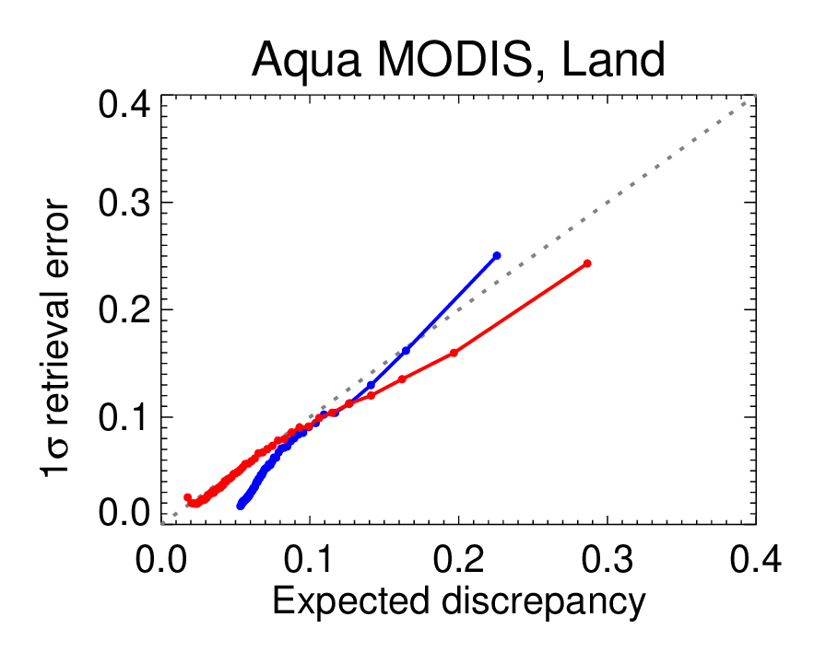
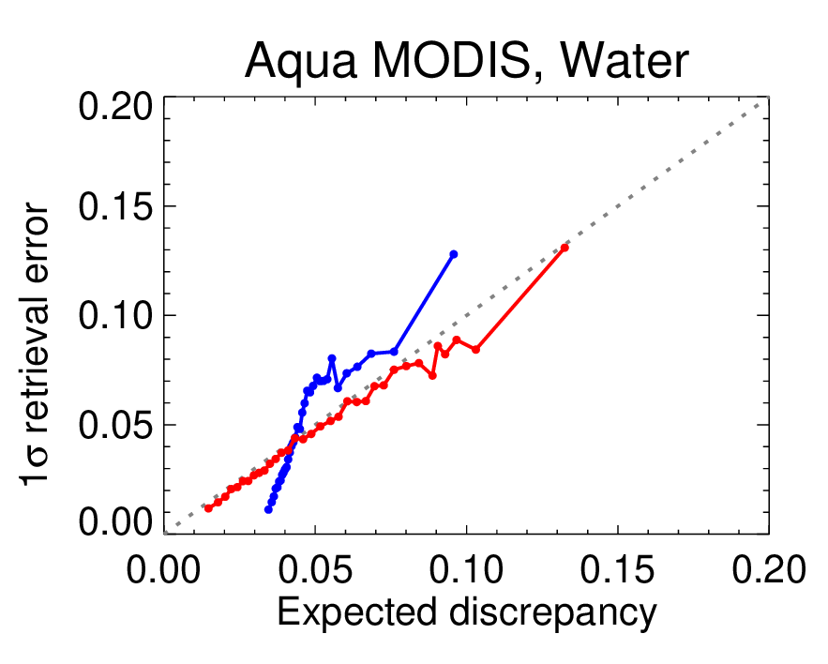
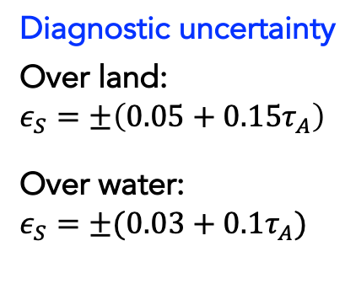
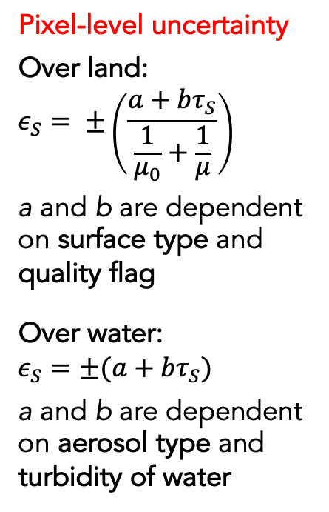
Prognostic Pixel-Level Uncertainty
Framework for the evaluation of uncertainty estimates (Sayer et al. 2020a, b)
Uncertainty estimates: finding 1-sigma confidence interval around retrieved value within which the true value is expected to lie ~68% of the time, following Gaussian statistics
Diagnostic uncertainty
Over land:
$$ε_{S}=±\left(0.05+0.15τ_{A}\right)$$
Over water:
$$ε_{S}=±(0.03+0.1τ_{A})$$
Pixel-level uncertainty
Over land:
$$ε_{S}= ±\left(\frac{a+bτ_{S}}{\frac{1}{μ_{0}}+\frac{1}{μ}}\right)$$
a and b are dependent on surface type and quality flag
Over water:
$$ε_{S}=±(a+bτ_{S})$$
a and b are dependent on aerosol type and turbidity of water

Slide 13
Summary
MODIS Collection 7 Deep Blue aerosol products show significant improvements relative to C6.1, particularly over high-elevation regions and heterogeneous/bright surfaces, and for mineral dust and fine-dominated aerosol cases.
The implementation of a consistent algorithm with cross-calibration enables the creation of a harmonized long-term aerosol data record from the twin MODIS and the VIIRS series.
Updates made to the MODIS C7 algorithm will be incorporated into the upcoming VIIRS Version 3 production stream.
The C7 Deep Blue aerosol products are currently in production and will be available through LAADS DAAC and Earthdata (https://earthdata.nasa.gov).

Slide 14
Backup slides

Slide 15
Status: Other Sensors
GEO
Demonstration data sets have been released for G16/17 ABI and H8 AHI.
Algorithm based on VIIRS V2 including over-water retrievals.
Consistent performance with LEO sensors despite lacking 412 nm band.
AVHRR (funded through MEaSUREs Program)
A subset of NOAA-11/14/18 AVHRR DB data has been available over both land and water.
Initial reprocessing for NOAA-7/9/11/14/16/18 is nearing completion for the period from 1981 to 2012.
Data release is scheduled for the end of 2026.

Slide 16
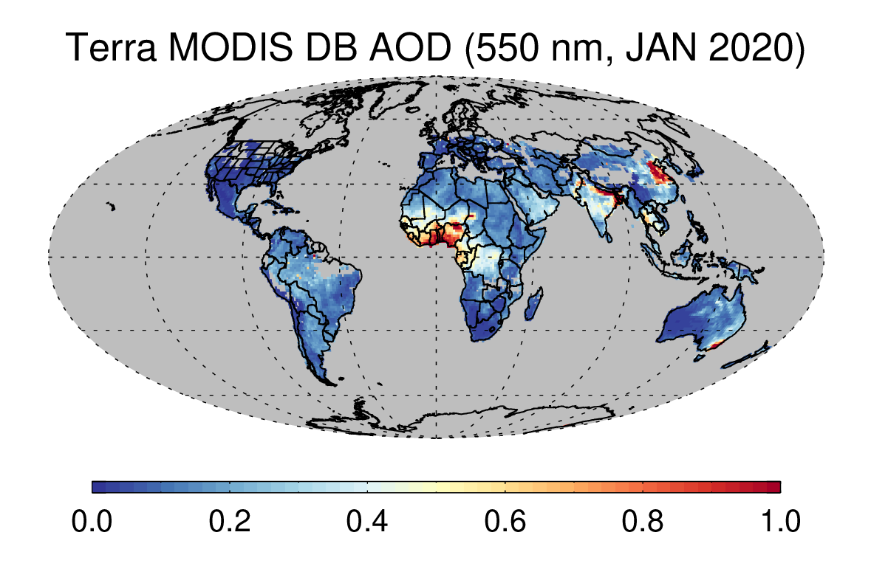
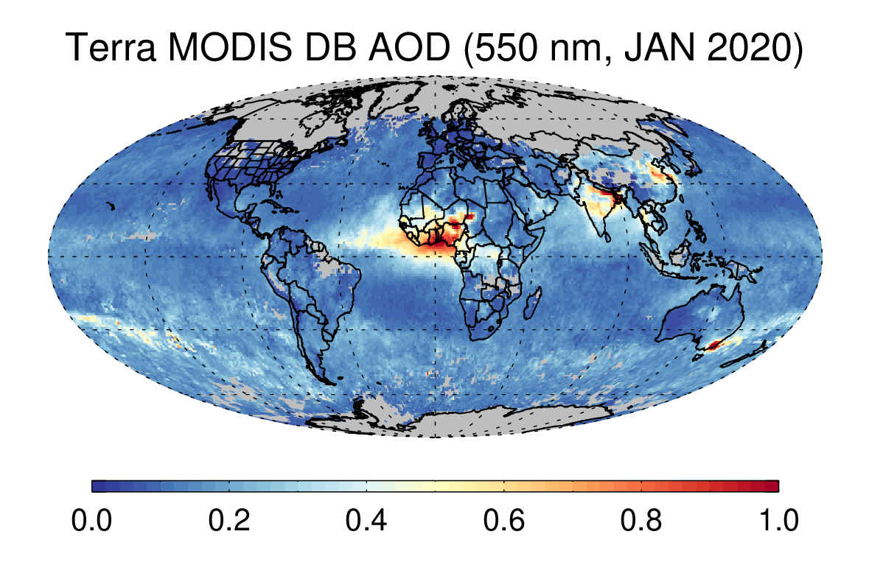
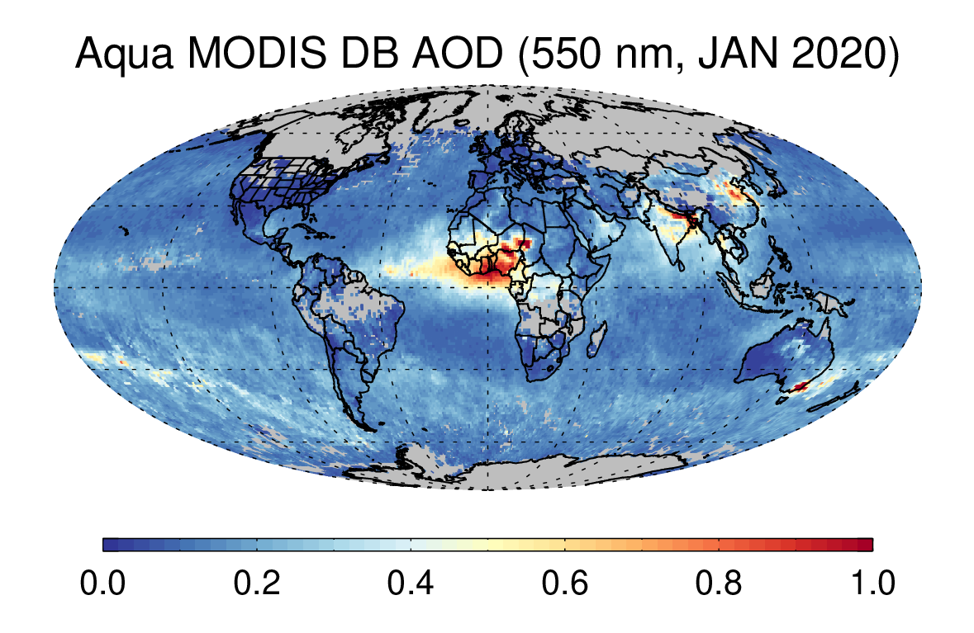
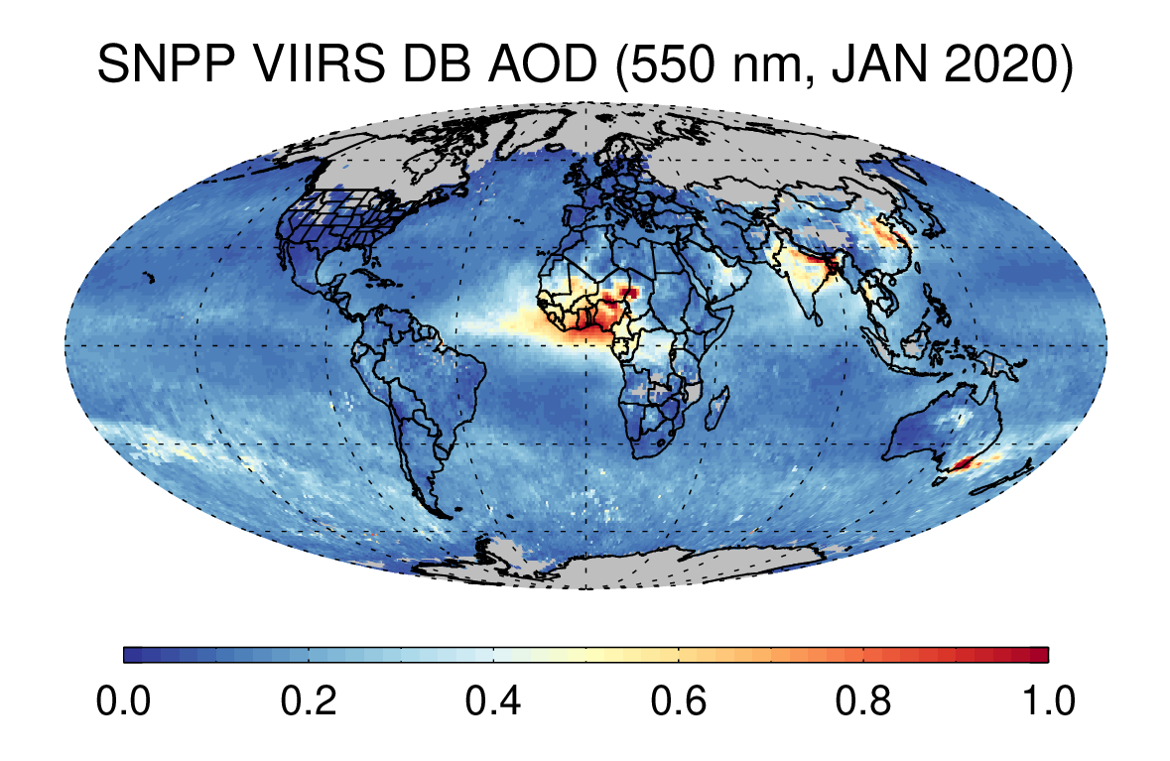
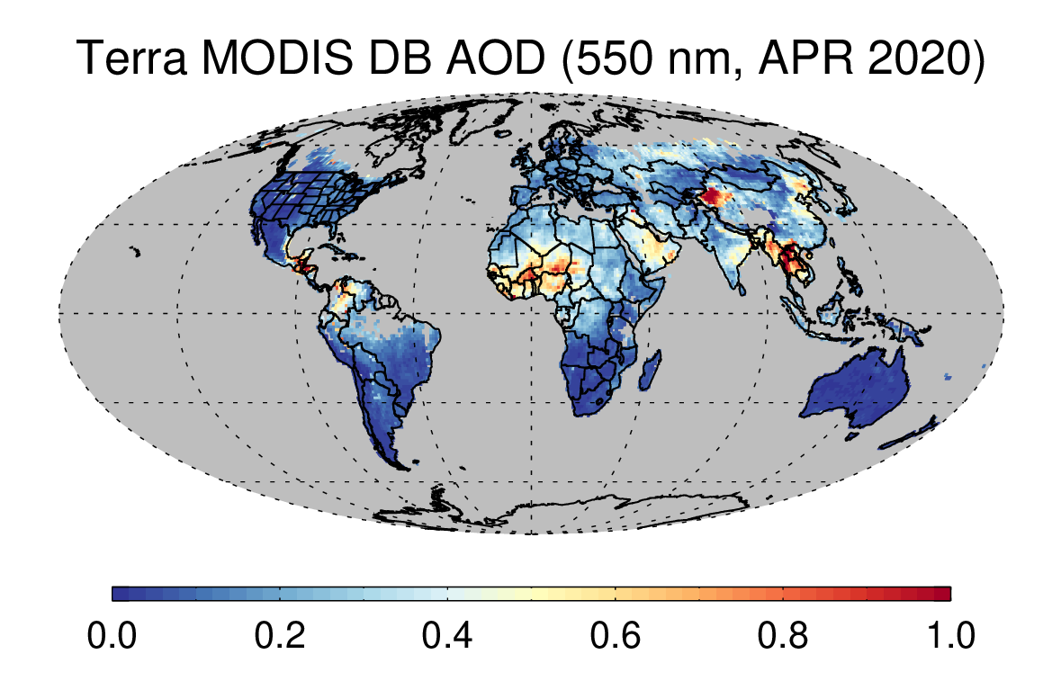
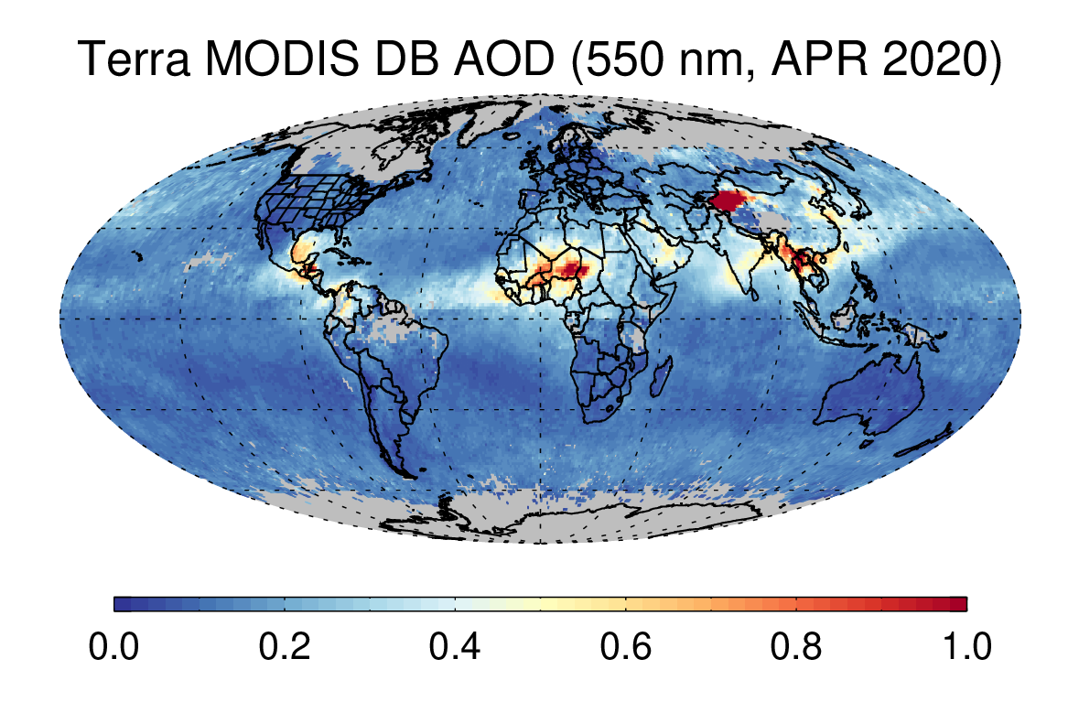
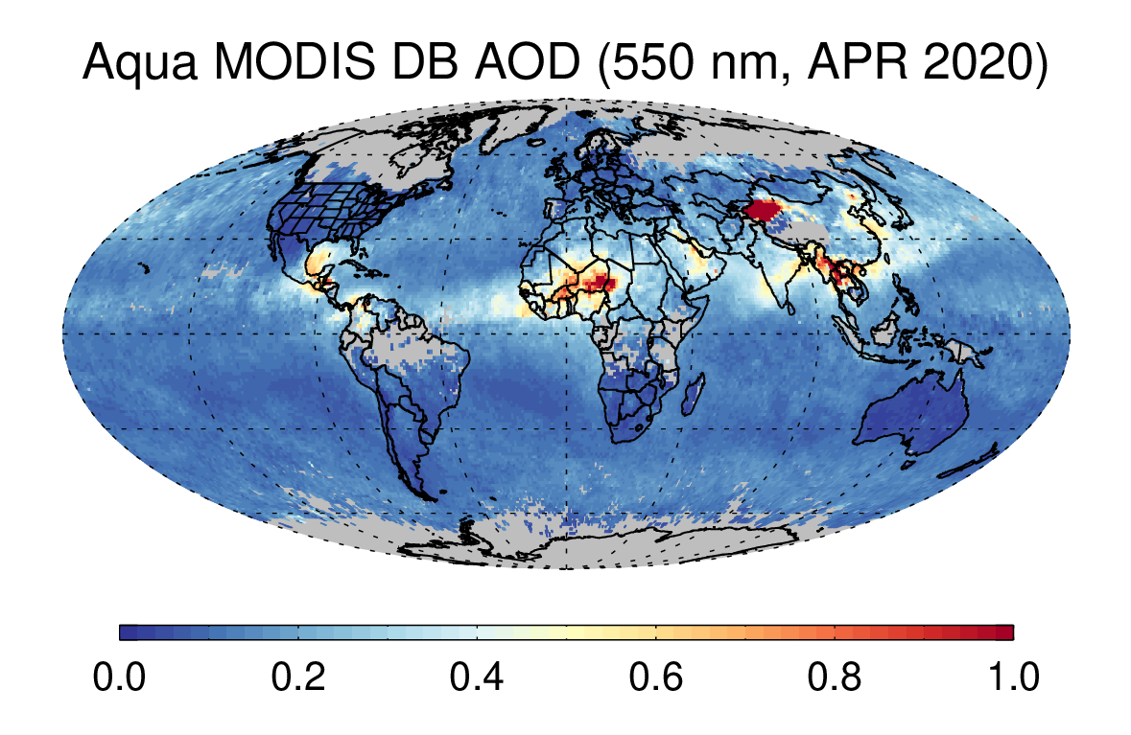
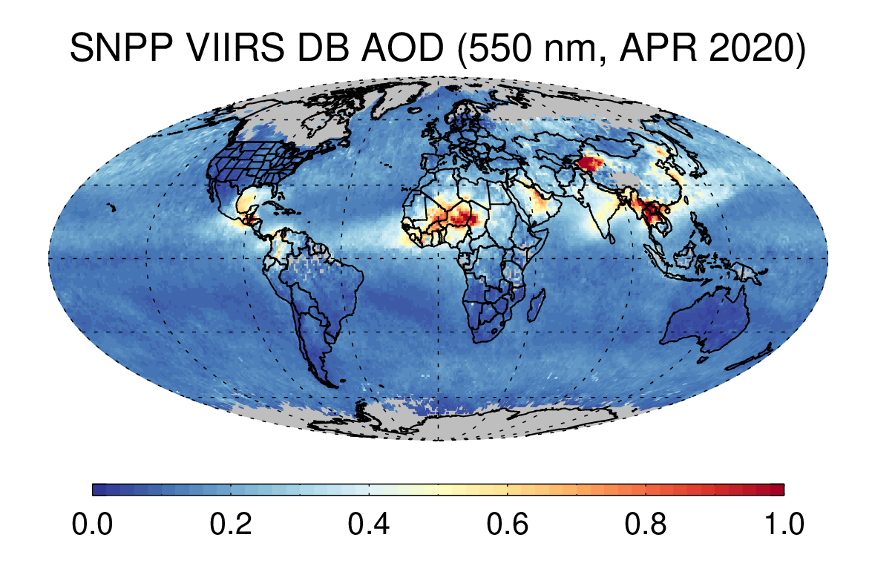
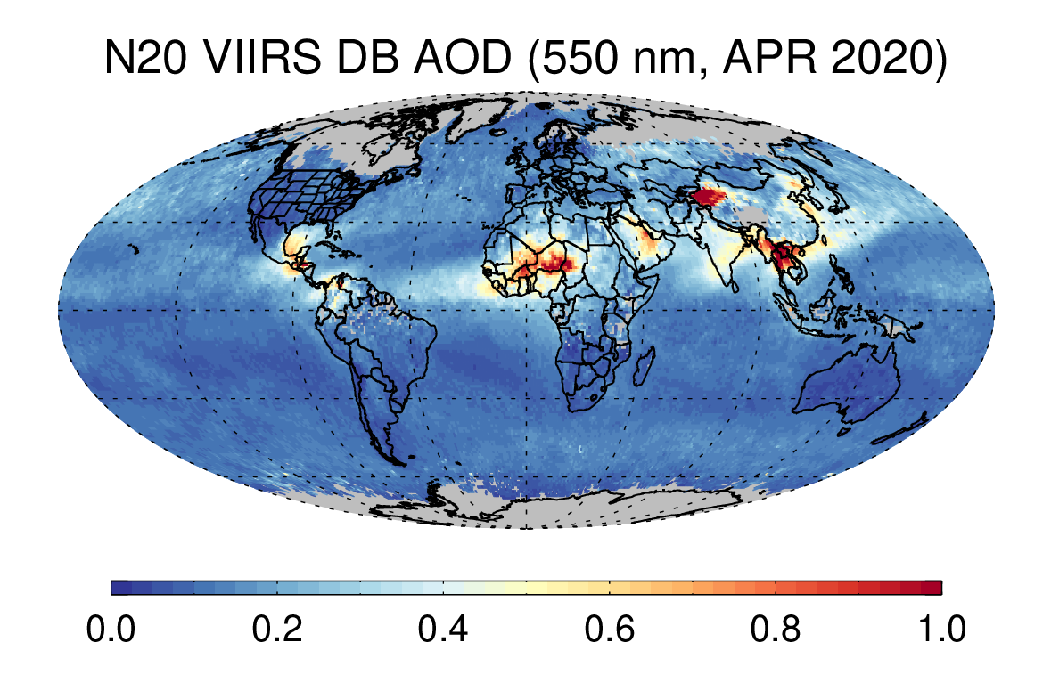
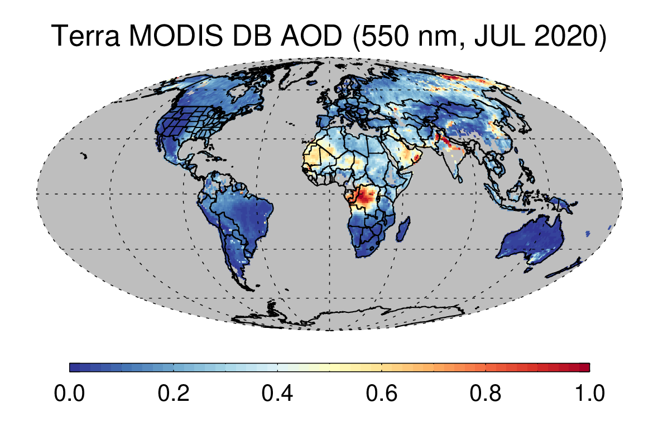
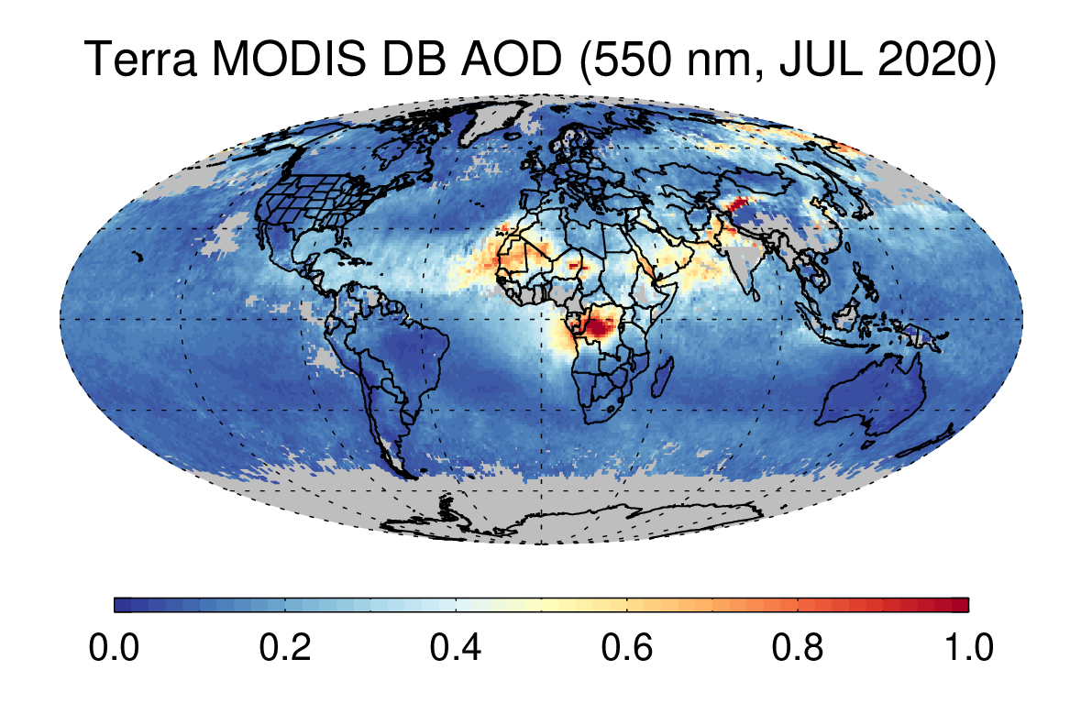
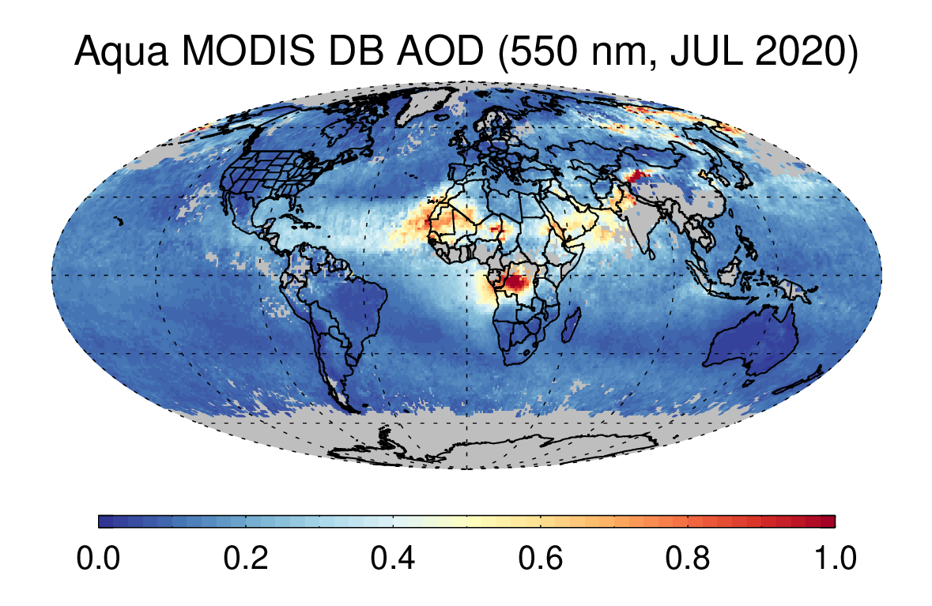
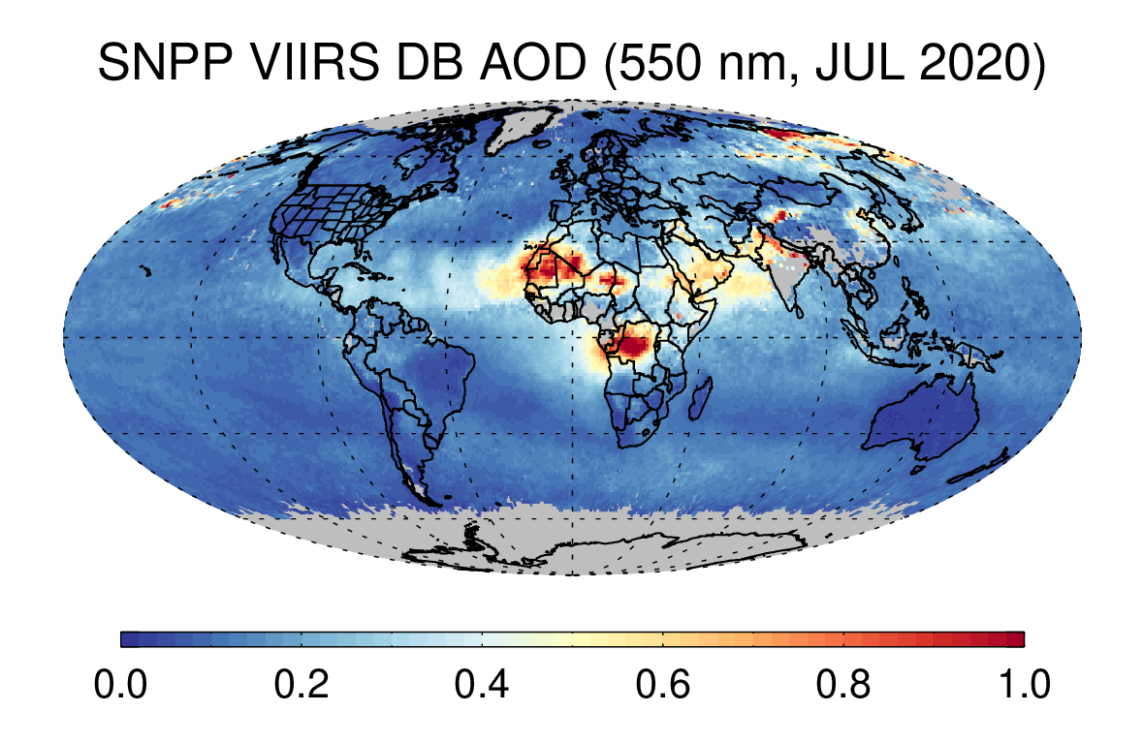
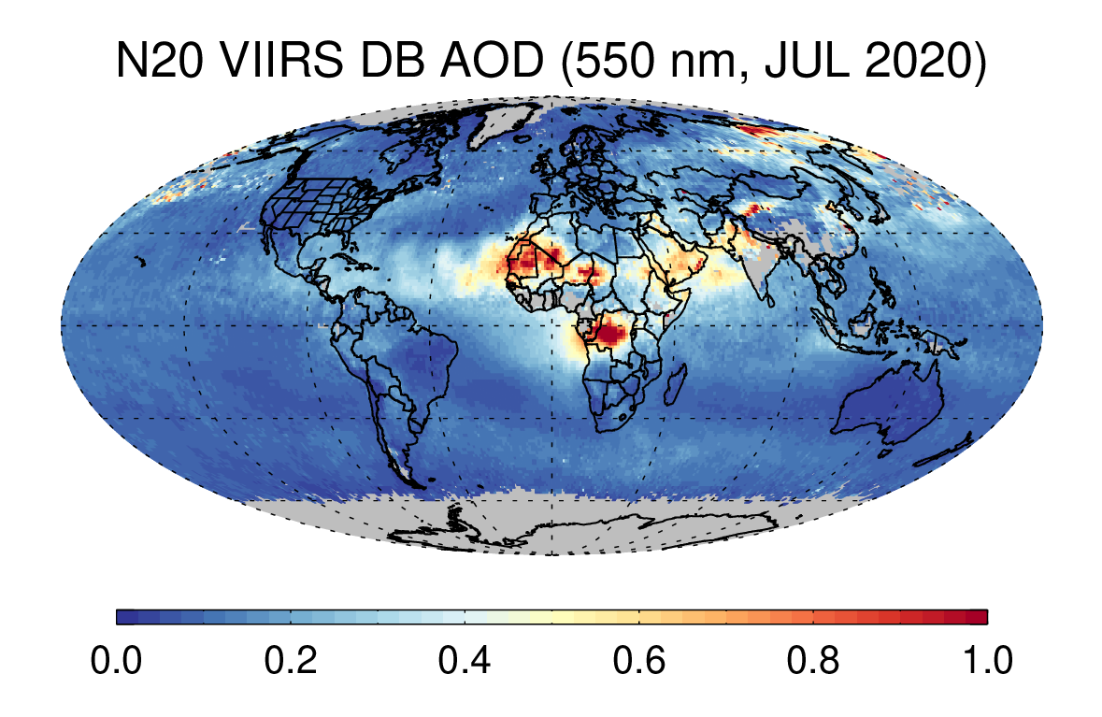
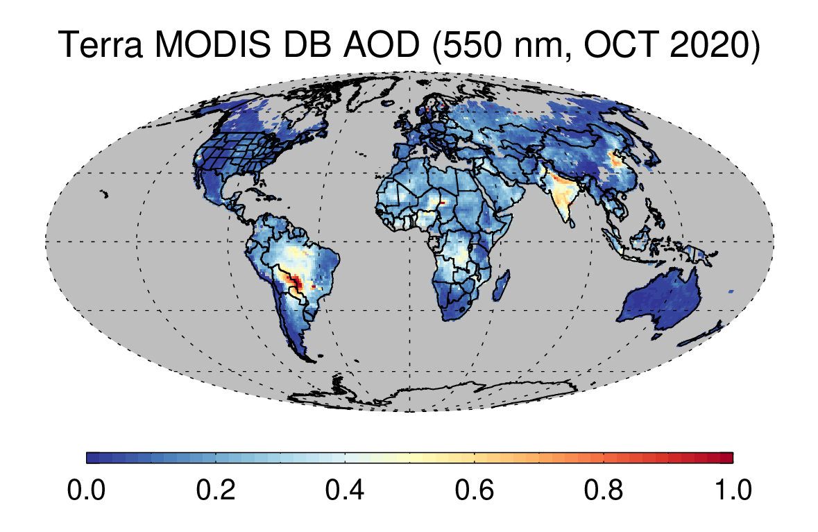
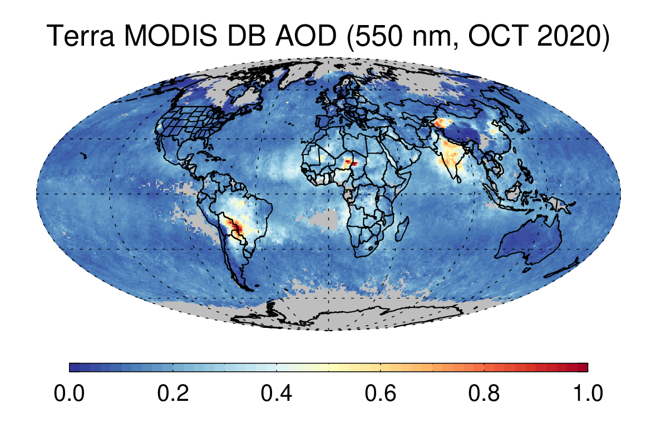




Multi-Sensor AOD
Monthly Mean AOD (550 nm)
Terra MODIS C6.1
Terra MODIS C7
Aqua MODIS C7
SNPP VIIRS V2
N20 VIIRS V2
JAN 2020
APR 2020
JUL 2020
OCT 2020

Slide 17


Cross-Calibration Across Sensors
Terra against Aqua MODIS
Calibration gain factors for Terra | 410 nm | 440 nm | 470 nm | 550 nm | 650 nm | 860 nm | 1240 nm | 1610 nm | 2130 nm
Angal et al. (2020) | N/A | N/A | 0.979 | 0.992 | 0.997 | 0.983 | 0.956 | N/A | 0.969
Terra MODIS is cross-calibrated against Aqua MODIS using RadCalNet data (caveats: gain factors were derived for C6.1 L1b).
Over water, SNPP VIIRS is cross-calibrated against MODIS using multi-sensor co-location files generated by A-SIPS.
Over land, NOAA-20/21 VIIRS is cross-calibrated against SNPP VIIRS using matchup data over Dome-C cal/val site.
Aqua MODIS serves as bridge between SNPP and NOAA-20/21.
This significantly reduces algorithm maintenance effort across multiple sensors.
Open to other approaches in the later versions.
SNPP VIIRS against Aqua MODIS over water
Across SNPP, N20, N21 VIIRS over land
Calibration gain factors for N20 | 410 nm | 440 nm | 490 nm | 550 nm | 670 nm | 860 nm | 1240 nm | 1610 nm | 2250 nm
Dome-C | 1.059 | 1.070 | 1.052 | 1.069 | 1.054 | 1.052 | 1.026 | 1.036 | 1.008
Meyer et al. (2020) over clouds |  |  |  |  | 1.053 | 1.041 | 1.030 | 1.041 | 1.021

Slide 18
SNPP VIIRS Calibration Gain Factors over Water
Calibration gain factors for SNPP | 410 nm | 440 nm | 490 nm | 550 nm | 670 nm | 860 nm | 1240 nm | 1610 nm | 2250 nm
 | 0.995 | 1.000 | 0.992 | 0.956 | 0.941 | 0.963 | 1.011 | 0.981 | 0.931

